Slide 1
Cornerstone City Church
Peninsula Plus Community
Hoo Are Ya
25th October 2026

Slide 2
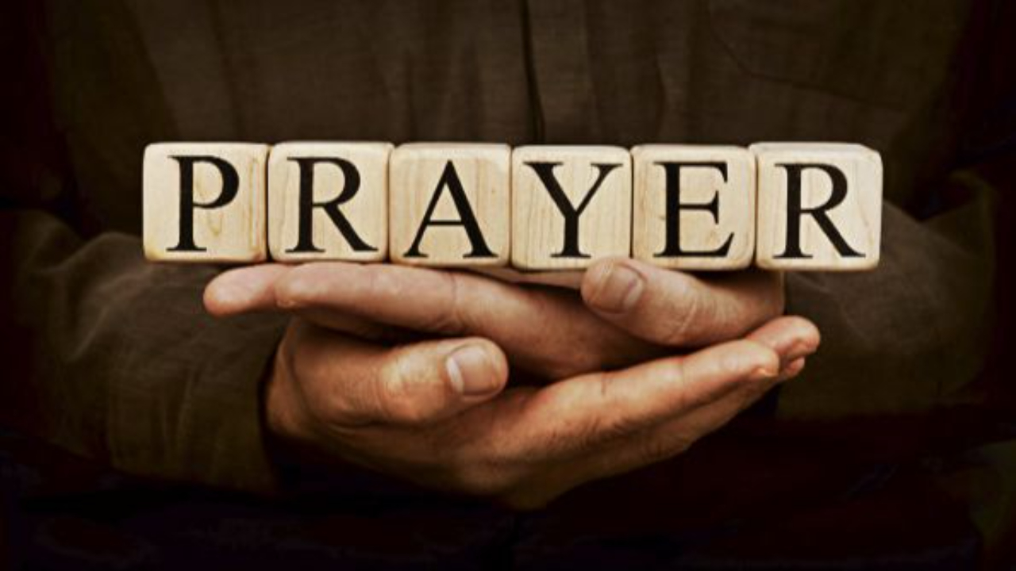

Slide 3
The Joy
CCLI Song # 7209419
Andrew Holt | Mitch Wong
© 2023 Andrew Holt Music Publishing; TBCO Publishing; A Wong Made Write Publishing; Integrity's Praise! Music
For use solely with the SongSelect® Terms of Use. All rights reserved. www.ccli.com
CCLI Licence No. 33265

Slide 4
1/10
This is the day You made
So I’ll rejoice and be glad
Rejoice and be glad in it
This is where I believe
That You are more than enough
More than enough for me

Slide 5
2/10
You are faithful to Your promise
You are strong when I am weak
When I’m standing in Your presence
I have everything I need

Slide 6
3/10
The joy of the Lord
The joy of the Lord is my strength
The joy of the Lord
The joy of the Lord is my strength
O my soul bless His Name
All that is within me say
The joy of the Lord
The joy of the Lord is my strength

Slide 7
4/10
Jesus come what may
You are worthy of all
Worthy of all my praise

Slide 8
5/10
You are faithful to Your promise
You are strong when I am weak
When I’m standing in Your presence
I have everything I need

Slide 9
6/10
The joy of the Lord
The joy of the Lord is my strength
The joy of the Lord
The joy of the Lord is my strength
O my soul bless His Name
All that is within me say
The joy of the Lord
The joy of the Lord is my strength

Slide 10
7/10
Let it rise up like a river
Overflowing Holy Spirit
Let it pour out with no limit
Overflowing Holy Spirit

Slide 11
8/10
The joy of the Lord
The joy of the Lord is my strength
The joy of the Lord
The joy of the Lord is my strength
O my soul bless His Name
All that is within me say
The joy of the Lord
The joy of the Lord is my strength

Slide 12
9/10
I've got the joy
I've got the joy
I've got the joy
It's the joy of the Lord
It's the joy of the Lord

Slide 13
10/10
O my soul bless His Name
All that is within me say
O my soul bless His Name
All that is within me say
O my soul bless His Name
All that is within me say
The joy of the Lord
The joy of the Lord is my strength

Slide 14
House Of The Lord
CCLI Song # 7168995
© 2020 Phil Wickham MusicSimply Global SongsBe Essential SongsCashagamble Jet Music
For use solely with the SongSelect® Terms of Use. All rights reserved. www.ccli.com
Note: Reproduction of this sheet music requires a CCLI Music Reproduction Licence. Please report all copies.
CCLI Licence No. 33265

Slide 15
1/9
We worship the God who was
We worship the God who is
We worship the God who evermore will be
He opened the prison doors
He parted the raging sea
My God He holds the victory yeah

Slide 16
2/9
There’s joy in the house of the Lord
There’s joy in the house of the Lord today
And we won’t be quiet
We shout out Your praise

Slide 17
3/9
There’s joy in the house of the Lord
Our God is surely in this place
And we won’t be quiet
We shout out Your praise

Slide 18
4/9
We sing to the God who heals
We sing to the God who saves
We sing to the God who always makes a way
'Cause He hung up on that cross
Then He rose up from that grave
My God’s still rolling stones away

Slide 19
5/9
There’s joy in the house of the Lord
There’s joy in the house of the Lord today
And we won’t be quiet
We shout out Your praise

Slide 20
6/9
There’s joy in the house of the Lord
Our God is surely in this place
And we won’t be quiet
We shout out Your praise

Slide 21
7/9
We were the beggars
Now we’re royalty
We were the prisoners
Now we’re running free
We are forgiven accepted
Redeemed by His grace
Let the house of the Lord sing praise
(REPEAT)

Slide 22
8/9
There’s joy in the house of the Lord
There’s joy in the house of the Lord today
And we won’t be quiet
We shout out Your praise

Slide 23
9/9
There’s joy in the house of the Lord
Our God is surely in this place
And we won’t be quiet
We shout out Your praise

Slide 25
Above All
CCLI Song # 2672885
Lenny LeBlanc | Paul Baloche
© 1999 Integrity's Hosanna! Music; LenSongs Publishing
For use solely with the SongSelect® Terms of Use. All rights reserved. www.ccli.com
CCLI License # 33265

Slide 26
1/3
Above all powers above all kings
Above all nature and all created things
Above all wisdom and all the ways of man
You were here before the world began

Slide 27
2/3
Above all kingdoms above all thrones
Above all wonders the world has ever known
Above all wealth and treasures of the earth
There's no way to measure
What You're worth

Slide 28
3/3
Crucified laid behind the stone
You lived to die rejected and alone
Like a rose trampled on the ground
You took the fall and thought of me
Above all

Slide 29
Reign Above It All
CCLI Song # 7134098
Ethan Hulse | Hannah McClure | Jess Cates | Paul McClure
© 2019 We Are TIM Music; Zoom Out Songs; Be Essential Songs; EGH Music Publishing; Bethel Music Publishing
For use solely with the SongSelect® Terms of Use. All rights reserved. www.ccli.com
CCLI Licence No. 33265

Slide 30
1/8
The reign of darkness now has ended
In the kingdom of light
In the kingdom of light
Forever under Your dominion
You’re the King of my life
You’re the King of my life

Slide 31
2/8
You reign above it all
You reign above it all
Over the universe
And over every heart
There is no higher name
Jesus You reign above it all

Slide 32
3/8
On the cross the work was finished
God You poured out Your life
Just to give us new life
Now from the lips of the forgiven
Hear an anthem arise
'Cause Jesus You’re alive

Slide 33
4/8
You reign above it all
You reign above it all
Over the universe
And over every heart
There is no higher name
Jesus You reign above it all

Slide 34
5/8
Let all of heaven
And the earth erupt in song
Sing hallelujah to the Everlasting One
There is no higher name
Jesus You reign above it all

Slide 35
6/8
You sent the darkness running
Out of an empty grave
Now seated alone in glory
Enthroned on the highest praise
(REPEAT)

Slide 36
7/8
You reign above it all
You reign above it all
Over the universe
And over every heart
There is no higher name
Jesus You reign above it all

Slide 37
8/8
Let all of heaven
And the earth erupt in song
Sing hallelujah to the Everlasting One
There is no higher name
Jesus You reign above it all

Slide 39


Slide 40


Slide 41
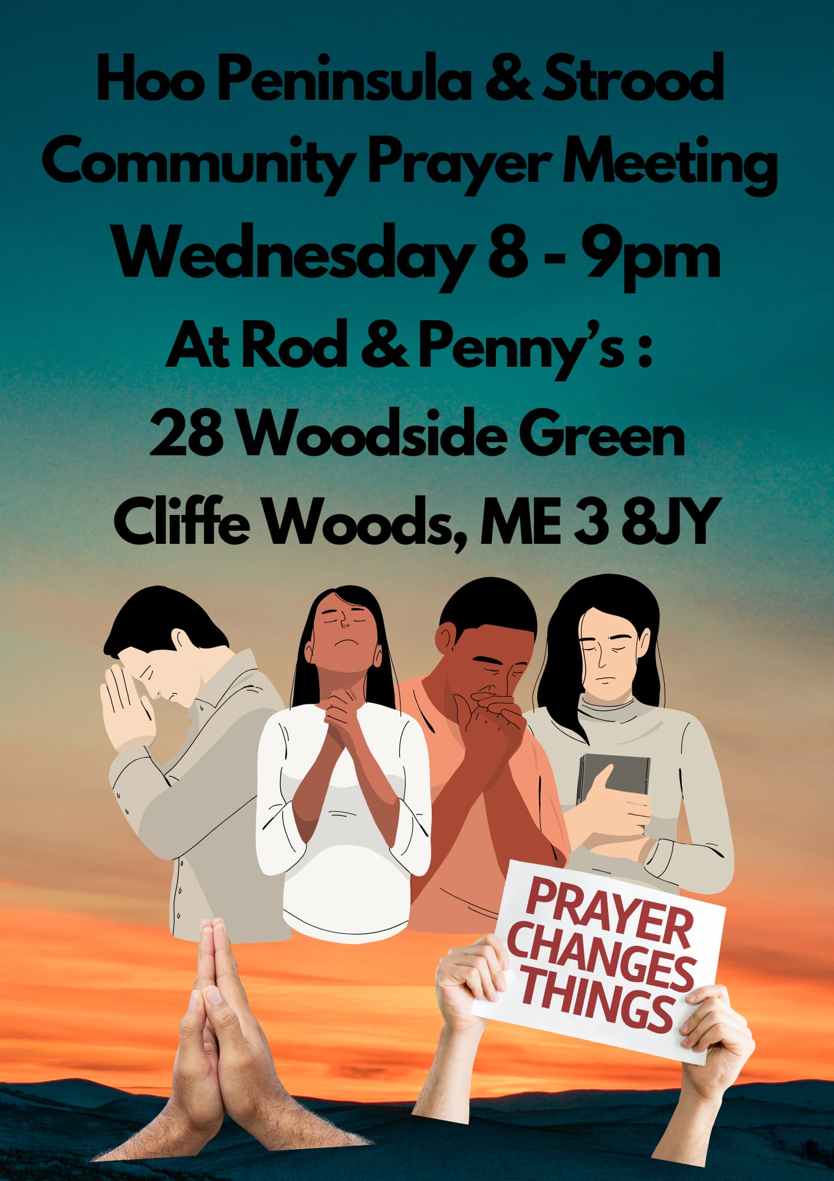

Slide 42
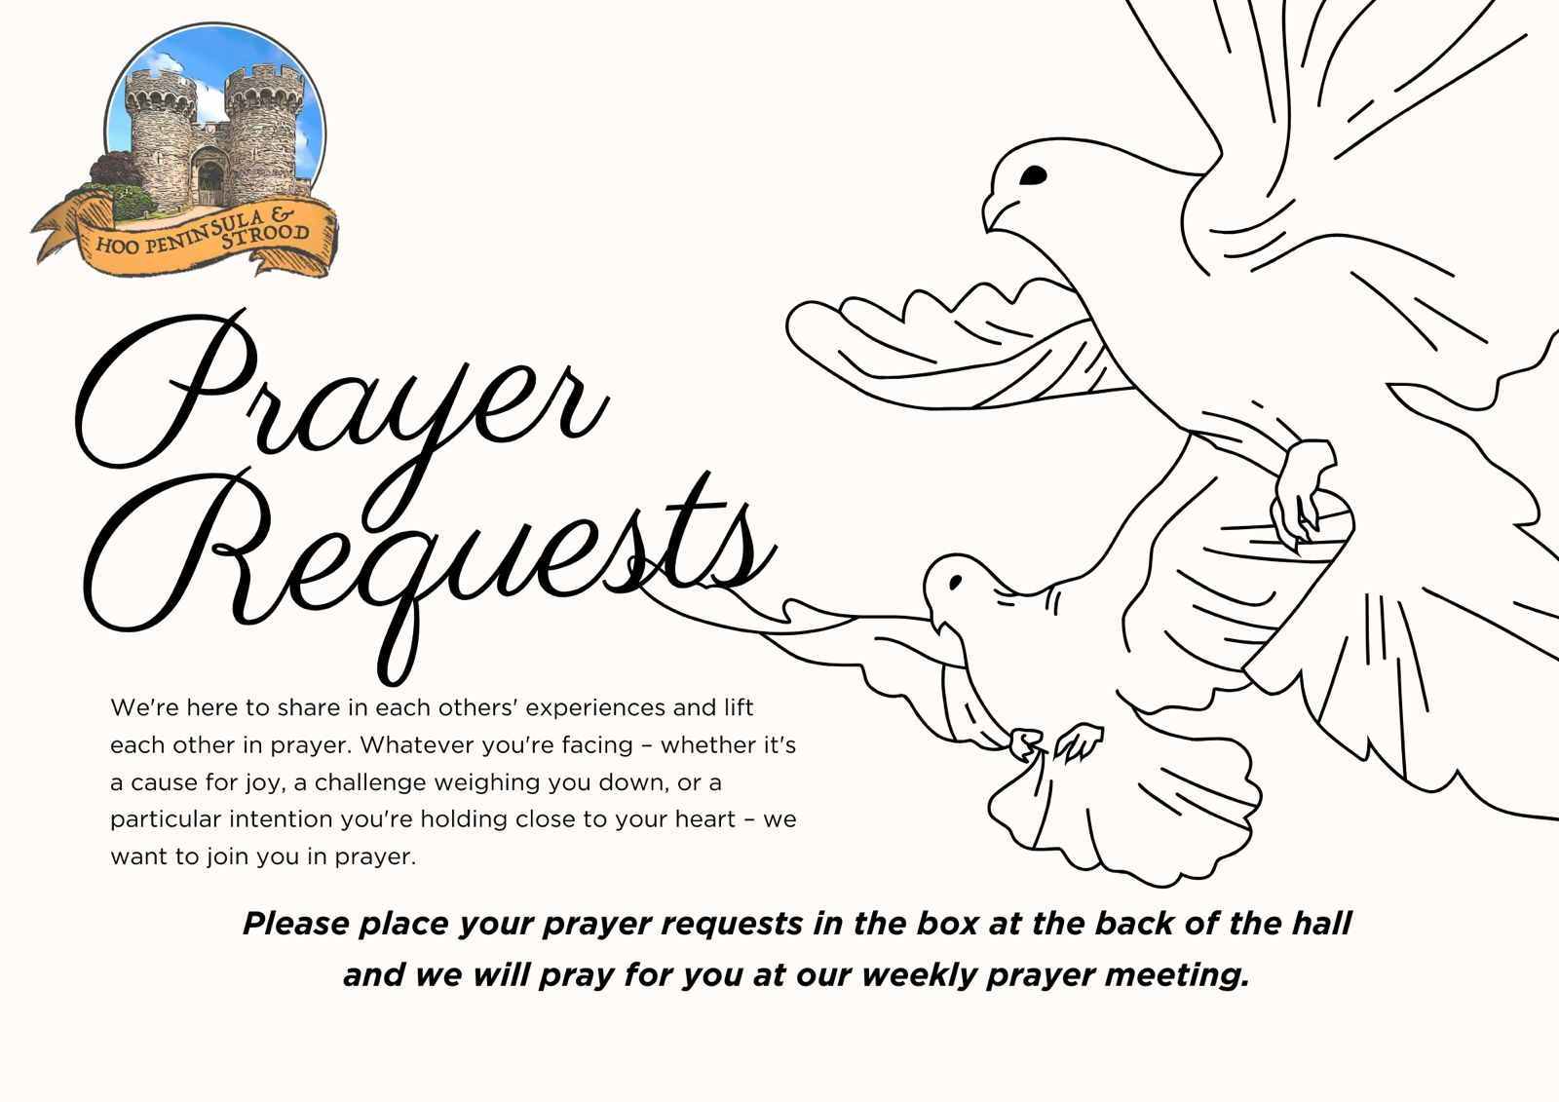

Slide 43


Slide 44


Slide 45


Slide 46


Slide 47


Slide 48
2 Corinthians 14
May the grace of the Lord Jesus Christ, and the love of God, and the fellowship of the Holy Spirit be with us all.
And….
Surely goodness and mercy shall follow us all the days of our lives, and we shall dwell in the house of the Lord forever.

Slide 49
Amen!

