Slide 1

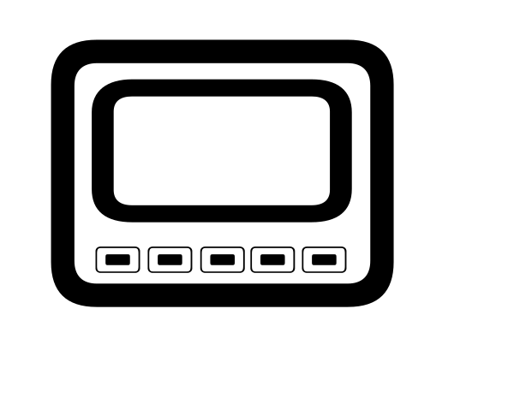




16°C
Gateway
Z-Wave Home
- - C

Slide 2
16°C
Gateway
Z-Wave Home
- - C

Slide 3
16°C
Gateway
Z-Wave Home
- - C

Slide 4
16°C
Gateway
Z-Wave Home
- - C

Slide 5
26°C
Gateway
Z-Wave Home
- - C

Slide 6
26°C
Gateway
Z-Wave Home
- - C

Slide 7
26°C
Gateway
Z-Wave Home
- - C

Slide 8
26°C
Gateway
Z-Wave Home
- - C

Slide 9
26°C
Gateway
Z-Wave Home
- - C

Slide 10
16°C
Gateway
Z-Wave Home

Slide 11
16°C
Gateway
Z-Wave Home

Slide 12
16°C
Gateway
Z-Wave Home

Slide 13
16°C
Gateway
Z-Wave Home

Slide 14
16°C
Gateway
Z-Wave Home

Slide 15
16°C
Gateway
Z-Wave Home

Slide 16
16°C
Gateway
Z-Wave Home

Slide 17
16°C
Gateway
Z-Wave Home

Slide 18
16°C
Z-Wave Home
Gateway

Slide 19
16°C
Z-Wave Home
Gateway

Slide 20
16°C
Gateway
Z-Wave Home

