Slide 1
Search for Physics Beyond the Standard Model in Opposite-Sign Dilepton Events at CMS
Ben Hooberman, on behalf of the RA6 Team
v5

Slide 2
Contents
Introduction and Overview
Lepton Trigger Search
HT Trigger Search
cMSSM Exclusion
Conclusions

Slide 3
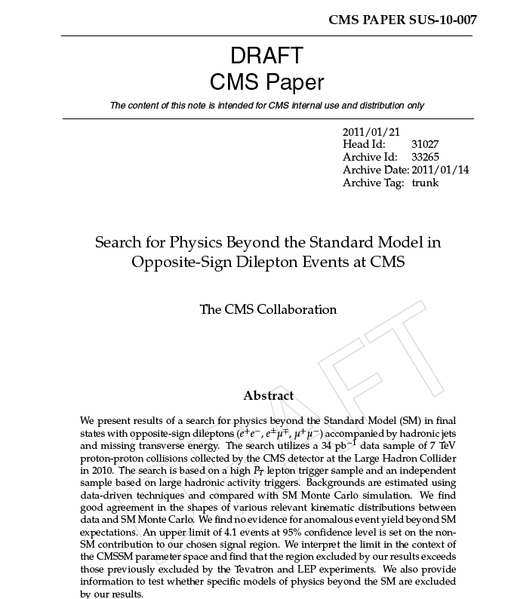
Documentation
CMS PAPER SUS-10-007: “Search for Physics Beyond the Standard Model in Opposite-Sign Dilepton Events at CMS”
  ARC: Boaz Klima (chair), Colin Jessop, Luca Lista, Ritchie J. Patterson
The paper contains 2 search approaches:
  AN-2010/370: based on high pT lepton triggers
  AN-2010/373: based on HT triggers
NOTE:
  Plots/tables in paper are marked:
  Plots/tables seeking approval for supplementary material marked:
PAPER
TWIKI

Slide 4
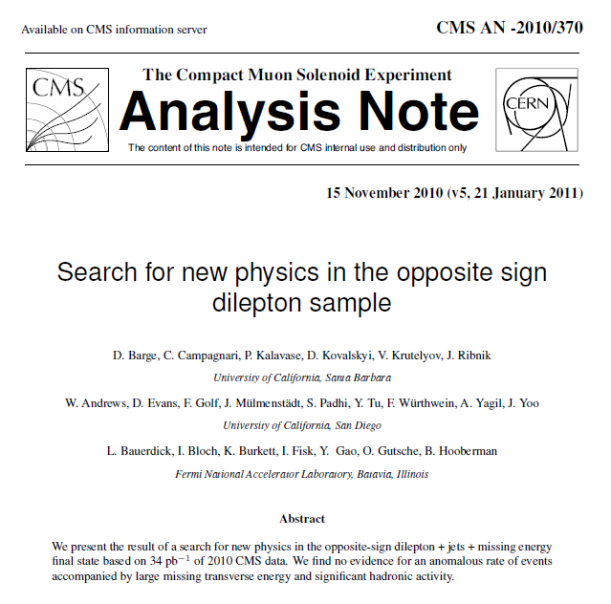
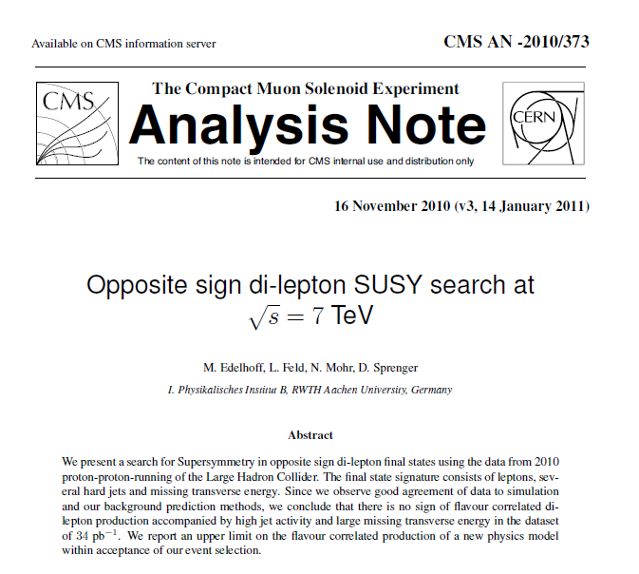
Analysis Notes
AN-2010/370
AN-2010/373
lepton trigger search
HT trigger search

Slide 5
Motivation
Searches in multiple channels crucial for discovery/probing of SUSY
  All-hadronic
  Single lepton
  Dilepton
    Same-sign (SS)
    Opposite-sign (OS): focus of this analysis
  Multi-lepton

Slide 6
Signature with OS Dileptons
most NP scenarios with high xsec produced strongly, so leptons are produced in decays of heavy, colored objects
LSP produced at end of decay chain escapes detection
significant jet activity
significant missing ET
signature: OS dileptons + jets + met
signature similar to tt → dilepton, but tends
to have more hadronic activity and missing ET

Slide 7
Search Strategy
Perform 2 complementary search approaches
  Lepton trigger search: high pT single/double lepton triggers
  HT trigger search: HT triggers, extend sensitivity to lower pT leptons
For each search:
  Define pre-selection to select pure tt → dilepton sample
  Compare data/MC, validate data-driven methods in this background-dominated regime
  Define signal region by adding requirements of large HT, MET to pre-selection
  Compare signal yields to MC predictions and data-driven background estimates:
    Lepton trigger search: ABCD and pT(ll) Template Methods
    HT trigger search: opposite-flavor (OF) subtraction

Slide 8
Contents
Introduction and Overview
Lepton Trigger Search
HT Trigger Search
cMSSM Exclusion
Conclusions

Slide 9
Pre-Selection
Use selection from ttdilepton x-sec measurement (Phys Lett B 695 (2011) 424–443) as baseline (colored text indicates changes w.r.t. this selection)
  Require at least 1 single lepton or dilepton trigger
  2 OS leptons, well-identified and isolated, pT > (20,10) GeV
    Veto ee/mm pairs in Z mass window
   2 JPT jets pT > 30 GeV, || < 2.5
  tcmet > 50 GeV, HT (scalar sum selected jet pT's ) > 100 GeV
    Tightened w.r.t. ttdilepton selection (significant reduction in other backgrounds, eg. DY)
  Minor changes to ttdilepton selection:
    Zmmg veto, muon s(pT)/pT < 0.1, muon || < 2.4
decreased 2nd lepton pT cut due to possibility of soft leptons in SUSY
Full selection and samples available in backup (slides 39-46)

Slide 10
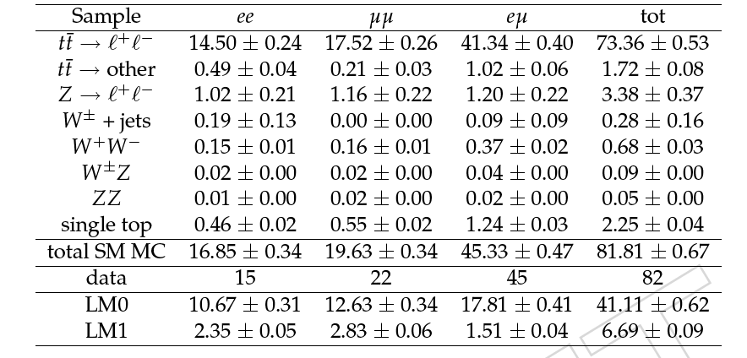
Yields Passing Pre-Selection
PAPER
MC errors statistical only
Yields dominated by ttdilepton (~90%)
Good data/MC agreement in all channels

Slide 11
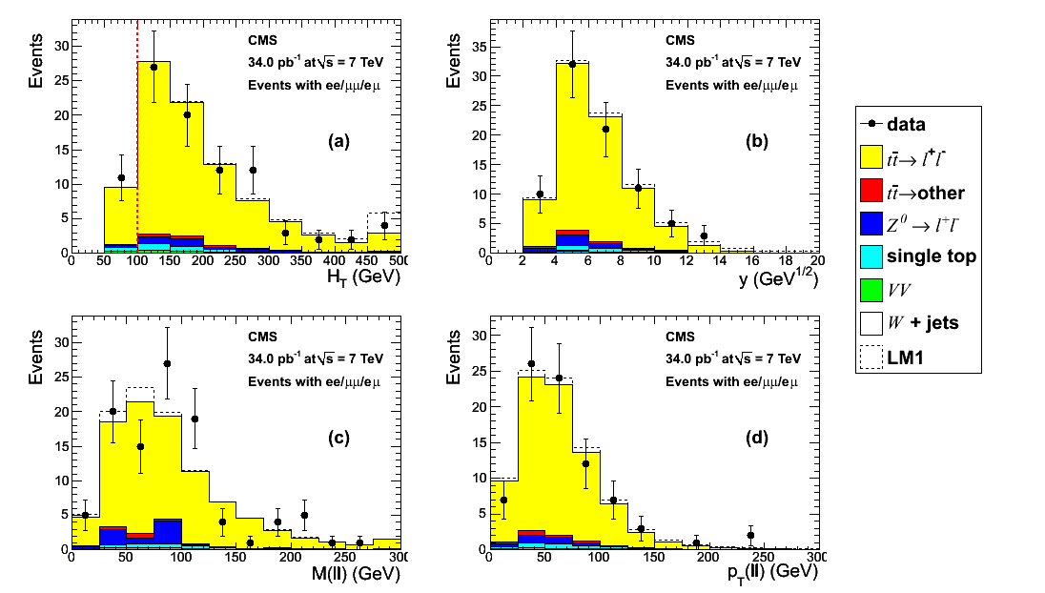
Data/MC Comparisons
ABCD vars
here and in the following, last bin contains overflow
PAPER
MET/HT (GeV^{1/2})
Observe good agreement between data and SM MC

Slide 12
Moving to Signal Region
Observe good data/MC agreement in ttbar bulk proceed to search for NP in tails of ttbar
Our signal region has been chosen based on
  Astrophysical evidence large MET
  Expect NP to have large s
  Expect strong production of NP particles significant jet activity
Signal region selected prior to examining data by adding requirements to pre-selection, such that O(1%) of tt → dilepton MC survives
  MET/HT > 8.5 GeV^{1/2}
  HT > 300 GeV
  These variables are chosen since they are uncorrelated for tt → dilepton, allowing an ABCD data-driven background estimate
^
(see BU slide 47)

Slide 13
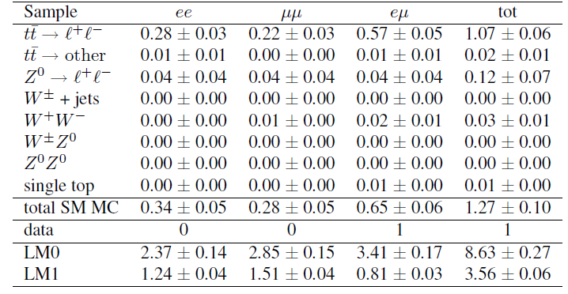
Data/MC Yields in Signal Region
TWIKI
Observe 1 event in signal region, consistent with MC yield of 1.3
  Signal event is em + 3 jets (more detail in backup, slides 48-51)
Expected NLO yields: LM0 8.6, LM1 3.6
We have verified using data-driven techniques that (see backup slides 52-55):
  DY contribution is negligible (using Rout/in method)
  Contribution from fake leptons is negligible

Slide 14
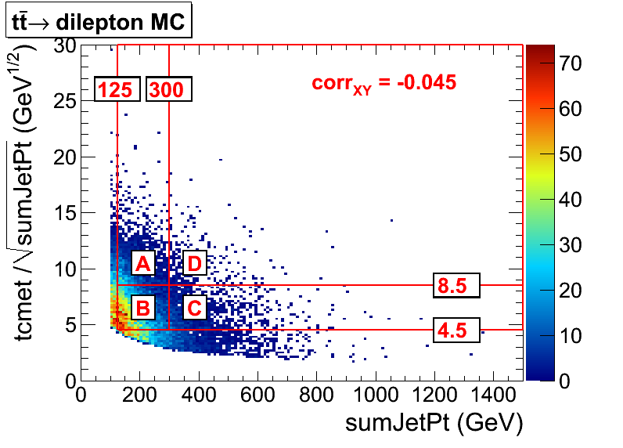
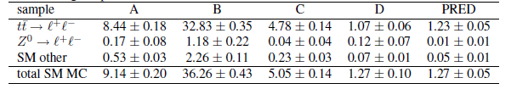
Intro to ABCD Method
more details on ABCD method in backup slides 56-57
Verified that chosen ABCD variables MET/HT, HT are weakly correlated (5%)
AC=BD → predicted background yield in region D = AC/B
Observed good agreement between observed and predicted MC yields
Assess 20% uncertainty to cover: MC stats in closure test, non tt → dilepton backgrounds, variation of ABCD boundaries from hadronic energy scale uncertainty
MET/HT (GeV^{1/2})
HT (GeV)
MC Expected Yields 34 pb⁻¹
AC/B

Slide 15
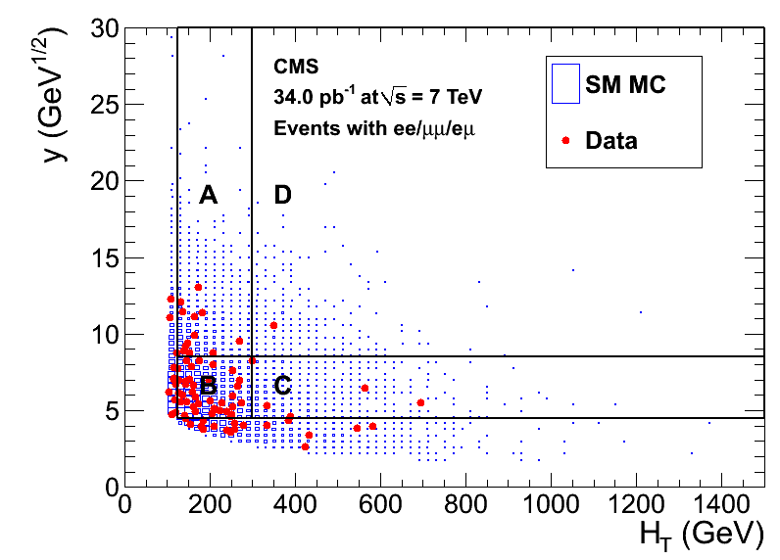
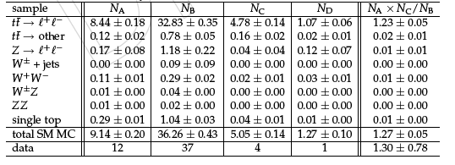
ABCD Results
Signal region yields:
  Observe 1 event
  1.3  0.8 (stat)  0.3 (syst) events predicted by ABCD method
Observed yield in agreement with ABCD prediction
Good data/MC agreement in all regions
MET/HT (GeV^{1/2})
1 event in sig region
PAPER
PAPER

Slide 16
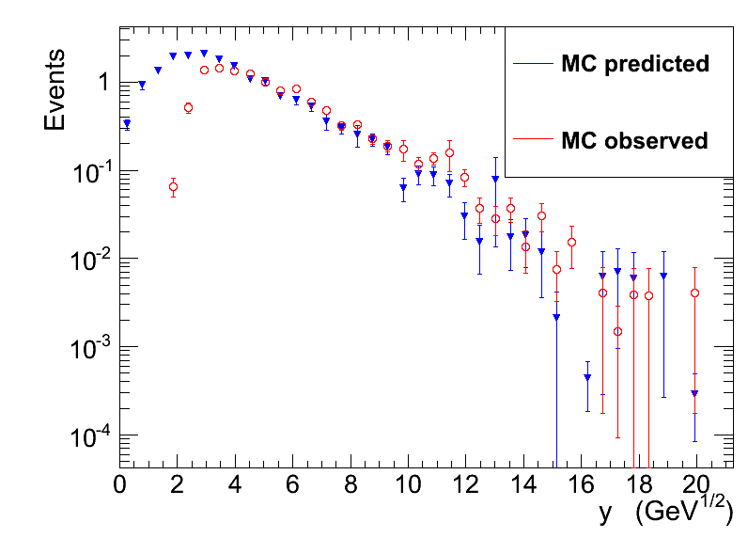
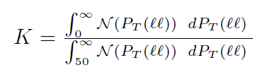
Intro to pT(ll) Template Method
In ttdilepton charged leptons and neutrinos from W decay have similar pT spectrum: use pT(ll) to model pT() (ie. MET) (V. Pavlunin, PRD 81, 035005 (2010))
Rescale pT(ll) distribution by K to account for MET cut in pre-selection
tt → dilepton MET distribution is modeled approximately by the rescaled pT(ll) distribution
SM MC (34 pb⁻¹)
Take scale factor from MC (K = 1.5)
Apply pre-selection + HT > 300 GeV
MET/HT (GeV^{1/2})

Slide 17
pT(ll) Method MC Closure Test
signal region
MET/HT > 8.5 GeV^{1/2}
SM MC (34 pb⁻¹)
 | MC Yield in Sig Region (34 pb⁻¹)
Observed | 1.27  0.10
Predicted | 0.92  0.09
Apply pre-selection + HT > 300 GeV
MET/HT (GeV^{1/2})
Observed yield: #events MET/HT > 8.5 GeV^{1/2}
Predicted yield: = K  #events pT(ll)/HT > 8.5 GeV^{1/2}
Prediction must be corrected further by factor KC = 1.4  0.4
  Due mainly to W polarization effects and also depends on hadronic energy scale, uncertainty dominated by hadronic energy scale uncertainty
(more details on pT(ll) method in BU slides 58-64)

Slide 18
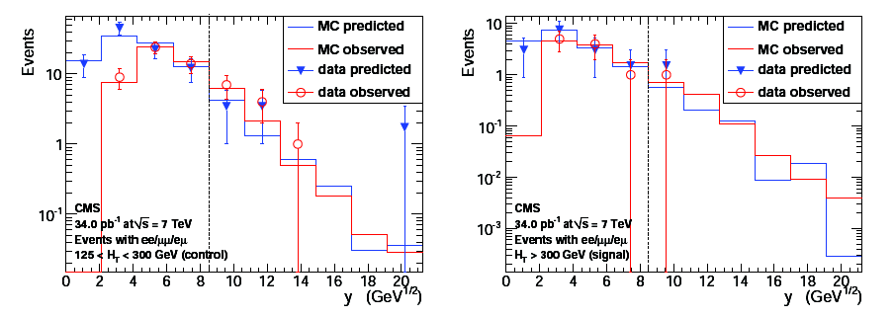
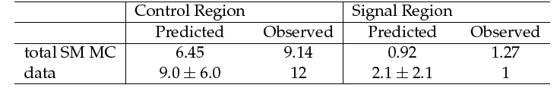
pT(ll) Results: Control Region A
control region: 125 < HT < 300 GeV signal region: HT > 300 GeV
PAPER
PAPER
control region A
signal region D
MET/HT (GeV^{1/2})
MET/HT (GeV^{1/2})
PAPER
First, validate method in control region A → observe good agreement between predicted and observed yields in region expected to be background dominated
Next, move to signal region → observed yield (1 event) is consistent with predicted yield: 2.1  2.1 (stat)  0.6 (syst)

Slide 19
pT(ll) Results: Signal Region D
control region: 125 < HT < 300 GeV signal region: HT > 300 GeV
PAPER
PAPER
control region A
signal region D
MET/HT (GeV^{1/2})
MET/HT (GeV^{1/2})
PAPER
First, validate method in control region A → observe good agreement between predicted and observed yields in region expected to be background dominated
Next, move to signal region → observed yield (1 event) is consistent with predicted yield: 2.1  2.1 (stat)  0.6 (syst)

Slide 20
Acceptance/Efficiency Systematics
Lepton selection
  Trigger: compare yields assuming 100% efficiency vs. yields using trigger efficiency model (<1%) (see slides 65-68)
  ID/iso: assess using T&P on Z data/MC (2%) (see slide 69)
Jet/MET: assess by varying hadronic energy scale by 5%
  Uncertainty very final-state dependent: tt → dilepton (27%), LM0 (14%), LM1 (6%) (see slide 70)
Luminosity (11%)

Slide 21
Summary (lepton trigger search)
Yields in signal region
  Observed yield: 1 event
  MC predicts: 1.3 events
  ABCD method predicts: 1.3  0.8 (stat)  0.3 (syst) events
  pT(ll) method predicts: 2.1  2.1 (stat)  0.6 (syst) events
We have not observed NP  set UL on non-SM contribution to yield in signal region
Take as best estimate of background yield the weighted average of the 2 data-driven methods: NBKG = 1.4  0.8
95% CL Bayesian upper limit on non-SM contribution to signal region: 4.1 events
  This UL is not very sensitive to choice of NBKG and s(NBKG) (see backup slide 71)
Expected yields 8.6  1.6 for LM0, 3.6  0.5 for LM1 (uncertainty from jet/MET, lumi, dilepton selection)

Slide 22
Contents
Introduction and Overview
Lepton Trigger Search
HT Trigger Search
cMSSM Exclusion
Conclusions

Slide 23
Overview of HT Trigger Search
Independent analysis in similar kinematic regime but with:
  Different trigger path (hadronic triggers) motivated by sensitivity to low pT leptons
  Different reconstruction objects (fully PFlow-based)
  Different background estimation method (OF subtraction)
    In tt → dilepton, the 2 lepton flavors are uncorrelated → N(ee) + N(mm) = N(em) (modulo differences in electron vs. muon selection efficiency)
    Restrict search to same-flavor (ee+mm) final states, use em yield to predict tt → dilepton background
    Method also predicts other backgrounds with un-correlated lepton flavors (eg. DY → tt, WW), and will subtract NP with un-correlated lepton flavors

Slide 24
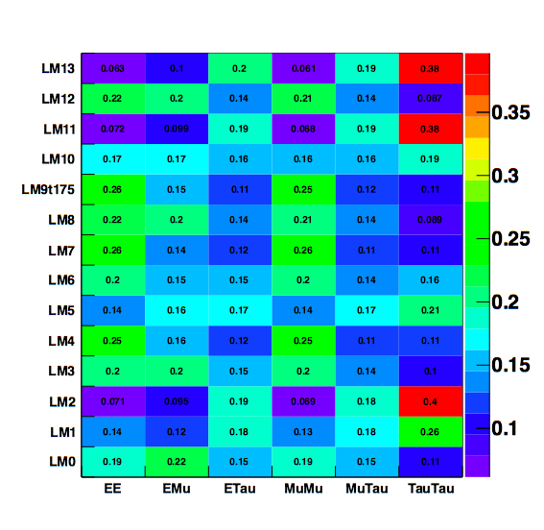
Event Selection
Trigger
  100U OR 140U OR 150U
Leptons
  2 pT > 10 GeV, well-identified and isolated OS same-flavor leptons
  em pairs used for bkg estimate
Jets
  2 jets, pT > 30 GeV, |η| < 3
Signal region: add requirements HT > 350 GeV, MET > 150 GeV
chosen signal channels
(object selection details on slide 74)

Slide 25
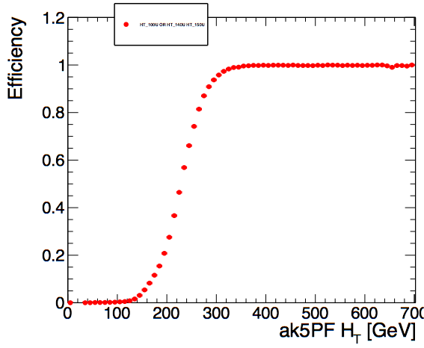
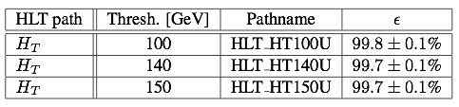
Trigger
HT_100U OR HT_140U_v* OR HT_150U_v*
Measure the efficiency on the muon stream
Trigger is fully efficient for an offline cut at HT > 350 GeV
This trigger turn-on point defines the HT cut
Slow turn-on due to better resolution of pfjets
We assume 1% as systematic uncertainty on signal yield
HT_100U OR HT_140U OR HT_150U

Slide 26
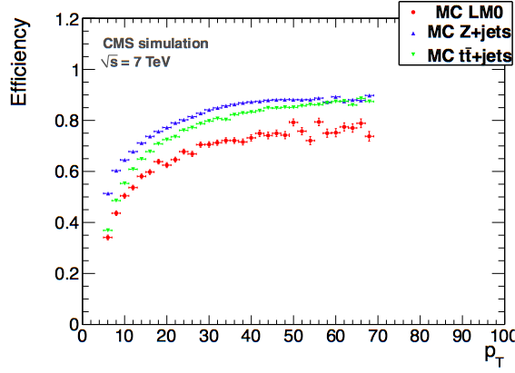
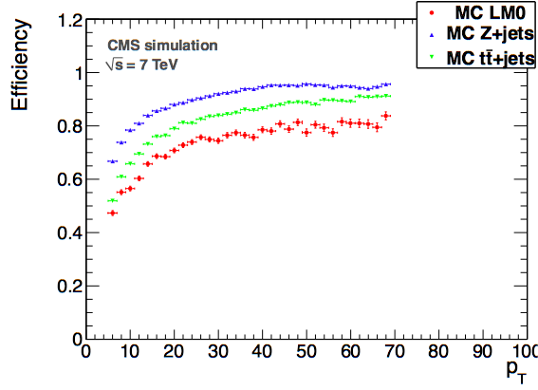
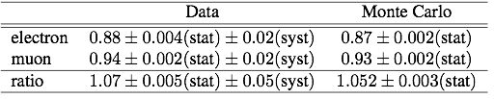
Lepton Efficiency
Electrons
Muons
Uncertainty on the lepton selection efficiency is dominated by the uncertainty on the hadronic activity (model dependent)
Measured efficiency using T&P on the Z
  Good agreement with simulation
  Find similar efficiency as in lepton trigger search

Slide 27
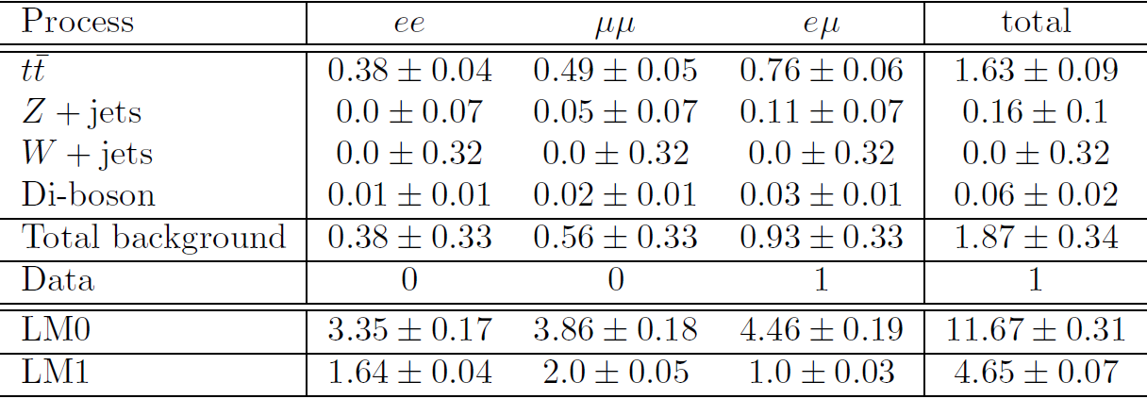
Signal Region Definition
Signal region: HT > 350 GeV, MET > 150 GeV, 2 pT > 10 GeV OS ee/mm leptons
  Chosen a priori based on simulation (expect ~1 event from SM MC)
  Dominant background is tt → dilepton (~90%): far away from large background Z+jets, W+jets, QCD
Observe 0 events in ee+mm channels, consistent with MC (0.9 events)
High sensitivity (similar to lepton trigger search) to LM0 and LM1 (7.2 and 3.6 ee+mm events, respectively)
  Overlap with lepton trigger search to 35%-60% for LM0, LM1

Slide 28

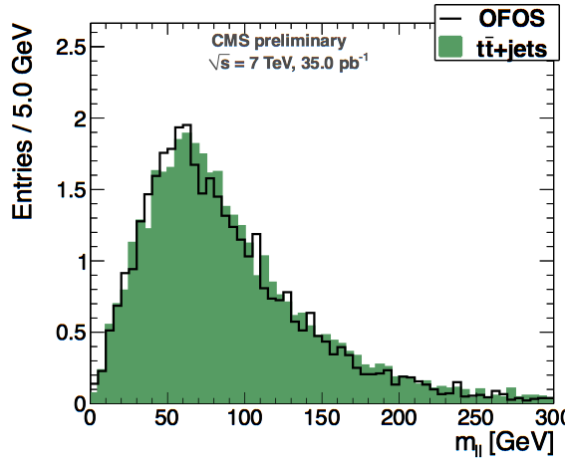
Opposite Flavour Subtraction
Predict number of tt → dilepton ee and μμ events from eμ events
Only relies on efficiency ratio rme = eff(e) / eff(m)
  Using efficiency from T&P on the Z
  5% systematic due to difference between Z vs. top events
MC closure: observe good agreement between MC predicted vs. observed
MC closure test
PAS:
SUS-08-001
SUS-09-002

Slide 29
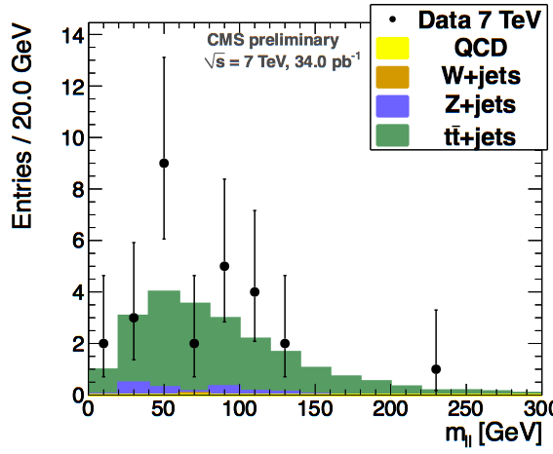
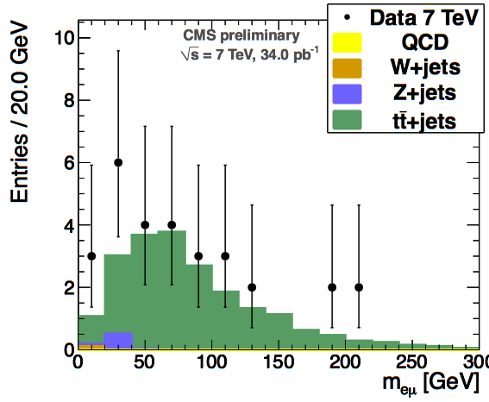
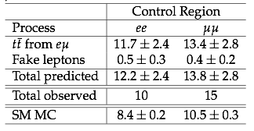
Results in Control Region
ee + μμ pairs
eμ pairs
TWIKI
TWIKI
Control region: 100 < HT < 350 GeV, MET > 80 GeV and pT > (20,10) OS leptons, lepton triggers
  tt → dilepton dominant in this region
Observe 25 ee+mm events compared to predicted yield from OF subtraction 25.0  5.0 with a fake contribution of 1.0± 0.5
  Prediction well in agreement with observed yield in control region
PAPER

Slide 30
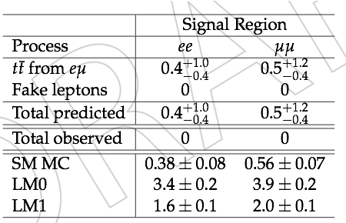
Results in the Signal Region
signal region:
HT > 350 GeV,
MET > 150 GeV,
2 pT > 10 GeV OS leptons
t
Observe 0 events in ee and mm channels
Few predicted fake leptons even without MET cut
  Predicted fakes 0.1  0.1 due to 1 event in em channel (50% syst)
1 event in em channel → OF subtraction predicted yield:
  0.9-0.8 (stat)  0.05 (syst)
MC signal yield 0.9
Everything is consistent with the SM in the signal region
^{+2.2}
PAPER

Slide 31
Summary (HT trigger search)
Yields in signal region
  Observed yield: 0 events
  MC predicts: 0.9 events
  OF subtraction predicts: 0.9-0.8 (stat)  0.05 (syst) events
Observe no excess → set Bayesian 95% CL limit (Log-normal prior)
Different interpretations
  ee+mm: 0 observed events → UL = 3.0 events
  ee+mm+em: generic limit in all 3 channels assuming 1 event is signal (most conservative) → UL = 4.8 events
At the two LM points we expect at NLO
  LM0 ee+μμ: 7.2 ± 1.6 (ee+μμ+eμ: 10.9 ± 2.4),
  LM1 ee+μμ: 3.6 ± 0.7 (ee+μμ+eμ: 4.2 ± 0.8)
    Uncertainty from hadronic energy scale, lepton efficiency, lumi
^{+2.2}

Slide 32
Contents
Introduction and Overview
Lepton Trigger Search
HT Trigger Search
cMSSM Exclusion
Conclusions

Slide 33
cMSSM Exclusion
Perform exclusion in cMSSM m0-m1/2 parameter space
  Show results based on lepton trigger search, find similar sensitivity for HT trigger search
Set tanb=3, A=0, sign m > 0, scan m0-m1/2 space in 10 GeV steps
At each scan point, calculate acceptance uncertainty from:
  Hadronic energy scale
  PDF uncertainty
  k-factor uncertainty due to renormalization/factorization scale
  Lumi uncertainty and dilepton selection efficiency uncertainty
  Total uncertainty ~0.2-0.3
Calculate 95% CL UL at each point, consider excluded if yield > UL
  Verified that signal contamination has negligible impact on exclusion

Slide 34
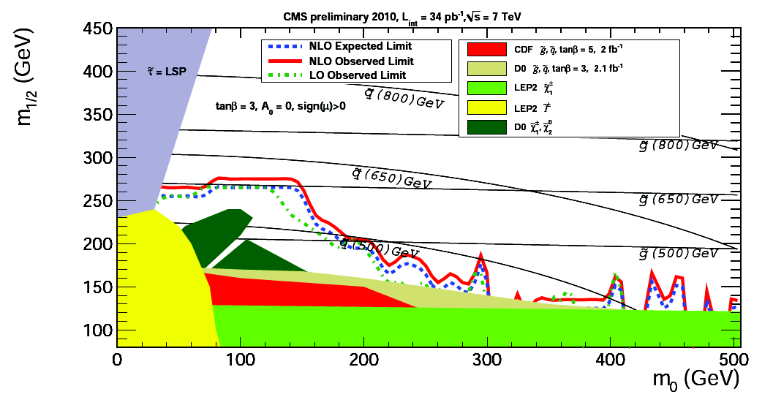
cMSSM Exclusion Results
PAPER
Excluded region exceeds those from previous LEP/Tevatron searches
NOTE: this is NOT the final version of the plot
  The Tevatron/LEP curves were taken from the hadronic analysis recently submitted for publication. It was discovered that SOME of them are wrong. When these are globally fixed for the SUSY group they will be updated.
  We're slightly improving the procedure for the exclusion curve at large m0 to better reflect our measurement
  We (authors) think that the expected limit curve should be removed because there is not enough granularity and statistics in the scan to make a meaningful distinction between expected and observed NLO, and the plot is too busy as it is... but this is still up for the discussion.

Slide 35
Additional Info for Model Testing
We want to provide enough info to allow others to check if their chosen model is ruled out by our upper limit  required info:
  Selection described in paper
  Lepton ID efficiencies (see slide 83)
    Muons: 95%
    Electrons: 63% (pT = 10 GeV) – 91% (pT > 30 GeV)
  Lepton isolation efficiencies (depends on final state) (see slide 84)
    For tt → dilepton
      pT = 10 GeV: 83% (muons), 89% (electrons)
      pT > 60 GeV: >95%
    For SUSY isolation efficiency can be significantly less due to increased hadronic activity
      For example, for LM0, LM1 efficiency decreases ~5-10% per lepton
  HT, MET/HT response/resolution (see slide 85)

Slide 36
Conclusions
Performed search for new physics in OS dilepton + jets + MET channel
Observed no evidence for NP
  Lepton trigger search: observed 1 event in signal region
  HT trigger search: observed 0 events in signal region
  Both results consistent with MC expectations and data-driven background predictions → set UL on non-SM event yields
Performed exclusion in cMSSM parameter space
Provided additional information on efficiencies, responses, etc. to allow others to check if their models are ruled out by our observations

Slide 37
Additional Material

Slide 38
Details of Lepton Trigger Search

Slide 39
Data/json
Data: ExpressStream v3 of PVT certification 34.0 pb⁻¹
  /EG/Run2010A-Sep17ReReco_v2/RECO
  /Mu/Run2010A-Sep17ReReco_v2/RECO
  /Electron/Run2010B-PromptReco-v2/RECO
  /Mu/Run2010B-PromptReco-v2/RECO

Slide 40
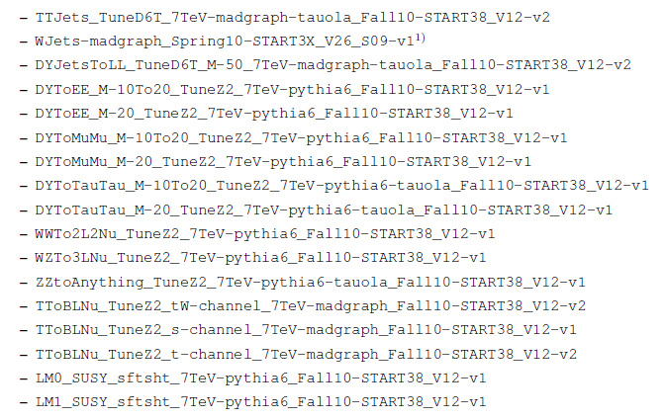
MC Samples

Slide 41
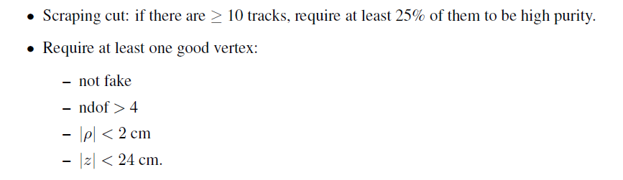
Event Cleaning

Slide 42
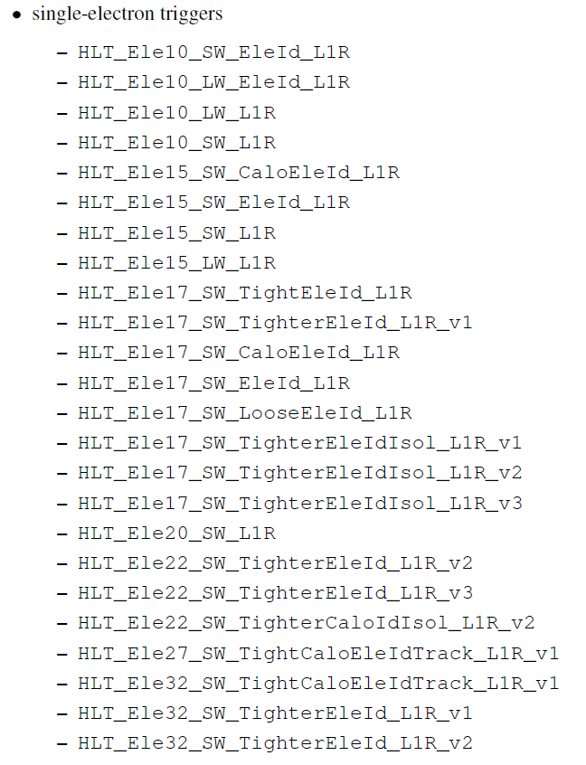
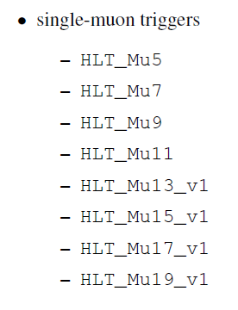
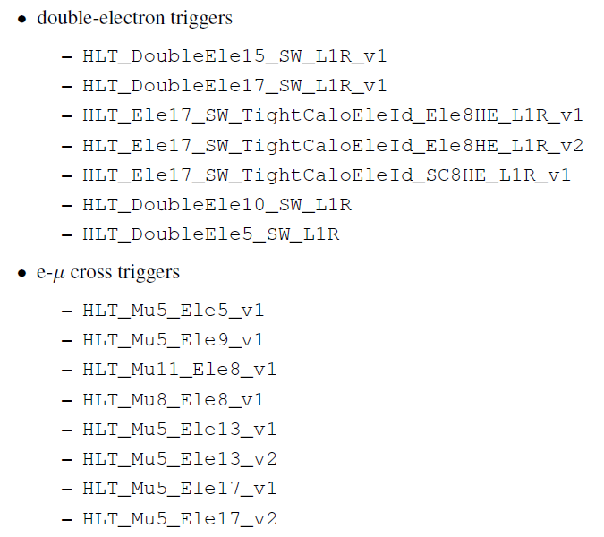
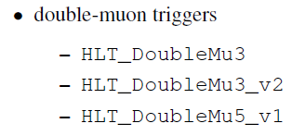
Trigger Selection
For data, require ee event to pass at least 1 single- or double-electron trigger, require mm to pass at least 1 single- or double-muon trigger, require em to pass at least 1 single-electron, 1 single-muon, or 1 e-m cross trigger
Apply model of trigger efficiency to MC

Slide 43
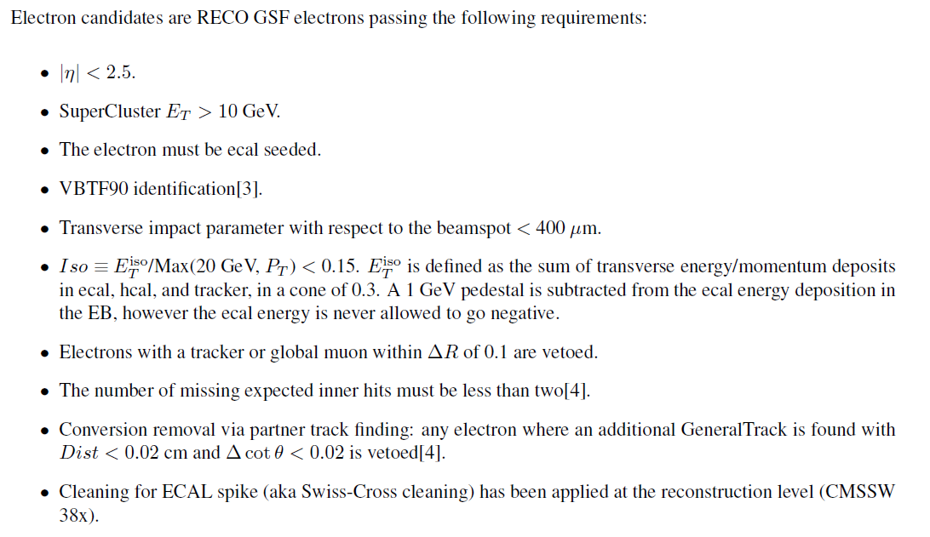
Electron Selection

Slide 44
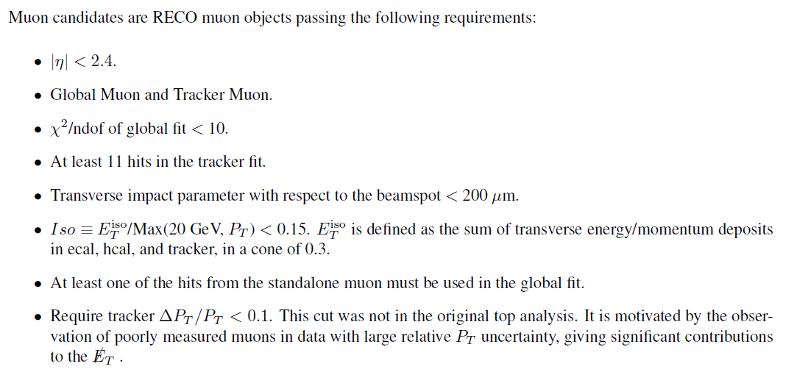
Muon Selection

Slide 45
Jet Selection
JPT jets
L2L3-corrected pT > 30 GeV
|| < 2.5
Pass caloJET ID
Veto jets DR < 0.4 from any lepton pT > 10 GeV passing full analysis selection

Slide 46
Dilepton Selection
If more than 2 leptons pass analysis selection, choose pair which maximizes pT(lep1) + pT(lep2)
Veto ee/mm pairs 76-106 GeV
Veto lepton pairs mass < 10 GeV (poorly modeled in MC)
Zmmg veto:
  Check for ECAL energy associated to muon. If E > 6 GeV, add energy to muon and recompute mm mass. If M(mm) 76-106 GeV, reject event.

Slide 47
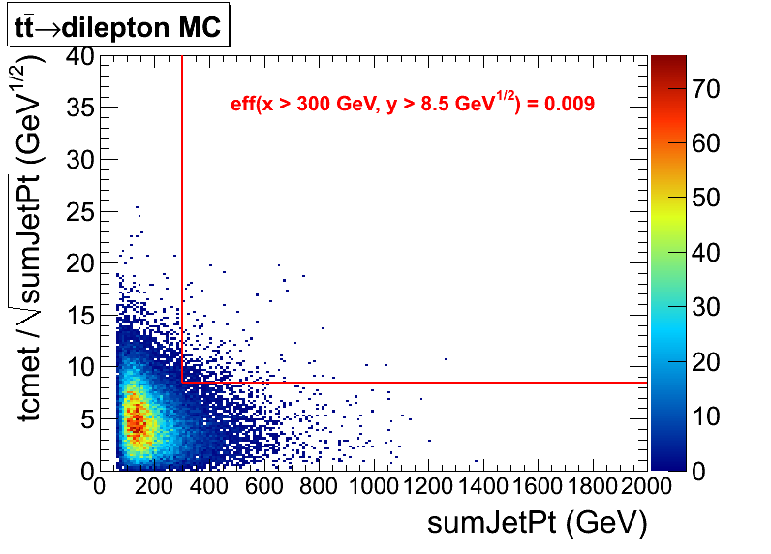
Definition of Signal Region
pT > (20,10) GeV
NJets  2
Z-veto
Efficiency to pass chosen sumJetPt, tcmet/(sumJetPt) cuts is ~1%

Slide 48
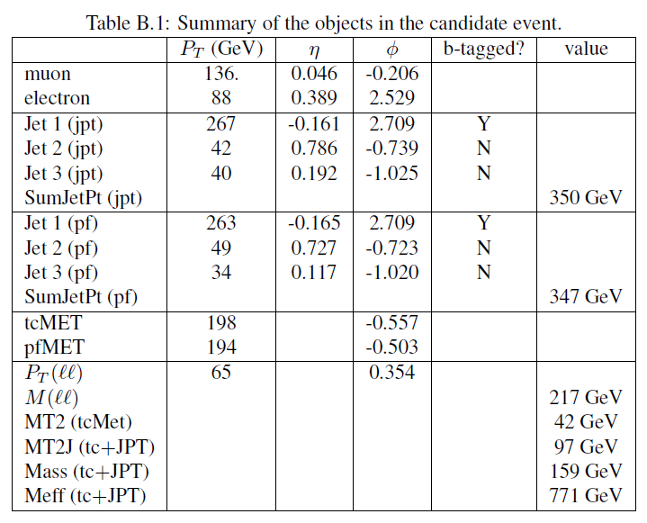
Signal Event
em + 3 jets event (148864 225 267767817)
pfmet/tcmet are consistent, pfjets/JPT's are consistent

Slide 49
Cross-Check: tcmet vs. pfmet
Yields passing pre-selection using MET > 50 GeV cut using given MET algorithm
-----------------------------------------------------------------------
| Sample | ee | mm | em | tot |
-----------------------------------------------------------------------
| tcmet | 15 | 22 | 45 | 82 |
-----------------------------------------------------------------------
| pfmet | 16 | 22 | 42 | 80 |
-----------------------------------------------------------------------
Yields in ABCD regions using given MET algorithm
--------------------------------------------------------------------------------------------
| sample | A | B | C | D | A X C / B |
--------------------------------------------------------------------------------------------
| tcmet | 12 | 37 | 4 | 1 | 1.30 +/- 0.78 |
--------------------------------------------------------------------------------------------
| pfmet | 11 | 35 | 3 | 1 | 0.94 +/- 0.63 |
--------------------------------------------------------------------------------------------

Slide 50
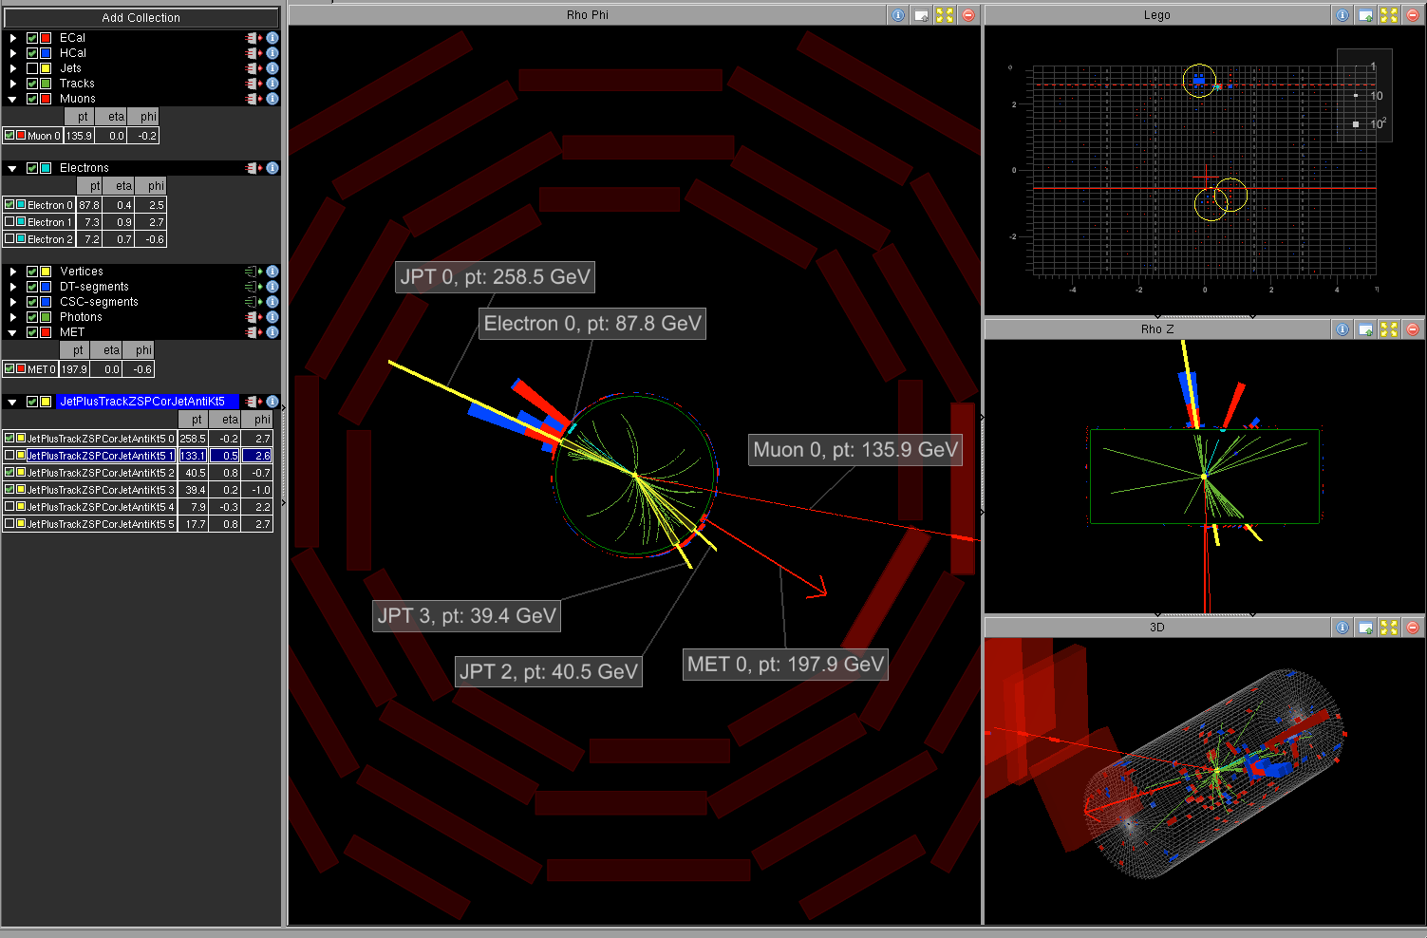
Signal Event
148864 225 267767817
148864 225 267767817

Slide 51
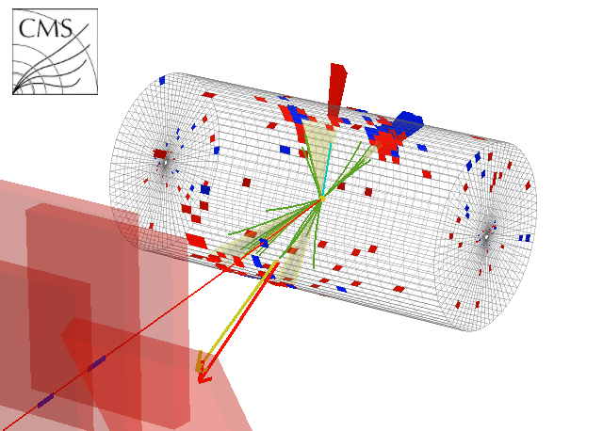
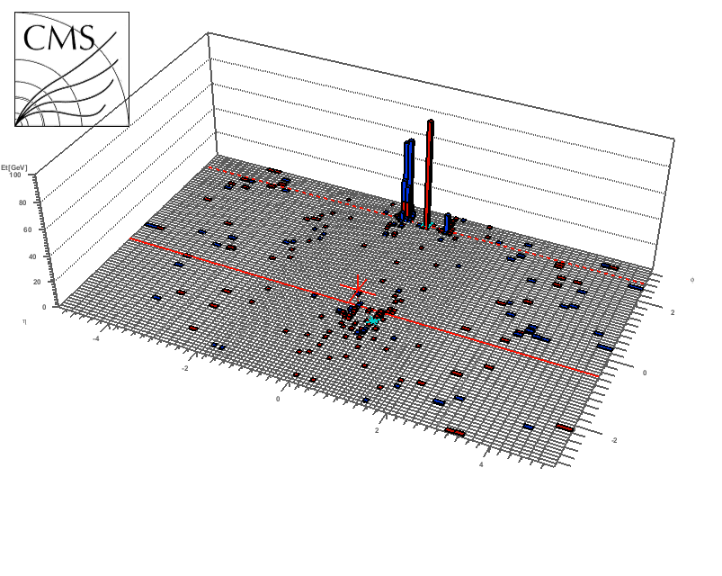
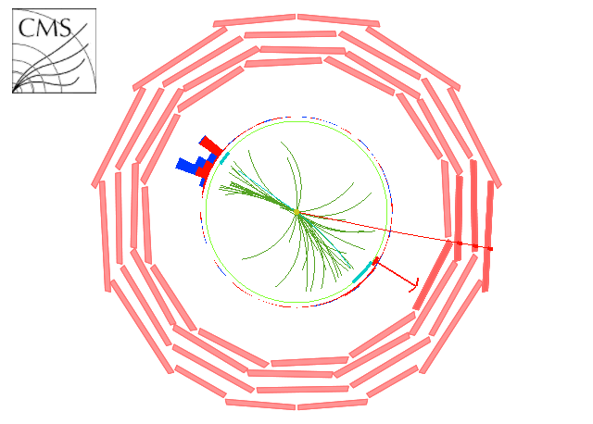
Signal Event
148864 225 267767817

Slide 52
DY Estimate in Signal Region
Estimate DY yield in signal region using data-driven technique (same as for tt → dilepton cross section analysis)
NDY = Rout/in ( NZ(ee+mm) – NZ(em) )
predicted DY yield
Nevents in data inside Z peak in ee, mm, em channels
ratio of Nevents outside:inside Z peak in Z MC
Observe 0 events inside Z peak (NZ(ee)=NZ(mm)=NZ(em)=0) → predicted DY yield in signal region is 0

Slide 53
Fake Rate Method
Single fakes (ttother & W+jets) are expected to be very small from MC (total contribution to signal region is 0.04 from MC)
Single fakes are expected to have a small contribution to ABCD and pT(ll) data-driven methods, which are taken into account with scale factors/uncertainties
We verify our assumption that the single fakes are small using the data-driven “fake rate” method used in ttbar analysis (CMS AN-2010/257)
  Single-fake estimate: observe 0 events with ( 1 selected lepton + 1 FO ) in sig region
    FR estimate 0.0^{+0.4}-0.0
    (error is conservative estimate, based on what we would assess if we had seen 1 event with 1 lepton + 1 FO )
  Double-fake estimate: observe no events with 2 FO's in signal region
    FR estimate = 0.00^{+0.04}-0.00
  Observe no FO's in data in signal: our data-driven estimate of contribution of fakes to signal region is therefore zero

Slide 54
Closure Test of the FR in MC
Use FR from QCD MC obtained in the same way as was done for data to “predict” the number of lepton+fake observed in the ttbar and W+jets MC
This was done for the preselection, yields normalized to 35 pb-1
Total observed fakes consistent with prediction within 50% systematic uncertainty
 | Observed | Predicted
ttbar | 1.74  0.08 (stat) | 2.1
W+jets | 0.29  0.17 (stat) | 0.8
sum | 2.03  0.19 (stat) | 2.9
31

Slide 55
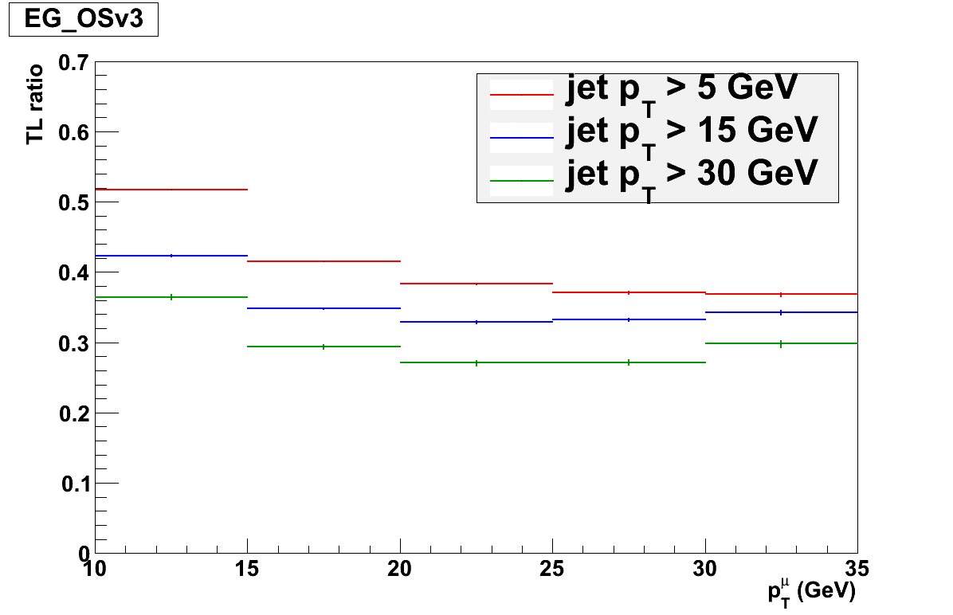
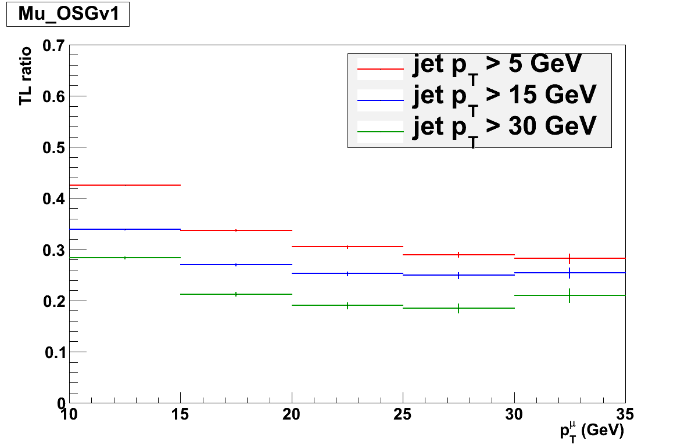
Jet pT dependence of Fake Rate
muons
electrons
Fake rates obtained by varying the minimum pT requirement on the highest uncorrected pT caloJET separated by DR > 1 from the “lepton”

Slide 56
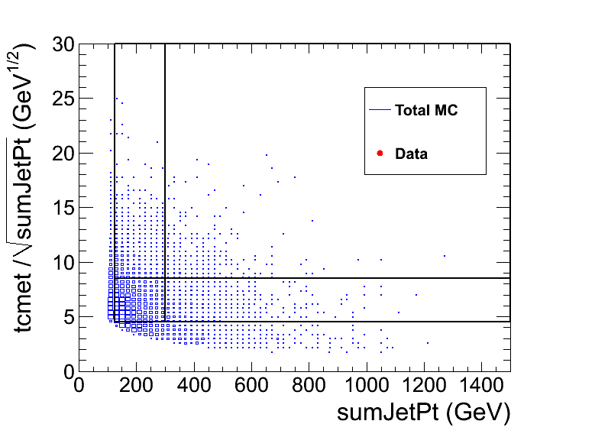
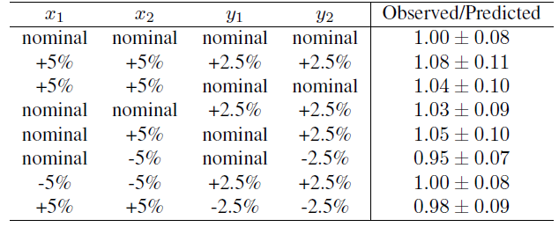
Systematics of ABCD Method
SM MC only
A D
B C
y2(8.5)
y1(4.5)
x1(125) x2(300)
Assess systematic by varying the boundaries from nominal values by an amount determined by energy scale uncertainty (5% for x-var, 2.5% for y-var), check effect on ratio observed:predicted signal yield
Variations in observed/predicted are consistent within ~10%: assess corresponding systematic uncertainty

Slide 57
ABCD MC Closure Test
MC Expected Yields 34 pb⁻¹
observed signal yield
predicted signal yield
x, y variables un-correlated for ttdilepton background  AC=BD  predict yield in sig region D as A  C / B
Observe good agreement between MC observed and predicted yields
Assess 20% uncertainty to cover: MC stats in closure test, non-tt→dilepton backgrounds, variation of observed/predicted due to smearing of ABCD boundaries by hadronic energy scale uncertainty

Slide 58
Systematic Uncertainties of pT(ll) Method
We traced the origin of the discrepancy in the MC closure test to the following effects, which spoil correspondence between MET and pT(ll)
  W polarization: neutrino pT > lepton pT (dominant effect)
  Lepton selection (pT and cuts)
  MET scale not =1, MET resolution worse than pT(ll) resolution
  W  t  l decays do not have pT(ll) ~ MET
  Non-ttbar backgrounds (especially DY)
    This contribution will be estimated separately using Rout/in method (next slide)
Apply correction factor KC = 1.4  0.4 (uncertainty due primarily to hadronic energy scale uncertainty)

Slide 59
Estimate of DY Contamination of pT(ll) Background Prediction
DY yield in signal region is very small due to large MET requirement (MC expected yield = 0.12)
However, high pT Z + jets events can enter pT(ll) control region, artificially increasing data-driven prediction of pT(ll) method
Estimate DY contamination to pT(ll) control region using same method as ttdilepton analysis CMS AN-2009/023: Rout/in method
In signal region, observe 0 events inside Z mass window  predicted DY yield in signal region is 0
Also apply pT(ll) method to ABCD control region A, where we find:
NDY = Rout/in ( NZ(ee+mm) – NZ(em) ) = 1.3  0.9
Rout/in = 0.3  0.2(stat) (ratio of yield outside:inside Z mass window in DY MC)
NZ = event yield in data inside Z mass window. NZ(ee+mm) = 4, NZ(em) = 0.

Slide 60
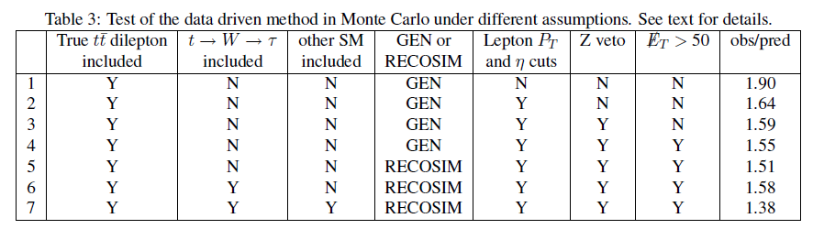
Systematics of pT(ll) Method
Several effects spoil the correspondence between pT(ll) and MET
  W polarization: neutrino pT > lepton pT (dominant effect, see backup)
  Lepton selection (pT and cuts)
  MET scale not =1, MET resolution worse than pT(ll) resolution
  W  t  l decays do not have pT(ll) ~ MET
  Non-ttbar backgrounds (in particular DY, this contribution will be estimated separately using the Rout/in method)
  Top spin correlations
Assess scale factor/systematic uncertainty by checking stability of ratio observed:predicted signal yield while varying the selection.
  This will be assessed using 38X MC, in the following we do not apply a correction

Slide 61
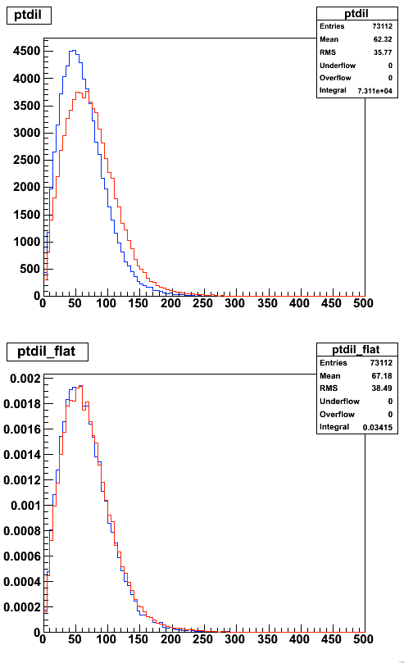
Effect of W Polarization
1) W's from top decay are polarized
2) costheta* (angle between charged lepton and W velocity in W CM frame) distribution is peaked at negative values
3) Charged lepton is emitted preferentially anti-parallel to W velocity
4) Leptons are softer in pt than neutrinos
5) met from W neutrinos > dilepton pt
If we remove this effect by reweighting the costheta* distribution, we get reasonable agreement between met from W neutrinos and dilepton pT
Disagreement between met, dilepton pt at gen-level is due to effects of W polarization
met from W neutrinos
dilepton pT
W polarization included
gen-level,
no cuts applied
met from W neutrinos
dilepton pT
W polarization removed
gen-level,
no cuts applied

Slide 62
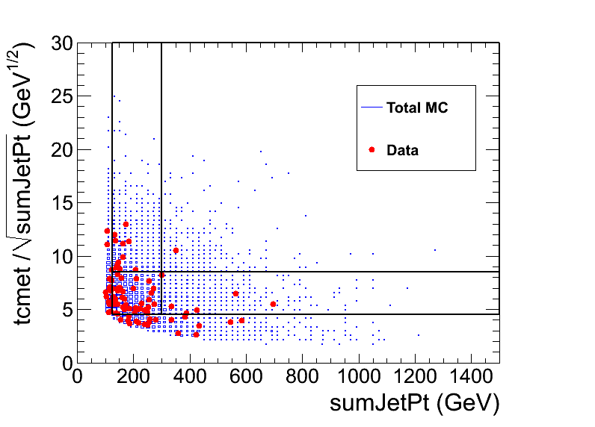
Dilepton pT Template Application
A D
B C
First, use pT(ll) method to predict yield in control region A which we expect to be dominated by background
Next, use pT(ll) method to predict yield in signal region D

Slide 63
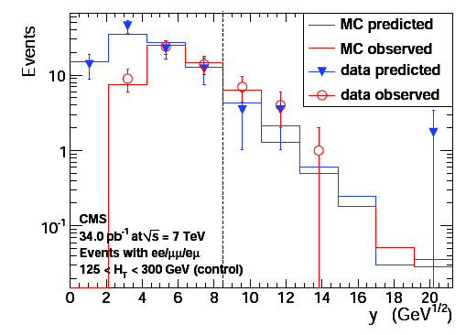
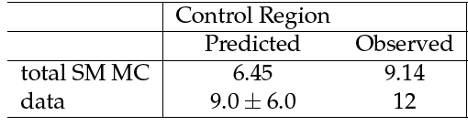
pT(ll) Template Results:
Control Region A
PAPER
PAPER
Yields in Control Region A
MET/HT (GeV^{1/2})
Predicted yield N(A) = K  KC  ( N(A') – NDY(A') ) = 9.0  6.0 (stat)
N(A') = 5 : observed yield in region A' (125 < HT < 300 GeV, pT(ll)/HT > 8.5 GeV^{1/2})
NDY(A') = 1.3  0.9: estimated DY contribution in A' using Rout/in method
K = 1.7: pT(ll) scaling factor from MC
KC = 1.4: observed/predicted scaling factor from MC
Observe agreement between predicted vs. observed yields in control region A proceed to predict yield in signal region D

Slide 64


pT(ll) Template Results:
Signal Region D
PAPER
Yields in Signal Region D
PAPER
MET/HT (GeV^{1/2})
Predicted yield N(D) = K  KC  ( N(D') – NDY(D') ) = 2.1  2.1 (stat)
N(D') = 1 : observed yield in region D' (HT > 300 GeV, pT(ll)/HT > 8.5 GeV^{1/2})
NDY(D') = 0: estimated DY contribution in D' using Rout/in method
K = 1.4: pT(ll) scaling factor from MC
KC = 1.4: observed/predicted scaling factor from MC
Observe agreement between predicted vs. observed yields in signal region D

Slide 65


Trigger Efficiencies (ee)
run < 144000
run > 144000
Material from CMS AN-2010/274
Single electron triggers have efficiency >98%
  Efficiency for at least 1 of 2 electrons to fire: 1-(1-e)² ~ 100%

Slide 66

Trigger Efficiencies (em)

Slide 67


Trigger Efficiencies (mm)

Slide 68
Trigger Efficiency Uncertainty
Trigger efficiency for 2 leptons pT > (20,10) GeV is close to 1, since there are 2 chances to pass single lepton triggers which each have high efficiency
Measure single-lepton trigger efficiencies using same T&P technique used for ttbar (CMS AN-201-/274)
Apply to MC a simplified model of trigger efficiency based on lepton flavors (ee, mm, em), lepton pT, and  (for muons only) (results in backup)
Evaluate uncertainty by comparing yield in signal region assuming 100% trigger efficiency (unweighted sig yield) vs. efficiency from trigger model (weighted sig yield), assess the difference as the systematic uncertainty
  tt → dilepton 0.3%, LM0 0.6%, LM1 0.6%
Trigger efficiency uncertainties less than 1%

Slide 69

Z T&P ID/iso Efficiency
data/MC agree to ~2%

Slide 70
Jet/MET Scale Uncertainties
Very final-state dependent: final state with lots of jets and MET less sensitive than one with jets and MET near threshold
Use method from ttdilepton analysis (CMS AN-10-258) to evaluate acceptance uncertainty for ttbar, LM0, LM1, assuming 5% uncertainty in CMS hadronic energy scale
  ttbar: 8% (pre-selection), 27% (signal region selection)
  LM0: 14% (signal region selection)
  LM1: 6% (signal region selection)

Slide 71
Upper Limits:
Dependence on NBKG and Uncertainty
All upper limits computed from bayes.f*: 1 observed event, 0 uncertainty on signal acceptance, 95% CL, integration upper limit 30, step size 0.02
Background
0.0  0.0: UL = 4.754
1.0  0.0: UL = 4.123
1.0  0.1: UL = 4.127
1.0  0.4: UL = 4.183
1.0  0.7: UL = 4.215
1.5  0.0: UL = 3.952
1.5  0.4: UL = 4.001
1.5  0.7: UL = 4.078
1.5  1.0: UL = 4.119
*J. Conway, http://www-cdf.fnal.gov/physics/statistics/code/bayes.f.

Slide 72

Signal Contamination
Signal contamination tends to dilute the significance of an excess by inflating the background prediction
Effects of signal contamination depend strongly on the signal, and we don't know what the signal looks like
Using multiple, independent data-driven techniques adds redundancy and achieves sensitivity to larger region of NP phase space
  Consider NP scenario with pT(ll) ~ MET: observe excess using ABCD method but not using pT(ll) template method
Quote expected results for LM0, LM1: signal contamination is present but does not hide the presence of the signal
MC Expected Results (34 pb⁻¹)

Slide 73
Details of HT Trigger Search

Slide 74


Object Selection
Jets |η| < 3, pT > 30 GeV
antikt5 jet algorithm
Corrected up to level 3 using jet energy corrections
Loose PFJetID as recommended
pfMET
All primary data streams
Require good vertex (!Fake, ndf > 4, |z| < 24 cm, r < 2 cm)
Beam scraping removal (25% high purity tracks)

Slide 75


Electron ID
sPlot: http://arxiv.org/abs/physics/0402083v3
chosen WP
~95%
~90%
~80%
ID can be done via BDT (energy momentum comparison, track quality, geometrical quantities)
One can choose desired working point depending on analysis
Good agreement to MC (similar results J/Ψ from particle flow commissioning)
Niklas Mohr

Slide 76

em Event Display
run lumi event: 149003 191 193813210

Slide 77



Fake Lepton Background Method
Signal from Z
simulation
Background data
(QCD selection)
Allows to extract the purity of the lepton selection in the final sample!

Slide 78


Background Templates
Electrons
Muons
DATA
DATA
Data driven fake template (HT > 200 GeV, MET < 20 GeV, exactly one lepton with all identification cuts)
  Dominated by QCD, but still some signal contamination left at low isolation
Fakes are a subdominant background suppressed by HT and MET cuts anyway
  In total 50% systematic uncertainty

Slide 79



Fit in control region
Very high purity as expected HT > 100, MET > 80 and 20 (10) OS leptons
  Slightly lower purity in electron channel
Number of fake events calculated using impurity
Impurity is similar to expectation in simulation

Slide 80


Closure test in simulation
Closure test on simulation
35 pb⁻¹ of pseudo data with MET > 50 GeV, HT > 100 GeV, 20 (10) GeV
We observe good agreement in simulation
From these numbers the impurity is determined
Number of fake events by multiplying impurity to the number of candidate leptons in selection
Fit | Electrons | Muons
Prompt | 147.0 ± 12.6 (151) | 182.2 ± 13.8 (178)
Fake | 5.1 ± 0.6 (4) | 4.8 ± 0.4 (3)
Closure test on first data: AN-2010/167

Slide 81


Lepton efficiency measurement
Electrons
Muons
Tag and probe on the Z using tracks and superclusters as probe via fit
Efficiency on the bulk of Z production is well in agreement with simulation
Use the ratio of electron to muon
efficiency in the opposite flavour
subtraction

Slide 82
Additional Info for Model Testing

Slide 83

Lepton Selection Efficiencies
ID/iso efficiencies for tWl and tWtl in ttbar MC

Slide 84

Isolation Efficiency
Isolation efficiency depends on final state jet activity
  Observe difference of ~5-10% per lepton ttbar vs. LM0, LM1

Slide 85

Efficiency/Response Curves
average sumJetPt response 1.02 with RMS 11%
average MET/HT response 0.94 with RMS ~14%
Plot efficiency and response (reco quantity/gen quantity) as a function of gen quantity
LM0 shown, but efficiency/response doesn't depend strongly on underlying physics

Slide 86


Comparison of cMSSM Exclusion Regions
lepton trigger search
HT trigger search

Slide 87

Comparison of cMSSM Exclusion Regions
OS search
SS search

