Slide 1
Muonix Detector Prototype Logbook
Ben Hooberman

Slide 2
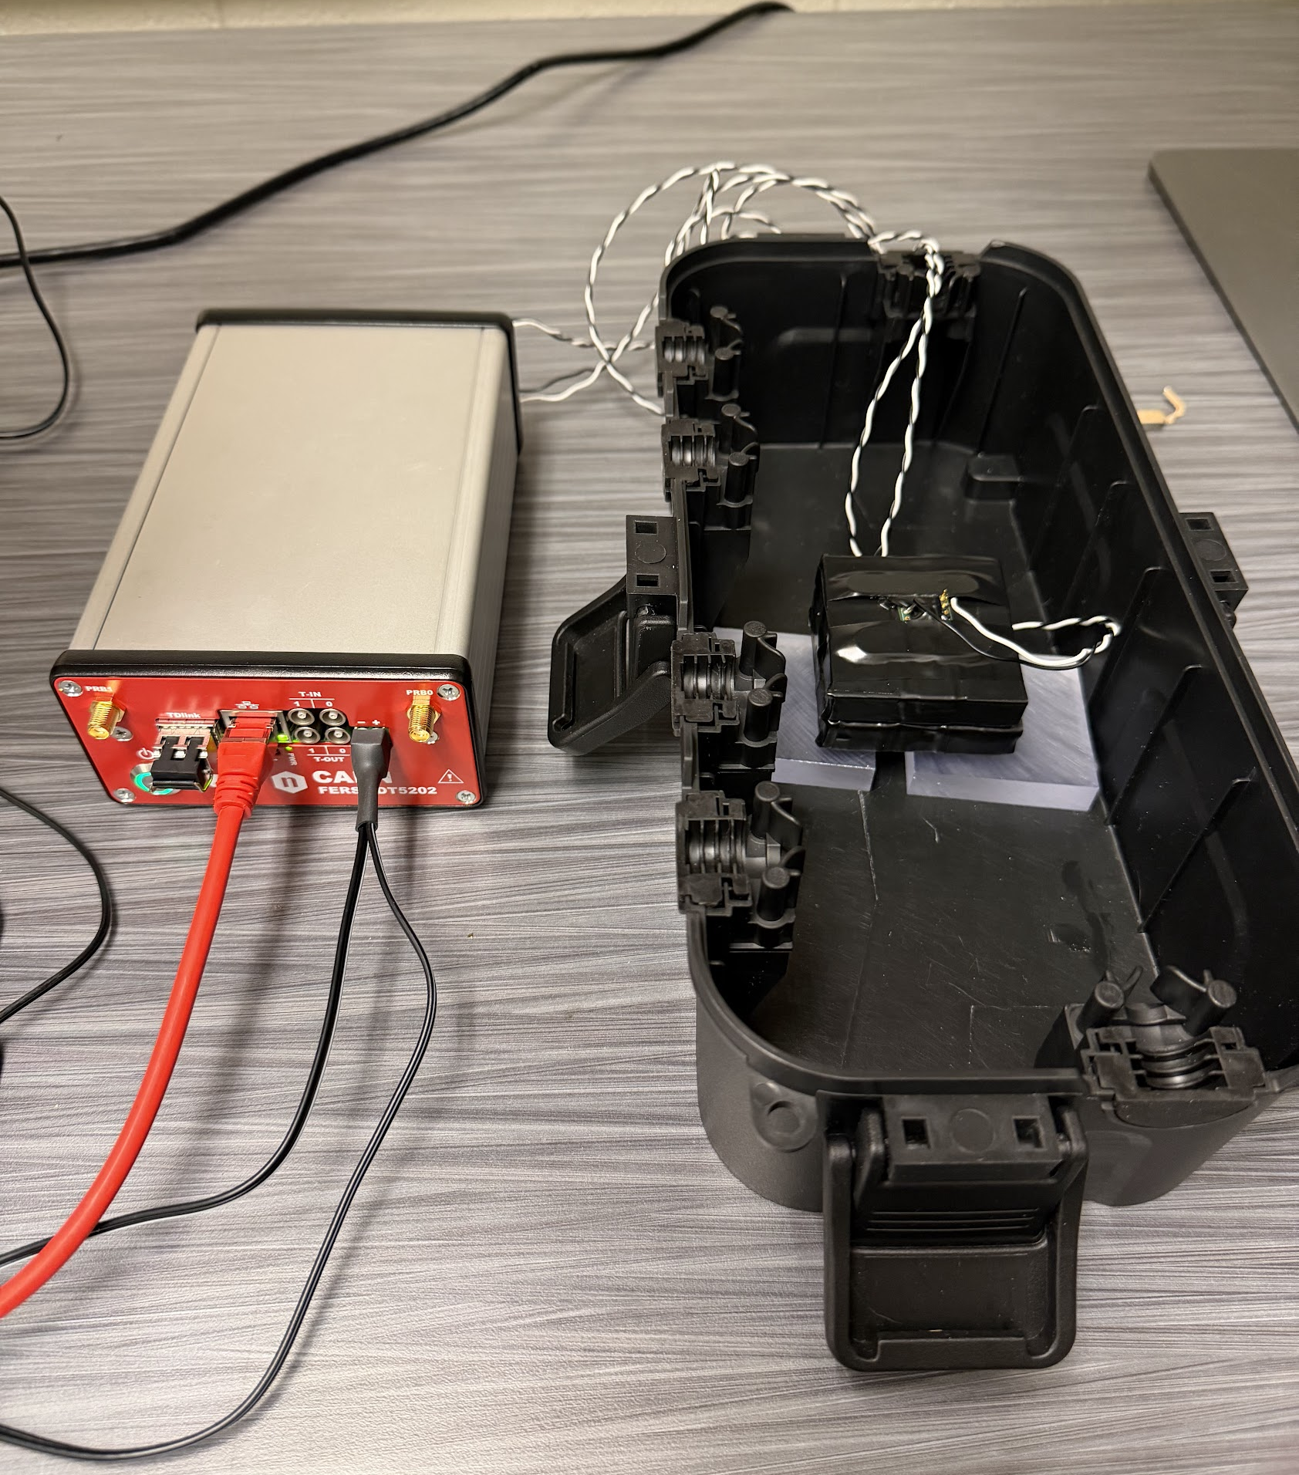
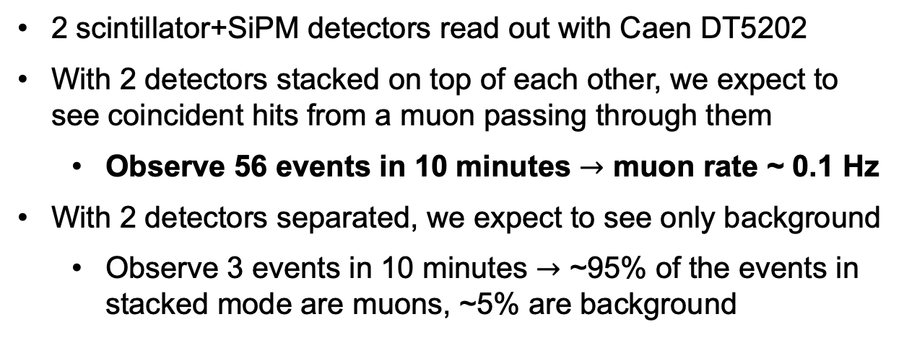

Observing First Muons – Experimental Setup
July 1, 2026
Caen DT5202
64-channel SiPM readout system
2 $×$ (scintillator + SiPM)
2 scintillator+SiPM detectors read out with Caen DT5202
With 2 detectors stacked on top of each other, we expect to see coincident hits from a muon passing through them
Observe 56 events in 10 minutes $→$ muon rate ~ 0.1 Hz
With 2 detectors separated, we expect to see only background
Observe 3 events in 10 minutes $→$ ~95% of the events in stacked mode are muons, ~5% are background

Slide 3
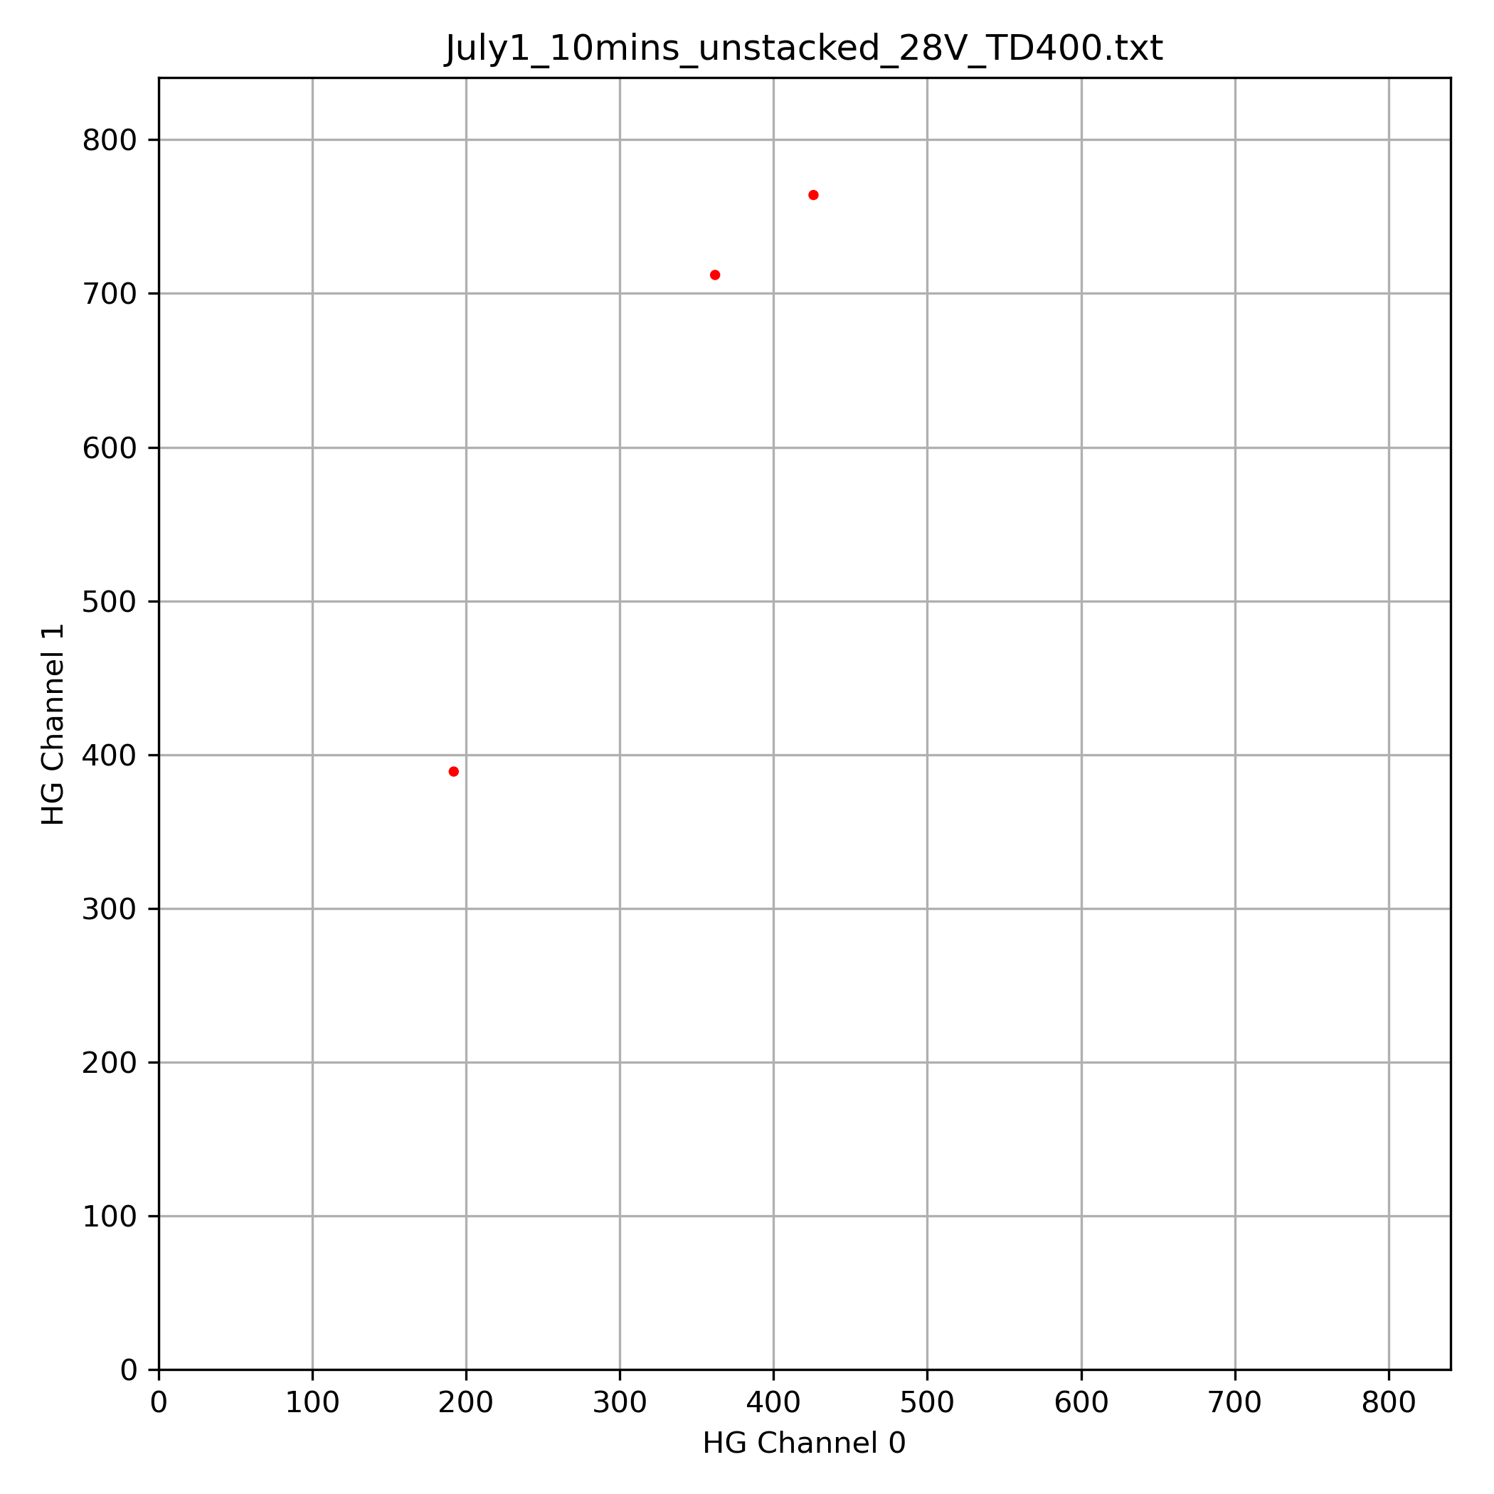
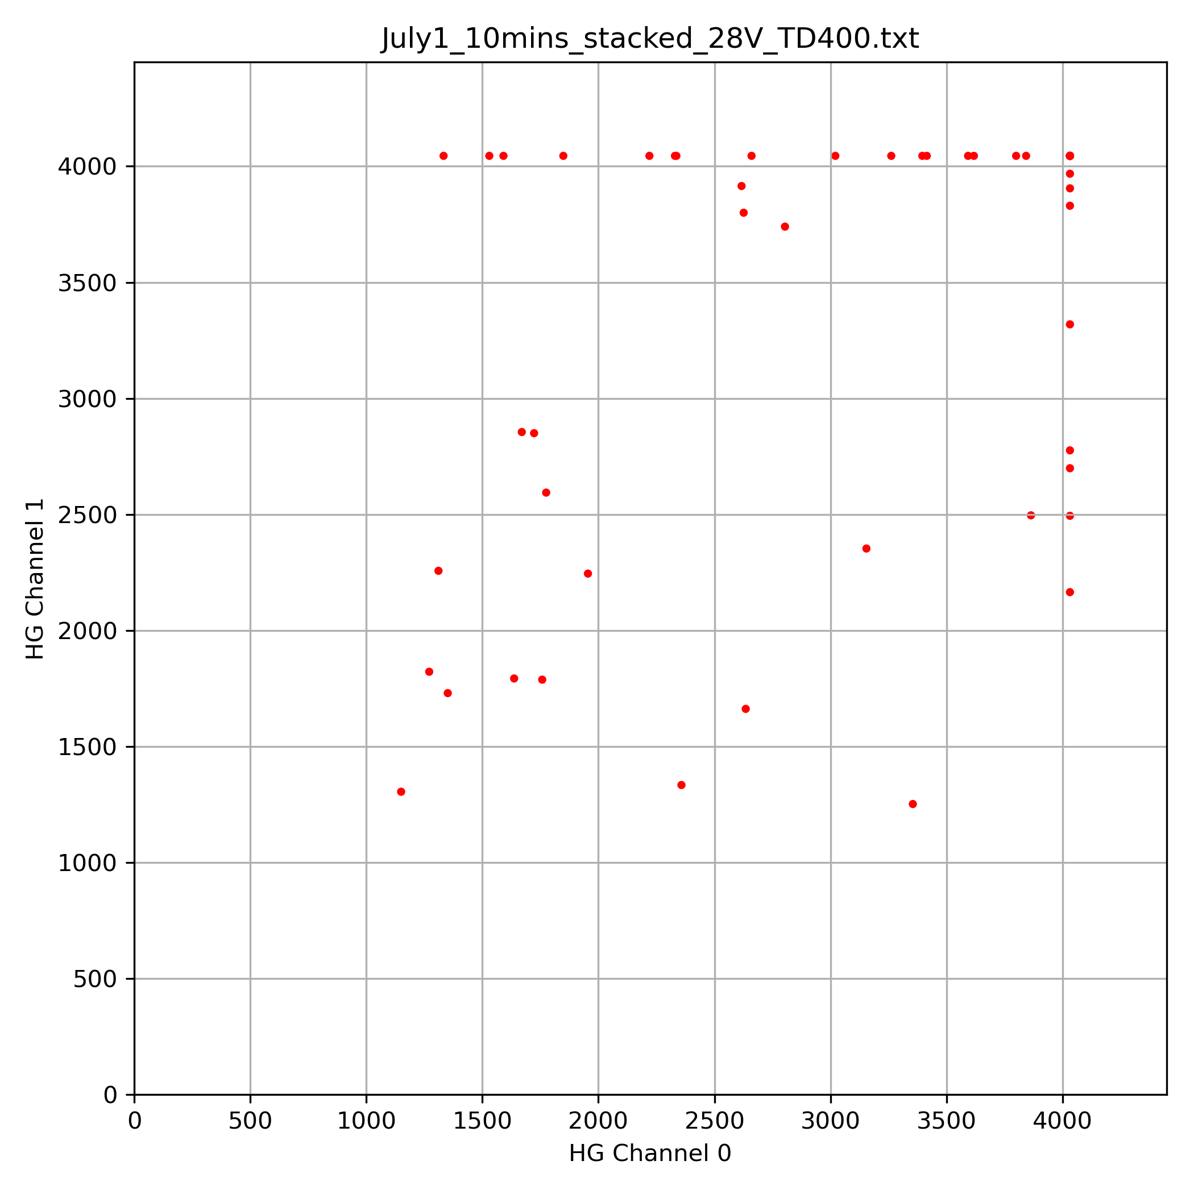
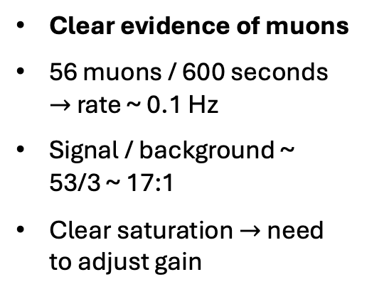
Observing First Muons – Results
July 1, 2026
Run for 10 minutes
Plot signals on channel 1 vs. channel
bias voltage 28V, trigger threshold 400
full config at July1_10mins_stacked_28V_TD400.conf
unstacked
(background)
stacked
(signal + background)
Clear evidence of muons
56 muons / 600 seconds $→$ rate ~ 0.1 Hz
Signal / background ~ 53/3 ~ 17:1
Clear saturation $→$ need to adjust gain
3 events
56 events

Slide 4
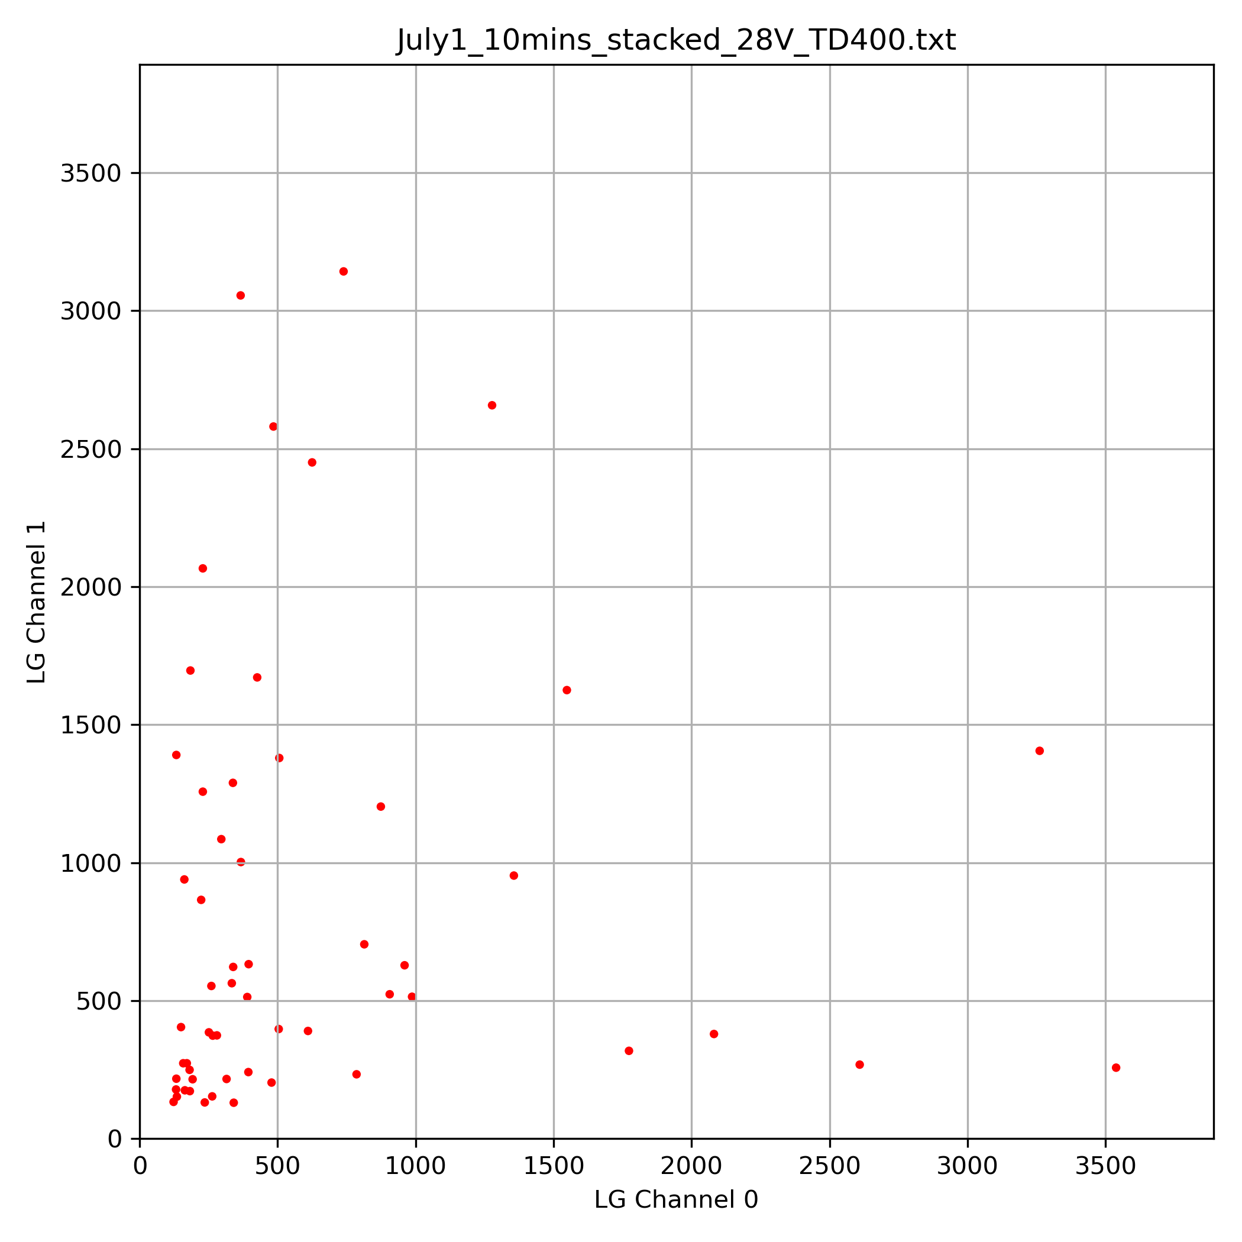
Observing First Muons – Results
July 1, 2026
Run for 10 minutes
Plot signals on channel 1 vs. channel
bias voltage 28V, trigger threshold 400
full config at July1_10mins_stacked_28V_TD400.conf
stacked
(signal + background)
stacked
(signal + background)
Low gain output is not saturating
Low gain output
High gain output

Slide 5
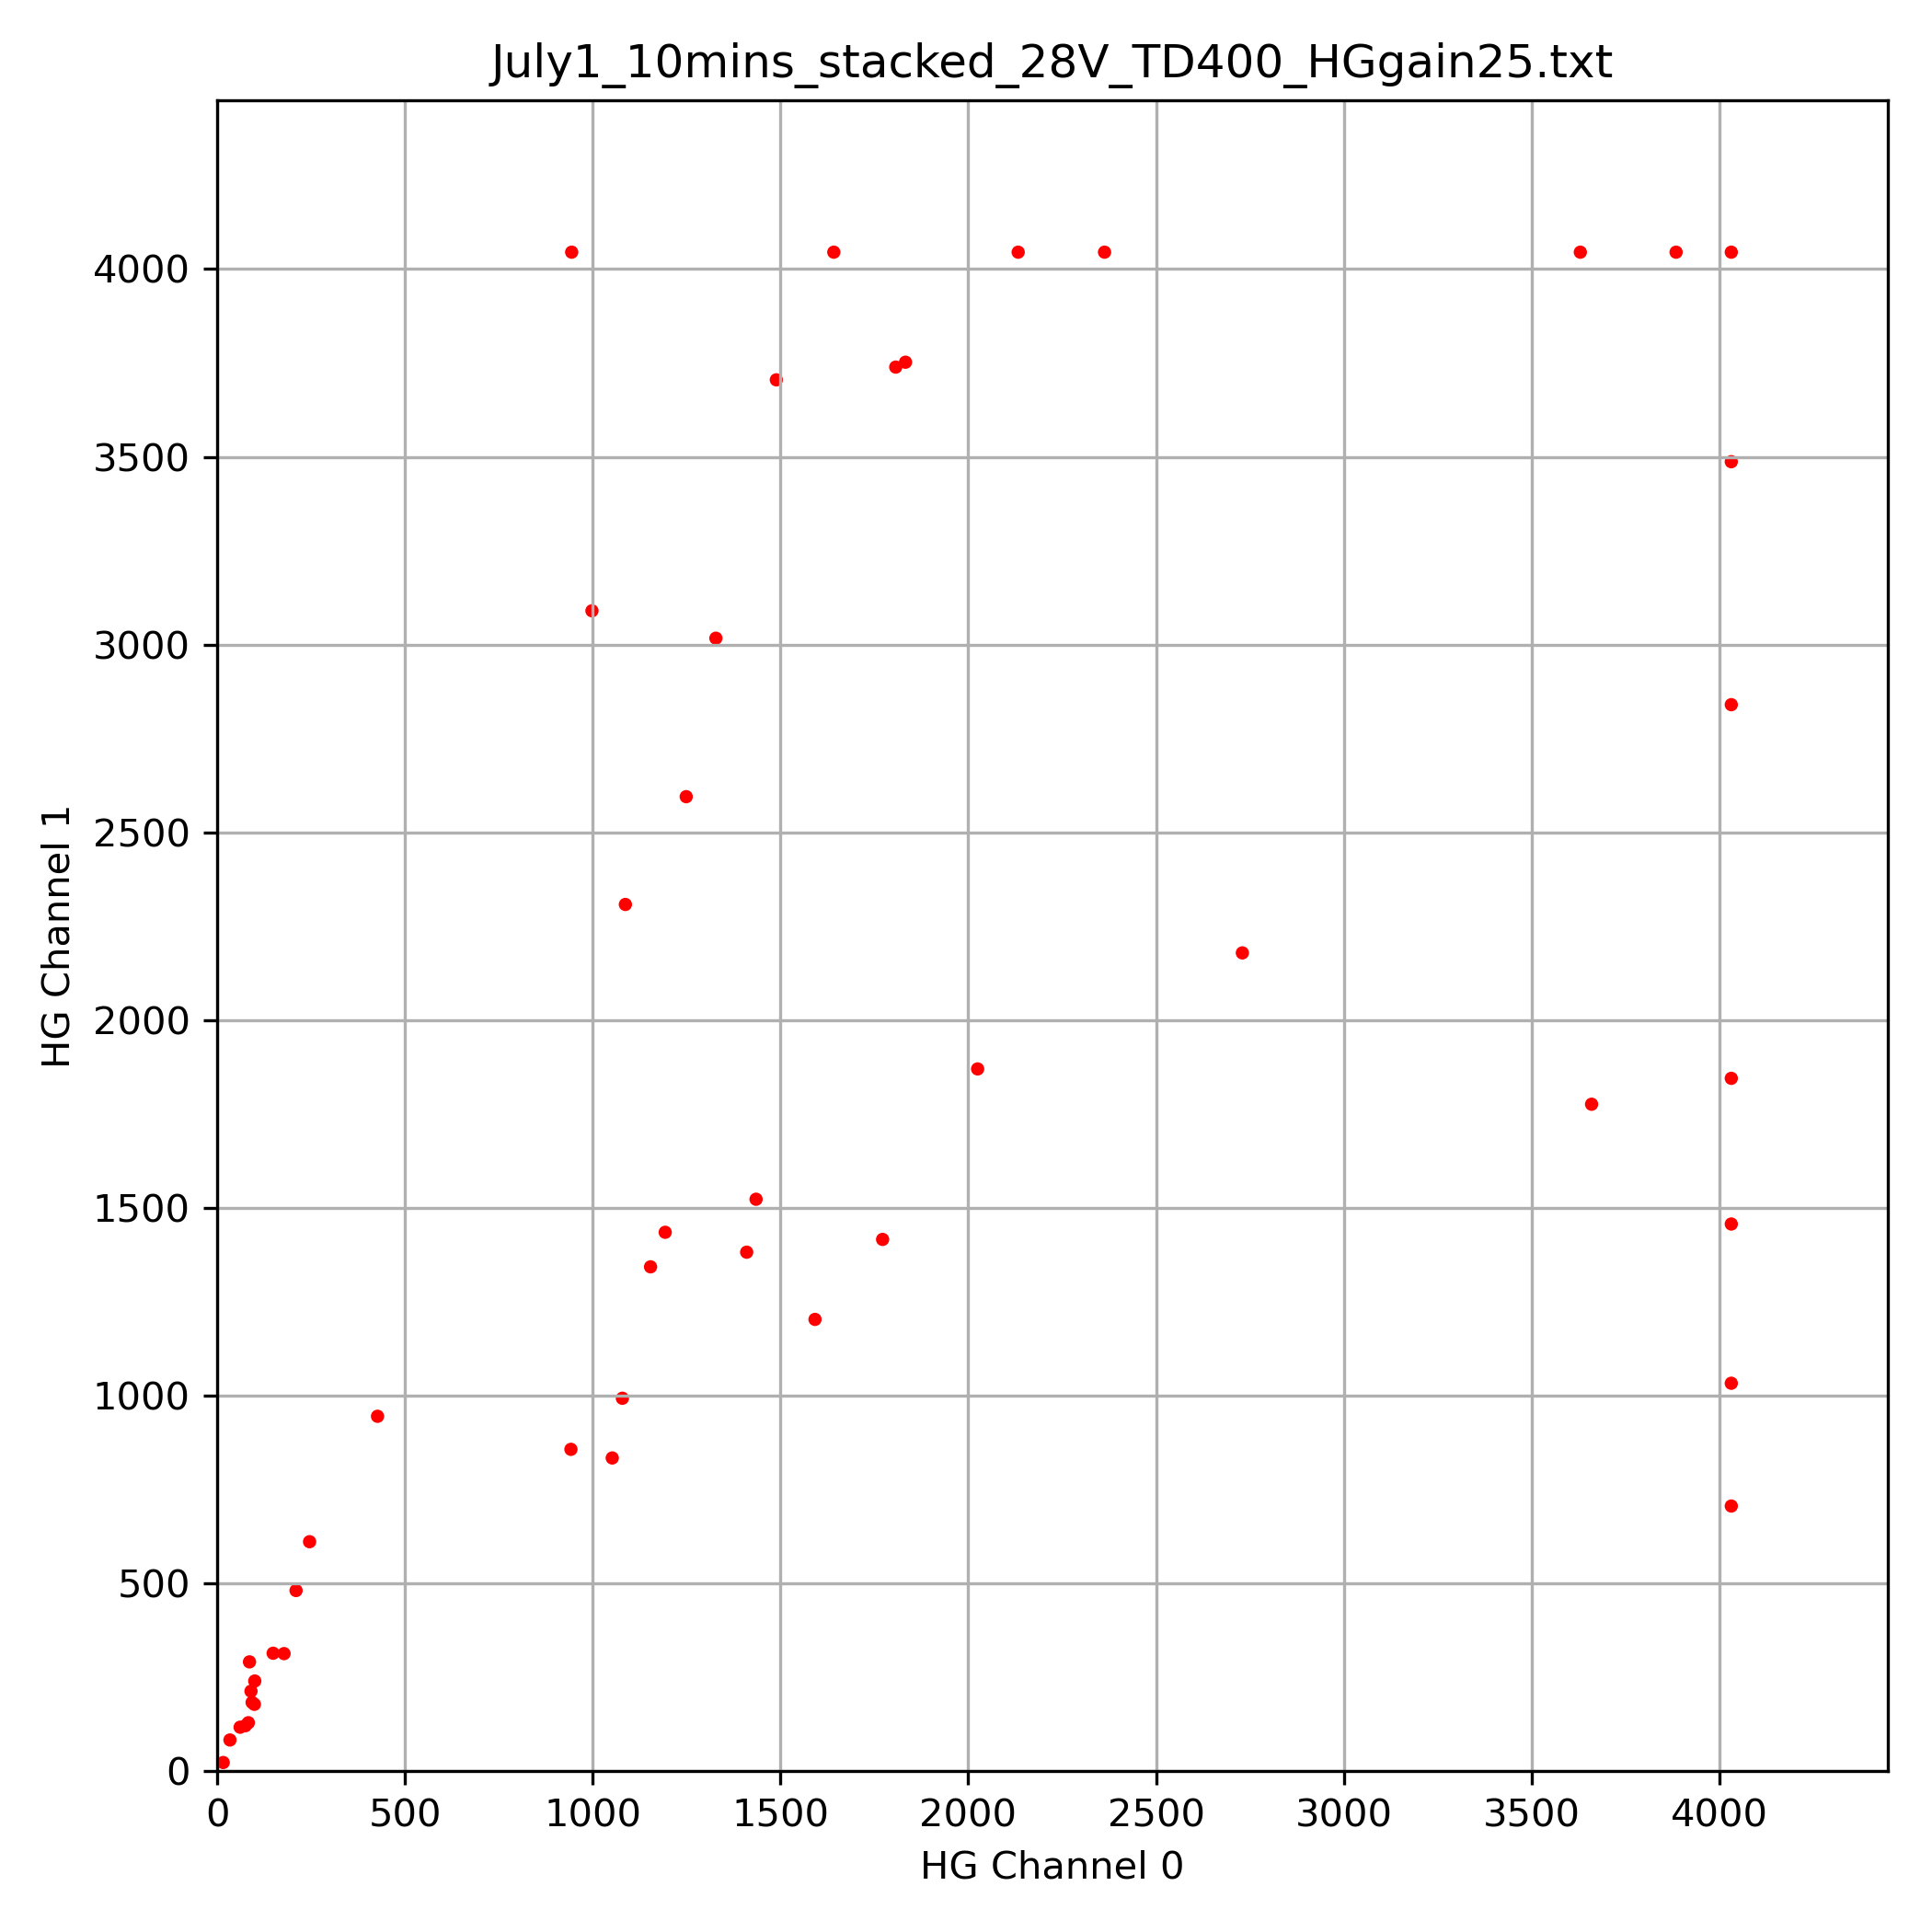
Observing First Muons – Results
July 1, 2026
Run for 10 minutes
Plot signals on channel 1 vs. channel
bias voltage 28V, trigger threshold 400
full config at July1_10mins_stacked_28V_TD400.conf
stacked
(signal + background)
stacked
(signal + background)
Reducing HG gain from 50 to 25 reduces but does not eliminate saturation
Gain = 25 (47 events)
Gain = 50 (56 events)

Slide 6
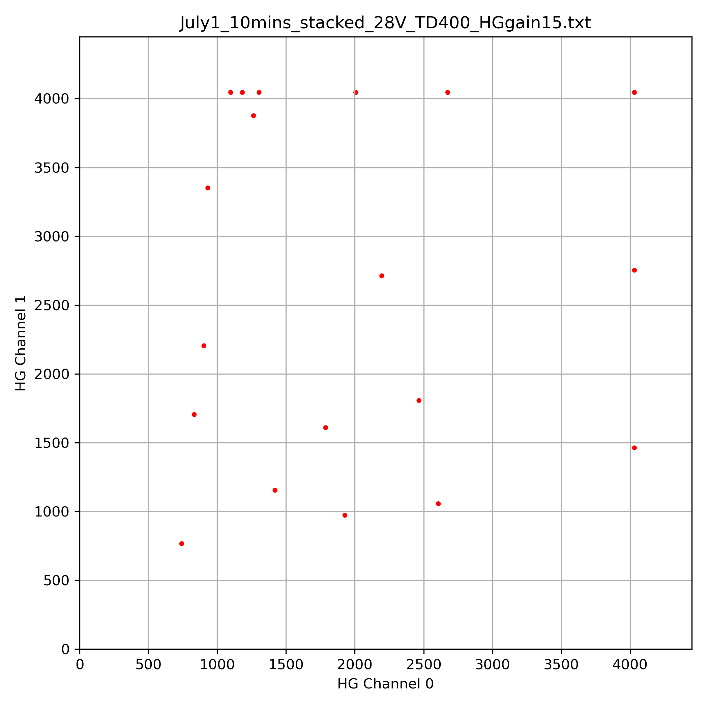
Observing First Muons – Results
July 1, 2026
Run for 10 minutes
Plot signals on channel 1 vs. channel
bias voltage 28V, trigger threshold 400
full config at July1_10mins_stacked_28V_TD400.conf
stacked
(signal + background)
stacked
(signal + background)
Reducing HG gain from 50 to 15 still doesn’t eliminate saturation, and the rate has gone down quite a bit
Gain = 15 (19 events)
Gain = 50 (56 events)

