Slide 1
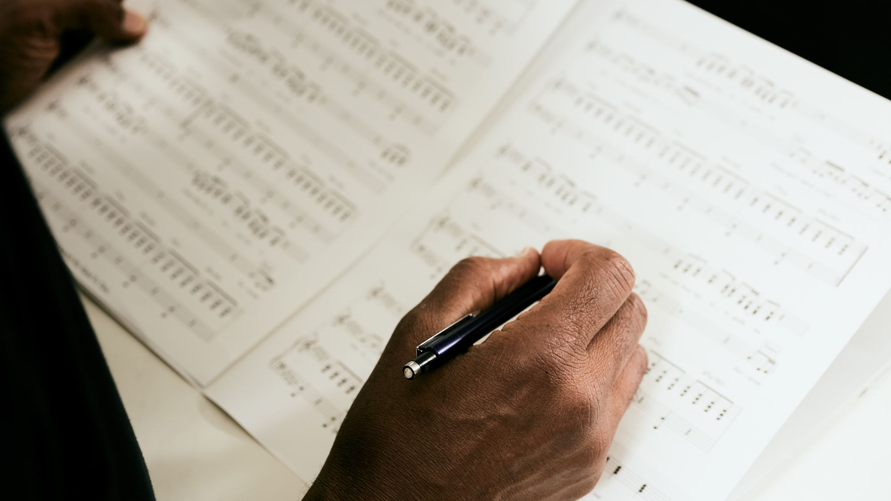
Time Series Analysis of Topics in Song Lyrics
Topic Modelling 2022Z

Slide 2
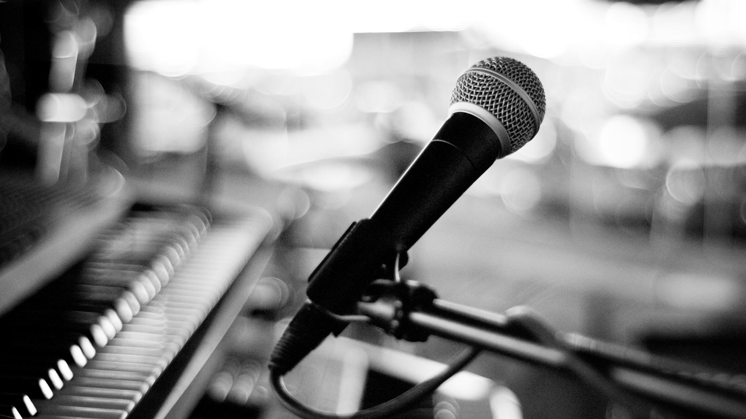
Research questions
How does the use of specific themes and subject matter in song lyrics change over time?
Are there any notable trends or shifts in the language and vocabulary used in song lyrics throughout different decades?
How do the most common topics discussed in song lyrics vary between different musical genres?
Are there any correlations between changes in societal or cultural events and shifts in the topics present in song lyrics?

Slide 3
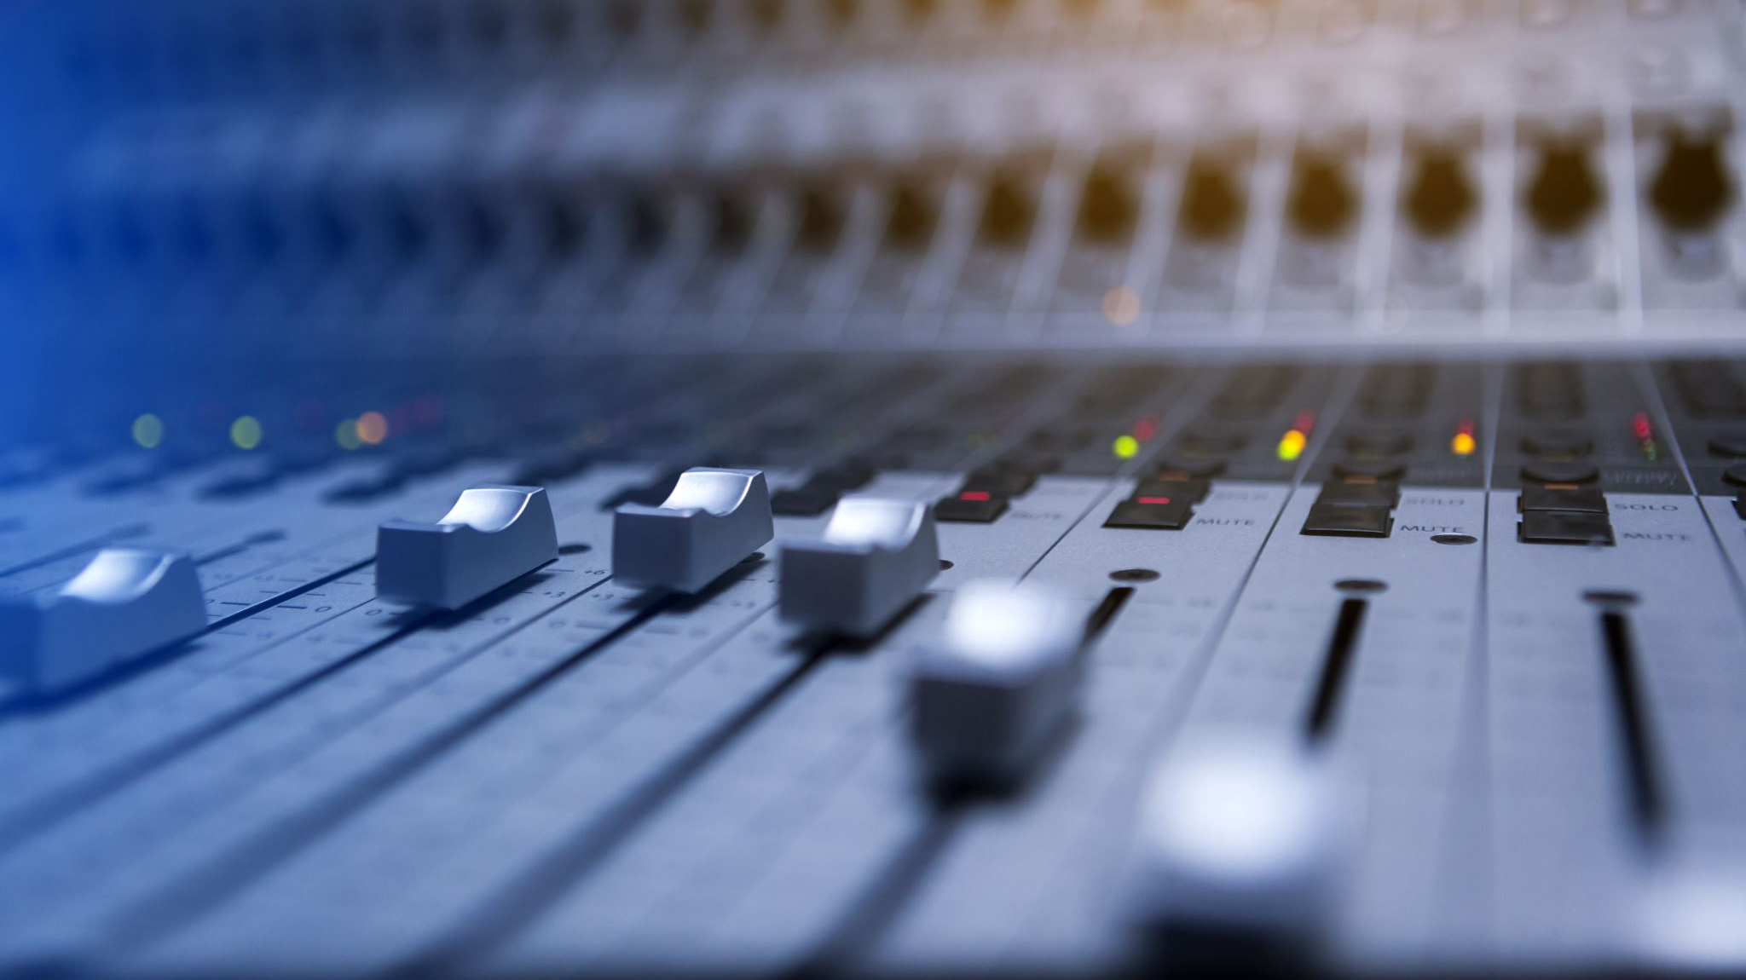
Analysed dataset source
Music Dataset: Lyrics and Metadata from 1950 to 2019
Moura, Luan; Fontelles, Emanuel; Sampaio, Vinicius; França, Mardônio (2020), “Music Dataset: Lyrics and Metadata from 1950 to 2019”, Mendeley Data, V2, doi: 10.17632/3t9vbwxgr5.2
This dataset provides a list of lyrics from 1950 to 2019 describing music metadata as sadness, danceability, loudness, acousticness, etc. We also provide some informations as lyrics which can be used to natural language processing.
The audio data was scraped using Echo Nest® API integrated engine with spotipy Python’s package. The spotify API permits the user to search for specific genres, artists,songs, release date, etc. To obtain the lyrics we used the Lyrics Genius® API as baseURL for requesting data based on the song title and artist name.

Slide 4
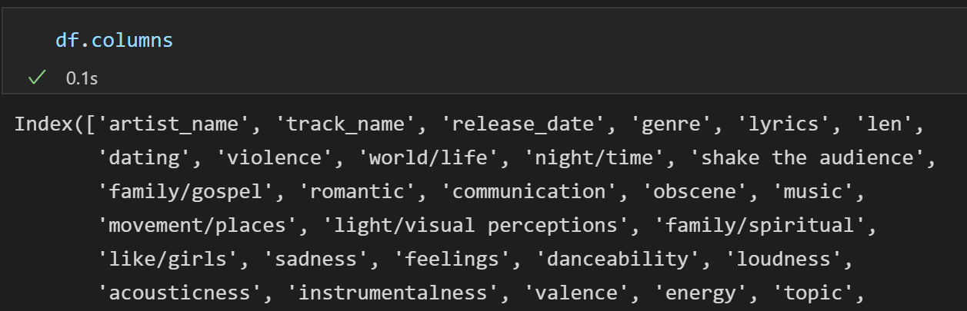
Dataset structure
28372 rows, 30 columns

Slide 5
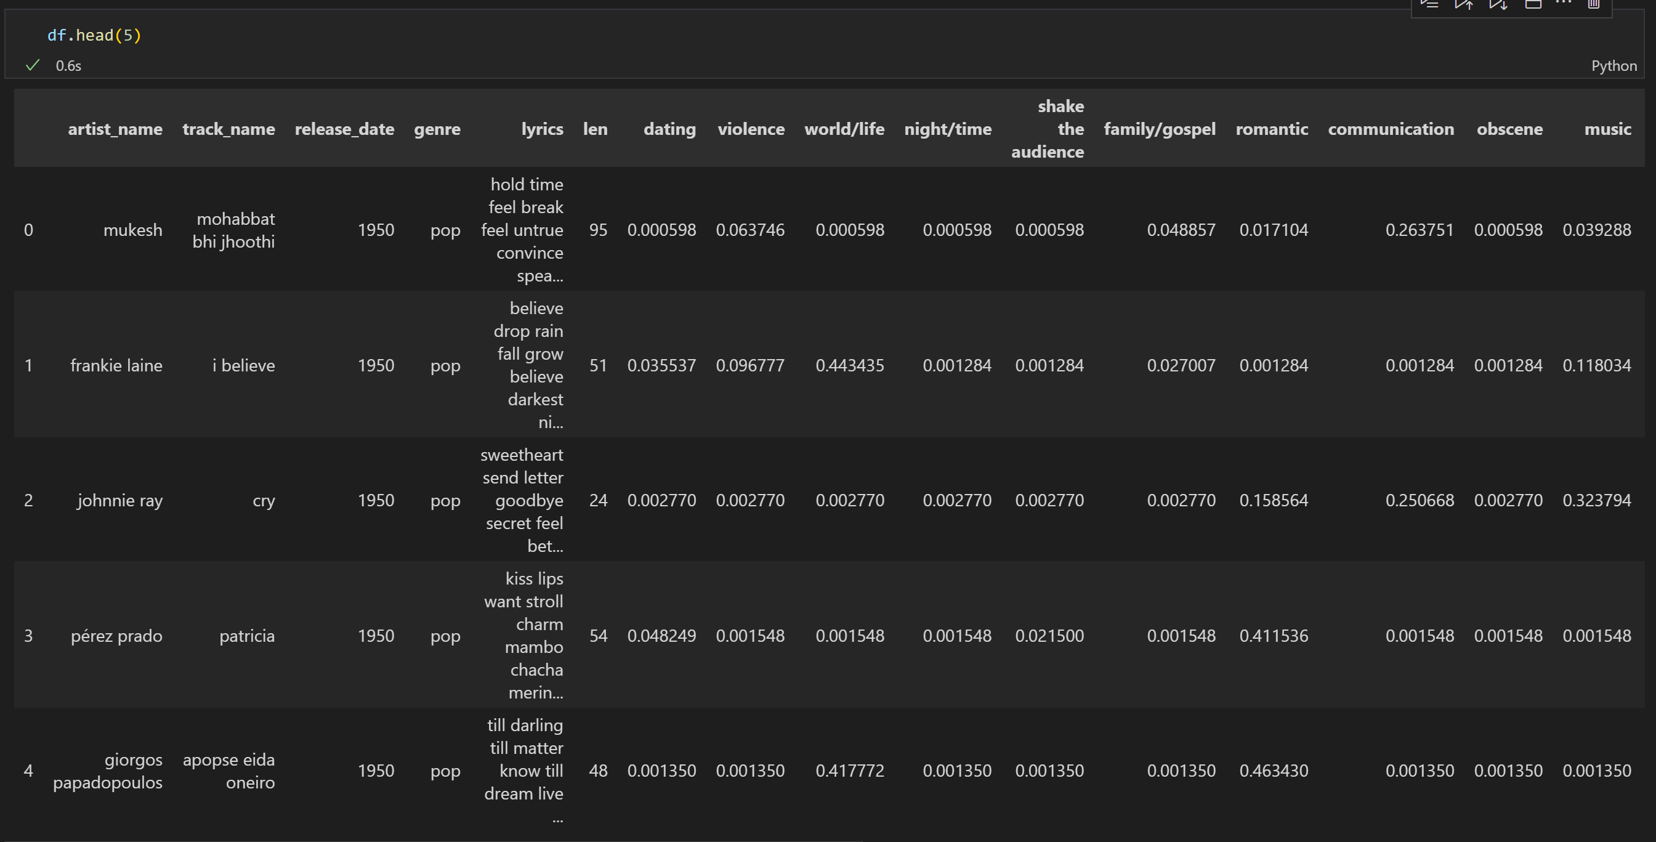
Dataset sample

Slide 6
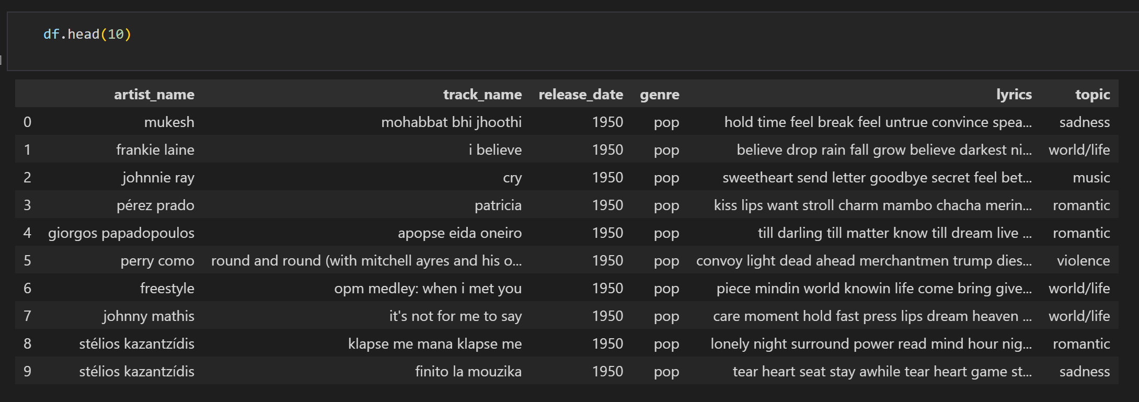
Used dataset

Slide 7
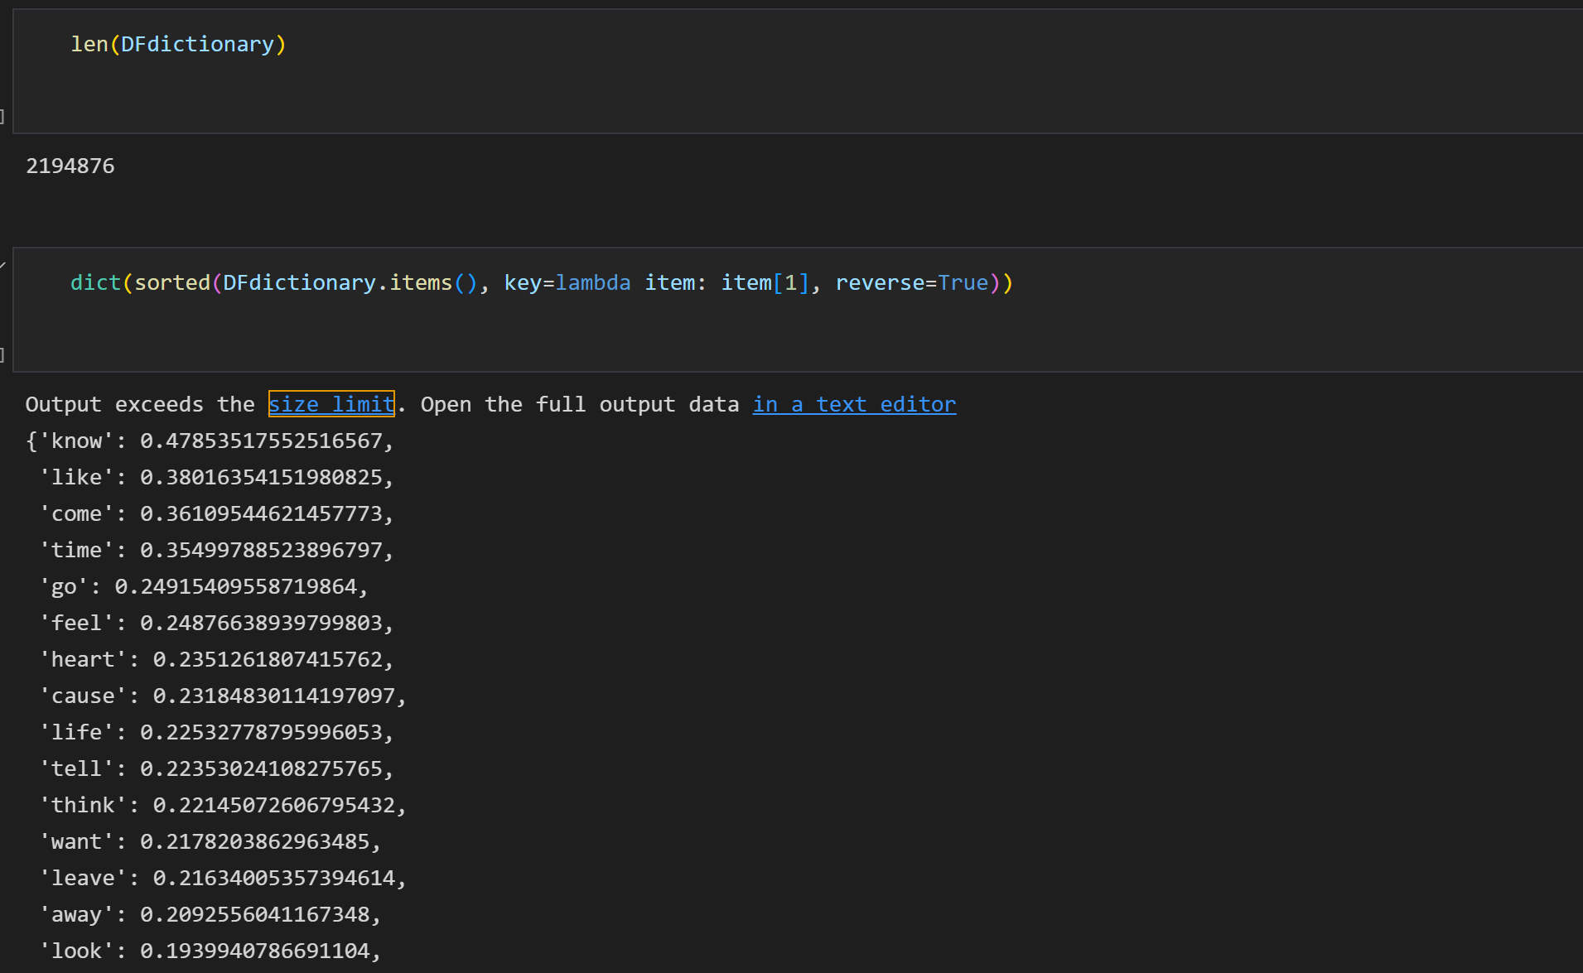
Tokens – count, popularity

Slide 8
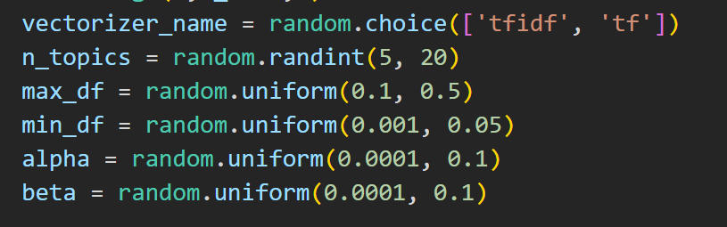
Some problems with modelling
Created a random search function to find a combination of parameters that results in the highest topic coherence

Slide 9
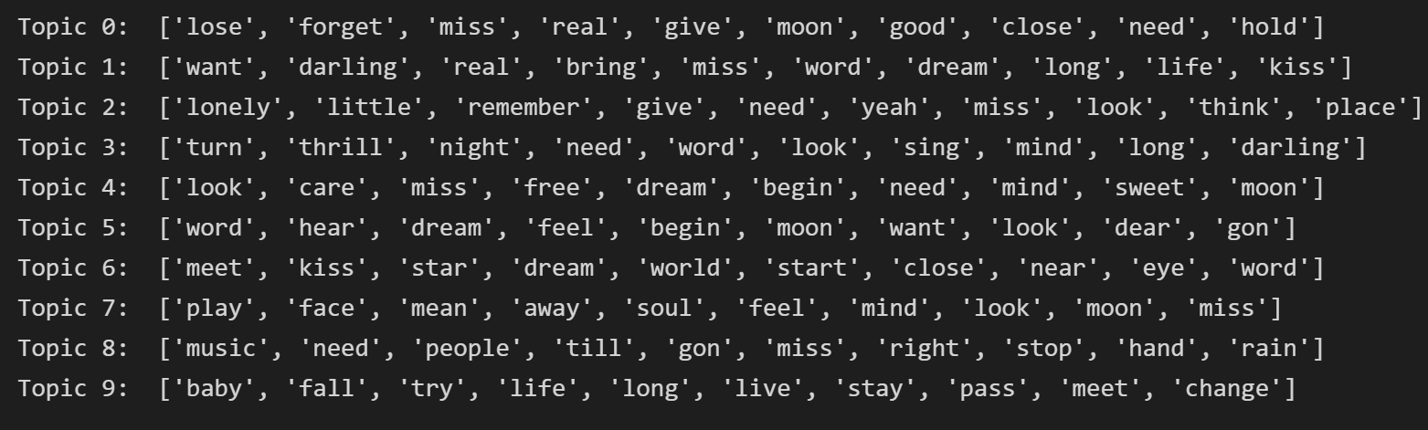
Some problems with modelling
Topics that were found using these „best” parameters were all very similar to each other (love, soul, dreams, longing)
The results looked similar to this for every decade!

Slide 10
„Expert” judgement as a solution
I’ve decided that the best option would be to tune the parameters myself in order to get better topic uniqueness and interpratibility - the results are better but still not ideal
Love, relationships: ['go', 'head', 'love', 'want', 'real', 'hand', 'help', 'baby', 'say', 'friend']
Self-reflection, self-awareness: ['believe', 'look', 'stand', 'place', 'inside', 'eye', 'face', 'sweet', 'know', 'like']
Heartbreak, emotional pain: ['heart', 'break', 'hold', 'baby', 'know', 'kiss', 'need', 'hurt', 'arm', 'soul']
Rebellion, attitude: ['like', 'know', 'cause', 'fuck', 'come', 'shit', 'yeah', 'play', 'leave', 'blue']
Life lessons, personal growth: ['life', 'feel', 'fall', 'good', 'come', 'change', 'know', 'cold', 'learn', 'live']
Loneliness, loss: ['away', 'walk', 'hear', 'tear', 'leave', 'dead', 'know', 'lose', 'wish', 'word']
Time, world, future: ['time', 'live', 'world', 'yeah', 'right', 'mind', 'black', 'gon', 'got', 'know']
Night, home, memories: ['night', 'long', 'home', 'come', 'remember', 'dream', 'sing', 'song', 'stay', 'gon']

Slide 11
Thank you for your time
Hubert Wojewoda

