Slide 1
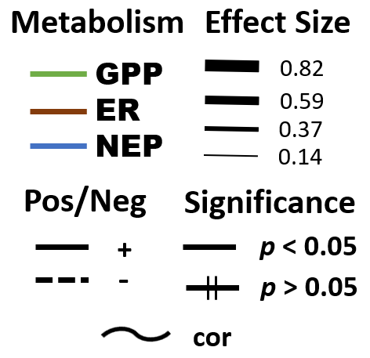
[N]
Temperature
N-Uptake
N₂ Fixation
Non-N₂-Fixer
Biomass
N₂-Fixer
Biomass
Metabolism

Slide 2

Legend
Metabolism
Effect Size
GPP
ER NEP
0.80
0.55
0.30
0.05
Pos/Neg
Significance
+
p < 0.05
-
p > 0.05
cor

