Slide 1
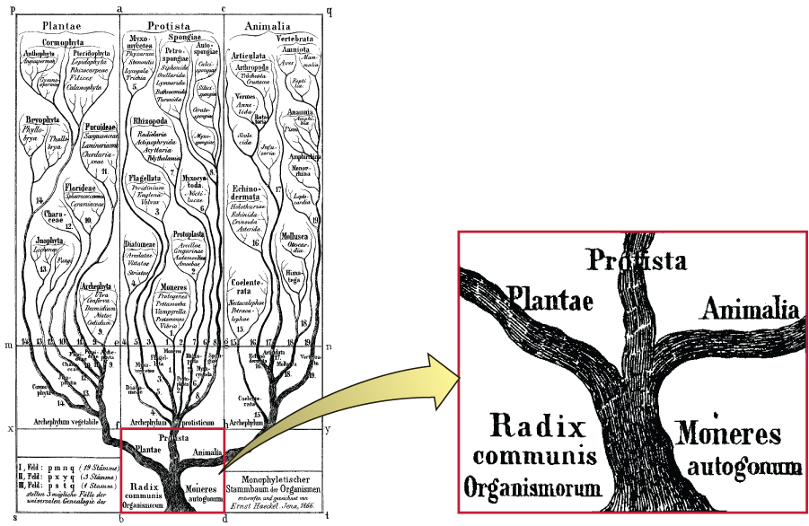
Basics
Genomes evolve by gradual accumulation of mutations
Can we use the difference in the NT between two genomes as a guidance for when they diverged (had a common ancestor)?
Initial research focused on similarities between species and mapped them into a tree called “tree of life”
Ancestor
This Photo by Unknown Author is licensed under CC BY

Slide 2
Basics
Initial studies focused by examining characters/features in the organisms
Ex morphological features
How to compare characters/features (& what characters to choose) led to lot of issues.
Ex. Bats (have wings) are closely related to Humans than to bats (have wings)
Main issue with this approach is how to convert characters into numerical quantities for modeling
Also this approach expects lots of data (which is a problem)
Molecular data as features (1904; formalized later in 1960s)
Characters in this case are Molecular Characters (ie A,C, G,T)
Unlike features (ex wings etc) this cannot be confused
Data is not a problem
Data conversion to numerical is not a problem.

Slide 3
Indirect methods → Sequencing (direct) methods
Earlier studies depended on indirect methods to understand the differences
Immunological data
If beta-globin is injected into rabbit (for example), then rabbit makes an antibody (protein) that binds to that protein. This antibody can also bind to other globins from other organisms due to similarity. This is a indirect measure of similarity
DNA-DNA hybridization can also lead to whether two DNAs are similar
Electrophoresis
Sequencing to NGS, we can read molecules directly (sort of)

Slide 4
DNA or Protein?
Many mutations will not lead to change in proteins
So, DNA, is assumed to have more information in this context than proteins
--G--A--I--L--D--R--
-GGAGCCATATTAGATAGA-
-GGAGCAATTTTTGATAGA-
Seq
Seq (mutated)
--G--A--I--L--D--R--
3 mutations in NTs (characters) leading to one amino acid change

Slide 5
Rooted/unrooted
A, B, C and D are genes. The length of the branches indicate the difference between the gene sequences (which can be calculated by seq comparison)
Unrooted tree
A
Branches
C
External nodes (A, B, C and D)
Internal Nodes
B
D
You can assume the root to be either 1 or 2 or 3 or 5. Here is a tree model with root as 1
Rooted trees are used for phylogenetic inferences The outgroup (from A,B,C,D) that makes us identify the root (ancestor)
Rooted tree
A
C
D
1
C
A
3
4
External nodes (A, B, C and D)
B
5
2
D
B
1

Slide 6
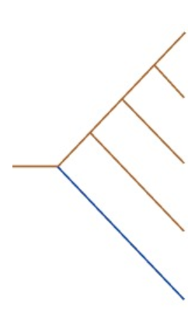
Establishing the common ancestor by building inferred tree
Ex. Human, Chimp, Gorilla and Orangutan. We can choose Baboon (branched away from the lineage leading to this 4 genes )
Human Gene
Genes from 5 different species
Chimp Gene
Gorilla Gene
model; sometimes prone to error
Orangutan Gene
Baboon Gene

Slide 7
Gene tree vs Species tree
Mutation and speciation can occur at different times.
A mutation can occur before speciation.
This assumption can make molecular clock theory fail (ie incorrect time for the speciation)
Gene A
Human
Mutations
Speciation
Gene B
Chimp
Gene C
Gorilla
Gene D
Orangutan
Gene E
Baboon

Slide 8
Alleles
“New alleles and haplotypes appear in a population because of mutations that occur in the reproductive cells of individual organisms. This means that many genes are polymorphic, two or more alleles being present in the population as a whole, each with its own allele frequency. Allele frequencies change over time as a result of natural selection and random genetic drift. ”
Taken from NCBI help/Genomes book

Slide 9
Tree construction
Focus on DNA for this example
Collecting sequences → MSA
Converting the MSA data into a reconstructed tree;
Assessing the accuracy of tree
Using theory (molecular clock) to assign time for the splitting events

Slide 10
Tree construction
Collecting sequences → MSA
How good is the data?
Are the data homologous sequences?
We have seen that the alignment will easy for highly similar sequences
Difficult for diverged sequences (indels in the wrong place!)

Slide 11
Tree construction
MSA
Seq1 xxxxxxxxx xxxxxxxx
Seq2 xxxxxxxxx xxxxxxxx
Seq3 xxxxxxxxx xxxxxxxx
…………………………………
Seq5 xxxxxxxxx xxxxxxxx
Collecting sequences → MSA
Converting the MSA data into a reconstructed tree;
Keep in mind that, no method that we know off is perfect. Some are better than others
Each approach Converts the sequence information into a measure (ex distance measure) which is then used to construct a tree
This simple measure of proportion of changes does not include multiple hits in the same position.
To convert this proportion of changes to evolutionary distance, we use statistics and Math to include corrections. That quantity is often called evolutionary distance
D12 = 4/20 = 0.2
If 20 is the sequence length of Seq1 and Seq2
Seq | 1 | 2 | 3 | 4 | 5
1 | - | D12 | D13 | D14 | D15
2 |  | - | D23 | D24 | D25
3 |  |  | - | D34 | D35
4 |  |  |  | - | D45
5 |  |  |  |  | -

Slide 12
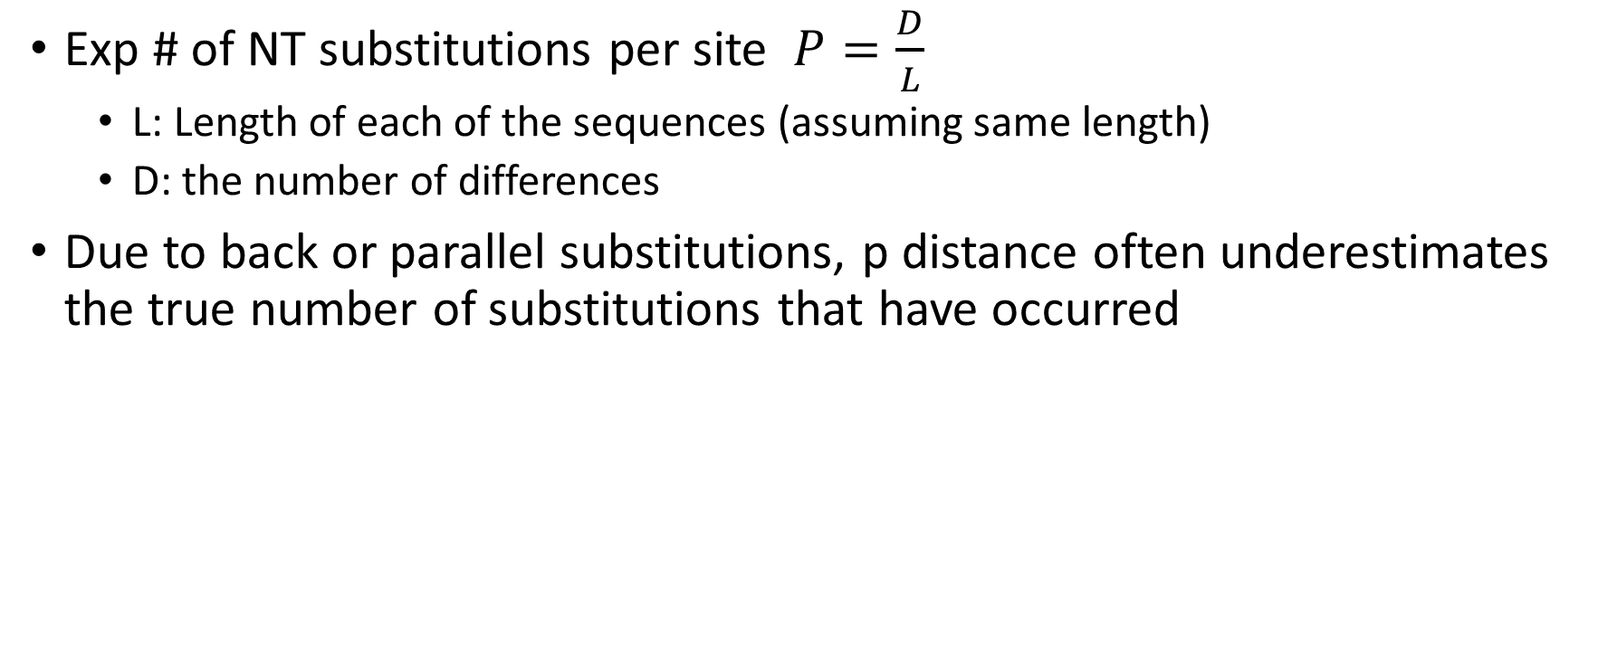
P-distance: Distance between 2 sequences
Exp # of NT substitutions per site $P=\frac{D}{L}$
L: Length of each of the sequences (assuming same length)
D: the number of differences
Due to back or parallel substitutions, p distance often underestimates the true number of substitutions that have occurred
T → C → A Multiple substitutions in site 1
A → A single substitution
C → A in both comparing sequences parallel substitution
A → G → in one and A → C in another convergent subsitutions
G → A → G back substitution

Slide 13
To estimate the actual # of sub, we need statistical models
Markov models
Each site is independently evolving independent of each other
Substitutions at any site are explained using Markov chain
Each NT is considered as a states of the chain

Slide 14
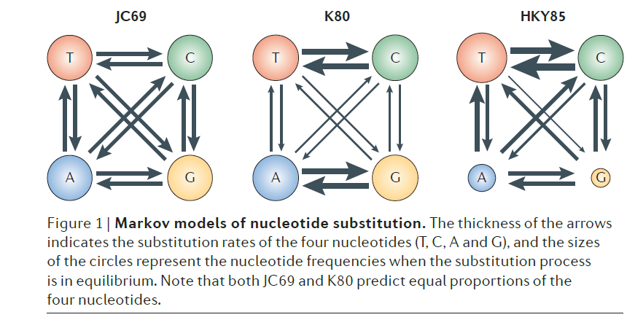
Models of Sequence evolution
From\To | T | C | A | G
T | . | λ | λ | λ
C | λ | . | λ | λ
A | λ | λ | .
G | λ | λ | λ | .
Nature Reviews Genetics, V13, p304, 2012 Figure 1
Substitution rate Matrices
Ex. JC69

Slide 15
Neighbor-Joining Tree
A
I
B
G
C
Based on distance-matrix approach (see last slide)
Starts with a Star like configuration
Ideal configuration a starting point
Two sequences are randomly extracted to be put in a separate node
Total branch length (from branches) is calculated.
Then the two sequences are returned to STAR configuration
Next two are randomly chosen until all the pairs are examined
The two pair extracted sub-tree with shortest branch length will be neighbors in the final tree and they are merged as one node for now
We will return to the star configuration with one less node
The process is continued until the node pairs reduced to one.
F
D
E
A
I
B
G
C
F
D
E

Slide 16
NJ tree
Advantages
Simple
Easy to calculate
Cons
Distance based, we lose the characters and focus on the distance

Slide 17
Maximum Parsimony
Corrects some of the issues with NJ distance based method
Taken from the Genomes book,
“recreate the series of nucleotide changes that resulted in the pattern of variation revealed by the multiple alignment. The assumption, possibly erroneous, is that evolution follows the shortest possible route and that the correct phylogenetic tree is therefore the one that requires the minimum number of nucleotide changes to produce the observed differences between the sequences.”

Slide 18
Character-Based: Parsimony
1 A A G A G T G C A
2 A G C C G T G C G
3 A G A T A T C C A 4 A G A G A T C C G
“The parsimony-informative sites are those at which at least two distinct characters are observed, each at least twice” Nature Reviews Genetics, V13, p304, 2012
MP identify phylogenetically informative sites:
Site 1 is informative? No ; Site 2 is informative? No
(all trees require 1 change); Site 3 is informative? (all trees require 2 changes); Site 4 informative? No. (all trees require 3 changes); Site 5 informative? Yes
Site 5 (left tree) is most parsimony tree
(Tree that minimizes the # of changes)

Slide 19
Maximum Parsimony method
Pros
More rigorous than NJ
Assumptions are not valid
Cons
# of trees grows enormously as the # of sequences increase
We have to randomly create many trees to identify the one with minimum changes

Slide 20
Many methods, how to access the accuracy of the trees?
Just like other methods, to access the accuracy, we need something to compare against
Accuracy could be the whole tree or parts of the tree
Take the MSA and create a random multiple sequence alignment derived form the original MSA (extracting random columns)
Sample with/without replacement; bootstrap
We should get a same tree as the original
How it is done?
100 new alignments are created from original and say 1000 replicate trees are built.
Assign the bootstrap value (how many times we have seen the same group) as the original). If this is > 80% (for example) then mark that as high confidence

Slide 21
Maximum-Liklihood
They don’t use distances; Use mismatches directly to construct trees
Tree (topology) is a model
Model: Tree
Parameters: Branch lengths and substitution parameters

Slide 22
Bayesian Methods
Assuming a model distance (Jukes Cantor etc.) → Trees
Probability based approach
Using uncertainty in complex models
Calculate the probability of observing some data given some probability model (ex. Tree == Model)
It seeks the probability of a tree given a model

Slide 23
Bayesian Methods
p[Tree|Data] is called posterior probability (correct Tree)

Slide 24
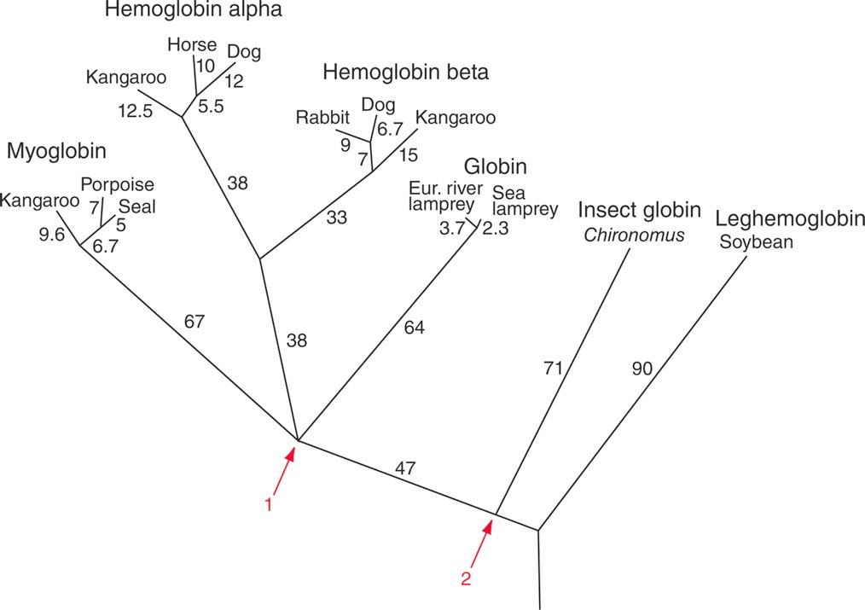
Inferred phylogeny using globins; Source Dayhoff Maximum Parsimony Approach
Source: Dayhoff et al. (1972). Reproduced with permission from National Biomedical Research Foundation. Fig 7.2 from Book
13 Globin gene from different species
Last common Ancestor of Vertebrate globins
Source: Dayhoff et al. (1972). (Pevsner 247)
Pevsner, Jonathan. Bioinformatics and Functional Genomics, 3rd Edition. Wiley-Blackwell, 2015-10-16. VitalBook file.
Last common Ancestor of Vertebrate & Insect Globins

Slide 25
Molecular Clock
Species A
AAGCTCAAC
TAGCTCAAC
AAGCTCAAG
A and B differ by 4 bases
Ancestor
ACGCTCAAG
ACGCGCAAG
Species B
Let us say, if we know that the Rate is 1 mutation/5 Million years (fossil records)
Note the rate is constant
Time
Time of divergence = 2 mutations each x 5 million years = 10 million years
Based on Mr. Rahilly’s notes on Molecular clocks

Slide 26
Estimating Human molecular clock
Human
Same previous page formula
# of sub = x
# per lineage = x/2
# per lineage per million years = x/(2*13)
Orangutan
Time: 13 Million years (based on fossil records)

Slide 27
Is there one clock?
It was though initially there was just one clock but we later found out that there are more than one clock
There are different clocks for different organisms
There are different clocks within an organism for some genes
Rodents have a faster clock than primates
Nonsyn substitutions are slower than Syn substitutions

Slide 28
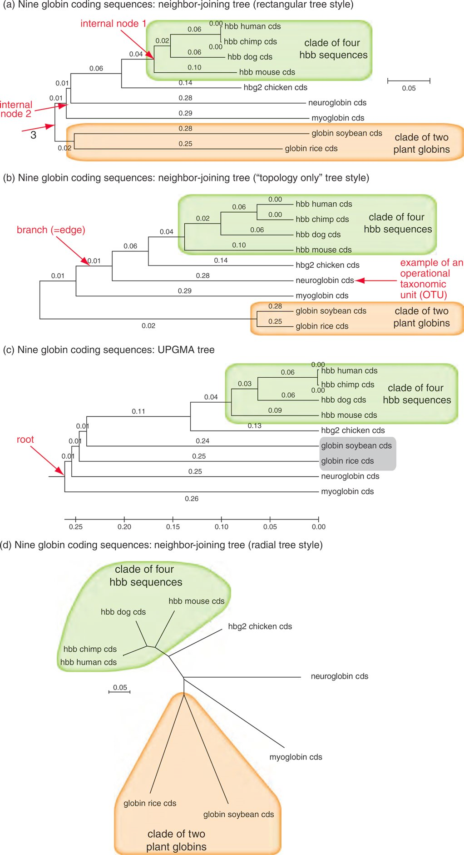
Evolution via Trees
Phylograms SCALED a,c,d NOT b
Each leaf is called Operational Taxon Unit (OTU) ; Extant (non-extinct)
Base differences/site Scaled UNROOTED
Root?
NOT Base differences/site UNSCALED; Cladogram

Slide 29
Evolution via Trees
Base differences/site Scaled
Rooted Tree
Base differences/site Scaled
UNROOTED (no ancestor)

Slide 30
Summary
The Jukes-Cantor (JC) statistical model that describes how one NT will change to other NTs in the DNA sequence over time
There are parameters in the model that are automatically estimated by MEGA
Both NJ and ML produce trees that are unrooted
Drawn from left to right
With an outcome, one can create a rooted tree

Slide 31
Summary
NJ and Max-Likelihood (ML) methods suitable for building evolutionary trees and use different statistical principles
In NJ, distances (pairwise evolutionary distances) and uses least squares method for minimization
In ML, the maximum likelihood is optimized such that the inferred tree is the most likely tree
ML and NJ (faster than ML) will produce very trees, but NJ is much faster.

