Slide 1
Status/Agenda for today BIFX-550
S.Ravichandran

Slide 2
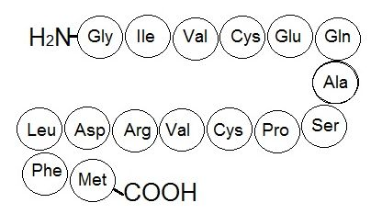
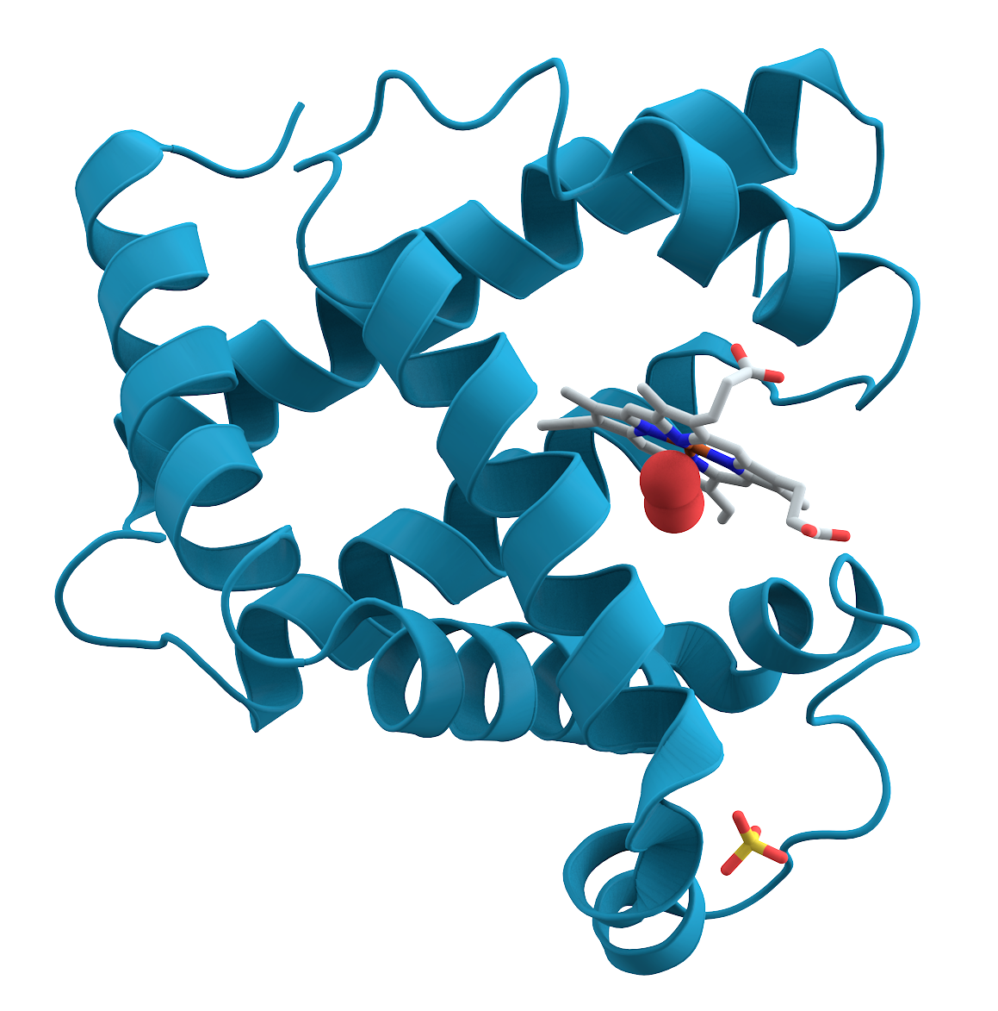


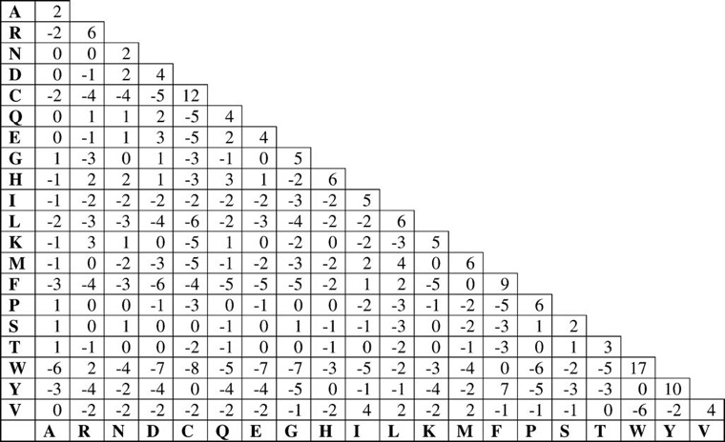
Analyze Alignments
Choose a DB/Matrix/Other parameters initiate BLAST
Proteins, DNA → Function
Algorithm to produce alignments using Matrices and penalties and other approximations
Approximation: strings of letters
CC BY-SA License image
How do we want to align; Global/Local
Gap Penalty parameters
Global: No Statistics/Math formulation; done with approximations
Local: We do have some backup
BLOSUMx, PAMs series
Local: BLAST; works in most cases; Let us focus with Local
To fill the target-frequency, we need high-confidence alignments. Which in most cases can be hand-derived
We need to know how to score and we need a base-line
Let us assume we are aligning random non-gapped strings
With certain conditions, we develop a procedure to create a scoring matrix

Slide 3
Discussion ?s
Midterm
Biology/basics (C1)
Command-line (C2-3)
Linux; R; edirect
Databases (C4)
NCBI, Ensembl, UniProt
Pairwise-Sequence comparison (C5-6)
Theory
Matrices (PAM/BLOSUM)
Dynamic Programming
BLAST (C7)
Tool for sequence comparison
MSA (C8)
Multiple sequence comparison
March 7 to 15 break
Midterm: March 19

Slide 4
Midterm
Section 1 (10 Questions; 20 points)
10 Questions; Basic Bioinformatics/Biology; involves looking up in NCBI/Ensembl databases
Section 2 (4 Questions; each 20 points)
Finding sequences ; Sequence related information
Be aware that NCBI contains species related information other than humans (plants, Rats, Ecoli etc.)
Analyzing BLAST sequences
Galaxy, edirect

Slide 5
Mid-term
Do you know NCBI also has sequence information other than humans?
Other animals, plants and viruses
Brush up your edirect skills
Sequence extraction and reporting
MSA using Galaxy
Loading a file or fasta sequence(s) and carrying out a simple alignment and reporting the results.

Slide 6
Looking ahead
March 5: MSA
March 12 No Class
March 19 Midterm
March 26 Adv BLAST Phylogeny
April 02 Phylogeny
(bifxb ongoing assignment deadline)??
April 09 NGS
April 16 Microarray/RNA-Seq
April 23 Impact Analysis
April 30 Protein Structure
Modeling (if time permits)
May 07
Find-a-gene presentation; bifxc deadline; presentation slides

