Slide 1
Gene Expression
MicroArray and RNA-Seq Data Analysis

Slide 2
Goals
Explain Microarray data preparation
T-test and related probability values
Exploratory statistics
Clustering
PCA
Visualization of gene expression data
Analyze both Microarray and RNA-seq Datasets

Slide 3
I will not talk about
Partek
RNA-seq analysis is not the same as Microarray but some steps can be carried out using R and others using Linux. Due to lack of time, we will not cover all the steps today.

Slide 4
Gene Expression Analysis
Large-scale gene expression (mRNA transcript levels)
Microarrays (became popular in 2000)
RNA-Seq (NGS based transcript profiling)
(commonly used after 2010)
Techniques in general
RNA is extracted from source (ex human fetal brain)
How the RNA is changed over time?
We can compare expression in Disease cells vs Control sample(s)?

Slide 5
mRNA expression via RNA-Seq
RNA-seq via NGS
RNA → cDNA
Packaged into libraries
Create short reads
Sequencing of short reads (BAM etc.) using NGS methods

Slide 6
NGS Application: RNA-seq differential expression
Take RNA→ cDNA and sequence them
Sample A
Reads
Aggregate
Align
Pile-up
GeneX
Reference
CTCTGGTCGAGGGTCTAAATCGCCCCTGTGTACCCGGGTAGAGAGAGACCAG
Sample B
Reads
Align
Aggregate
Statistics
Pile-up
GeneX is expressed more in Sample A than B

Slide 7
Microarray
Microarray
RNA → cDNA or cRNA (stable)
Affymetrix is the popular form and we restrict to this platform
Labelled with a fluorescent dye
Hybridized to a microarray

Slide 8
Microarray
Compare the differences between a cancer cell and healthy (expression)
We have about 21K genes
At a given time, some cells are turned on and many are turned off
We basically count molecules
We can answer this using Microarray experiments

Slide 9
Microarrays
Old technology
A simple example
http://www.ncbi.nlm.nih.gov/pubmed/9381177
Exploring the metabolic and genetic control of gene expression on a genomic scale
DeRisi et al, science 1997
https://www.ncbi.nlm.nih.gov/pubmed/9381177

Slide 10
Microarray vs RNA-seq
De novo transcript assembly
Identifying transcripts to improve annotation of genes
Measuring transcript abundance

Slide 11
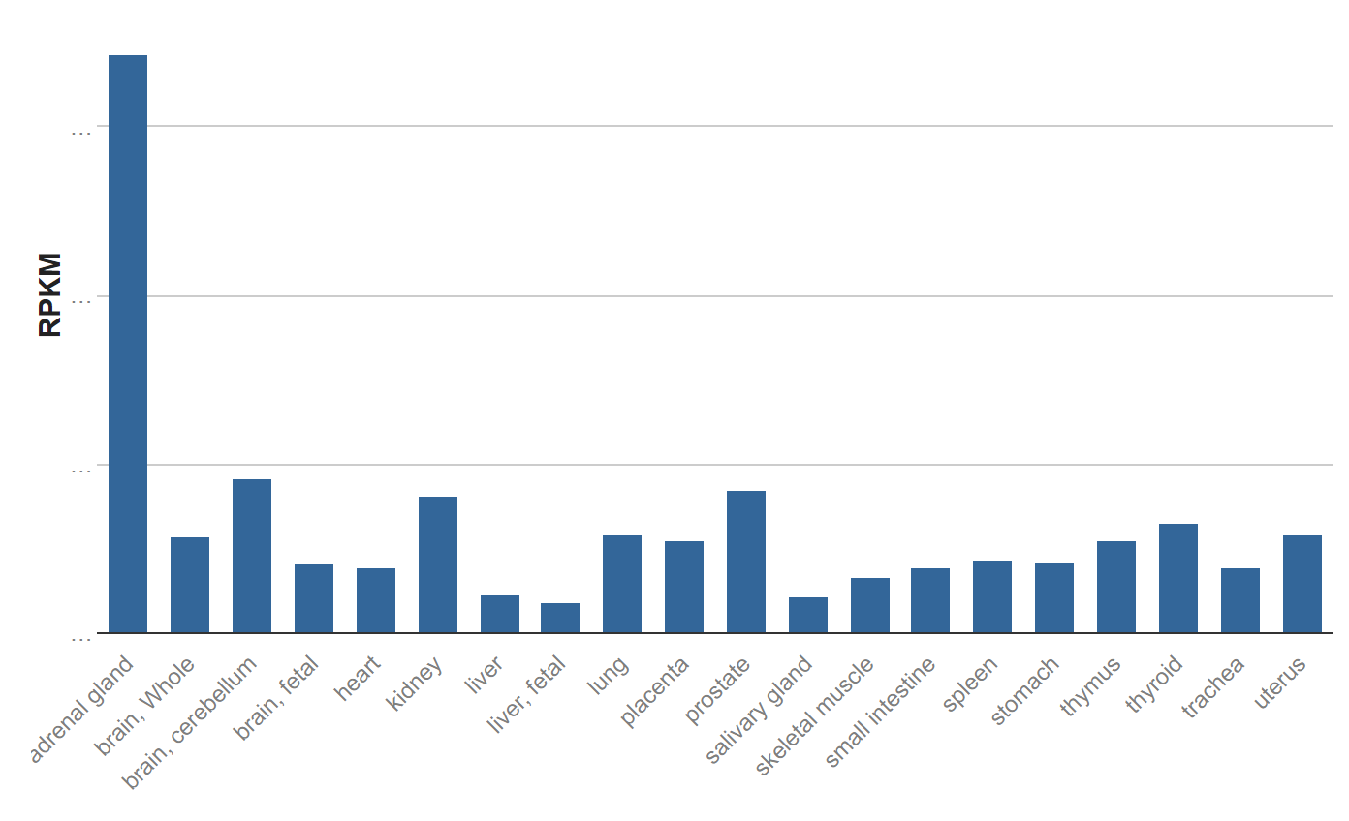
ADRENAL GLAND
Gene CASP9
RNA sequencing of total RNA from 20 human tissues

Slide 12
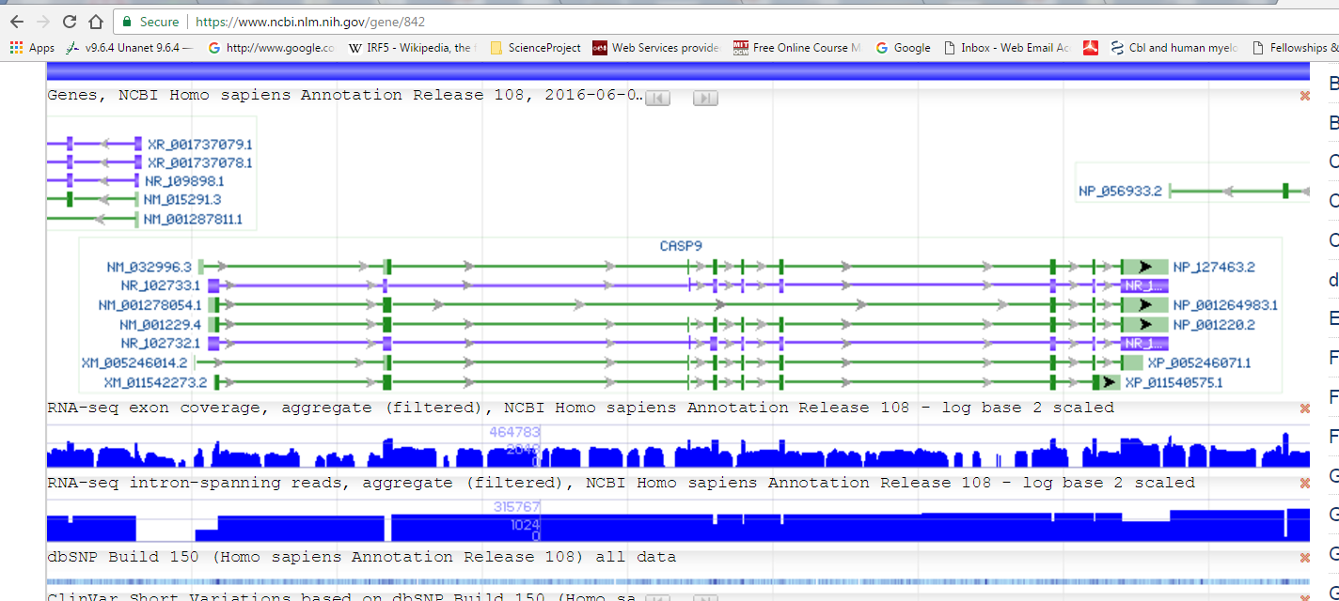
RNA-seq exon, intron coverage for hCASP9

Slide 13
Gene Expression
Northern (Detect RNA)
http://en.wikipedia.org/wiki/Northern_blot
Western (Detect Protein)
http://en.wikipedia.org/wiki/Western_blot
Primary
GenBank and EST (bulk)
200-500 bases
mRNA (tissues/cells) → DNA
Reason for sequencing ESTs
Identify genes; abundance of proteins
Newer: Sequence Read Archive (SRA)

Slide 14
Expression
ESTs No guarantee that these have any biological annotation. Large-scale EST projects provide the raw material to construct gene catalogs and annotation
UniGene
GenBank Seqs (EST)
Sequences
Seq. Alignment
Reference Sequences
Gene Clusters
NCBI GEO Datasets DB
“Profiles represent relative expression of a particular gene across the samples of a study” taken from NCBI
GEO Profiles
Microarray Experiments

Slide 15
Microarray
How do we know whether a gene is turned on or off?
By measuring the mRNA
Example
Muscle cell will express muscle related proteins
Actin, myosin and not Insulin (Hormone) or Melanin (Pigment)
One could collect the expression profiles of two different cells
If we compare we will know what is expressed and where?

Slide 16
Microarray
Molecular basis for phenotypic differences
Questions?
Why we are all different?
Why cancer cells live longer?
We know the differences are due to genomic differences
Can we identify variations and relate them to phenotypic differences?

Slide 17
Microarray
SNP
Genotypes
AA
AC
CC
C
GGATCGAGTNTTAAGCCTA
A

Slide 18
Microarray
Method to count molecules
Steps
Denaturation
Hybridization
Convert intensity to number
Important
Works only when you have many many copies of molecules

Slide 19
Microarray
Different microarray methods
Density
one or two labels
Platforms
Affymetrix (high density; one color)
Agilent (circles on grid, 1 or 2 color)
Illumina (high density, 1 or 2 color)

Slide 20
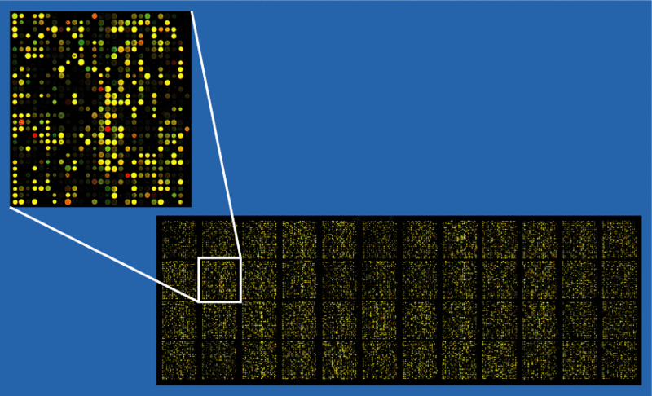
Example of an approximately 37,500 probe spotted oligo microarray with enlarged inset to show detail
https://commons.wikimedia.org/wiki/File:Microarray2.gif

Slide 21
Cancer Sample
Normal Sample
Probes
No corresponding probe
Pour and Wash
Measure the intensity
Compare the normal vs cancer samples

Slide 22
Cancer Sample
Normal Sample
Probes
Intensity
Count molecules
Genes
4 1 0 2 0 4 0 2

Slide 23
Microarray Applications
Gene expression
Why 3’
Target the slow decaying end
SNP
Person will have AA, AG, GG
5’
mRNA
3’
Probes
G
GGATCGAGTNTTAAGCCTA
A
Probe for allele-1 CCTAGCTCACAATTCGGAT Probe for allele-2 CCTAGCTCATAATTCGGAT

Slide 24
Microarray Applications
CHIP Microarray
Transcription factor binding sites
Proteins bind to DNA
Identifying the sites

Slide 25
Platforms
Affymetix
High density, one color
Agilent
Circles on grid, 1 or two colors
Illumina
High density, one or two color
Use beads instead of in-situ sequencing

Slide 26
Two color Microarray
Sample 1
Sample 2
You use two color labels. Ex. Red for Sample 1 and Green for sampl2
And pour the samples to the same array.
The same molecules can bind to the same probe
Probe
Hybridize 2 samples in one array

Slide 27
For convenience, the numbers are often presented as ratios
Experimental Number will always be placed on numerator
A coloring scheme will be chosen to show a visual representation
Black indicates 1:1
Red: Induced (ratio > 1)
Darker means more expression
Green: Repressed (ratio < 1)

Slide 28
Ratio of experimental/control in the expression of mRNA from 12 hypothetical genes (geneC-geneN) Example from Discovering Genomics, Proteomics & Bioinformatics, Campbell and Heyer .
Red Green Red:Green ratio
GeneA 1,356 169 8.00 …… ….. …. …..
Response of genes
Genes | 0 hours | 2 hours | 4 hours | 6 hours | 8 hours | 10 hours
geneC | 1 | 8.000 | 12.0000 | 16.0000 | 12.0000 | 8.000
geneD | 1 | 3.000 | 4.0000 | 4.0000 | 3.0000 | 2.000
geneE | 1 | 4.000 | 8.0000 | 8.0000 | 8.0000 | 8.000
geneF | 1 | 1.000 | 1.0000 | 0.2500 | 0.2500 | 0.100
geneG | 1 | 2.000 | 3.0000 | 4.0000 | 3.0000 | 2.000
geneH | 1 | 0.500 | 0.3300 | 0.2500 | 0.3300 | 0.500
geneI | 1 | 4.000 | 8.0000 | 4.0000 | 1.0000 | 0.500
geneJ | 1 | 2.000 | 1.0000 | 2.0000 | 1.0000 | 2.000
geneK | 1 | 1.000 | 1.0000 | 1.0000 | 3.0000 | 3.000
geneL | 1 | 2.000 | 3.0000 | 4.0000 | 3.0000 | 2.000
geneM | 1 | 0.330 | 0.2500 | 0.2500 | 0.3300 | 0.500
geneN | 1 | 0.125 | 0.0833 | 0.0625 | 0.0833 | 0.125

Slide 29
Correlation coefficient; Spearman; Calculations using R ver 3.1.2
Example from Discovering Genomics, Proteomics & Bioinformatics, Campbell and Heyer .
geneC geneD geneE geneF geneG geneH geneI geneJ geneK geneL geneM geneN
geneC 1.00 0.89 0.78 -0.30 1.00 -1.00 0.48 0.10 0.00 1.00 -0.89 -1.00
geneD 0.89 1.00 0.61 0.06 0.89 -0.89 0.80 0.10 -0.32 0.89 -1.00 -0.89
geneE 0.78 0.61 1.00 -0.66 0.78 -0.78 0.07 0.12 0.49 0.78 -0.61 -0.78
geneF -0.30 0.06 -0.66 1.00 -0.30 0.30 0.64 -0.42 -0.78 -0.30 -0.06 0.30
geneG 1.00 0.89 0.78 -0.30 1.00 -1.00 0.48 0.10 0.00 1.00 -0.89 -1.00
geneH -1.00 -0.89 -0.78 0.30 -1.00 1.00 -0.48 -0.10 0.00 -1.00 0.89 1.00
geneI 0.48 0.80 0.07 0.64 0.48 -0.48 1.00 -0.10 -0.75 0.48 -0.80 -0.48
geneJ 0.10 0.10 0.12 -0.42 0.10 -0.10 -0.10 1.00 0.00 0.10 -0.10 -0.10
geneK 0.00 -0.32 0.49 -0.78 0.00 0.00 -0.75 0.00 1.00 0.00 0.32 0.00
geneL 1.00 0.89 0.78 -0.30 1.00 -1.00 0.48 0.10 0.00 1.00 -0.89 -1.00
geneM -0.89 -1.00 -0.61 -0.06 -0.89 0.89 -0.80 -0.10 0.32 -0.89 1.00 0.89
geneN -1.00 -0.89 -0.78 0.30 -1.00 1.00 -0.48 -0.10 0.00 -1.00 0.89 1.00

Slide 30
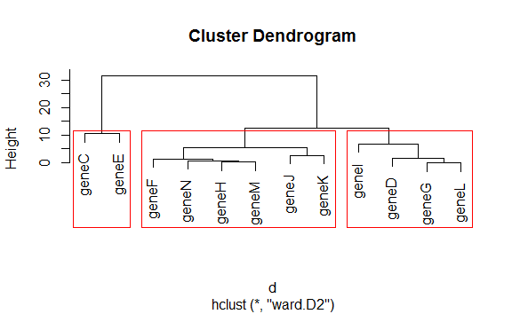
Ward method (Euclidian) was used for clustering. Calculations using R ver 3.1.2
Euclidean Distances were computed and Hierarchical Clustering was used to generate the Dendrogram
Tree was cut to find three clusters
geneC geneE
geneF geneN
geneH geneM
geneJ
geneK
Distance
geneD geneG
geneL geneI

Slide 31
Microarray Technologies
Gene Expression (Affymetrix gene chip array )
5’
3’
Probes are Complementary to 3’ end segments
RNA degrade tent to degrade more on 5’ end than on 3’ end.
Probe the sample and use them on the matrix and see which one lights up

Slide 32
Microarray Technologies: Genotyping
gDNA A TACATGGCCATCGGTANGTACTCAATGATGATA G
TACATGGCCATCGGTANGTACTCAATGATGATA
ATCGGTAGCCATTCATGAGTTACTA ATCGGTAGCCATCCATGAGTTACTA
Probe for Allele 1
Probe for Allele 2
AA Probe 1 you will only get hybridization for probe1 and will be much higher than for AG condition
AG or GA will bind to both probes 1 and 2. the Intensity will be same
GG: Probe 2 will show intensity and almost same as the AA probe intensity for AA.
Genotyping can answer this question?
Is a person AA, AG or GG at this SNP?

Slide 33
ChIP microarray
DNA → Where is this protein bound TF
Use controls to identify the measure protein-binding such as Transcription factors

Slide 34
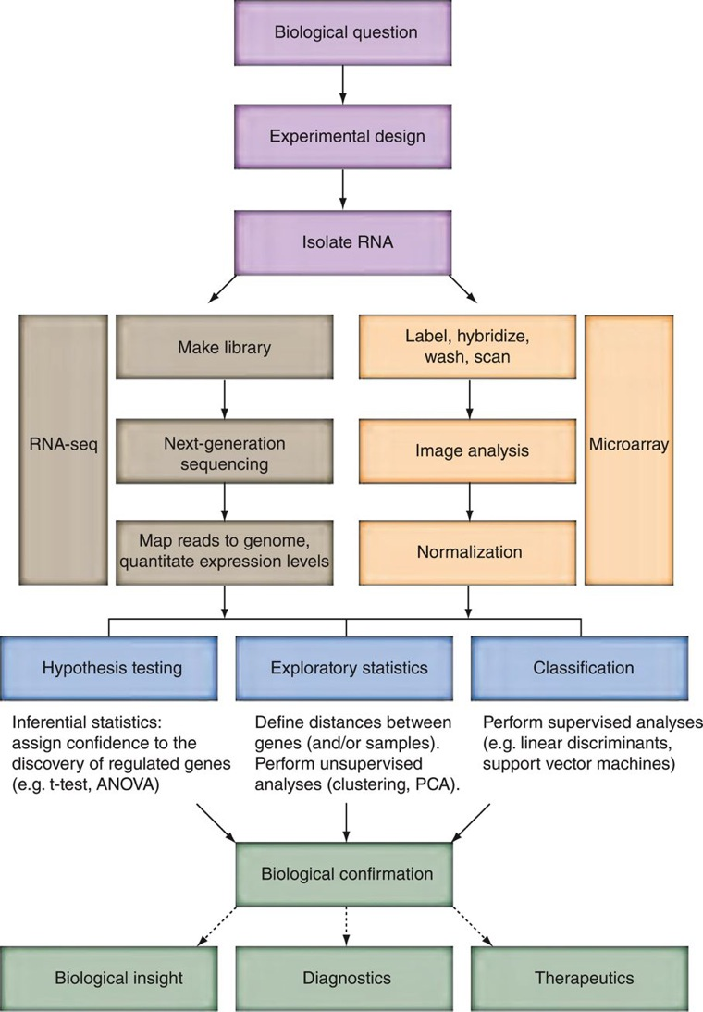

Slide 35
Biological vs Technical Replicates
Offer confidence and statistical power
Two types
Technical
One sample analyzed in 6 different arrays
Biological
Six different human samples across six different arrays
PDF from the Illumina link available in Blackboard
http://www.illumina.com/Documents/products/technotes/technote_power_replicates.pdf

Slide 36
Go to NCBI for GEO2R
Go to R session
https://www.ncbi.nlm.nih.gov/geo/query/acc.cgi?acc=GSE18388
Create Groups Select and assign to groups Analyze
GEO2R
Analysis

Slide 37
Why normalization?
Dyes are incorporated to measure the expression
They get incorporated in different efficiencies
They have differences in DNA quality, washing efficiency/signal detection
Without normalization, it would be difficult to compare the expression levels

Slide 38
How to normalize the data?
Simple idea is to compute background intensity and subtract it from the signal for each probe set
This also can vary locally
Other approach is global normalization so that average ratio for gene expression is one.
Main idea
Average gene expression for a house-keeping gene does not change in the sample that is tested.

Slide 39
RMA and GCRMA 2 popular methods
Robust multiarray analysis (RMA)
Uses background correction,
Quantile normalization procedure
A nonparametric approach
Nonparametric approaches do not make assumptions about the population distribution
Affy provides RMA procedure
GCRMA adjustments for RMA and usually improves the accuracy

Slide 40
How do we know what we are doing is correct?
Gold standard
31 algorithms for the analysis of Affymetric probe sets (reference page 488/489; cope et al, Irizarry et al 2006)
The authors found that background correction impacts performance, and tends to improve accuracy and worsens precision
What is accuracy/precision?

Slide 41
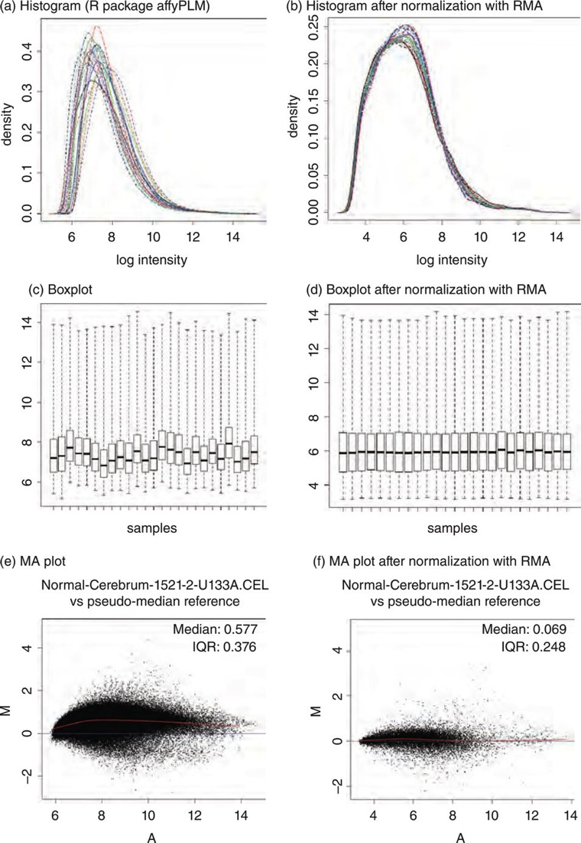

Slide 42
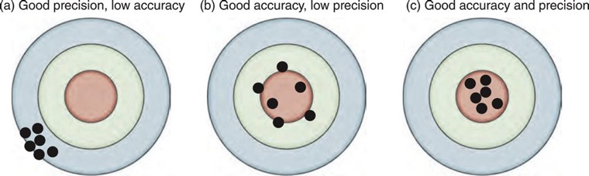

Slide 43
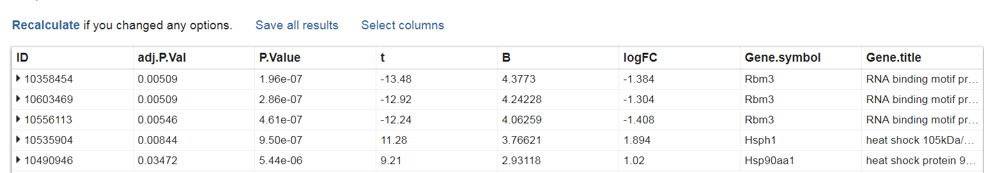
Expression Ratios (Fold Change)
Gene 10358454 or Rbm3 log2(control/Space-flown) = log2(1/2.6) = -1.384
Reflects the magnitude in the difference in RNA transcript levels between the mean of space-flown and the mean of control samples.

Slide 44
What tests GEO2R perform?
Our goal is to carry out inferential analysis to test the hypothesis that there are some genes that are differently expression in the two sets (& for some conditions)
Each gene, we carry out a statistical test
There are >22,000 transcripts on the array

Slide 45
For each transcript there are 11 measurements in the experimental group and 11 measurements in the control group
There belong to two groups e and c
Transcrip1 e1 e2 e3 e4 e5 e6 e7 e8 d9 d10 e11 c1 c2 c3 c4 c5 c6 c7 c8 c9 c10 c11

Slide 46
Hypothesis Testing
Null hypothesis (H₀) no difference in the signal intensity between the two sets
Alternate Hypothesis (H_{A}): There is a difference
Have cutoff (α = 0.05 )
Do a test assuming that we have null distribution
We also assume that the data are normally distributed with mean (0) and sd (1)

Slide 47
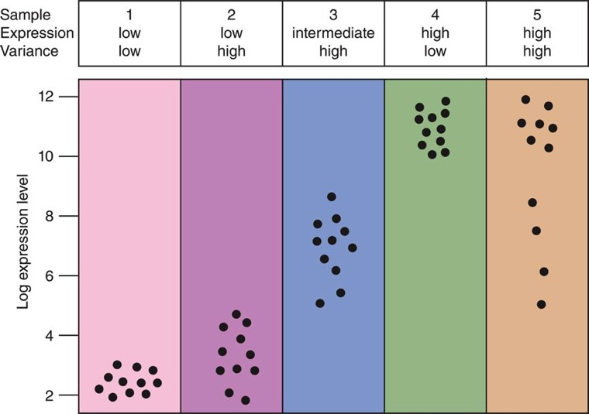
Test is called t-test
We have shown here five hypothetical transcripts
10 biological replicates for each transcript
t-test is done comparing two samples by comparing the means and provide an answer whether they are significantly different?

Slide 48

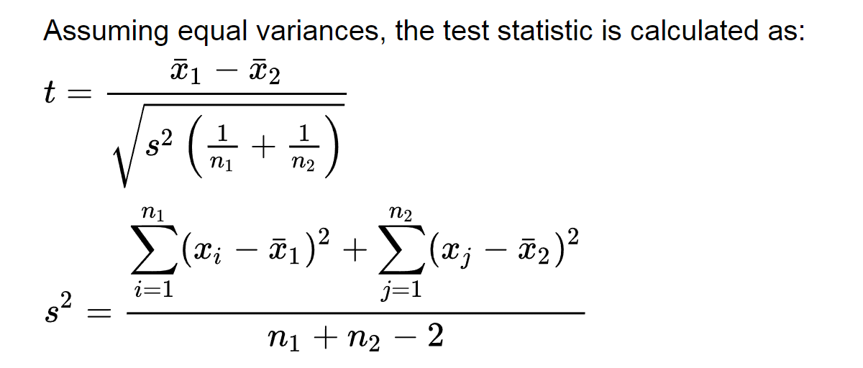
Typo in the book
Not correct. It should be X1_bar – X2_bar on the numerator

Slide 49
Rbm3
P value of 1.96 x 10⁻⁷ ≈ 10⁻⁷
Indicates that the expression levels between trisomic and euploid samples will occur by chance 1/10000000
This is less than our cut-off (95% cutoff; 0.05), so we reject the Null Hypothesis

Slide 50
t.test example
R scripts are available from
BlackBoard
Hands-on.zip
Go to t.test.R file
We will setup up mock t-tests
We will learn about power
We will learn how to compute the sample size
We will learn how variability affects our predictions
Note that the t-tests make an assumption that the sample expression values are normally distributed
If this assumption is violated then we cannot use t-tests

Slide 51
What are my options if my normality is violated?
Nonparametric tests
They rank the outcome and do not assume normality
What are the tests?
Mann-Whitney and Wilcoxon Rank Sum test
The nonparametric is also useful when we have outliers (extreme)

Slide 52
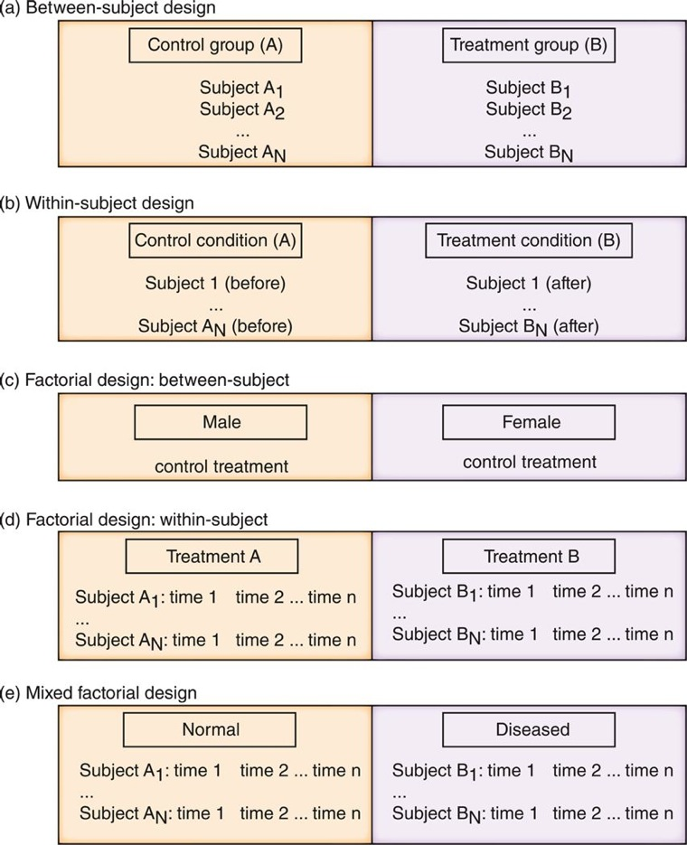
Tests depend on Experimental Design
Most experiments have to be carefully setup
With the help from statistician; this should be done before the planning of experiments
We need to make sure there are no confounding effects within groups. Differences in age, gender or weight between individuals in the two groups.

Slide 53
Before and After cases, test for the differences in the mean values between two set of paired measurements (Paired-t-test)

Slide 54
What cutoff should one use?
If we are doing one test, then p-values make sense.
If you are doing many thousands of tests like the expression data analysis, then accidentally, you can find differences
This is based on the cut-off
So, 1000 transcripts, 0.05*1000 = 50
What is the correct cut-off?

Slide 55
Errors
Type-1 error (FP results)
FP ; involve concluding a transcript differentially expressed when it is not
Null hypothesis is true but unfortunately rejected
Type-II error (FN results)
Failing to identify a truly regulated transcript
Null hypothesis should have been rejected
How can we correct these problems?

Slide 56
Bonferroni correction
Instead of alpha (say 5/100 or 5%) is divided by the number of measurements
( (5/100)/n ) (if n = 20,000, new cutoff is 2.5x10⁻⁶
This correction is considered too severe
Other alternative (commonly used) is FDR
False Discovery Rate
FDR of 0.05, 5% of transcripts that are called significant are False Positives

Slide 57
Scatter Plots and MA Plots
Scatter plot
A plot to compare two real valued variables (2 samples)
Common for visualizing Microarray data
Most data are 45 degree line
Because most of the genes have same expression but some are up/down regulated
these are observed as deviations from the 45 degree line

Slide 58
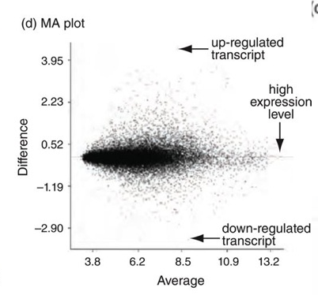
MA Plot
M (log ratios) and A (mean average) scale.
MA is useful when the data expression values are mostly concentrated on the lower left end.
Transformation that allows to view all the data from the 2 samples
M
X-axis: log2(expression)
low values on left and high (right)
Y-axis displays the difference.
A

Slide 59
Common Transformation
Mostly the expression values are transformed into log scale (to be precise log2)
Example
Consider 3 genes
One is unchanged, other two are up-regulated by 2-fold and down-regulated by two-fold
Ratios are 1:1; 2:1,0.5:1
Log2 space: 0,1,-1 (note the symmetry)
Also the log transformations stabilize the variance across a wide range of Intensity measurements

Slide 60
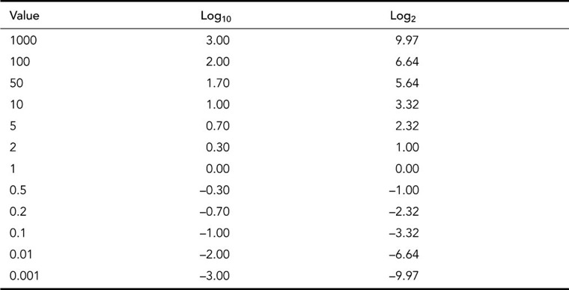
Copyright figure from table 11.1 from Pevsner Bioinformatics and Functional Genomics III edition.

Slide 61
PCA
Principal Components Analysis
Unsupervised method (data transformation)
Technique to reduce the high Dimensionality of the data in 2 or 3 dimensions
Transform the variables into a small number of uncorrelated variables called principal components
For example, the genes whose expression values doesn’t change between cases and controls are not informative and can be removed

Slide 62
Principal Components Analysis
Height (ht) and Weight (wt.) could be related
Heart Rate and Systolic Blood Pressure (sbp) could be again related.
We can form two new variables (PC1, PC2), components
PC1 = k₁x₁ + k₂ x₂
PC2 = k₃x₃ + k₄ x₄
Case | ht.(x₁) | Wt(x₂) | Age(x₃) | Sbp(x₄) | Heart rate (x₅)
1 | 153 | 160 | 22 | 113 | 69
2 | 181 | 120 | 38 | 128 | 76
n | 198 | 200 | 62 | 145 | 59
5 variables are reduced (projected) to 2 (PC1 and PC2) without loss of information
Another Example: 3D real object pictured as 2D objects. Reduction in dimensionality
Based on the lecture Multivariate Statistics, Manchester Metropolitan University

Slide 63
Principal Components Analysis (PCA)
Data Reduction Technique
It is not a regression method
Removes redundancies between descriptors
Correlation matrix
It will not change the spatial orientation of the points, with reference to each other
What is PCA?
Linear combination of original descriptors explaining the maximum variance
PC’s are orthogonal to each other
Pearson (1901) Hotelling (1933)

Slide 64
PCA
PC₁ = a_{1,1}x₁ + a_{1,2}x₂ +……a_{1,n}x_{n} PC₂ = a_{2,1}x₁ + a_{2,2}x₂ +……a_{2,n}x_{n} PC₃ = a_{3,1}x₁ + a_{3,2}x₂ +……a_{3,n}x_{n}
Linear combination of original descriptors.

Slide 65
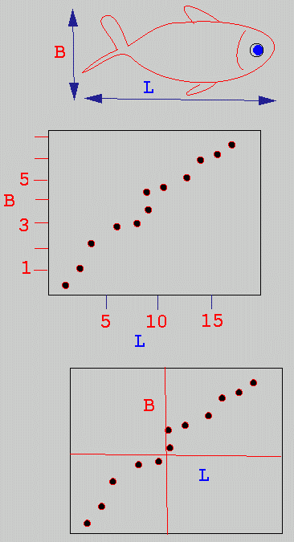
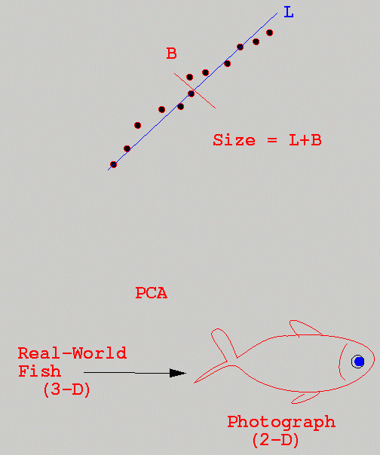
An example of PCA
Based on the Dept. of Biological Sciences, Manchester Metropolitan University
Linear positive relationship
Move the origin and rotate the axes

Slide 66
T-test to ANOVA
What is ANOVA?
The analysis of Variance (ANOVA) is more appropriate than the t-test
Example, effects of several drugs on gene expression
ANOVA identifies the differentially expressed genes taking into account the variability that occurs within and between the groups
Example microarray experiment that compares two different disease states or multiple factors for each treatment (ex. Gender, age, date of RNA isolation, hybridization batch)

Slide 67
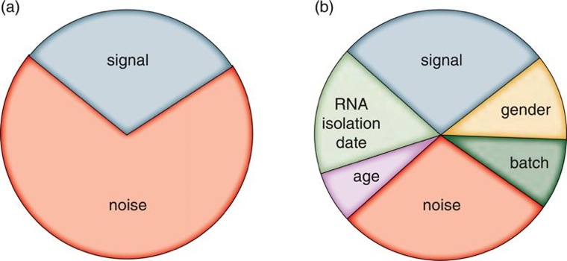
Signal/noise ratio
T-test
ANNOVA
Error term
ANNOVA is a Statistical Model called General Linear Model

Slide 68
Y_{ijk} represents a pre-processed probe intensity measurement k (in log2 scale) of transcript i measured by platform j;
If there are ~20,000 transcripts represented on a microarray, there will be Y_{ijk} values
Theta and Phi are independent variables associated with expression measurements and probe effects.
Theta_j is the absolute Gene Expression in log2 scale
Phi_ij is the platform specific probe effect epsilon_ijk is the error (residual and unexplained variance)

Slide 69
Clustering
Dozen samples with 20K gene expression data is a typical output from Microarray
Expression → Distance Matrix → Clustering
Gene Expression methods produce huge amounts of data
High dimensions the distances between any two points are large and are often equal.
So, the goal of many expression data analysis is to reduce the dimensionality
PCA ex.
Other option is to find patterns or clustering
Clustering.R (Hands-on)

Slide 70
Correlations
To compare results from multiple platforms
Pearson
Spearman

Slide 71
Reproducibility
Document what you do
Write comments
Use websites
Document the DBs (date them)
Document how you got the results

Slide 72
After Class Work
The following are the assigned ComputerLabs for this week:
Self-test/Quiz
11-1
11-3

