Slide 1
Multiple Sequence Alignment (MSA) BIFX-550
S. Ravichandran, Ph.D. Biology,
Hood College, Frederick, MD 21701

Slide 2
Online
Clustalw
NCBI
Software
Jalview
http://www.jalview.org/Web_Installers/install.htm

Slide 3
Typos/issues with the Book
Clustalw site mentioned in the book doesn’t work
Pfam-B DB no longer exists
EBI, NCBI, TCOFFEE, ENSEMBL can be used for creating MSA
Software (Mac and Windows versions)
http://www.jalview.org/download
Any Questions

Slide 4
Discussion Questions (Chapter 4)
[4.1] Why doesn’t anyone offer “Basic Global Alignment Search Tool” (BGAST) to complement BLAST?

Slide 5
[4-2] Should you consider a significant expect value to be 1, 0.05, or 10−5? Does this depend on the particular search you are doing?
N = Search Space

Slide 6
Discussion question
[4-3] Why is it that database programs such as BLAST must make a trade-off between sensitivity and selectivity? How does the BLASTP algorithm address this issue?
What is sensitivity?
What is selectivity?

Slide 7
http://www.people.virginia.edu/~wrp/papers/wrp_protsci04.pdf
Two characteristics of a search algorithm are important when searching a database: sensitivity and selectivity. A more sensitive algorithm will find a larger percentage of the total number of true positives, or homologs in the database, at a given threshold of statistical significance or false positives. A more selective algorithm will find a smaller number of false positives, or nonhomologs that receive high similarity scores to the query, at a given threshold of coverage. Generally there is a trade-off between these two characteristics, such that improving the performance of one degrades the performance of the other.

Slide 8
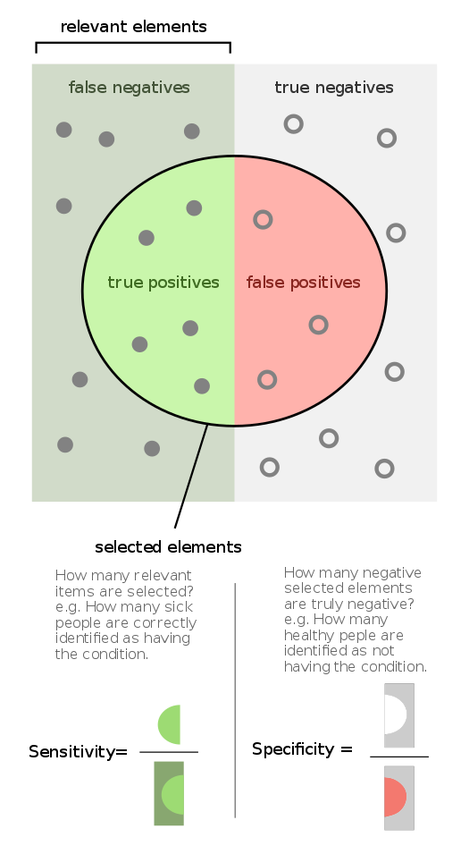
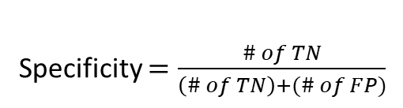
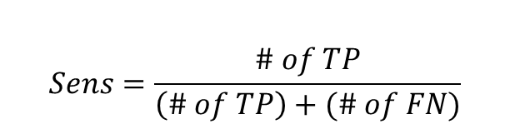
Selectivity = Specificity
$$Sens=\frac{\# of TP}{\left(\# of TP\right)+(\# of FN)}$$
Specificity $=\frac{\# of TN}{\left(\# of TN\right)+(\# of FP)}$
Image taken from Wikipedia
CC BY-SA 4.0
https://en.wikipedia.org/wiki/Sensitivity_and_specificity#/media/File:Sensitivity_and_specificity.svg

Slide 9
Scaled or Bit score
“It can be used to compare alignments that may or may not have used the same scoring matrix.”

Slide 10
Aim
How to create MSA of proteins?
Databases that use MSA
PFAM
MSA of genomic DNA
Regions from different species

Slide 11
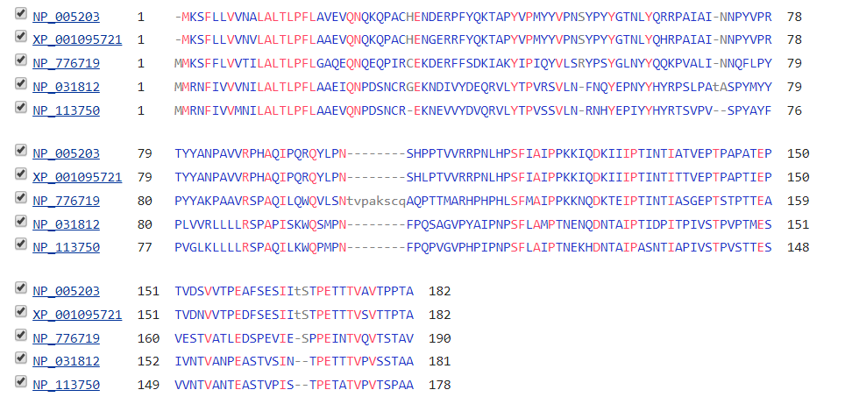
What is MSA?
https://www.ncbi.nlm.nih.gov/protein/NP_005203,XP_001095721,NP_776719,NP_031812,NP_113750
Conserved Y
Sequences
Align using COBALT
GAP
Total Length of Sequences

Slide 12
Why MSA?
How is my protein/gene related to other proteins/genes?
What is different from pairwise alignments
Two sequences may not align well, but in presence of other sequences may align well to explain the relationship between them
Protein functions are assigned based on homology ( alignments ) than biochemical assays (mostly)

Slide 13
Why MSA?
Often used for
Secondary Structure prediction
Phylogenetic analysis
Generating Position-specific Scoring matrices for use with highly sensitive search such as RPS BLAST, PSI-BLAST, Delta-BLAST etc.
Mutagenesis experiments

Slide 14
Considerations during MSA
Goal is to create alignments (of same type; DNAs or proteins) with many aligning characters (sequence letters) as possible
Keeping the function in mind
What can replace an amino acid without affecting the function of the protein?
3D structure can often guide or modify/correct the MSA

Slide 15
DNA vs Protein in MSA
For MSA
Protein MSA is more informative on protein side
20 aa vs 4 nt ; less prone for inaccuracies
Exceptions
Regulatory elements use nucleotide

Slide 16
Definition
“MSA is a collection of 3 or more protein (or nucleic acid) sequences that are partially or completely aligned”
Each column
Homologous resides (evolutionary sense using structural information)
Same position in 3D structure

Slide 17
MSA
In most cases, it is not Easy to create a multiple sequence alignment

Slide 18
Easy Case

Slide 19
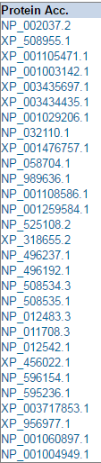
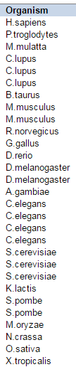
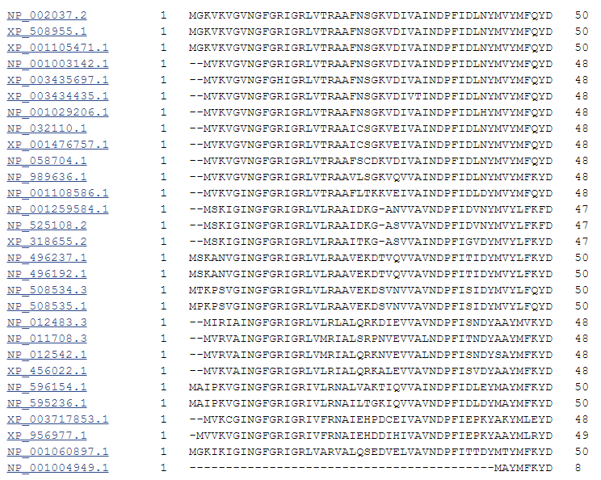
GADPH Glyceraldehyde 3-phosphate dehydrogenase

Slide 20
Not So Easy Case

Slide 21
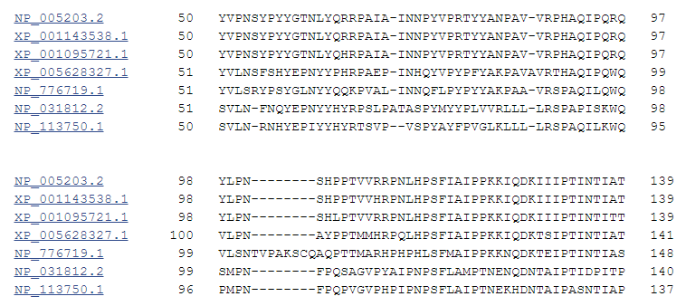
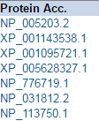
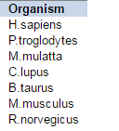

Slide 22
MSA outline
No one correct way to align sequences
Protein sequence evolve time and more rapidly than their 3D folds
Conditions for MSA
Choose homologous sequences (reasonable E-value cutoff)
A software
Maximize the total score of the a series of pairwise alignments
With appropriate gap-opening and extension penalties
Analyze/inspect the output
Remove large gaps contributing sequences
Rerun if necessary

Slide 23
How to carry out MSA?
Collect Homologous protein sequences
Orthologous/paralogous
Choose appropriate software that uses appropriate scoring functions
Choose appropriate parameters
Gap penalties
Interpret the output and re-run if needed

Slide 24
How can residues/residue features help us to get a meaningful alignment
Cysteines involved in S-S conserved
TM domains
Secondary structural elements should guide the alignment
Loops and coils
Order of secondary structural elements

Slide 25
Selecting Sequences
Use reasonable high quality sequences
What alignment method? Global or Local
Alignment time is a bottle-neck
Keep in mind that most alignment methods are ineffective when the # of sequences increases
Is there a guideline for # of sequences?
10-15 sequences (minimum but can be lower)
50-100 sequences (upper limit)

Slide 26
Selecting Sequences
Do you need to have the sequences of same length?
Yes (roughly of same length)
How can we achieve this?
We can trim the sequences
Use PSI-BLAST and other techniques to get some leads on how to accomplish this step.
Use visualization software to guide you during this step.
Jalview or DiscoveryStudio sequence viewer

Slide 27
Selecting Sequences
Use pre-aligned DBs and 3D structure based alignments for guidance.

Slide 28
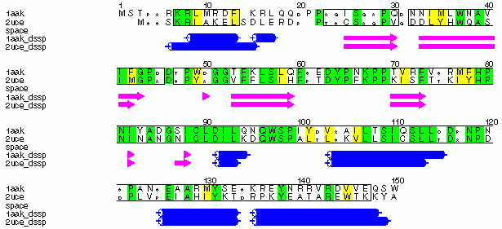
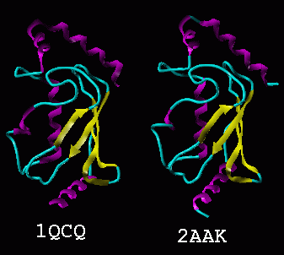
Comparing Homologous enzymes
Family:Ubiquitin Conjugating enzyme
1QCQ: Arabidopsis Thaliana (flower) 2AAK: Baker’s Yeast
Sequence Identity 43%
Topological Similarity
Using PredictProtein
Russell et al, JMB, 269, 423-439 1997
Notes:
Species: Baker’s Yest and Arabidopsis Thaliana same super-family means homologous

Slide 29
Pairwise alignments doesn’t work when comparing distant homologs
MSA will have more information to properly align the misaligned region

Slide 30
Where do we use MSA?
Impact Assessment
SIFT, Polyphen2 etc.
How can we predict which ones are bad?
MSA is a very sensitive method to detect distant homologs
MSA can lead to critical residues in a family

Slide 31
Where do we use MSA?
Phylogenetic tree based algorithm's (upcoming class) begin with MSA
Optimal alignment is critical
Regulatory regions of a gene
Transcription factor binding site
Conserved non-coding regions

Slide 32
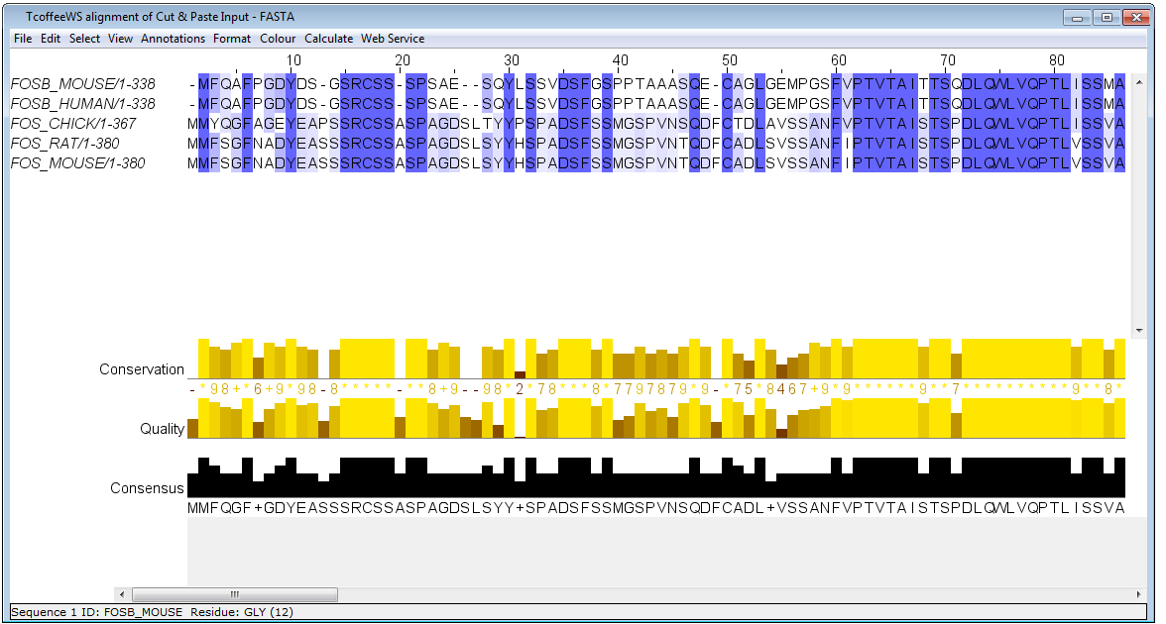
Software for Viewing the MSA
Conservation Color
81-100% Dark Blue 61-80% Medium Blue
41-60% Light Blue
<= 40% White
Jalview
Demo
Use sequences from next page

Slide 33
>FOSB_MOUSE Protein fosB
MFQAFPGDYDSGSRCSSSPSAESQYLSSVDSFGSPPTAAASQECAGLGEMPGSFVPTVTA
ITTSQDLQWLVQPTLISSMAQSQGQPLASQPPAVDPYDMPGTSYSTPGLSAYSTGGASGS
GGPSTSTTTSGPVSARPARARPRRPREETLTPEEEEKRRVRRERNKLAAAKCRNRRRELT
DRLQAETDQLEEEKAELESEIAELQKEKERLEFVLVAHKPGCKIPYEEGPGPGPLAEVRD
LPGSTSAKEDGFGWLLPPPPPPPLPFQSSRDAPPNLTASLFTHSEVQVLGDPFPVVSPSY
TSSFVLTCPEVSAFAGAQRTSGSEQPSDPLNSPSLLAL
>FOSB_HUMAN Protein fosB
MFQAFPGDYDSGSRCSSSPSAESQYLSSVDSFGSPPTAAASQECAGLGEMPGSFVPTVTA
ITTSQDLQWLVQPTLISSMAQSQGQPLASQPPVVDPYDMPGTSYSTPGMSGYSSGGASGS
GGPSTSGTTSGPGPARPARARPRRPREETLTPEEEEKRRVRRERNKLAAAKCRNRRRELT
DRLQAETDQLEEEKAELESEIAELQKEKERLEFVLVAHKPGCKIPYEEGPGPGPLAEVRD
LPGSAPAKEDGFSWLLPPPPPPPLPFQTSQDAPPNLTASLFTHSEVQVLGDPFPVVNPSY
TSSFVLTCPEVSAFAGAQRTSGSDQPSDPLNSPSLLAL
>FOS_CHICK Proto-oncogene protein c-fos
MMYQGFAGEYEAPSSRCSSASPAGDSLTYYPSPADSFSSMGSPVNSQDFCTDLAVSSANF
VPTVTAISTSPDLQWLVQPTLISSVAPSQNRGHPYGVPAPAPPAAYSRPAVLKAPGGRGQ
SIGRRGKVEQLSPEEEEKRRIRRERNKMAAAKCRNRRRELTDTLQAETDQLEEEKSALQA
EIANLLKEKEKLEFILAAHRPACKMPEELRFSEELAAATALDLGAPSPAAAEEAFALPLM
TEAPPAVPPKEPSGSGLELKAEPFDELLFSAGPREASRSVPDMDLPGASSFYASDWEPLG
AGSGGELEPLCTPVVTCTPCPSTYTSTFVFTYPEADAFPSCAAAHRKGSSSNEPSSDSLS
SPTLLAL
>FOS_RAT Proto-oncogene protein c-fos
MMFSGFNADYEASSSRCSSASPAGDSLSYYHSPADSFSSMGSPVNTQDFCADLSVSSANF
IPTVTAISTSPDLQWLVQPTLVSSVAPSQTRAPHPYGLPTPSTGAYARAGVVKTMSGGRA
QSIGRRGKVEQLSPEEEEKRRIRRERNKMAAAKCRNRRRELTDTLQAETDQLEDEKSALQ
TEIANLLKEKEKLEFILAAHRPACKIPNDLGFPEEMSVTSLDLTGGLPEATTPESEEAFT
LPLLNDPEPKPSLEPVKNISNMELKAEPFDDFLFPASSRPSGSETARSVPDVDLSGSFYA
ADWEPLHSSSLGMGPMVTELEPLCTPVVTCTPSCTTYTSSFVFTYPEADSFPSCAAAHRK
GSSSNEPSSDSLSSPTLLAL
>FOS_MOUSE Proto-oncogene protein c-fos
MMFSGFNADYEASSSRCSSASPAGDSLSYYHSPADSFSSMGSPVNTQDFCADLSVSSANF
IPTVTAISTSPDLQWLVQPTLVSSVAPSQTRAPHPYGLPTQSAGAYARAGMVKTVSGGRA
QSIGRRGKVEQLSPEEEEKRRIRRERNKMAAAKCRNRRRELTDTLQAETDQLEDEKSALQ
TEIANLLKEKEKLEFILAAHRPACKIPDDLGFPEEMSVASLDLTGGLPEASTPESEEAFT
LPLLNDPEPKPSLEPVKSISNVELKAEPFDDFLFPASSRPSGSETSRSVPDVDLSGSFYA
ADWEPLHSNSLGMGPMVTELEPLCTPVVTCTPGCTTYTSSFVFTYPEADSFPSCAAAHRK
GSSSNEPSSDSLSSPTLLAL
Another Example to try in Clustal Omega
http://www.ebi.ac.uk/Tools/msa/clustalo/
Demo using ClustalW

Slide 34
Accessing MSA methods
Exact methods
Goal: Maximize the alignment score
Pros
Multi-dimensional version of Dynamic Programming
Exact result
Cons
O(2^{N}L^{N}) (N: # of seqs; L = average sequence length
Not possible beyond 2 or 3 sequences

Slide 35
Accessing MSA Methods: Dynamic Programming
Rather than using pairwise scoring scheme
Pairwise match/mismatch/gap
One could use
Frequency of match/mismatch/gap across MSA
Example
aa in SeqA =aa in SeqB = aa in SeqC (score =2)
aa in SeqA = aa in SeqB or aa in SeqC (score = 0)
If aa in SeqA is aligned to a gap in SeqB & SeqC (score = -2)

Slide 36
Accessing MSA methods
Progressive Sequence Alignment
Fitch and Yasunobu (1975)
Progressive: Strategy is to start with 2 (closest) and build the alignment by including the rest.
Pros:
Can handle 100s or even thousands of seqs.
Cons:
Final alignment depends on the order in which the alignments were joined.

Slide 37
Examples of Progressive Alignment Methods (Software)
ClustalW
Clustal Omega
ProbCons
Muscle
T-COFFEE

Slide 38
For the next exercise, use
http://www.ebi.ac.uk/Tools/msa/
Clustal Omega
Inputs are shown below
>beta_globin 2hhbB NP_000509.1 [Homo sapiens]
MVHLTPEEKSAVTALWGKVNVDEVGGEALGRLLVVYPWTQRFFESFGDLSTPDAVMGNPKVKAHGKKVLG
AFSDGLAHLDNLKGTFATLSELHCDKLHVDPENFRLLGNVLVCVLAHHFGKEFTPPVQAAYQKVVAGVAN
ALAHKYH
>myoglobin 2MM1 NP_005359.1 [Homo sapiens]
MGLSDGEWQLVLNVWGKVEADIPGHGQEVLIRLFKGHPETLEKFDKFKHLKSEDEMKASEDLKKHGATVL
TALGGILKKKGHHEAEIKPLAQSHATKHKIPVKYLEFISECIIQVLQSKHPGDFGADAQGAMNKALELFR
KDMASNYKELGFQG
>neuroglobin 1OJ6A NP_067080.1 [Homo sapiens]
MERPEPELIRQSWRAVSRSPLEHGTVLFARLFALEPDLLPLFQYNCRQFSSPEDCLSSPEFLDHIRKVML
VIDAAVTNVEDLSSLEEYLASLGRKHRAVGVKLSSFSTVGESLLYMLEKCLGPAFTPATRAAWSQLYGAV
VQAMSRGWDGE
>soybean_globin 1FSL leghemoglobin P02238 LGBA_SOYBN [Glycine max]
MVAFTEKQDALVSSSFEAFKANIPQYSVVFYTSILEKAPAAKDLFSFLANGVDPTNPKLTGHAEKLFALV
RDSAGQLKASGTVVADAALGSVHAQKAVTDPQFVVVKEALLKTIKAAVGDKWSDELSRAWEVAYDELAAA
IKKA
>rice_globin 1D8U rice Non-Symbiotic Plant Hemoglobin NP_001049476.1 [Oryza sativa (japonica)
MALVEDNNAVAVSFSEEQEALVLKSWAILKKDSANIALRFFLKIFEVAPSASQMFSFLRNSDVPLEKNPK
LKTHAMSVFVMTCEAAAQLRKAGKVTVRDTTLKRLGATHLKYGVGDAHFEVVKFALLDTIKEEVPADMWS
PAMKSAWSEAYDHLVAAIKQEMKPAE

Slide 39
Progressive Alignment
Steps
All possible pairs of sequences aligned to get scores for each alignment
Similarity scores are used to construct a guide tree
Multiple alignment is built in a systematic manner using DP starting with the closest pair

Slide 40
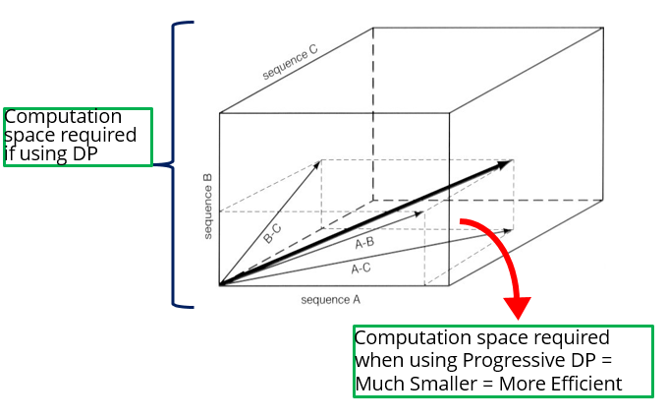

Slide 41
Steps of Progressive Alignment
Stage 1
Needleman and Wunch Global alignment is carried out
In this case 10 alignments were made

Slide 42
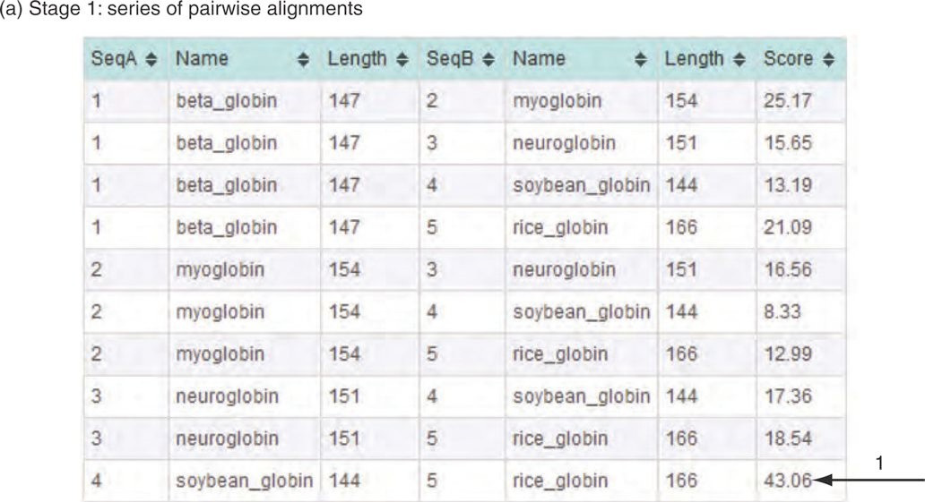
Clustalw2
http://embossgui.sourceforge.net/demo/
Five distantly related proteins

Slide 43
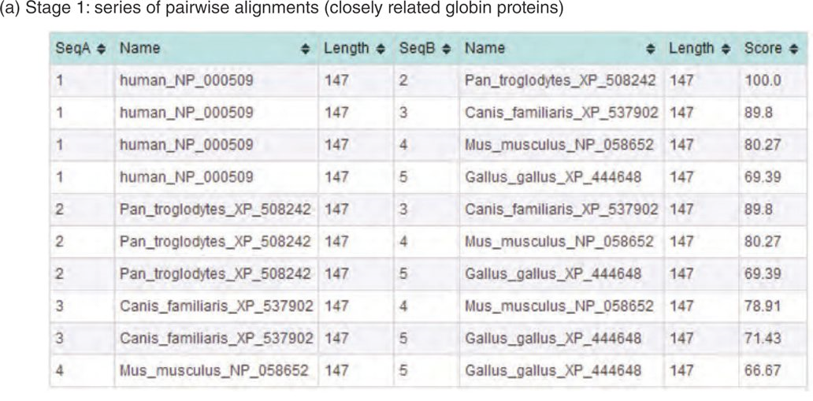
Compare the scores of distantly to closely related proteins

Slide 44
Stage 2
1: beta_globin 100.00 25.34 20.98 17.65 16.78
2: myoglobin 25.34 100.00 15.65 12.41 14.29
3: neuroglobin 20.98 15.65 100.00 18.12 19.59
4: soybean_globin 17.65 12.41 18.12 100.00 43.06
5: rice_globin 16.78 14.29 19.59 43.06 100.00
Similarity scores between sequences are often converted into distance matrix
Introduced by Feng and Doolittle
(N*(N-1))/2 is the number of alignments needed to computer the scores and matrices. This is why these approaches are slow

Slide 45
How to measure distances between sequences?
Count the number of mismatches in a pairwise alignment.
Feng and Doolittle
Convert similarity scores to distance scores
S_rand(i,j) = mean score from 1000 random shuffling(s) of sequences; S_iden(ij) mean of (S_ii + S_jj )/2

Slide 46
How to score the alignment?
Conventional Scoring
Entropy scoring
Define observed probability for each possible nucleotide or residue in each column of the MSA

Slide 47
Distance matrix to Guide Tree
Two approaches
UPGMA
Unweighted Pair-Group Method of Arithmetic averages
Neighbor joining method
Two things are important in trees
Topology (the branching order)
Branching length (drawn to reflect the evolutionary distance)

Slide 48
Finally Guide Tree is used as a guidance to create MSA
Aligned sequences (high score) are placed at the nodes of a tree, then progressively other sequences or pairs are added. Sometimes profiles are created and added to alignments or added to profiles

Slide 49
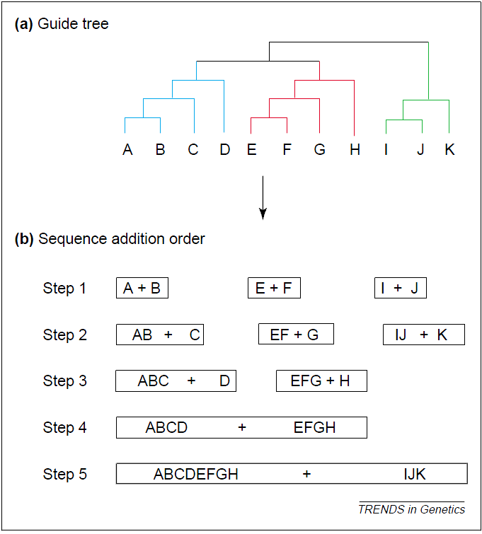
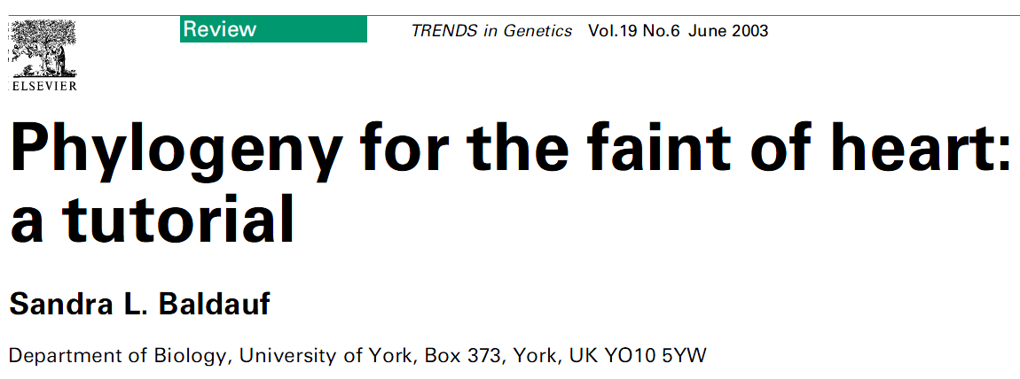
Figs 4a and b from the above paper

Slide 50
Before we go to discuss the algorithm, let us introduce Profiles

Slide 51
Intro to Profiles
Consensus Sequence (Majority is taken as the consensus; skips Variation); useful to search DB
Becomes binary; not very useful (binary etc.)
Pattern (regular expression) GHx(2)[IV] (no probabilities)
PSSM (uses frequencies for each position)
Profiles (extension of PSSM; with gaps)
Multiple Seq Alignment (MSA)
DNA Binding Function to the domains

Slide 52
Profiles
The following matrix when filled with score is Position-Specific Scoring Matrix/Table
Numerical representations of MSA
Common characteristics of a protein family
Allow for distantly related proteins
Pos | Cons | A | T | G | C | -
1 | C | 0 | 0.2 | 0 | 0.6 | 0.2
2 | A | 1 | 0 | 0 | 0 | 0
3 | G | 0 | 0 | 1 | 0 | 0
4 | - | 0 | 0 | 0.2 | 0 | 0.8
5 | C | 0 | 0 | 0 | 1 | 0
6 | T | 0 | 1 | 0 | 0 | 0
7 | A | 1 | 0 | 0 | 0 | 0
8 | T | 0 | 0.6 | 0 | 0.4 | 0
9 | C | 0 | 0 | 0 | 1 | 0
10 | A | 1 | 0 | 0 | 0 | 0
11 | C | 0 | 0 | 0 | 0.6 | 0.4
12 | - | 0 | 0 | 0 | 0.2 | 0.8
13 | G | 0 | 0.2 | 0.4 | 0 | 0.4
14 | G | 0 | 0 | 1 | 0 | 0

Slide 53
Profile based alignment
S1 G T C T G A S2 G T C A G C
S1,2 G T C A/T GA A/C (profile)
4 sequences
1,2,3,4
1-2, 1-3, 1-4, 2-3, 2-4, 3-4
Find the high scoring pair and create a profile
Use the profile to align to the next pair
Use DP for this step
…..

Slide 54
Aligning Sequences
Aligning sequence vs Sequence
We know how to do this
Can we align sequence vs Profile
Yes
Can we align Profile vs Profiles
Yes

Slide 55
Patterns
[ ] OR ex [FY] F or Y
x Any
x(2) any two residues
{ } NOT example {VA} not V or A
H(3) 3 HIS residues
[FY]-x-C-x(2)-{VA}-x-H(3)
PFAM
GHEGV GHKKI GHIKV GHAMI GH**[I/V]
GHEGV GHKKV GHIKV GH**V

Slide 56
Other Database examples
PFAM
MSA-HMMER→ Members of a family
Very accurate DB
Prosite
SMART
CDD

Slide 57
Algorithm
Based on Philip Compeau and Pavel Pevzner Lecture
Sequences: GATTCA, GTCTGA, GATATT, GTCAGC
Score: Match: +1, Penalties (indels/mismatches): -1
S2 GTCTGA S1 GATTCA—- S1 GAT-TCA S4 GTCAGC S4 G-T-CAGC S2 G-TCTGA Score 2 Score: 0 Score: +1
Create Profiles
S2 G-TCTGA S1 GAT-TCA S3 GAT-ATT S3 GATAT-C S3 GATAT-T S4 G-TCAGC Score -1 Score: 1 Score: -1
S2 G T C T G A S4 G T C A G C S2,4 G T C A/T G A/C
New set has 3 sequences only to align
S1 G A T T C A S3 G A T A T C S2.4 G T C A/T G A/C

Slide 58
A
C
B
DP
A-B
DP
Guiding tree is used to choose what sequence (based on similarity) is chosen next to the alignment

Slide 59
Add other information
Guide trees are not true phylogenetic trees
Phylogenetic trees are usually based on a model that includes multiple substitution on the aligned position
Dynamic Programming can be used to align the closest pair identified in Guide Tree
But they are used in the III stage in ClustalW to create MSA

Slide 60
Stage 3
MSA is created using guide tree
Select two most similar sequences
Appear at the terminal node of the tree
Next dissimilar sequence is either added to the first pair or a new pair with the sequences 3 and 4 (for ex.) and the pairs are then added together
This will be done until there are no sequences left

Slide 61
Feng-Doolittle Approach
“Once a gap, always a gap”
2 closely related sequence information should be weighed more. So, a gap shown in the first alignments most probably a true one!
ClustalW
Once a gap always a gap policy
In addition, closely related sequences are down weighted (reducing their over-dominant impact on the alignment)

Slide 62
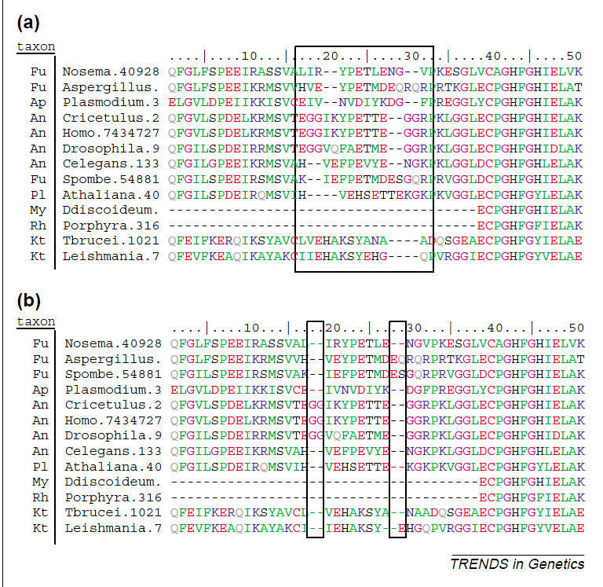
More on once a gap always a gap
Figs 5a and b from the above paper
Failure of once a gap always a gap
Manual adjustment yields meaningful alignment

Slide 63
Once a gap always a gap
In most genes, INDELs do not happen with ease
STOP codons, out of frame mutations yielding bad folding etc.
So, gap has to be penalized for insertion more than extension

Slide 64
Alignment is important for Trees
An approach is to look at the alignment and delete all residues around gaps (and surrounding residues)
Why?
If there is misalignment then there is no real information
If there is a huge insertion and the rest of the alignment is all correct. The group that shares the extra (let us say 9-NT ins), then you have 9 extra characters for the OTUs that have it.

Slide 65
Alignment is important for Trees
In reality, a gap is a single evolutionary event (regardless of size)
The gap size is not important because the opening penalty is much bigger than extension penalty

Slide 66
Iterative Approaches
Progressive methods have a limitation that once an error occurs it progresses and cannot be corrected
Iterative approaches offer a solution to that approach
So, what are Iterative approaches?

Slide 67
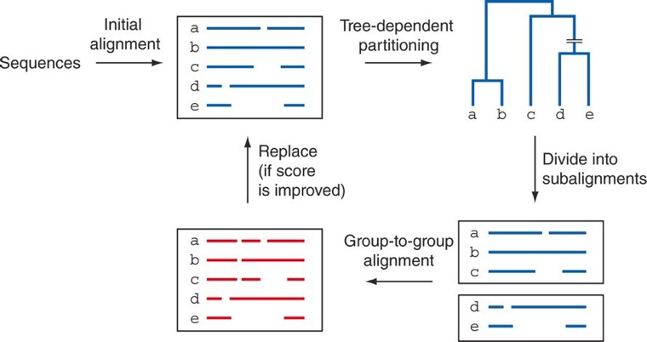
Iterative Refinement by MAFFT
Progressive initial Alignment

Slide 68
Benchmarking MSA
How do we know, how we are doing?
There are gold standard (true positive) sets available for us to compare
Good estimators of Bench-mark
Solvability: sequences should not be too easy > 50 % similarity or too difficult
Scalability: The time to finish the problems
Free access to the results
Evolution: Should be able to modify and test

Slide 69
Benchmarking MSA
Good estimators of Bench-mark
Evolution: Should be able to expand over time and include newer cases
Benchmarks available
BALIbase
And others
One good way to choose the sequences is based on the availability of structural information

Slide 70
Benchmarking MSA
But not all sequences have 3D structures
Non-core cannot be aligned well and the structures cannot offer any help there

Slide 71
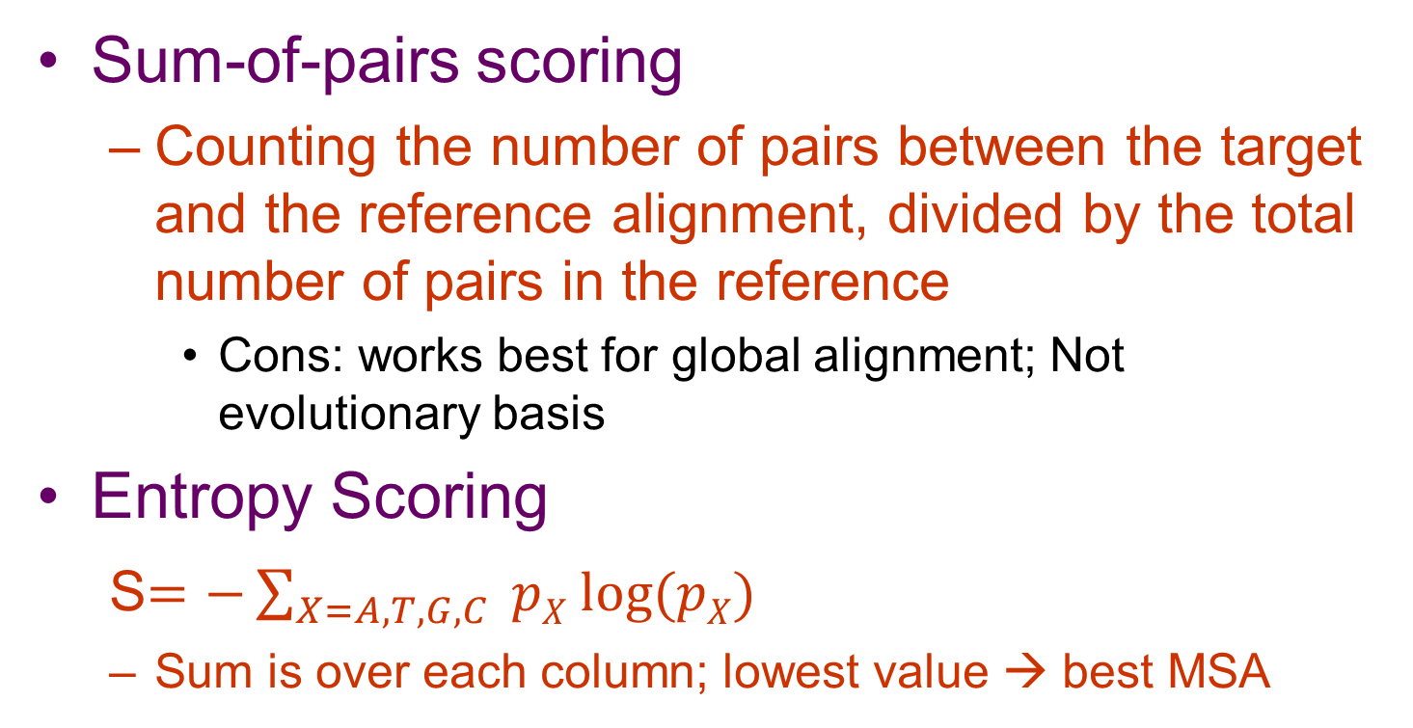
Metrics commonly used to evaluate the performance
Sum-of-pairs scoring
Counting the number of pairs between the target and the reference alignment, divided by the total number of pairs in the reference
Cons: works best for global alignment; Not evolutionary basis
Entropy Scoring
S$=−\sum_{X=A,T,G,C}{ pX log⁡(pX)}$
Sum is over each column; lowest value → best MSA

Slide 72
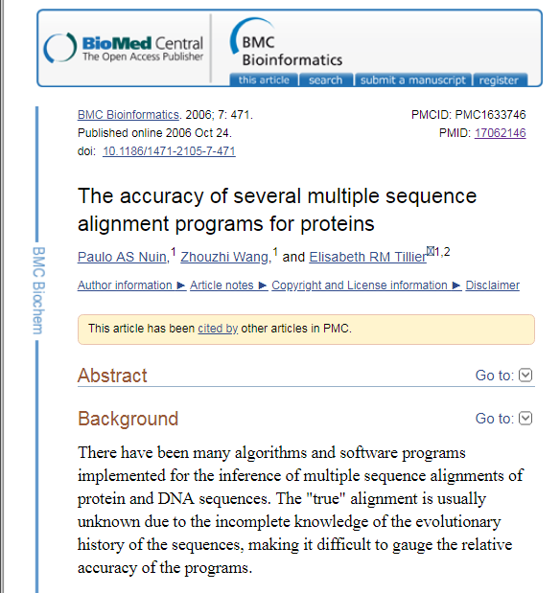
MSA and accuracy
https://www.ncbi.nlm.nih.gov/pubmed/17062146
ProbCons method seems to very accurate according to this paper
Use ProbCons via T-COFFEE

Slide 73
Databases for MSA

Slide 74
Structure-based approach
Structure evolves slowly than sequences, so adding a structure to the sequence alignment is more helpful
PRALINE and T-COFFEE (Expresso modules) are examples of this approach
You can do this via T-COFFEE server
Add sequences;
Add PDB for some
Choose algorithm and submit

Slide 75
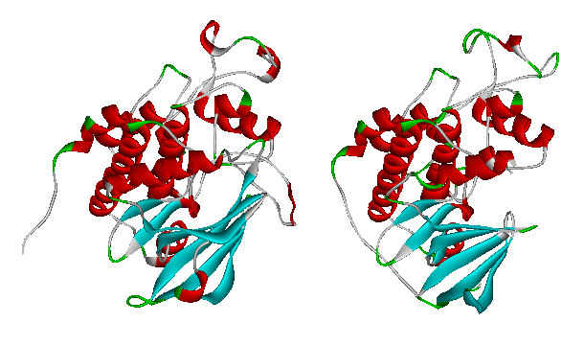
Cyclin Dependent Kinase (Alpha + Beta)
42% identity RMSD 1.8 Ang
Human CDK6
Human CDK2
Structural Overlay done using DeepView
1blx
1ckp
Nayeem et al, Protein Science, 15:808 (2006)

Slide 76
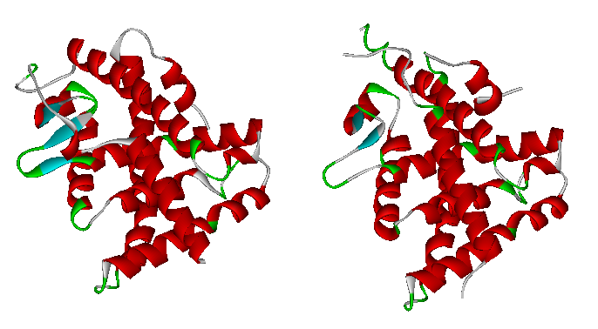
Nuclear Hormone Receptor (All Alpha)
38% identity RMSD 1.3 Ang
Core fold is conserved
Loop regions
differ
Human Nuclear receptor subfamily 1 group B member 3
Human Nuclear receptor NER
Structural Overlay done using DeepView
2LBD
1P8D
Nayeem et al, Protein Science, 15:808 (2006)

Slide 77
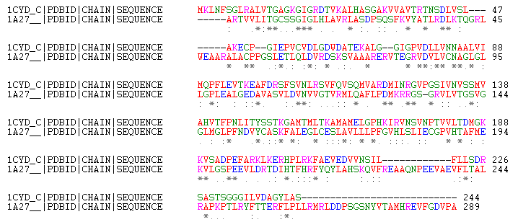
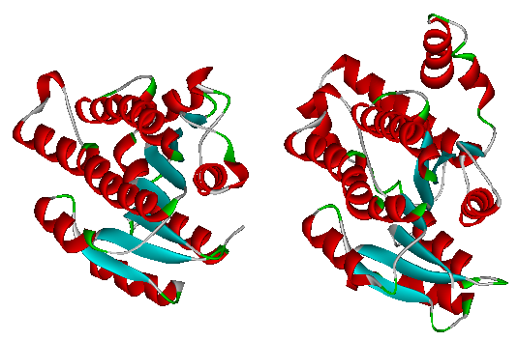
ClustalW 1.83 www.ebi.ac.uk
19% identity RMSD 1.7 Ang
Human Estradiol 17-beta-dehydrogenase 1
Mouse Carbonyl reductase [NADPH] 2
Nayeem et al, Protein Science, 15:808 (2006)
Short Chain Dehydrogenase (Alpha + Beta)
Structural Overlay done using DeepView
1CYD_C
1A27

Slide 78
Structure-based approach
One can compare sequence alignment
Repeat them with structure information
One can compare how well are we doing
Are the residues important for function are aligned?

Slide 79
Run T-COFFEE
>hbb_human
MVHLTPEEKSAVTALWGKVNVDEVGGEALGRLLVVYPWTQRFFESFGDLSTPDAVMGNPKVKAHGKKVLGAFSDGLAHLDNLKGTFATLSELHCDKLHVDPENFRLLGNVLVCVLAHHFGKEFTPPVQAAYQKVVAGVANALAHKYH
>hbb_chimp
MVHLTPEEKSAVTALWGKVNVDEVGGEALGRLLVVYPWTQRFFESFGDLSTPDAVMGNPKVKAHGKKVLGAFSDGLAHLDNLKGTFATLSELHCDKLHVDPENFRLLGNVLVCVLAHHFGKEFTPPVQAAYQKVVAGVANALAHKYH
>hbb_dog
MVHLTAEEKSLVSGLWGKVNVDEVGGEALGRLLIVYPWTQRFFDSFGDLSTPDAVMSNAKVKAHGKKVLNSFSDGLKNLDNLKGTFAKLSELHCDKLHVDPENFKLLGNVLVCVLAHHFGKEFTPQVQAAYQKVVAGVANALAHKYH
>hbb_mouse
MVHLTDAEKSAVSCLWAKVNPDEVGGEALGRLLVVYPWTQRYFDSFGDLSSASAIMGNPKVKAHGKKVITAFNEGLKNLDNLKGTFASLSELHCDKLHVDPENFRLLGNAIVIVLGHHLGKDFTPAAQAAFQKVVAGVATALAHKYH
>hbb_chicken
MVHWTAEEKQLITGLWGKVNVAECGAEALARLLIVYPWTQRFFASFGNLSSPTAILGNPMVRAHGKKVLTSFGDAVKNLDNIKNTFSQLSELHCDKLHVDPENFRLLGDILIIVLAAHFSKDFTPECQAAWQKLVRVVAHALARKYH
>myoglobin
MGLSDGEWQLVLNVWGKVEADIPGHGQEVLIRLFKGHPETLEKFDKFKHLKSEDEMKASEDLKKHGATVLTALGGILKKKGHHEAEIKPLAQSHATKHKIPVKYLEFISECIIQVLQSKHPGDFGADAQGAMNKALELFRKDMASNYKELGFQG
>neuroglobin
MERPEPELIRQSWRAVSRSPLEHGTVLFARLFALEPDLLPLFQYNCRQFSSPEDCLSSPEFLDHIRKVMLVIDAAVTNVEDLSSLEEYLASLGRKHRAVGVKLSSFSTVGESLLYMLEKCLGPAFTPATRAAWSQLYGAVVQAMSRGWDGE
>soybean
MVAFTEKQDALVSSSFEAFKANIPQYSVVFYTSILEKAPAAKDLFSFLANGVDPTNPKLTGHAEKLFALVRDSAGQLKASGTVVADAALGSVHAQKAVTDPQFVVVKEALLKTIKAAVGDKWSDELSRAWEVAYDELAAAIKKA
>rice
MALVEDNNAVAVSFSEEQEALVLKSWAILKKDSANIALRFFLKIFEVAPSASQMFSFLRNSDVPLEKNPKLKTHAMSVFVMTCEAAAQLRKAGKVTVRDTTLKRLGATHLKYGVGDAHFEVVKFALLDTIKEEVPADMWSPAMKSAWSEAYDHLVAAIKQEMKPAE

Slide 80
CDD
PSSM (uses frequencies for each position)
Profiles (extension of PSSM; with gaps)
Searches against profiles generated from pre-aligned sequences
CDD
CD search is carried out using RPS-BLAST,Variant of PSI BLAST
What is it used for?
Identify conserved domains in query sequence
Query searched against a DB of profiles
Reverse becos, opposite of PSI-BLAST (profile vs DB of sequences)

Slide 81
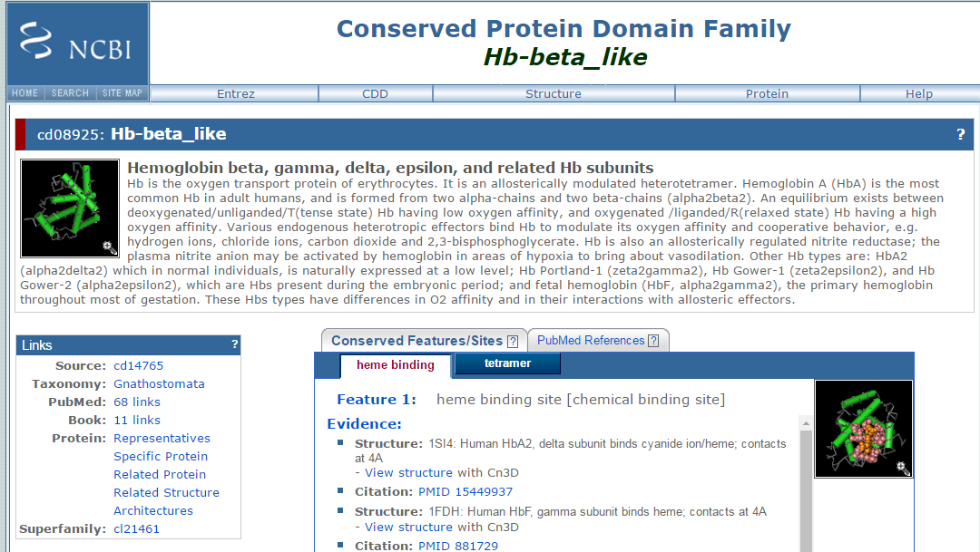
Many ways to get to CDD; Blast, or from Gene→Protein → identify conserved Domains

Slide 82
Delta BLAST
PSSM (uses frequencies for each position)
Domain Enhanced Lookup Time Accelerated BLAST
Most accurate tool than usual BLASTP
How is it different?
Query is searched using pre-created PSSMs
Basically this first step is a RPS-BLAST
Use the resulting PSSM to search against protein Database

Slide 83

Integerated MSA Resources
Interpro and iProClass
These allow to explore the features using several DBs in parallel
PROSITE, PRINTS, ProDom, Pfam, TIGRFAMs with cross ref to BLOCKS
www.ebi.ac.uk/interpro

Slide 84
Manual vs Automated
Pfam
Curated manually
Sean Eddy and Colleagues;
PROSITE, BLOCAS and PRINTS
Manually annotated
ProDom DOMO
Automated

Slide 85
Manual vs Automated
Is Manual better?
Yes, but time consuming
Automated
PSI-BLAST & DELTA-BLAST
If error occurs in first cycle, then it easily propagates

Slide 86
Multiple Sequence Alignment Genomic Regions
Motivation
Genomes are sequenced in a phase that is faster than ever
Species sequence comparison is very informative for phylogenetic analysis
Identify DNA regions that are under
positive selection
Hence rapidly changing in a given lineage
Negative selection

Slide 87
Differences in MSA of DNA
Few sequences with lengths 1-10s of millions
Protein sequence lengths are much smaller
Far diverged comparison like Fish vs Human (islands of good conservation followed by low conservation)
Repetitive elements in DNA (transposons and long and short interspersed nuclear elements

Slide 88
Differences in MSA of DNA
Chromosomal duplications, delectations and translocations
Issues for alignment algorithms
No reliable benchmarks for genomic alignments compared to proteins that are based on 3D structures

Slide 89
Examples using ClustalO
Let us use these FASTA nucleotide sequences:
qSaccharomyces cerevisiae tbp from Chromosome V (NC_001137.3:465303-466025)
qHomo sapiens tbp from Chromosome 6 (M34960.1)
qHalogeometricum borinquense 14680 (NC_014729.1:1380275-1380835)
qHalogeometricum borinquense 00070 (NC_014729.1:4008-4571)
qHalogeometricum borinquense 13200 (NC_014729.1:1235777-1236319)

Slide 90
After the talk
Problems/Computer Lab
6-1, 6-2, 6-3, 6-4 and 6-8

Slide 91
Thanks
ravichandran@hood.edu

