Slide 1
Smart Parking
———— Submitted by: Shubham Pun ————

Slide 2
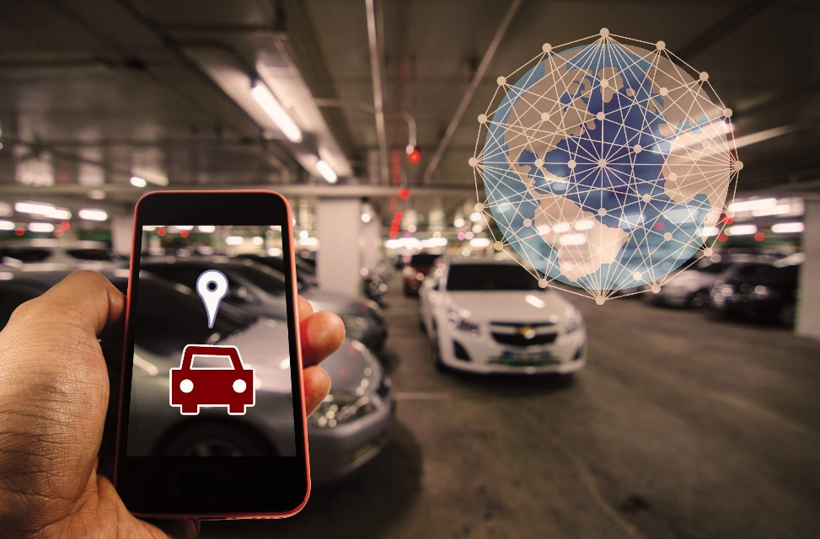
Introduction
What is Smart Parking?
Smart Parking is a cutting-edge and imaginative way of parking management that utilizes sensors, cameras, and so on like Internet of Things (IoT) technology to improve the proficiency, comfort, and overall user experience associated with parking facilities.

Slide 3
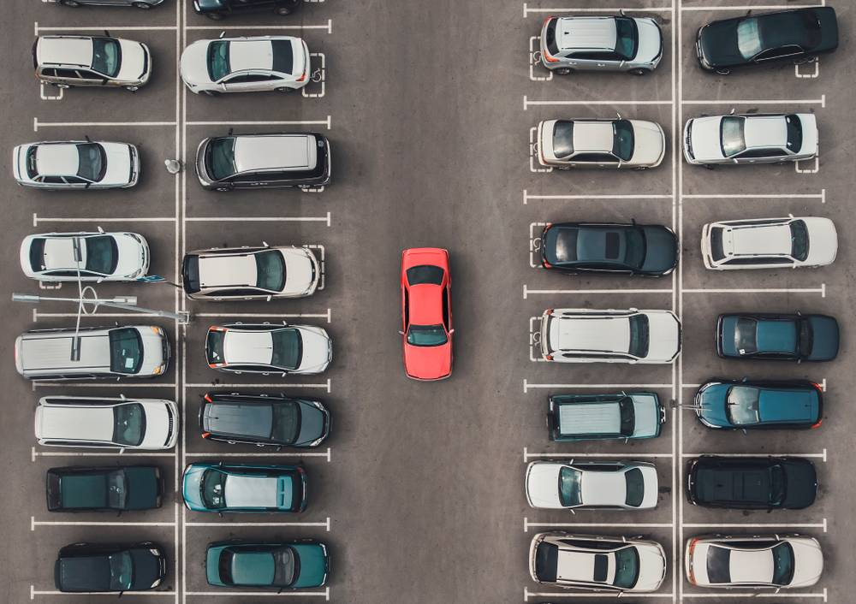
Why Smart Parking?
Time Efficiency
Safety
Less Pollution

Slide 4
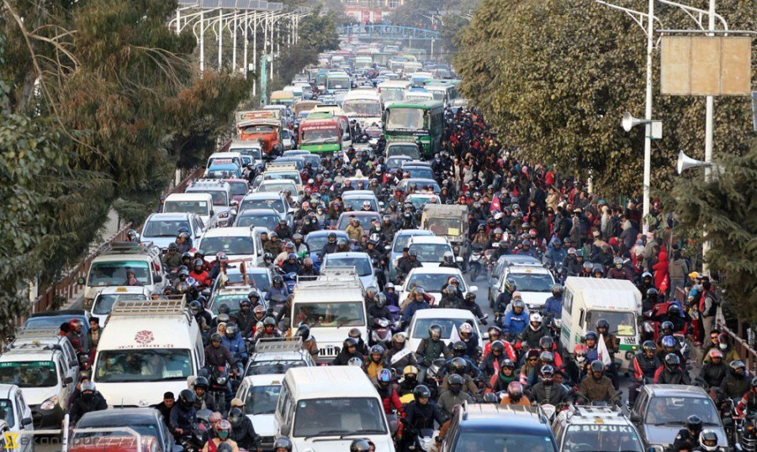
Urbanization Challenges
Rapid urbanization leads to increased vehicle ownership.
Cities face challenges in managing the growing number of vehicles.

Slide 5
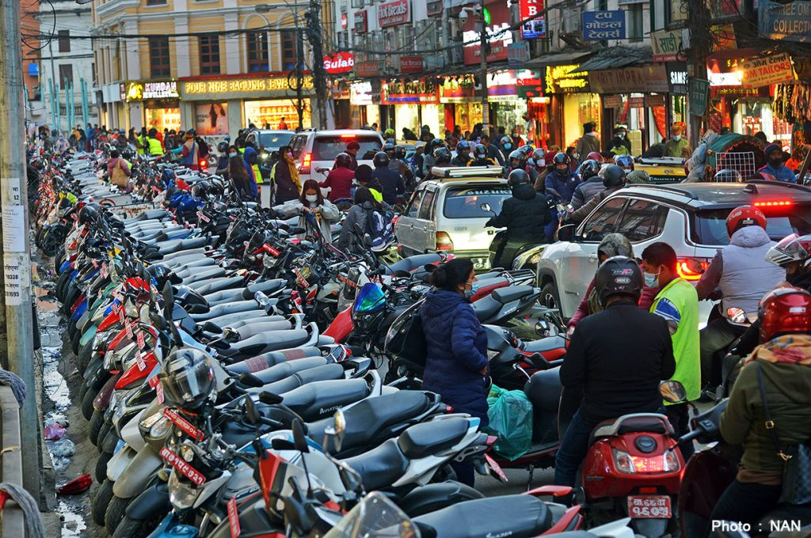
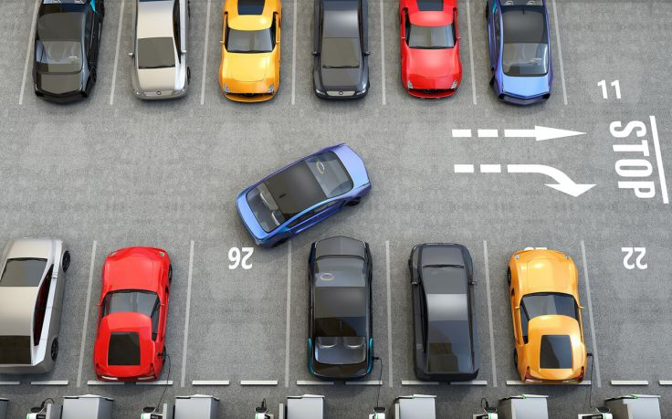
Inefficient Parking Search
Drivers spend a significant amount of time searching for parking spaces.
Inefficient parking search contributes to traffic congestion.

Slide 6




Technology
Sensors and Detection
Communication Infrastructure
Management System
Payment and Ticketing

Slide 7
1
2
3
4
Real-Time Occupancy Data
IoT Connectivity
User-Friendly Mobile App
Predictive Analytics
Enables real-time updates and remote monitoring.
Intuitive interface for users to check parking availability
Enhances planning and optimizes resource allocation.
Enhances user experience and reduces search time
5
6
7
Automated Payment System
Scalability
Integration with Navigation Apps
Ensures long-term viability and adaptability.
Enable cashless transactions through the mobile app
Enhances visibility and accessibility.

Slide 8
1
2
3
4
Environmental Impact
Customizable Alerts
Secure Data Handling
Community Engagement
Reduces traffic congestion and associated emissions.
Enhances user engagement and satisfaction.
Addresses privacy concerns and builds trust.
Encourages user participation and continuous improvement.
5
6
7
Centralized Management Dashboard
Adaptive Pricing Models
Emergency Response Integration
Maximizes revenue and optimizes resource utilization.
Facilitates effective monitoring and management.
Enhances safety and public services.

Slide 9
Data
Visualization
for
Decision-Making
Data
Acquisition
Data
Processing
and
Management
Data
Analytics
Data
Transmission

Slide 10
Data Acquisition
Ultrasound Sensors
Camera Systems
These sensors can detect the presence of vehicles, providing an additional layer of accuracy.
Presence Sensors
Capturing visual data like license plate recognition and overall parking space occupancy.
Detect the presence or absence of vehicles in parking spaces.

Slide 11
Data Transmission
IoT Gateway
Device: Raspberry Pi or Arduino-based gateway devices.
Functionality: Aggregates data from various sensors and transmits it to the central server or cloud platform.
Connectivity: Utilizes wireless technologies such as Wi-Fi, Bluetooth, or cellular networks for data transmission.

Slide 12
Data Processing and Management
Cloud-Based Platform
Processor Chips
Infrastructure: Hosted on platforms like AWS, Azure, or Google Cloud.
Data Storage: Utilizes databases like MySQL or NoSQL databases to store sensor data.
Infrastructure: Hosted on platforms like AWS, Azure, or Google Cloud.
Data Storage: Utilizes databases like MySQL or NoSQL databases to store sensor data.

Slide 13
Data Analytics
Predictive Analytics Engine
Adaptive Pricing Algorithms
Algorithm: Machine learning algorithms such as regression or neural networks.
Functionality: Analyzes historical and real-time data to predict future parking space availability.
Algorithm: Dynamic pricing algorithms based on demand and supply.
Optimization: Adjusts pricing in real-time to maximize revenue and resource utilization.

Slide 14
Data Visualization for decision-making purposes
Dashboard
User Interface: Web-based or mobile app interface for users and administrators.
Visualization: Utilizes charts (bar graphs, pie charts) and maps to represent parking space occupancy and trends.

Slide 15
Emergency Response Integration
Visualization: Real-time visualization of emergency situations on the dashboard.
Alerts: Instant alerts to emergency services for swift response.

Slide 16
Community Feedback Mechanism
Visualization: User feedback presented in a graphical format on the dashboard.
User Engagement: Encourages community engagement and improvements based on feedback

Slide 17
Challenges
Power Consumption
Technical issues
Privacy Concerns
Infrastructure Compatibility
Limited Coverage

Slide 18
Solution
Implementing energy-efficient devices
Regular maintenance and Software updates
Data protection regulations
Prioritize scalable and adaptable solutions
Expanding coverage gradually

Slide 19
Conclusion
Towards Smart and Sustainable Urban Mobility:
Efficiency Through Real-Time Data Management:
Informed Decision-Making with Analytics and Visualization:

Slide 20
The End

