Slide 1
Factors of Success for Funded EdTech Startups
By Logan Bernard
Spring 2015
CS591

Slide 2
Data Characteristics
CrunchBase API #EdTech – funded startups
Imperfect dataset:
Funding
Number of Employees
Primarily small, US based companies
What statistics epitomize successful EdTech startups?

Slide 3
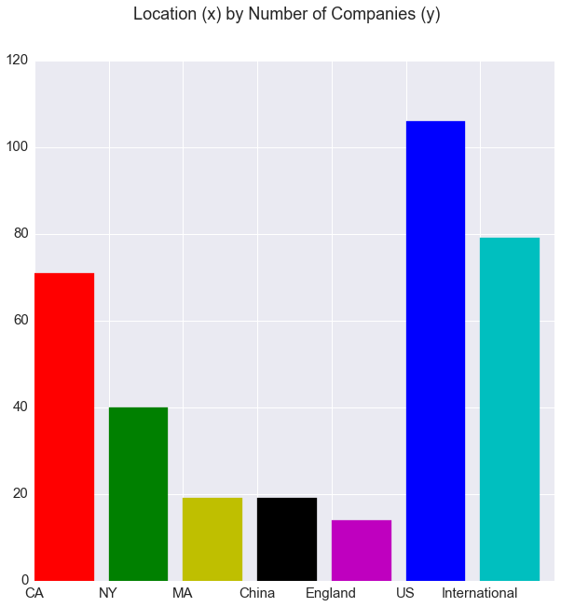

Slide 4
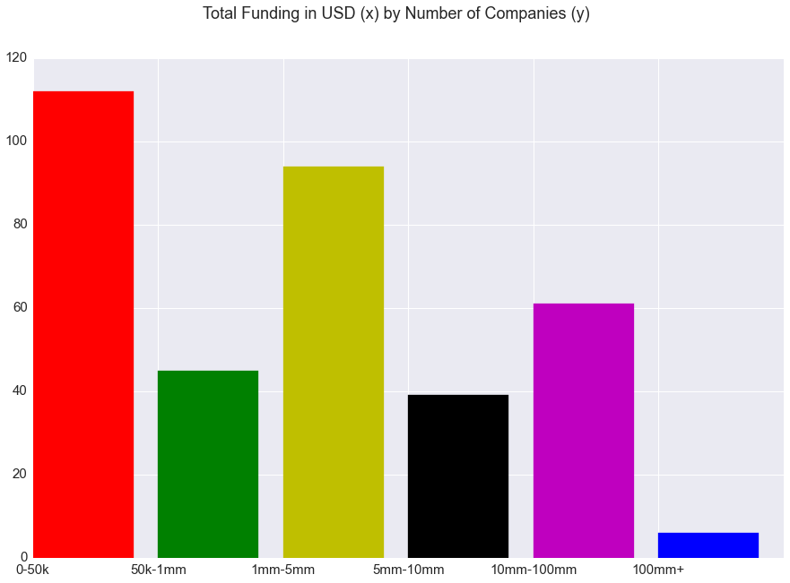

Slide 5
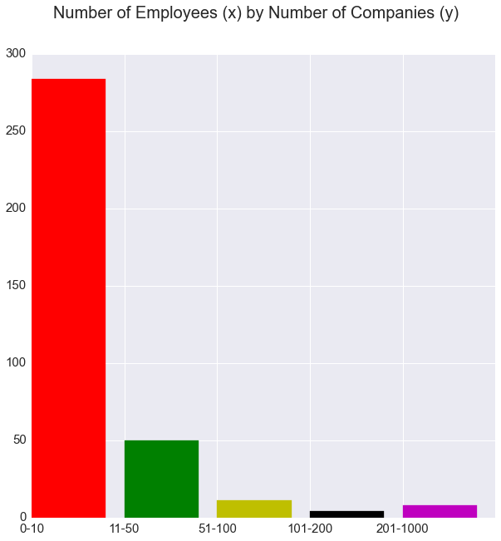

Slide 6
Hypotheses
Longevity for a company will be strongly correlated with the amount of Funding per Employee
Using these two indicators of success, California will be found to produce the majority of these “successful” funded EdTech startups

Slide 7
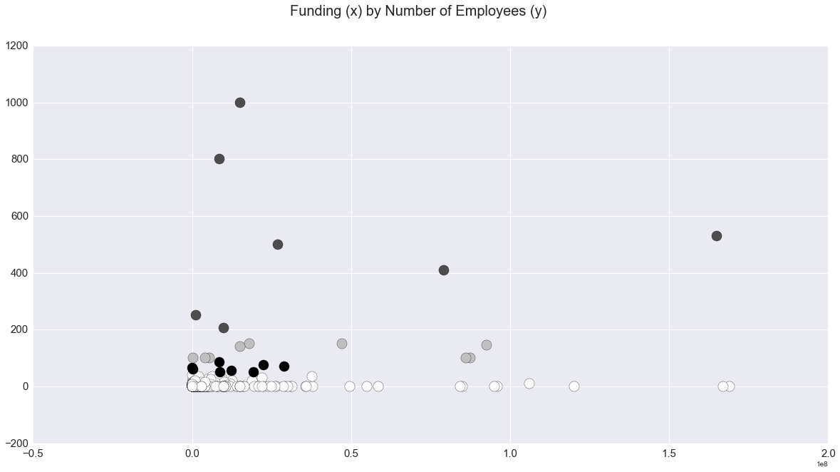

Slide 8
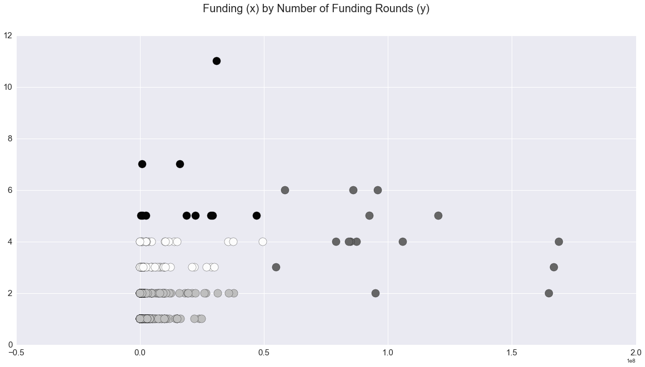

Slide 9
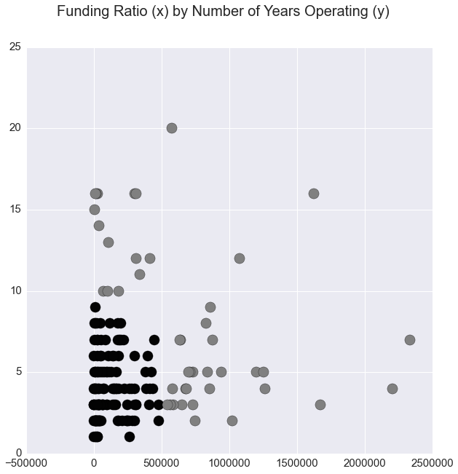

Slide 10
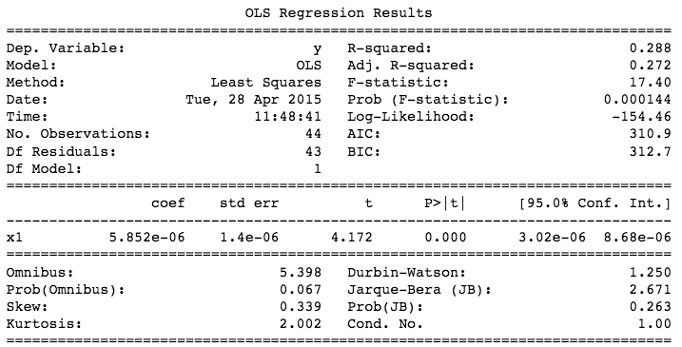

Slide 11
Data Summary
Averages:
Employees: 92
Funding per Employee: $920,000
Total Funding: $84,640,000
Funding Rounds: 2.6
Years Operating: 8.1
Locations:
CA: 12
NY: 9
England: 4
India: 2

Slide 12
Conclusion
Longevity not strongly correlated with Funding per Employee
Strong revenue streams a potential factor
California and New York – EdTech startup leaders
India surprisingly high on the list

