Slide 1
Insights from Tourism Data
Hoo Fang Yu

Slide 2
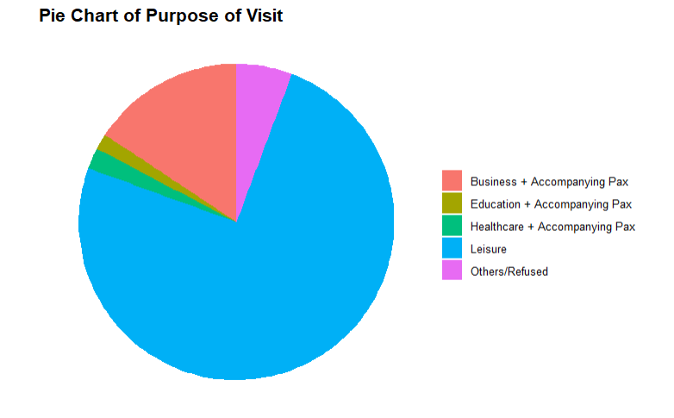
Travel Purpose Demographics
The survey data reveals that majority of the visitors come to Singapore for leisure, indicating that marketing efforts should continue to highlight Singapore's diverse leisure offerings, including cultural experiences, shopping, and entertainment.
A smaller but significant portion of visitors are business travelers, often accompanied by others, suggesting an opportunity to promote Singapore as both a business hub and a destination for leisure, with packages catering to this dual purpose.

Slide 3
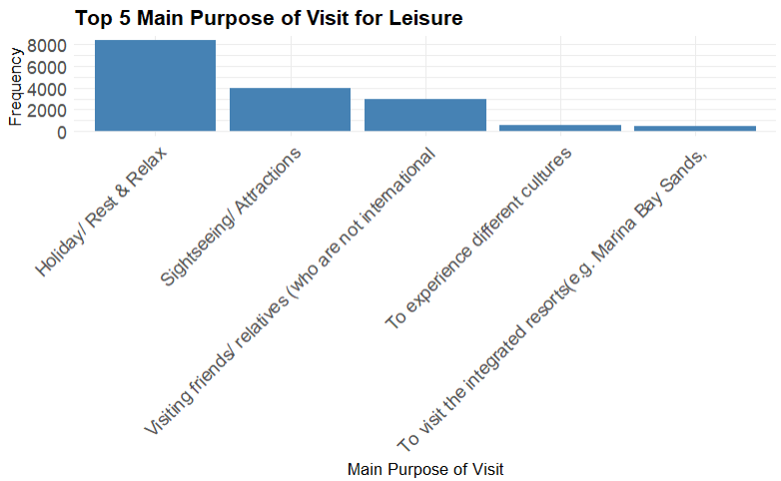
Travel Purpose (Leisure) Demographics
Analyzing these top leisure purposes reveals a strong preference for relaxation and sightseeing, suggesting that promoting packages that combine relaxation with cultural and sightseeing experiences could increase visitor satisfaction and spending.
For business visitors, offering add-on leisure experiences that align with these popular activities could encourage them to extend their stay or bring family members along, thereby boosting overall expenditure.

Slide 4
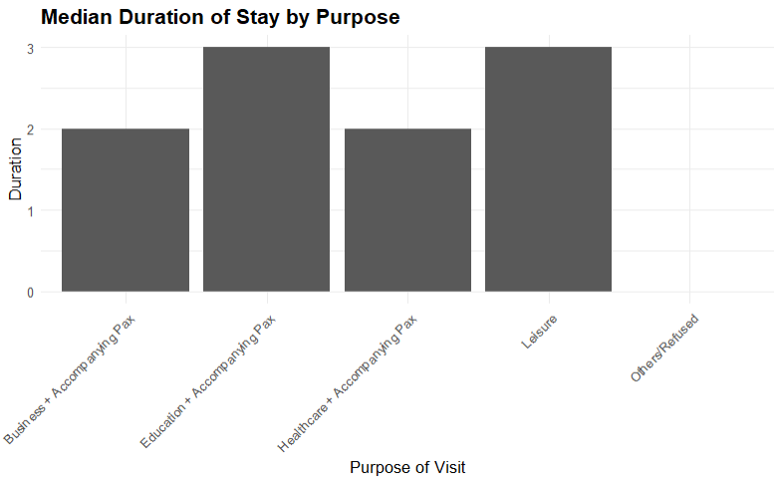
Travel Duration Analysis
In general, tourists do not stay in Singapore for very long (merely 2-3 days) and this is a common trend regardless of Purpose of Visit for the Tourists.
This could possibly be because Singapore is a very small country, and it is possible to explore Singapore completely within a short period of time.
There are two strategies that can be considered to try to extend the duration of stay for tourists. The first would be to create more attractions, either by building new infrastructure or by making tourist attractions on what Singapore already has (e.g. HDB heartlands etc.). The second would be to design longer tour packages for those who are here on a packaged tour so as to extend the duration of stay for the tourists.

Slide 5
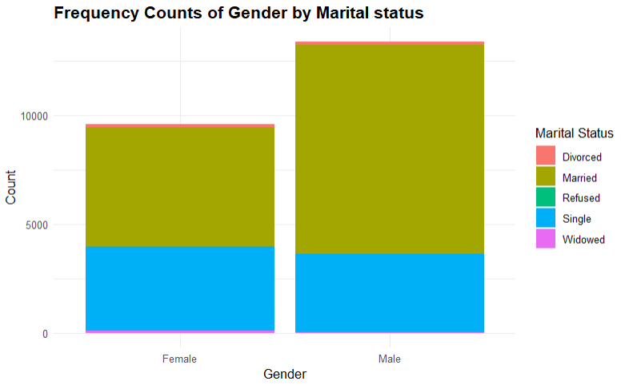
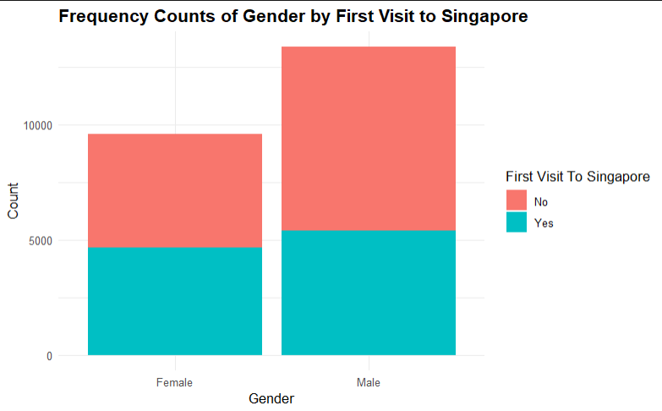
Gender-Based Analysis
In general, there is a greater proportion of males than females that visit Singapore. Majority of people who visit Singapore are Married Couples. Interestingly, there is a hidden demographic that we can observe from here which are Single Females as they form a higher proportion within the females as compared to their Single Male counterparts. This suggests that marketing efforts can be targeted towards both married couples (e.g. designing romantic attractions). In addition, marketing efforts can also be targeted towards Single Females by understanding what their preferences are.
As for the distribution of Tourists who are first-time visitors, there seems to be an equal distribution for females but there is a higher proportion of returning visitors who are male. This probably suggests that our marketing efforts to reattract tourists is probably doing fine.

Slide 6
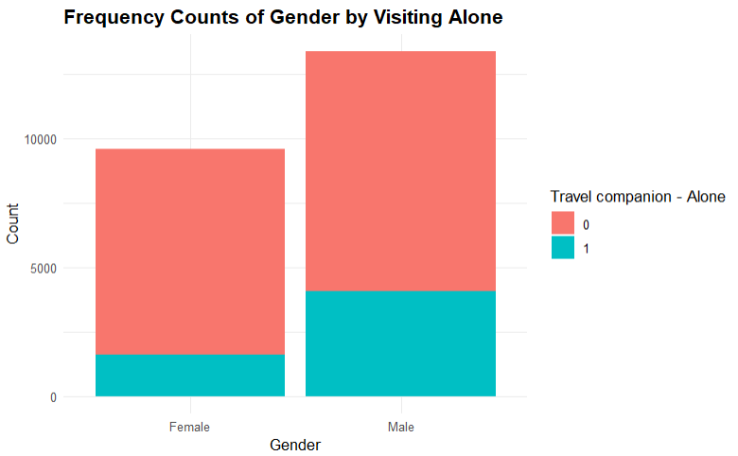
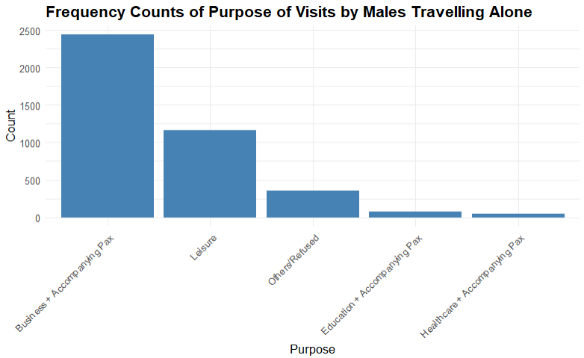
Gender-Based Analysis
When comparing across genders on whether the tourist is travelling alone, we can observe that majority of tourists travel with a companion. What is more interesting from the chart is that there is a greater proportion of males who are travelling alone than females.
Upon analyzing the demographic of males travelling alone, we could observe that they are primarily here for Business. This suggests that we could possibly target marketing campaigns towards these males to make them feel less lonely when they spend time away from their family.

Slide 7
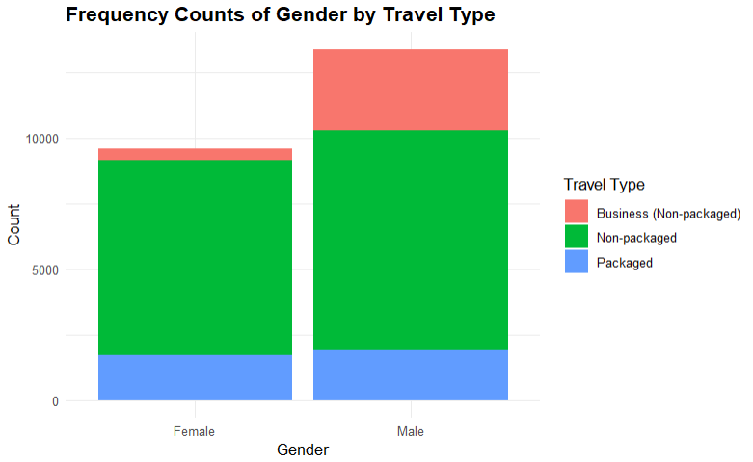
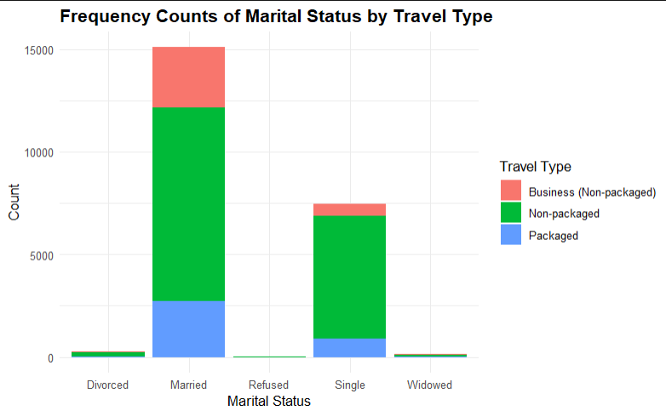
Travel Type Analysis
When analyzing travel type, we can observe that a large proportion of tourists are here for non-packaged travels. This distribution is consistent across gender and marital status.
This suggests that greater efforts should be placed into designing attractive travel packages. This is certainly a market that we could into expanding and I believe would also help to increase the travel duration of each tourist should we have well-designed travel packages.

Slide 8
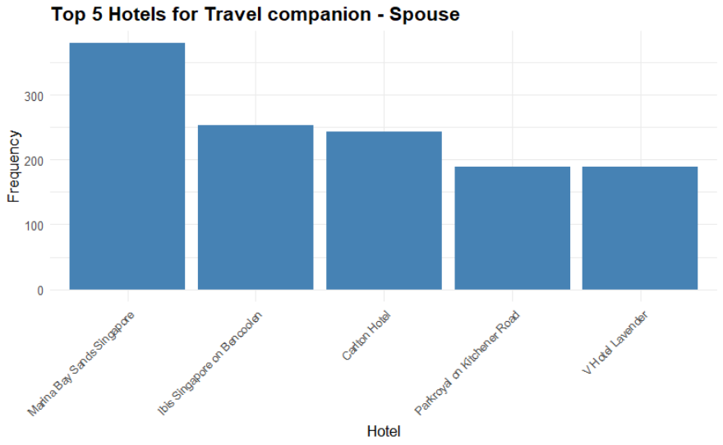
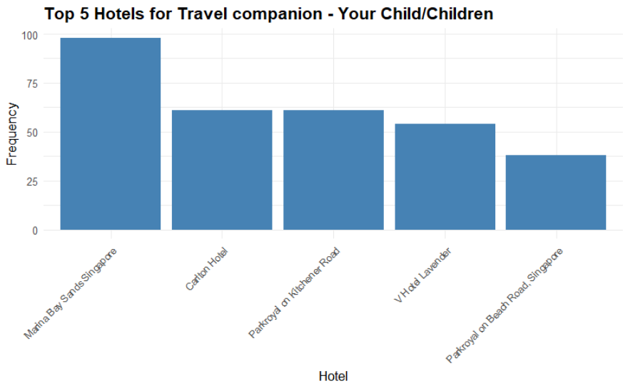
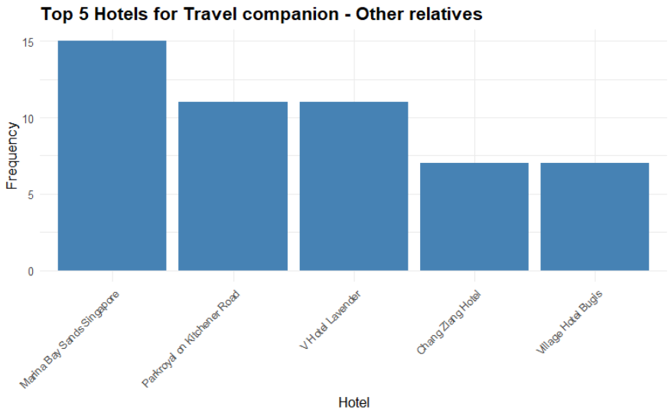
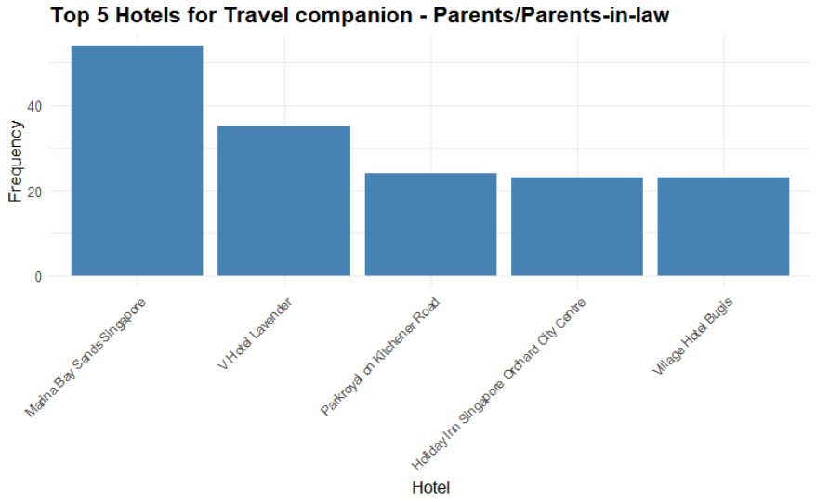
Hotel Choice Analysis (Significant Correlations)
When analyzing Hotel Choice when travelling with inter-generational family members, we can observe that a is also a popular preference for budget hotels (V hotel, Ibis etc.) amongst the more luxurious options (MBS, Carlton, Parkroyal etc.)
This suggests that luxury hotels could offer family packages to attract families to stay at their premises such as multi-room deals or discounts on family activities to entice more families to stay in them.
Budget hotels could also offer more family-friendly amenities such as larger rooms etc. Marketing efforts could focus on providing a comfortable, affordable experience that doesn’t compromise on quality or convenience for families.

Slide 9
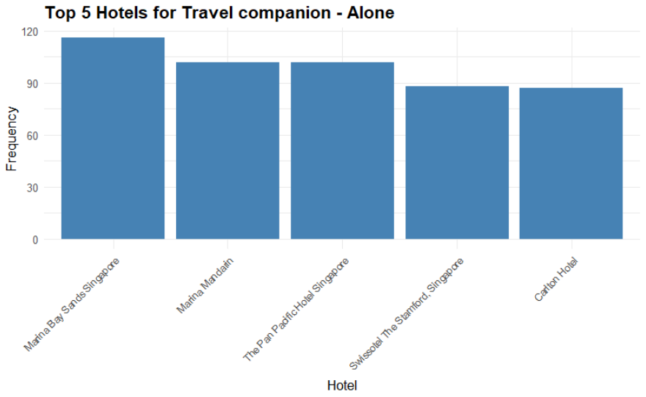
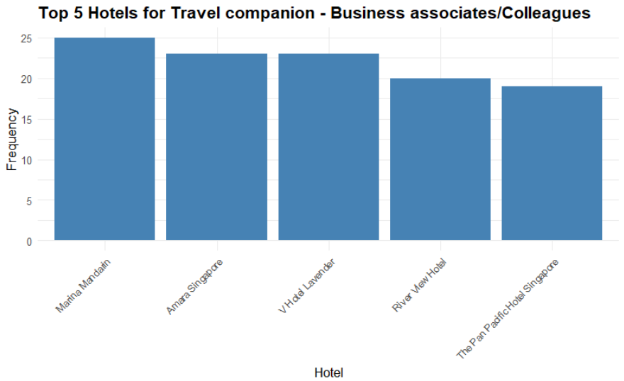
Hotel Choice Analysis (Significant Correlations)
Tourists who travel alone or with Business associates/colleagues tend to live in more luxurious options.
Since tourists who travel alone or with business associates/colleagues prefer luxurious accommodations, luxury hotels can create and market exclusive packages tailored to this group, including premium amenities such as high-speed internet, business centers, and quiet workspaces, as well as networking events or exclusive lounges to enhance the appeal for business travelers.

Slide 10
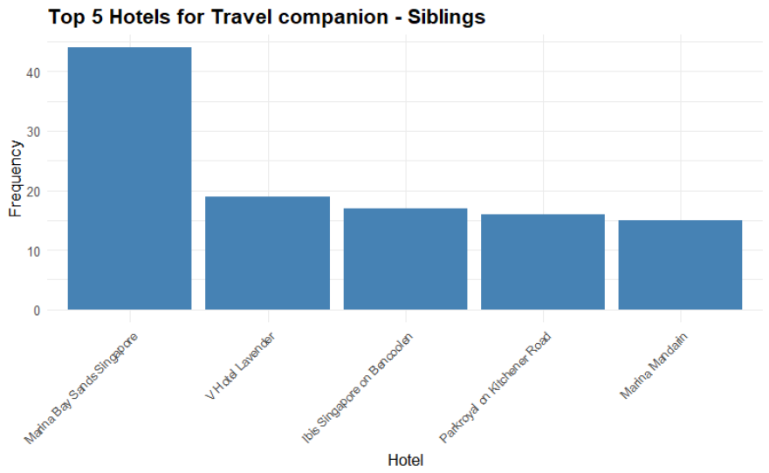
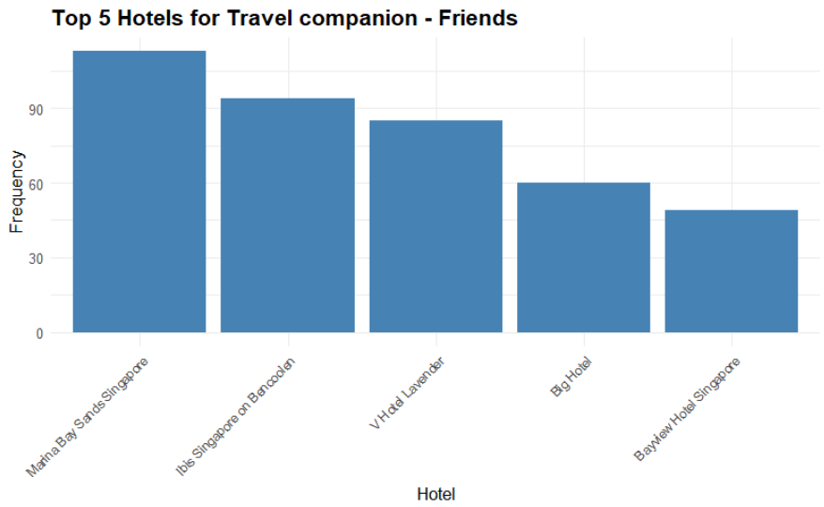
Hotel Choice Analysis (Significant Correlations)
Tourists who travel with peers from their generation such as siblings and friends also has a preference to live in budget options.
Tourists traveling with peers from the same generation, such as siblings and friends, who show a preference for budget options, might be attracted by marketing campaigns that emphasize affordability without sacrificing quality. Budget hotels could offer group discounts, complimentary breakfast, or partnership deals with local attractions to create more value for these travelers.

Slide 11
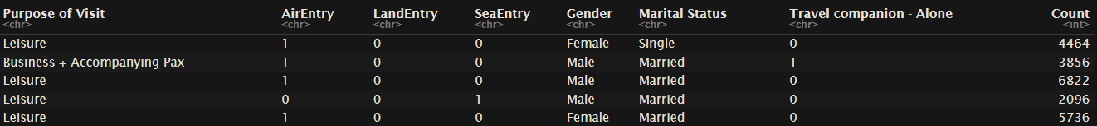
K-Modes Cluster Analysis
Three main (dominant) demographics:
Cat1: Married Businessmen Travelling Alone,
Cat2: Married Couples Travelling Together for Leisure
Cat3: Single Females Travelling with others for Leisure

Slide 12
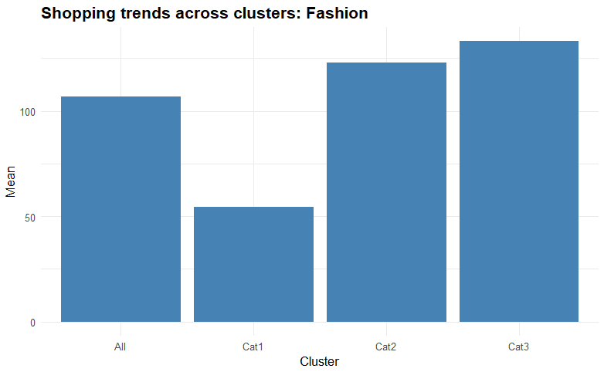
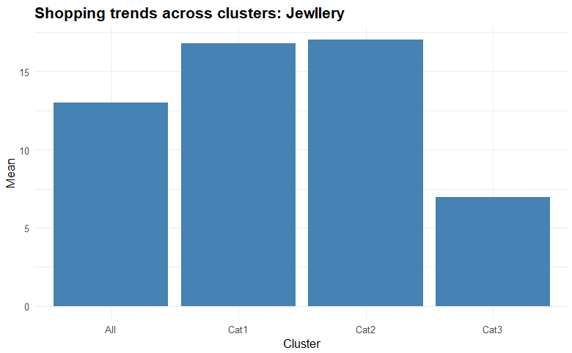
Insights within Cluster: Shopping Habits
Three main (dominant) demographics:
Cat1: Married Businessmen Travelling Alone,
Cat2: Married Couples Travelling Together for Leisure
Cat3: Single Females Travelling with others for Leisure
Married Couples and Single Females show strong interest in Fashion while Businessmen are not as interested.
Businessmen and Married Couples show strong interest in Jewellery while Single Females are not as interested

Slide 13
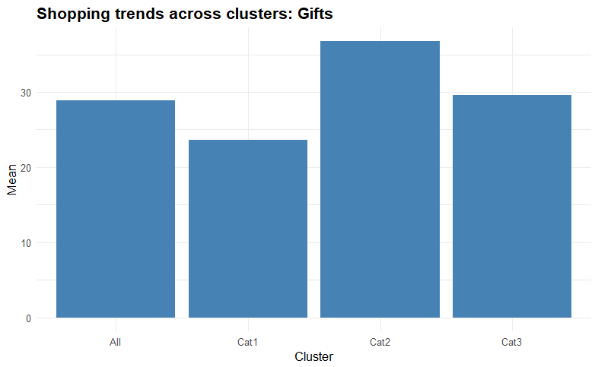
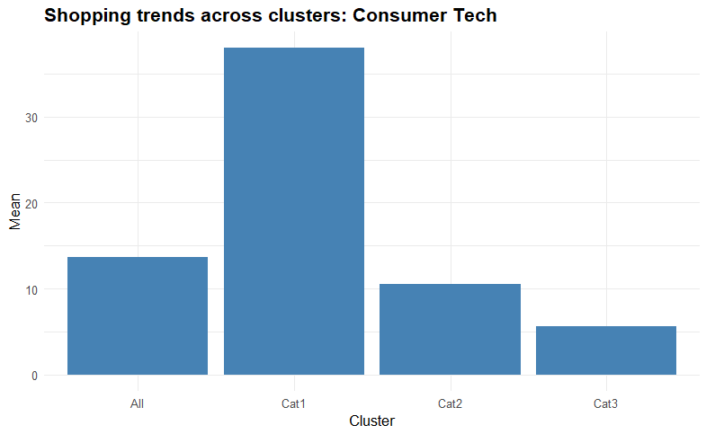
Insights within Cluster: Shopping Habits
Three main (dominant) demographics:
Cat1: Married Businessmen Travelling Alone,
Cat2: Married Couples Travelling Together for Leisure
Cat3: Single Females Travelling with others for Leisure
Married Couples tend to be more interested in purchasing gifts, presumably souvenirs for their other family members
Businessmen seem to be the primary population that has strong interest in consumer tech.

Slide 14
Shopping Profiles for Clusters
Married Businessmen Travelling Alone: Interest in Jewllery and Consumer Tech
Since they show an interest in jewelry and consumer tech, hotels and local businesses could offer targeted promotions on luxury items, high-end electronics, or exclusive shopping experiences. Concierge services might also recommend tailored shopping trips or partnerships with luxury brands.
Married Couples Travelling Together for Leisure: Interest in Fashion, Jewllery and Gifts
Their interest in fashion, jewelry, and gifts suggests that marketing should emphasize romantic or celebratory packages, including shopping experiences, gift shops, and exclusive access to designer boutiques. Hotels could offer special couple’s packages that include discounts at nearby luxury stores or personalized gift services.
Single Females Travelling with others for Leisure
With a focus primarily on fashion, hotels and local attractions could create packages that highlight popular fashion districts, boutique tours, or even exclusive styling sessions. Collaboration with fashion retailers to offer discounts or fashion-focused events could also enhance their experience and encourage spending.

Slide 15
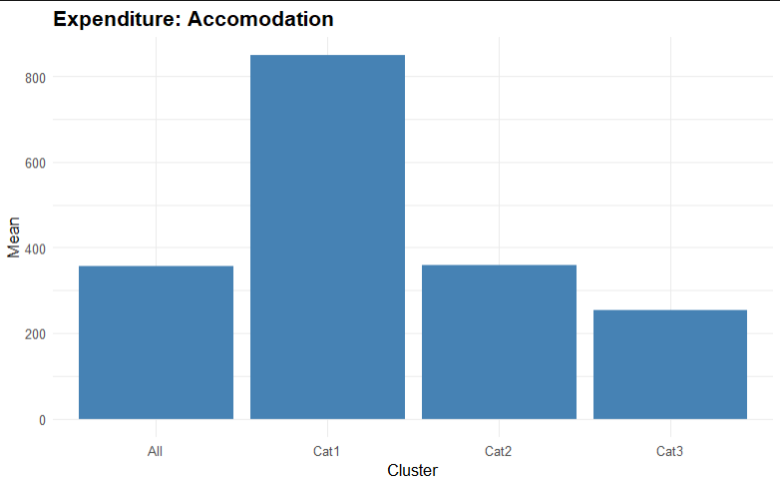
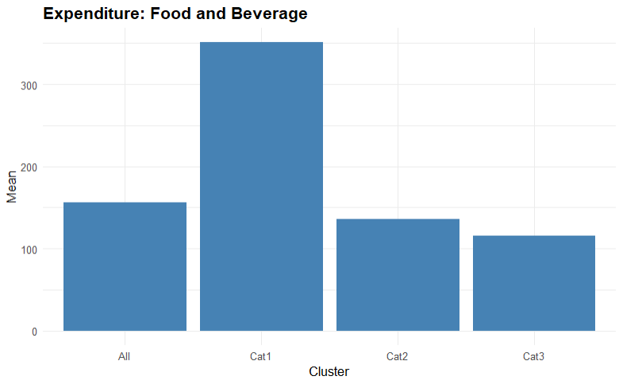
Insights within Cluster: Expenditure
Three main (dominant) demographics:
Cat1: Married Businessmen Travelling Alone,
Cat2: Married Couples Travelling Together for Leisure
Cat3: Single Females Travelling with others for Leisure
Businessmen tend to be high spenders for Accommodation, possibly staying in more luxurious accommodations as discussed earlier
Similarly, Businessmen tend to be high spenders for Food and Beverage.

Slide 16
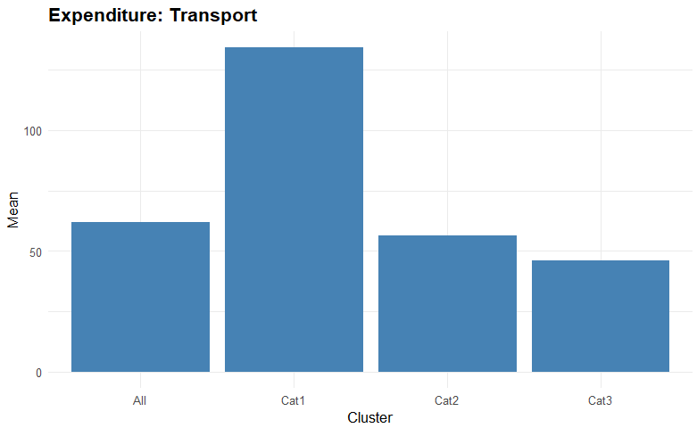
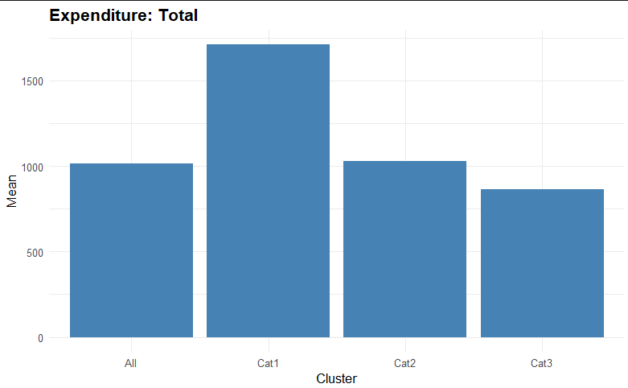
Insights within Cluster: Expenditure
Three main (dominant) demographics:
Cat1: Married Businessmen Travelling Alone,
Cat2: Married Couples Travelling Together for Leisure
Cat3: Single Females Travelling with others for Leisure
Businessmen tend to be high spenders for transport, which is likely from them doing ride hire as compared to taking public transport
In general, Businessmen tend to spend more in total when they are here in Singapore as compared to the other groups, and this is because of their luxurious spending habits, while the other groups remain modest.
(I don’t have anything insightful to recommend for Expenditure)

