Slide 1
CSCI 4430 – Fall 25
Tutorial 8
Credits to CUHK CSCI 4430 Spring 2020 Tutorial 03

Slide 2
Assignment 3
Due: Nov 30th, 2025, 11:59 PM
Topic
Static router
Reliable transport protocols
! The deadline maybe is close to the final exam time, so please arrange your time properly.

Slide 3
Outline
UDP Introduction
Socket Programming for UDP

Slide 4
UDP (User Datagram Protocol)
Another transport layer protocol (recall TCP).
Difference from TCP:
TCP guarantees reliable data transmission by establishing connection between client and server.
UDP is a connection-less protocol which does not establish connection between server and client before transferring data.
Each datagram is handled independently.
No handshaking between UDP sender and receiver.
Thus, UDP does not guarantee the arrival, arrival order, arrival time and content of the message (unreliable data transmission).

Slide 5
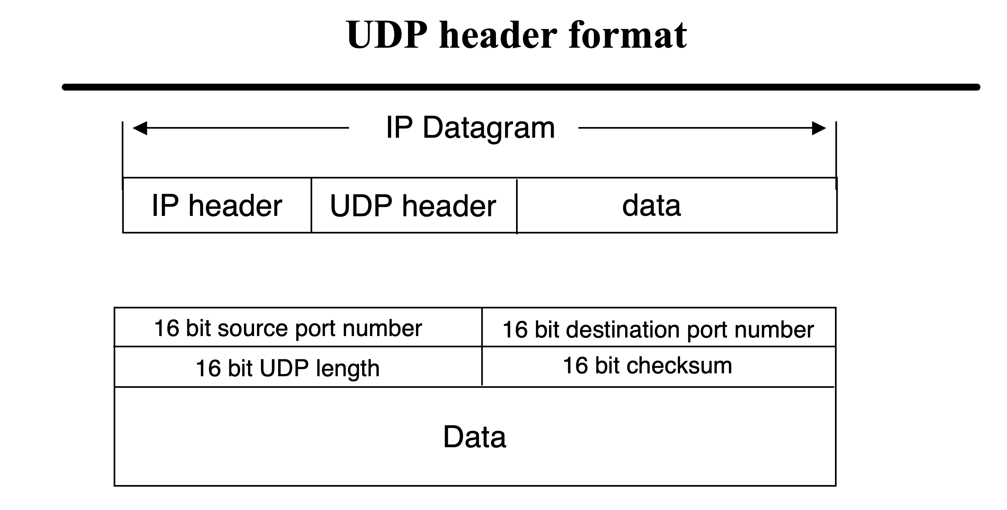
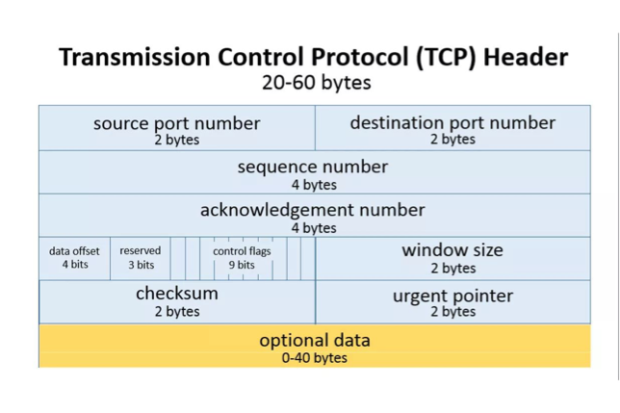
UDP (User Datagram Protocol)

Slide 6
TCP Socket Programming Workflow:
Listen to connection requirements from client
Server
Client
Handshakes of TCP

Slide 7
UDP Socket Programming Workflow:
socket()
bind()
socket()
Server
Client
recvfrom()
sendto()
recvfrom()
sendto()
close()
close()

Slide 8
Outline
UDP Introduction
Socket Programming for UDP

Slide 9
UDP Socket Programming: socket()
Create a socket

Slide 10
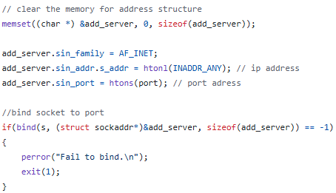
UDP Socket Programming: Server bind()
Bind an address to a socket
Server code
Receive from any IP of this machine (any interface)
Port used for UDP packets

Slide 11
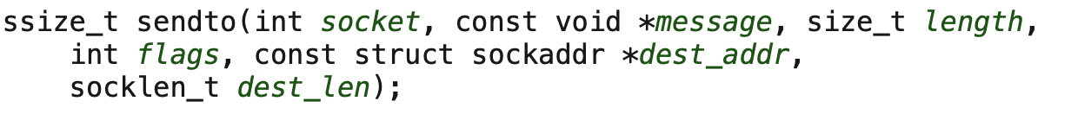
UDP Socket Programming: sendto()
Send a message on a socket
Return: sent length
Question here: How do I know the sockaddr of the receiving side?

Slide 12
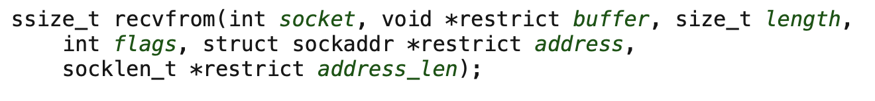
UDP Socket Programming: recvfrom()
Receive a message on a socket
(This part will be populated)
Return: received length

Slide 13
UDP Socket Programming: A Demo
The source code in C language has been released in Github Webpage.

Slide 14
Thanks!

