Slide 1
CSCI 4430 – Fall 25
Tutorial 12

Slide 2
Routing
Intra-Domain Routing
OSPF
Link State
RIP
Distance Vector
IGP = Interior Gateway Protocol
Inter-Domain Routing
BGP = Border Gateway Protocol
eBGP = external BGP
iBGP = internal BGP

Slide 3
BGP Attributes
Priority | Rule | Remarks
1 | LOCAL PREF | Pick highest LOCAL PREF (AS egress router)
2 | ASPATH | Pick shortest ASPATH length
3 | MED | Lowest MED preferred (AS ingress router)
4 | eBGP > iBGP | Prefer via eBGP announcements over iBGP
5 | iBGP path | Lowest IGP cost to next hop (internal egress router)
6 | Router ID | Prefer lowest BGP neighbor router ID, serve as tie break

Slide 4
Q1
In the given network, suppose AS2 and AS3 are running OSPF for their intra-AS routing protocol. Suppose AS1 and AS4 are running RIP for their intra-AS routing protocol. Suppose eBGP and iBGP are used for the inter-AS routing protocol, and there is no physical link between AS2 and AS4. Assume every link in an AS has the same cost.
● Router 3c learns about prefix x from which routing protocol? eBGP
● Router 3a learns about prefix x from which routing protocol? iBGP
● Router 1c learns about prefix x from which routing protocol? eBGP

Slide 5
Q1
Once router 1d learns about x it will put an entry (x, I) in its forwarding table.
● Will I be equal to l1 or I2 for this entry? l1
● Now suppose that there is a physical link between AS2 and AS4, shown by the dotted line. Suppose router 1d learns that x is accessible via AS2 as well as via AS3. Will I be set to I1 or I2 ? l2
● Now suppose there is another AS, called AS5, which lies on the path between AS2 and AS4. Suppose router 1d learns that x is accessible via AS2, AS5, AS4 as well as AS3, AS4. Will I be set to I1 or I2 ? l1
ASPATH > iBGP Path

Slide 6
Q2
Suppose AS X and AS Z are not directly connected but instead are connected by AS Y. Further suppose that X has a peering agreement with Y, and that Y has a peering agreement with Z. Finally, suppose that Z wants to transit all of Y’s traffic but does not want to transit X’s traffic. Does BGP (alone) allow Z to implement this policy?
Yes, AS Z can selectively advertise the routes. AS Z can only advertise the routes it learns from AS Y, but not the routs of AS X that AS Y has learned from AS X.

Slide 7
Q3
In the given network, ISP B provides national backbone service to regional ISP A. ISP C provides national backbone service to regional ISP D. Each ISP consists of one AS. B and C peer with each other in two places using BGP. Consider traffic going from A to D. B would prefer to handle that traffic over to C on the West Coast (so that C would have to absorb the cost of carrying the traffic cross-country), while C would prefer to get the traffic via its East Coast peering point with B (so B would have carried the traffic across the country). What BGP mechanism might C use so that B would hand over A-to-D traffic at its East Coast peering point?

Slide 8
MED
● Multi-exit discriminator (MED) is used when ASes are interconnected via 2 or more links; it is used to advertise to neighbors how they should enter our AS.
● MED is exchanged between ASes.
● The lowest MED is the preferred path.
● MED is propagated to all routers within the neighbor AS but not passed along to any other ASes.

Slide 9
Q3
ISP C wants Router 4 to be the ingress router instead of router 3, so we must have MED4 < MED3, e.g. MED4 = 10, MED3=20

Slide 10
Data Link Layer
Protocols
Ethernet (IEEE 802.3)
CSMA (Carrier-sense multiple access)/CD (Collision detection)
Recover after collision is detected
Wi-Fi (IEEE 802.11)
CSMA/CA (collision avoidance)
Designed to avoid collision
etc.
Device working in this layer use MAC address

Slide 11
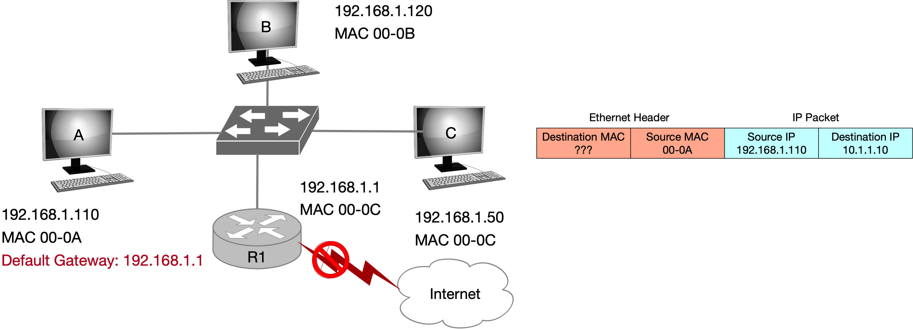
Address Resolution Protocol (ARP)
Used to find the MAC address of another device within subnet
ARP cache: A list from IPv4 address (32 bits) to MAC address (48 bits)
ARP broadcast address (when sending an ARP finding request): ff:ff:ff:ff:ff:ff

Slide 12
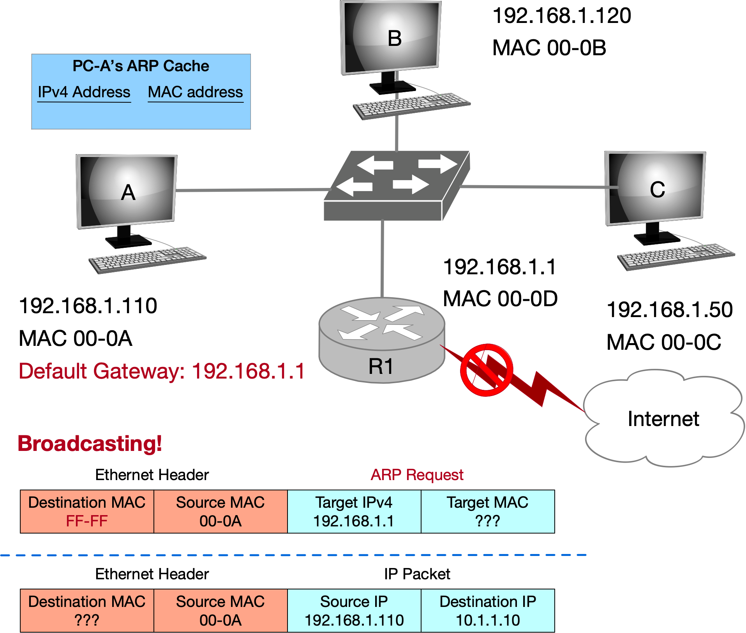
Address Resolution Protocol (ARP)

Slide 13
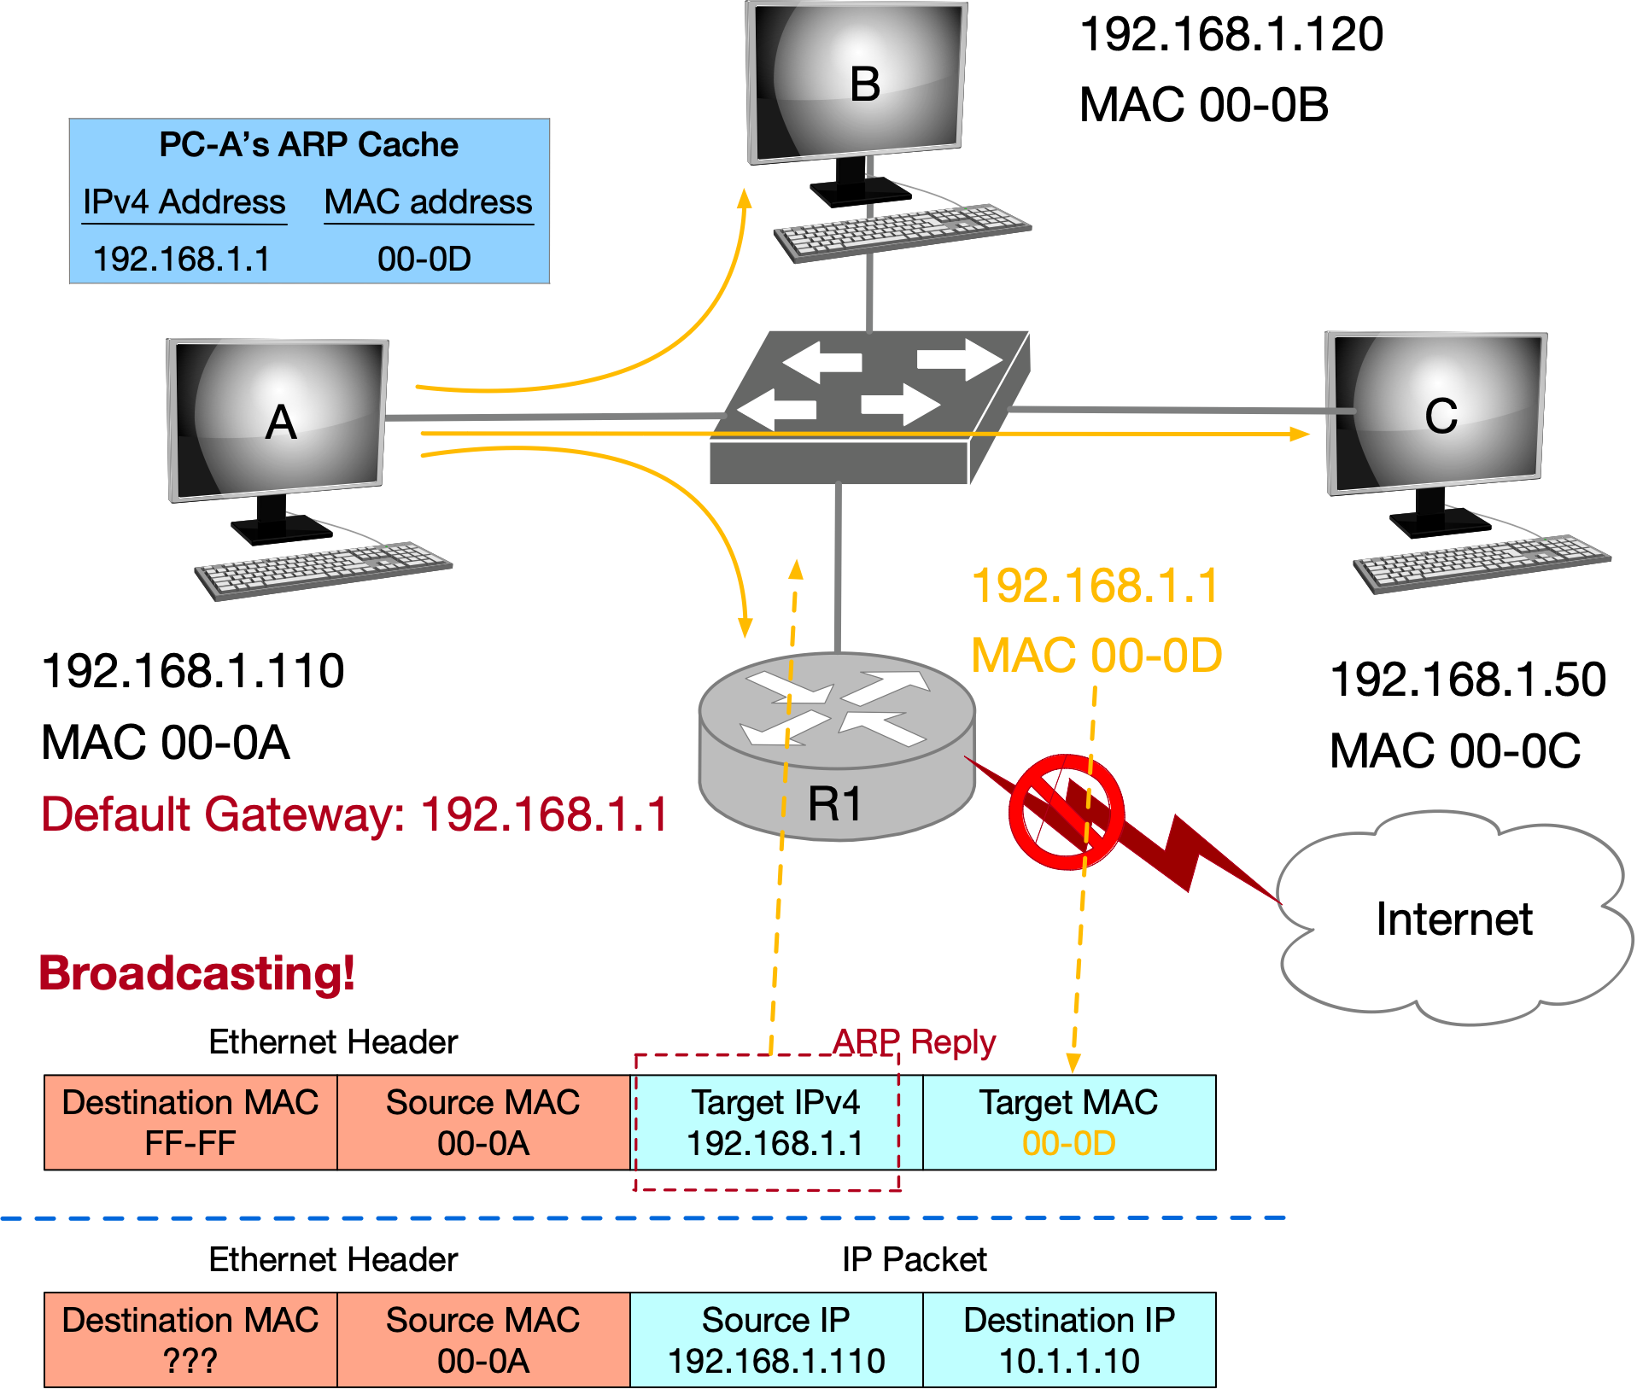
Address Resolution Protocol (ARP)

Slide 14
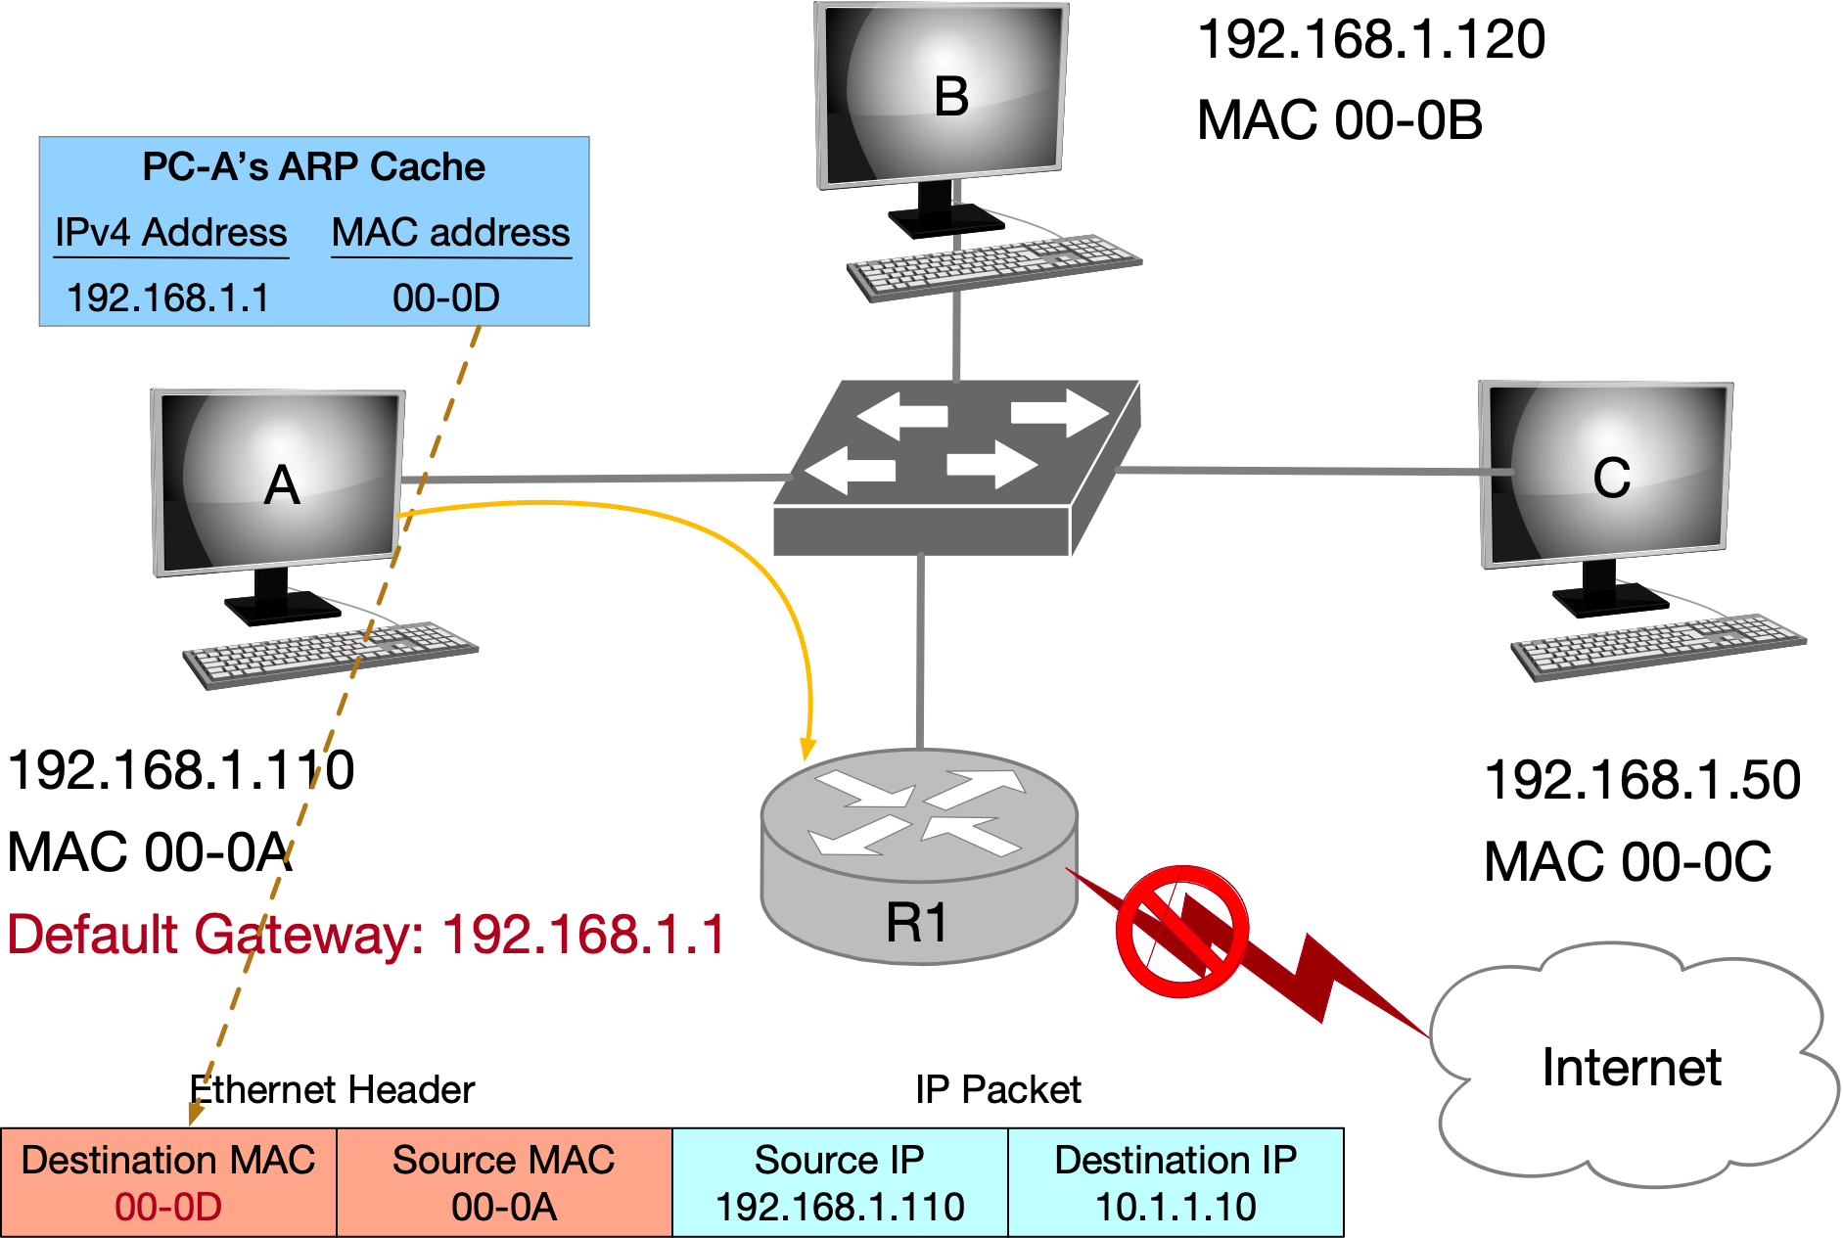
Address Resolution Protocol (ARP)

Slide 15
Spanning Tree Algorithm
Used to broadcast messages of switches in subnets and avoid loops
Aimed to construct a spanning tree of the topology
Messages (Y, d, X) (Each node)
From node X
Proposing Y as the root
Advertising distance d to Y
(Each node) Advertising Messages to its neighbors.
Switches elect the node with smallest identifier (MAC address) as root.
Each switch determines if a link is on its shortest path to the root; excludes it from the tree if not.
Breaking ties: choose the lowest switch ID.

Slide 16
Spanning Tree Algorithm
Algorithm Procedure
Initially, each switch proposes itself as the root
Switch X announces (X, 0, X) to its neighbors
Switches update their view of the root
Upon receiving (Y, d, Z) from Z, check Y’s id
If Y’s id < current root: set root = Y
Switches compute their distance from the root
Add 1 to the shortest distance received from a neighbor
If root or shortest distance to it changed, send neighbors updated message (Y, d+1, X)

Slide 17
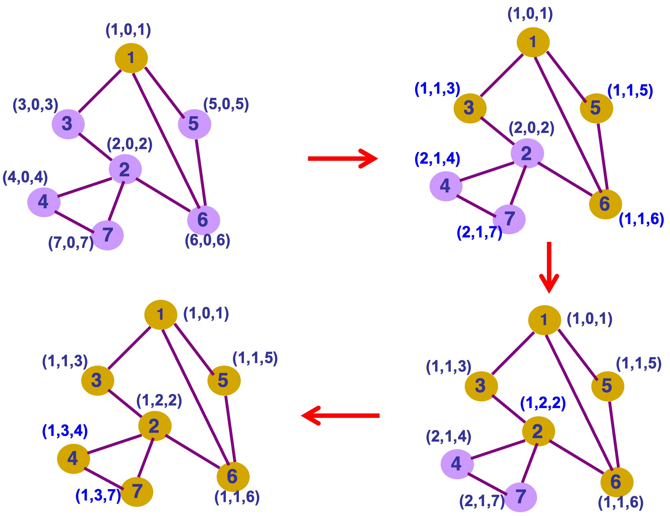
Initialize
1st step
2nd step
update
Switch root (compare id with neighbors)
distance = neighbor distance + 1
Switch root (compare id with neighbors)
distance = neighbor distance + 1
update
4th step
3rd step
update
Switch root (compare id with neighbors)
distance = neighbor distance + 1
Breaking ties: lowest neighbor ID
Breaking ties
Tree completed (coverage)

Slide 18
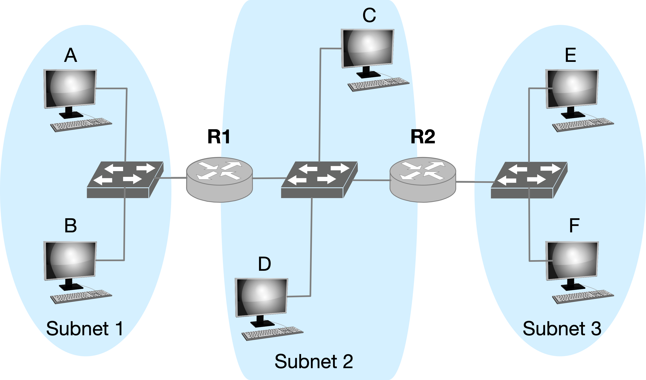
Q1 Forwarding
Consider sending an IP packet from Host E to Host F. Will Host E ask router R2 to forward the packet? Why?
No. Host E and Host F are on the same subnet and are connected via switch.

Slide 19
Q2 ARP
2-1. Consider E sending an IP packet to B. Assume E’s ARP cache is empty. Will E make an ARP request to find B’s MAC address?
No. Host B and Host E are on the different subnets.
2-2. Will E make an ARP request to? If yes, to whom?
R2 (its first-hop router).

Slide 20
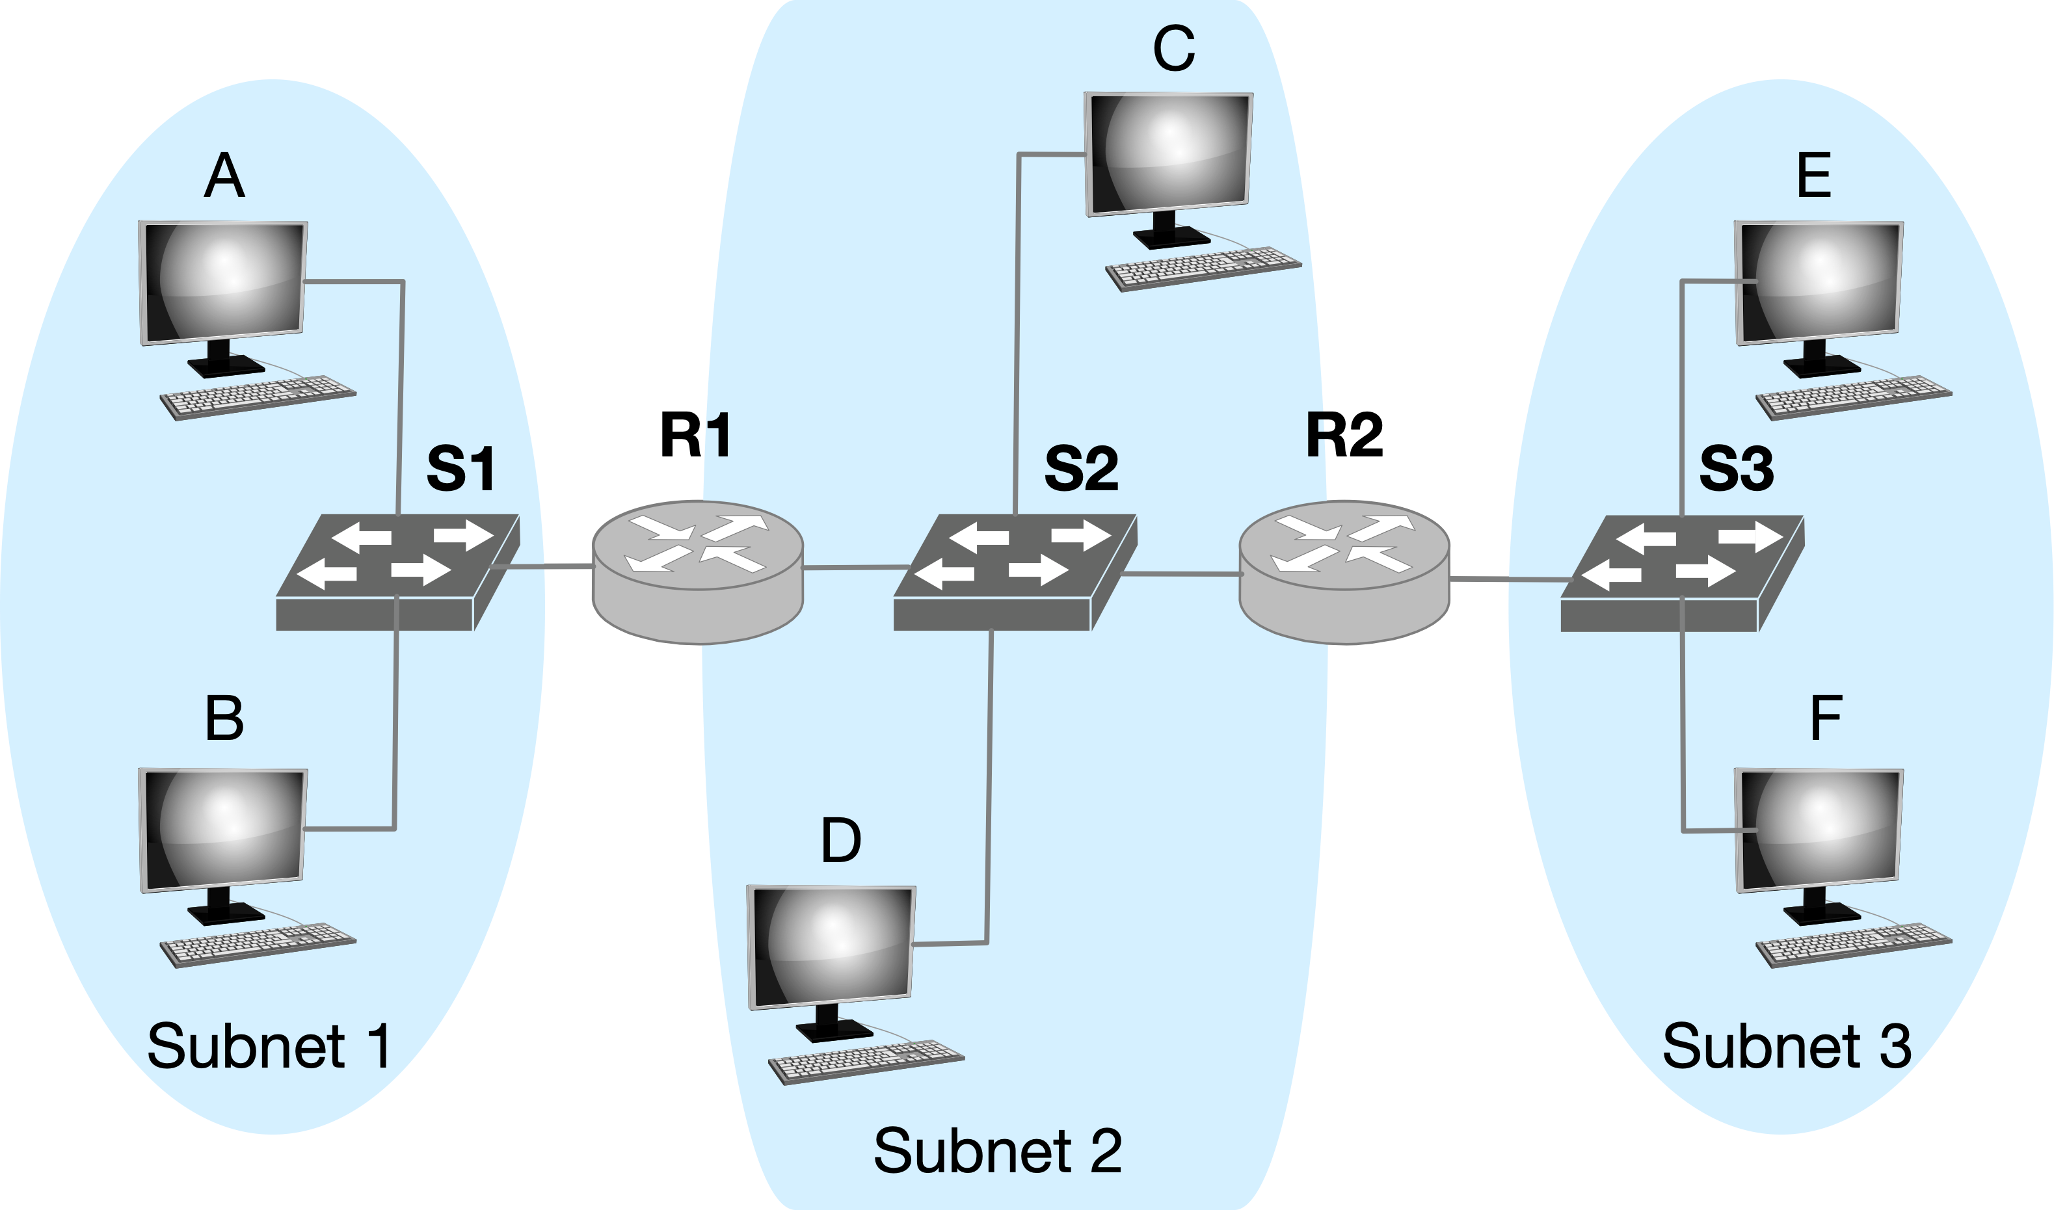
Q3 ARP and IP
Consider E sending an IP packet to B.
In the Ethernet frame of the IP packet from E to B is being delivered to router R1, what are the source and destination IP and MAC addresses?
srcIP: IP-E, dstIP: IP-B
srcMAC: MAC-R2, dstMAC: MAC-R1

Slide 21
Final Exam
Time&location:
This is a two-hour closed-book exam.
One A4-size aid-sheet is allowed.
One approved calculator is allowed.
Six Questions
Covering all lecture and tutorial contents
No coding

Slide 22
Thanks!

