Slide 1
Discussion 4
Presenter:
Devyani Kulkarni
(Slides adapted from slides by Pooja Bhat)

Slide 2
Agenda for today
Review through HW4 (and some of the concepts it involves).
Interview/Midterm Prep Questions

Slide 3

stack
One of the most common data structures (well technically a Data Type as it is made up of basic data structures) in computer algorithms.
Ordered list of elements in which all operations such as insert and delete are made at one end – called the top.
Insert – push( )
Delete/Remove - pop( )
LIFO structure

Slide 4
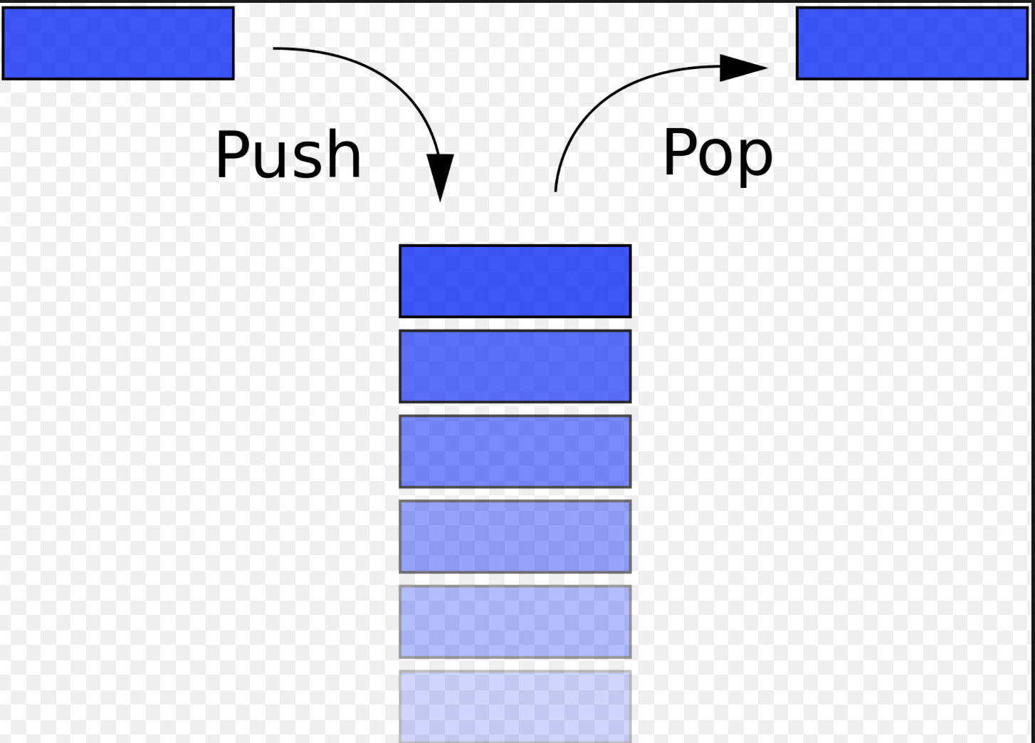
If I push elements a, b, c, d, e(in the same order) into a stack, in what order will they be popped?
A, B, C, D, E
E, D, C, B, A
A, C, B, D, E
E, D, B, C, A

Slide 5

queue
It is an ordered list of elements in which all insertions take place at one end, called the “rear”, and all deletes take place at the other end, called the “front”.
Insert – enqueue( )
Delete/Remove – dequeue( )
FIFO? LIFO?

Slide 6
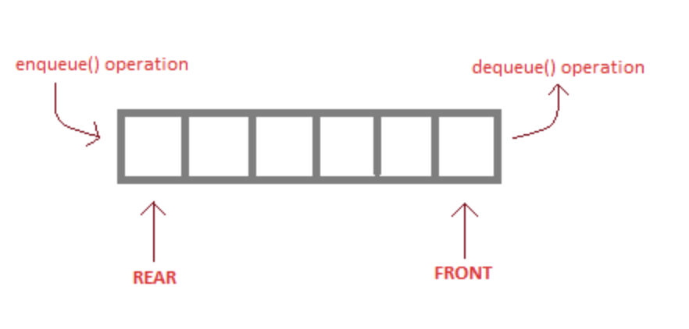
If I insert elements a, b, c, d, e(in the same order) into a queue, in what order will they be removed?
A, B, C, D, E
E, D, C, B, A
A, C, B, D, E
E, D, B, C, A

Slide 7
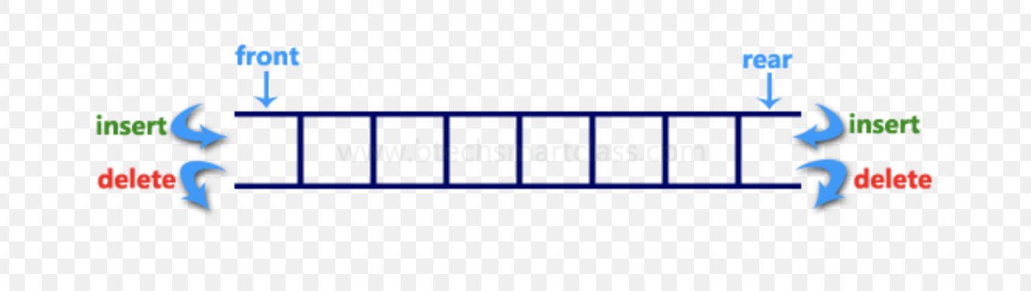
deque
Stands for “Double-ended Queue”
It is a generalized queue in which insertions and deletions can be performed from either ends
Basically :- addFront, addRear, removeFront, removeRear, are all valid operations
For HW4, you have to design a class DEQUE12 that implements the BoundedDeque interface using a circular ArrayList.
Read instructions for the constructor and methods in the Javadoc comments in the BoundedDeque.java

Slide 8
Mystack.java
Implements the BoundedStack interface
Use you ADP knowledge to model the stack methods using the methods implemented in Deque12
Will you need all methods from Deque12? If not, which ones will you need?

Slide 9
Myqueue.java
Implements the BoundedQueue interface
Use you ADP knowledge to model the queue methods using the methods implemented in Deque12
Will you need all methods from Deque12? If not, which ones will you need?

Slide 10
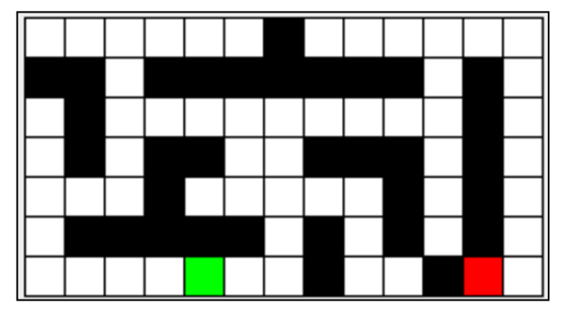
square
Each cell in the Maze is a Square
What do you think are the variables of a Square?
Row, column
Type of cell - Start? Exit? Wall? Space?
Anything else?
You should have getters and setters to access/modify variables
Easy to implement. You can think of it as similar to the Node class in your DLL. Node was the unit of DLL and here Square is the unit of our Maze.

Slide 11
maze
What instance variables would a Maze primarily have?
A 2D array of Squares
Mazes are given as txt files to you.
How to load this Maze to your 2D array?
Don’t worry as that code is already provided to you :)
Implement other methods of the Maze such as
getNeighbors(Square sq) : returns all valid neighbors. For example, neighbors of (0,7) are?
Getters and Setters
toString() is already provided

Slide 12
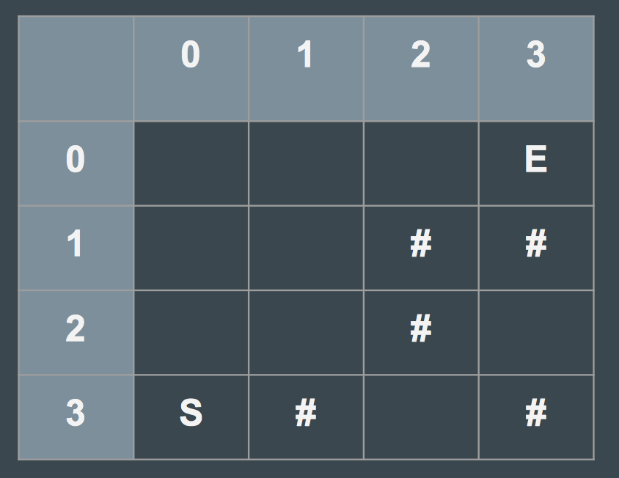
What are the valid neighbors of square (2,1) ?
(1, 1), (2, 2), (3, 1), (2,0)
(1, 1), (2, 2), (3, 1)
(1, 1), (2, 0)
(2, 0), (3, 1)

Slide 13
Maze solver algorithm- stack
Initialize worklist = Start
While worklist is not empty, do
Get next location from worklist.
Is it an Exit?
If yes, Yayy we found the escape!!
If not, then explore it as follows:
Find its valid neighbors in the order Up, Right, Down, Left
Add them to the worklist to be explored later (if they have not been already added)
Mark it as visited so that it is not explored again
If worklist is empty and no escape has been found, then there is no escape from the maze :(

Slide 14
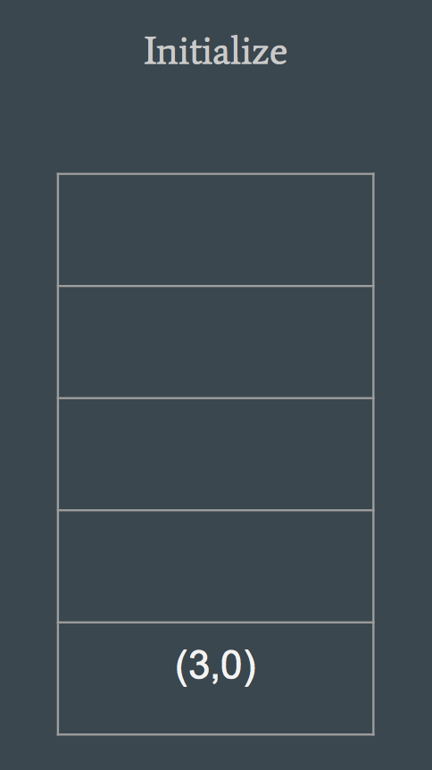
Maze solver algorithm- stack

Slide 15
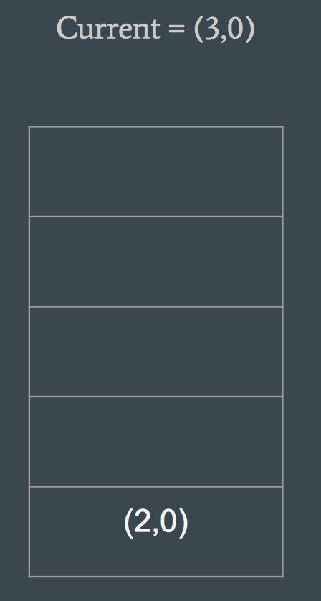
Maze solver algorithm- stack

Slide 16
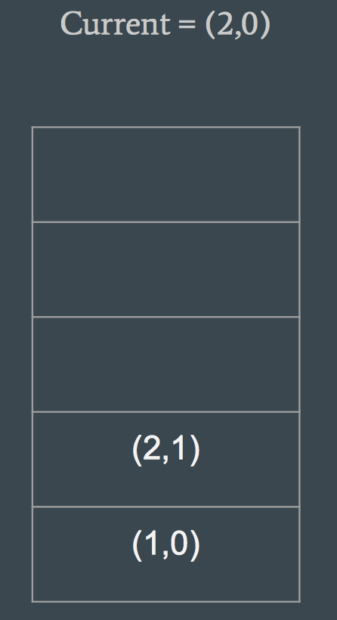
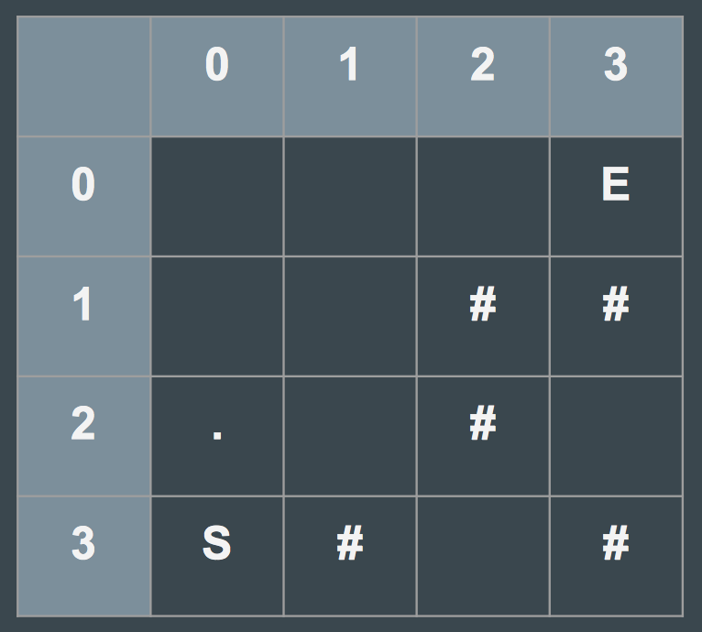
Maze solver algorithm- stack

Slide 17
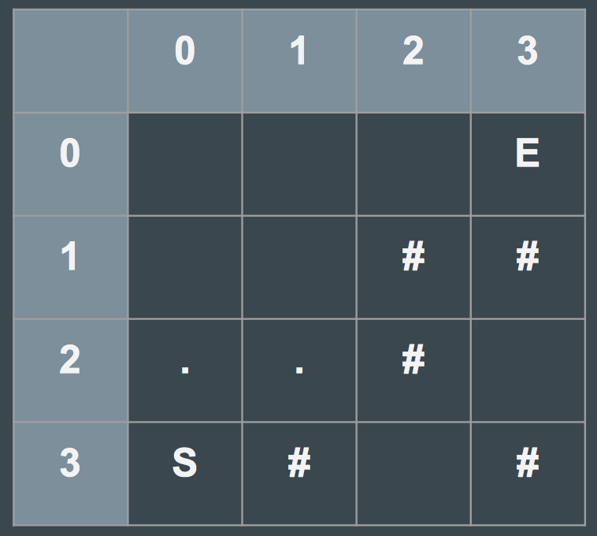
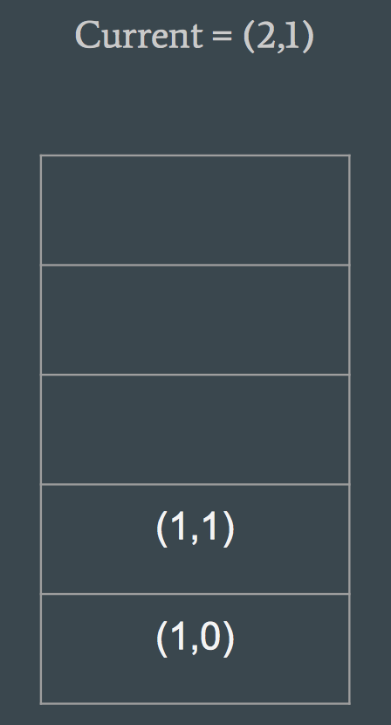
Maze solver algorithm- stack

Slide 18
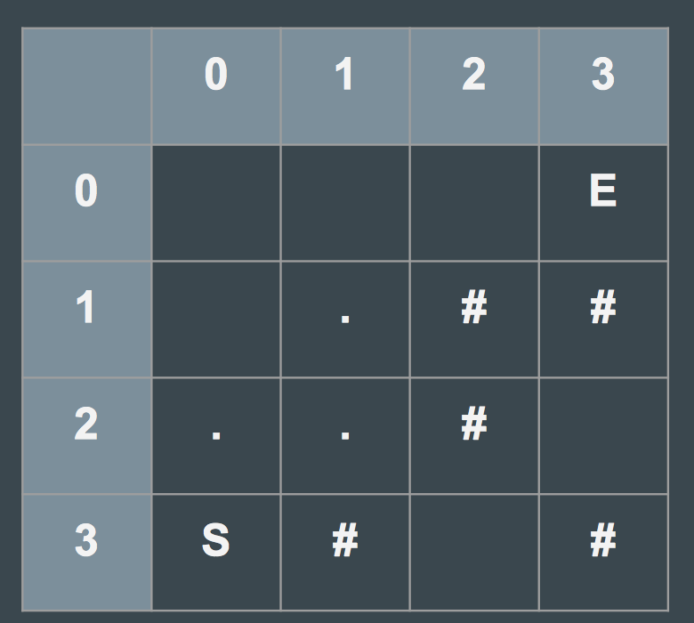
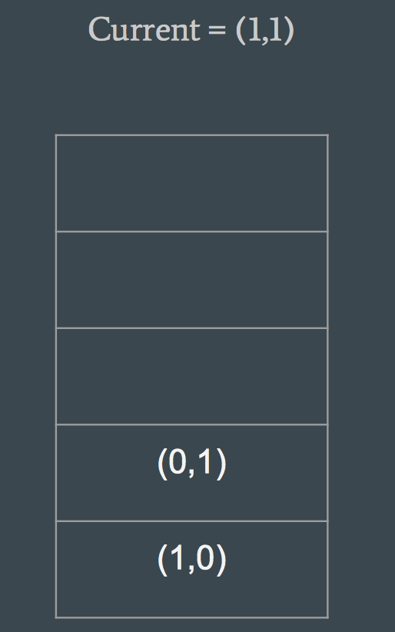
Maze solver algorithm- stack

Slide 19
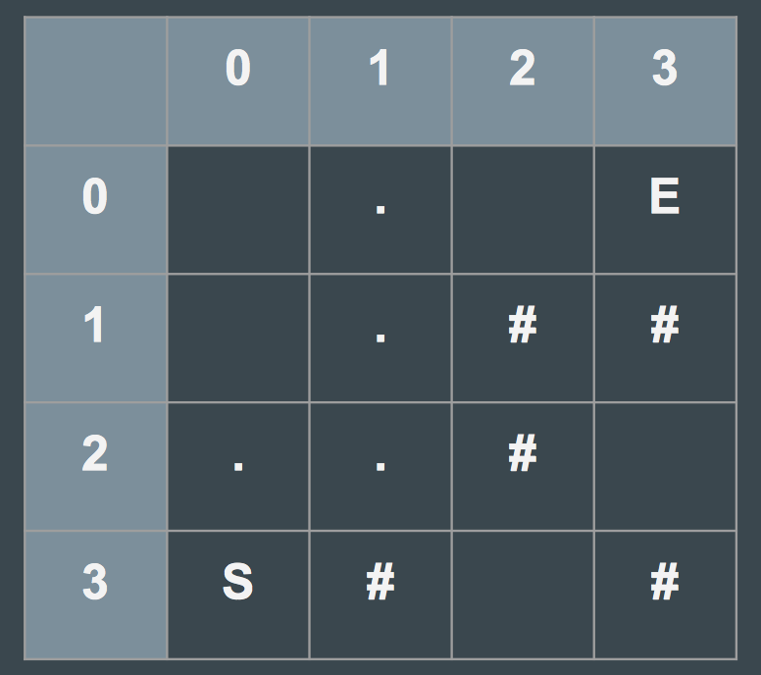
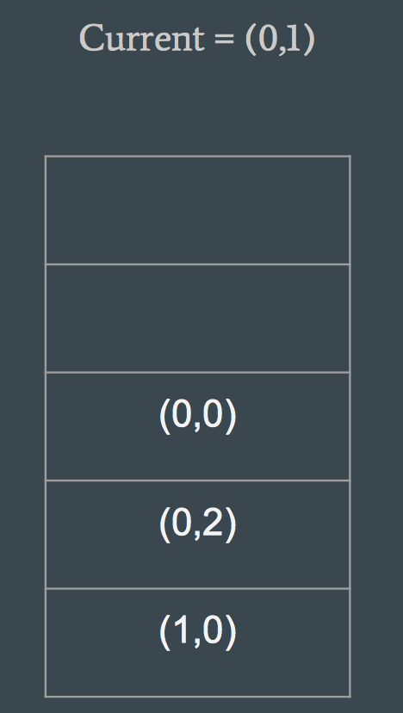
Maze solver algorithm- stack

Slide 20
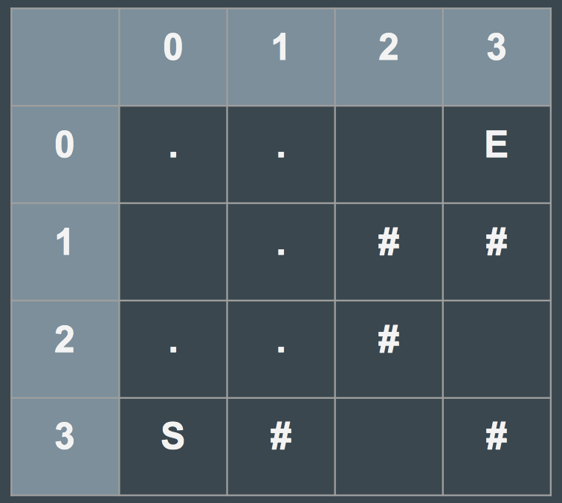
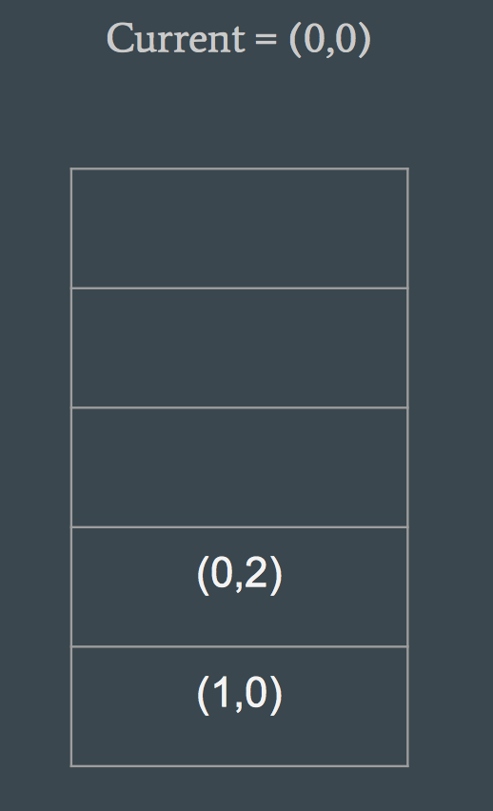
Maze solver algorithm- stack

Slide 21
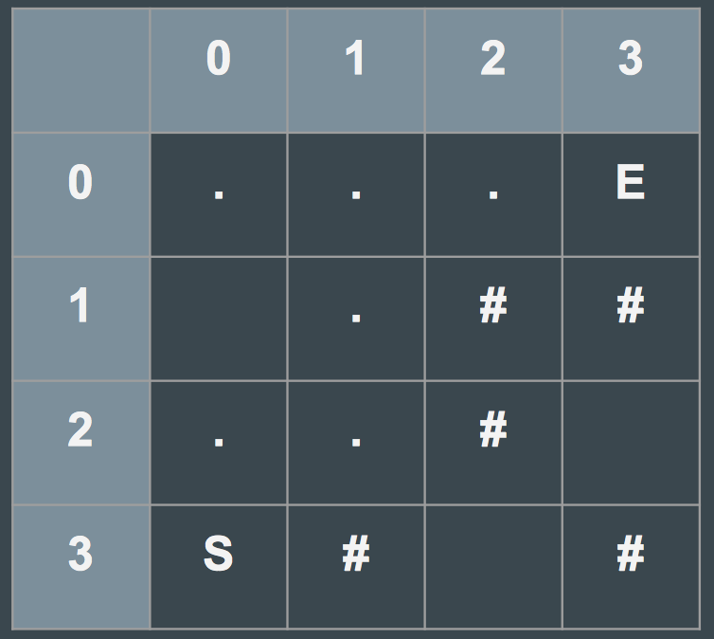
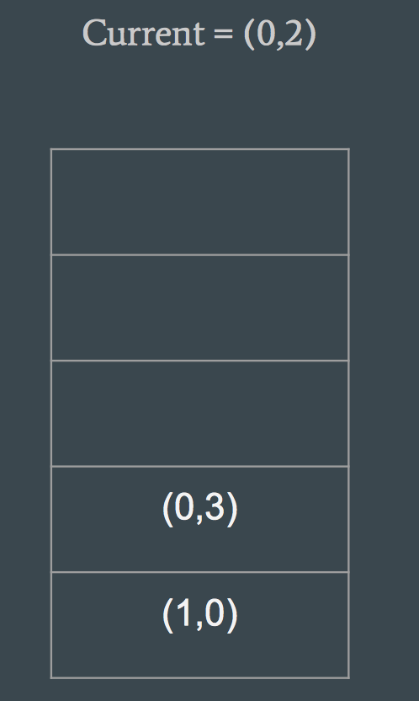
Maze solver algorithm- stack

Slide 22
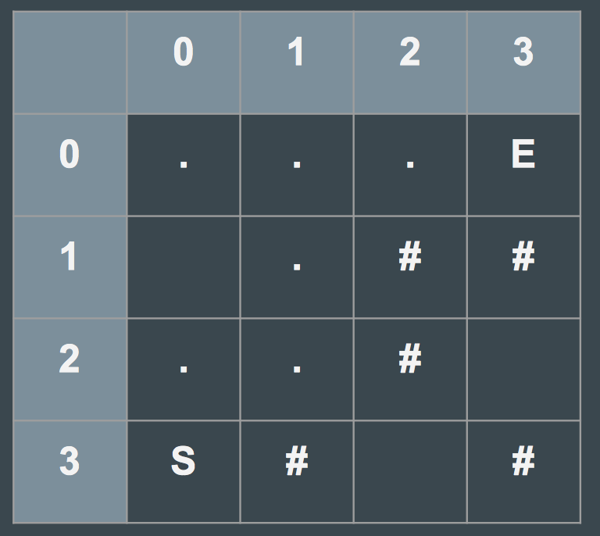
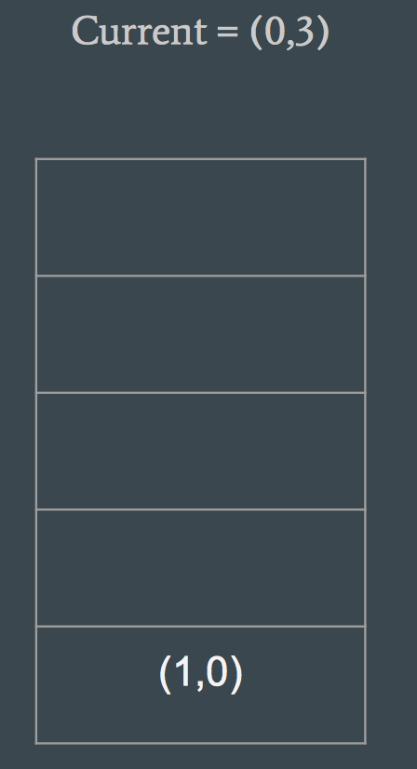
Maze solver algorithm- stack

Slide 23
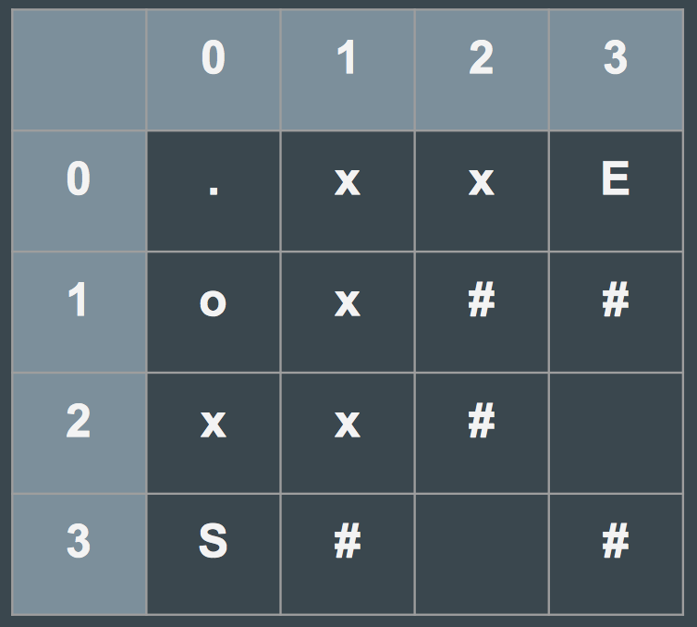
Maze solver algorithm- stack
Tracing Path:
Start from E and keep track of who added it to the worklist
This is where it is useful to have each Square keep track of a previous Square that added it to the worklist

Slide 24
An abstract class can have both abstract as well as non abstract methods
True
False

Slide 25
Maze solver
Create an abstract class MazeSolver that will implement the above algorithm, with a general worklist.
Its abstract methods will be implemented differently depending on whether the worklist is a stack or a queue.
You will also have non-abstract methods that implement the algorithm for solving the maze in the MazeSolver class.
MazeSolver (abstract)
MazeSolverStack
MazeSolverQueue

Slide 26
Interview/mid-term prep
Given an expression string, write a program to examine whether the pairs and the orders of “{“,”}”,”(“,”)”,”[“,”]” are correct in expression.
For example, the program should print true for exp = “[()]{}{[()()]()}” and false for exp = “[(])”.
What data structure do you think will be most useful?

Slide 27
Thank you!

