Slide 1

Lecture 1 Syllabus, Intro
Marina Langlois

Slide 2
Today’s plan
Course structure
Arrays for everything, why not?

Slide 3
About me
Marina Langlois: “Prof. Langlois”, “Marina”, “Prof. Marina”, “Dr. Langlois”
Research:
Theoretical CS (algorithms in AI)
Teaching:
CSE 8A, CSE 12, CSE 20, CSE 150
When I’m not working:
My family
Cross-stitching, Ping-Pong

Slide 4
My office hours
Are still uncertain.
Most likely right after lectures somewhere. I need to find a good place. My office is too far, since lectures are every other hours.
I will let you know.
Email me if you prefer some other time.

Slide 5
Your grade
5% iClickers
Participation only, not correctness
Answer at least 75% to get credit for that lecture
+6 misses are allowed
Do not click for your friend.
If your midterm is above 95%, I will drop 8 more classes.
5% reading quizzes (drop 3)
5% review quizzes (Monday, before class) (drop 3)
Next week it will be on Wed.
25% Midterm (1 exam, during the class)
30% Homework (~ 9 projects)
30% Final Exam

Slide 6
Have you used clickers before?
A: Yes
B: No
Please register your clicker via TED.
I will post your score on TED by to tonight. If you were in class but do not see your point, talk to me ASAP!!
You have 1 week to resolve any issues.

Slide 7
Textbook
ZyBooks.com, required.
Check the website on how to get it.
Reading assignments
Most reading quizzes (activities)
Not very expensive.
98% students recommended it.
If you drop the class within a month – money back.
Email the zybooks people, not me.

Slide 8
Reading quiz info
There always be a quiz unless otherwise specified in the schedule (always means MWF ☺).
Either book activity (zybooks). As many attempts as you want.
Quiz via quia.com (for this Wed, for example). You will have 3 attempts.
I usually post quizzes for the entire week.
Quizzes are open book and open notes, but must be done SOLO
Quizzes close at 9am on MFW.

Slide 9
Websites (a lot, I know)
Vocareum -> to submit your homework, gradebook
Zybooks -> reading assignments
Piazza -> Discussion Forum
TED -> Your participation grades
Quia -> For review and some reading quizzes
Gradescope -> for midterm exam.
PLEASE, PLEASE use your ucsd emails! Ted is very picky about it.
IF, only IF you do not have ucsd email, at the very least be consistent. This way, there is a higher chance that a tutor will not make a mistake uploading your grades.
If you did not use your ucsd for zybooks, then you can change it to ucsd. Please do so!

Slide 10
Monday review quizzes
Each Monday (except next one) you will have a short quiz on topics from the previous classes.
Drop 3 lowest
There serve as a checkpoint for your learning
If you don’t do well
Go to discussion to get your points back
Use tutors/TA and my office hours

Slide 11

Discussion Section
Discussion will be taught by our TA (Pooja or Max)
You can come to any discussion
If your review quiz score is low, you can get a full credit by coming.

Slide 12
Midterm, week 5
One midterm is worth 25% of your grade.
Date (Day): Let’s vote on that
A: Monday
B: Wednesday
C: Friday
D: Does not matter
Entire class period. Close books

Slide 13
Typical lecture flow
We will have a lot of iclicker questions based on your reading or on the material I present in class.
First, you vote solo (20-30 seconds)
Then we might have a group discussion (you talk to your 1-2 neighbors) and we vote again.
Make sure to vote even if your choice does not change to receive participation points.

Slide 14
Rules
Homework assignment: OK:
Discuss it with your classmates (general discussion)
Use the Java APIs
Work individually
Use tutors/TA help, post on Piazza etc
Use a “slip day”, worth a 24 hour extension
NO:
Using both “slip days” in one assignment
Late turn in. Start early, submit early. Do no wait until the last minute.
Looking at anyone else’s code, including Google.
Work in groups, with roommates or friends.

Slide 15
Re-grades
You have 7 days to request a re-grade. (Special piazza post after the grades are released).

Slide 16
Academic Integrity
You are working on your programming assignment for CSE 12, and you can’t remember how to get input from the user. You Google “Java user input” and find a few lines of code demonstrating how to use the Scanner class to get input from the user. You copy these lines of code to your program, and continue.
Is this allowed in CSE 12?
A. Yes
B. No

Slide 17
Academic Integrity
You are working on your programming assignment for CSE 12, and you can’t remember how to use Java’s LinkedList class. You Google and find a former CSE 12 student’s implementation of what you recognize to be the assignment you are working on. You look at this code, just to see how this student used the LinkedList class.
Is this allowed in CSE 12?
A. Yes
B. No

Slide 18
Academic Integrity: Rule of Thumb
Looking at/Googling for “generic”, API-level code is fine, and even encouraged.
Looking at (or copying) code that has anything at all to do with the assignment you are working on is not OK, even if it’s easy to find.

Slide 19
Class website
https://sites.google.com/a/eng.ucsd.edu/cse12-winter-2017

Slide 20
Podcast issues
No podcast is available for Mandeville B-210. Use the one from 10am class.

Slide 21
Why not just an array?

Slide 22
What are Data Structures?
Data structures are ways in which data is arranged (stored) in computer’s memory
Array
Variable
Linked lists
Are NOT data structures
Stacks
Hash tables
Binary Trees
….

Slide 23
Question
Why can't I just use arrays and for loops to handle my data?
Data Structure is a particular way of storing and organizing data in a computer so that it can be used efficiently (more on this later)
10 weeks of it actually ;)

Slide 24
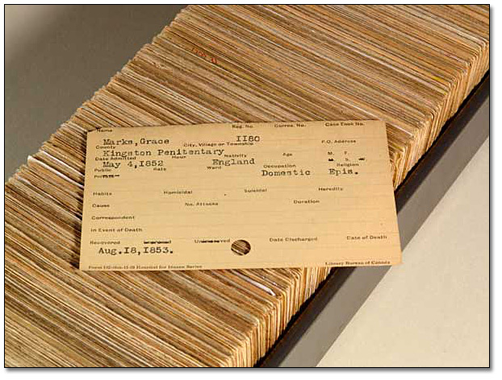
Library Database Era without Computers
What did we use before?

Slide 25
Library Hired You
How would you store the data in your computer’s memory?
Would your method work for a hundred file cards? A thousand? A million?
Would your method permit quick insertion of new cards and deletion of old ones?
What happens more often?
Would it allow for fast searching for a specified card?
Suppose you wanted to arrange the cards in alphabetical order. How would you sort them?

Slide 26
Unordered Array (not ArrayList)
Assume you know how many elements are in your array.
What are the advantages of the array?:
A: Quick insertion (assume the size is large enough)
B: Fast access if index is known.
C: Fast search
D: Fast deletion (includes search)
E: More than one

Slide 27
Unordered Array
Assume you know how many elements are in your array.
What are the advantages of the array?:
A: Quick insertion (assume the size is large enough)
B: Fast access if index is known.
C: Fast search
D: Fast deletion (includes search)
E: More than one

Slide 28
Unordered Array
Assume you know how many elements are in your array.
What are the disadvantages of the array?
A: Fixed size
B: Fast access if index is known.
C: Slow search
D: Slow deletion (includes search)
E: More than one/Other

Slide 29
Unordered Array
Assume you know how many elements are in your array.
What are the disadvantages of the array?:
A: Fixed size
B: Fast access if index is known.
C: Slow search
D: Slow deletion (includes search)
E: More than one/Other

Slide 30
Delete without search
In Unordered array.
Assume you know how many elements are in your array.
A: Fast
B: Slow
C: It depends

Slide 31
Ordered (Sorted) Array
Advantages?:
A: Deletion
B: Fixed size
C: Insertion
D: Search
E: Other/more than one

Slide 32
Ordered (Sorted) Array
Advantages?:
A: Deletion
B: Fixed size
C: Insertion
D: Search
E: Other/more than one

Slide 33
Ordered (Sorted) Array
Disadvantages?:
A: Deletion
B: Fixed size
C: Insertion
D: Fast access if index is known.
E: Other/more than one

Slide 34
Ordered (Sorted) Array
Disadvantages?:
A: Deletion
B: Fixed size
C: Insertion
D: Fast access if index is known.
E: Other/more than one

Slide 35
When deal with Data
Need to know how and how long will it take to:
Insert new item
Delete new item
Access an item
Search for an item
Iterate through items
Sort

Slide 36
After we are done with the class
By the end of this course, you will hopefully ☺ know:
What data structures are.
Why selecting the right data structure is important.
When to use a particular type of data structure.
How the most common data structures are implemented in code and in memory.
How object-orientation can facilitate good program design.

Slide 37
Homework assignment #1
In your first programming project you will
Sign CSE 12 Integrity of Scholarship Agreement
Complete a short survey via quia.com
Create a small Java Program: Tic-Tac-Toe
Create simple documentation using JavaDoc
Create a few JUnit tests
Answer 25 True/False questions about Java
It will be out today, the deadline is January 15th, 11:59pm
I will send you an email when I post it on TED.

