Slide 1
Lecture 2
JUnit tester
Abstraction
Interface

Slide 2
iClicker issues
I will transfer the grades right away to TED, so that you can check it right after class.
If the issue is resolved, great.
If not and you have time, please stay.

Slide 3
Homework assignment #1
In your first programming project you will
Sign CSE 12 Integrity of Scholarship Agreement
Complete a short survey via qiaa.com
Create a small Java Program: Tic-Tac-Toe
Create simple documentation using JavaDoc
Create a few JUnit tests
Answer 25 True/False questions about Java
The deadline is Jan 15th, 11:59pm (Sun).

Slide 4
When deal with Data
Need to know how and how long will it take to:
Insert new item
Delete new item
Access an item
Search for an item
Iterate through items
Sort

Slide 5

Plan for today
Java Warm-up questions
JUnit Testing
Abstraction
Interface

Slide 6

Java warm-up

Slide 7
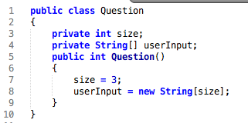
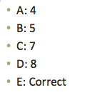
Is there a problem? B

Slide 8
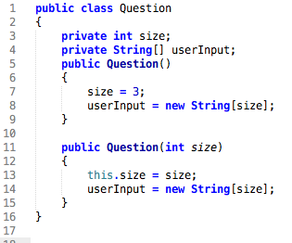
Java warm-up

Slide 9
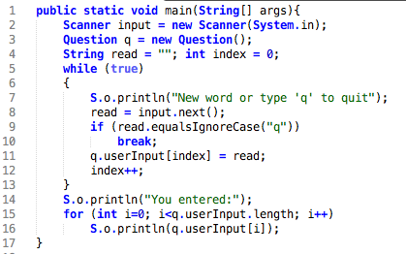
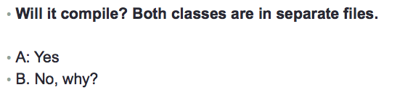
Ans: B

Slide 10

Ans: B

Slide 11

Ans: A

Slide 12
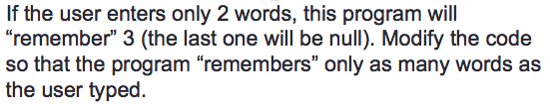

Slide 13
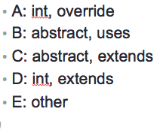
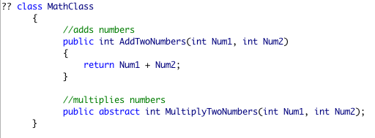
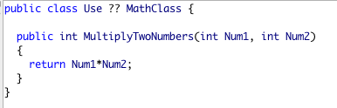
What is missing? Ans: C

Slide 14
What of the following is true
About an abstract class?
A: An abstract class can have abstract method without body and it can have methods with implementation.
B: An abstract class can not be instantiated.
C: Is used to provide common method implementation to all the subclasses or to provide default implementation.
D: All the above
E: I’ve never seen it before (if that’s the case, read about it)

Slide 15

Software testing. JUnit

Slide 16
Testing
Black-box Testing
You don’t know (or you pretend you don’t know) how something is implemented
You test only based on inputs and outputs
Clear-box Testing
(Also known as “white-box testing”)
If you can look inside the black box and see how a method is implemented, you can do more detailed testing

Slide 17
Unit (micro)-testing
Whether you are doing black-box or clear-box testing, you should test every unit of a software system
What is a unit? In object-oriented programming, usually a software unit is taken to be a single method
So: we should test every method of every class in the software
JUnit is a widely used framework for unit testing of Java software.

Slide 18
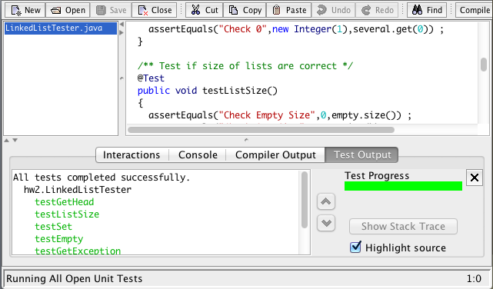
JUnit testing in Dr. Java

Slide 19
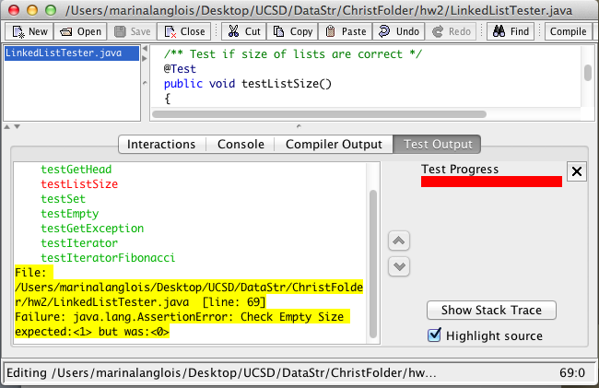
When a test is failed

Slide 20
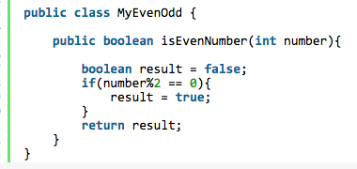
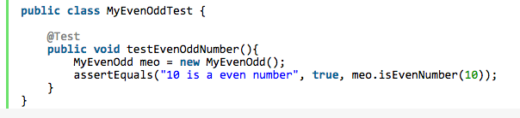
Sample test
assertEquals(String message, Object expected, Object actual): Asserts that two objects are equal.

Slide 21
More on JUnit
But you might want to just write the assert statements and reuse the test data you created
Use fixtures: Unit invokes this method before every testXXX method. The @Before tag tells JUnit to run this method before each test.
@Before
public void setup()
{
// Add your data initialization code here
}

Slide 22
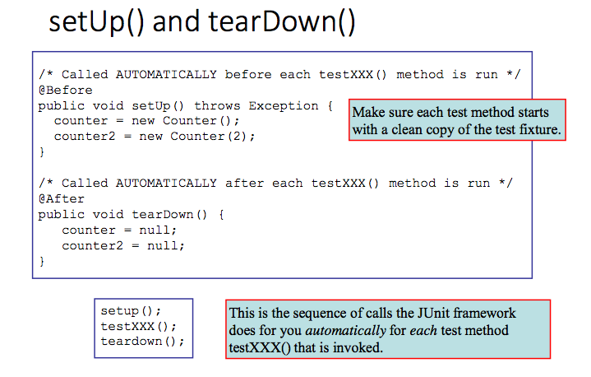

Slide 23
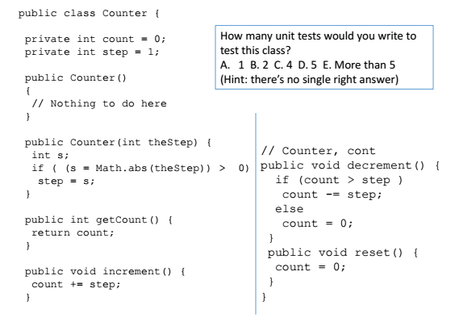
Ans: D or E

Slide 24
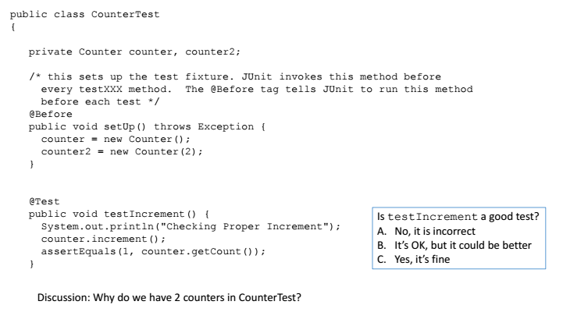


ANS: B

Slide 25

Do not confuse the two
Abstract Data Type vs Data Structure

Slide 26
Data Types vs Data Structures
Abstract Data type: is a mathematical model of the data objects that make up a data type as well as the functions that operate on these objects
Stack, Queue, List, Priority Queue, Heap, Binary Tree, Set, Map..
Data structure: a physical implementation of an abstract data type.

Slide 27
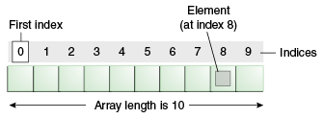
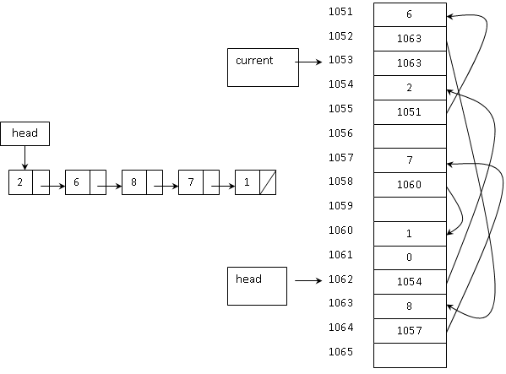
Data Structures
There are two fundamental kinds of data structures:
array of contiguous memory locations
linked structures.
You can even combine the two mechanisms.

Slide 28
Implementing Data Types with Data Structures
You can generally implement:
stacks and queues with singly-linked lists
lists and deques with doubly-linked lists
Trees and priority queues with arrays
etc.
You can have a data type called Stack, but data structures called LinkedStack, ArrayStack, etc.

Slide 29
Abstraction to hide details
Key idea in designing code

Slide 30
Abstraction
Abstraction:
Hiding irrelevant details to focus on the main features needed to understand and use a thing.
Abstraction is an essential tool for managing complexity
Designing, implementing, and using complex systems would be impossible without abstraction

Slide 31
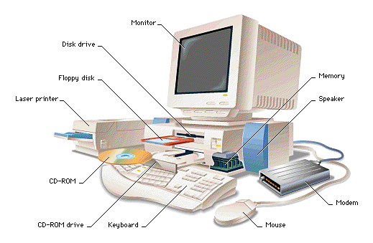
Abstraction example: computer

Slide 32
Could you think of
An example(s) of abstraction that you have experienced in CSE 8B/11?

Slide 33
Abstraction Example Implementers and Users
Users: We can use ADT and we do not care how it works!
Implementers: We can implement the ADT however we want!
I rely on the abstract idea of computer.
For that idea to work, a computer needs to have a
specific implementation.

Slide 34
ADTs
The details of how the methods are implemented are generally not visible to the “user”.
The “user” is the programmer who wants to use the ADT to manage his/her data.
The “user” doesn’t necessarily care how the ADT is implemented, as long as the methods work according to the interface specification.
This allows flexibility in the implementation of the ADT.

Slide 35
ADTs are language-neutral
In CSE 12 we will concentrate on implementing ADT’s in Java
And we will consider many features of Java that are useful for implementing ADT’s
But always keep in mind that the basic principles of ADT design and analysis are language-neutral!
APIs (Abstract Programming Interface) are like ADTs, but specify the interface in a particular language
Users and implementers still do things as they please, but both within a common language

Slide 36
ADTs and APIs
Which of the following would be elements of ADT specification, and which would be elements of an API?
int GetValueAtIndex (int index) throws IndexOutOfBounds exception.
Get operation: given an index, returns the value at that index.
A: I is part of an API and II is part of an ADT
B: II is part of an API and I is part of an ADT
C: Both I and II could be part if an API or ADT
D: Other

Slide 37
Let’s make things concrete: Lists
Sometimes you need to manage a collection of variables:
Students
Customers
List of programs currently running
The first approach is…just to use an array:
Student[ ] cse12students = new Student[50];

Slide 38
Problems
What if the number of students is not known ahead of time?
Possible solution? Possible problems with it?

Slide 39
Array idea, cont
Ok, start out with a small array, and make it bigger when it’s full.
But it’s annoying for the programmer to have to keep “enlarging the array”.
What we want is an object that manages the array for us.
We don’t really care how it’s done, as long as it works
We’re not concerned with the details.

Slide 40
What we want
We can add a particular element to the list.
The data structure should automatically “grow” itself as needed in an “efficient” manner (much more later). Time cost
It should not use memory wastefully. Space cost
We can retrieve a particular element specified by index i.
We can remove a particular element specified by index i.

Slide 41
List specification
A description of methods…
What the methods do
What parameters they take
What they return
What exceptions they might throw.
..is known as an interface.
An interface in Java contains:
No instance variables
No method bodies

Slide 42
List interface
interface List {
// Adds the specified element to the end of the list.
void add (Object element);
// Returns the element contained in the list at index..
Object get (int i) throws NoSuchElementException;
// Removes the element contained in the list at index
void remove (int i) throws NoSuchElementException;
}

Slide 43
Using a List interface
List myList = new List();
Will it compile?
A: Yes, we create a new object here, of type List
B: No, Java does not know how it works…

Slide 44
Using a List interface
The List is an abstraction – we can’t create List objects by writing:
List myList = new List(); // Will not compile ☹
Reason: List is just a description of what a list should do – not how it would actually work.
What to do next?

Slide 45
Implementing the List interface
In order to create an instance of List, you must first create a (concrete) class that implements the (abstract) List interface.
What does this mean?
It means that we must implement the body of every method defined in the interface.
Except when might we skip a method or two?

Slide 46
Implementing the List interface
class ListImpl implements List { Tell the compiler explicitly that ListImpl implements the List interface .
private Object[] array;
private int numElements;
void add (Object element) {
...
array[numElements++] = element;
}
Object get (int i) throws NoSuchElementException {
...
}
void remove (int i) throws NoSuchElementException {
...
}
}

Slide 47
Creating a List
Now that we (hypothetically) have a ListImpl implementation of List, we can create a List object:
List myList = new ListImpl(); //This is OK!
myList.add(new Student (“Robert”, 24));
…

Slide 48
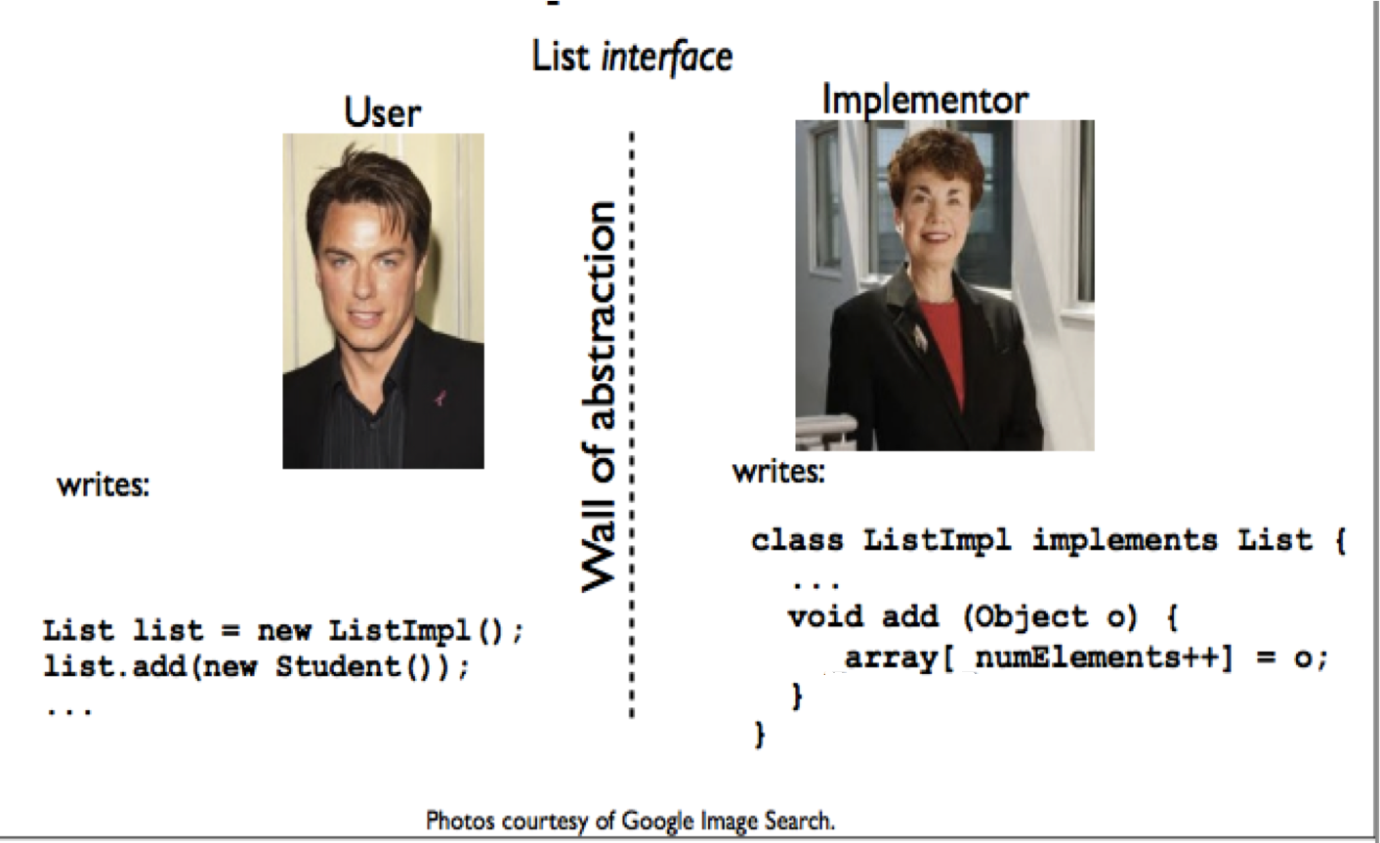
Separation is important!

Slide 49
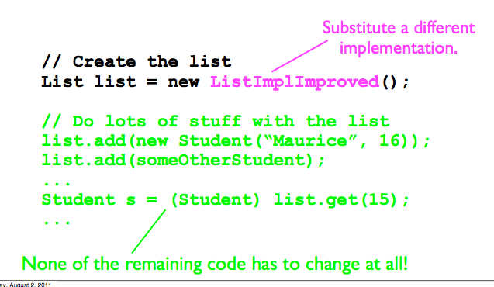
Separation
Programming an application that uses objects of an interface type is more flexible.
If a new, better implementation comes out, you can switch by changing one line of code.

Slide 50
Abstract class vs. Interface
Could you name the differences?

Slide 51
Abstract class vs. Interface
Interface is NOT a class. Implementing an interface consumes very little CPU.
Abstract classes, unlike interfaces, are classes.
Abstract classes can have constants, members, method stubs (methods without a body) and defined methods, whereas interfaces can only have constants and methods stubs.
Methods and members of an abstract class can be defined with any visibility, whereas all methods of an interface must be defined as public (they are defined public by default).
A child class can only extend a single class (abstract or concrete), whereas an interface can extend or a class can implement multiple other interfaces.

