Slide 1
Lecture 3

Slide 2
Today topics
1. Generics, part1.
2. Java Collections

Slide 3
Implementing a List ADT.

Slide 4
List implementations
Let’s finally talk about how to implement a List with the three methods add, get, and remove. We will talk only about add method.
We will cover two kinds of list implementations:
Array lists.
Linked lists.

Slide 5
ArrayLists, method add
What needs to be checked before you add an item?
If it gets full, what do you do?

Slide 6
Enlarging an array
Q: What does it mean?
A: Make the original array larger.
B: Create another array, copy data, make it larger
C: Create another (larger) array, copy data.
D: Other.

Slide 7
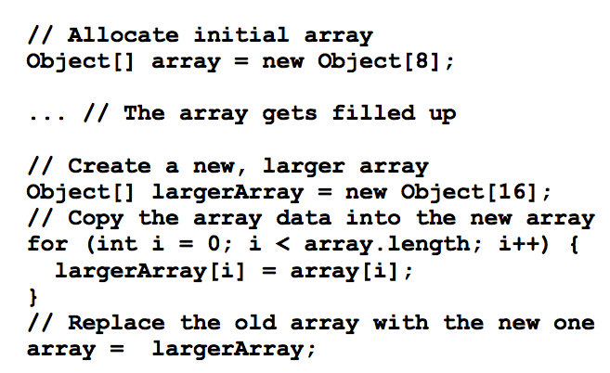
Enlarging an array

Slide 8
Enlarging an array
Q: Where would you implement the resizing?
A: In a List ADT once and for all.
B: The User side
C: Does not matter where
D: Other

Slide 9
Enlarging the array: implementation issues
When should we resize the array?
How do we keep track of how full the current array is?
By how much should we enlarge the array?

Slide 10
Generics. motivation

Slide 11
Quick question
What do you know about generics?
A: Everything! I’m a pro ☺
B: I’ve heard of it, but did not really used it.
C: huh?

Slide 12
Old Way
You have worked with ArrayList - a “collection”
public void add (Object o);
public Object get (int index);
Every object in Java is of type Object; hence, these collections can store variables of any type.
ArrayList listOfStrings = new ArrayList();
listOfStrings.add(“yo”);
ArrayList listOfIntegers = new ArrayList();
listOfIntegers.add(new Integer(32));

Slide 13
Downside of downcasting
Unfortunately, the fact that the List interface takes and returns Objects also means that we have to downcast the Object every time we call get(index):
listOfStrings.add(“hello”);
String s = (String) listOfStrings.get(0);
Having to downcast every time is both tedious and distracting because it litters the code with parentheses and class names
Easy to introduce errors.

Slide 14
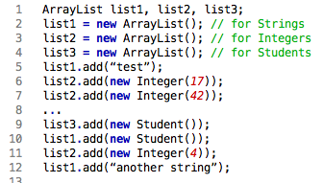
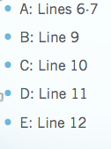
Downside of downcasting. A: C

Slide 15
Downside of downcasting
If we later retrieve an Object from list1 and assume (incorrectly) that it contains only Strings, our program will crash:
String s = (String) list1.get(1); Given the code on previous slide, this will trigger a ClassCastException.
It is still nice that the JVM catches our mistake at run-time, but it would be even nicer for the Java compiler to catch our mistake at compile-time.

Slide 16
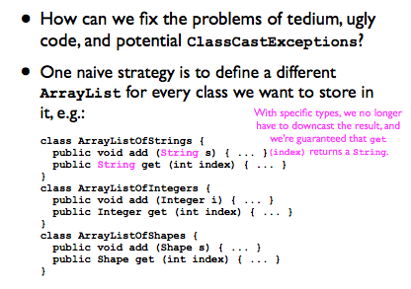
Naïve fix

Slide 17
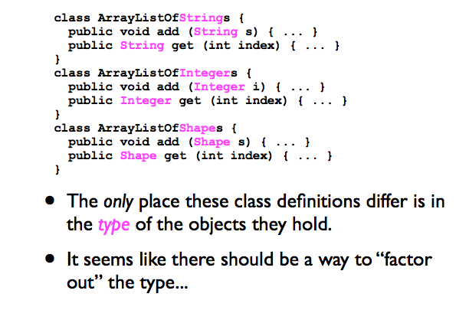
Better fix: “factor out” the type

Slide 18
Java Generics. Part 1.

Slide 19
Java Generics
Since Java 1.5, Java has offered the ability to parameterize a class by a type.
For example, when writing a “collection” class such as ArrayList, we can give it a type parameter T, or element E.
Type parameters are typically given one-letter names:
K for “key”, V for “value”, E for “element, etc.

Slide 20
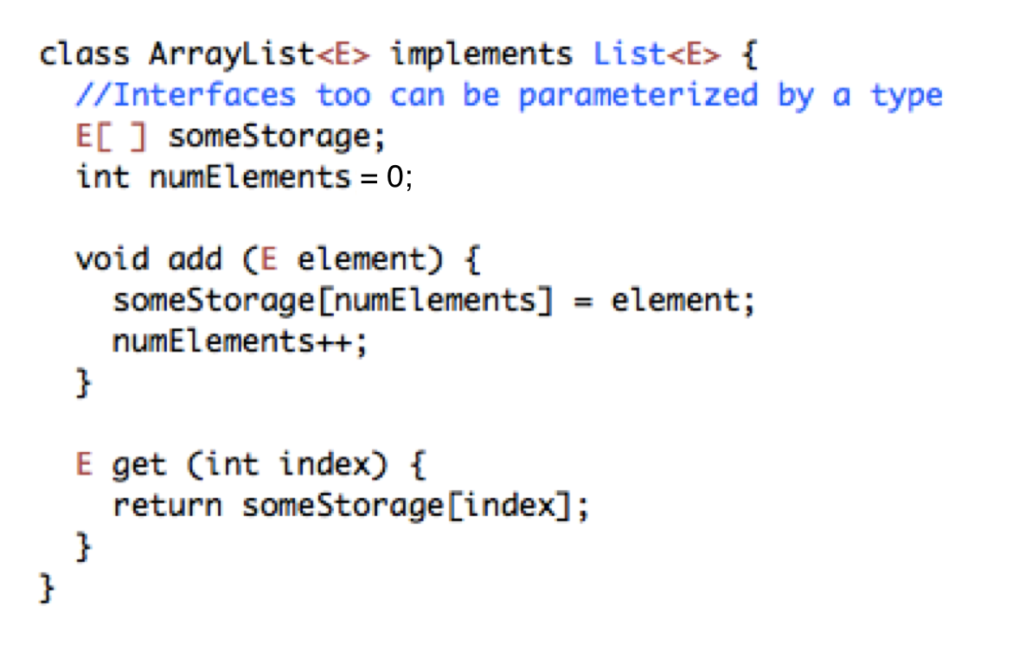
Generics for “ArrayListOfX”

Slide 21
Generics for “ListOfX”
Similarly to classes, interfaces too can be parameterized by a type:
interface List<E> {
void add (E element);
E get (int index);
void remove (int index);
}

Slide 22
Example
For example, the following statement creates a list for strings:
ArrayList<String> list = new ArrayList<String>();
You can now add only strings into the list. For instance,
list.add("Red");
list.add(new Integer(1)); // this is NOT ok

Slide 23
Generic types
Generic types must be reference types. You cannot replace a generic type with a primitive type such as int, double, or char.
For example, the following statement is wrong:
ArrayList<int> intList = new ArrayList<int>();
To create an ArrayList object for int values, you have to use:
ArrayList<Integer> intList = new ArrayList<Integer>();
You can add an int value to intList. For example,
intList.add(5);
Java automatically wraps 5 into new Integer(5). This is called autoboxing.

Slide 24
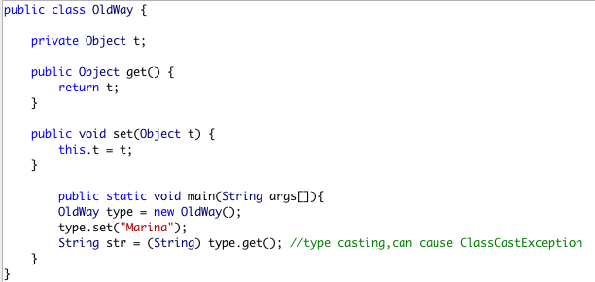

Slide 25
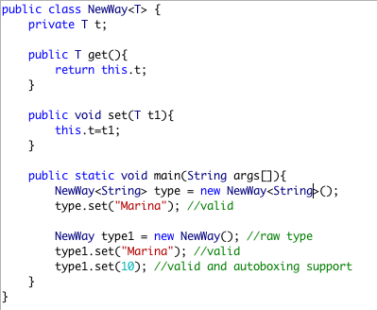

Slide 26
Raw type
If we don’t provide the type at the time of creation, compiler will produce a warning that
“NewWay is a raw type. References to generic type NewWay<T> should be parameterized”.
When we don’t provide type, the type becomes Object and hence it’s allowing both String and Integer objects.
We should always try to avoid this because we will have to use type casting while working on raw type that can produce runtime errors.
Done for a backward compatibility.

Slide 27
Diamond operator <>, idea
Before JDK 7:
Explicitly specifying generic class's instantiation parameter type.
ArrayList<String> list = new ArrayList<String>();
After JDK 7:
ArrayList<String> list = new ArrayList<>();
//interesting discussion on stackoverflow about it.

Slide 28
Exceptions

Slide 29
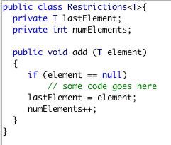
Handling bad input
What code could I add if I want to prevent null elements from being added to this class?
A: throw new NullPointerException();
B: return -1;
C: Either A or B
D: None of the above

Slide 30
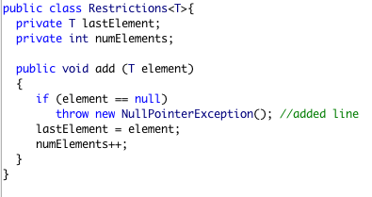
Exceptions
Will this code compile even though it does not declare the NullPointerException being thrown?
A: Yes (why?)
B: No (why not?)

Slide 31
“Unchecked” exceptions
There is a class of exceptions that I do not need to declare. We just can throw them
We also do not need to handle them explicitly with catch/try block
If you declare them, it is also OK.
Reason: these exceptions are very common
(show the example of the checked exception, eclipse)

Slide 32
Java collections

Slide 33
Collection
What is a collection in real life?
Collection of similar objects
A data structure (abuse of notation) is a collection of data organized in some fashion. The structure not only stores data but also supports operations for accessing and manipulating the data.
The Collection interface defines the common operations for lists, vectors, stacks, queues, priority queues, and sets.

Slide 34
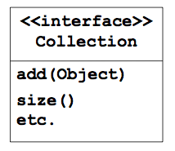
Collections
Fundamentally, what we as programmers do with data is to store it and retrieve it and then operate on it.
A collection is an ADT that contains data elements, and provides operations on them.
There are different ways that elements can be collected:
Set, List, Sorted List…
All collections implement the interface Collection

Slide 35
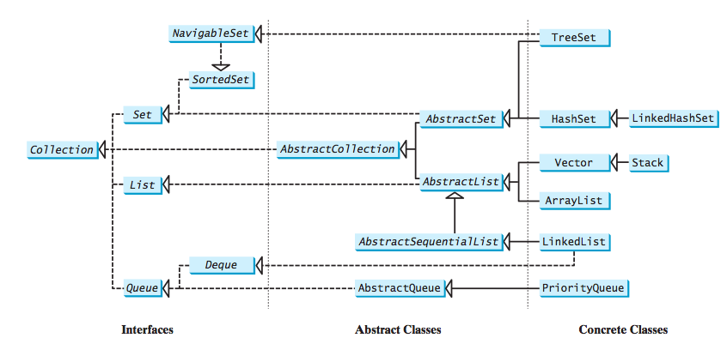
A collection is a container that stores objects.

Slide 36
public interface Collection<E> extends Iterable<E>
What does the <E> mean in the above code?
A: That this collection can only be used with objects of a built-in Java type called E
B: That an object that implements collection can be instantiated to work with any object type
C: That a single collection can hold objects of different types.

