Slide 1
Lecture 4-5. Linked Lists
Marina Langlois
Some slides were borrowed from Prof. Alvarado.

Slide 2
Quick check
Did you have a chance to read through hw2?
A: Yes. I’m speech-less.
B: Yes. I still can talk ☺
C: Not yet but going to read it today
D: Not yet, I have time to start. You gave us 10 days.
E: Not yet, a few days will be enough, I’m a good programmer.

Slide 3
Plan for today
1. Understanding a starter code
2. Memory model(quick review)
3. Linked Lists

Slide 4
Implementation of the List interface with a LinkedList
public class MySinglyLL<E> implements List<E>
the implementation the ADT

Slide 5
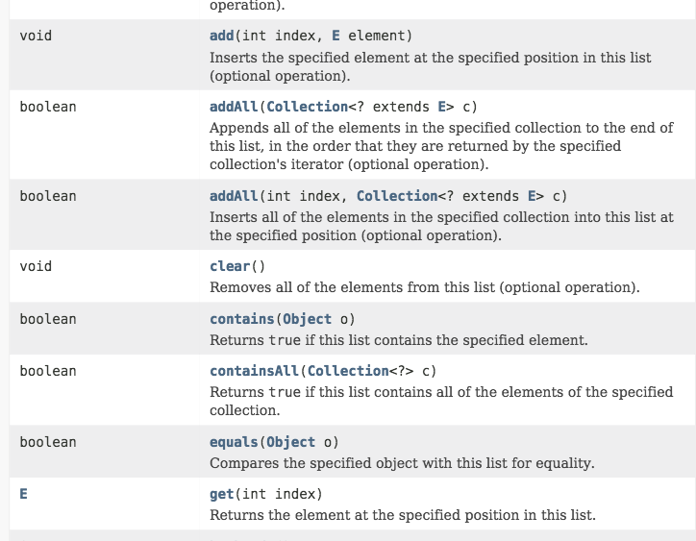
List interface is long

Slide 6
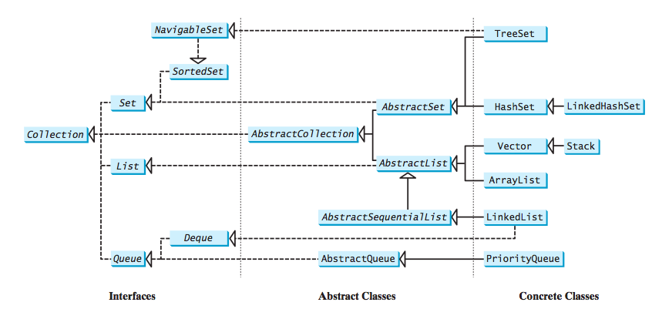
A collection is a container that stores objects.

Slide 7
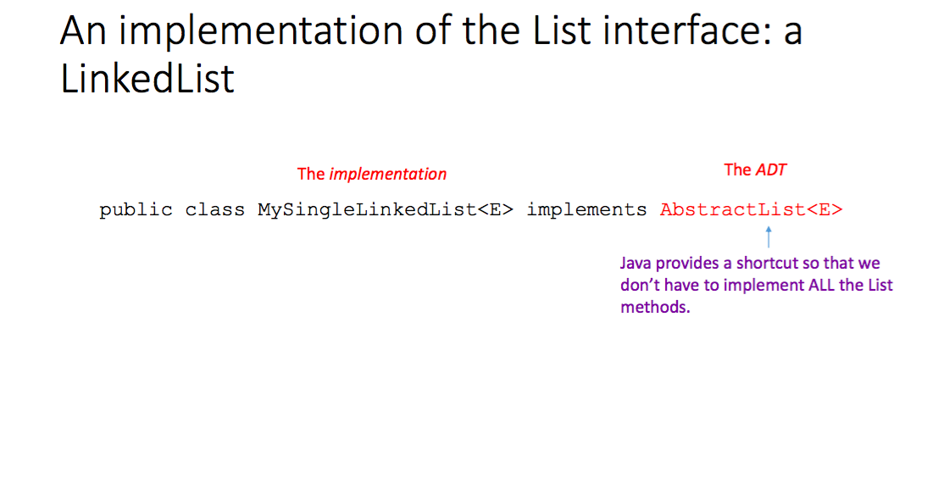

Slide 8
Abstract List
public class MySingleLinkedList<E> implements List<E>
public class MySingleLinkedList<E> extends AbstractList<E>
AbstractList provides implementations for most methods in List interface.
We can override its methods with our own.

Slide 9
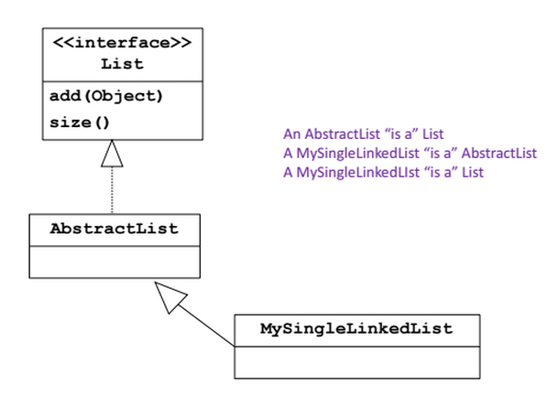
UML Model (Unified Modeling Language)

Slide 10
Memory model

Slide 11
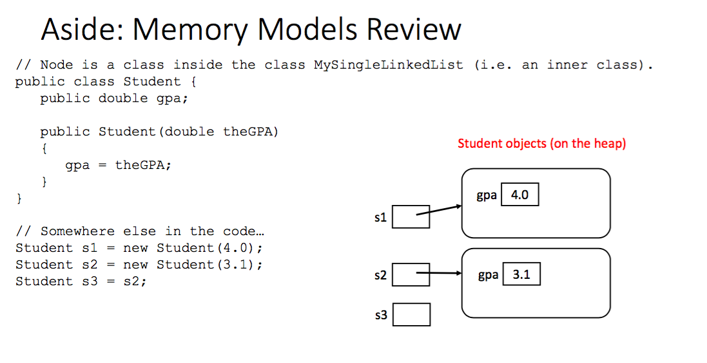

Slide 12
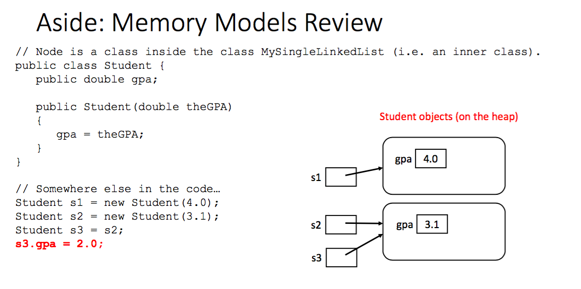

Slide 13

Today’s Lecture

Slide 14
ArrayLists vs LinkedLists
Problems with ArrayLists:
Wasteful in memory
It does not solve the contiguity problem (fragmentation)
Adding/Removing elements to the front requires shifting the whole array. (Not efficient)
Linked Lists solve these problems.
but introduce other problems ☺

Slide 15
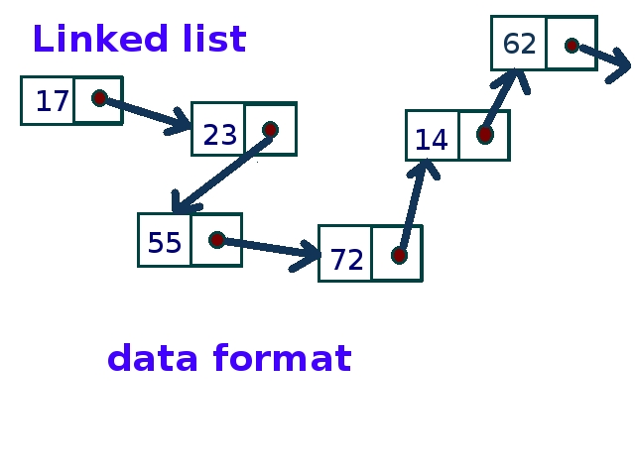
Nodes and Lists
A different way of implementing a List interface
Each element of a Linked List is a separate Node object.
Each Node tracks a single piece of data plus a reference (pointer) to the next node.
Create a new Node every time we add something to the List
Remove nodes when item is removed from list and allow garbage collector to reclaim that memory

Slide 16
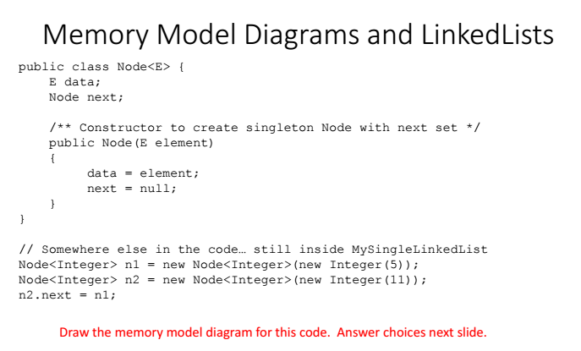
Draw a memory diagram

Slide 17
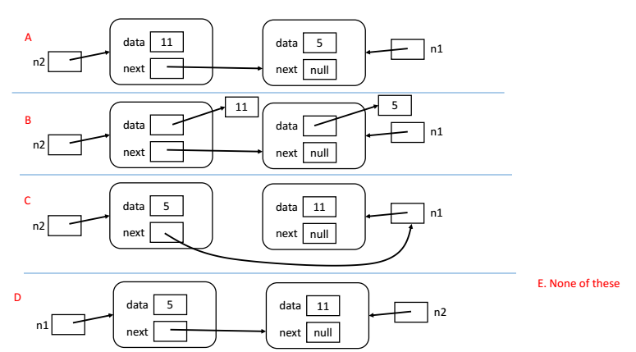
Ans: B

Slide 18
Class Node
Node class is a part of Linked List implementation
The (typical) Node contains:
A reference to the next node in the list
A reference to the data stored at that position in the list
For DoublyLinked List (HW2) a reference to the previous node
The Linked List itself contains a reference to the FIRST node in the list (head, first). Sometimes it might store some info about the list (like list size).
Sometimes it also stores a reference to the last node (tail, last).

Slide 19
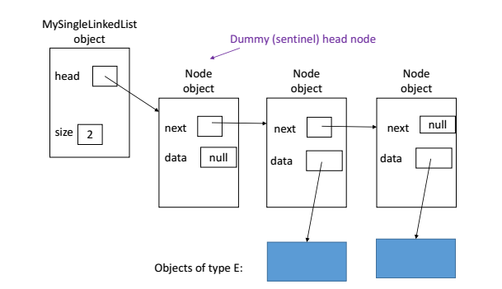
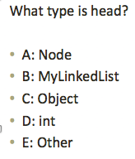
Dummy node: Picture. Ans: A

Slide 20
Lists with sentinel (dummy) node
Dummy nodes are Nodes whose data fields are always null – they contain no data from the “user”.
The dummy nodes will always exist, even if the user hasn’t added any data yet.
These nodes will simplify the implementation.

Slide 21
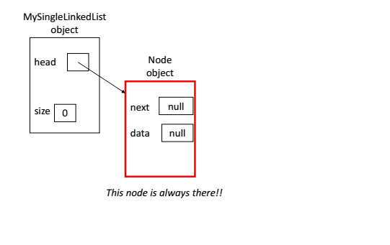
Empty list with sentinel node

Slide 22
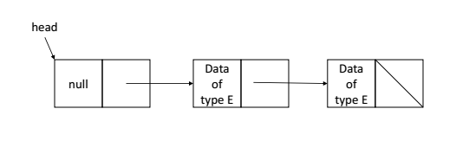
Quick check
Does this list have a dummy (sentinel) node?
A: Yes
B: No.
C: What is a dummy node?

Slide 23
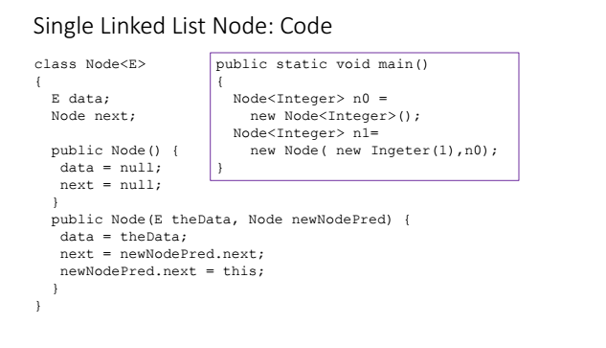
Class Node

Slide 24
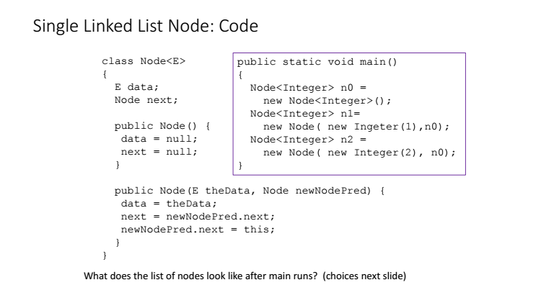
Do it yourself

Slide 25
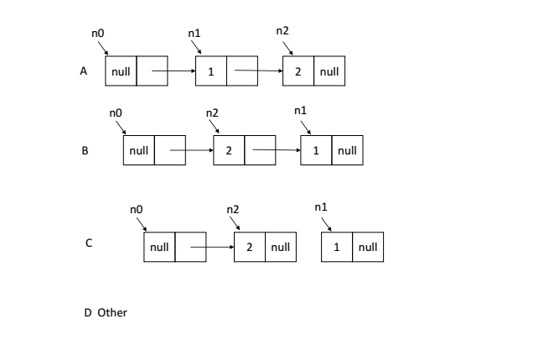
Ans: B

Slide 26
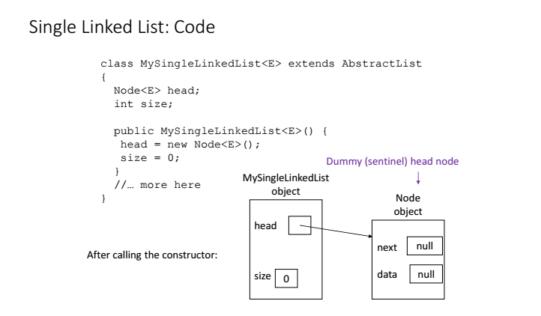
What do we have after the constructor call?

Slide 27
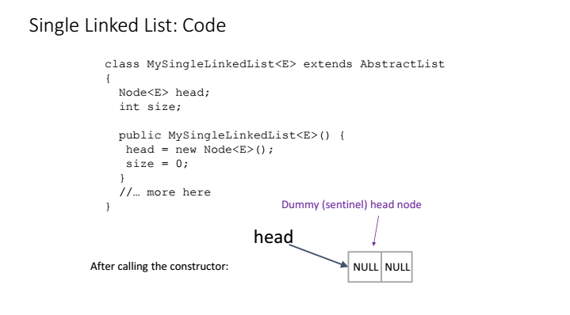

Slide 28
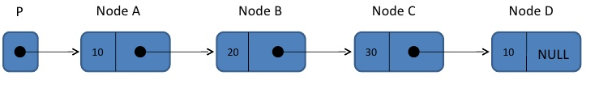
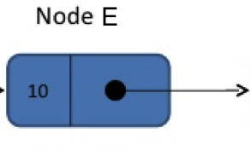
Add Front: NodeE,
A: P = NodeE;
B: NodeE.next = NodeA;
C: P = NodeE;
NodeE.next = P;
D: NodeE.next = P;
E: NodeE.next = P;
P = NodeE;

Slide 29
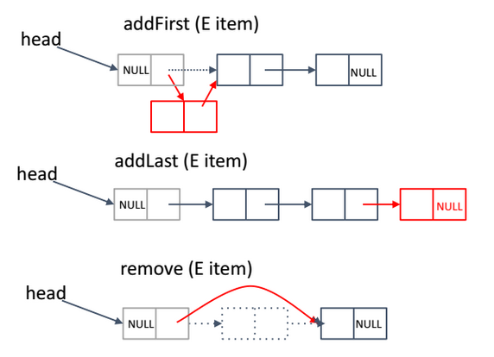
A few methods

Slide 30
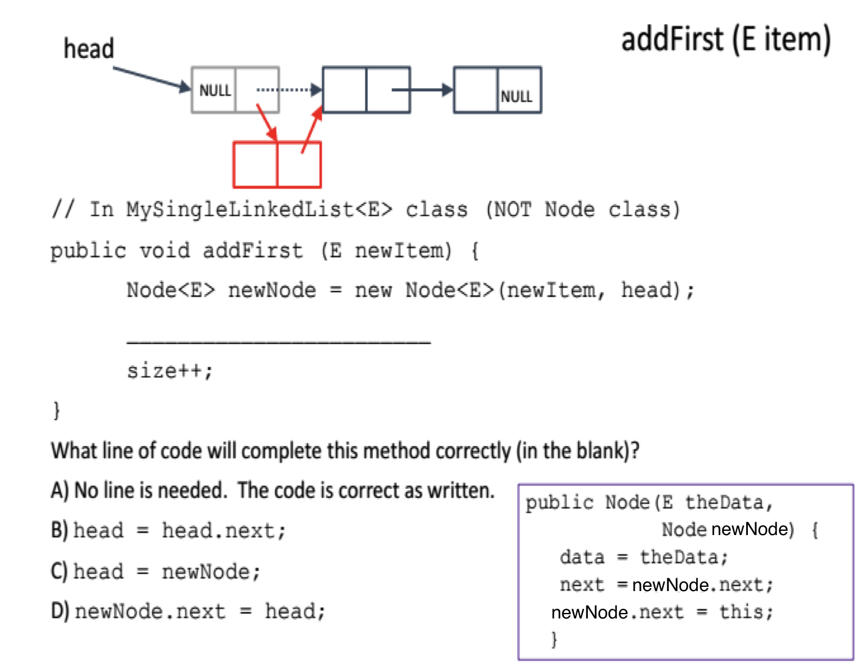
Ans: A

Slide 31
Add to the back: NodeE
A: NodeD.next = NodeE;
B: need to loop through the list to get to node D.
then NodeD.next = NodeE;
C: NodeC.next.next = NodeE;
D: Other

Slide 32
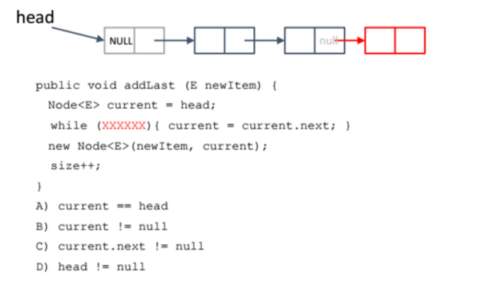
What replaces the XXXXXX? C

Slide 33
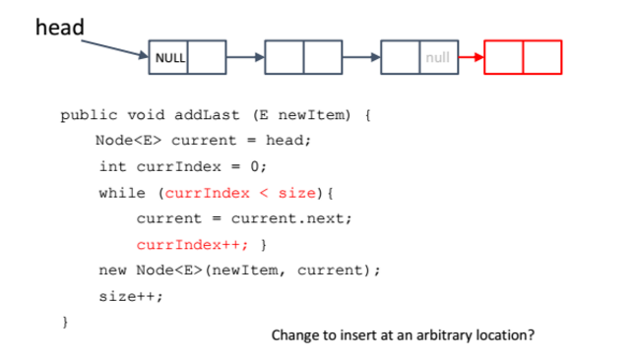
Another implementation

Slide 34
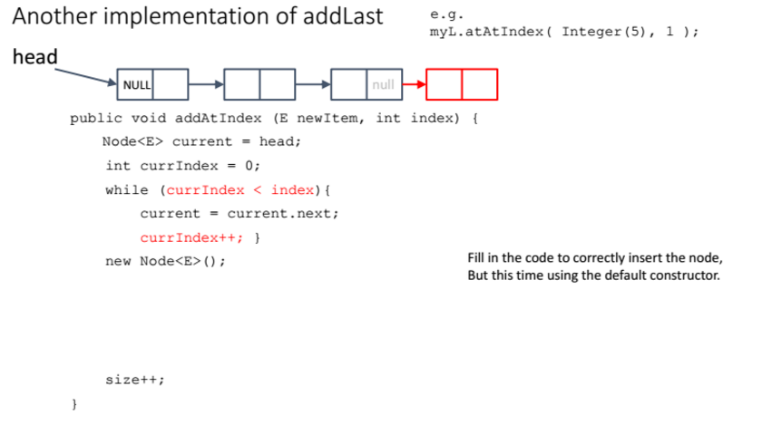

Slide 35
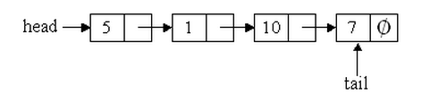
List with Head and Tail
How to add Node E to the end in this case?
A: tail = Node E;
B: tail.next = Node E;
C: tail = Node E;
tail.next = Node E;
D: tail.next = Node E;
tail = Node E;

Slide 36
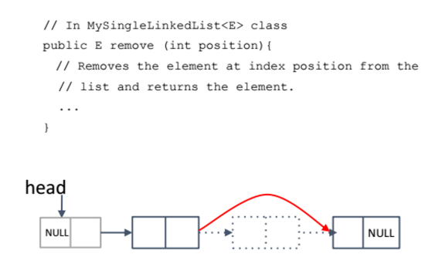
Removal from LL

Slide 37
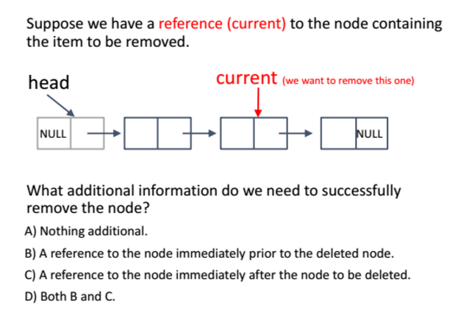
Ans: B

Slide 38
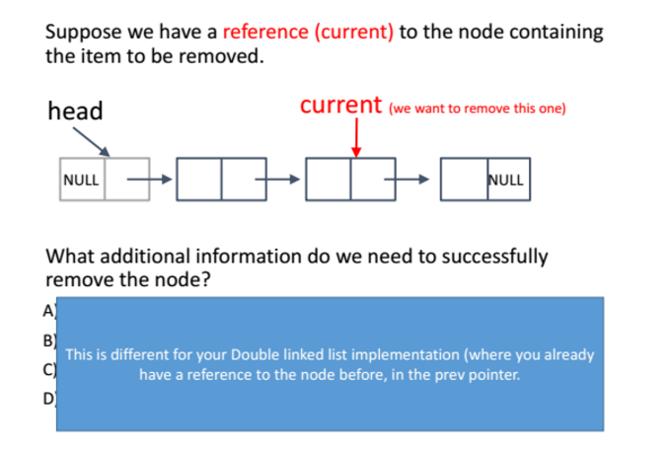

Slide 39
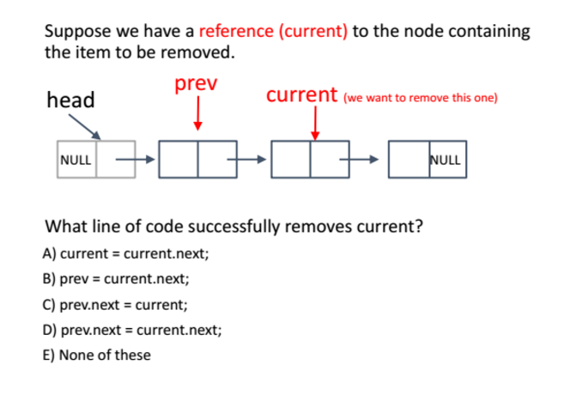
Ans: D

Slide 40
