Slide 1
Lecture 6

Slide 2
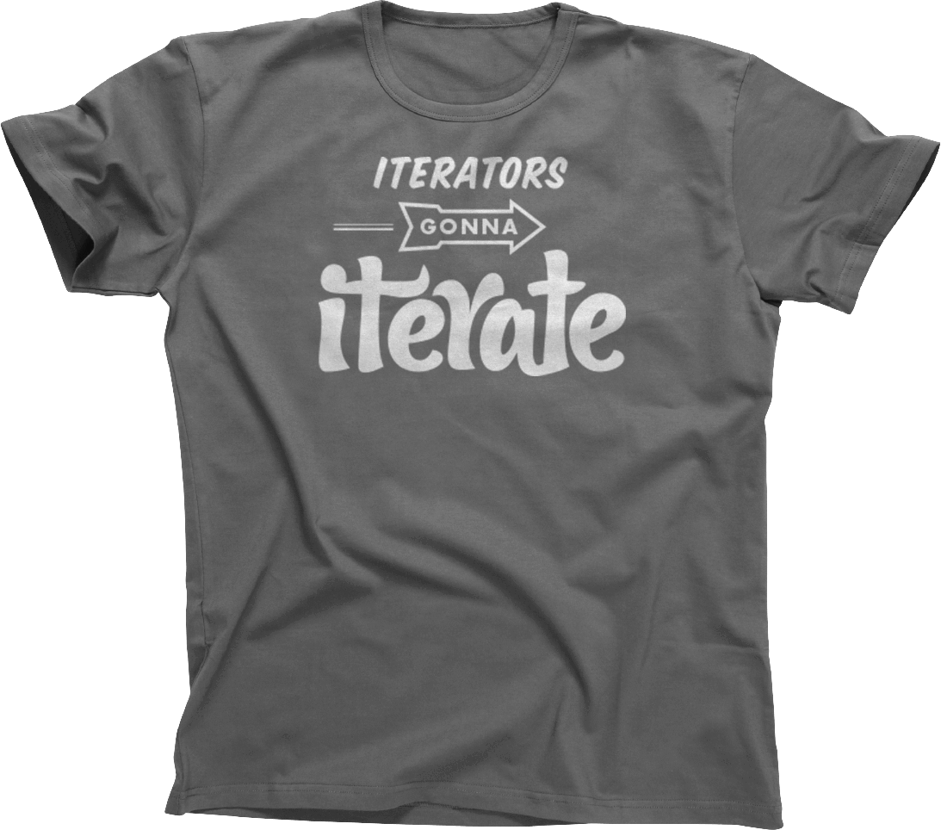
Iterators

Slide 3
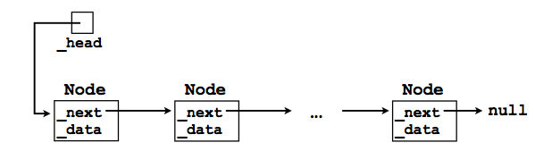
Iterating through the whole list
Suppose we wish to iterate through the entire list and print out the data in each node?
Node cursor = head;

Slide 4
Iterating through the whole list
Suppose we wish to iterate through the entire list and print out the data in each node?
Node cursor = head;
while ( ) {
}

Slide 5
Iterating through the whole list
Node cursor=_head;
while (cursor!=null) {
System.out.println( cursor.data );
cursor = cursor.next;
}

Slide 6
Iterator: life without them
How would you implement get() method?
E get(int index) throws IndexOutOfBoundsException;
Using either for/while loop:
Node cursor = head;
for (int i=0; i<index; i++)
cursor=cursor.next;
return cursor.data;

Slide 7
Iterating over elements of a data structure
Many ADTs offer the user the ability to iterate over all of their elements in some “natural order”.
With the simple List interface this is already possible using the get (int index) methods:
int size = linkedList.size();
for (int i = 0; i < size; i++) {
System.out.println(linkedList.get(i));
}
VERY slow, always starts from the beginning

Slide 8
Iterators: performance benefits
An “iterator” object helps us to avoid this wasted computation.
An iterator is a “helper object” with which the user can iterate across all elements in a data structure.
The iterator will “remember” where it left off.

Slide 9
Iterators: software design gain
Iterators are also useful because they offer a uniform way of accessing all of a data structure’s elements.
Even very different data structures --e.g., graphs and lists -- can both support iterators.
An “iterator” is one of the fundamental design patterns of software engineering.

Slide 10
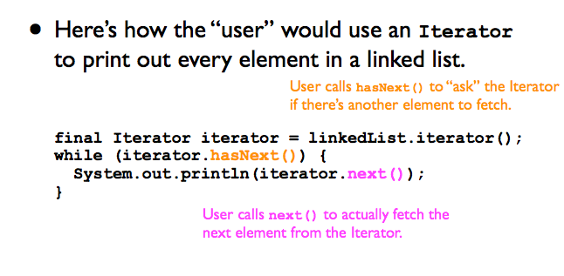
How Iterators are used

Slide 11
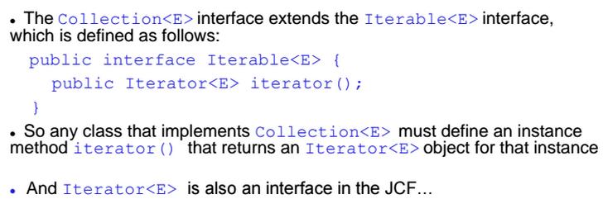
Iterable Interface

Slide 12
Interface Iterator
In Java, the Iterator interface contains three method signatures:
boolean hasNext();
E next();
void remove();
The ListIterator interface adds a few more methods.
Boolean hasPrevious();
E previous();
…

Slide 13
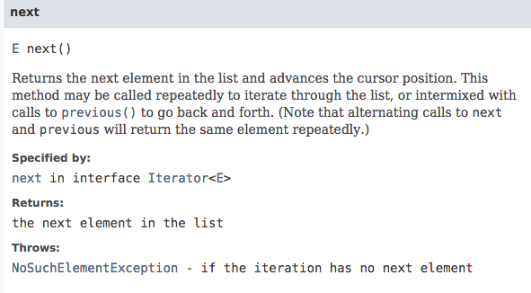

Slide 14
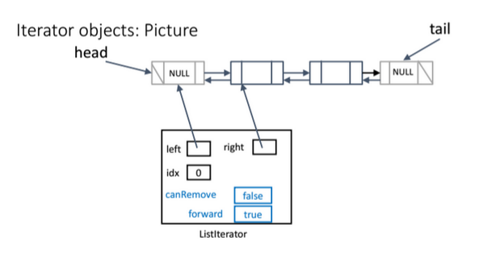
Forward: direction of the iterator
canRemove: only true if last call of iterator was next() or prev()

Slide 15
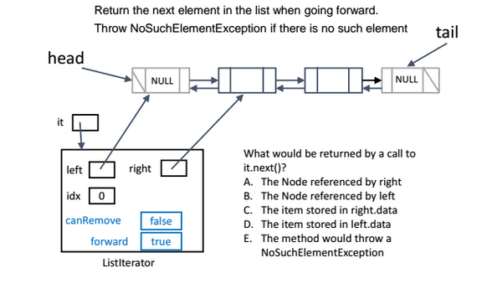
E next(). Ans: C

Slide 16
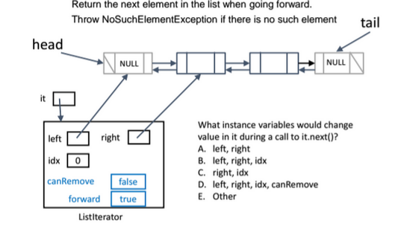
E next(). Ans: D

Slide 17
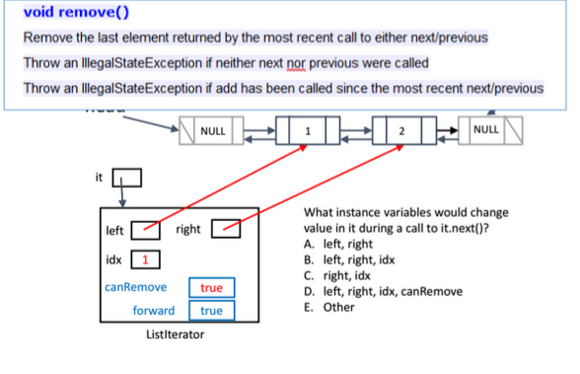
Ans: D

Slide 18
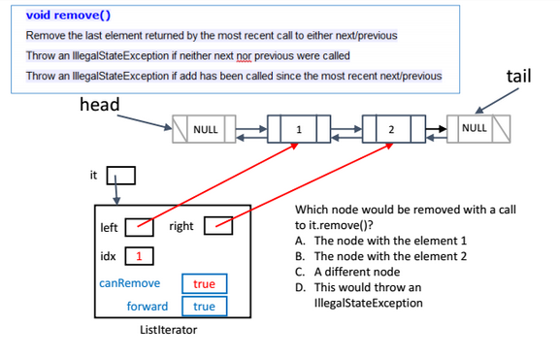
Ans: A

Slide 19
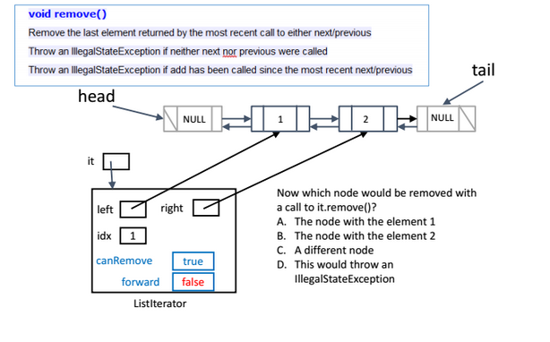
Ans: B

Slide 20
Practice

Slide 21
Interview questions: 1
Consider sorted singly linked list having following nodes
10->30->50->70->NULL
You are given pointer to node 50 and a new node having value 40. Can you inserted node 40 correctly in the list maintaining the ascending order?

Slide 22
Interview questions: 2
Find the middle element in a linked list on one pass (one for loop). You can’t use use variables like number of elements or the size of the list.
A) No tail
B) With a tail.

Slide 23
Question
What does the following function do for a given Linked List with first node as head?
void fun1(Node head)
{
if(head == NULL)
return;
fun1(head.next);
print (head.data);
}

Slide 24
Question
void fun(Node head)
{
Node temp = NULL;
Node current = head;
while (current != NULL)
{
temp = current.prev;
current.prev = current.next;
current.next = temp;
current = current.prev;
}
if(temp != NULL )
head= temp.prev;
}
Assume that reference of head of following doubly linked list is passed to above function 1 <--> 2 <--> 3 <--> 4 <--> 5 <-->6. What should be the modified linked list after the function call?

