Slide 1
Lecture 8

Slide 2
A few things
Extra credit, how I will handle it
A few typos on the write-up.
Extensions for submitted files

Slide 3
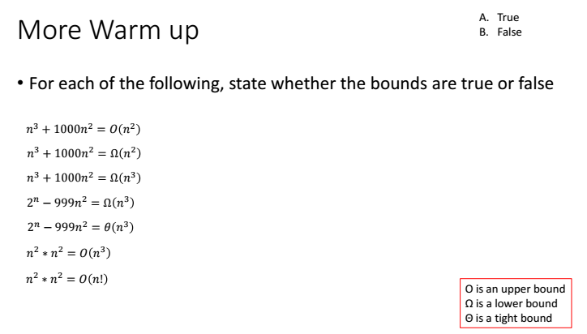

Slide 4
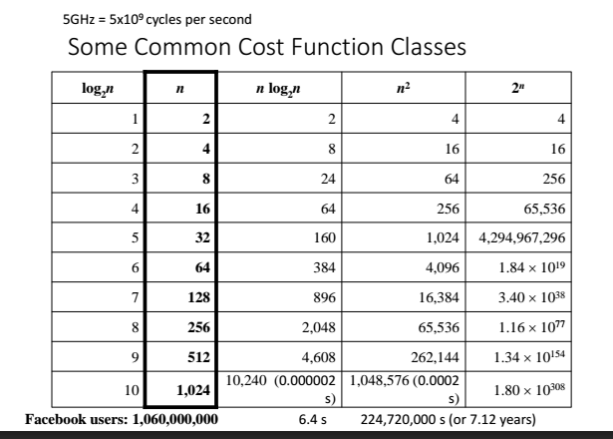

Slide 5
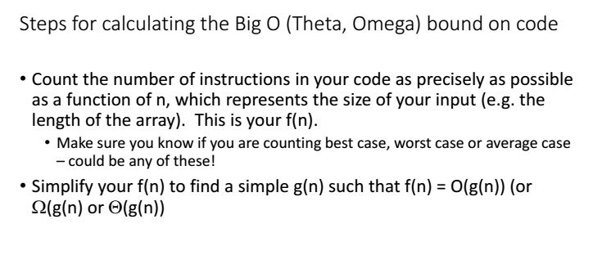

Slide 6
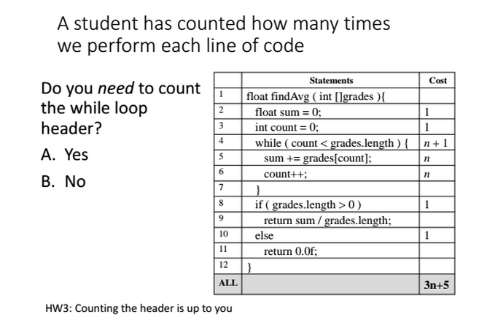

Slide 7
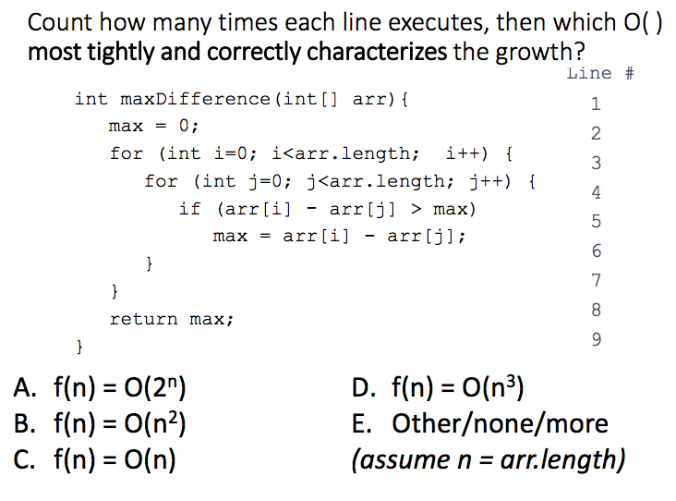
X

Slide 8
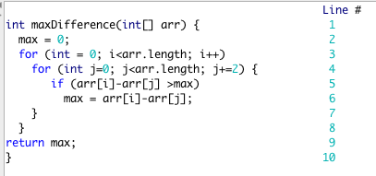

Tightest bound
X

Slide 9
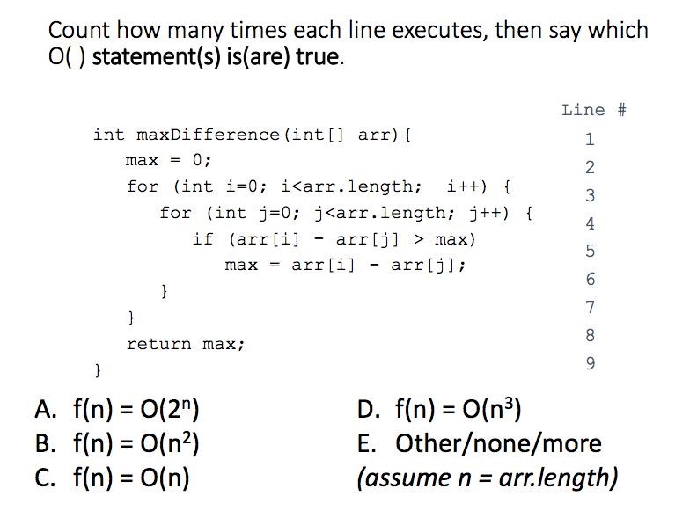
A, B, D

Slide 10
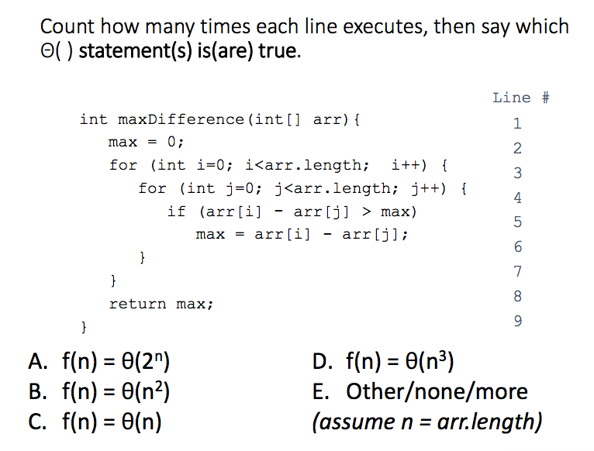
B

Slide 11
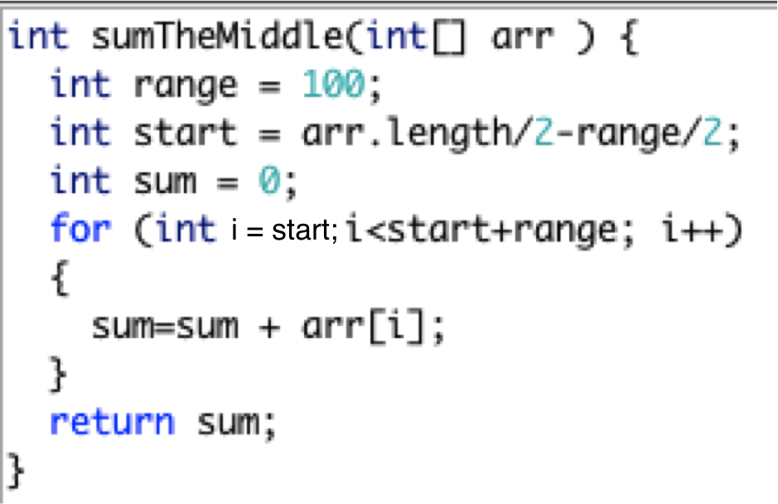

Count instructions, then say which statement is true
X

Slide 12
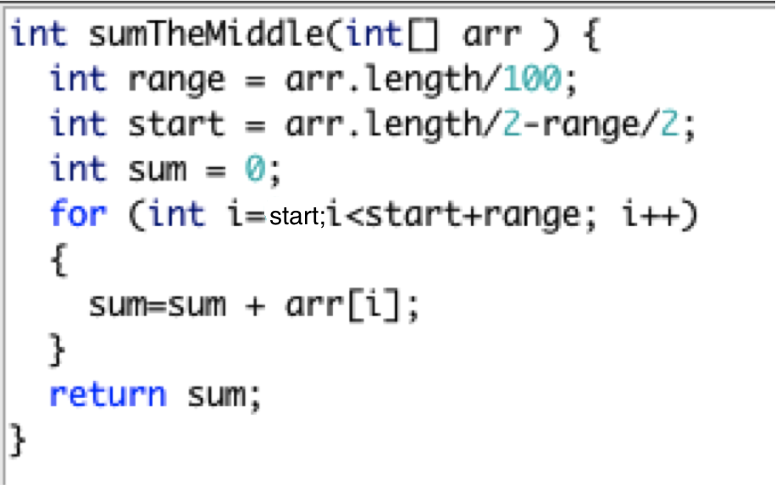
Count instructions, then say which statement is true
X

Slide 13
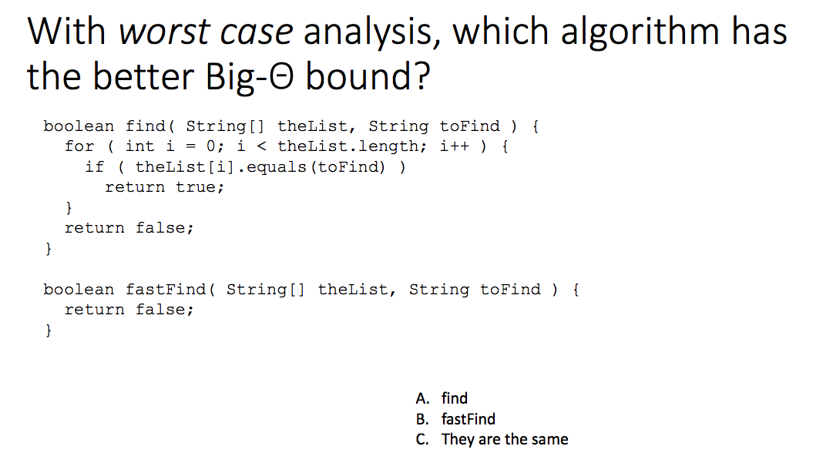
X

Slide 14
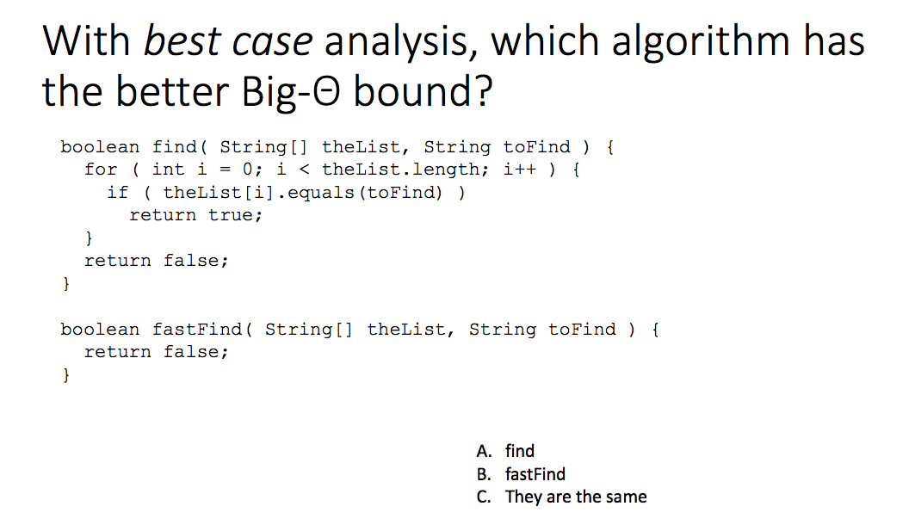
X

Slide 15
Don’t fall into the trap
http://www.programmerinterview.com/index.php/data-structures/big-o-versus-big-omega-notations/
The above link is not 100% correct, and there are a lot of them!

Slide 16
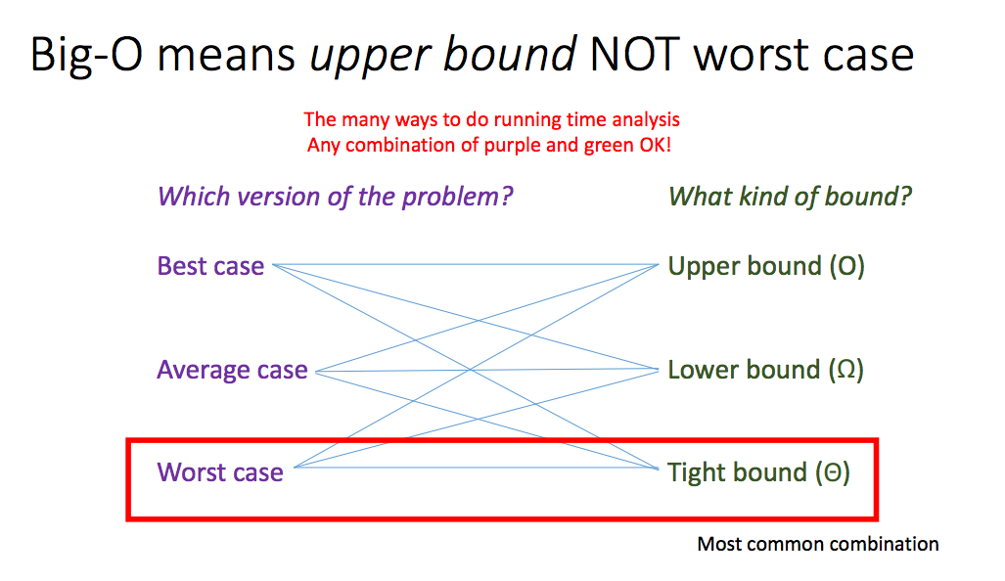

Slide 17
Empirical performance measurement

Slide 18
Practical world
Sometimes calculating instructions is not possible or very difficult.
As an alternative to describing an algorithm’s performance with a “number of abstract operations”, we can also measure its time empirically using a clock.

Slide 19
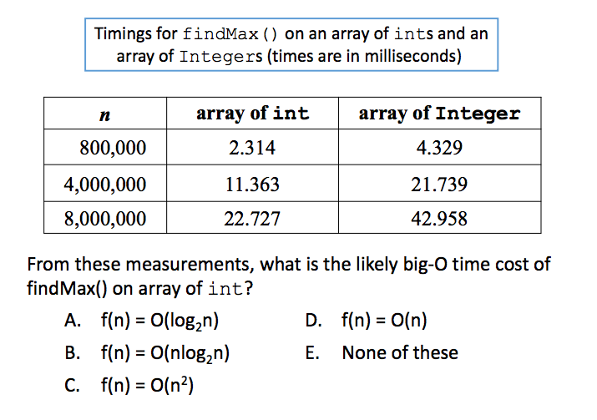
Explain these results
X

Slide 20
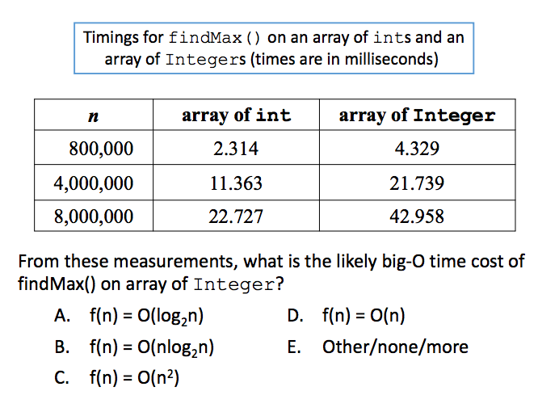
Explain these results
X

Slide 21
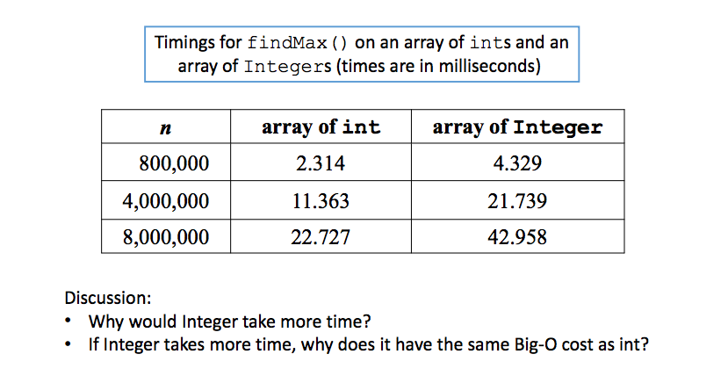
Explain these results

Slide 22
Reasons to use “real timers”
As illustrated, counting “abstract operations” can anyway hide real performance differences, e.g., between using int[] and Integer[].
Many programs and libraries are not open source!
You have to analyze an algorithm’s performance as a black box.

Slide 23
Procedure for measuring time cost
Let’s suppose we wish to measure the time cost of algorithm A as a function of its input size n.
We need to choose a set of values of n that we will test.
If we make n too big, our algorithm A may never terminate (the input is “too big”).
If we make n too small, then A may finish so fast that the “elapsed time” is practically 0, and we won’t get a reliable clock measurement.

Slide 24
Procedure for measuring time cost
In practice, one “guesses” a few values for n, sees how fast A executes on them, and selects a range of values for n.
Let’s define an array of different input sizes, e.g.:
int[ ] N = { 1000, 2000, 3000, ..., 10000 };
Now, for each input size N[i], we want to measure A’s time cost.

Slide 25
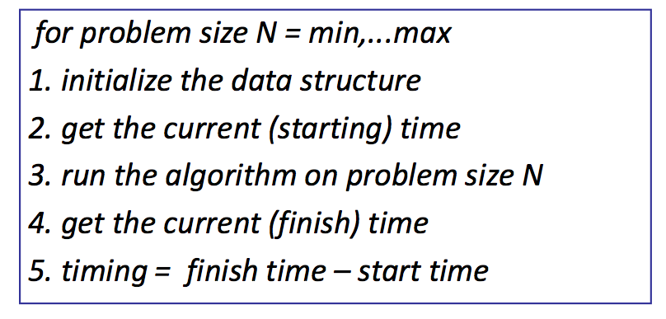
Basic procedure for benchmarking

Slide 26
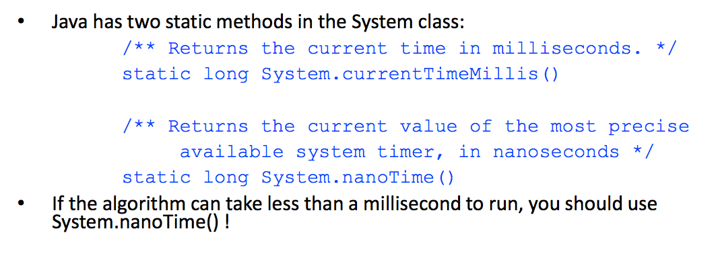
Timer methods in Java

Slide 27
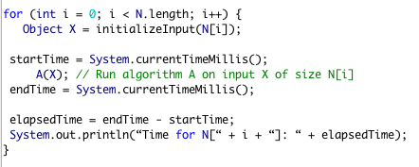
Draft 1.

Slide 28
Is it enough to execute once?
Unfortunately, in the “real world”, each measurement of the time cost of A(X) is corrupted by noise:
Garbage collector!
Other programs running.
Cache locality.
Swapping to/from disk.
Input/output requests from external devices
If we measured the time cost of A(X) based on just one measurement, then our estimate of the “true” time cost of A(X) will be very imprecise.
We might get unlucky and measure A(X) while the computer is doing a “system update”.

Slide 29
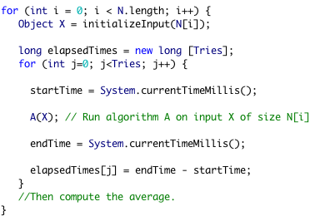
Draft 2
A much-improved procedure for measuring the time cost of A(X) is to compute the average time across Tries attempts.

Slide 30
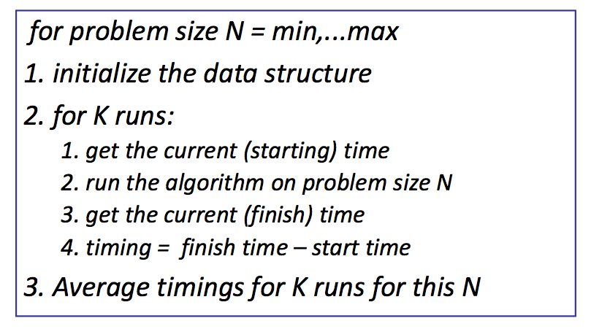
IMPROVED procedure for benchmarking

Slide 31
Question
One way to improve the accuracy of measuring the running time of algorithm is by
A. Using a faster computer
B: Averaging the measurement results
C: Starting up more applications to have a larger set of running applications
D. Improving the time the algorithm takes to finish executing

