Slide 1
Lecture 10

Slide 2
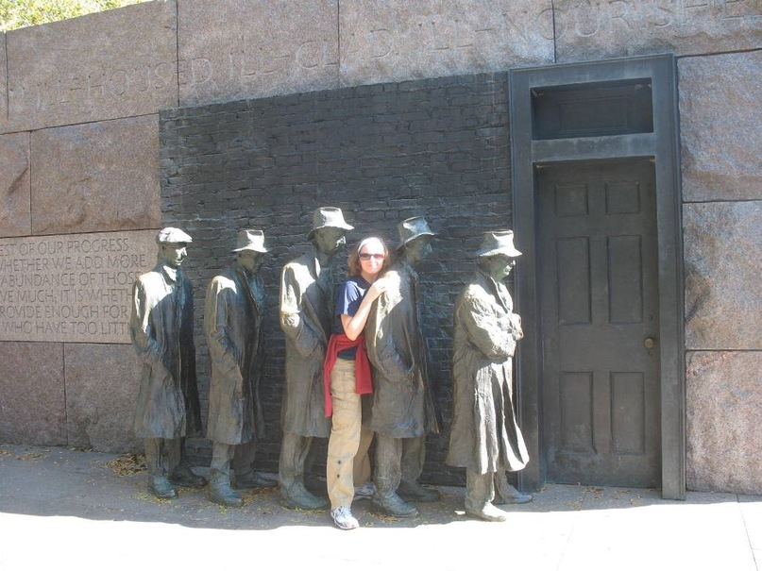
Queues (I’m cheating here ☺)

Slide 3
Queues
Operations:
enqueue – append (add) an element to the queue.
dequeue – remove element from the queue.
peek – return element that would be dequeued with the next call to dequeue.
Enqueue and Dequeue operate at opposite ends of the Queue.
FIFO data structure
First In, First Out

Slide 4
Queues, warm up question
It is a good idea to implement a queue with a class that extends LinkedList
A: Sure, it’s fine
B: No, that’s not a great idea

Slide 5
Bounds with LList
What is the time cost of adding/removing an element from the queue if we use a LinkedList (doubly, with a tail).
A: O(1), O(1)
B: O(1), O(n)
C: O(n), O(1)
D: O(n), O(n)
C: I have no idea ;(

Slide 6
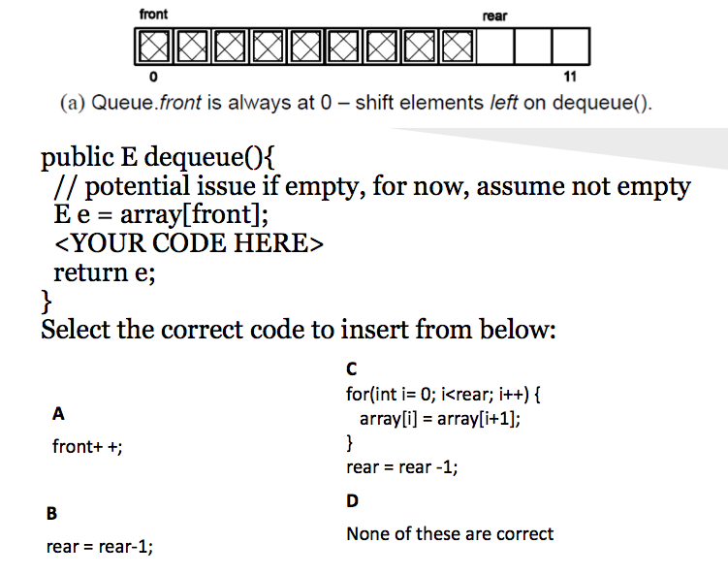
C

Slide 7
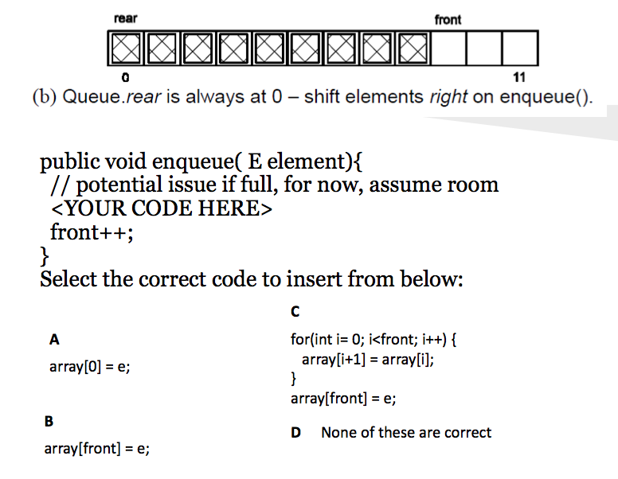
D

Slide 8
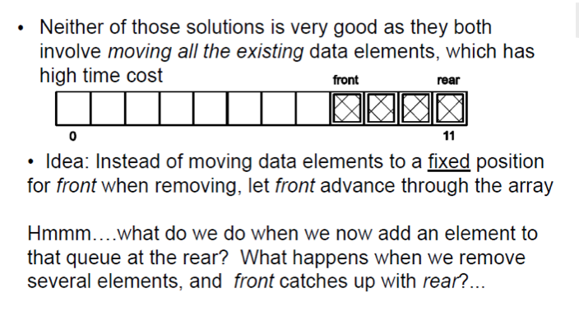
ArrayQueue: another option

Slide 9

Circular array (Ring buffer)

Slide 10
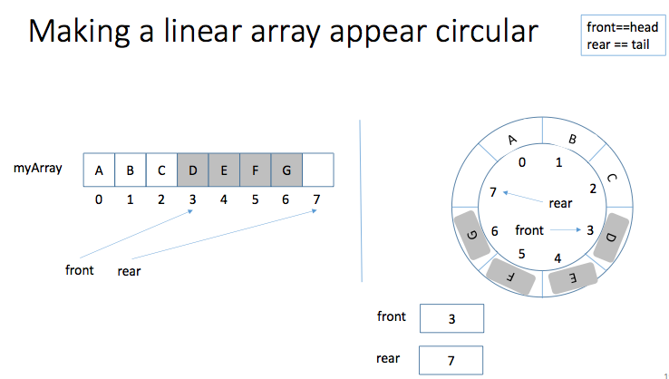

Slide 11
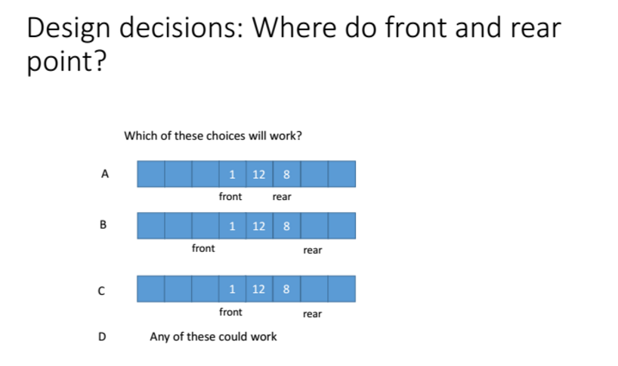
D

Slide 12
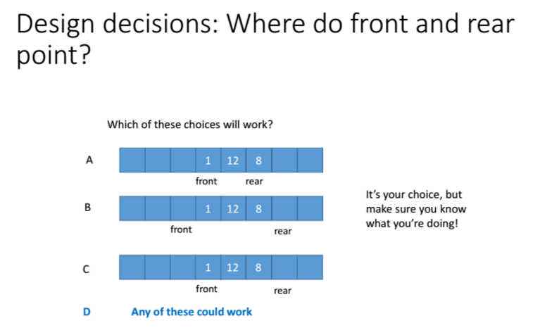

Slide 13
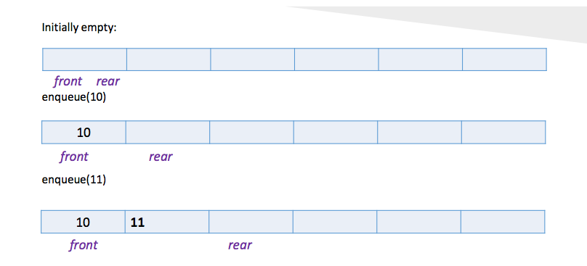
Queues using circular Array

Slide 14
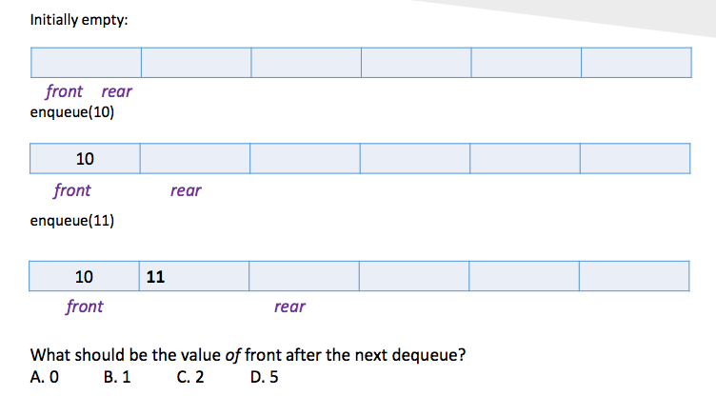
Queues using circular Array
B

Slide 15
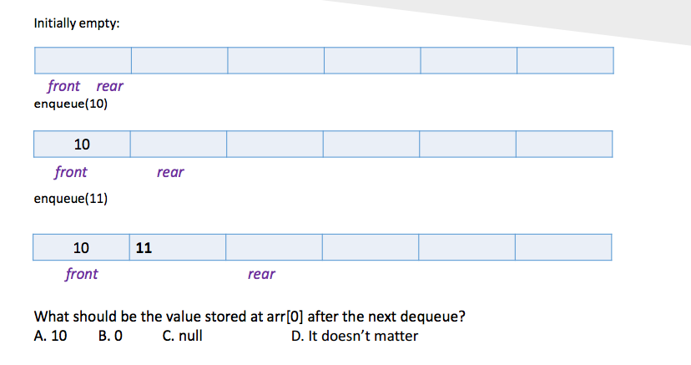
Queues using circular Array
D

Slide 16
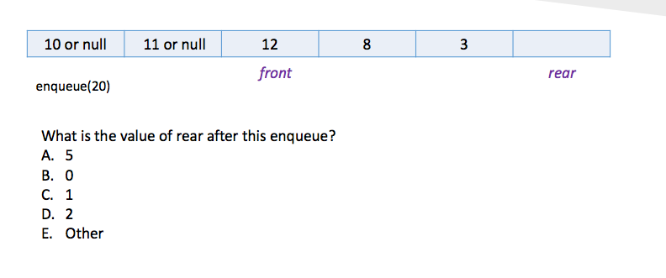
Queues using circular Array
B

Slide 17
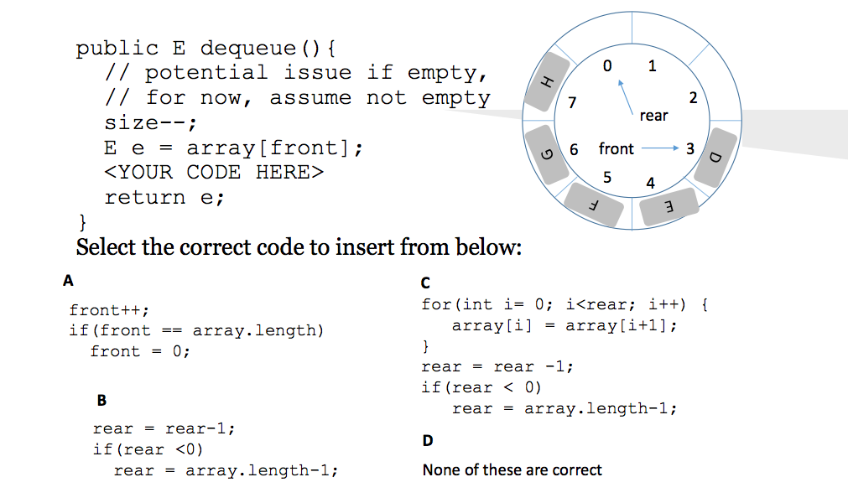
B

Slide 18
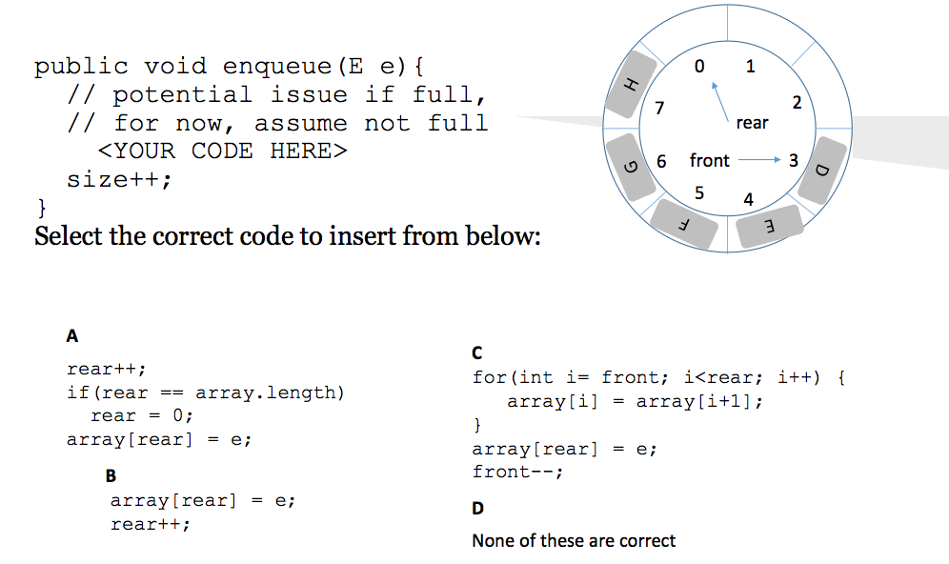
D

Slide 19
Double-ended queue
a double-ended queue is an abstract data type that generalizes a queue, for which elements can be added to or removed from either the front or back.
abbreviated to deque, pronounced “deck”.
What is a good data structure to implement it?
An input-restricted deque: deletion can be made from both ends, but insertion can be made at one end only.
An output-restricted deque: can be made at both ends, but deletion can be made from one end only.

