Slide 1
Lecture 11

Slide 2
Exam materials
Everything including bubble, selection and insertion sorts
1) Practice problems
And solutions a bit later, so you have a chance to work on them without peeking.
2) Reading Quizzes.
3) Solutions for HW3.
4) Shared Google doc where you fill in the “complexity tables” for different algorithms
Don’t copy/paste from Google, Wiki etc.

Slide 3
Lecture Plan
Parentheses checker algorithm
Graphs
Depth First Search
Breadth First Search
Simple Sorting algorithms

Slide 4
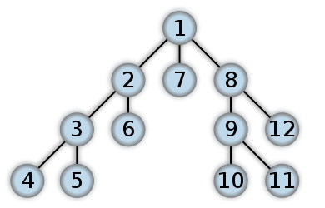
Graph (Trees)
Vertices (node)
Edges (connect vertices)
How to traverse a graph?
(and print every node)

Slide 5
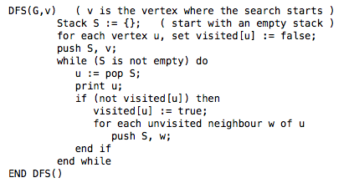
Depth First Search

Slide 6
DFS uses stack
Let’s run DFS on this graph

Slide 7
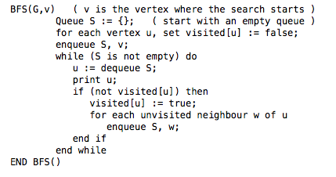
BFS uses queue

Slide 8
BFS uses queue
Let’s run BFS on this graph

Slide 9
Simple Sorts

Slide 10
Sorting
Sorting takes an unordered collection and makes it an ordered one.
1 2 3 4 5 6
77
42
35
12
101
5
1 2 3 4 5 6
5
12
35
42
77
101

Slide 11
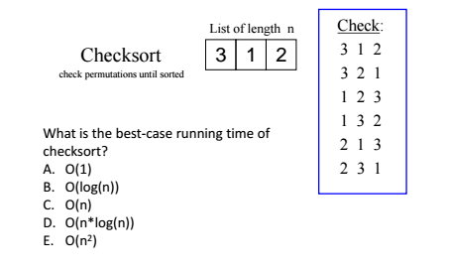
Sorting algorithms
C

Slide 12
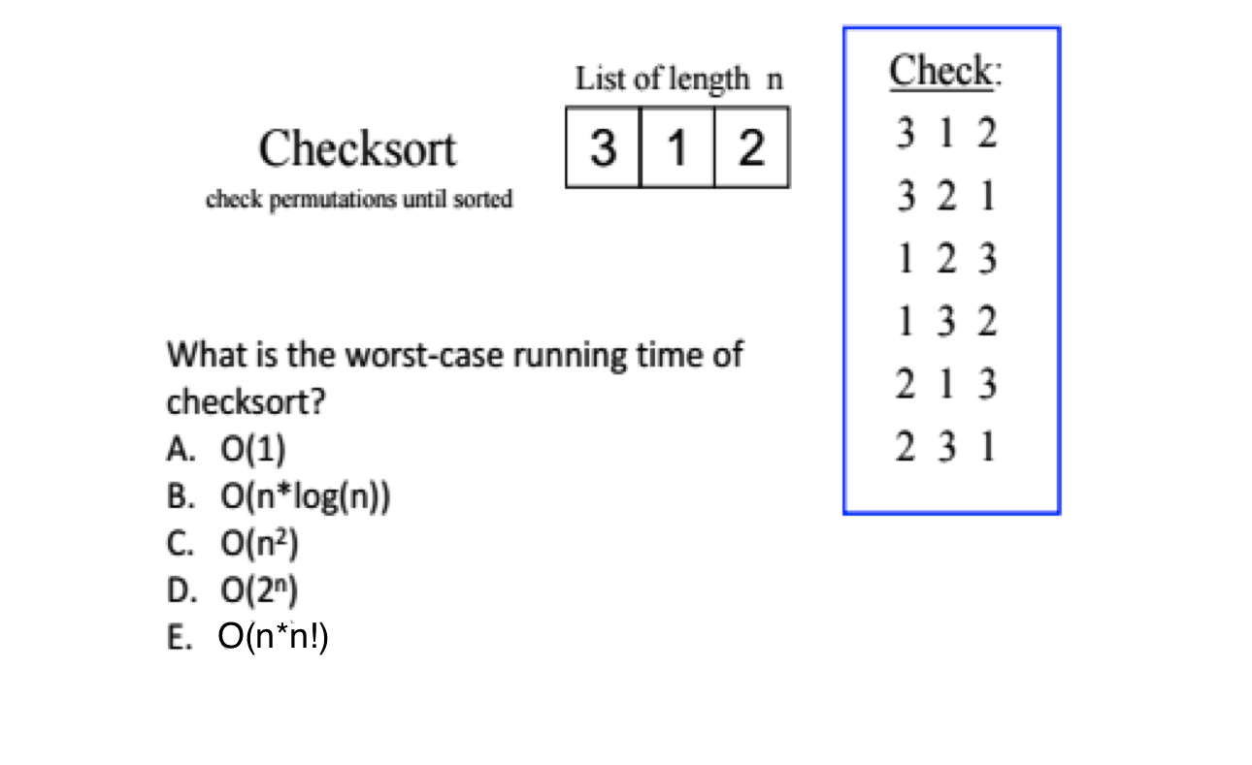
Sorting algorithms
E

Slide 13
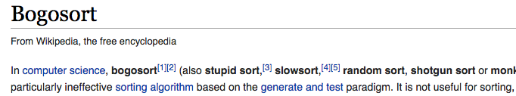
Bogosort
while not isInOrder(deck):
shuffle(deck)

Slide 14
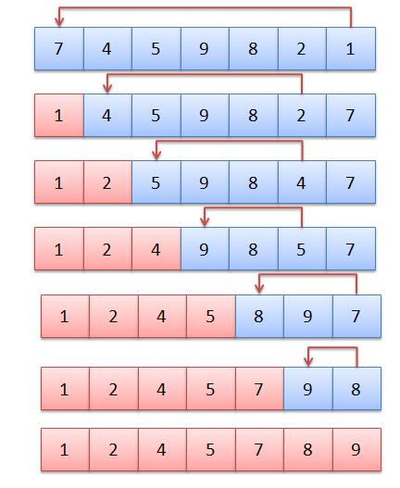
Selection Sort
Do we have to shift
elements?
A: Yes
B: No

Slide 15
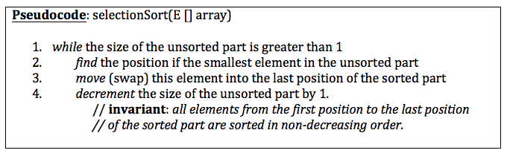

Running time
Approximately how many times does the algorithm have to select the smallest element from the unsorted part of the list? (i.e. how many times does the outer loop run?)
A: 1 time
B: N times
C: N² times

Slide 16
Running time
Approximately how many comparisons does it take to select the smallest element from the unsorted part of the list?
A: 1 comparison
B: N-1 comparisons
C: At most N-1, but usually less than N-1

Slide 17

Running time

Slide 18
Running time
As a conclusion, what is the worst running time for selection sort?
A: O(1)
B: O(N)
C: O(N-1)
D: O(N²)

Slide 19
Best Running time
for selection sort?
A: O(1)
B: O(N)
C: O(N-1)
D: O(N²)

Slide 20
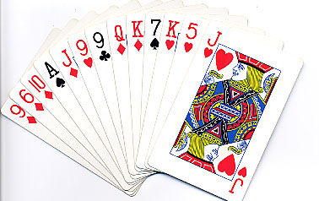
Insertion Sort

Slide 21
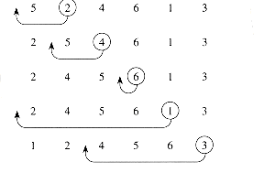
Insertion Sort: partly sorted

Slide 22
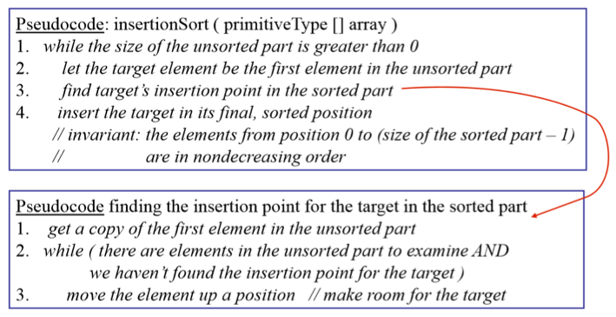
Insertion Sort

Slide 23
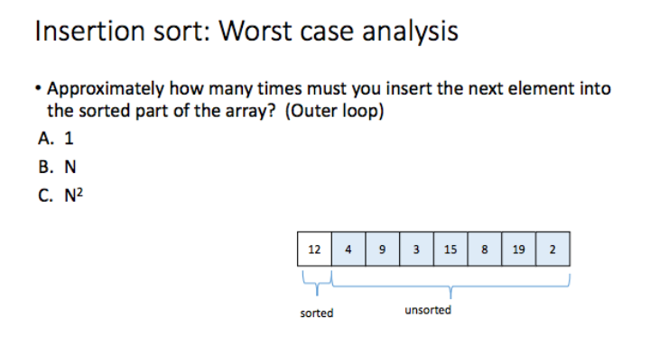
B

Slide 24
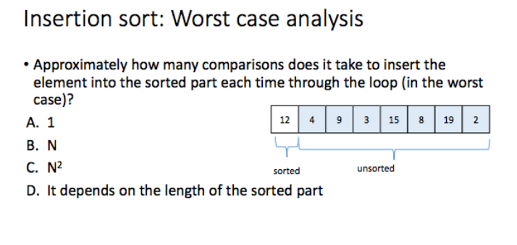
B

Slide 25
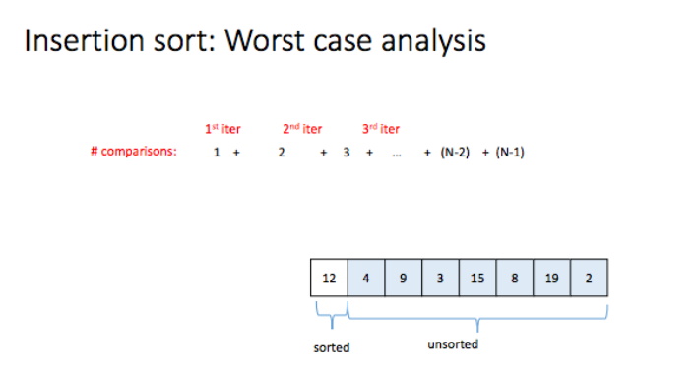

Slide 26
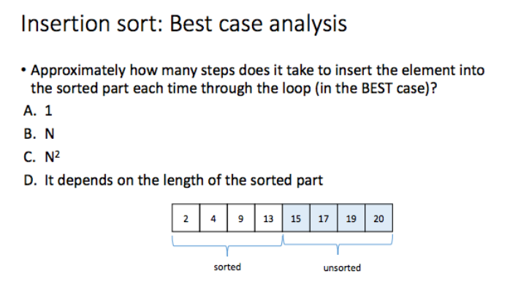
A

Slide 27
Insertion Sort
In most cases the insertion sort is the best of the elementary sorts.
It still executes in O(N²) time, but it’s about twice as fast as the bubble sort and somewhat faster than the selection sort in normal situations.
It’s also not too complex, although it’s slightly more involved than the bubble and selection sorts.
It’s often used as the final stage of more sophisticated sorts, such as quicksort.
Even runs in O(n) for “almost sorted” arrays!

Slide 28
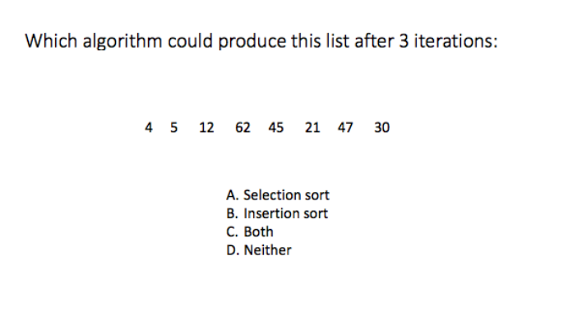
C

Slide 29
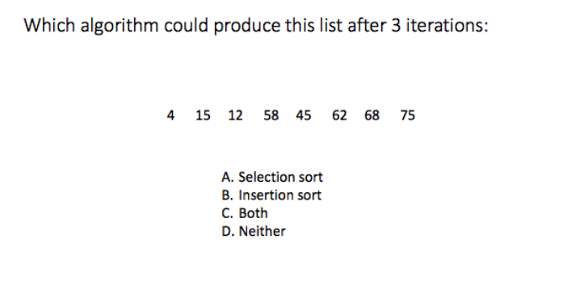
C or D (we could sort from right to left)

Slide 30
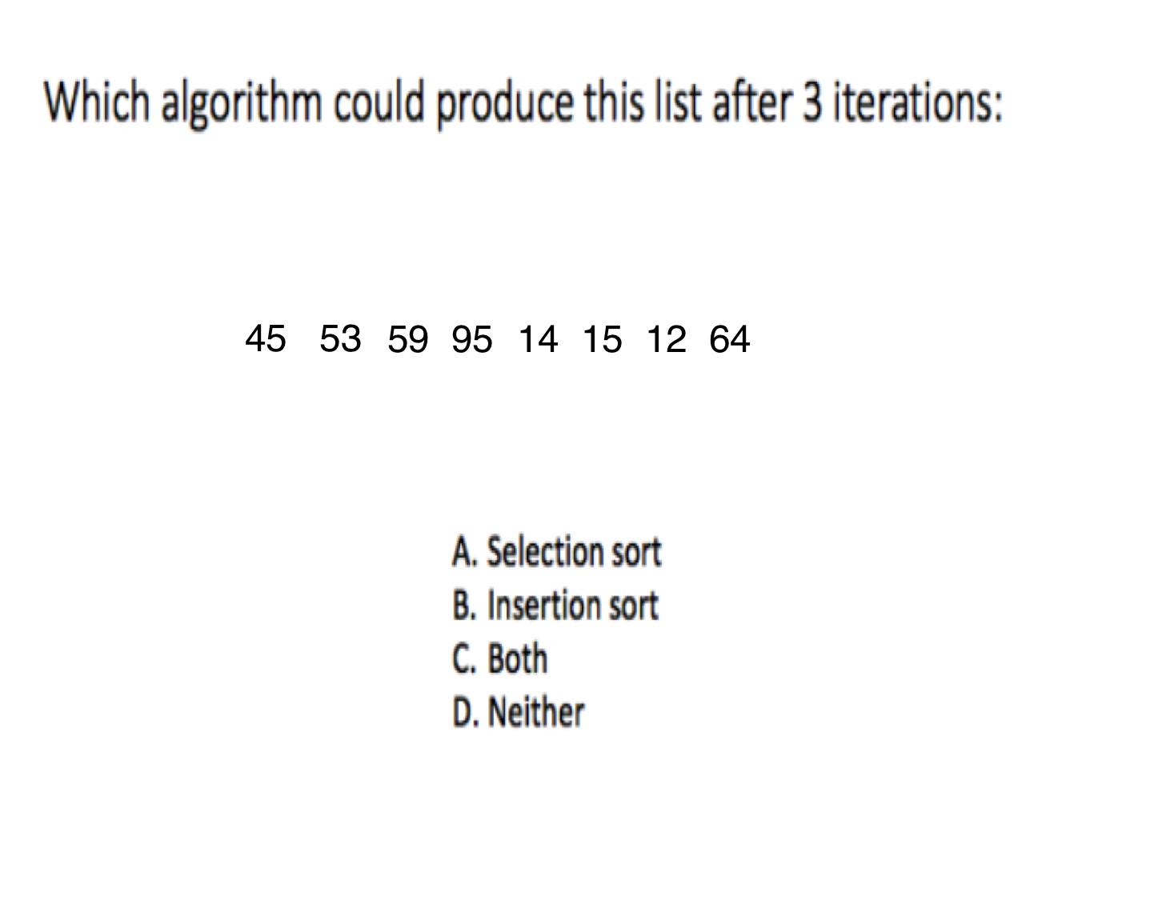
B

Slide 31
Running time comparison
Shell: https://en.wikipedia.org/wiki/Shellsort (if there is time)
http://www.sorting-algorithms.com/
Looser?
A: Bubble
B: Selection
B: Insertion
C: Shell

Slide 32
Recursion background
A: Recursion is my second nature.
B: I’ve used it before but still not very comfortable
C: I’ve heard of it but never used it
D: I have no idea what the recursion is.

