Slide 1
Lecture 9

Slide 2
Announcements
Rest is over: HW4 is out. It is LONG and has a lot of pieces that you need to put together.
2 milestone submissions to get you started.
Deadline is a bit longer than a week. (till next Tuesday)
Today’s reading quiz: new link, new time, new hope.
Next week you will have HW5 (about sorts), not a long one again.
+ midterm.

Slide 3
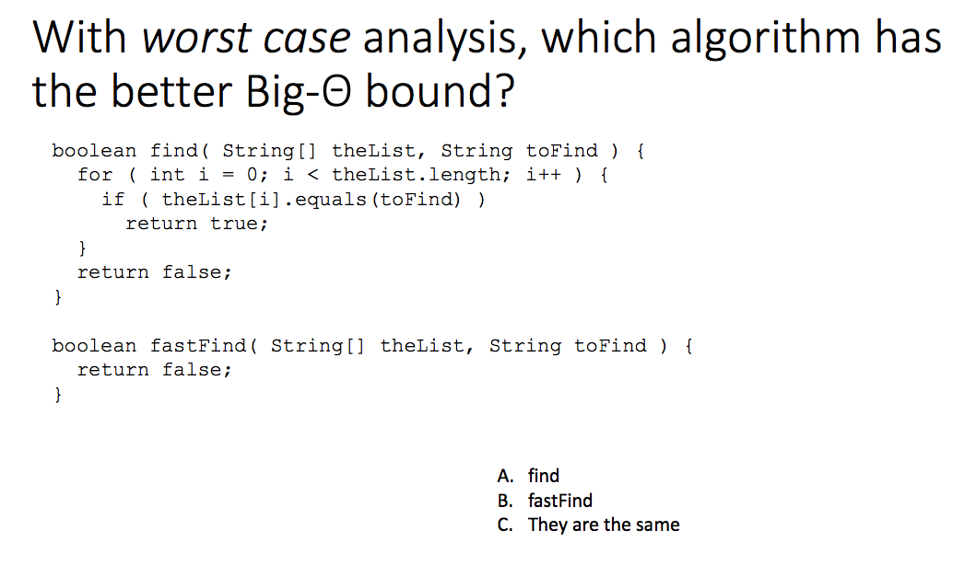

Slide 4
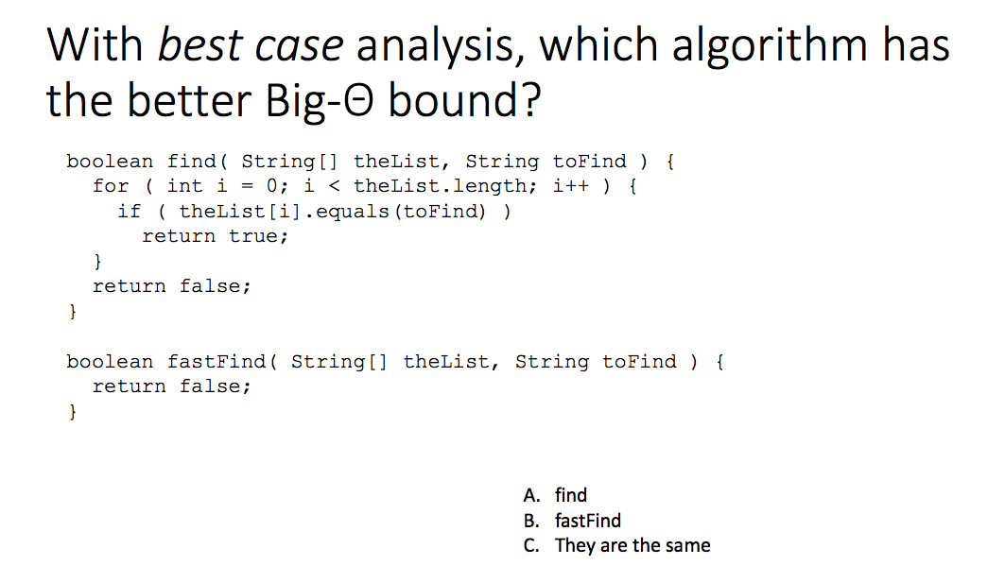

Slide 5
Don’t fall into the trap
http://www.programmerinterview.com/index.php/data-structures/big-o-versus-big-omega-notations/
The above link is not 100% correct, and there are a lot of them!

Slide 6
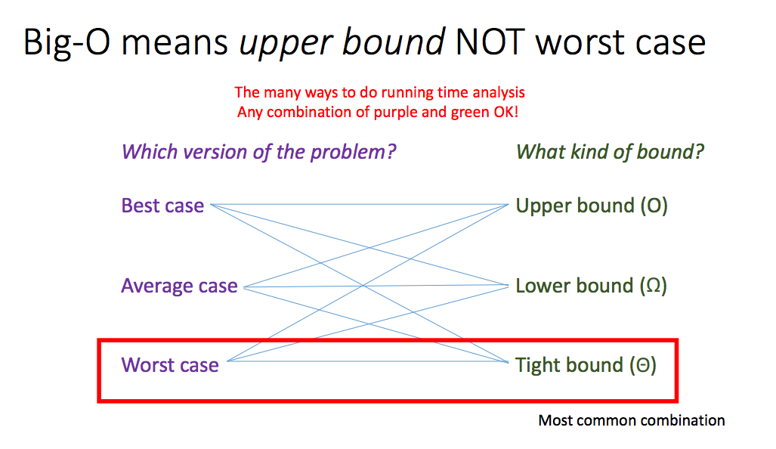

Slide 7
Today’s Plan
The Stack ADT
Building a Stack using the Adapter Pattern Design
How underlying data structure (and choices of mapping) affects complexity.

Slide 8
Stacks and Queues
Stacks and queues are examples of linear data structures in which every object inserted into it will generally be removed.
Usually a stack/queue is intended only as “temporary” storage.
Both stacks and queues allow the user to add and remove elements.
Not good for sorting.
Where they differ is the order in which elements are removed relative to when they were added.

Slide 9

Stack of crepes

Slide 10
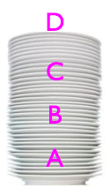
Stacks (LIFO)
Stacks are last-in-first-out (LIFO) data structures.
The classic analogy for a “stack” is a pile of dishes:
Suppose you’ve already added dishes A, B, and C
to the “stack” of dishes.
Now you add one more, D.
Now you remove one dish -- you get D back.
If you remove another, you get C, and so on.
With stacks, you can only add to/remove
from the top of the stack.

Slide 11
Warm Up
When using push() operation to place the following items on a stack:
push(10)
push(20)
push(30)
push(0)
push(-30)
the output when popping from the stack is:
A: 10, 20, 30, 0 , -30
B: -30, 0, 10, 20, 30
C: 30, 10, 20, 0, -30
D: -30, 0, 30, 20, 10
E: 0, 30, -30, 10, 20

Slide 12
Stacks
Operations:
Push – push (add) element on top of the stack
Pop – pop (remove) element from the top of the stack
Peek – return element at the top of the stack, without removing it
What else could be useful?
All operations are made on top of the stack

Slide 13
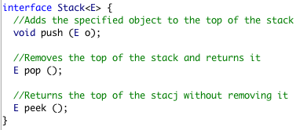
Stack ADT
To support the LIFO adding/removal of elements, a stack must adhere to the following interface:

Slide 14
Stack ADT
Stack can be implemented using two kinds of storage:
Array: More efficient for stacks of a fixed maximum capacity.
Linked list: More flexible for stacks with a “growable” capacity.

Slide 15
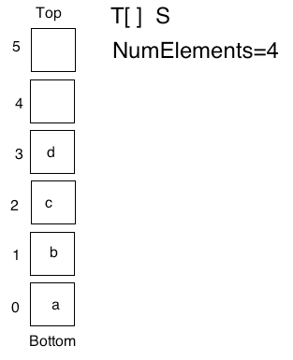
Array-based stacks

Slide 16
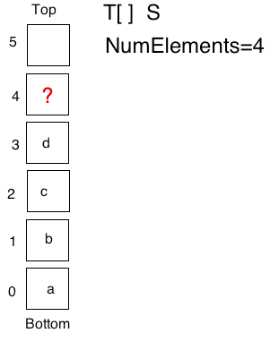
Array-based stacks
Push ?
A: S[S.length]=e;
B: S[NumElements]=e;
C: S[NumElements+1]=e;
D: S[NumElements-1]=e;
E: Other

Slide 17
Exceptions
If you are to implement an array-based stack, how many exceptions would you throw?
A: None
B: 1
C: 2
D: 3
E: More than 3

Slide 18
Exceptions
If a stack has reached its maximum capacity and the user calls push(o), then the stack will overflow.
If a stack is empty (numElements == 0) and the user calls pop(), then the stack will underflow.

Slide 19
Stack Complexity
What is complexity of the array-based stack operations?
Assume there is room to add and there are elements to remove.
Push, then Pop
A: O(1)
B: O(n)
C: O(log n)
D: O(n²)
E: Other

Slide 20
Stack as a linked list

Slide 21
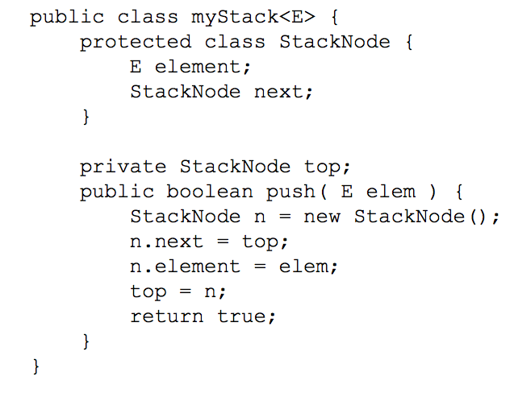
Linked list-based stacks

Slide 22
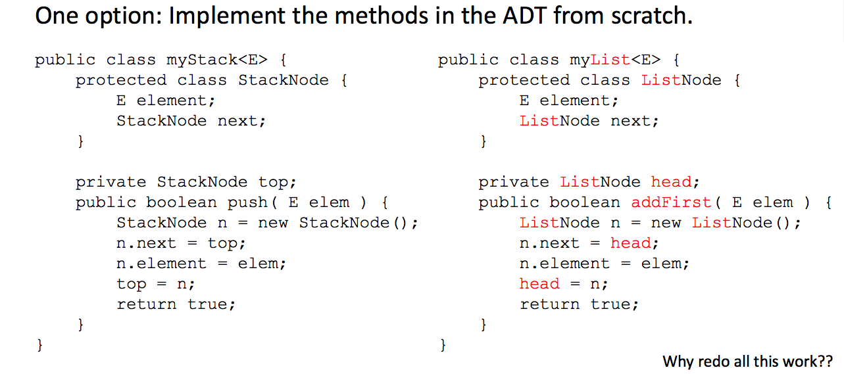

Slide 23
Adapter Pattern Design

Slide 24
Adapter Pattern
We need to implement the Stack interface with the following methods:
push (E element) - add element on the stack
E pop() – remove element from top of the stack
E peek() – return the element at the top of the stack
We would like to find a way to reduce our work

Slide 25
Adapter Pattern
We know that there is a nice implementation of a Double-ended List (head and tail) interface DList which provides the following methods:
addFront (E element)
E removeFront()
E peekFront()
addBack(E element)
E RemoveBack()
E peekBack()

Slide 26

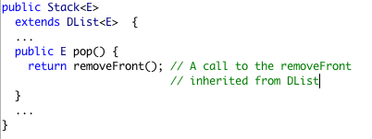
Idea: Inheritance!
We could just make Stack extend the List and write the additional methods by using other existing methods.
Example:
Pros? Cons? Discuss with your group

Slide 27
Idea: Inheritance!
It is possible just make Stack extend the List
public Stack<E> extends DList<E>
Which of the following is the biggest drawback of this approach:
A: It is inefficient from a running-time perspective: A double-ended linked list is not a good choice for a Stack implementation
B: It is incorrect. There is no way to implement all the methods in the Stack interface with the methods in the double-ended linked list
C: It exposes methods that are not supposed to be part of the Stack interface.

Slide 28
Inheritance is not always the right answer
We know that there is a nice implementation of a Double-ended List interface DList which provides the following methods:
addFront (E element)
E removeFront()
E peekFront()
addBack(E element)
E RemoveBack()
E peekBack()
The other methods in the List are public and accessible by anyone. But a Stack does not expose such methods! (Ex: addBack, removeBack() etc)

Slide 29

Adapter Design Pattern
In software engineering, one of the classic “design patterns” is the adapter.
An adapter is a class that “maps” from the interface of one ADT -- the one we’re trying to implement -- into the interface of another ADT that already exists.
If we adapt an ADT B to implement another ADT A, then every method of A must be “converted” into a related call of B.

Slide 30
Adapter Design Pattern
I can use a private List variable
And use its methods within a Stack class

Slide 31
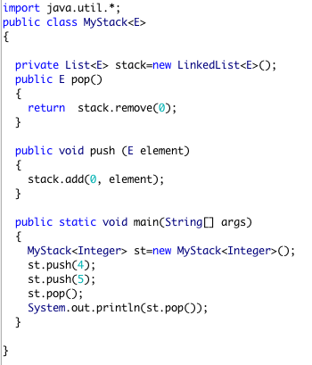
Adapter Design Pattern

Slide 32
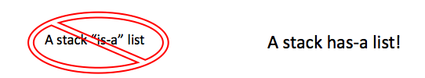
Adapter Design Pattern
Making the List variable private makes sure that users of the Stack cannot access the List or its methods.
Only the Stack methods are public and therefore usable by clients.
You can happily use List within Stack and pass on operations to it.

Slide 33
Adapter Design Pattern Summary
You would like to implement an Interface A.
You have an implementation B that implements another interface C which defines methods very much similar to the methods in A but differ slightly (like name).
You use an instance of B inside your class that implements A and delegate tasks to it.
Your class A “has a” class B.

Slide 34
Mapping Attributes
Before deciding on what methods to use, one needs to map the corresponding attributes.
For example: To use the List as a Stack, we need to map the Top of the stack to some position in the list (front or back—our choice, but how to choose?)

Slide 35
Mapping methods
Once this is done, we can map the methods on top of the stack to methods operating on the head of the List.
If we choose the front....
• push -> addFront • pop -> removeFront • peek -> peekFront

Slide 36
Mapping

Slide 37
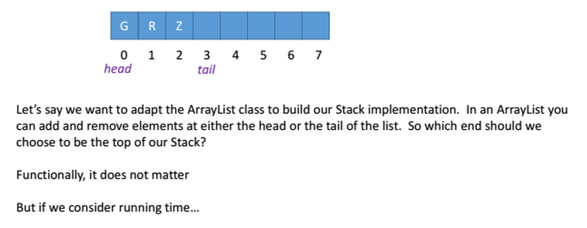
Mapping between ArrayList and Stack

Slide 38
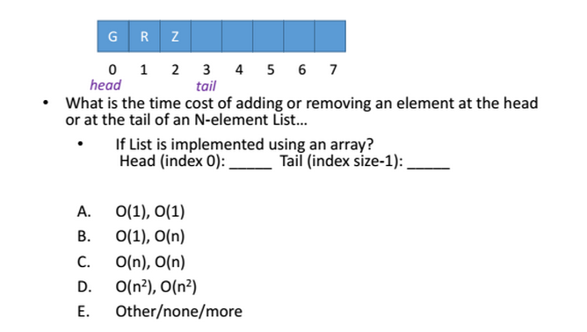
Mapping between ArrayList and Stack
E

Slide 39
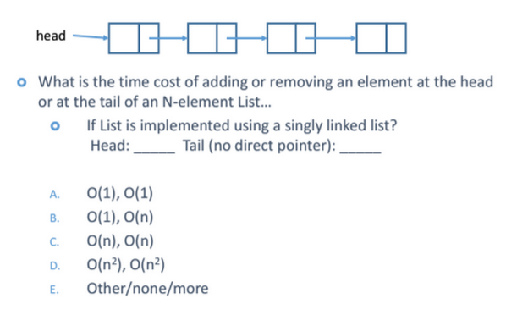
Mapping between single linked list and Stack
A

Slide 40
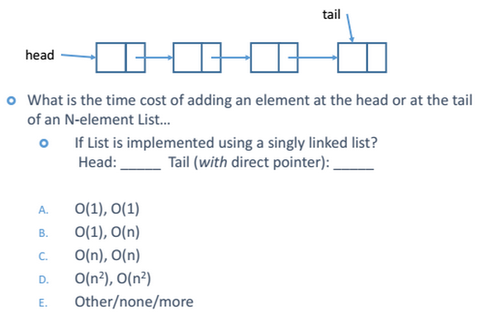
Mapping between single linked list and Stack
A

Slide 41
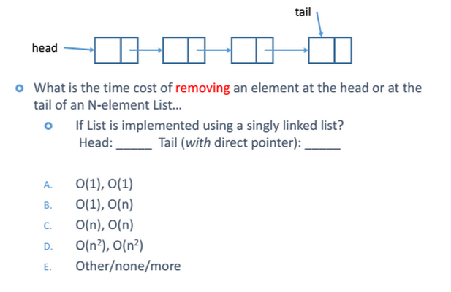
Mapping between single linked list and Stack
B

Slide 42
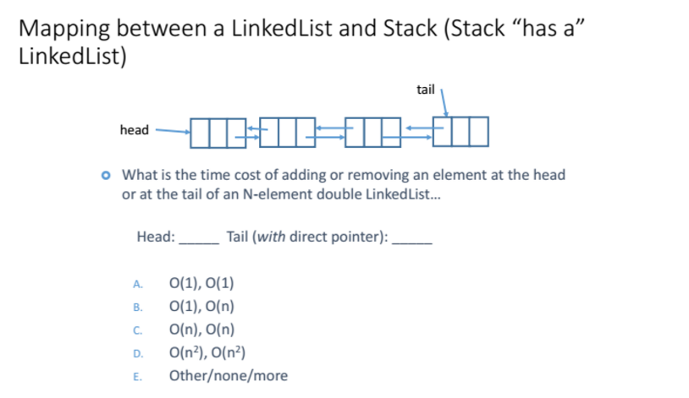
A

Slide 43
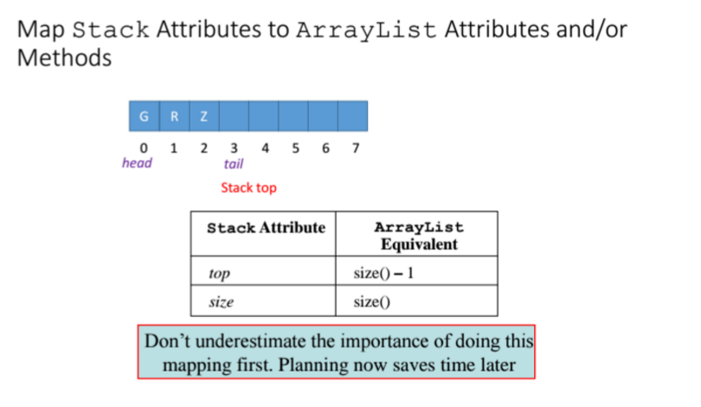

Slide 44
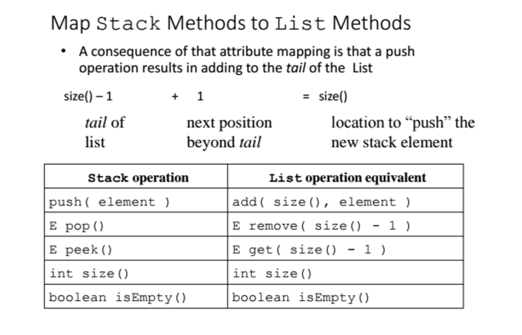

Slide 45
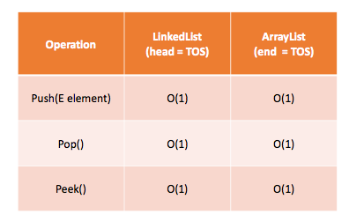
Stack Implementations, done correctly…

Slide 46
Famous Stack Application
Parentheses checker algorithm

