Slide 1
Lecture 12

Slide 2

Recursion
In order to understand recursion, one must first understand recursion

Slide 3
Recursive Definition
In a recursive definition, an object is defined in terms of itself.
f(0) = 3 (base case)
f(n + 1) = 2f(n) + 3
f(4)?
f(4) = 2*f(3) +3
f(3)= 2*f(2) + 3
f(2) = 2* f(1) +3
f(1) = 2*f(0) + 3
Use the base to stop unrolling and work up to find f(4)

Slide 4
Recursively Defined Functions
How can we recursively define the factorial function n! ?
A: n! = n * (n – 1)*(n-2)*…..*1
B: n! = n * (n + 1)!
C: n! = n * (n – 1)!
D: n! = n! * (n – 1)
E: None of the above

Slide 5
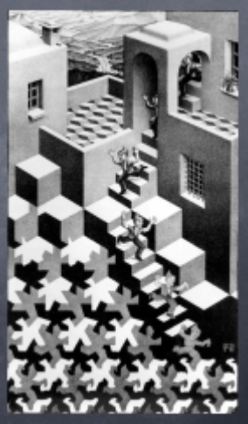
Lost in Recursion Land
Beginners often fail to appreciate that a recursion must have a conditional statement or conditional expression that checks for the “bottom-out” condition of the recursion and terminates the recursive descent
We call the bottom-out condition
the “base case” of the recursion
Warning!!
If you fail to do this properly, you
end up lost in Recursion Land and
you never return!

Slide 6
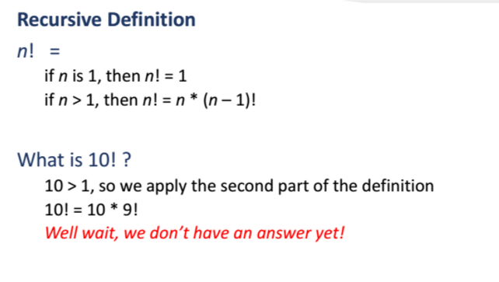

Slide 7
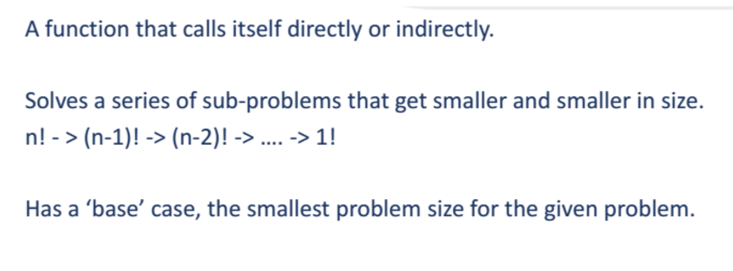
Recursive function

Slide 8
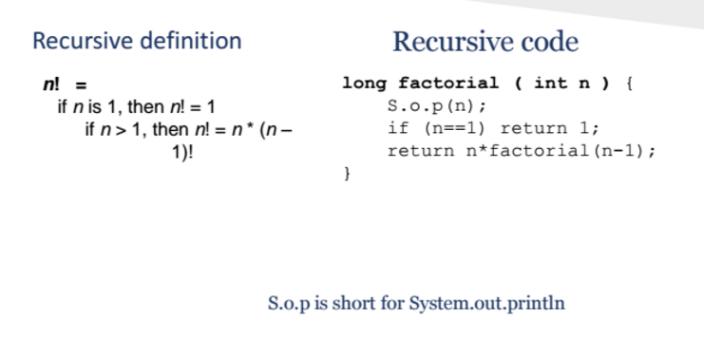
Recursion

Slide 9
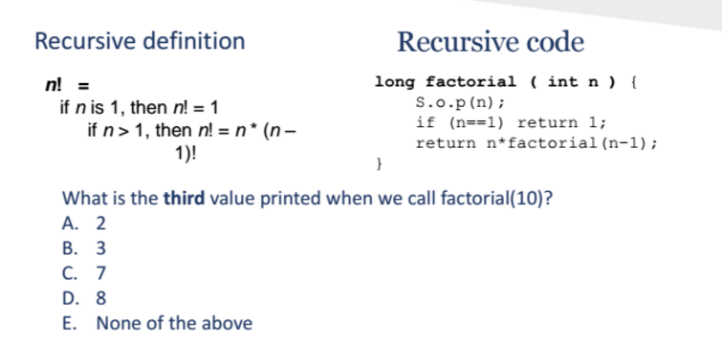
Recursion
D

Slide 10
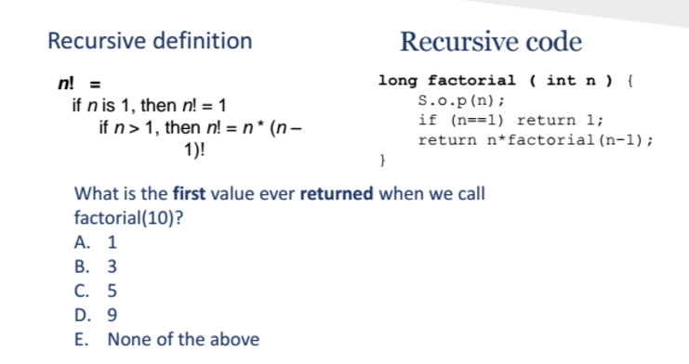
Recursion
A

Slide 11
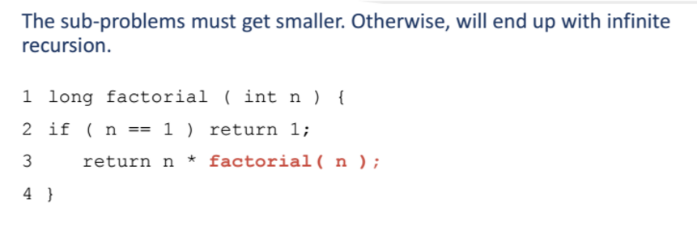
Recursion

Slide 12
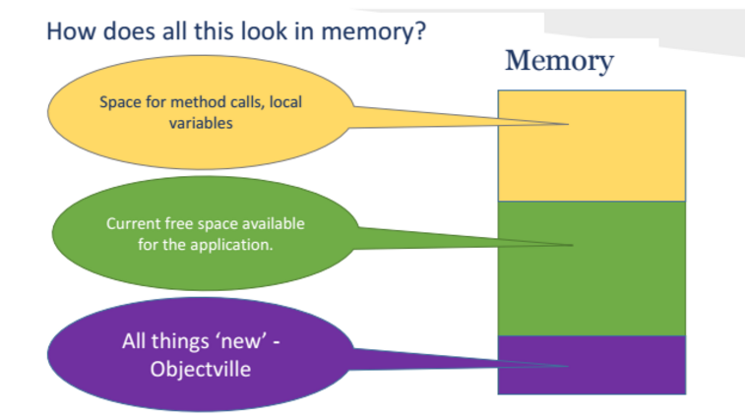
Memory, memory

Slide 13
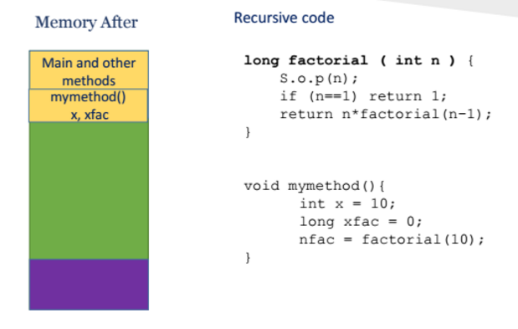
Recursion

Slide 14
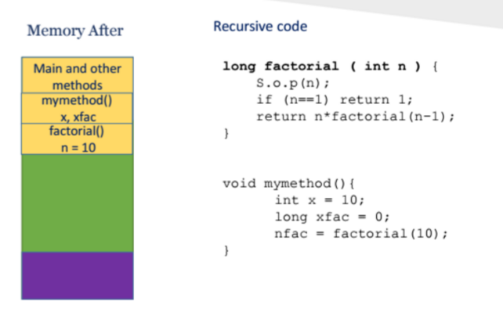
Recursion

Slide 15
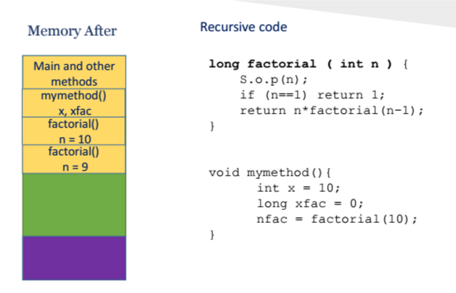
Recursion

Slide 16
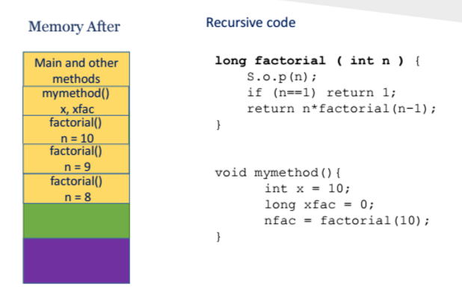
Recursion

Slide 17
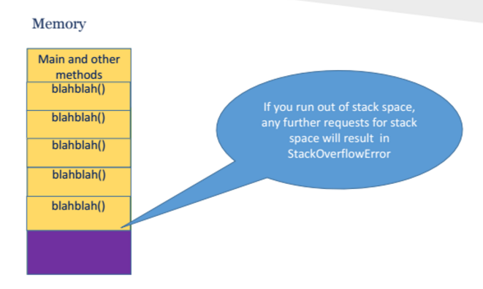
Recursion

Slide 18
Recursive Algorithms
For every recursive algorithm, there is an equivalent iterative algorithm.
Recursive algorithms are often shorter, more elegant, and easier to understand than their iterative counterparts.
However, iterative algorithms are usually more efficient in their use of space and time.

Slide 19

Merge sort

Slide 20
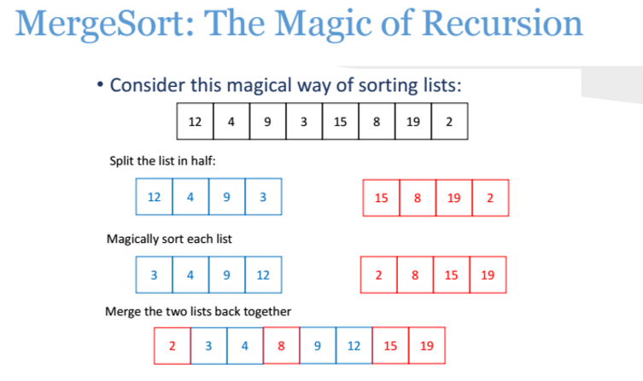

Slide 21
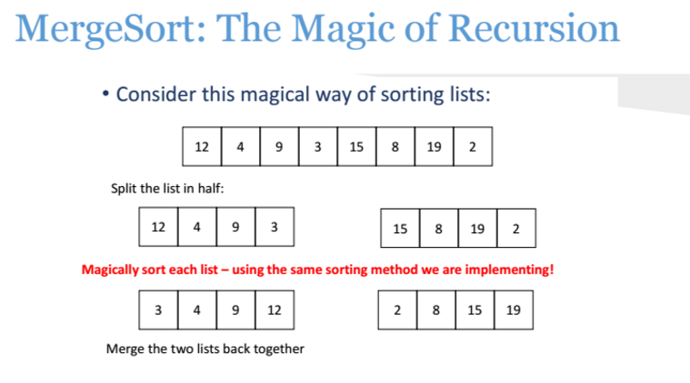
More than one recursive call

Slide 22
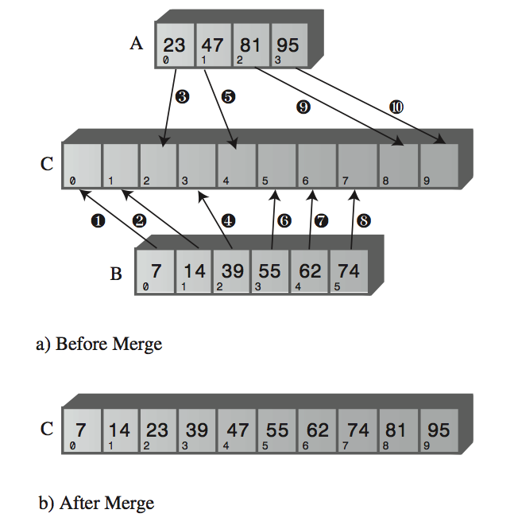
Merge Step, complexity
A: O(log n)
B: O(n)
C: O(n log n)
D: Other

Slide 23
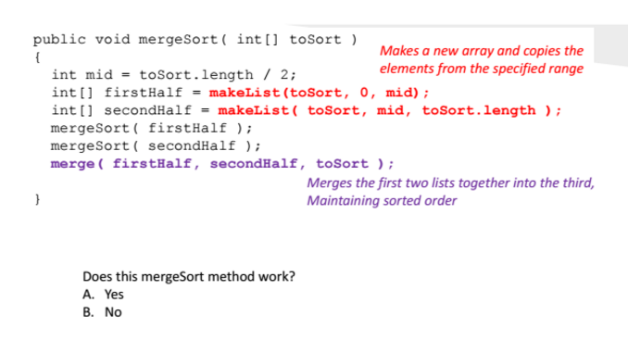
More than one recursive call
B

Slide 24
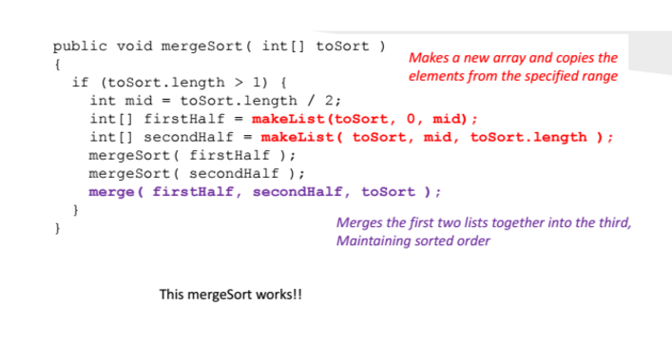

Slide 25

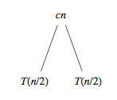
Complexity

Slide 26
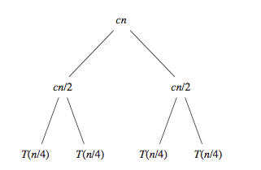
Complexity

Slide 27
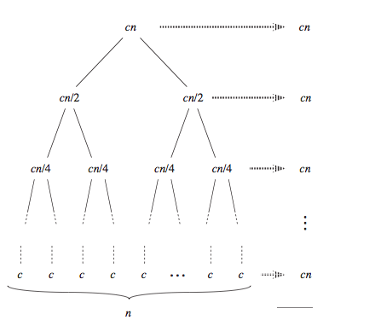
Complexity
How many levels?
A: log₂ n
B: n
C: n log₂n
D: n²

Slide 28
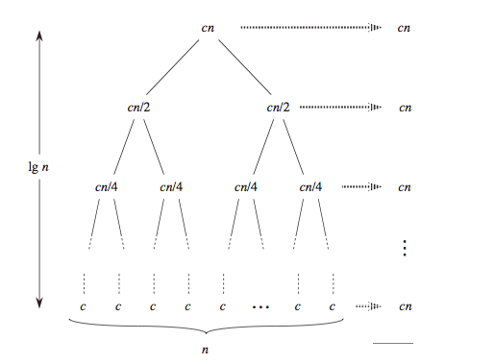
Complexity
To find total complexity, we need to add complexity at every level:
What is it going to be?
A: O(n log n)
B: O(n²)
C: O(n)
D: Other

Slide 29
Space overhead
Merge sort is not in place, in means it needs an additional space to sort numbers.
What does it use?
What is the space complexity?
A: O(1)
B: O(log n)
C: O(n)
D: O (n log n)
E: O(n^2)

Slide 30
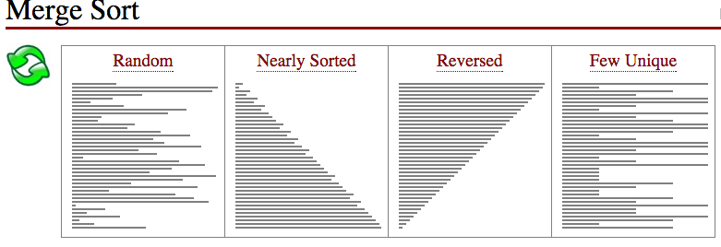
http://www.sorting-algorithms.com/merge-sort
Fastest?
A: Random
B: Nearly Sorted
C: Reversed
D: Few Unique
E: All the same

Slide 31
Merge Sort
Takes O( n log n)
Not “in place” (there is a complex version that is “in place”)
Stable (maintain the relative order of records with equal keys)

Slide 32

Quick Sort

Slide 33
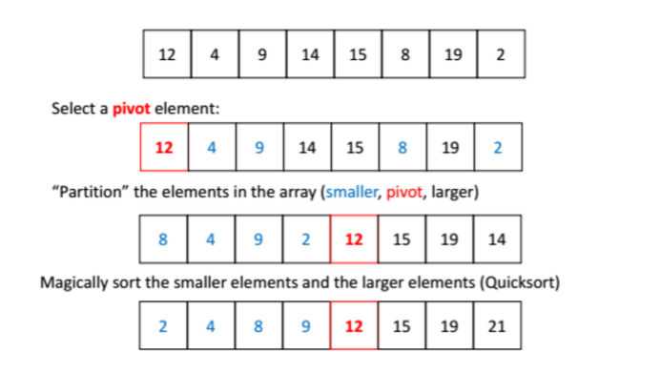
Quick Sort

Slide 34
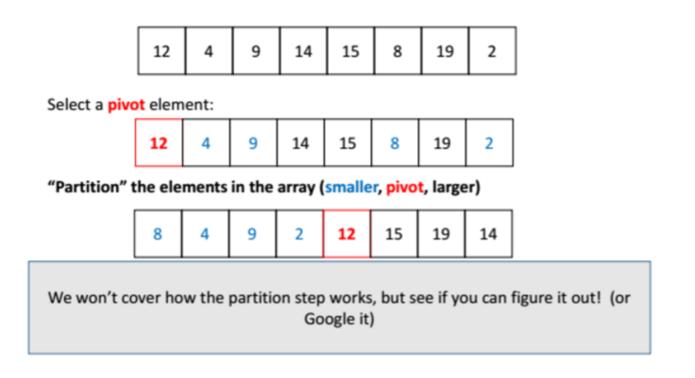
Quick Sort

Slide 35
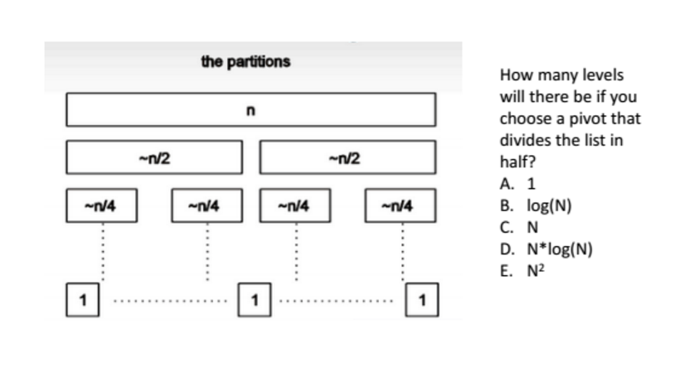
Using a “good” pivot
B

Slide 36
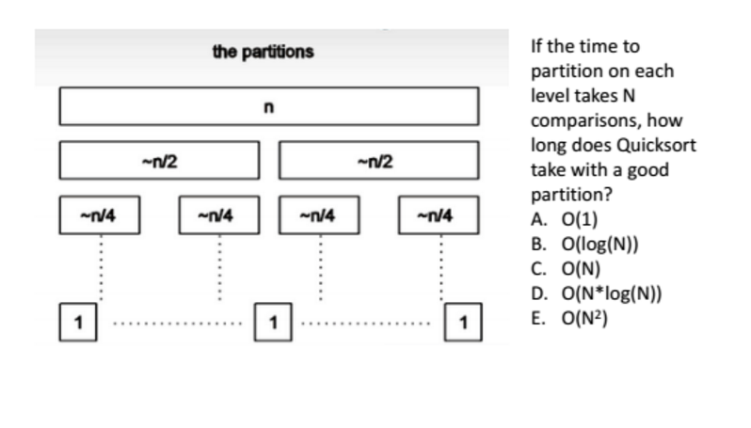
Using a good pivot
D

Slide 37
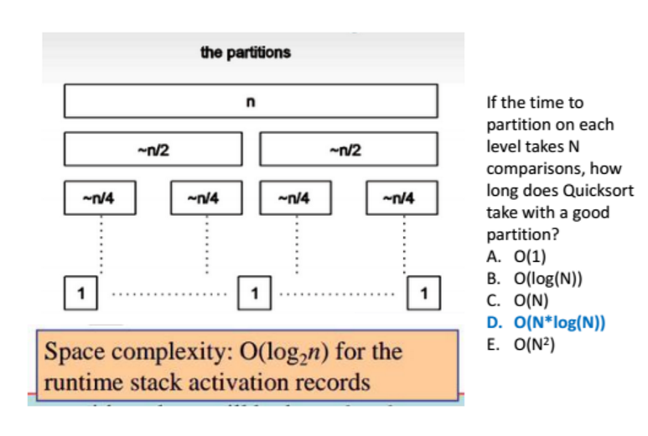
Using a good pivot

Slide 38
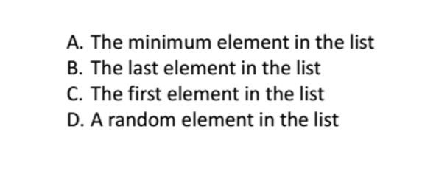
Question
Which of these choices would be the worst choice for the
pivot?
A

Slide 39
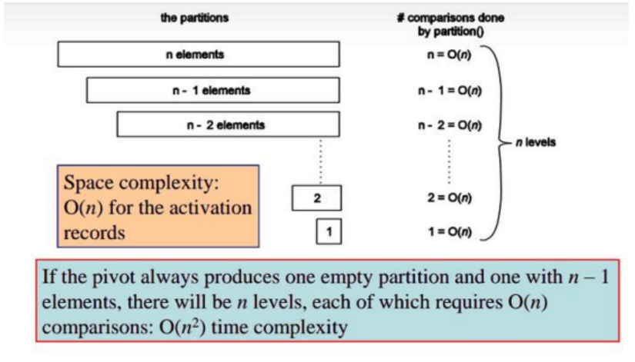
Quick sort with a bad pivot

Slide 40
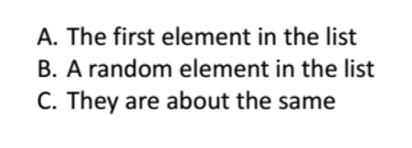
Question
Which of these choices is a better choice for the pivot?
A

Slide 41
Quick Sort
Average O(n logn )
Worst O(n²)
“In place”
Not Stable

Slide 42
If time permits
https://www.youtube.com/watch?v=XaqR3G_NVoo
https://www.youtube.com/watch?v=semGJAJ7i74&list=PLOmdoKois7_FK-ySGwHBkltzB11snW7KQ

