Slide 1
Lecture 13
Generics, part 2

Slide 2
Consider this code
List intList = new LinkedList();
intList.add(new Integer(0));
...
String s = (String) intList.get(0);
Does it compile?
Does it run?

Slide 3
Consider this code
List intList = new LinkedList();
intList.add(new Integer(0));
...
String s = (String) intList.get(0);
Does it compile?
Yes.
Does it run?
No! ClassCastException

Slide 4
How about this?
List<Integer> intList = new LinkedList<>();
intList.add(new Integer(0));
...
String s = (String) intList.get(0);
Does it compile?

Slide 5
How about this?
List<Integer> intList = new LinkedList<>();
intList.add(new Integer(0));
...
String s = (String) intList.get(0);
Does it compile?
No. Generics performs a stronger type checking at compile time.

Slide 6
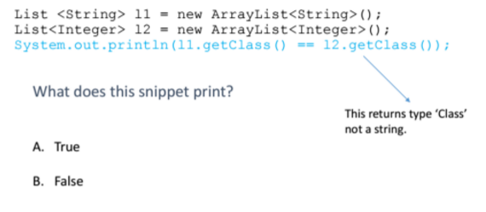
What does this snippet print?

Slide 7
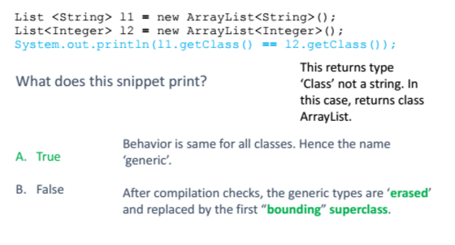
Generics

Slide 8
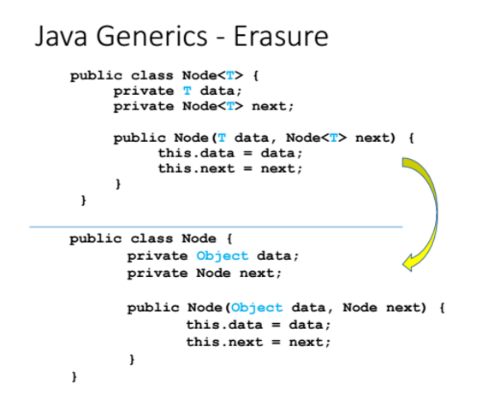

Slide 9
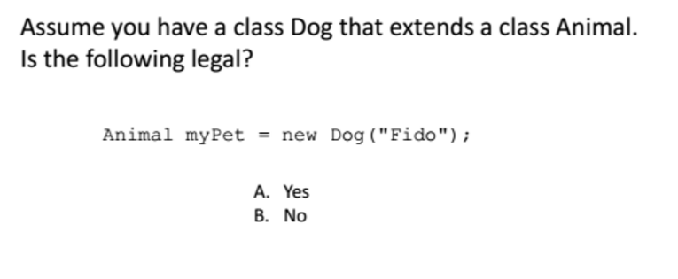
Generics and subclasses

Slide 10
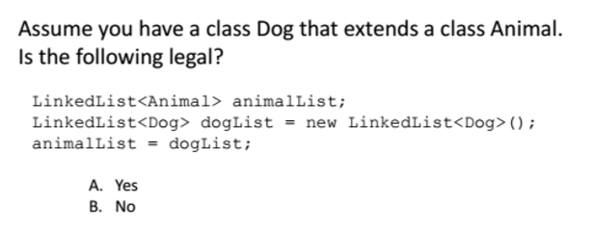
Generics and subclasses
B

Slide 11
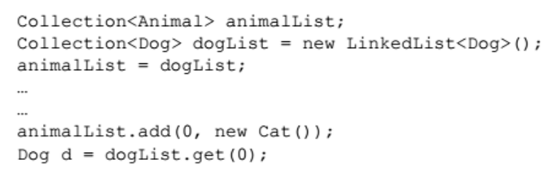
Non-covariance of Generics
A: Java parameterized types are not covariant! A collection of Dogs is NOT a collection of Animals!
This means that a Collection (or any class) parameterized by a subclass cannot be assigned to a Collection parameterized by the superclass.

Slide 12
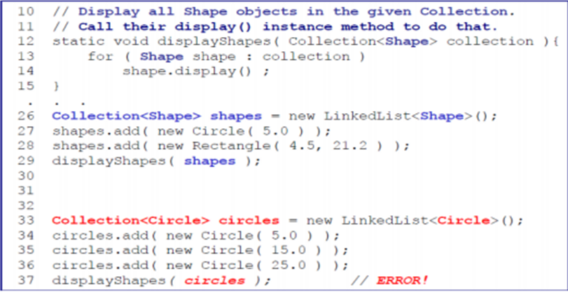
Another example

Slide 13

Generics and wild cards

Slide 14
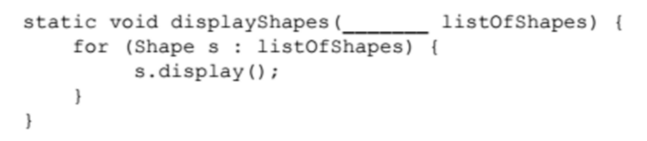
Problem
The method should accept a Collection of any subclass of Shape:
Java provides a flexible type – the wildcard – ‘?’

Slide 15
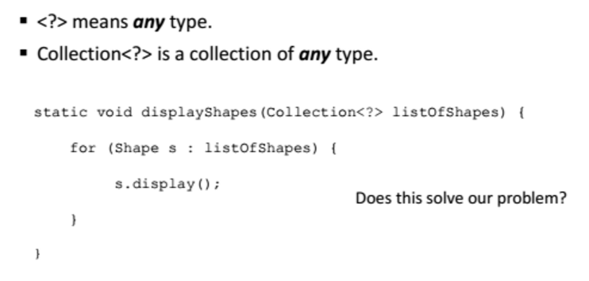
Unbounded wildcard – ‘?’

Slide 16
Bounded wildcards
Problem: The method should accept a Collection of any subclass of Shape:
Unbounded wildcards do not help as they accept a Collection of any type.
What we want is “any type that extends Shape”
<? extends Shape>
Accept any type that is ‘upper bounded’ by Shape

Slide 17
Bounded wildcards
static void
displayShapes(Collection<? extends Shape> listOfShapes) {
for (Shape s : listOfShapes) {
s.display();
}
}

Slide 18
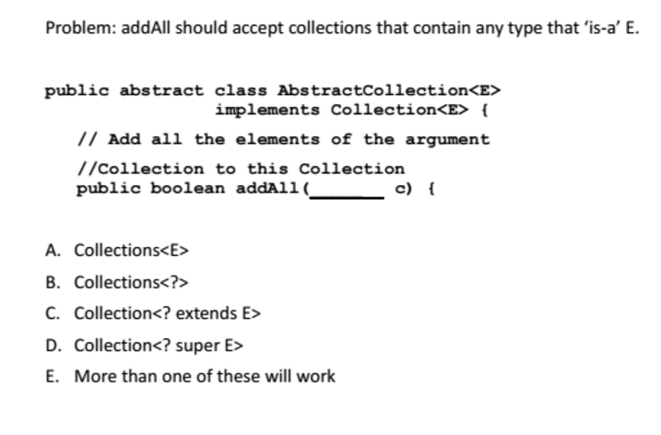
question
C

Slide 19
Generics... can you do:
Which of the following compile?
Collection<List> c = new LinkedList<List>();
LinkedList<List> myL = new LinkedList<List>();
LinkedList<List> myL = new LinkedList<ArrayList>();
LinkedList<? extends List> myL = new LinkedList<ArrayList>();
LinkedList<? super List> myL = new LinkedList<List>();
LinkedList<? super List> myL = new LinkedList<Collection>();
LinkedList<Collection> myL = new LinkedList<Collection>();
myL.add( new ArrayList() );

Slide 20
Hw6 starter code line
Class myHeap<T extends Comparable<? super T>>…
T must be a type that implements the Comparable interface
What does it have to be able to compare itself to?
Anything that is a E, and all SUPER classes of E.

Slide 21
Constraints on T
Sometimes the type T can’t be “just any old Object”,
Type T must sometimes satisfy some conditions.
An example of this is the dHeap class you are going to implement is your PA 6.
The elements must all be Comparable -- the heap implementation needs to be able to call compareTo (o) on every element stored in the tree.

Slide 22
Constraints on T
Suppose we add three objects to a heap:
heap = new dHeap<Object>();
heap.add(“Marina”); //OK, String is Comparable
heap.add(“Robert”); //OK, String is Comparable
heap.add(new Object()); //Not OK, Object not Comparable

Slide 23
Constraints on T
Suppose we add three objects to a heap:
heap = new dHeap<Object>();
heap.add(“Marina”); //OK, String is Comparable
heap.add(“Robert”); //OK, String is Comparable
heap.add(new Object()); //Not OK, Object not Comparable
if (node[index1].compareTo(node[index2]<0) {…
But if index1 refers to the Object we added, this method will fail because Object does not implement the Comparable interface.

Slide 24
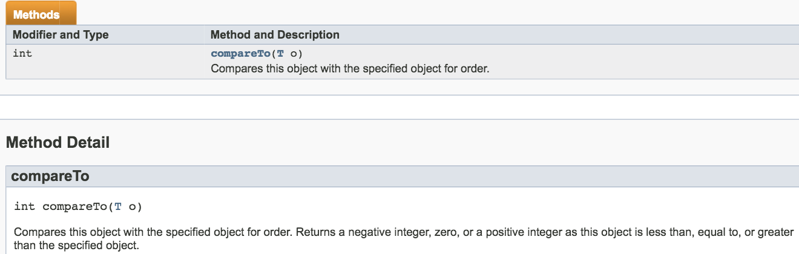
Comparable Interface

Slide 25
Bounds on type parameters
What we want is a way of enforcing that the type parameter T be of type Comparable.
Bounds on type parameters.

Slide 26
Bounds on type parameters
We can also require that type T implement some interface.
For example, dHeap class should only store elements that are all Comparable.
class dHeap <T extends Comparable> implements dHeapIntfce<T>
The “extends Comparable” enforces that any T we pass in as the type parameter
must be of type Comparable.
dHeap<Object> heap = new dHeap <Object>() // not ok. Compile Error

Slide 27
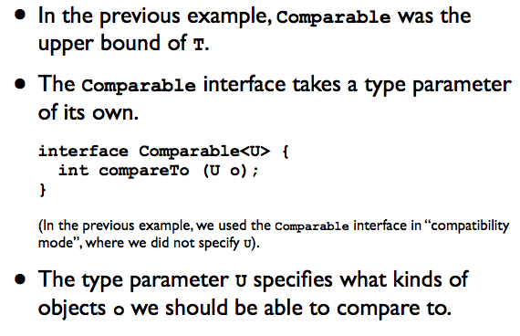
Bounds on type parameters

Slide 28
Bounds on type parameters
We can define what kind of objects U we can compareTo:
Example:
class dHeap<T extends Comparable<T>>…
Here we require that whatever type T the dHeap is instantiated with, it must be Comparable to other objects of type T

Slide 29
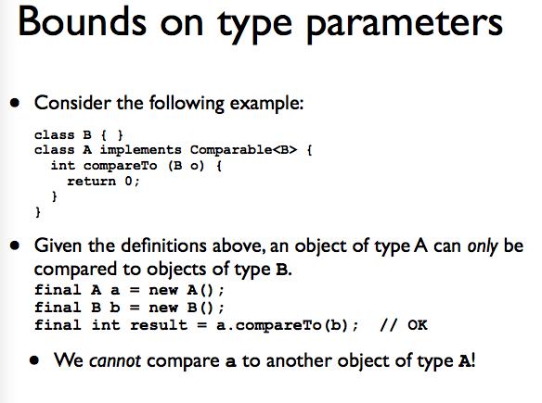

Slide 30
Bounds on type parameters
Given
class dHeap<T extends Comparable<T>>…
If we try to instantiate a dHeap with A as the type parameter
dHeap<A> heap = new dHeap<A>; //not OK!
This error occurs because, even though A is Comparable to something (B), it is not Comparable<A>.

Slide 31
Bounds on type parameters
On the other hand,
String implements Comparable<String>
Integer implements Comparable<Integer>
Both String and Integer would be accepted as type parameters for dHeap:
dHeap<String> heap = new dHeap<String>;
dHeap<Integer> heap = new dHeap<Integer>;
//both are fine

Slide 32
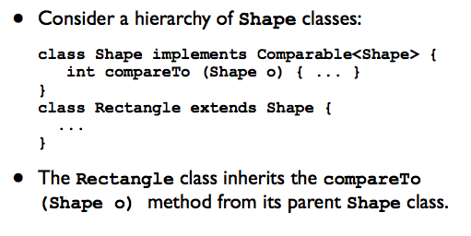
Bounds on type parameters
While useful, our current definition of dHeap is a bit overly restrictive:

Slide 33
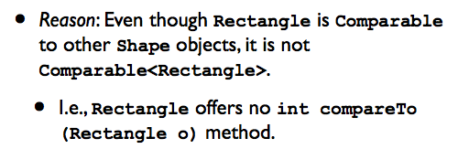
Bounds on type parameters
However, Rectangle does not offer a method compareTo (Rectangle o) designed specifically for other Rectangle objects.
Hence, the Rectangle class could not be used as the type parameter T when instantiating a dHeap:

Slide 34
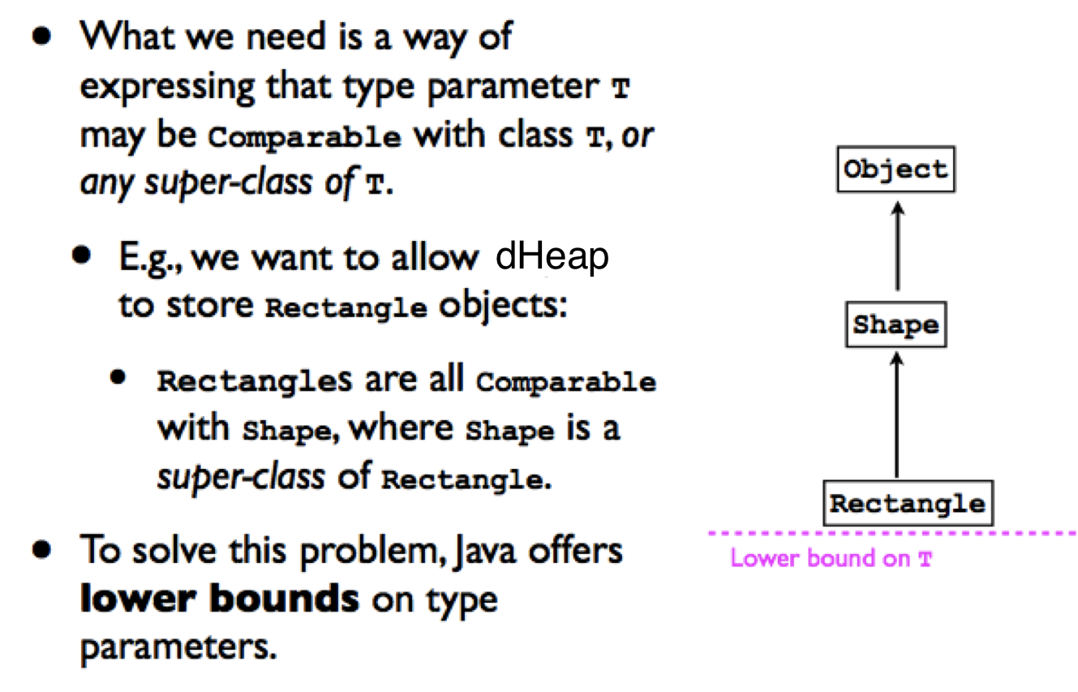
Lower bounds on types

Slide 35
Lower bounds on types
For example, we can allow the dHeap class to accept any type T as long as T is Comparable to class T OR any super-class of T.
Class dHeap<T extends Comparable<? Super T>>…
The wildcard type ? Indicates:
“We don’t care which type T is Comparable to, so long as it’s Comparable to some super-class of T (or T itself).”
The keyword super indicates the lower bound of the type parameter.

Slide 36
Lower bounds on types
Given this revised definition of dHeap, we can now instantiate a heap of Rectangle objects:
dHeap<Rectangle> heap = new dHeap<Rectangle>(); // OK

