Slide 1
Lecture 17
Binary search trees, cont

Slide 2
Plan
Insert
Delete
Running time

Slide 3
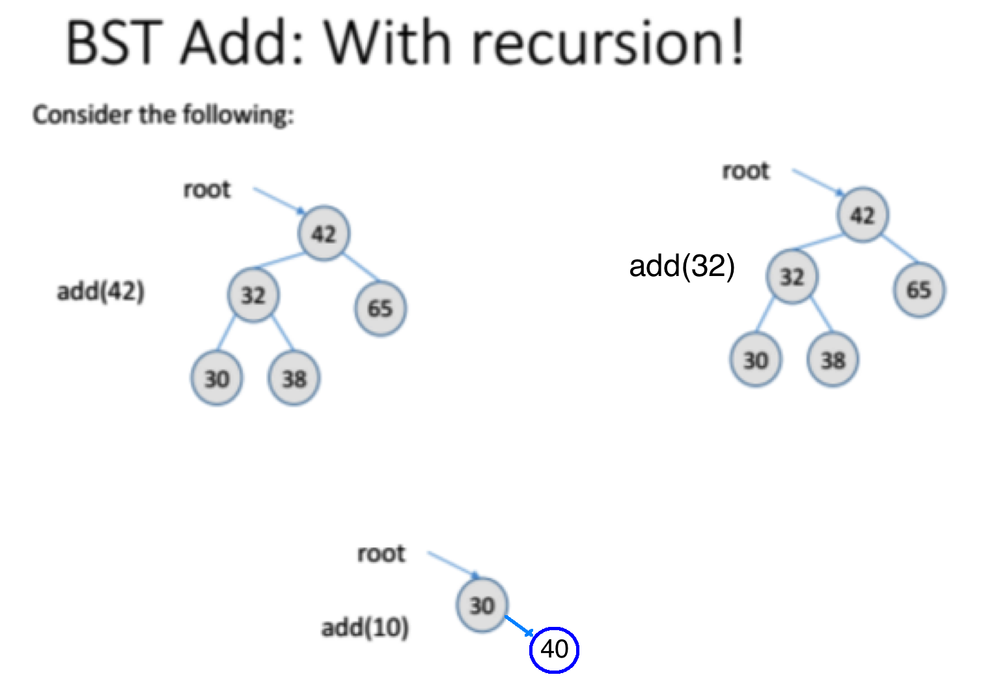
Insert a node in a BST

Slide 4
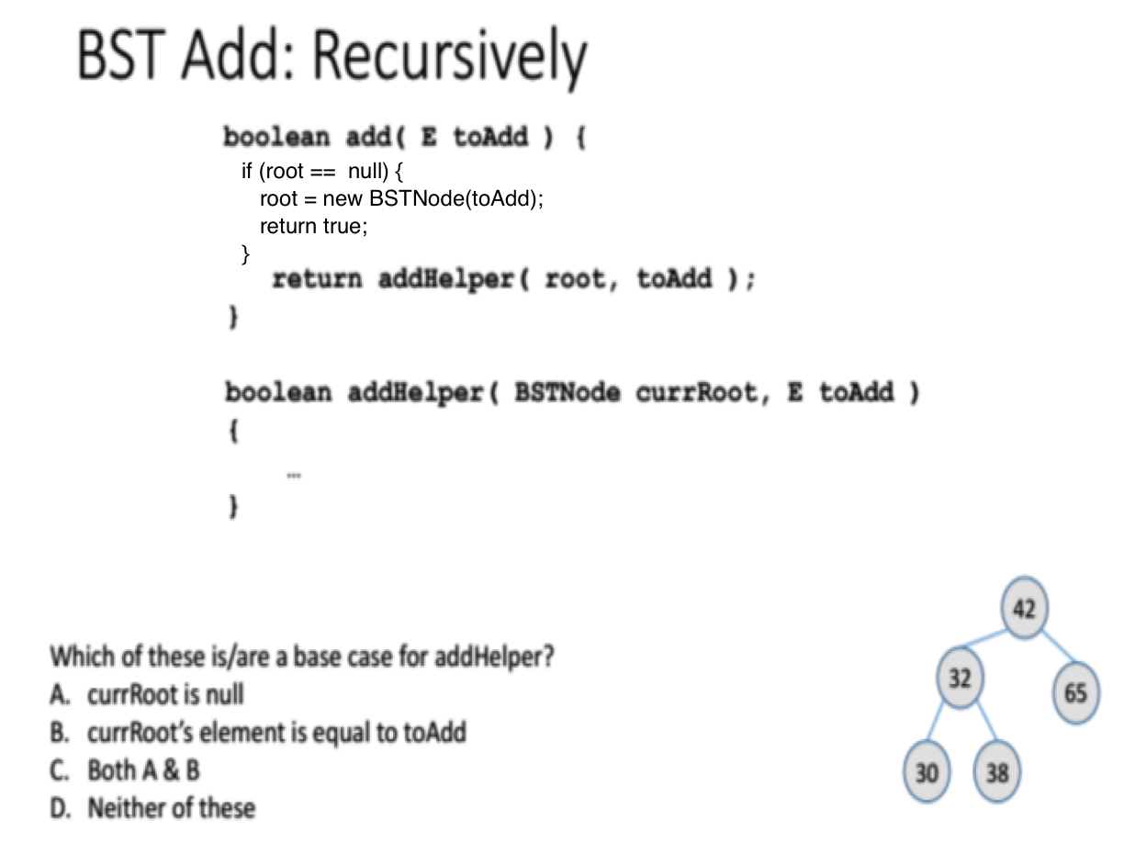
Add() is missing something
A

Slide 5
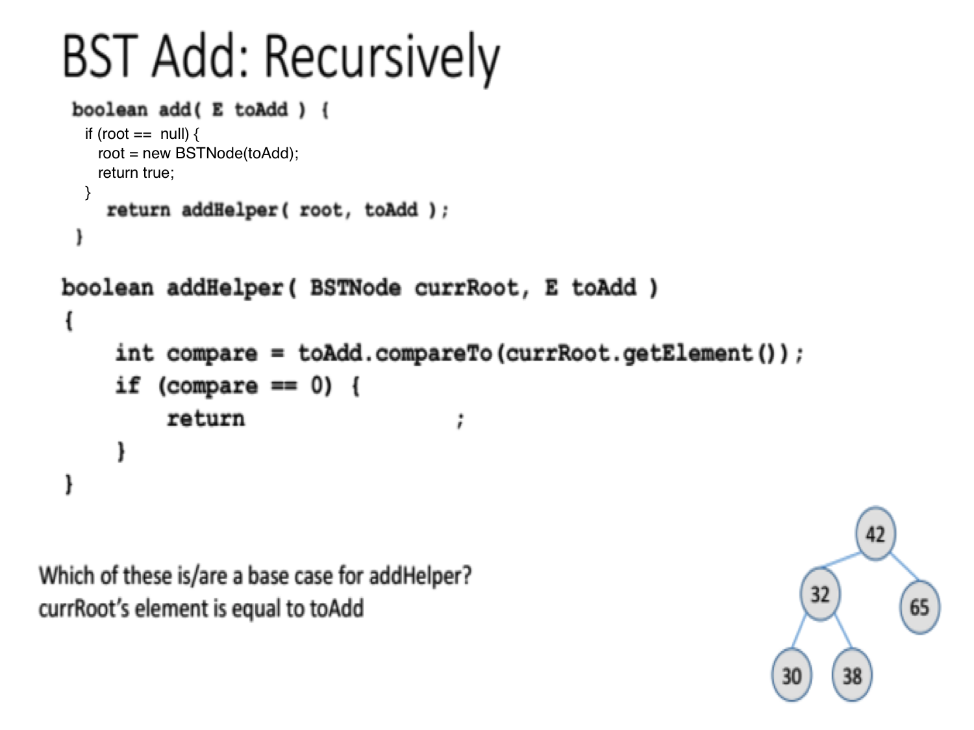

Slide 6
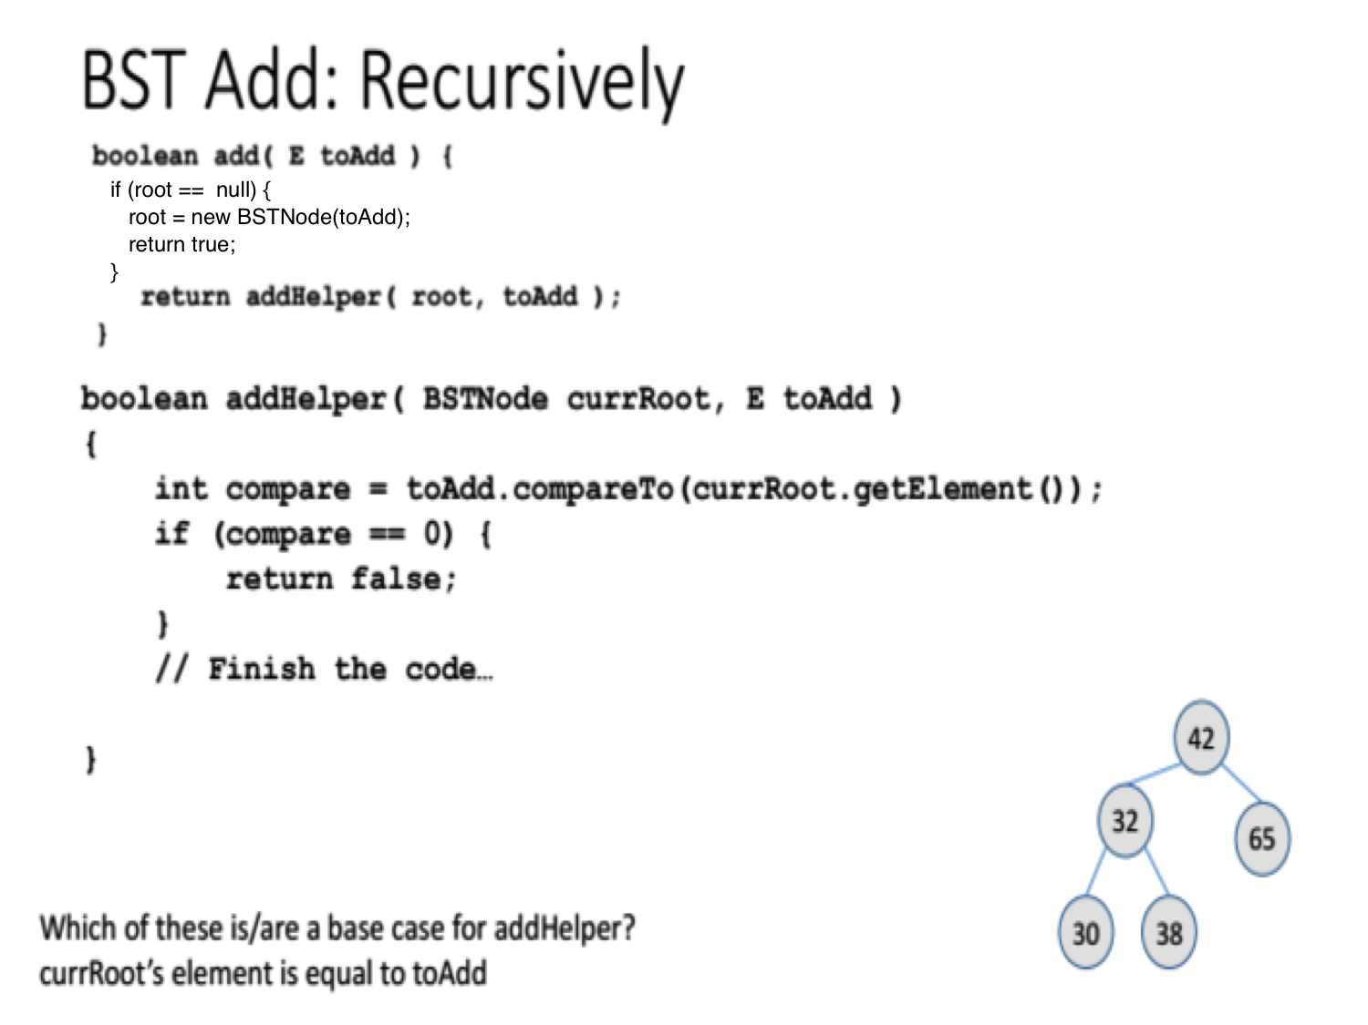

Slide 7
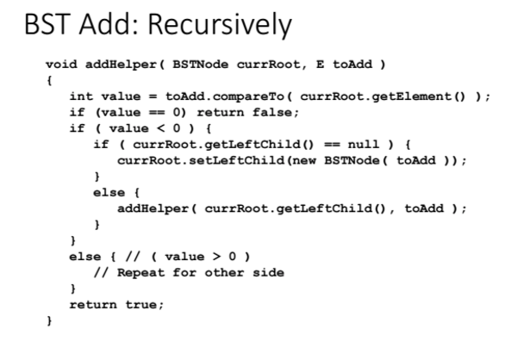

Slide 8
Remove a node
Real deletion (blackboard)
Lazy deletion.

Slide 9
Duplicate keys
Allow them and be consistent with the rule
Node is a linked list. All duplicates are linked.

Slide 10
Complexity

Slide 11
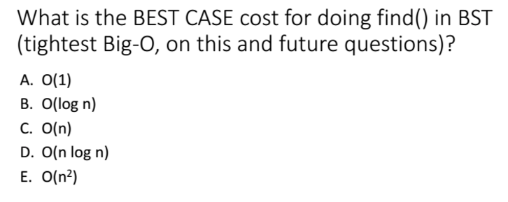
A

Slide 12
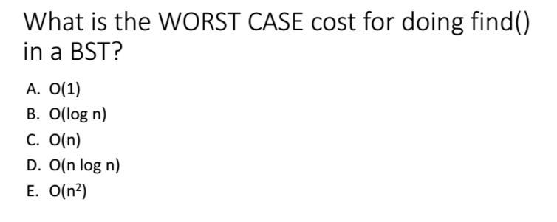
C

Slide 13
Balance
The #1 issue to remember with BSTs is that they are great when balanced (O(log n) operations), and horrible when unbalanced (O(n) operations)
Balance depends on order of insert/delete of elements
Over the years, people have devised many ways of making sure BSTs stay balanced no matter what order the elements are inserted.
We won’t talk about these ways here, but stay tuned for CSE 100...

Slide 14
Fun Questions
Find k-th minimum element in a BST.
Given a binary tree, check whether it’s a binary search tree or not.

