Slide 1
Lecture 16

Slide 2
Plan for today
A few questions from the midterm, T/F
Homework comment
A few feedback questions
Binary Trees traversals
Binary search trees

Slide 3
Best case for heapsort
Statement: If array has only 1 element then it is sorted, therefore the best running time for heapsort is O(1).
A: True
B: Kinda makes sense, I would say yes.
C: I feel it is wrong but not sure why
D: False

Slide 4
Best case for heapsort
Statement: If array has only 1 element then it is sorted, therefore the best running time for heapsort is O(1)
This statement is false.
Big-O is a behavior of the method (function) when n goes to infinity. (just describes asymptotic bounds)

Slide 5
Line from the exam
for(int i = n; i>=1; i=i/2){ for (int j=0; j<=c∗n; j++} {
Does the running time depend on c? (C is positive)

Slide 6
Adapter design pattern
Implementing a queue using a circular array is an example of adapter design pattern.
This statement is false.
Adapter design pattern: allows the interface of an existing class to be used as another interface

Slide 7
T/F answers

Slide 8
Homework note
Items should be added to a priority queue in first-come first-serve order (if the keys are equal).
private long timestamp;
//Sets the timestamp inside this registration to be the current time.
public void setTimestamp() {
timestamp = System.nanoTime(); }
Call it when adding to waitlist:
public void addToWaitlist(Registration r) {
r.setTimestamp(); // <= Added
….....
}
Then use the timestamp if necessary when comparing:
public int compareTo( Registration o ) { …... }

Slide 9
Pace of the class
A: Too slow, please speed up
B: A little too slow
C: Just right
D: A little too fast
E: Way too fast for me

Slide 10
iClicker questions
What do you think about me using them
A: I enjoy them
B: I Like them ok
C: Indifferent
D: I do not like them
E: Not a fan at all

Slide 11
Time given for solo vote
A: Too much time
B: Just right
C: Sometimes not enough, sometimes too much
D: Never enough

Slide 12
Group discussions
A: I think they are useful.
B: Does not make any difference, I do participate
C: Does not make any difference, I do not participate
D: I do not like them.

Slide 13
Zybooks
A: I like it, keep on using it
B: I like it OK, not in depth
C: Indifferent
D: Not fan
E: Waste of money

Slide 14
Last heap question
There is only one configuration of a valid min-heap containing the elements {34, 12, 1, 30, 45}
A: True
B: False

Slide 15
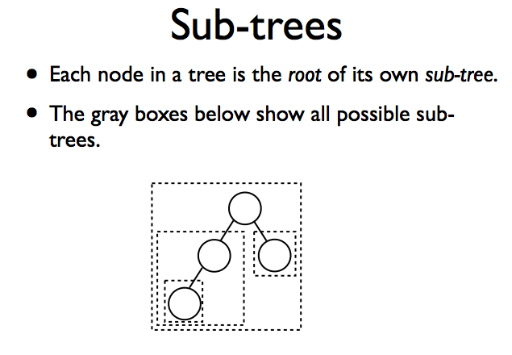

Slide 16
Binary tree traversals

Slide 17
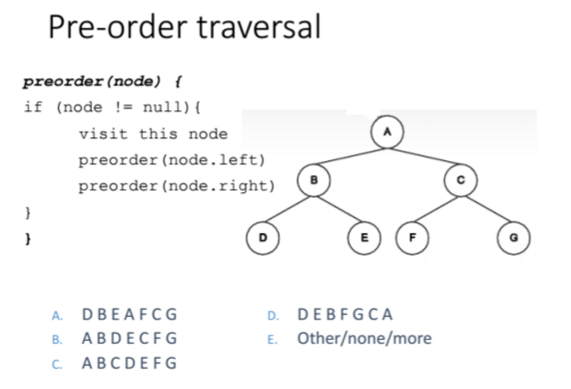

Slide 18
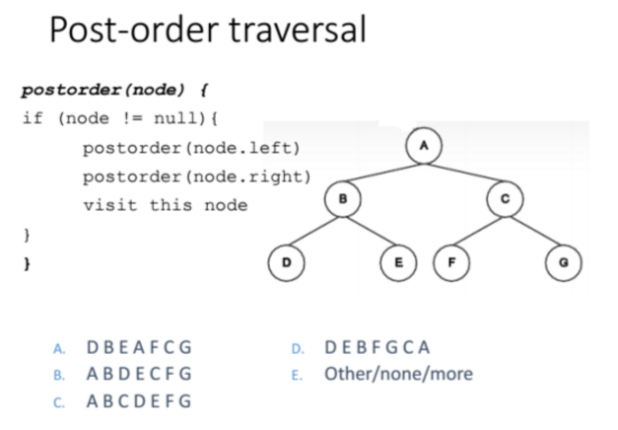

Slide 19
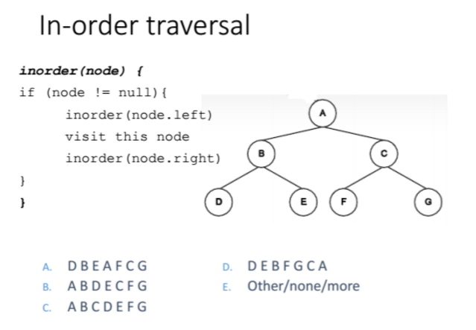

Slide 20
Could you do it?
Give a tree with at least 3 nodes (all nodes must have different keys) such that both its in-order read and its pre-order read are the same, or prove that there is no such tree.
Give a tree with at least 3 nodes (all nodes must have different keys) such that both its pre-order read and its post-order read are the same, or prove that there is no such tree.

Slide 21
Binary search trees

Slide 22
Heaps are not enough!
Heaps offer fast access to the largest element in a collection.
This is most useful in a priority queue.
However, finding an arbitrary element is still slow -- O(n) time.
We may want to sacrifice efficiency of getting the largest element in exchange for increased efficiency to access any arbitrary element.

Slide 23
Binary SEARCH tree
A binary search tree (BST) is a binary-tree based data structure that offers O(log n) average-case time costs for:
Add (element)
Find (element)
Remove (element)
findLargest/removeLargest (element)

Slide 24
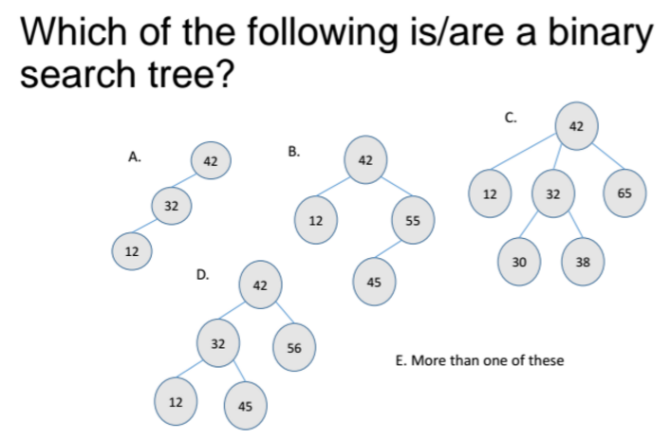
A,B

Slide 25
Binary SEARCH tree (BST)
BST property? For each node n
A: all nodes in left subtree of n are “less than” node n, and all nodes in the right subtree of n are “greater than node n.
B: It must be complete
C: all nodes in left subtree of n are “greater than” node n, and all nodes in the right subtree of n are “less than node n.
D: answer A + tree must be complete.
E: answer C + tree must be complete

Slide 26
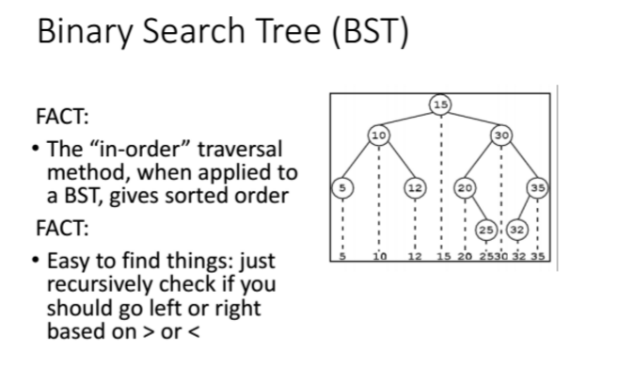

Slide 27
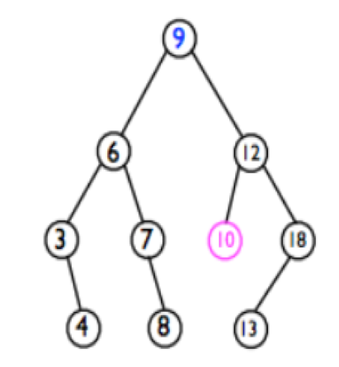
Where to find a min element?
In a given a binary tree?

Slide 28
BST implementation

Slide 29
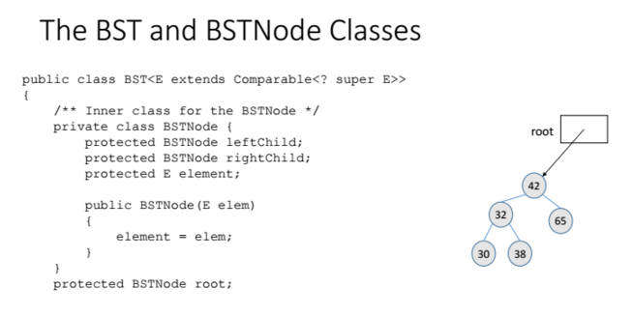

Slide 30
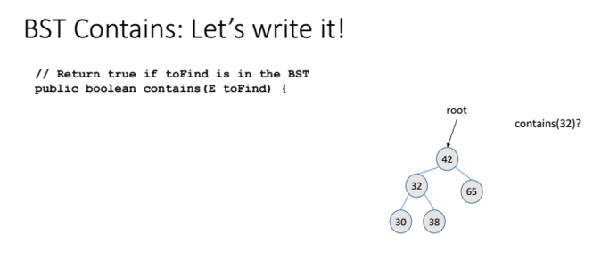

Slide 31
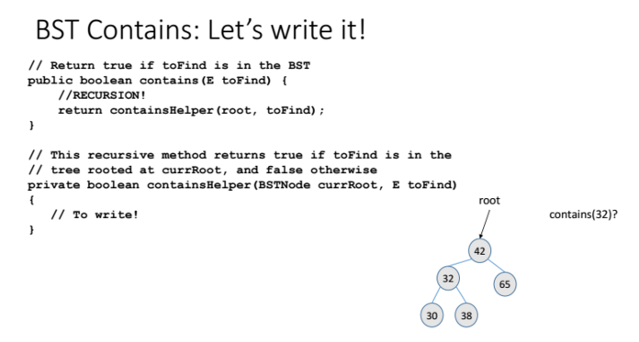

Slide 32
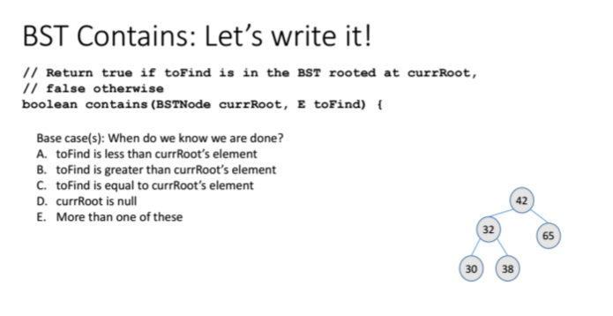
C

Slide 33
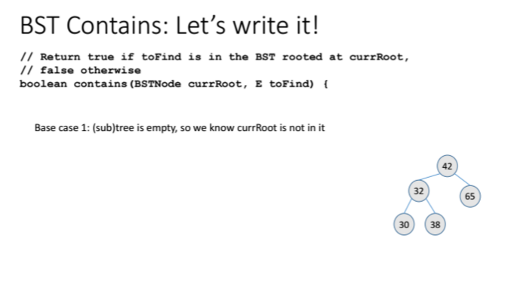

Slide 34
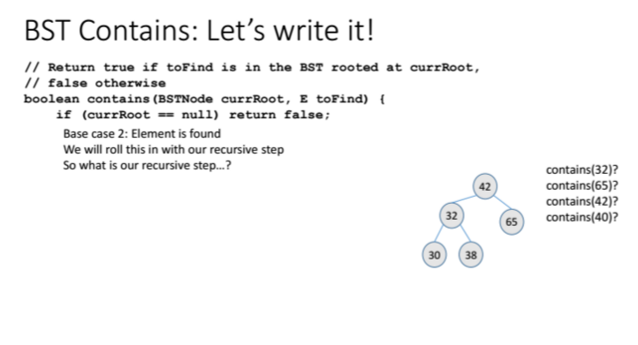

Slide 35
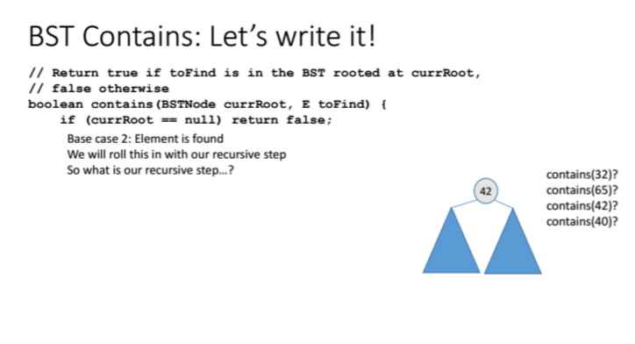

Slide 36
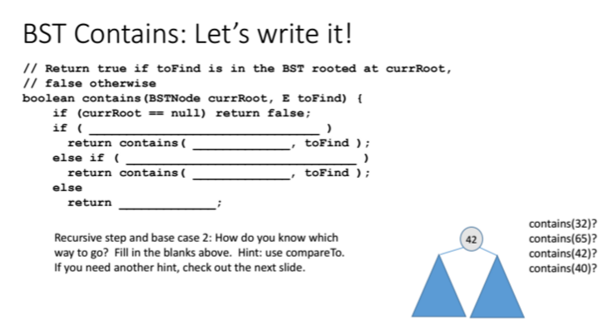

Slide 37
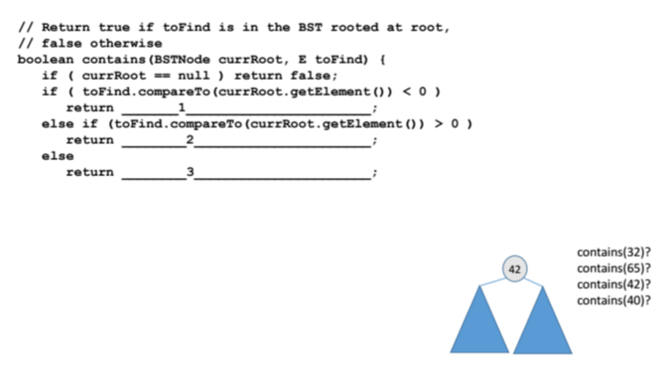

Slide 38
