Slide 1
Hash Functions

Slide 2
Strings as keys
Keys are not always integers.
The classic example is a dictionary (hw8). If you want to put every word of an English-language dictionary, from a to zyzzyva
(who knows what it is and how to pronounce it?)
into your computer’s memory so they can be accessed quickly, a hash table is a good choice.
A similar widely used application for hash tables is in computer-language compilers, which maintain a symbol table in a hash table.
The symbol table holds all the variable and function names made up by the programmer, along with the address where they can be found in memory.
https://en.wikipedia.org/wiki/Symbol_table

Slide 3
Converting words to numbers
Let’s say we want to store a 50,000-word English-language dictionary in main memory
Use the length of a word as a hash function:
A: It is a good choice
B: It is not uniform
C: It is not fast
D: It is not deterministic

Slide 4
Converting words to numbers (50,000-words)
Another idea: Use ASCII code, in which a is 97, b is 98, and so on, up to 122 for z. Then add the numbers.
Let’s say a is 1, b is 2, c is 3, and so on up to 26 for z. We’ll also say a blank is 0, so we have 27 characters. (assume no capitals).
I subtracted 96 to make the math easier.
“cat”= 3 + 1 + 20 = 24.
A: It is a good choice
B: It is not uniform
C: It is not fast
D: It is not deterministic
.

Slide 5
Converting words to numbers (multiplying powers)
Idea: Hash each word into a unique location.
How? Number analogy:
7,546 = 7*1000 + 5*100 + 4*10 + 6*1
(or using powers of 10):
7,546 = 7*10³ + 5*10² + 4*10¹ + 6*10⁰
Why base 10? Because there are 10 possible digits.

Slide 6
Converting words to numbers (multiplying powers)
Why base 10? Because there are 10 possible digits.
If we are apply the same idea to strings, what is our base?
A: 10
B: 27 (26 letters and the space)
C: Can’t apply the method

Slide 7
Converting words to numbers (multiplying powers)
We will use base 27 because we have 26 letters and 1 space.
“cat”: c = 3, a = 1, t = 20.
What is the corresponding conversion?
A: 3*27³ + 1*27² + 20*27¹
B: 3*27² + 1*27¹ + 20*27⁰
C: 3*27 + 1*27 + 20*27

Slide 8
Converting words to numbers (multiplying powers)
The largest 10-letter word (let’s assume 10 is the max length of the word), zzzzzzzzzz, translates into …
?

Slide 9
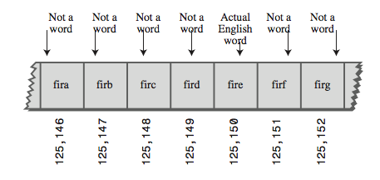
Converting words to numbers (multiplying powers)
The largest 10-letter word (let’s assume 10 is the max length of the word), zzzzzzzzzz, translates into …
26*27⁹ + 26*27⁸ + 26*27⁷ + 26*27⁶ + 26*27⁵ + 26*27⁴ + 26*27³ + 26*27² + 26*27¹ + 26*27⁰ ←HUGE NUMBER.
Another problem:

Slide 10
Conclusion
Our first scheme—adding the numbers—generated too few indices.
This latest scheme—adding the numbers times powers of 27—generates too many.
Hash Tables have large but reasonable size. We will use the second approach with some changes.
key = 3*27² + 1*27¹ + 20*27⁰
index = (key) % tableSize;

Slide 11
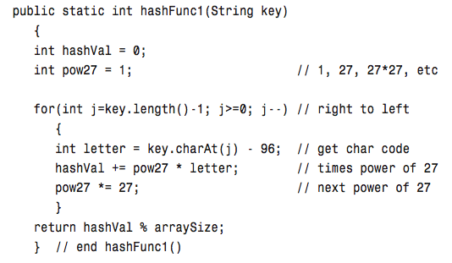
Hash Strings: “cat” hashVal= 3*27² + 1*27¹ + 20*27⁰

Slide 12
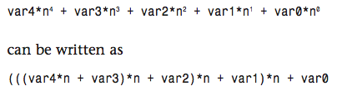
Not efficient yet
Aside from the character conversion, there are two multiplications and an addition inside the loop
Horner’s Method.

Slide 13

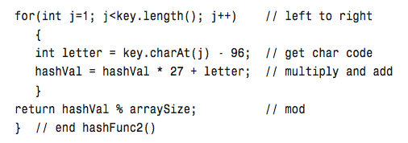
Another version

Slide 14
Are we done improving?
A: Yes, looks good.
B: No, it is not deterministic
C: No, it is not uniform
D: No, can’t handle large words

Slide 15
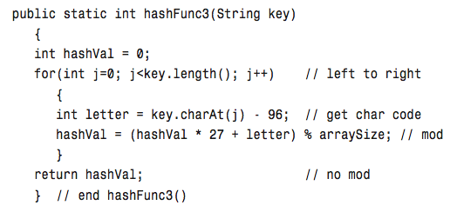
Final modification (do not -96 in your HW)

Slide 16
Even faster
Various bit- manipulation tricks can be played as well, such as
using a base of 32 (or a larger power of 2) instead of 27, so that multiplication can be effected using the shift operator (>>),

Slide 17
Folding: another idea
For larger strings: (length over 7)
Group more than one digit. (2, 3, 4).
Add them.
% tableSize.

Slide 18
Right and Left shifts
https://en.wikipedia.org/wiki/Logical_shift

Slide 19
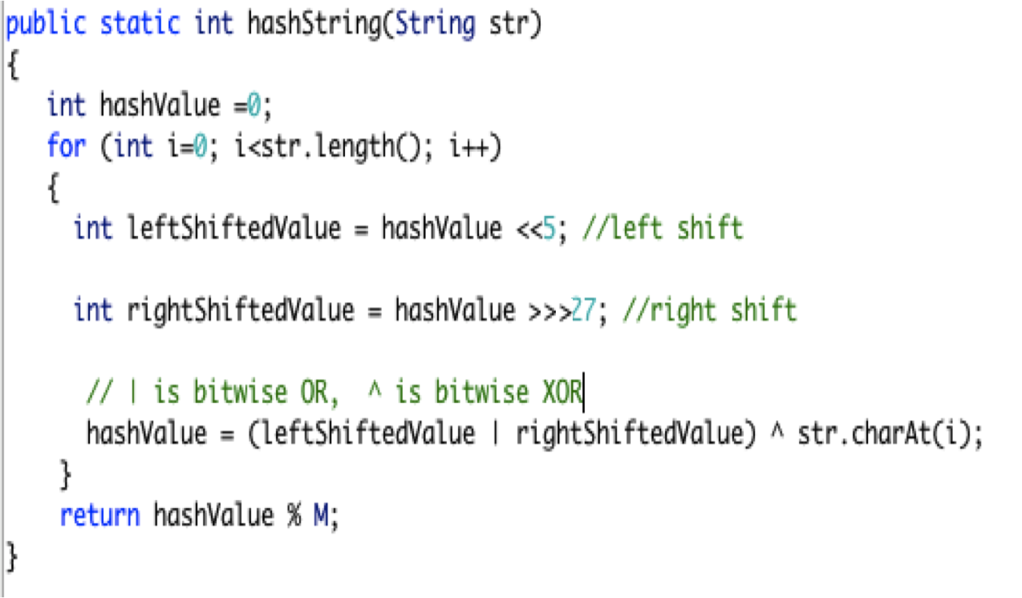
CRC (simplified) Cyclical Redundancy Checking

Slide 20
More ideas
I have a few word documents with different hash function ideas. There are a few implementations in C++ so you can convert to Java. (credit goes to Geoff Kuenning)
Statistics:
http://programmers.stackexchange.com/questions/49550/which-hashing-algorithm-is-best-for-uniqueness-and-speed

