Slide 1
Discussion 3
Presented by
Devyani Kulkarni
(Slides adapted from slides by Max Jiao)

Slide 2
Hw3 is out!
Covers lot of questions on Runtime Analysis.
Time for you to write your first C program!

Slide 3
Agenda for today
A review through the Review Quiz questions
Discussion on Runtime Analysis
Questions and examples on Runtime Analysis (Will probably help you get started with the HW).

Slide 4
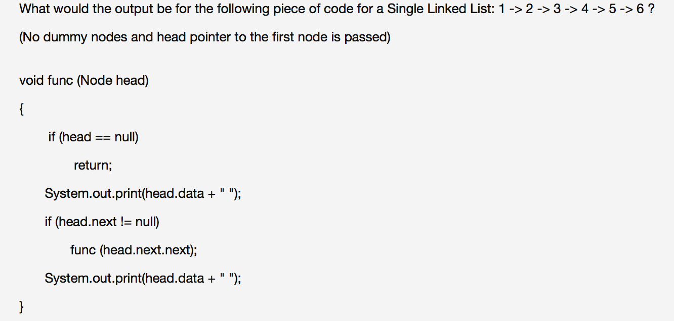
Review quiz questions
Answers:
1 3 5 6 4 2
1 3 5 5 3 1
1 3 5
1 3 5 3 1

Slide 5
Review quiz questions
Answers:
1 3 5 6 4 2
1 3 5 5 3 1
1 3 5
1 3 5 3 1

Slide 6
Review quiz questions
Which of the following about ArrayList and LinkedList are true?
Getting an element/node at a given index in an ArrayList is faster as compared to LinkedList
Adding to the beginning of the list is faster in LinkedList as compared to ArrayList
ArrayList deals with the problem of fragmentation better
Per element/node overhead in an ArrayList is lesser compared to a LinkedList

Slide 7
Review quiz questions
Which of the following about ArrayList and LinkedList are true?
Getting an element/node at a given index in an ArrayList is faster as compared to LinkedList
Adding to the beginning of the list is faster in LinkedList as compared to ArrayList
ArrayList deals with the problem of fragmentation better
Per element/node overhead in an ArrayList is lesser compared to a LinkedList

Slide 8
Review quiz questions
Each node(class is Node) in a Singly Linked List generally contains 2 fields. One field is the data and the other field is of type?
Integer
Node
String
Character

Slide 9
Review quiz questions
Each node(class is Node) in a Singly Linked List generally contains 2 fields. One field is the data and the other field is of type?
Integer
Node
String
Character

Slide 10
Review quiz questions
What is the size of the following Singly Linked List with dummy head and tail nodes?
DummyHead -> 3 -> 6 -> 9 -> DummyTail
3
6
9
5

Slide 11
Review quiz questions
What is the size of the following Singly Linked List with dummy head and tail nodes?
DummyHead -> 3 -> 6 -> 9 -> DummyTail
3
6
9
5

Slide 12
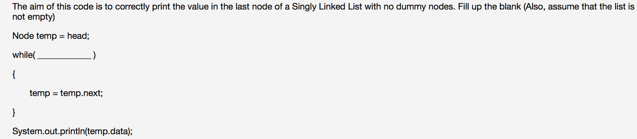
Review quiz questions
temp != null
temp.next != null
temp.next.next != null
head != null

Slide 13
Review quiz questions
temp != null
temp.next != null
temp.next.next != null
head != null

Slide 14
Runtime analysis

Slide 15
why analyze algorithms?
Classify problems and algorithms by difficulty
Predict performance, compare algorithms, tune parameters.
Better understand and improve implementations and algorithms
TRIVIA:
Analysis of algorithms is one of the subfields of computer science. People dedicate themselves to study the different ways of analyzing and improving algorithms.

Slide 16
Measuring time
The absolute running time of an algorithm cannot be predicted, since this depends on
the programming language used to implement the algorithm,
the computer machine the program runs on,
other programs running at the same time,
the quality of the operating system,
and many other factors. We need a machine-independent notion of an algorithm’s running time.
The current state-of-the-art in analysis is finding a measure of an algorithm’s relative running time, as a function of how many items there are in the input, i.e., the number of symbols required to reasonably encode the input, which we call n.
We count the number of abstract operations as a function of n.

Slide 17
example
for (int i = 0; i < a.length; i++)
{
System.out.println(a[i]);
}
Here n=a.length
1 initialization of i
n comparisons of i against a.length
n increments of i
n array indexing operations (to compute a[i])
n invocations of System.out.println

Slide 18
Time complexity
Different programming languages will yield different factors when we count their instructions.
For example, Pascal requires 3 instructions for each array access instead of the 1 instruction Java requires.
Dropping this factor goes along the lines of ignoring the differences between particular programming languages and compilers and only analyzing the idea of the algorithm itself.
This filter of "dropping all factors" and of "keeping the largest growing term" as described above is what we call asymptotic behavior.
So the asymptotic behavior of f( n ) =4n + 1 is described by the function f( n ) = n

Slide 19
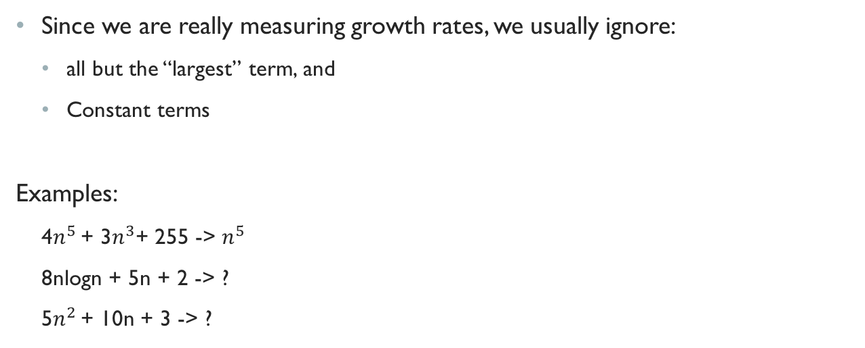
Time complexity
Since we are really measuring growth rates, we usually ignore:
all but the “largest” term, and
Constant terms
Examples:
4$n^{5}$ + 3$n^{3}$+ 255 -> $n^{5}$
8nlogn + 5n + 2 -> ?
5$n^{2}$ + 10n + 3 -> ?

Slide 20
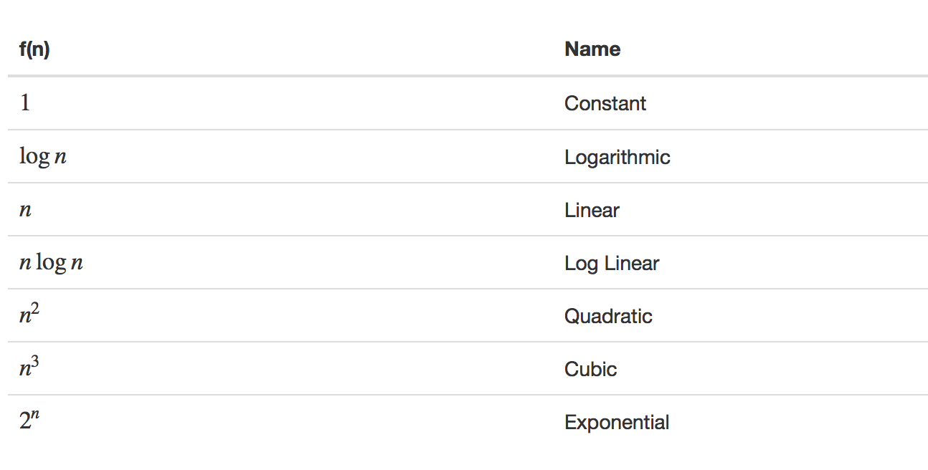
Common functions encountered

Slide 21
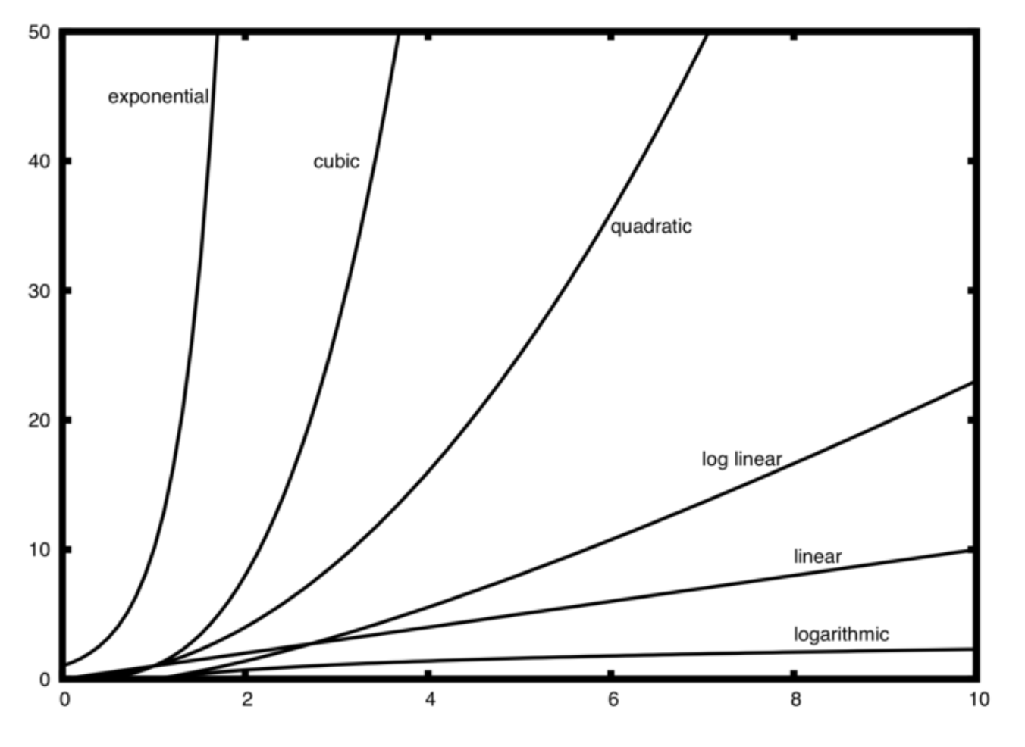
GROWTH rates

Slide 22
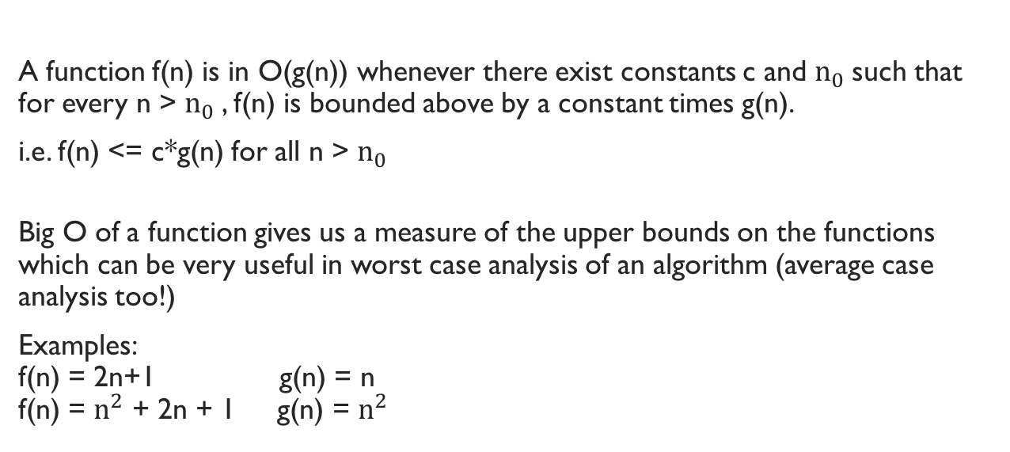
Big-O: Asymptotic Upper Bounds
A function f(n) is in O(g(n)) whenever there exist constants c and $n_{0}$such that for every n > $n_{0}$, f(n) is bounded above by a constant times g(n).
i.e. f(n) <= c*g(n) for all n > $n_{0}$
Big O of a function gives us a measure of the upper bounds on the functions which can be very useful in worst case analysis of an algorithm (average case analysis too!)
Examples: f(n) = 2n+1 g(n) = n f(n) = $n^{2}$ + 2n + 1 g(n) = $n^{2}$

Slide 23

question 1
Which if the following is true in terms of tightest bounds?
F(n) = $n^{2}+4n+16$
$O\left(n^{2}\right)$
O($n^{3})$
O(1)
O(n)

Slide 24

question 1
Which if the following is true in terms of tightest bounds?
F(n) = $n^{2}+4n+16$
$O\left(n^{2}\right)$
O($n^{3})$
O(1)
O(n)

Slide 25

question 2
Which of the following is true?
F(n) = $n^{5}+nlogn+4log7+2^{n}$
1. O($n^{5}$)
2. O($nlogn$)
3. O(1)
4. O($2^{n}$)

Slide 26

question 2
Which of the following is true?
F(n) = $n^{5}+nlogn+4log7+2^{n}$
1. O($n^{5}$)
2. O($nlogn$)
3. O(1)
4. O($2^{n}$)

Slide 27
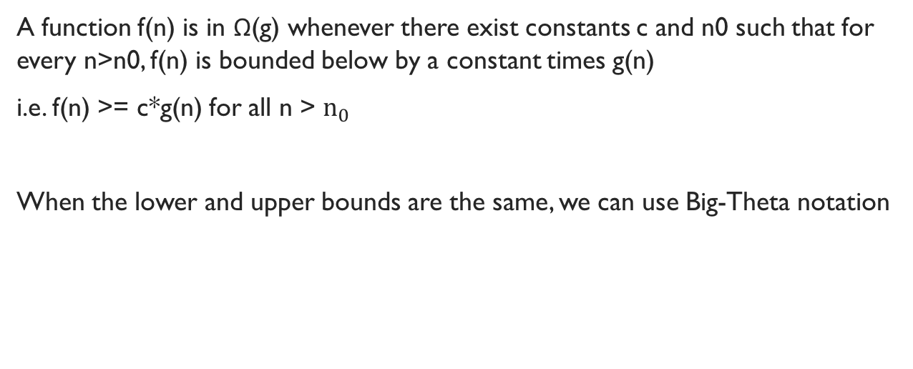
Big-Omega and BIG-theta
A function f(n) is in Ω(g) whenever there exist constants c and n0 such that for every n>n0, f(n) is bounded below by a constant times g(n)
i.e. f(n) >= c*g(n) for all n > $n_{0}$
When the lower and upper bounds are the same, we can use Big-Theta notation

Slide 28
Analyzing simple algorithms
Given an array “arr” of size n, what is the runtime of getting the 5th value of arr? Arr[5]
Given the same array “arr”, what is the runtime of finding the value 5 in arr? if (arr[i] == 5)
Given a DoublyLinkedList with head and tail, and with nelems=n, what is the
runtime complexity of add(data)?

Slide 29
Analyzing simple algorithms
Given an array “arr” of size n, what is the runtime of getting the 5th value of arr? Arr[5]
a. O(1)
Given the same array “arr”, what is the runtime of finding the value 5 in arr? if (arr[i] == 5)
a. O(n)
Given a DoublyLinkedList with head and tail, and with nelems=n, what is the
runtime complexity of add(data)?
a. O(1)

Slide 30

Big-O Hierarchy
O(1)
O(log n)
O(n)
O(n log n)
O($n^{2}$) and beyond, $n^{3}$, $n^{4}$...
O($2^{n}$) and beyond, $3^{n}$, $4^{n}$..
There are other “weird” ones but are not usually used

Slide 31

question
Is $\log_{10}{n}$ a different runtime than $\log_{2}{n}$?
Yes
No

Slide 32

question
Is $\log_{10}{n}$ a different runtime than $\log_{2}{n}$?
Yes
No
$\log_{10}{n}$ = log(n) / log 10 (which is same as multiplying by a constant!!)

Slide 33
How can we get O(log n)?
Binary search
Given a sorted array, find the value n in the array
Start at the middle, is the value you want smaller or greater?
Get rid of the unneeded half of the array
Try again until you find it
The reason this is O(log n) is because it gets rid of half of the possibilities per iteration

Slide 34
Things to memorize
Array accesses and abstract operations are O(1)
Traversing an array is O(n)
Sorting algorithms are O(n log n) (if you use good ones)
Search as usually O(n), unless it’s a binary search.
HashTables (haven’t been covered) are considered O(1)

Slide 35
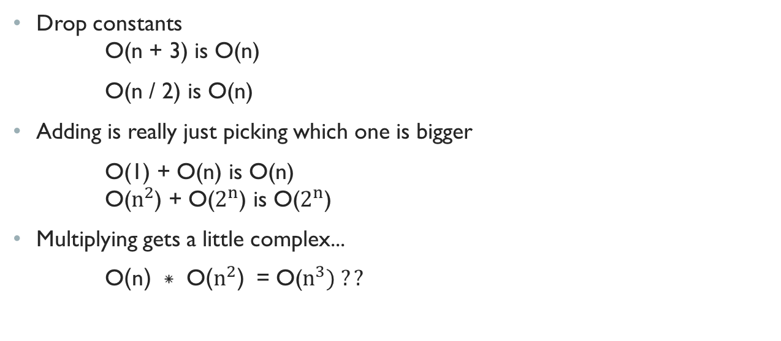
Review: How to calculate Big O
Drop constants O(n + 3) is O(n)
O(n / 2) is O(n)
Adding is really just picking which one is bigger
O(1) + O(n) is O(n) O($n^{2}$) + O($2^{n}$) is O($2^{n}$)
Multiplying gets a little complex...
O(n) * O($n^{2}$) = O($n^{3}) ??$

Slide 36
Analyzing runtime
for(int i=0; i<n; i++)
{
//do stuff here
}
Runtime? O(n)

Slide 37
Analyzing runtime
for(int i=0; i<n; i++)
{
//do stuff here
} for(int i=0; i<n; i++)
{
//do stuff here
}
Runtime: O(n) + O(n) = ??

Slide 38

Analyzing runtime
for(int i = 0; i < n; i++)
{
for(int j = 0; j < n; j++)
{
// do more stuff here
}
}
Runtime?
n + n + n + .........n = n*n = O($n^{2}$)

Slide 39
Analyzing runtime
for(int i = 1; i < =n; i++)
{
for(int j = 0; j <i; j++)
{
// do more stuff here
}
}
Runtime??

