Slide 1
mid term review discussion
Presenter:
Devyani Kulkarni

Slide 2
Tips for midterm
Time Management is crucial
Estimate and divide your time among different questions
Do not waste your time if you get stuck on a particular question. Revisit it later
Make sure you time the Practice Midterm to see what your current pace is and how much you can improve.
Practice writing code with pen and paper (VERY IMPORTANT)
Go over all the review material available for all the HWs (HW2, HW3 and HW4 are especially important)
Go through all lecture concepts
True/False, Multiple choice, Short answers and Coding

Slide 3
Question 1: Consider a singly linked list with a head and tail pointer. Given that representation, which of the following operations could be implemented in O(1) time?
Insert item at the front of the list
Insert item at the rear of the list
Delete front item from list
Delete rear item from list
Search for an item in the list
I and II
I and III
I, II, and III
I, II, and IV
all of them

Slide 4
Consider a singly linked list with a head and tail pointer. Given that representation, which of the following operations could be implemented in O(1) time?
Insert item at the front of the list
Insert item at the rear of the list
Delete front item from list
Delete rear item from list
Search for an item in the list
I and II
I and III
I, II, and III
I, II, and IV
all of them

Slide 5
Question 2: Consider an implementation of a singly linked list with a head pointer only. Given the representation, which of the following operation can be implemented in O(1) time?
i) Insertion at the front of the linked list
ii) Insertion at the end of the linked list
iii) Deletion of the front node of the linked list
iv) Deletion of the last node of the linked list
a) I and II
b) I and III
c) I,II and III
d) I,II and IV

Slide 6
Question 2: Consider an implementation of a singly linked list with a head pointer only. Given the representation, which of the following operation can be implemented in O(1) time?
i) Insertion at the front of the linked list
ii) Insertion at the end of the linked list
iii) Deletion of the front node of the linked list
iv) Deletion of the last node of the linked list
a) I and II
b) I and III
c) I,II and III
d) I,II and IV

Slide 7
Question 3: Which of the following operations are constant time O(1) operations on an array?
Add to the end (assume array is not full)
Add to the beginning (assume array is not empty)
Search for an item
Remove from the beginning (assume array has >1 item)
Remove from the end (assume non-empty array)
1, 2, 5
1, 5
1, 2. 4, 5
1, 2, 3, 4, 5

Slide 8
Question 3: Which of the following operations are constant time O(1) operations on an array?
Add to the end (assume array is not full)
Add to the beginning (assume array is not empty)
Search for an item
Remove from the beginning (assume array has >1 item)
Remove from the end (assume non-empty array)
1, 2, 5
1, 5
1, 2. 4, 5
1, 2, 3, 4, 5

Slide 9
Question 4: True/False
I decided to implement a stack using an array, where the top of the stack is always at array index 0. This will guarantee pop and push operations to run in O(1). (Do not worry about resizing).
True
False

Slide 10
True/False
I decided to implement a stack using an array, where the top of the stack is always at array index 0. This will guarantee pop and push operations to run in O(1). (Do not worry about resizing).
True
False

Slide 11
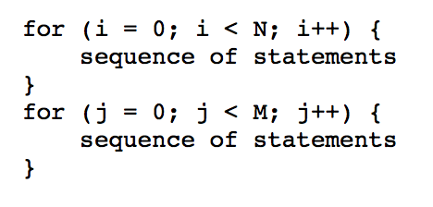
Question 5: What is the worst case complexity of the following piece of code?

Slide 12
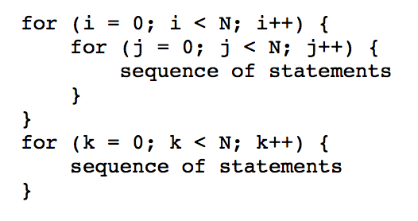
Question 6: What is the worst case complexity of the following piece of code?

Slide 13
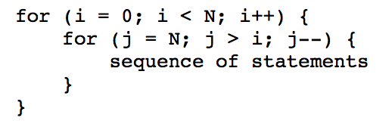
Question 7: What is the worst case complexity of the following piece of code?

Slide 14
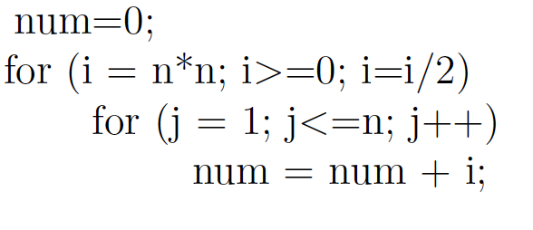
Question 8: What is the worst case complexity of the following piece of code?

Slide 15
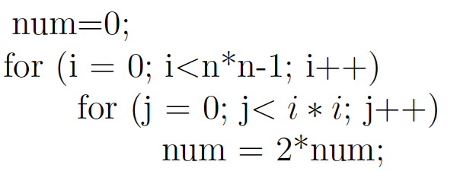
Question 9: What is the worst case complexity of the following piece of code?

Slide 16
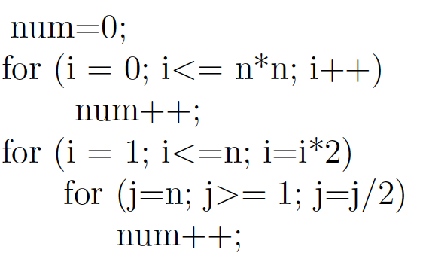
Question 10: What is the worst case complexity of the following piece of code?

Slide 17
Question 11: Write a method isIdentical that checks whether two LinkedLists are identical. Two lists are identical if they have the same contents. Assume that you have access to the head nodes of both lists, as well as a getter for the element in every node.
public boolean isIdentical(DoublyLinkedList12 list1, DoublyLinkedList12 list2)
{
}
1) Does it work for empty lists?
2) Does it work if only one list is empty?
3) What if lists are not of equal length?
Example: List1: 1->2->3->null List2: 1->2->3->4->null

Slide 18
Question 12: True/False
Binary search is as efficient on linked lists as on arrays, provided the list is sorted
A. True
B. False

Slide 19
Question 12: True/False
Binary search is as efficient on linked lists as on arrays, provided the list is sorted
A. True
B. False

Slide 20
Question 13: Assume that you are given a Stack ADT with push, and pop operations. Answer the questions referring to the code given below.
Stack s1 = new Stack(8); s1.push("A"); s1.push("B"); s1.push("C"); s1.push("D");
s1.push(“E”);
Stack s2 = new Stack(8);
for (int i=0; i<3; i++) {
s2.push(s1.pop());
}
Stack s3 = new Stack(8);
while (s2.size() > 0) {
s3.push(s2.pop());
} while (s3.size() > 0) {
s1.push(s3.pop());
}
a) What is the size of the stack s1 after the code executes? b) What is the size of s2 after code executes?
c) What is the size of s3 after code executes? d) What is the top of the stack s1 after the code executes?
e) What is the top of the stack s2 after the code executes?

Slide 21
Question 14: Consider the following method in Doubly Linked List class. If the input list is 1-2-3-4-5, what is the output list after this method executes? Assume list is not empty
public void magic()
{
Node temp = head;
while(temp != tail)
{
E val = temp.data;
temp.data = temp.next.data;
temp.next.data = val; temp = temp.next;
}
}

Slide 22
Question 15: Given an efficient circular array-based queue Q capable of holding 10 objects. Show/Draw the final contents of the array after the following code is executed:
for (int k = 1; k ≤ 7; k++)
Q.enqueue(k);
for (int k = 1; k ≤ 7; k++)
Q.enqueue(Q.dequeue());

Slide 23
Question 16: Suppose you were asked to write a method that will take two sorted stacks A and B (min on top) and create one stack that is sorted (min on top). You are allowed to use only the stack operations such as pop, push, size and top. No other data structure such as arrays are not allowed. You are allowed to use extra stacks. How would you do this?
Did you use extra stacks?
If yes, how many?
What was the time complexity of this algorithm?

Slide 24
Question 17: For each of the following scenarios choose the best data structure from the following list: an unsorted array, linked list, DLL, stack, queue. In each case, justify your answer briefly.
The size of a file is unknown. The entries need to be entered as they come in. Entries must be deleted when they are no longer needed. It is important that structure has flexible memory management
A program needs to remember operations it performed in opposite order
A list must be maintained so that any element can be accessed randomly
Suppose that a grocery store decided that customers who come first will be served first

Slide 25
Question 17: For each of the following scenarios choose the best data structure from the following list: an unsorted array, linked list, DLL, stack, queue. In each case, justify your answer briefly.
The size of a file is unknown. The entries need to be entered as they come in. Entries must be deleted when they are no longer needed. It is important that structure has flexible memory management LL
A program needs to remember operations it performed in opposite order Stack
A list must be maintained so that any element can be accessed randomly Array
Suppose that a grocery store decided that customers who come first will be served first Queue

Slide 26
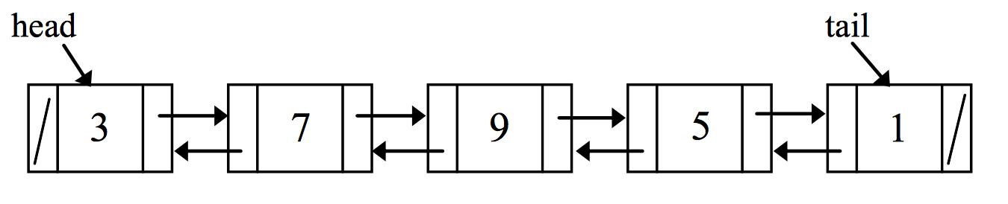
Question 18: Given a Doubly Linked List where each node has two references (prev and next): one that points to a previous node and another that points to a next node. Assume the linked list below and provide the output for the following code fragments.
(The list is restored to its initial state before each line executes)
1) head.next.next.prev.prev.data
II) tail.prev.prev.prev.prev.next.data

