Slide 1
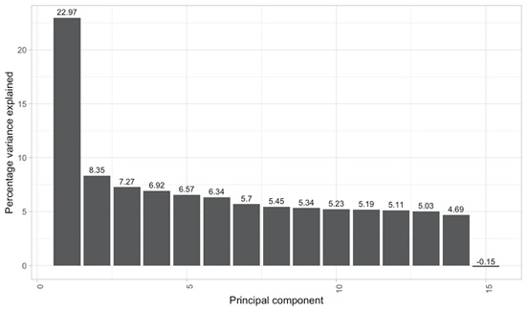
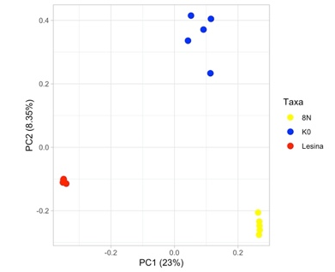
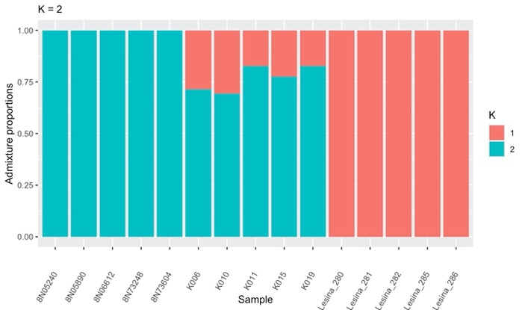
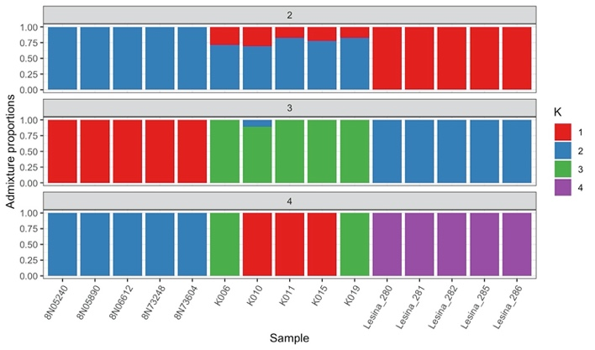
PC1 disclosed three major clusters corresponding to 8N, K0 and Lesina. The distance between 8N and K0 is closer on the PC1 axis. Admixture findings (K=2) found that K0 had the highest probabilities of clustering with the 8N.

Slide 2
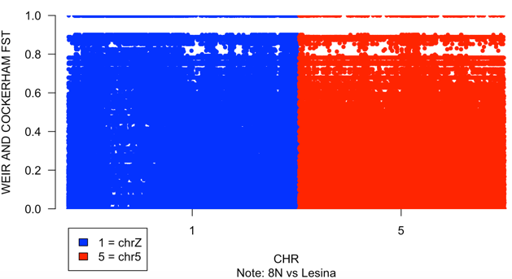
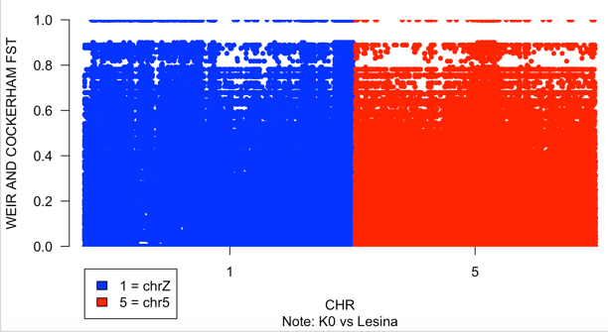
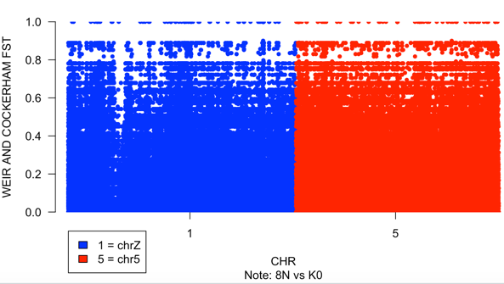
Moderate genetic differentiation between 8N and K0, as well as between K0 and Lesina. Relatively high genetic differentiation between 8N and Lesina, suggesting a notable degree of genetic divergence. The PCA and admixture findings support the genetic relationships observed through Fst analysis, with K0 showing a closer relationship to 8N compared to Lesina.
Conclusion
The Fst in the range of 0.05–0.15 indicates moderate divergence. Fst estimate between the 8N and K0 was 0.054429, K0 and Lesina was 0.13074, indicating a moderate level of genetic differentiation being studied. 8N and Lesina was 0.20142 indicated that relatively high genetic differentiation between taxa

