Slide 1


Austin Animal Shelter Analysis
Team 05

Slide 2
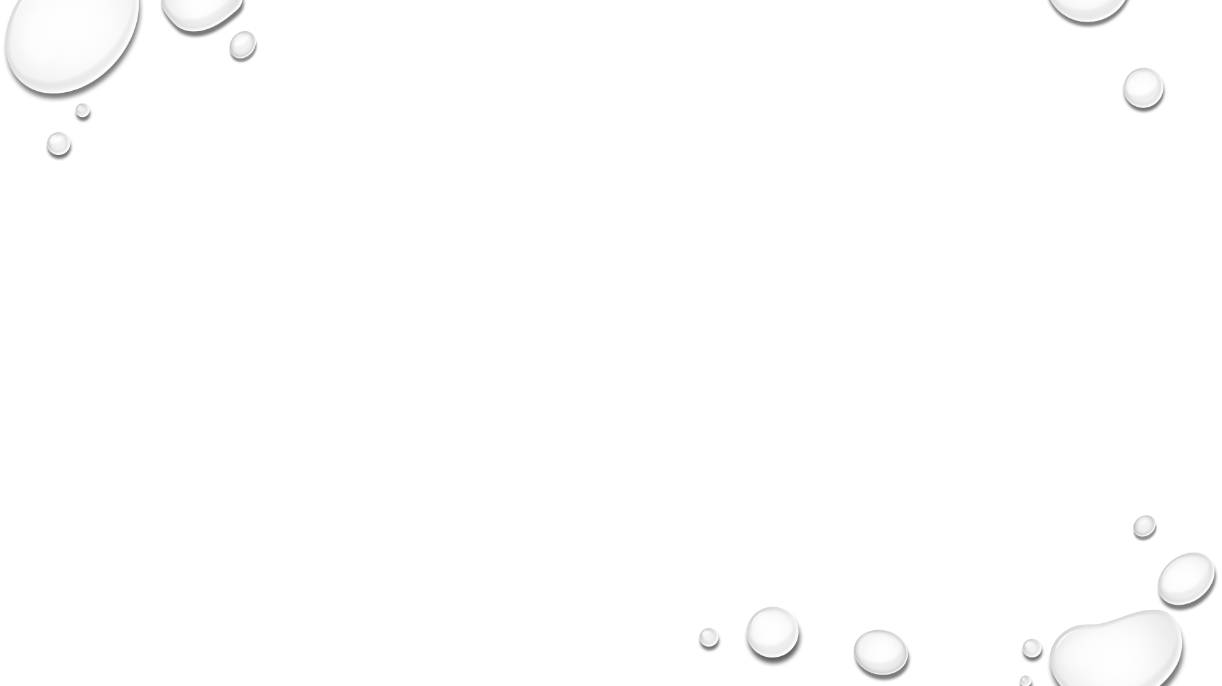
Project Team
Team Member | Role
Jack Kenning | ML Engineer
James Hook | GitHub Admin
Elijah B | Database Developer
Prathima Bandi | Presentation

Slide 3
Project Overview
The Austin Animal Center is the largest no-kill animal shelter in the United States that provides care and shelter to over 18,000 animals each year. The focus of this analysis is to provide exploratory analysis using features and build a machine learning model to predict the animal adoption rate.

Slide 4
Resources and Communication
Python - For ETL
Juptier Notebook - IDE
PostgreSQL - Database to store data
Dashboard - Tableau/HTML Page
GitHUB - Source code storage and common portal to merge group work
Slack - a group channel for posting files and refernce links
Mobile phones - Group text messaging for faster communication and response
Zoom - For group meetings and paired programming

Slide 5
Weeks Goal
Determine
As a team determine a project and dataset
Decide on
Decide on group communication protocol
Understand
Understand the roles and responsibilities
Assign
Assign Roles
Take
Take Ownership
Work
Work to as team

Slide 6
Outcome
Read input data
Load to database – In segment 1 we have used python data frame s data store
Transform – Eliminate columns, remove null values, transform values and prepare the dataset for analysis
Predictive modeling

