Slide 1
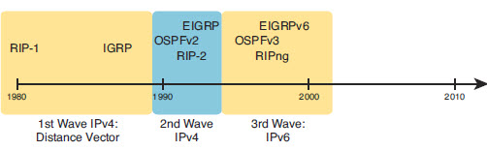
EIGRP and Distance Vector
Earlier routing protocols were Distance Vector
EIGRP and OSPFv2 are currently most used
RIPv2 has fallen off due to slower convergence
ICND2 9-<number>

Slide 2

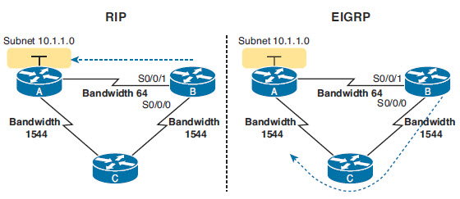
Why EIGRP
EIGRP uses a robust metric based on both link bandwidth and link delay, so routers make good choices about the best route to use
EIGRP converges quickly, meaning that when something changes in the internetwork, EIGRP quickly finds the currently best loop-free routes to use.
RIP is limited to hop count
  No awareness of the quality of the link
ICND2 9-<number>

Slide 3
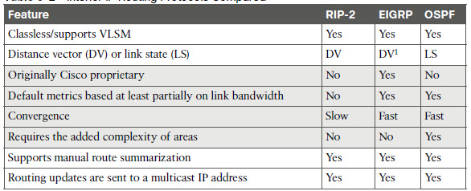
EIGRP
Cisco Proprietary
  They have release an RFC so other vendors can implement
Considered a “hybrid” of Distance Vector
ICND2 9-<number>

Slide 4
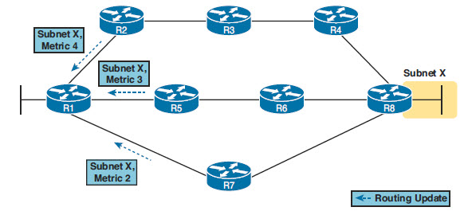
Distance Vector Features
Distance Vector is a reference to what a router knows about each route
  Distance(number of hops) and Direction (Vector)
Lists R1 perspective on getting to Subnet X
Which will RIP choose
Through R7
ICND2 9-<number>

Slide 5
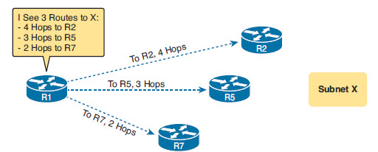
DV Protocols
Distance: The metric for a possible route
Vector: The direction, based on the next-hop router for a possible route
ICND2 9-<number>

Slide 6
Messages and Split Horizon
Routers need to share information
  Update messages/advertisements
Routers need to be aware of changes
  EIGRP uses HELLO
RIP sent full periodic updates of all routes
  Can be lots of information
Split Horizon
  Keeps a router from repeating learned routes to the router it learnt from
ICND2 9-<number>

Slide 7
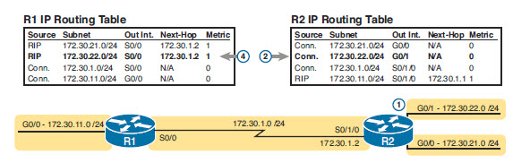
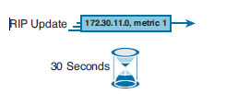
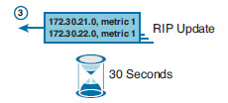
Updates and Split Horizon
What will R1 advertise
What will R2 advertise
Split Horizon prevents R1 from repeating the 172.3.21.0 and 172.3.22.0 networks back to 172.30.1.2
ICND2 9-<number>

Slide 8
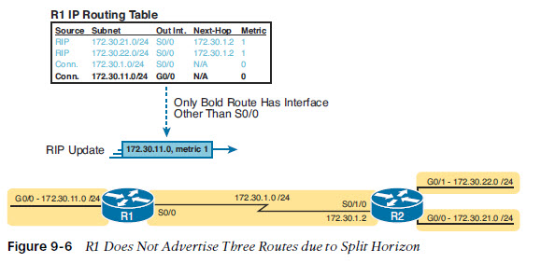
Split Horizon
Don’t advertise networks out an interface where that interface is the exit interface
ICND2 9-<number>

Slide 9
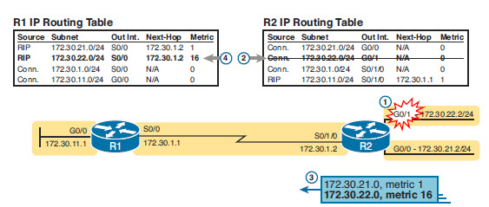
Route Poisoning
1. R2’s G0/1 interface fails.
2. R2 removes its connected route for 172.30.22.0/24 from its routing table.
3. R2 advertises 172.30.22.0 with an infinite metric (which for RIP is 16).
4. Depending on other conditions, R1 either immediately removes the route to 172.30.22.0 from its routing table, or marks the route as unusable (with an infinite metric) for a few minutes before removing the route.
ICND2 9-<number>

Slide 10
EIGRP Messages
EIGRP sends updates about a route when it is learned
EIGRP sends partial updates with new or changed information
  Not periodic full update like RIP
EIGRP maintains neighbors with HELLO packets
  HELLOs must be received within Hold Time
ICND2 9-<number>

Slide 11
Routing Protocol Comparison
Feature | RIPv2 | EIGRP | OSPF
Metric based on | Hop Count | Bandwidth & Delay | Cost
Sends Periodic Full Updates | Yes | No | No
Sends Periodic HELLO | No | Yes | Yes
Uses route poisoning for failed routes | Yes | Yes | No
Multicast Address | 224.0.0.9 | 224.0.0.10 | 224.0.0.5 224.0.0.6
Metric considered infinite (Unreachable) | 16 | 2³²-1 Or 2⁵⁶-1 | 2²⁴-1
ICND2 9-<number>

Slide 12
EIGRP Concepts
1. Neighbor discovery: EIGRP routers send Hello messages to discover potential neighboring EIGRP routers and perform basic parameter checks to determine which routers should become neighbors. Neighbors that pass all parameter checks are added to the EIGRP neighbor table.
2. Topology exchange: Neighbors exchange full topology updates when the neighbor relationship comes up, and then only partial updates as needed based on changes to the network topology. The data learned in these updates is added to the router’s EIGRP topology table.
3. Choosing routes: Each router analyzes its respective EIGRP topology tables, choosing the lowest-metric route to reach each subnet. EIGRP places the route with the best metric for each destination into the IPv4 routing table.
ICND2 9-<number>

Slide 13
EIGRP Step One
Neighbor Table:
  When newly discovered neighbors are learned, the address and interface of the neighbor is recorded.
  Neighbors are discovered through the sending and receiving of hello packets (every 5 seconds).
  When a neighbor sends a hello packet, it advertises a hold time (dead timer) (typically 15 seconds).
  When the hold time expires, the neighbor is considered unavailable and the new topology must be recalculated.
ICND2 9-<number>

Slide 14
EIGRP Step Two
Topology Table:
  The topology table is made up of all the EIGRP routing tables in the autonomous system.
  DUAL uses the information in the neighbor and topology tables to calculate the best path to each destination.
  All learned routes to a destination are maintained in the topology table.
    This is where I have successor routes
    This is where I have feasible successor routes
    This is where I define feasible distance and advertised distance
  “Active” routes in this table are being re-evaluated
  “Passive” routes in this table are stable routes
ICND2 9-<number>

Slide 15
EIGRP Neighbors
To become neighbors the following must match in HELLO
HELLO sent to 224.0.0.10
  It must pass the authentication process if used.
  It must use the same configured autonomous system number (which is a configuration setting).
  The source IP address used by the neighbor’s Hello must be in the same subnet as the local router’s interface IP address/mask.
  Same K Values (Metric)
ICND2 9-<number>

Slide 16
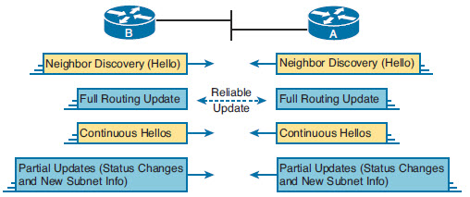
EIGRP Topology information
Topology updates can be sent to 224.0.0.10 or specific router
Uses RTP-allows systems to verify message received (Not same RTP as voice)
ICND2 9-<number>

Slide 17

Finding Best Route
Uses a composite Metric
  Combine bandwidth and delay
    Can be configured on a router
  Can also use Load and reliability
Updates contain
  Subnet number and mask
  Cumulative delay
  Minimum bandwidth
ICND2 9-<number>

Slide 18
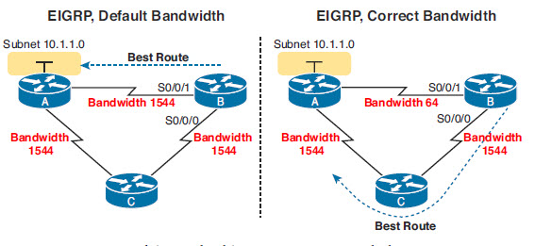
Bandwidth and Delay on Serial
In order to make good decisions, bandwidth information on interfaces must be accurate
Be aware of the default bandwidth being used
  Doesn’t represent the actual bandwidth
ICND2 9-<number>

Slide 19
DUAL Concepts
Diffusing Update ALgorithm (DUAL) uses several terms that we will discuss in more detail throughout this section:
  Successor.
  Feasible distance.
  Feasible successor.
  Reported distance or advertised distance.
  Feasible condition or feasibility condition.
ICND2 9-<number>

Slide 20
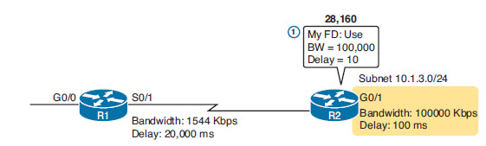



Feasible Distance and Reported Distance
Reported Distance (RD): The next-hop router’s best metric for that same subnet
Feasible Distance (FD): The local router’s metric of the best route to reach a subnet, as calculated on the local router
ICND2 9-<number>

Slide 21

Successor and Feasible Distance
FD
A successor is:
  A neighboring router that is used for packet forwarding.
  The least-cost route to the destination network.
The IP address of a successor is shown in a routing table entry right after the word via.
The Feasible Distance or Calculated Distance is the Metric
ICND2 9-<number>

Slide 22
Successors and Feasible Successors
For Each destination EIGRP calculates
  Successor –route with best metric
  Metric is feasible distance
  This information goes in Routing Table
EIGRP can keeps backup route in mind
  Feasible successor-next best route
  If a nonsuccessor route’s RD is less than the FD, the route is a feasible successor route.
ICND2 9-<number>

Slide 23
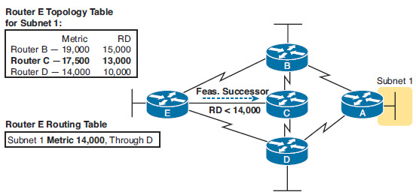
Feasible Successor
Router D is the Successor-Lowest FD
Router C is a feasible successor because the RD from C is less than the successor FD
ICND2 9-<number>

Slide 24
Query and Reply
If no feasible successor is know, router will asks other routers
  Diffusing Update Algorithm (DUAL)
Confirms there is a loop free route before putting new route in table
Takes longer than using a Feasible Successor
ICND2 9-<number>

