Slide 1
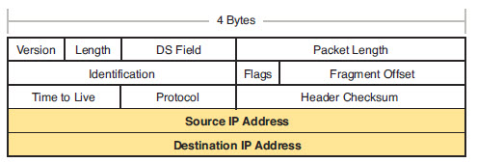
IPv4 Header
IP header has source IP and destination IP
IP packet doesn’t change, is used end to end
  NAT and proxies may modify, but think of it as end to end
We will learn about other fields later
CCENT 4-1

Slide 2
IPv4 Addresses
IP addresses
  Formats- 32 bits
  Grouping concepts- Are source and destination local or remote
  Subnetting- How subnet masks/prefixes affect network address
  Interpret the documentation- Read and analyze diagrams
CCENT 4-<number>

Slide 3
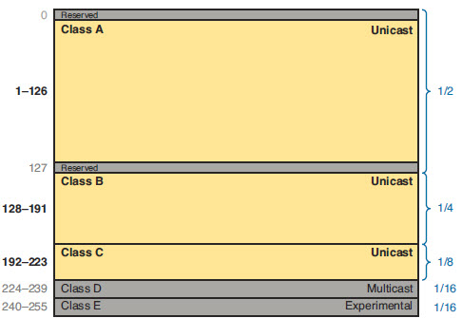

IP address classes
Recognize original classes by the number in the first octet of an IPv4 address
CCENT 4-<number>

Slide 4
Legacy IPv4 Addressing
In the early 1980’s, unicast address ranges were grouped into specific sizes or classes of address.
Each class defined:
  A specifically sized network.
  Specific address blocks for these networks.
Class | High Order Bits | First Octet Range | Number of Network Bits | Number of Host Bits | Number of Networks | Number of Hosts per Network
A | 0 | 0-127 | 8 | 24 | 128 | 16,777,216
B | 10 | 128-191 | 16 | 16 | 16,384 | 65,536
C | 110 | 192-223 | 24 | 8 | 2,097,152 | 256
D | 1110 | 224-239 | Used for Multicasting to multiple hosts.
E | 1111 | 240-255 | Reserved for research and development.
CCENT 4-<number>

Slide 5
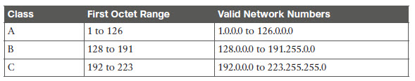
IP addresses classes
For valid host IP addresses
Current IP addressing is “classless”
You should still recognize the original class
CCENT 4-<number>

Slide 6
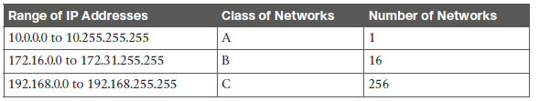
Private Addressing
Publix IP addresses are needed when:
  Communicating across autonomous systems and the Internet
  If a system outside your network needs to connect (when you host a server)
Private addresses are fine otherwise
CCENT 24-<number>

Slide 7
Other Network Layer Features
Domain Name System (DNS)
Address Resolution Protocol (ARP)
Ping
CCENT 4-<number>

Slide 8
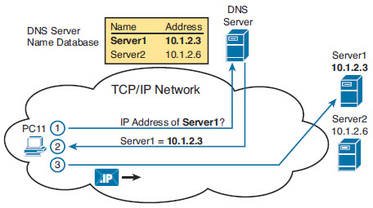
DNS
Lets users use names
and computers get the
IP address
Host machines usually
have an entry for a DNS server
  This is the machine that finds the IP addresses for you
If DNS isn’t responding, you may be able to ping by IP address, but not name
CCENT 4-<number>

Slide 9
Address Resolution Protocol (ARP)
Maps IP address to MAC address
  Network Layer to Data Link Layer
Hosts use arp to find the correct MAC address for forwarding the IP packets they encapsulate
  Host knows the IP they want to send to, but need the MAC address to forward the frame.
Arp Request- includes target IP and broadcast MAC
Arp reply- includes MAC address
CCENT 4-<number>

Slide 10
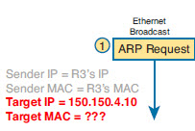

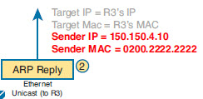
ARP
R3 has a packet for 150.150.4.10
  Needs MAC Address
Sends Arp Request
PC2 sees the request and sends an ARP reply
CCENT 4-<number>

Slide 11
ARP
Most systems keep a cache of addresses they have learned
  Windows- Arp –a
  Cisco IOS- Show ip arp
CCENT 4-<number>

Slide 12
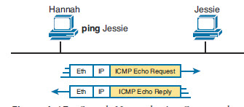
PING
Ping command uses ICMP Echo Request and ICMP Echo Reply to IP connectivity between hosts
Tests layers 1, 2 and 3
CCENT 4-<number>

