Slide 1

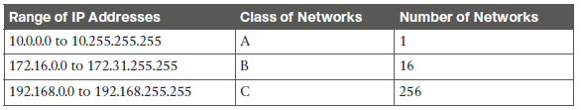
Private Addressing
Publix IP addresses are needed when:
  Communicating across autonomous systems and the Internet
  If a system outside your network needs to connect (when you host a server)
Private addresses are fine otherwise
CCENT 24-<number>

Slide 2
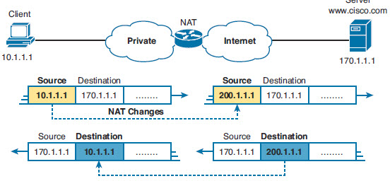
NAT example
Client with private address wants to communicate with Server through Internet
NAT Device changes the Source IP for a public IP address and maps back to private address for return traffic
CCENT 24-<number>

Slide 3
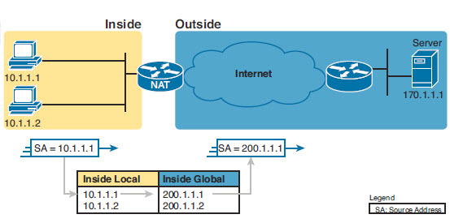
NAT Variations and
Terminology
Static NAT
  Build a table of public to private IP address mappings
  The mapping is fixed ahead of time, always the same
  One to One of public to Private addresses
CCENT 24-<number>

Slide 4
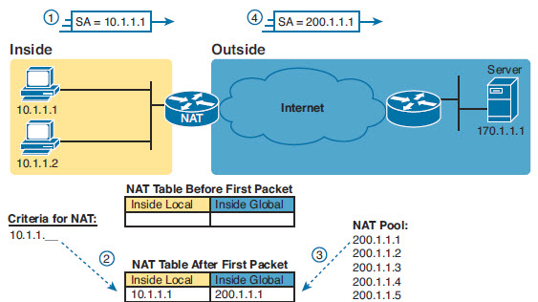
Dynamic NAT
Designate a pool of addresses public addresses
Identify the private addresses that can map
Usually a one to one-need as many public IPs as private
  If you only have 10 public addresses, the 11th user won’t get a public address
  Can also “overload” so single addresses can be reused
CCENT 24-<number>

Slide 5
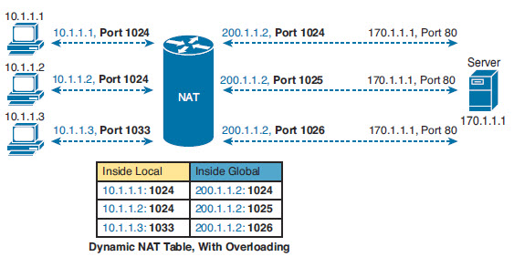
Port Address Translation (PAT)
NAT Overloading
Since communications between devices always uses a unique set of port numbers, multiple hosts can share the same IP address, as long as the NAT server keeps track of who uses which port
CCENT 24-<number>

Slide 6
Configure Static NAT
Step 1 Configure interfaces to be in the inside part of the NAT design using the ip nat inside interface subcommand.
Step 2 Configure interfaces to be in the outside part of the NAT design using the ip nat outside interface subcommand.
Step 3 Configure the static mappings with the ip nat inside source static insidelocal inside-global global configuration command
CCENT 24-<number>

Slide 7
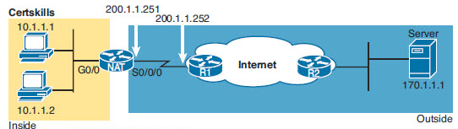

Static NAT Example
interface GigabitEthernet0/0
  ip address 10.1.1.3 255.255.255.0
  ip nat inside
interface Serial0/0/0
  ip address 200.1.1.251 255.255.255.0
  ip nat outside
!
ip nat inside source static 10.1.1.2 200.1.1.2
ip nat inside source static 10.1.1.1 200.1.1.1
CCENT 24-<number>

Slide 8
Dynamic NAT
Step 1 Configure interfaces to be in the inside part of the NAT design using the ip nat inside interface subcommand.
Step 2 Configure interfaces to be in the outside part of the NAT design using the ip nat outside interface subcommand.
Step 3 Configure an ACL that matches the packets coming in inside interfaces for which NAT should be performed.
Step 4 Configure the pool of public registered IP addresses using the ip nat pool name first-address last-address mask subnet-mask global configuration command.
Step 5 Enable dynamic NAT by referencing the ACL (Step 3) and pool (Step 4) with the ip nat source list acl-number pool pool-name global configuration command.
CCENT 24-<number>

Slide 9
Dynamic NAT Example
interface GigabitEthernet0/0
ip address 10.1.1.3 255.255.255.0
ip nat inside
!
interface Serial0/0/0
ip address 200.1.1.251 255.255.255.0
ip nat outside
ip nat pool fred 200.1.1.1 200.1.1.2 netmask 255.255.255.252
ip nat inside source list 1 pool fred
!
access-list 1 permit 10.1.1.2
access-list 1 permit 10.1.1.1
CCENT 24-<number>

Slide 10
NAT Overloading (PAT)
Two variations
  Overloading with Dynamic NAT
    Use the same steps for configuring dynamic NAT, as outlined in the previous section, but include the overload keyword at the end of the ip nat inside source list global command
  Overloading the address assigned to an interface
    More common
CCENT 24-<number>

Slide 11
PAT Configuration
Step 1 Configure inside interfaces with the ip nat inside interface subcommand.
Step 2 Configure outside interfaces with the ip nat outside interface subcommand.
Step 3 Configure an ACL that matches the packets coming in inside interfaces.
Step 4 Configure the ip nat source list acl-number interface interface name/ number overload global configuration command, referring to the ACL created in Step 3 and to the interface whose IP address will be used for translations.
CCENT 24-<number>

Slide 12
PAT Example
interface GigabitEthernet0/0
ip address 10.1.1.3 255.255.255.0
ip nat inside
!
interface Serial0/0/0
ip address 200.1.1.251 255.255.255.0
ip nat outside
ip nat inside source list 1 interface s0/0/0 overload
!
access-list 1 permit 10.1.1.2
access-list 1 permit 10.1.1.1
CCENT 24-<number>

Slide 13
Troubleshooting
Ensure that the configuration includes the ip nat inside or ip nat outside interface subcommand. These commands enable NAT on the interfaces, and the inside/outside designation is important.
For static NAT, ensure that the ip nat source static command lists the inside local address first and the inside global IP address second.
For dynamic NAT, ensure that the ACL configured to match packets sent by the inside host match that host’s packets, before any NAT translation has occurred. For example, if an inside local address of 10.1.1.1 should be translated to 200.1.1.1, ensure that the ACL matches source address 10.1.1.1, not 200.1.1.1.
For dynamic NAT without PAT, ensure that the pool has enough IP addresses. Symptoms of not having enough addresses include a growing value in the second misses counter in the show ip nat statistics command output, as well as seeing all the addresses in the range defined in the NAT pool in the list of dynamic translations.
CCENT 24-<number>

Slide 14
Troubleshooting
For PAT, it is easy to forget to add the overload option on the ip nat inside source list command. Without it, NAT works, but PAT does not, often resulting in users’ packets not being translated and hosts not being able to get to the Internet.
Perhaps NAT has been configured correctly, but an ACL exists on one of the interfaces, discarding the packets. Note that IOS processes ACLs before NAT for packets entering an interface, and after translating the addresses for packets exiting an interface.
Make sure that some user traffic is entering the NAT router on an inside interface, triggering NAT to do a translation. NAT reacts to packets that come in an interface, and then matches the logic referenced in the NAT configuration. The NAT configuration can be perfect, but if no inbound traffic occurs that matches the NAT configuration, NAT does nothing.
CCENT 24-<number>

Slide 15
NAT Verification
NAT# show ip nat translations
Pro Inside global Inside local Outside local Outside global
tcp 200.1.1.249:3212 10.1.1.1:3212 170.1.1.1:23 170.1.1.1:23
tcp 200.1.1.249:3213 10.1.1.2:3213 170.1.1.1:23 170.1.1.1:23
tcp 200.1.1.249:38913 10.1.1.2:38913 170.1.1.1:23 170.1.1.1:23
NAT# show ip nat statistics
Total active translations: 3 (0 static, 3 dynamic; 3 extended)
Outside interfaces:
Serial0/0/0
Inside interfaces:
GigabitEthernet0/0
Hits: 103 Misses: 3
CCENT 24-<number>

Slide 16
NAT Terminology
Inside Local Address:
  An RFC 1918 address assigned to a host on an inside network.
Inside Global Address:
  A valid public address that the host on the inside network is assigned as it exits the router.
Outside Global Address:
  A reachable IP address assigned to a host on the Internet.
Outside Local Address:
  A local address assigned to a host on an outside network.
CCENT 24-<number>

