Slide 1
Routing Protocols
Routed/Routable Protocol
  Protocols that define a packet structure and forwarding process
  IPv4 and IPv6 are routed protocols
Routing Protocol
  A set of messages, rules, and algorithms used by routers for the overall purpose of learning routes. This process includes the exchange and analysis of routing information
  Analysis includes selected best path when multiple paths exist
  OSPF, EIGRP, BGP, etc.
CCENT 17-1

Slide 2
Routing Protocol Functions
1. Learn routing information about IP subnets from other neighboring routers.
2. Advertise routing information about IP subnets to other neighboring routers.
3. If more than one possible route exists to reach one subnet, pick the best route based on a metric.
4. If the network topology changes—for example, a link fails—react by advertising that some routes have failed and pick a new currently best route. (This process is called convergence.)
CCENT 17-<number>

Slide 3
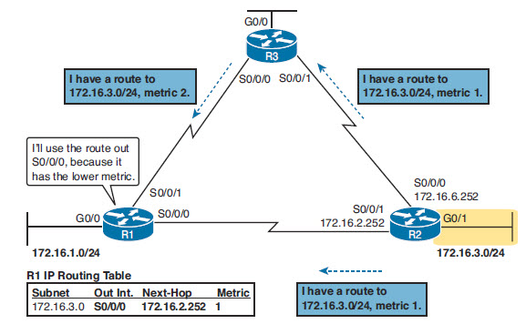
Routing Protocol Decision
R1 compares the information it receives about the 172.16.3.0 network
CCENT 17-<number>

Slide 4
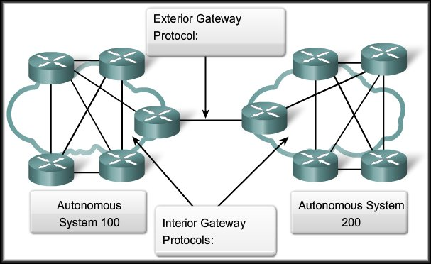
Classifying Dynamic Routing Protocols
Allow one AS to exchange routing information with another AS.
IGP vs. EGP Routing Protocols:
Allow routers within an AS to exchange information.
CCENT 17-<number>

Slide 5

IGP
Distance vector (sometimes called Bellman-Ford after its creators)
Advanced distance vector (sometimes called “balanced hybrid”)
Link-state
CCENT 17-<number>

Slide 6
Metrics
Each Routing Protocol has a metric
  Measure used to compare paths to a destination
IGP | Metric | Description
RIP-2 | Hop Count | The number of routers (hops) between a router and the destination subnet.
OSPF | Cost | The sum of all interface cost settings for all links in a route, with the cost defaulting to be based on interface bandwidth.
EIGRP | Composite of Bandwidth & Delay | Calculated based on the route’s slowest link and the cumulative delay associated with each interface in the route.
CCENT 17-<number>

Slide 7
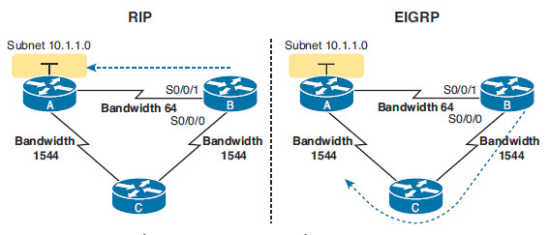
Metrics and Routing Choices
CCENT 17-<number>

Slide 8
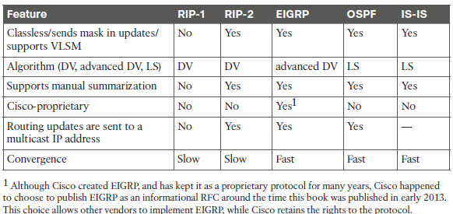
Protocol Details
CCENT 17-<number>

Slide 9
Administrative Distance
Used to “rank” value of routing protocol information
If more than one routing protocol is in use at a time
Route Type | Administrative Distance
Connected | 0
Static | 1
BGP (external routes) | 20
EIGRP (internal routes) | 90
IGRP | 100
OSPF | 110
IS-IS | 115
RIP | 120
EIGRP (external routes) | 170
BGP (internal routes) | 200
Unusable | 255
CCENT 17-<number>

Slide 10
Static Routes and
Admin Distance
Can configure a non-standard admin distance for a static route
  Used as a backup route to dynamic protocols
ip route 10.1.3.0 255.255.255.0 10.1.130.253
  Would take precedence over dynamic protocols
ip route 10.1.3.0 255.255.255.0 10.1.130.253 210
  Would only be used if no protocols provided a route to 10.1.3.0
CCENT 17-<number>

Slide 11
OSPF and Link State Protocols
How OSPF routers learn information
How OSPF routers choose what routes to add to the routing table
How OSPF routers use neighbor relationships, and how routers must be neighbors before they ever exchange routing information and learn routes.
CCENT 17-<number>

Slide 12
Link State
Link State:
  A Link State routing protocol can create a complete map of the network topology.
  A link-state router:
    Receives an update.
    Builds a topology database.
    Uses a Dijkstra Shortest Path First (SPF) algorithm to create its view of the network.
    Builds the routing table.
  Routing updates (not the entire table) are only sent to neighboring routers when the topology changes.
  (e.g.. Open Shortest Path First - OSPF)
CCENT 17-<number>

Slide 13
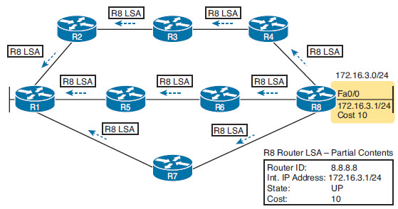
Topology Information and LSA
OSPF Routers send out Link State Advertisements to their “neighbor” routers
LSAs are flooded through to other routers
Each router has a set of LSA from all routers to complete a Link State Database
Show ip ospf database lets you view the details
CCENT 17-<number>

Slide 14
OSPF Process
Neighbors: A relationship between two routers that connect to the same data link, created so that the neighboring routers have a means to exchange their LSDBs.
Database exchange: The process of sending LSAs to neighbors so that all routers learn the same LSAs.
Adding the best routes: The process of each router independently running SPF, on their local copy of the LSDB, calculating the best routes, and adding those to the IPv4 routing table.
CCENT 17-<number>

Slide 15
Neighbors
Routers connected to each other on a link will attempt to become neighbors
  Must be neighbors to exchange information
HELLO messages are sent out each link
  The Hello message follows the IP packet header, with IP protocol type 89.
  Hello packets are sent to multicast IP address 224.0.0.5, a multicast IP address intended for all OSPF-speaking routers.
  OSPF routers listen for packets sent to IP multicast address 224.0.0.5, in part hoping to receive Hello packets and learn about new neighbors.
HELLO Messages include RID, Network and timing information
  Must match some details to become neighbors
CCENT 17-<number>

Slide 16
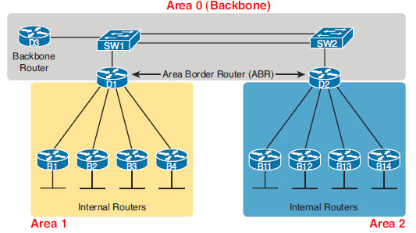
OSPF Hierarchical Design
To support scaling to larger networks, OSPF allows for a hierarchical design and the use of areas
  Allow routing information to be managed within each area to prevent too much traffic from LSAs
CCENT 17-<number>

Slide 17
Basic OSPF configuration
Step 1. Enter OSPF configuration mode for a particular OSPF process using the router ospf process-id global command.
Step 2. (Optional) Configure the OSPF router ID by:
  A. Configuring the router-id id-value router subcommand
  B. Configuring an IP address on a loopback interface
Step 3. Configure one or more network ip-address wildcard-mask area area-id router subcommands, with any matched interfaces being added to the listed area.
CCENT 17-<number>

Slide 18

The network Command
The network command used with OSPF has the same function as when used with other IGP routing protocols:
  Any interfaces on a router that match the network address in the network command will be enabled to send and receive OSPF packets.
  This network (or subnet) will be included in OSPF routing updates.
CCENT 17-<number>

Slide 19
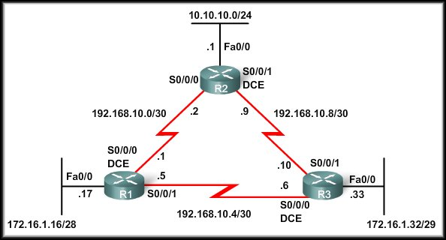
Topology
Basic Single Area OSPF design
Each router is set to share the networks with ospf
CCENT 17-<number>

Slide 20
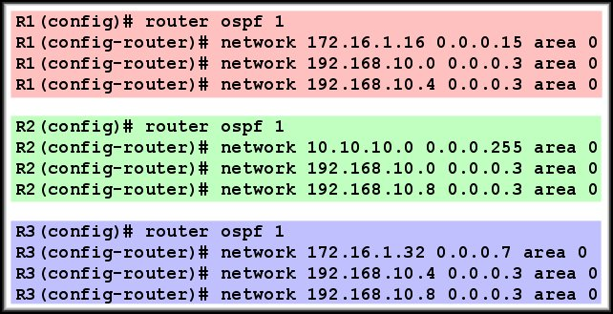
The network Command
network commands for all three routers, enabling OSPF on all interfaces.
At this point, all routers should be able to ping all networks.
CCENT 17-<number>

Slide 21
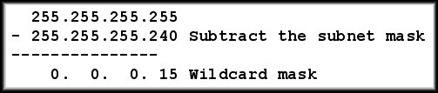
Wildcard Masks
OSPF requires the wildcard mask.
  The network address, along with the wildcard mask, is used to specify the interface or range of interfaces that will be enabled for OSPF using this network command.
CCENT 17-<number>

Slide 22
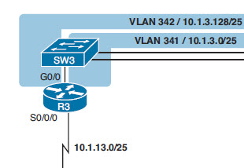
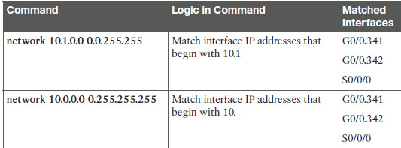
Wildcard mask
Can be specific to a subnetwork or generalized to cover a group of networks
R3 in diagram has 3 network connections
CCENT 17-<number>

Slide 23
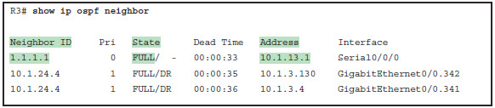
Verifying OSPF
Show ip ospf neighbor
  Should see the RID of routers
  that connect to your router
CCENT 17-<number>

Slide 24
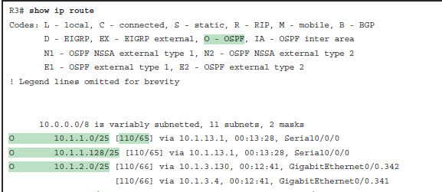
Show IP route
Notice the O for OSPF
The Admin Distance is 110 for OSPF
CCENT 17-<number>

Slide 25
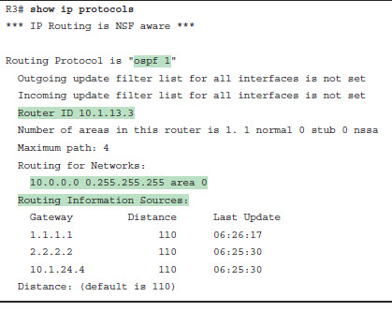
Show ip protocols
See the details of configured routing protocols
Network commands that were used
Sources of information (gateway)
  Neighbors
CCENT 17-<number>

Slide 26
OSPF Router ID
1. If the router-id rid OSPF subcommand is configured, this value is used as the RID.
2. If any loopback interfaces have an IP address configured, and the interface has an interface status of up, the router picks the highest numeric IP address among these loopback interfaces.
3. The router picks the highest numeric IP address from all other interfaces whose interface status code (first status code) is up. (In other words, an interface in up/down state will be included by OSPF when choosing its router ID.)
CCENT 17-<number>

Slide 27
OSPF Router ID
Duplicate Router IDs:
  When two routers have the same router ID in an OSPF domain, routing might not function properly.
  If the router ID is the same on two neighboring routers, the neighbor establishment might not occur.
  When duplicate OSPF router IDs occur, Cisco IOS software displays the following message.
CCENT 17-<number>

Slide 28
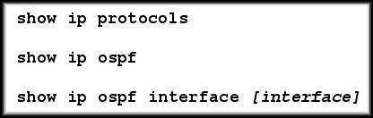
Verifying OSPF
Two routers may not form an OSPF adjacency if any one of the following conditions is present:
  The subnet masks do not match, causing the routers to be on separate networks.
  OSPF Hello or Dead timers do not match.
  OSPF network types do not match.
  There is a missing or incorrect OSPF network command.
Other powerful troubleshooting tools:
CCENT 17-<number>

Slide 29


Any Questions?
CCENT 17-<number>

Slide 30
Router ID and the Designated Router
For multi-access networks (like ethernet) and Non Broadcast Multi Access (like Frame Relay) OSPF routers will elect a Designated Router (DR)and a Backup Designated Router (BDR)
The DR is the router with the highest Router ID
Router can identify network by interface encapsulation/ interface type setting
All non DR routers send updates to the DR at 224.0.0.6 and DR floods details to all neighbors oat 224.0.0.5
CCENT 17-<number>

Slide 31
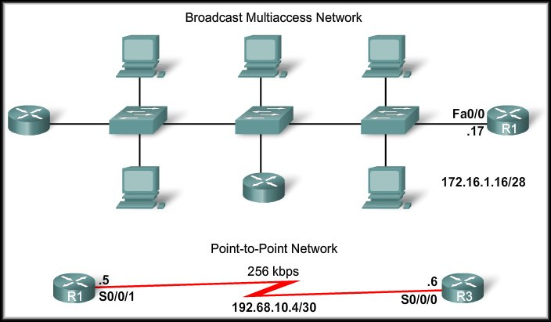
Challenges in Multi-access Networks
Multi-access Broadcast network because a single device is capable of sending a single frame that has all devices on the network as its destination.
As opposed to the point-to-point links we have been using.
CCENT 17-<number>

Slide 32
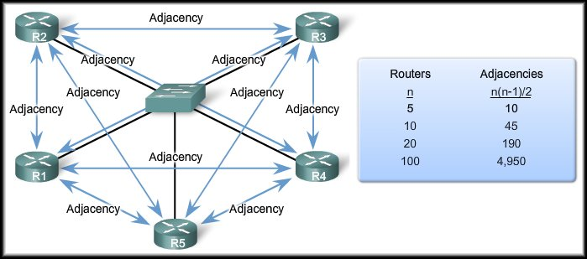
Multiple Adjacencies
The creation of an adjacency between every pair of routers in a network would cause the number of adjacencies to grow exponentially.
CCENT 17-<number>

Slide 33
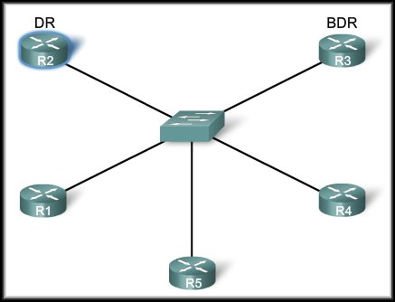
Solution: Designated Router
The solution to managing
the number of adjacencies
and the flooding of LSAs
on a multi-access network
is the Designated Router
(DR).
On multi-access networks,
OSPF elects a DR to be
the collection and
distribution point for LSAs sent and received.
A Backup Designated Router (BDR) is also elected in case the DR fails.
All other routers become DROthers.
CCENT 17-<number>

Slide 34
Solution: Designated Router
DROthers only form full adjacencies with the DR and BDR in the network.
Instead of flooding LSAs to all routers in the network, DROthers only send their LSAs to the DR and BDR using the multicast address 224.0.0.6.
CCENT 17-<number>

Slide 35
Passive Interface
For networks where the router doesn’t need to send HELLO packets to find a neighbor
  LAN connections
Saves bandwidth and processing
  router ospf 1
  passive-interface gigabitethernet0/0.11
  OR
  router ospf 1
  passive-interface default
  no passive-interface serial0/0/0
Quit sending OSPF Hellos on the interface
Ignore received Hellos on the interface
Do not form neighbor relationships over the interface
CCENT 17-<number>

Slide 36
OSPF Default Routes
For most enterprises
  All routers learn specific routes for subnets inside the company; a default route is not needed when forwarding packets to these destinations.
  One router connects to the Internet, and it has a default route that points toward the Internet.
  All routers should dynamically learn a default route, used for all traffic going to the Internet, so that all packets destined to locations in the Internet go to the one router connected to the Internet.
CCENT 17-<number>

Slide 37
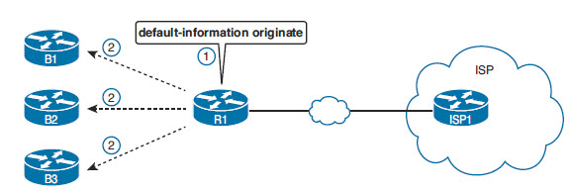
OSPF default routes
With OSPF, only networks highlighted with the Network command are shared
default-information originate
  This will allow OSPF to send default routes
CCENT 17-<number>

Slide 38
Commands
Show ip ospf database
Router ospf #
  Network networkID mask area #
sh ip ospf neighbor
Sh ip route
Sh ip protocols
default-information originate
CCENT 17-<number>

