Slide 1
QoS Basics

Slide 2
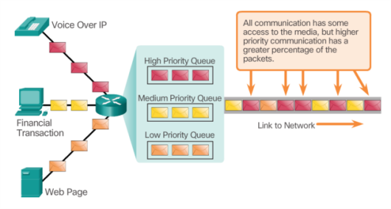
Network Transmission Quality Prioritizing Traffic
Applications such as voice and live video transmissions, create higher expectations for the quality of the delivered services.
Congestion occurs when the demand for bandwidth exceeds the amount available.
When the volume of traffic is greater than what can be transported across the network, devices queue the packets.
If the number of packets to be queued continues to increase, the memory queues fill up and packets are dropped.

Slide 3
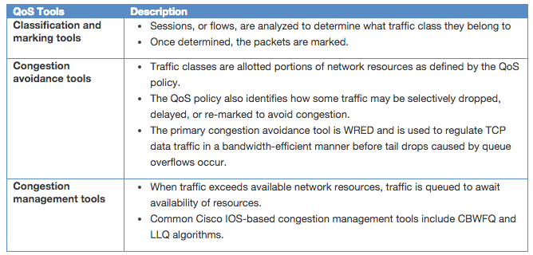
QoS Implementation Techniques QoS Tools
Three categories of QoS tools:

Slide 4
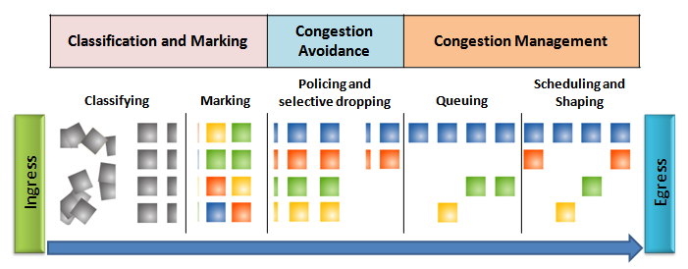
QoS Implementation Techniques QoS Tools
Ingress packets (i.e. gray squares) are classified and their respective IP header is marked (i.e., colored squares).
To avoid congestion, packets are then allocated resources based on defined policies.
Packets are then queued and forwarded out the egress interface based on their defined QoS shaping and policing policy.

Slide 5
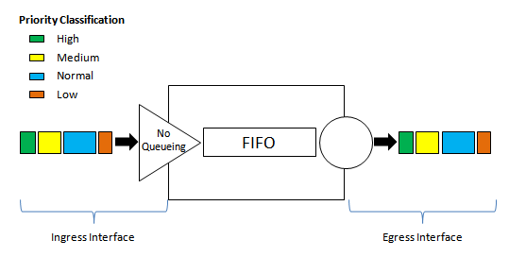
Queuing Algorithms First In First Out (FIFO)
FIFO queuing involves buffering and forwarding of packets in the order of arrival.
FIFO does not recognize priority or classes of traffic.
Traffic is sent out in the order it is received.
FIFO, which is the fastest method of queuing, is effective for large links that have little delay and minimal congestion.

Slide 6
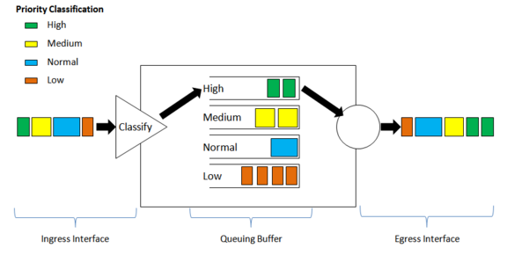
Queuing Algorithms Weighted Fair Queuing (WFQ)
WFQ is an automated scheduling method that provides fair bandwidth allocation to all network traffic.
WFQ allows you to give low-volume, interactive traffic, such as Telnet sessions and voice, priority over high-volume traffic, such as FTP sessions.
WFQ classifies traffic into different flows based on packet header addressing
Low-bandwidth traffic streams receive preferential service.

Slide 7
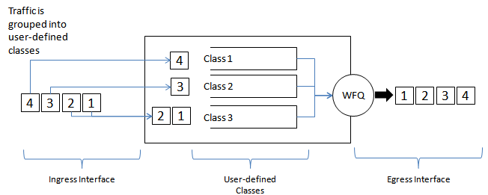
Queuing Algorithms Class-Based Weighted Fair Queuing (CBWFQ)
CBWFQ extends the standard WFQ functionality to provide support for user-defined traffic classes.
A FIFO queue is reserved for each class, and traffic belonging to a class is directed to the queue for that class.
To characterize a class, you assign it bandwidth, weight, and maximum packet limit.
The bandwidth assigned to a class is the guaranteed bandwidth delivered to the class during congestion.

Slide 8
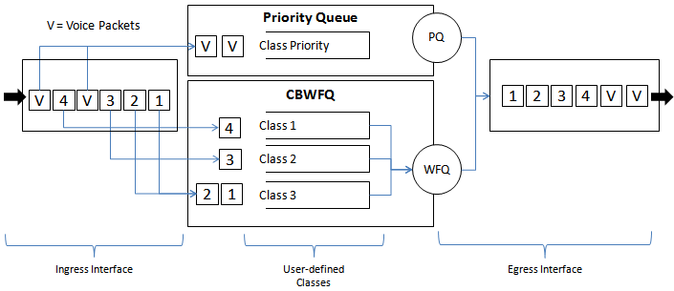
Queuing Algorithms Low Latency Queuing (LLQ)
LLQ feature brings strict priority queuing (PQ) to CBWFQ.
With LLQ, delay-sensitive data is sent first, before packets in other queues are treated.
LLQ allows delay-sensitive data such as voice to be sent first (before packets in other queues), giving delay-sensitive data preferential treatment over other traffic.
Although it is possible to enqueue various types of real-time traffic to the strict priority queue, Cisco recommends that only voice traffic be directed to it.

Slide 9
QoS Implementation Techniques Classification and Marking
Before a packet can have a QoS policy applied to it, the packet has to be classified.
Classification determines what class of traffic packets or frames belong to.
Only after traffic is positively identified can policies be applied to it.
Methods of classifying traffic flows at Layer 2 and 3 include using interfaces, ACLs, and class maps.
Marking means that we are adding a value to the packet header.
Devices receiving the packet look at this field to see if it matches a defined policy.
Marking should be done as close to the source device as possible.
This establishes the trust boundary.

Slide 10
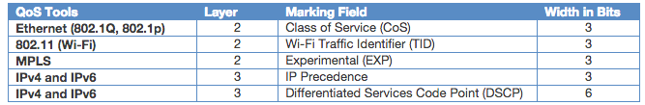
QoS Implementation Techniques Classification and Marking
How traffic is marked usually depends on the technology.
The decision of whether to mark traffic at Layers 2 or 3 or both is not trivial and should be made after consideration of the following points:
Layer 2 marking of frames can be performed for non-IP traffic.
Layer 2 marking of frames is the only QoS option available for switches that are not “IP aware”
Layer 3 marking will carry the QoS information end-to-end.

Slide 11
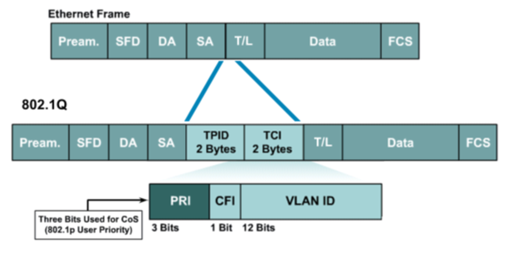
QoS Implementation Techniques Marking at Layer 2
802.1Q standard is an IEEE specification for implementing VLANs in Layer 2 switched networks.
Two fields are inserted into the Ethernet frame following the source address field.

Slide 12
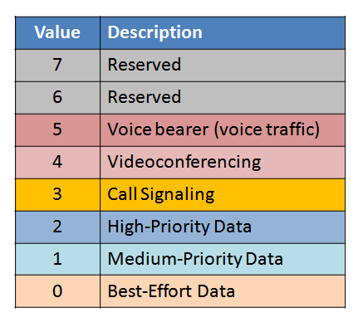
QoS Implementation Techniques Marking at Layer 2
Tag protocol identifier (TPID) is currently fixed and assigned the value 0x8100.
The Tag control information (TCI) contains 3-bits PRI (Priority) field that identifies the Class of Service (CoS) markings.
The CoS marking allows a Layer 2 Ethernet frame to be marked with eight levels of priority (values 0–7).

Slide 13
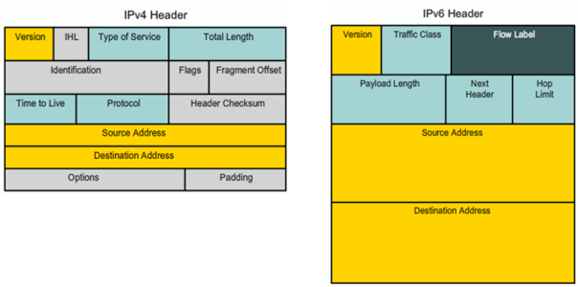
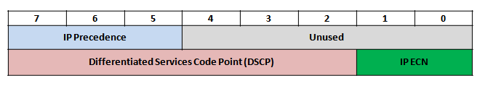
QoS Implementation Techniques Marking at Layer 3
IPv4 and IPv6 specify an 8-bit field in their packet headers to mark packets
IPv4: “Type of Service”
IPv6 “Traffic Class”
Type of Service and Traffic Class Content

Slide 14
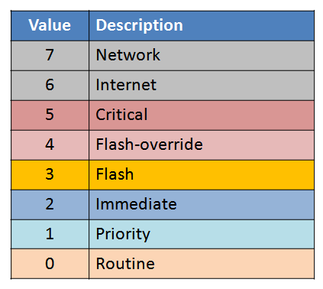
QoS Implementation Techniques Marking at Layer 3
The first 3 significant left-hand high-order bits are referred to as the IP Precedence field.
The 8 bits provides a total of eight possible classes of service.

Slide 15
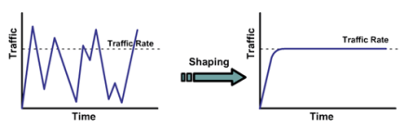
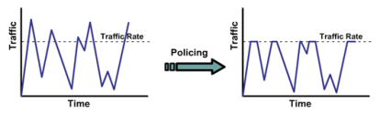
QoS Implementation Techniques Shaping and Policing
Traffic shaping and traffic policing are two mechanisms provided by Cisco IOS QoS software to prevent congestion.
Traffic shaping retains excess packets in a queue and then schedules the excess for later transmission over increments of time.
The result of traffic shaping is a smoothed packet output rate.
Traffic policing propagates bursts.
When the traffic rate reaches the configured maximum rate, excess traffic is dropped (or remarked).
The result is an output rate that appears as a saw-tooth with crests and troughs.

