Slide 1
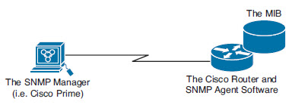

SNMP
Message format for communicating between managers and agents
  Agents on the machines you are monitoring
    Management Information Base (MIB)
  Manager is the server
ICND2 19-1

Slide 2
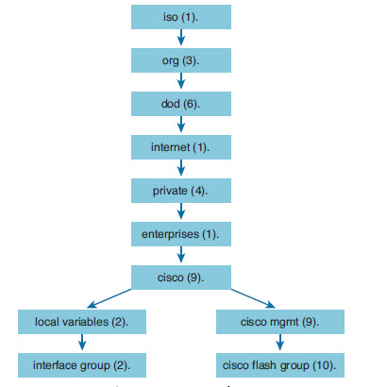
SNMP
Get Messages
  Poll the agents for details
Set messages
  Change settings in the database
SNMP Traps
  Messages sent by agent (without
  being polled)
ICND2 19-<number>

Slide 3

SNMP in action
-v2c: The version on SNMP in use
-c community: The SNMP password, called a community string
10.250.250.14: The IP address of the monitored device
1.3.6.1.4.1.9.2.1.58.0: The numeric object identifier (OID) of the MIB variable
ICND2 19-<number>

Slide 4
Configure SNMP
Step 1. (Required) Configure the community string and access level (read-only or readwrite) with the snmp-server community string RO|RW global command.
Step 2. (Optional) Document the location of the device using the snmp-server location text-describing-location global configuration command.
Step 3. (Optional) Document the location of the device using the snmp-server contact contact-name global configuration command.
Step 4. (Optional) Restrict SNMP access to NMS hosts that are permitted by an access control list (ACL) by defining an ACL and referencing the ACL on the snmp-server community string acl-name-or-number global configuration command.
ICND2 19-<number>

Slide 5
Configure SNMP
R1(config)# ip access-list standard ACL_PROTECTSNMP
R1(config-std-nacl)# permit host 10.10.10.101
R1(config-std-nacl)# exit
R1(config)# snmp-server community V011eyB@11!!! RO ACL_PROTECTSNMP
R1(config)# snmp-server location Tampa
R1(config)# snmp-server contact Anthony Sequeira
R1(config)# end
R1#
Sets Read Only access for addresses that match the ACP_PROTECTSNMP statements
Gives SNMP details about the router
ICND2 19-<number>

Slide 6
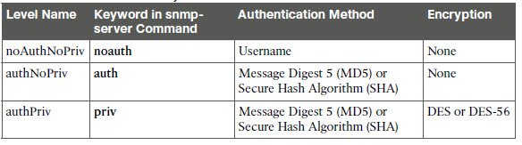
SNMPv3
Message integrity: This helps ensure that a packet has not been tampered with in transit.
Authentication: This helps ensure that the packet came from a known and trusted source.
Encryption: This helps to ensure that information cannot be read if the data is captured in transit.
ICND2 19-<number>

Slide 7

ICND2 19-<number>

Slide 8
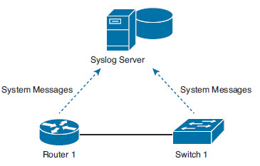
Syslog
Options for syslog messages
  The logging buffer (RAM inside the router or switch)
  The console line (default)
  The terminal lines
  A syslog server
ICND2 19-<number>

Slide 9
Syslog Messages
*Dec 18 17:10:15.079: %LINEPROTO-5-UPDOWN: Line protocol on Interface FastEthernet0/0, changed state to down
A timestamp: *Dec 18 17:10:15.079
  Can change timestamps for sequence numbers
    R1(config)# no service timestamps
    R1(config)# service sequence-numbers
The facility on the router that generated the message: %LINEPROTO
The severity level: 5
A mnemonic for the message: UPDOWN
The description of the message: Line protocol on Interface FastEthernet0/0, changed state to down
ICND2 19-<number>

Slide 10
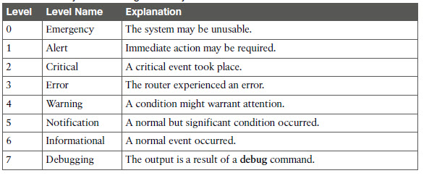
Syslog Severity Levels
ICND2 19-<number>

Slide 11
Configure and Verify Logging
Logging [console|buffered]
  Default is usually console
R1# show logging
Syslog logging: enabled (0 messages dropped, 2 messages rate-limited,0 flushes, 0
overruns, xml disabled, filtering disabled)
No Active Message Discriminator.
No Inactive Message Discriminator.
Console logging: level debugging, 10 messages logged, xml disabled, filtering disabled
Monitor logging: level debugging, 0 messages logged, xml disabled, filtering disabled
Buffer logging: level debugging, 10 messages logged, xml disabled,filtering disabled
Logging Exception size (8192 bytes)
Count and timestamp logging messages:
ICND2 19-<number>

Slide 12
Table 33-2 How to Configure Logging Message Levels for Each Log Service
Service To Enable Logging To Set Message Levels
Console logging console logging console level-name | level-number
Monitor logging monitor logging monitor level-name | level-number
Buffered logging buffered logging buffered level-name | level-number
Syslog logging host address | hostname logging trap level-name | level-number
ICND2 19-<number>

Slide 13
Configure Syslog
Step 1. First, configure the destination hostname or IP address of the syslog server:
  R1(config)# logging 192.168.1.101
Step 2. Next, you can control which messages are sent there. For example, to limit the messages for levels 4 and lower (0 through 4), use the following command:
  R1(config)# logging trap 4
ICND2 19-<number>

Slide 14
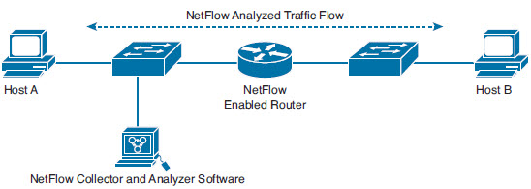
NetFlow
Provide statistics on IP packets flowing through network devices
For communication between Host A and B for an application
NetFlow monitors and push stats to Collector
ICND2 19-<number>

Slide 15
NetFlow Uses
General network traffic accounting for baseline analysis
Usage-based network billing for consumers of network services
Network design, including redesigns to include new network devices and applications to meet the needs of growing infrastructures
General network security design
Denial of service (DoS) and distributed DoS (DDoS) detection and prevention data
Ongoing network monitoring
ICND2 19-<number>

Slide 16
Identifying a “Flow”
Source IP address
Destination IP address
Source port number
Destination port number
Layer 3 protocol type
Type of Service (ToS) marking
Input logical interface
ICND2 19-<number>

Slide 17
Configure NetFlow on a router
Configuring the capture of data about flows, using the ip flow interface subcommand
  Ip flow ingress for incoming
  Ip flow egress for outgoing
2. Configuring details of how to send that data to the NetFlow collector, using the ip flow-export global command
ICND2 19-<number>

Slide 18
Configure NetFlow collector
1. The NetFlow collector’s IP address and UDP port number, on the ip flow-export destination address port global command
2. The version of NetFlow to follow when formatting the NetFlow records sent to the collector, with the ip flow-export version version global command
3. The source interface to use as the source of the packets sent to the collector, using the ip flow-export source type number global command
ICND2 19-<number>

Slide 19
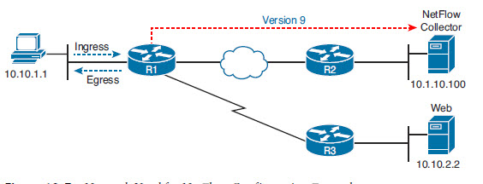
NetFlow Example
R1(config)# interface fastethernet0/0
R1(config-if)# ip flow ingress
R1(config-if)# ip flow egress
R1(config-if)# exit
R1(config)# ip flow-export destination 10.1.10.100 99
R1(config)# ip flow-export version 9
R1(config)# ip flow-export source loopback 0
R1(config)# end
ICND2 19-<number>

Slide 20
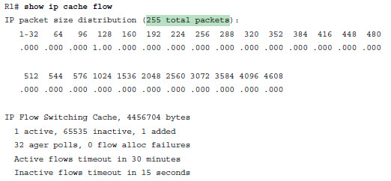
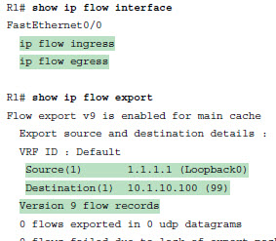
Verifying NetFlow
ICND2 19-<number>

