Slide 1

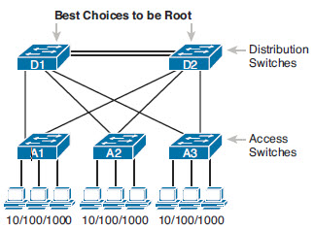
STP Configuration
& Verification
STP will work out of the box without configuration
  May not be “best” root for traffic flow
May want to “choose” which switch will be root
ICND2 2-<number>

Slide 2
Setting STP Mode
802.1 D Spanning Tree
  Had no VLAN Awareness
  Cisco created Per-VLAN Spanning Tree Plus (PVST+, PVSTP)
    Different STP process for each VLAN
    Added PortFast
802.1W Rapid Spanning Tree
  Cisco has RPVST+
Cisco Switches generally use PVST+
Can Configure with
  spanning-tree mode pvst
  spanning-tree mode rapid-pvst
  spanning-tree mode mst
ICND2 2-<number>

Slide 3
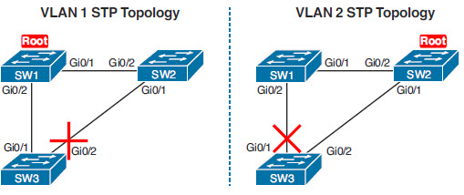
Configuration Options
Bridge ID/Priority
STP Port Cost
Can make changes per-vlan
  So VLAN 1 and VLAN 2 have different Root and DP
ICND2 2-<number>

Slide 4
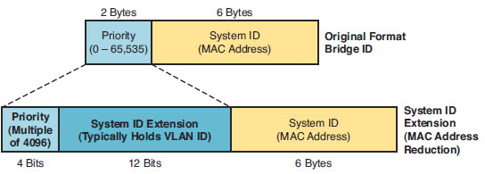
BID and System Extension ID
New BID includes a System Extension ID
  This adds the VLAN ID to the BID
  Lets you recognize which VLAN a BPDU is from
ICND2 2-<number>

Slide 5
Configurations
Setting the Priority
  spanning-tree vlan vlan-id priority x
    Priority must be a multiple of 4096
Per VLAN port cost
  At the interface command prompt
    spanning-tree [vlan vlan-id] cost cost
    For trunks, you can specify a cost per vlan
ICND2 2-<number>

Slide 6
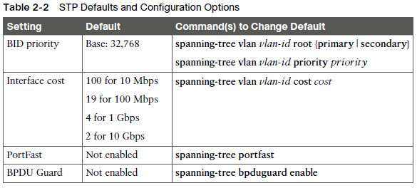
Config Options
ICND2 2-<number>

Slide 7
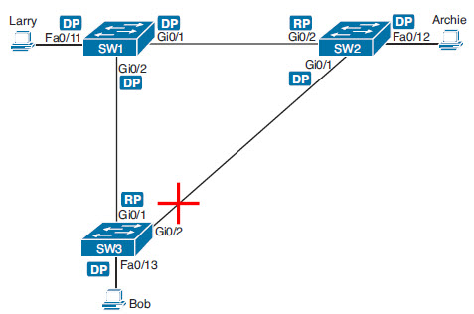
Verifying STP
SW1# show spanning-tree vlan 10
VLAN0010
Spanning tree enabled protocol ieee
Root ID Priority 32778
Address 1833.9d7b.0e80
This bridge is the root
Hello Time 2 sec Max Age 20 sec Forward Delay 15 sec
Bridge ID Priority 32778 (priority 32768 sys-id-ext 10)
Address 1833.9d7b.0e80
Hello Time 2 sec Max Age 20 sec Forward Delay 15 sec
Aging Time 300 sec
Interface Role Sts Cost Prio.Nbr Type
------------------- ---- --- --------- -------- --------------------------------
Fa0/11 Desg FWD 19 128.11 P2p Edge
Gi0/1 Desg FWD 4 128.25 P2p
Gi0/2 Desg FWD 4 128.26 P2p
ICND2 2-<number>

Slide 8
Verifying STP
SW2# show spanning-tree vlan 10
VLAN0010
Spanning tree enabled protocol ieee
Root ID Priority 32778
Address 1833.9d7b.0e80
Cost 4
Port 26 (GigabitEthernet0/2)
Hello Time 2 sec Max Age 20 sec Forward Delay 15 sec
Bridge ID Priority 32778 (priority 32768 sys-id-ext 10)
Address 1833.9d7b.1380
Hello Time 2 sec Max Age 20 sec Forward Delay 15 sec
Aging Time 300 sec
Interface Role Sts Cost Prio.Nbr Type
------------------- ---- --- --------- -------- --------------------------------
Fa0/12 Desg FWD 19 128.12 P2p
Gi0/1 Desg FWD 4 128.25 P2p
Gi0/2 Root FWD 4 128.26 P2p
ICND2 2-<number>

Slide 9
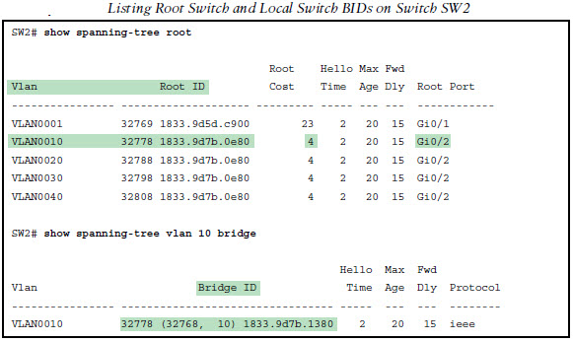
Verifying STP
ICND2 2-<number>

Slide 10
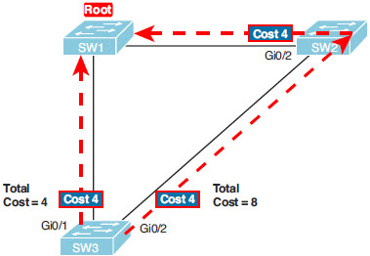
Configure Port costs
spanning-tree [vlan x] cost x
SW3(config)# interface gigabitethernet0/1
SW3(config-if)# spanning-tree vlan 10 cost 30
SW3(config-if)# ^Z
SW3#
*Mar 11 06:28:00.860: STP: VLAN0010 new root port Gi0/2, cost 8
*Mar 11 06:28:00.860: STP: VLAN0010 Gi0/2 -> listening
*Mar 11 06:28:00.860: STP: VLAN0010 sent Topology Change Notice on Gi0/2
ICND2 2-<number>

Slide 11
Configure Priority for Root Election
spanning-tree vlan vlan-id root primary
  If the current root has a base priority higher than 24,576, the local switch uses a base priority of 24,576 .
  If the current root’s base priority is 24,576 or lower, the local switch sets its base priority to the highest multiple of 4096 that still results in the local switch becoming root.
Can also manually configure
  spanning-tree vlan 10 priority 28672
ICND2 2-<number>

Slide 12
PortFast and BPDU Guard
Can do per interface or global
  Global will turn it on for any access mode port
Per Interface
  SW3(config)# interface fastEthernet 0/4
  SW3(config-if)# spanning-tree portfast
  SW3(config-if)# spanning-tree bpduguard enable
Global
  SW3(config)# spanning-tree portfast default
  SW3(config)# spanning-tree portfast bpduguard default
ICND2 2-<number>

Slide 13
STP Troubleshooting
Step 1. Begin with a list or diagram of switches, and consider all as possible root switches.
Step 2. Rule out any switches that have an RP (show spanning-tree, show spanning-tree root), because root switches do not have a RP.
Step 3. Always try show spanning-tree, because it identifies the local switch as root directly: “This switch is the root” on the fifth line of output.
Step 4. Always try show spanning-tree root , because it identifies the local switch as root indirectly: The RP column is empty if the local switch is the root.
Step 5. When using a sim, rather than try switches randomly, chase the RPs. For example, if starting with SW1, and SW1’s G0/1 is an RP, next try the switch on the other end of SW1’s G0/1 port.
Step 6. When using a Sim, using show spanning-tree vlan x on a few switches, and recording the root switch, RP, and DP ports can quickly show you most STP facts. Use that strategy if available.
ICND2 2-<number>

Slide 14
Determine RP
RP has lowest cost to root
  Add cost of each interface a frame would pass through
Tie-Breakers
  If two ports are equal cost
    Either through topology or through non-standard port cost
    1. Choose based on the lowest neighbor bridge ID.
    2. Choose based on the lowest neighbor port priority.
    3. Choose based on the lowest neighbor internal port number.
ICND2 2-<number>

Slide 15
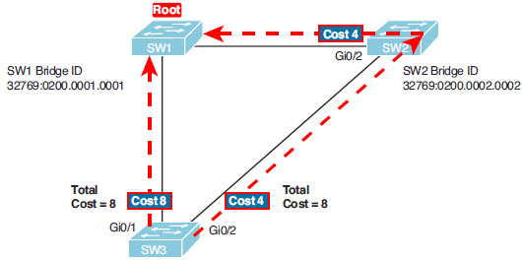
RP Tiebreakers
Gi0/1 will be root since the neighbor bridge ID is lower
ICND2 2-<number>

Slide 16

RP Tiebreaker
SW2 is root because of BID
SW1 has two equal cost paths to root
Neighbor bridge has same BID
  Tiebreak on priority
  If all ports are default Priority, use interface number
On SW1 Port Fa0/14 will be RP
In real life, you could use etherchannel
ICND2 2-<number>

Slide 17
RP on Exam
1. If available, look at the show spanning-tree and show spanning-tree root commands. These both list the root port, and the first of these also lists the root cost
2. The show spanning-tree command list cost in two places: the root cost at the top, in the section about the root switch; and the interface cost, at the bottom, in the perinterface section. Be careful, though; the cost at the bottom is the interface cost, not the root cost !
3. For problems where you have to calculate a switch’s root cost:
  a. Memorize the default cost values: 100 for 10 Mbps, 19 for 100 Mbps, 4 for 1 Gbps, and 2 for 10 Gbps.
  b. Look for any evidence of the spanning-tree cost configuration command on an interface, because it overrides the default cost. Do not assume default costs are used.
  c. When you know a default cost is used, if you can, check the current actual speed as well. Cisco switches choose STP cost defaults based on the current speed, not the maximum speed .
ICND2 2-<number>

Slide 18
Determining Designated Port
Step 1. For switches connected to the same LAN segment, the switch with the lowest cost to reach the root, as advertised in the hello they send onto the link, becomes the DP on that link.
Step 2. In case of a tie, among the switches that tied on cost, the switch with the lowest BID becomes the DP.
ICND2 2-<number>

Slide 19
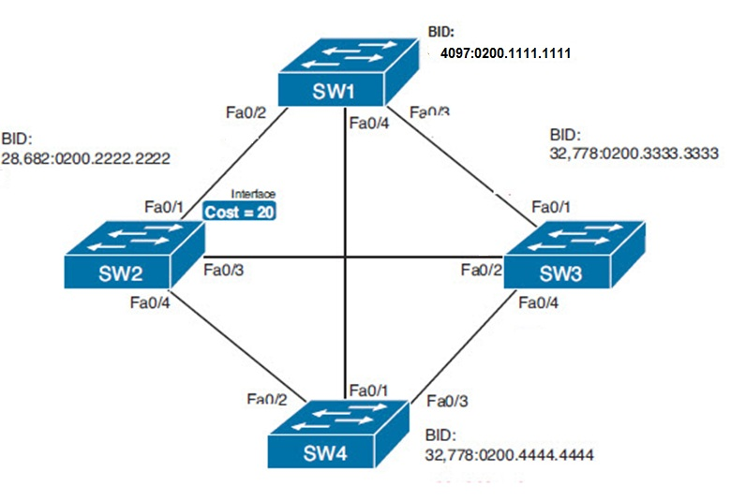
Designated Ports
Root Bridge?
ROOT
Root Ports?
Designated Ports?
SW2-SW3?
DP
DP
DP
RP
RP
DP
DP
SW3-SW4?
RP
SW4-SW2?
DP
ICND2 2-<number>

Slide 20
DP on Exam
1. If available, look at the show spanning-tree commands, at the list of interfaces at the end of the output. Then, look for the Role column, and look for Desg, to identify any DPs .
2. Identify the root cost of a switch directly by using the show spanning-tree command. But be careful! This command lists the cost in two places, and only the mention at the top, in the section about the root, lists the root cost.
3. For problems where you have to calculate a switch’s root cost, do the following:
a. Memorize the default cost values: 100 for 10 Mbps, 19 for 100 Mbps, 4 for 1 Gbps, and 2 for 10 Gbps.
b. Look for any evidence of the spanning-tree cost configuration command on an interface, because it overrides the default cost. Do not assume default costs are used.
c. When you know a default cost is used, if you can, check the current actual speed as well. Cisco switches choose STP cost defaults based on the current speed, not the maximum speed .
ICND2 2-<number>

Slide 21
STP Convergence
For interfaces that stay in the same STP state, nothing needs to change.
For interfaces that need to move from a forwarding state to a blocking state, the switch immediately changes the state to blocking.
For interfaces that need to move from a blocking state to a forwarding state, the switch first moves the interface to listening state, then learning state, each for the time specified by the forward delay timer (default 15 seconds). Only then is the interface placed into forwarding state.
ICND2 2-<number>

Slide 22
Commands
spanning-tree vlan vlan-id priority x
show spanning-tree vlan 10
spanning-tree [vlan x] cost x
spanning-tree vlan vlan-id root primary
channel-group 1 mode on
show etherchannel summary
ICND2 2-<number>

Slide 23

EtherChannel
Multiple links between switches treated as a single link
STP recognizes the etherchannel as a single link
Add interfaces to a channel group
Step 1. Add the channel-group number mode on interface subcommand under each physical interface that should be in the channel.
Step 2. Use the same number for all commands on the same switch, but the channelgroup number on the neighboring switch can differ.
ICND2 2-<number>

Slide 24
EtherChannel
SW1(config)# interface fa 0/14
SW1(config-if)# channel-group 1 mode on
SW1(config)# interface fa 0/15
SW1(config-if)# channel-group 1 mode on
ICND2 2-<number>

Slide 25
EtherChannel
  SW1# show spanning-tree vlan 3
  VLAN0003
  Spanning tree enabled protocol ieee
  Root ID Priority 28675
  Address 0019.e859.5380
  Cost 12
  Port 72 (Port-channel1)
  Hello Time 2 sec Max Age 20 sec Forward Delay 15 sec
  Bridge ID Priority 28675 (priority 28672 sys-id-ext 3)
      Address 0019.e86a.6f80
      Hello Time 2 sec Max Age 20 sec Forward Delay 15 sec
      Aging Time 300
  Interface Role Sts Cost Prio.Nbr Type
  Po1 Root FWD 12 128.64 P2p Peer(STP)
ICND2 2-<number>

Slide 26
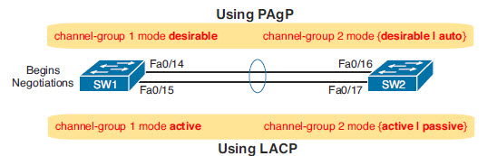
Dynamic Etherchannel
Cisco proprietary Port Aggregation Protocol (PAgP)
IEEE Link Aggregation Control Protocol (LACP)
Both use variations of channel group command
ICND2 2-<number>

Slide 27
Troubleshooting Etherchannel
1. On the local switch, all the channel-group commands for all the physical interfaces must use the same channel-group number.
2. The channel-group number can be different on the neighboring switches.
3. If using the on keyword, you must use it on the corresponding interfaces of both switches.
4. If you use the desirable keyword on one switch, the switch uses PAgP; the other switch must use either desirable or auto.
5. If you use the active keyword on one switch, the switch uses LACP; the other switch must use either active or passive.
ICND2 2-<number>

Slide 28
Etherchannel show commands
SW1# show etherchannel summary
Flags: D - down P - bundled in port-channel I - stand-alone
s – suspended H - Hot-standby (LACP only) R - Layer3 S - Layer2
U - in use f - failed to allocate aggregator
Number of channel-groups in use: 1
Number of aggregators: 1
Group Port-channel Protocol Ports
------+-------------+-----------+-----------------------------------------------
1 Po1(SD) PAgP Fa0/14(I) Fa0/15(I)
SW1# show interfaces status | include Po|14|15
Port Name Status Vlan Duplex Speed Type
Fa0/14 connected 301 a-full a-100 10/100BaseTX
Fa0/15 connected 301 a-full a-100 10/100BaseTX
Po1 notconnect unassigned auto auto
Tells us the etherchannel is down
ICND2 2-<number>

Slide 29
Etherchannel checks
Speed
Duplex
Operational access or trunking state (all must be access, or all must be trunks)
If an access port, the access VLAN
If a trunk port, the allowed VLAN list (per the switchport trunk allowed command)
If a trunk port, the native VLAN
STP interface settings
ICND2 2-<number>

