Slide 1
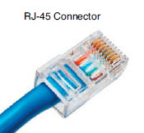
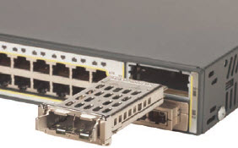
Ethernet with Twisted Pair
Base T standards use Unshielded Twisted Pair (UTP) cabling
Currently Cat 5 or higher is used
  8 pins or wires in 4 pairs
  RJ 45 Connectors
Can also add capabilities to devices through GBICs and SFPs
CCENT 2-1

Slide 2
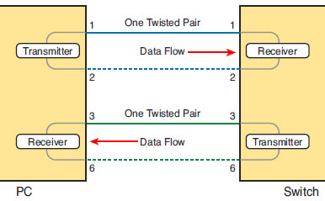
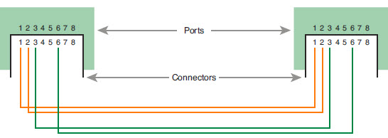
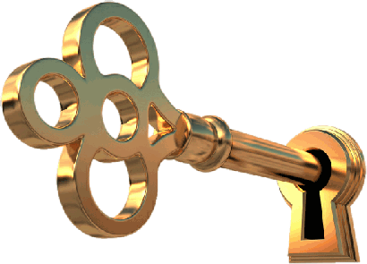
Cable Pinouts and Types
10 Base-T and 100 Base-T use same pins
Transmit 1, 2
Receive 3, 6
1000 Base-T uses all
4 pairs
CCENT 2-<number>

Slide 3
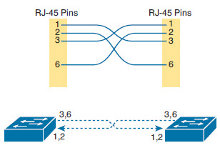
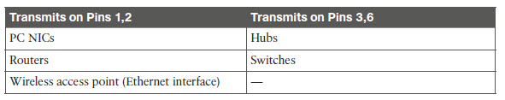
Crossover Cable
Used when connecting like devices directly
Cross 1-3 and 2-6
CCENT 2-<number>

Slide 4

Ethernet Data Link Protocols
Ethernet Frame Formats may vary, but common format shown below
Data is usually the IP Packet
Type/Length is usually type
  IPv4 Type 0800
  IPv6 Type 86DD
Minimum Length is 46 Bytes and a Maximum of 1500
  So Frame without preamble and SFD is 64 to 1518
CCENT 2-<number>

Slide 5
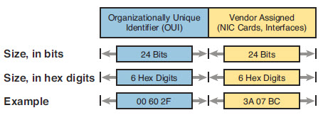
Ethernet Addressing
Ethernet or MAC addresses are 6 bytes/48 bits long
Unicast MAC Addresses must be unique
  Used to get packets to the correct destination on local network
CCENT 2-<number>

Slide 6
Ethernet Unicast, Multicast and Broadcast
Different MAC addresses are used to provide different types of communication.
  Unicast:
    A unique address identifying a specific host.
  Multicast:
    An address recognized by a specific group of hosts.
  Broadcast:
    An address used to send information to all hosts.

Slide 7
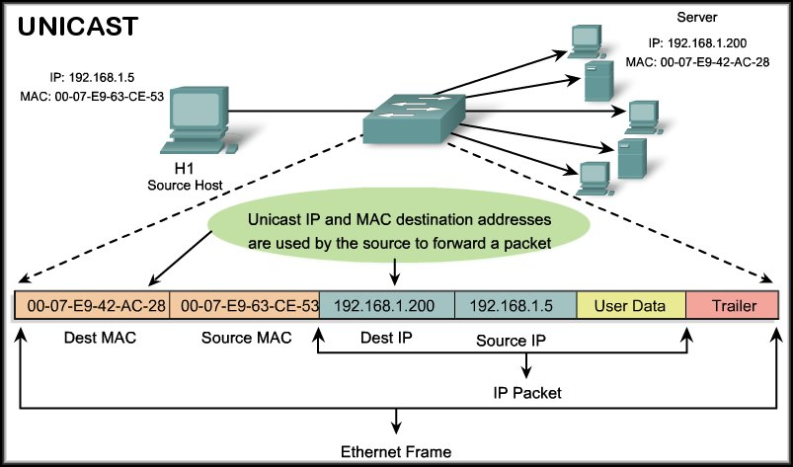
Ethernet Unicast, Multicast and Broadcast

Slide 8
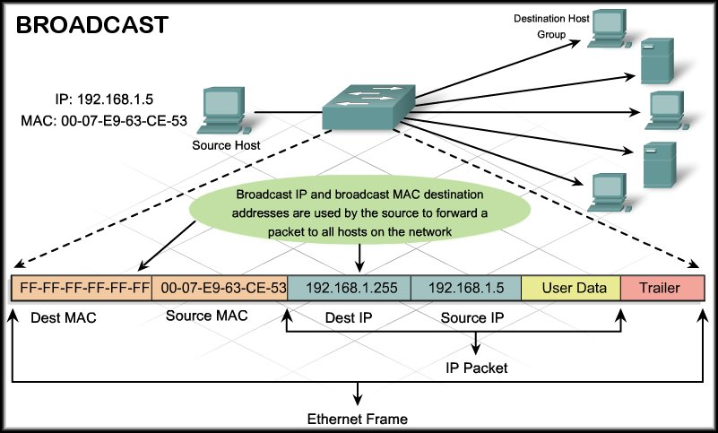
Ethernet Unicast, Multicast and Broadcast

Slide 9
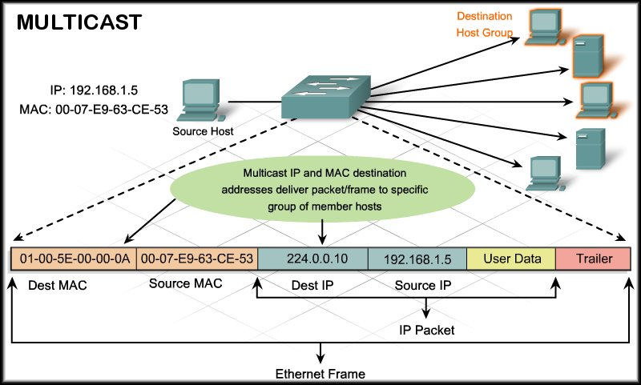
Ethernet Unicast, Multicast and Broadcast

Slide 10
Error Detection
Ethernet supports Error Detection with the Frame Check Sequence (FCS)
The sender applies a complex formula (CRC) to the frame and stores the result of the in the FCS field.
The receiver applies the same formula to the received frame and compares its results with the sender’s results.
If the results are the same, the frame did not change; otherwise, an error occurred, and the receiver discards the frame.
Ethernet discards the Frame, but doesn’t deal with error correction. That is left to other layers.
CCENT 2-<number>

Slide 11
Ethernet with Switches and Hubs
Modern network usually use switches
  If a single device is connected to a switch port, the connection is full-duplex
Half-duplex: Logic in which a port sends data only when it is not also receiving data; in other words, it cannot send and receive at the same time.
Full-duplex: The absence of the half-duplex restriction.
Older networks were half duplex
  Hubs were layer 1 devices- mulitport repeaters
  Collisions could occur
  Ethernet used CSMA/CD to avoid collisions
CCENT 2-<number>

Slide 12
CSMA/CD
Step 1. A device with a frame to send listens until the Ethernet is not busy.
Step 2. When the Ethernet is not busy, the sender begins sending the frame.
Step 3. The sender listens while sending to discover whether a collision occurs; collisions might be caused by many reasons, including unfortunate timing. If a collision occurs, all currently sending nodes do the following:
  A. They send a jamming signal that tells all nodes that a collision
  happened.
  B. They independently choose a random time to wait before trying again, to avoid unfortunate timing
  C. The next attempt starts again at Step 1.
CCENT 2-<number>

