Slide 1
LANS and VLANS
LAN includes all devices in the same broadcast domain
Same Network IP address
Without VLANS, all switch interfaces are in same broadcast domain
  Separated by layer 3 device-router
CCENT 9-1

Slide 2
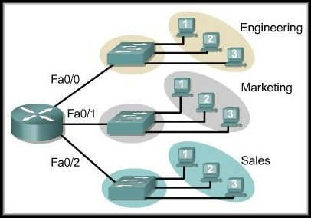
Defining VLANs
The above design shows 3 separate broadcast domains created using one router with 3 ports and 3 switches.
The router filters the broadcasts for each LAN.
CCENT 9-<number>

Slide 3
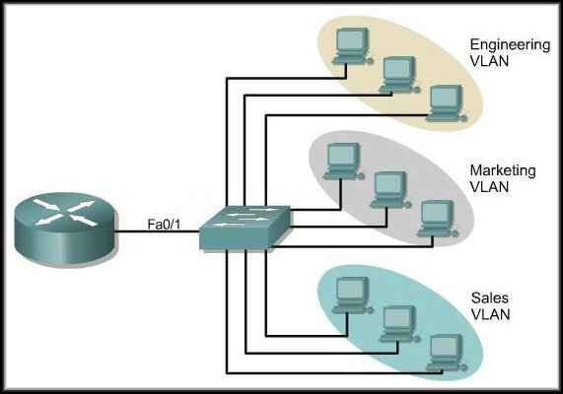
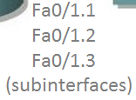
Defining VLANs
One Physical Link
A better design still creates the 3 separate broadcast domains but only requires 1 switch.
The router provides broadcast filtering over a single link.
CCENT 9-<number>

Slide 4


VLAN Example
Single switch
2 broadcast domains
  Each needs a different network or subnet number
Can only communicate through a layer 3 device (router or layer 3 switch)
CCENT 9-<number>

Slide 5
Reasons to put hosts in separate VLANS
To reduce CPU overhead on each device by reducing the number of devices that receive each broadcast frame
To reduce security risks by reducing the number of hosts that receive copies of frames that the switches flood (broadcasts, multicasts, and unknown unicasts)
To improve security for hosts that send sensitive data by keeping those hosts on a separate VLAN
To create more flexible designs that group users by department, or by groups that work together, instead of by physical location
To solve problems more quickly, because the failure domain for many problems is the same set of devices as those in the same broadcast domain
To reduce the workload for the Spanning Tree Protocol (STP) by limiting a VLAN to a single access switch
CCENT 9-<number>

Slide 6
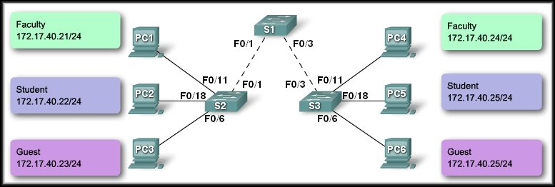
Controlling Broadcast Domains with VLANs
Network without VLANs:
Sends a Broadcast
CCENT 9-<number>

Slide 7
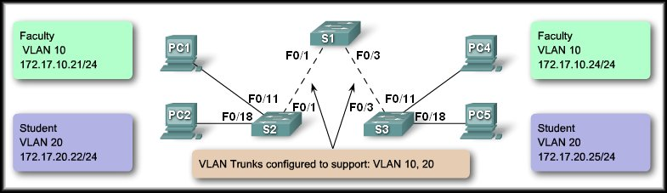
Controlling Broadcast Domains with VLANs
Network with VLANs:
Sends a Broadcast
Sends a Broadcast
CCENT 9-<number>

Slide 8
Multiswitch VLANS using trunking
Switches identify the VLAN for traffic because the port is assigned to a VLAN
  End devices don’t need to know
When connecting switches you can use one interface for each VLAN
  Waste of interfaces
You can also create TRUNK ports
  Carry traffic for multiple VLANS
  Use tagging to let switch identify which VLAN the traffic is for
CCENT 9-<number>

Slide 9
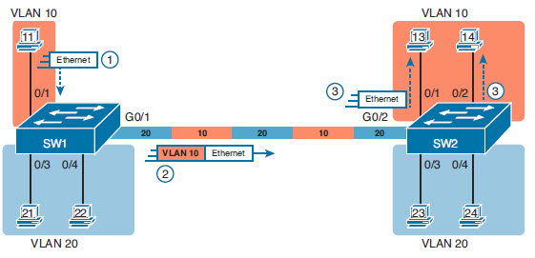
VLAN Trunking and Tagging
Tagging is used to let switches know which VLAN
1. PC 11 in VLAN 10 sends traffic
2. Switch receives and forward out all ports including the trunk port. Since it is a trunk, SW1 TAGS the frame so SW2 knows which ports to send on
3. SW2 forwards out ports in VLAN 10
CCENT 9-<number>

Slide 10
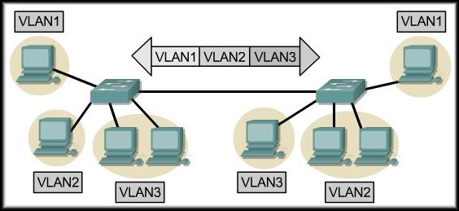
IEEE 802.1Q Frame Tagging
Remember that switches are Layer 2 devices.
  Only use the Ethernet frame header information.
  Frame header does not contain information about VLAN membership.
VLAN membership (i.e. VLAN ID or VLAN Number) must be identified for each frame that is transferred over the trunk.
The process is called 802.1Q VLAN Tagging.
CCENT 9-<number>

Slide 11
IEEE 802.1Q Frame Tagging
Length 1518 Bytes
Generated by the host
6 | 6 | 2 | 1500 | 4
Destination Address | Source Address | Type / Length | Data Max of 1500 Bytes | FCS
Length 1522 Bytes
Generated by the switch (ingress)
6 | 6 | 2 | 2 | 2 | 1500 | 4
Destination Address | Source Address | 802.1Q Tag |  | Type/ Length | Data Max of 1500 Bytes | New FCS
 |  | 0x8100 | Tag
CCENT 9-<number>

Slide 12
802.1q Frame Tagging
VLAN IDs 1-4094
  Normal Range 1-1005
    Commonly used
    Defaults are 1, 1002, 1003, 1004, 1005
  Extended Range 1005-4094
Native VLAN
  Special VLAN for which traffic ISN’T tagged
  If a switch receives untagged data on a trunk, it assumes it is part of Native VLAN
  Default Native VLAN on Cisco is 1
CCENT 9-<number>

Slide 13
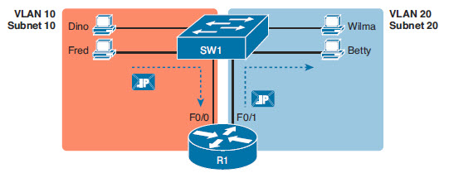
Routing Packets between VLANS
To go between VLANS, you need a layer 3 device
  Router or Layer 3/Multilayer Switch
CCENT 9-<number>

Slide 14
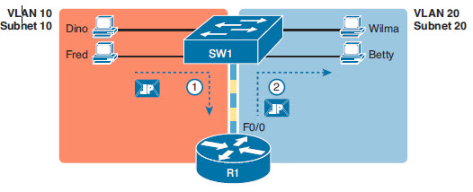
Router on a Stick
Connect the router to a trunk port on the switch
CCENT 9-<number>

Slide 15
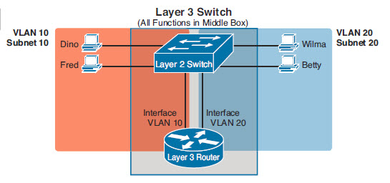
Routing with a Layer 3 switch
Routing on a stick has limits
  Router interfaces are expensive
  Single port has bandwidth constraints
Layer 3/Multilayer Switches can perform layer 3 forwarding
  Often used to route packets between VLANs
CCENT 9-<number>

Slide 16
VLAN and VLAN Trunk Configuration
Cisco Switches work as switches with no configuration
However, VLANs require configuration
  Management through Console or VTY
1. Create the VLAN
2. Assign ports to the VLAN
3. Set trunk ports
CCENT 9-<number>

Slide 17
Basic VLAN Configuration
Step 1. To configure a new VLAN, follow these steps:
A. From configuration mode, use the vlan vlan-id global configuration command to create the VLAN and to move the user into VLAN configuration mode.
B. (Optional) Use the name name VLAN subcommand to list a name for the VLAN. If not configured, the VLAN name is VLANZZZZ, where ZZZZ is the 4-digit decimal VLAN ID
CCENT 9-<number>

Slide 18
Basic VLAN Configuration
Step 2. For each access interface (each interface that does not trunk, but instead belongs to a single VLAN), follow these steps:
A. Use the interface command to move into interface configuration mode for each desired interface.
B. Use the switchport access vlan id-number interface subcommand to specify the VLAN number associated with that interface.
C. (Optional) To disable trunking on that same interface, so that the interface does not negotiate to become a trunk, use the switchport mode access interface subcommand.
Recommended
CCENT 9-<number>

Slide 19
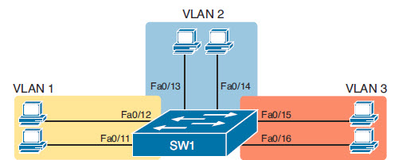
Configuration Example
SW1(config)# vlan 2
SW1(config-vlan)# name Freds-vlan
SW1(config-vlan)# exit
SW1(config)# interface range fastethernet 0/13 - 14
SW1(config-if)# switchport access vlan 2
SW1(config-if)# switchport mode access
CCENT 9-<number>

Slide 20
Shortcuts and verification
If you assign ports to a VLAN, the vlan will be created automatically
  SW1(config)# interface range Fastethernet 0/15 - 16
  SW1(config-if-range)# switchport access vlan 3
  % Access VLAN does not exist. Creating vlan 3
Show vlan
Show vlan brief
Show vlan id #
CCENT 9-<number>

Slide 21
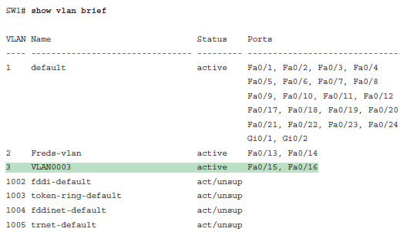
Show vlan
CCENT 9-<number>

Slide 22
VLAN Trunking Protocol
Allows switches to share VLAN database information
  NOT port assignments
VTP Modes: Server, Client, Transparent
  Can’t always disable completely
Set the switch to transparent mode to limit VTP effects
  SW1(config)# vtp mode transparent
If your switch uses VTP server or client mode, you will find
The server switches can configure VLANs in the standard range only (1–1005).
The client switches cannot configure VLANs.
The show running-config command does not list any vlan commands.
CCENT 9-<number>

Slide 23
VLAN Trunking Configuration
Simplest- Manually configure trunking
  switchport mode trunk
Two main trunking options
  Trunk encapsulation if multiple trunk types supported
    switchport trunk encapsulation {dot1q | isl | negotiate}
  Trunking administrative mode
  switchport mode {access|trunk|dynamic Auto|dynamic desirable}
CCENT 9-<number>

Slide 24
Dynamic Trunking Protocol (DTP):
On: (switchport mode trunk)
  Periodically sends DTP advertisements, to the remote port that it is dynamically changing to a trunking state.
Dynamic Auto: (switchport mode dynamic auto)
  The switch does not send DTP frames to the remote port. It advertises to the remote switch port that it is able to trunk but does not request to go to the trunking state.
Dynamic Desirable: (switchport mode dynamic desirable)
  DTP frames are sent periodically to the remote port. It advertises to the remote switch port that it is able to trunk and asks the remote switch port to go to the trunking state.
CCENT 9-<number>

Slide 25
Dynamic Trunking Protocol (DTP) (cont.)
Turn off DTP: (switchport nonegotiate on a trunk port)
(switchport mode access on an access port)
  The local port does not send out DTP frames to the remote port.
  The local port is then considered to be in an unconditional trunking state.
  Use this feature when you need to configure a trunk with a switch from another switch vendor.
CCENT 9-<number>

Slide 26
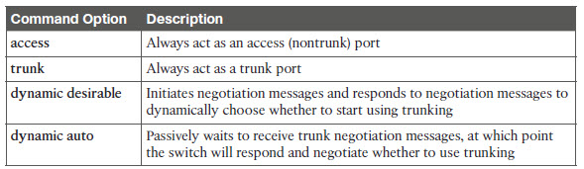
Dynamic Trunking Options
CCENT 9-<number>

Slide 27
Switchport configurations
show interfaces [type #] switchport
  Lets you see current settings- Access VLAN, DTP Admin setting, Operational Mode, Native VLAN, and more
SW1# show interfaces gigabit 0/1 switchport
Name: Gi0/1
Switchport: Enabled
Administrative Mode: dynamic auto
Operational Mode: static access
Administrative Trunking Encapsulation: dot1q
Operational Trunking Encapsulation: native
Negotiation of Trunking: On
Access Mode VLAN: 1 (default)
Trunking Native Mode VLAN: 1 (default)
Administrative Native VLAN tagging: enabled
Voice VLAN: none
Access Mode VLAN: 1 (default)
CCENT 9-<number>

Slide 28
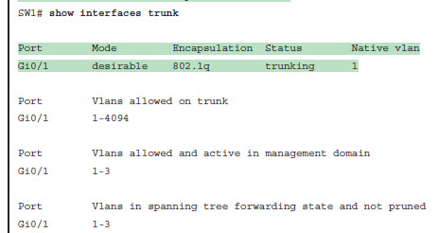
Switchport Configurations
Show interfaces trunk
  See details about interfaces which are in trunking operational mode
CCENT 9-<number>

Slide 29
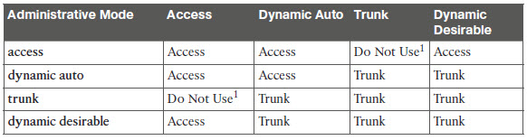
Trunking between Switches
CCENT 9-<number>

Slide 30
Controlling VLANS on a trunk
Default is for all VLANS to be allowed
Can manually control with switchport trunk allowed vlan command
switchport trunk allowed vlan {add | all | except | remove} vlan-list
CCENT 9-<number>

Slide 31
Reasons a trunk won’t carry traffic
A VLAN has been removed from the trunk’s allowed VLAN list.
A VLAN does not exist in the switch’s configuration (as seen with the show vlan command).
A VLAN does exist, but has been administratively disabled (shutdown).
A VLAN has been automatically pruned by VTP.
A VLAN’s STP instance has placed the trunk interface into a blocking state.
CCENT 9-<number>

Slide 32
Shortcuts and verification
Switchport mode access/ trunk
Vlan #
Show vlan
Show vlan brief
Show vlan id #
vtp mode [server|client|transparent]
Show interfaces switchport
Show interfaces trunk
switchport trunk allowed vlan {add | all | except | remove} vlan-list
CCENT 9-<number>

