Slide 1
Week1
Game Engine Development
GAME3121
Hooman Salamat

Slide 2

Instructor
Hooman Salamat (Lectures & Labs)
Hooman.Salamat@georgebrown.ca
Other contact info on Brightspace

Slide 3
Assessment
2x Assignments 20%
📝📝
(10) Labs 20%
💻💻💻💻💻
💻💻💻⌨⌨
1x Midterm Exam 30%
📚
1x Final Exam 30%
🕹

Slide 4

Textbook
Game Engine Architecture, Third Edition
By: Jason Gregory
ISBN-13: 978-1-1380-3545-4
Publisher: CRC Press

Slide 5
Objective & Concept
Objective
This course provides students with an in-depth exploration of 3D game engine architecture.
Students will learn state-of-the-art software architecture principles in the context of game engine design, investigate the subsystems typically found in a real production game engine, survey some engine architectures from actual shipping games, and explore how the differences between game genres can affect engine design.
Students will participate in individual hands-on lab exercises, and also work together like a real game development team to design and build their own functional game engine by designing and implementing engine subsystems and integrating 3rd party components.
Concepts
Engine subsystems including rendering, audio, collision, physics and game world models.
Large-scale C++ software architecture in a games context.
Tools pipelines for modern games.

Slide 6
Week 1 – Introduction
Course overview
What is a game engine?
game engines like Epic Games’ Unreal Engine, Valve’s Source engine and, Crytek’s CRYENGINE®, Electronic Arts DICE’s Frostbite™ engine, and the Unity game engine—have become fully featured reusable software development kits that can be licensed and used to build almost any game imaginable.
Engine differences between game genres
Survey of runtime engine subsystems
  Virtually all game engines contain a familiar set of core components, including the rendering engine, the collision and physics engine, the animation system, the audio system, the game world object model, the artificial intelligence system and so on.
Survey of tools and the asset pipeline
Reading:
Course text: 1.2 – 1.7
Notes:
• https://www.youtube.com/watch?v=-oKdIbexbPw
how real industrial-strength production game engines are architected;
• how game development teams are organized and work in the real world;
• which major subsystems and design patterns appear again and again in virtually every game engine;
• the typical requirements for each major subsystem;
• which subsystems are genre- or game-agnostic, and which ones are typically designed explicitly for a specific genre or game; and
• where the engine normally ends and the game begins.

Slide 7
Structure of a game team
Game studios are usually composed of five basic disciplines:
  Engineers (design and implement the software that makes the game, and the tools, work)
    Runtime programmers (who work on the engine and the game itself)
    tools programmers (who work on the offline tools that allow the rest of the development team to work effectively).
  Artists:
    “Content is king.”
    The artists produce all of the visual and audio content in the game, and the quality of their work can literally make or break a game.
    Concept artists, 3D modelers, Texture artists, Lighting artists, Animators, Motion capture actors, Sound designers, Voice actors, composers
  Game Designers (design the interactive portion of the player’s experience, typically known as gameplay)
    Responsible for gameplay(story line, puzzles, levels, weapons)
    Employ a game writer whose job can range from collaborating with the senior game designers to construct the story arc of the entire game
  Producers (manage the schedule and serve as a human resources manager, liaisons between the development team and the business unit of the company)
  Publisher (The marketing, manufacture and distribution of a game title)
    A publisher is typically a large corporation, like Electronic Arts, THQ, Vivendi, Sony, Nintendo, etc.
    Electronic Arts directly manages its studios. First-party developers are game studios owned directly by the console manufacturers (Sony, Nintendo and Microsoft). These studios produce games exclusively for the gaming hardware manufactured by their parent company.
  Other Staff (legal, information technology/technical support, administrative, etc.)
Notes:
On both sides of the runtime/tools line, engineers have various specialties. Some engineers focus their careers on a single engine system, such as rendering, artificial intelligence, audio or collision and physics. Some focus on gameplay programming and scripting, while others prefer to work at the systems level and not get too involved in how the game actually plays. Some engineers are generalists—jacks of all trades who can jump around and tackle whate ver problems might arise during development.
Motion-capture acting, also called performance-capture acting, sometimes abbreviated as MoCap or Pcap, is a type of acting in which an actor wears markers or sensors on a skintight bodysuit^{[1]} or directly on the skin.
Many games have one or more composers, who compose an original score for the game. The score forms part of the film's soundtrack, which also, usually includes pre-existing music, dialogue and sound effects, and comprises a number of orchestral, instrumental, or choral pieces called cues, which are timed to begin and end at specific points during the film in order to enhance the dramatic narrative and the emotional impact of the scene in question.
Some (usually senior) game designers work at the macro level, determining the story arc, the overall sequence of chapters or levels, and the high-level goals and objectives of the player. Other designers work on individual levels or geographical areas within the virtual game world, laying out the static background geometry, determining where and when enemies will emerge, placing supplies like weapons and health packs, designing puzzle elements and so on.
Charles Brace Darrow was the first millionaire game designer in history for the design of the “Monopoly board game” in 1930s, which was based on Lizzie Magie’s original invention “The landlord’s game” who received only $500 by game manufacturer Parker Brothers (became a brand of Hasbro in 1991).

Slide 8







What is a Game?
Raph Koster is the lead designer of Ultima Online and the creative director behind Star Wars Galaxies
In his book, “A Theory of Fun for Game Design”, Raph Koster defines a game:
Interactive experience that provides the player with an increasingly challenging sequence of patterns which he or she learns and eventually masters
This includes lots of things, but the core idea is that the “fun” is experience during the eureka moment
For the purposes of this course, we’ll focus on the subset of games that comprise two- and three-dimensional virtual worlds with a small number of players (between one and 16 or thereabouts).
Much of what we’ll learn can also be applied to HTML5/JavaScript games on the Internet, pure puzzle games like Tetris, or massively multiplayer online games (MMOG).
Our primary focus will be on game engines capable of producing first-person shooters, third-person action/platform games, racing games, fighting games and the like.

Slide 9
Games for us
Focus primarily on 2D and 3D virtual worlds. Most of these can be described as soft real-time agent-based computer simulations.
In soft real-time systems—if the frame rate dies, the human player generally doesn’t! Contrast this with a hard real-time system, in which a missed deadline could mean severe injury to or even the death of a human operator. The avionics system in a helicopter or the control-rod system in a nuclear power plant are examples of hard real-time systems.
In most video games, some subset of the real world—or an imaginary world using a mathematical model so that it can be manipulated by a computer
The model (analytic or numerical) is an approximation to and a simplification of reality: a simulation of the real or imagined game world.
Approximation and simplification are two of the game developer’s most powerful tools.
In an agent-based simulation, a number of distinct entities known as “agents” interact.
They are interactive so have at least one actor or agent, where the agents are vehicles, characters, fireballs, power dots and so on.
Most games nowadays are implemented in an object oriented programming language
All interactive video games are “temporal simulations”, meaning that the virtual game world model is dynamic—the state of the game world changes over time as the game’s events and story unfold.
Most video games present their stories and respond to player input in real time, making them interactive real-time simulations (exception turn-based games like chess).
They have some (loose) real-time constraints.
Notes:
A turn-based strategy (TBS) game is a strategy game (usually some type of wargame, especially a strategic-level wargame) where players take turns when playing. This is distinguished from real-time strategy (RTS), in which all players play simultaneously.
In mathematics, some problems can be solved analytically and numerically. An analytical solution involves framing the problem in a well-understood form and calculating the exact solution. A numerical solution means making guesses at the solution and testing whether the problem is solved well enough to stop.
In physics, a rigid body (also known as a rigid object ^{[2]}) is a solid body in which deformation is zero or so small it can be neglected. The distance between any two given points on a rigid body remains constant in time regardless of external forces exerted on it. A rigid body is usually considered as a continuous distribution of mass.
For example, the analytic (closed-form) mathematical model of a rigid body falling under the influence of constant acceleration due to gravity y(t) =1/2gt^2+ v0t + y0. An analytic model can be evaluated for any value of its independent variables, such as the time t, given only the initial conditions v and y0 and the constant g. However, many problems in mathematics have no closed-form solution. And in video games, where the user’s input is unpredictable, we cannot hope to model the entire game analytically..
A numerical model of the same rigid body under gravity can be expressed y(t + Δt) = F(y(t), y˙(t), y¨(t), . . .). That is, the height of the rigid body at some future time (t + Δt) can be found as a function of the height and its first, second, and possibly higher-order time derivatives at the current time t. Numerical simulations are typically implemented by running calculations repeatedly, in order to determine the state of the system at each discrete time step.
Games work in the same way. A main “game loop” runs repeatedly, and during each iteration of the loop, various game systems such as artificial intelligence, game logic, physics simulations and so on are given a chance to calculate or update their state for the next discrete time step. The results are then “rendered” by displaying graphics, emitting sound and possibly producing other outputs such as force-feedback on the joypad.

Slide 10

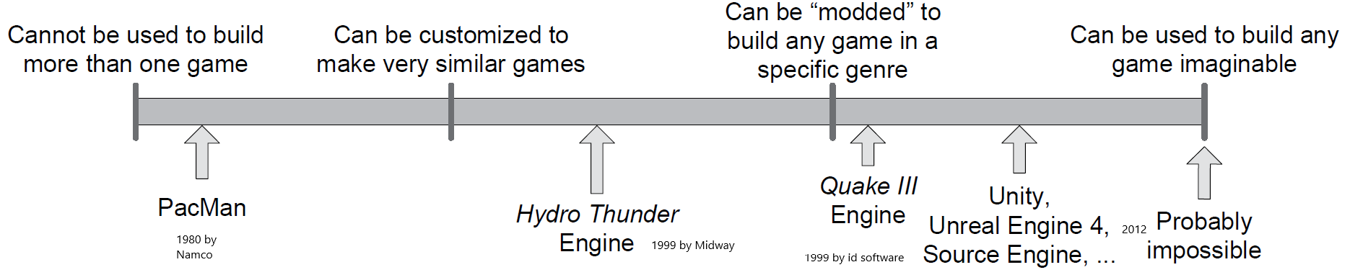
What is a game engine?
  The term game engine arose in the 1990s.
  Doom by id Software was at the center (On June 24, 2009, ZeniMax Media acquired the company).
  The core components were separated from the game content
  Quake III and Unreal were designed with the separation in mind
    Sold licenses to their engine and tools
    Engine licensing began to be a viable secondary revenue stream for the developers who created them.
    You can license a game engine and reuse significant portions of its key software components in order to build games.
    Some of you may have done modding using these tools
  Game engine are data-driven architectures that are reusable and therefore do not contain game content – mostly true
  Game Engine Reusability Gamut
Notes:
https://www.youtube.com/shorts/cp-ChC4zL-Q
In 1996, two ex-Microsoft employees sought an engine for their game. Quake's potential led Mike Harrington and Gabe Newell (Valve founders) to license and modify it, birthing the influential Half-Life.
The term “game engine” arose in the mid-1990s in reference to first-person
shooter (FPS) games like the insanely popular Doom by id Software. Doom
was architected with a reasonably well-defined separation between its core
software components (such as the three-dimensional graphics rendering system,
the collision detection system or the audio system) and the art assets,
game worlds and rules of play that comprised the player’s gaming experience.
The value of this separation became evident as developers began licensing
games and retooling them into new products by creating new art, world layouts,
weapons, characters, vehicles and game rules with only minimal changes
to the “engine” software. This marked the birth of the “mod community”—
a group of individual gamers and small independent studios that built new
games by modifying existing games, using free toolkits provided by the original
Developers.
A mod (short for "modification") is an alteration by players or fans of a video game^{[1]} that changes one or more aspects of a video game, such as how it looks or behaves. Mods may range from small changes and tweaks to complete overhauls, and can extend the replay value and interest of the game.
Modding a game can also be understood as the act of seeking and installing mods to the player's game, but the act of tweaking pre-existing settings and preferences is not truly modding.
Towards the end of the 1990s, some games like Quake III Arena and Unreal
were designed with reuse and “modding” in mind. Engines were made highly
customizable via scripting languages like id’s Quake C, and engine licensing
began to be a viable secondary revenue stream for the developers who created
them. Today, game developers can license a game engine and reuse significant
portions of its key software components in order to build games. While this
practice still involves considerable investment in custom software engineering,
it can be much more economical than developing all of the core engine
components in-house.
The line between a game and its engine is often blurry. Some engines make
a reasonably clear distinction, while others make almost no attempt to separate
the two. In one game, the rendering code might “know” specifically how
to draw an orc. In another game, the rendering engine might provide general purpose
material and shading facilities, and “orc-ness” might be defined entirely
in data. No studio makes a perfectly clear separation between the game
and the engine, which is understandable considering that the definitions of
these two components often shift as the game’s design solidifies.
Arguably a data-driven architecture is what differentiates a game engine
from a piece of software that is a game but not an engine. When a game
contains hard-coded logic or game rules, or employs special-case code to render
specific types of game objects, it becomes difficult or impossible to reuse
that software to make a different game. We should probably reserve the term
“game engine” for software that is extensible and can be used as the foundation
for many different games without major modification.
Clearly this is not a black-and-white distinction. We can think of a gamut
of reusability onto which every engine falls. This figure shows Game engine reusability gamut, which takes a stab at the locations
of some well-known games/engines along this gamut.
One would think that a game engine could be something akin to Apple
QuickTime or Microsoft Windows Media Player—a general-purpose piece of
software capable of playing virtually any game content imaginable. However,
this ideal has not yet been achieved (and may never be). Most game engines
are carefully crafted and fine-tuned to run a particular game on a particular
hardware platform. And even the most general-purpose multiplatform engines
are really only suitable for building games in one particular genre, such
as first-person shooters or racing games. It’s safe to say that the more general purpose
a game engine or middleware component is, the less optimal it is for
running a particular game on a particular platform.
This phenomenon occurs because designing any efficient piece of software
invariably entails making trade-offs, and those trade-offs are based on
assumptions about how the software will be used and/or about the target hardware on which it will run. For example, a rendering engine that was designed
to handle intimate indoor environments probably won’t be very good
at rendering vast outdoor environments. The indoor engine might use a binary
space partitioning (BSP) tree or portal system to ensure that no geometry
is drawn that is being occluded by walls or objects that are closer to the camera.
The outdoor engine, on the other hand, might use a less-exact occlusion mechanism,
or none at all, but it probably makes aggressive use of level-of-detail
(LOD) techniques to ensure that distant objects are rendered with a minimum
number of triangles, while using high-resolution triangle meshes for geometry
that is close to the camera.
The advent of ever-faster computer hardware and specialized graphics
cards, along with ever-more-efficient rendering algorithms and data structures,
is beginning to soften the differences between the graphics engines of
different genres. It is now possible to use a first-person shooter engine to build
a strategy game, for example. However, the trade-off between generality and
optimality still exists. A game can always be made more impressive by fine tuning
the engine to the specific requirements and constraints of a particular
game and/or hardware platform.

Slide 11
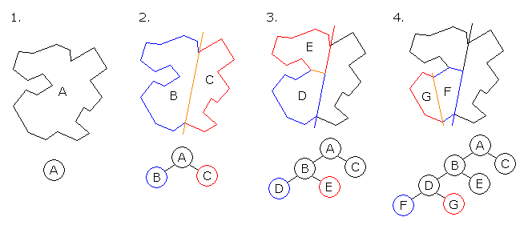
data-driven architecture
a data-driven architecture is what differentiates a game engine from a piece of software that is a game but not an engine.
When a game contains hard-coded logic or game rules, or employs special-case code to render specific types of game objects, it becomes difficult or impossible to reuse that software to make a different game.
“game engine” is a software that is extensible and can be used as the foundation for many different games without major modification.
The target hardware on which a game runs.
A rendering engine that was designed to handle intimate indoor environments probably won’t be very good at rendering vast outdoor environments.
The indoor engine might use a binary space partitioning (BSP) tree or portal system to ensure that no geometry is drawn that is being occluded by walls or objects that are closer to the camera.
In 1993, Doom was the first video game to make use of BSP after John Carmack utilized the most efficient 1991 algorithms describing front-to-back rendering with the use of a specialized data structure to record parts of the screen that had been drawn already.
The outdoor engine, on the other hand, might use a less-exact occlusion mechanism, or none at all, but it probably makes aggressive use of level-of-detail (LOD) techniques to ensure that distant objects are rendered with a minimum number of triangles, while using high-resolution triangle meshes for geometry that is close to the camera.
Notes:
A strategy game or strategic game is a game (e.g. a board game) in which the players' uncoerced, and often autonomous decision-making skills have a high significance in determining the outcome. Almost all strategy games require internal decision tree style thinking, and typically very high situational awareness.

Slide 12

First-person shooters
The first-person shooter (FPS) genre is typified by games like Quake, Unreal Tournament, Half-Life, Battlefield,
Destiny, Titanfall and Overwatch
FPS focuses on:
  On-foot locomotion, rail-confined or free roaming ground vehicles, hovercraft, boats and aircraft.
  Efficient rendering of large 3d worlds
  Responsive camera control
  High-fidelity animations and artificial intelligence for the non-player characters (NPCs)—the player’s enemies and allies
  Cool weapons
  Forgiving physics model
  Small-scale online multiplayer capabilities (between 10 and 100 simultaneous players)
  The ubiquitous “death match” gameplay mode.
Rendering technology focuses on optimization for the environment
For example, indoor “dungeon crawl” games often employ binary space partitioning trees or portal-based rendering systems.
Outdoor FPS games use other kinds of rendering optimizations such as occlusion culling, or an offline sectorization of the game world with manual or automated specification of which target sectors are visible from each source sector.
Notes:
Game engines are typically somewhat genre specific. An engine designed for
a two-person fighting game in a boxing ring will be very different from a massively
multiplayer online game (MMOG) engine or a first-person shooter (FPS)
engine or a real-time strategy (RTS) engine. However, there is also a great deal
of overlap—all 3D games, regardless of genre, require some form of low-level
user input from the joypad, keyboard and/or mouse, some form of 3D mesh
rendering, some form of heads-up display (HUD) including text rendering in
a variety of fonts, a powerful audio system, and the list goes on. So while
the Unreal Engine, for example, was designed for first-person shooter games,
it has been used successfully to construct games in a number of other genres
as well, including the wildly popular third-person shooter(TPS) franchise Gears of
War by Epic Games, the hit action-adventure games in the Batman: Arkham series
by Rocksteady Studios, the well-known fighting game Tekken 7 by Bandai
Namco Studios, and the first three role-playing third-person shooter games in
the Mass Effect series by BioWare.
Let’s take a look at some of the most common game genres and explore
some examples of the technology requirements particular to each.
Deathmatch, also known as free-for-all, is a widely used gameplay mode integrated into many shooters, including first-person shooter (FPS), and real-time strategy (RTS) video games. Normally the goal of a deathmatch game is to kill (or "frag" [a military term]) as many other players as possible until a certain condition or limit is reached, commonly a frag limit or a time limit. Once one of the conditions is met, the match is over, and the winner is the player that accumulated the greatest number of frags.

Slide 13
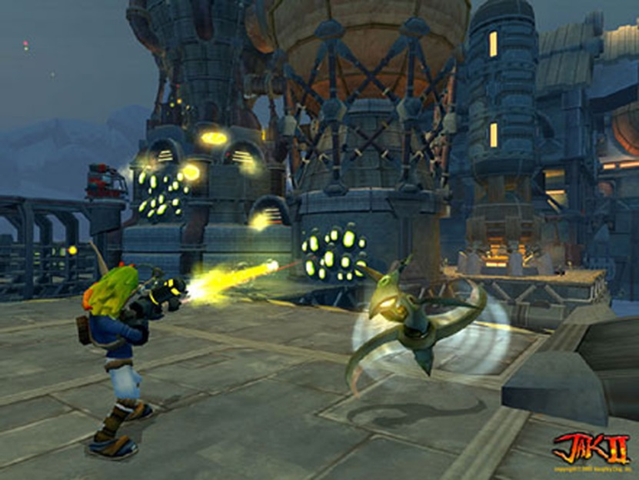
Platformers and the other third-person games
Third-person shooter(TPS) is a subgenre of 3D shooter games in which the player character is visible on-screen during gaming, and the gameplay consists primarily of shooting.
“Platformer” is the term applied to third-person character-based action games where jumping from platform to platform is the primary gameplay mechanic.
Typical games from the 2D era include Space Panic, Donkey Kong, Pitfall! And Super Mario Brothers.
The 3D era includes platformers like Super Mario 64, Crash Bandicoot, Rayman 2, Sonic the Hedgehog, the Jak and Daxter series, Ratchet and Clank, Gears of War
Platformers can usually be lumped together with third-person shooters
Third-person action/adventure games like Just Cause 2, Gears of War 4, the Uncharted series, the Resident Evil series, The Last of Us series, Red Dead Redemption 2, and the list goes on.
In a platformer, the main character is often cartoon-like and not particularly realistic or high-resolution.
Third-person shooters often feature a highly realistic humanoid player character.
Focus on
  Puzzle like elements
  Moving environmental objects
  Third person follow camera
  Complex camera collision system
  Main character’s abilities and locomotion modes

Slide 14
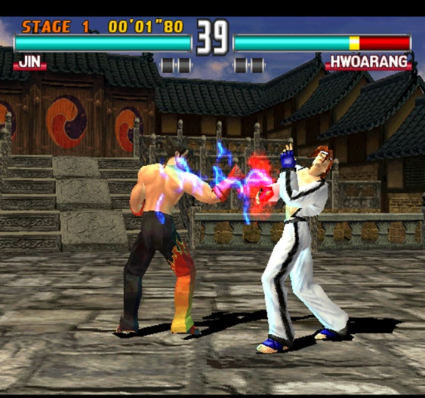
Fighting games
Games like Tekken (Figure), Fight Night, and Soul Calibur
Technology focus on
  Fighting animations
  Hit detection
  User input system capable of detecting complex button and joystick combinations
  Crowds
Modern fighting games like EA’s Fight Night Round 4 and NetherRealm Studios’ Injustice 2 have upped the technological ante with features like:
• high-definition character graphics;
• realistic skin shaders with subsurface scattering and sweat effects;
• photo-realistic lighting and particle effects;
• high-fidelity character animations;
• physics-based cloth and hair simulations for the characters.
Notes:
It’s important to note that some fighting games like Ninja Theory’s Heavenly
Sword and For Honor by Ubisoft Montreal take place in a large-scale virtual
world, not a confined arena. In fact, many people consider this to be a separate
genre, sometimes called a brawler. This kind of fighting game can have technical
requirements more akin to those of a third-person shooter or a strategy
game.

Slide 15

Racing games
The genre has many subcategories:
Simulation-focused racing games (“sims”) aim to provide a driving experience that is as realistic as possible (e.g., Gran Turismo).
Arcade racers favor over-the-top fun over realism (e.g., San Francisco Rush, Cruis’n USA, Hydro Thunder).
Street racing with tricked out consumer vehicles (e.g., Need for Speed, Juiced).
Kart racing is a subcategory in which popular characters from platformer games or cartoon characters from TV are re-cast as the drivers of whacky vehicles (e.g., Mario Kart, Jak X, Freaky Flyers).
Technology tricks include
  Using simple cards for background objects
  Track is broken down into sectors(2D regions)
  Third-person and first person cameras
  Camera collision with background geometry
Notes:
A racing game is often very linear, much like older FPS games. However,
travel speed is generally much faster than in an FPS. Therefore, more focus is
placed on very long corridor-based tracks, or looped tracks, sometimes with
various alternate routes and secret short-cuts. Racing games usually focus all
their graphic detail on the vehicles, track and immediate surroundings. As an
example of this, Figure shows a screenshot from the latest installment in the
well-known Gran Turismo racing game series, Gran Turismo Sport, developed
by Polyphony Digital and published by Sony Interactive Entertainment. However,
kart racers also devote significant rendering and animation bandwidth
to the characters driving the vehicles.
Some of the technological properties of a typical racing game include the
following techniques:
• Various “tricks” are used when rendering distant background elements,
such as employing two-dimensional cards for trees, hills and mountains.
• The track is often broken down into relatively simple two-dimensional
regions called “sectors.” These data structures are used to optimize rendering
and visibility determination, to aid in artificial intelligence and
path finding for non-human-controlled vehicles, and to solve many other
technical problems.
• The camera typically follows behind the vehicle for a third-person perspective, or is sometimes situated inside the cockpit first-person style.
• When the track involves tunnels and other “tight” spaces, a good deal
of effort is often put into ensuring that the camera does not collide with
background geometry.

Slide 16
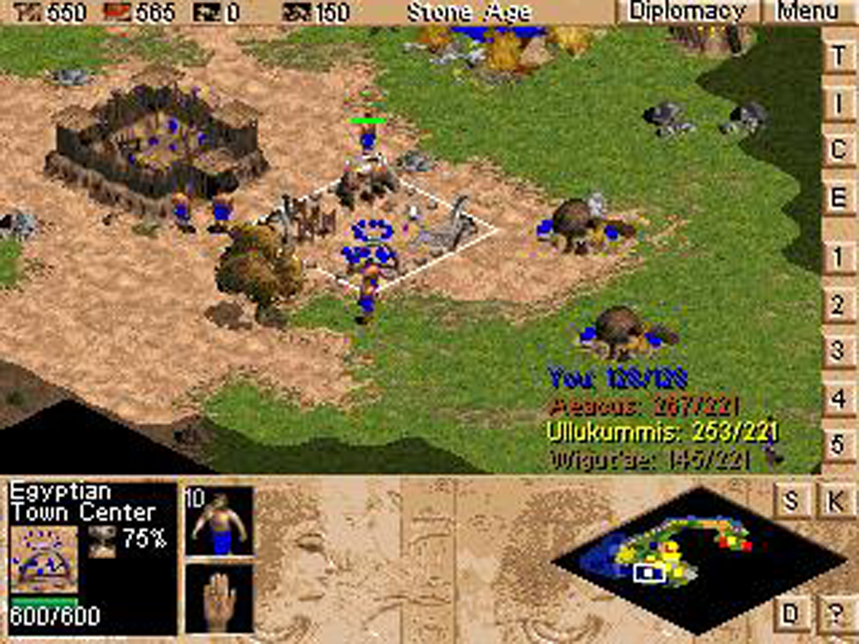
Real-time strategy
In this genre, the player deploys the battle units in his or her arsenal strategically across a large playing field
in an attempt to overwhelm his or her opponent.
The modern strategy game genre was arguably defined by Dune II: The Building of a Dynasty (1992).
Other games include Warcraft, Command & Conquer, Age of Empires(figure) and Starcraft.
Technology involves
• Each unit is relatively low-res, so that the game can support large numbers of them on-screen at once.
• Height-field terrain is usually the canvas upon which the game is designed and played.
• The player is often allowed to build new structures on the terrain in addition to deploying his or her forces.
• User interaction is typically via single-click and area-based selection of units, plus menus or toolbars containing commands, equipment, unit types, building types, etc.
Notes:
The game world is typically displayed
at an oblique top-down viewing angle. A distinction is often made between
turn-based strategy games and real-time strategy (RTS). For a discussion of
this genre, see https://en.wikipedia.org/wiki/Strategy_video_game.
The strategy game player is usually prevented from significantly changing
the viewing angle in order to see across large distances. This restriction permits
developers to employ various optimizations in the rendering engine of a
strategy game.
Older games in the genre employed a grid-based (cell-based) world construction,
and an orthographic projection was used to greatly simplify the renderer.
For example, Figure above shows a screenshot from the classic strategy
game Age of Empires.
Modern strategy games sometimes use perspective projection and a true
3D world, but they may still employ a grid layout system to ensure that units
and background elements, such as buildings, align with one another properly.

Slide 17
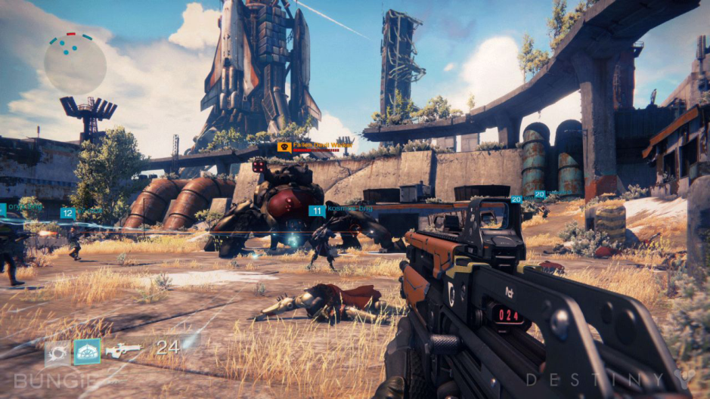
Massively Multiplayer Online Games (MMOG)
Guild Wars 2 (AreaNet/NCsoft), EverQuest (989 Studios/SOE), World of Warcraft (Blizzard) and Star Wars Galaxies (SOE/Lucas Arts)
MMOG supports huge numbers of simultaneous players (from thousands to hundreds of thousands), usually all playing in one very large, persistent virtual world
Very powerful battery of servers
These servers maintain the authoritative state of the game world, manage users signing in and out of the game, provide inter-user chat or voice-over-IP (VoIP) services and more.
Graphics fidelity in an MMO is almost always lower than its non-massively multiplayer counterparts
Figure shows a screen from Bungie’s FPS game, Destiny
Destiny has been called an MMOFPS because it incorporates some aspects of the MMO genre.
Notes:
Other Subcategories of this genre include MMO role-playing games (MMORPG), MMO realtime strategy games (MMORTS) and MMO first-person shooters (MMOFPS). http://en.wikipedia.org/wiki/MMOG
We should note here that the game Player Unknown’s Battlegrounds (PUBG)
has recently popularized a subgenre known as battle royale. This type of game
blurs the line between regular multiplayer shooters and massively multiplayer
online games, because they typically pit on the order of 100 players against
each other in an online world, employing a survival-based “last man standing”
gameplay style.

Slide 18
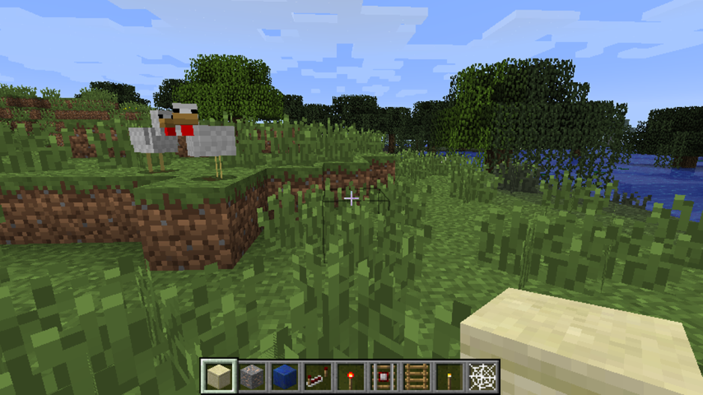
Player-authored content
As social media takes off, games are becoming more and more collaborative in nature.
A recent trend in game design is toward player-authored content
For example, Media Molecule’s LittleBigPlanet™ 3: The Journey Home are technically puzzle platformers, but they encourage players to create,
publish and share their own game worlds.
Media Molecule’s latest installment in this engaging genre is Dreams for the PlayStation 4
The most popular game today in the player-created content genre is Minecraft

Slide 19
Virtual Reality
Computer-generated VR (CG VR) is a subset of this VR technology in which the virtual world is exclusively generated via computer graphics.
Headsets: HTC Vive, Oculus Rift, Sony PlayStation VR, Samsung Gear VR or Google Daydream View
In augmented reality (AR) and mixed reality (MR) a viewing device like a smart phone, tablet or tech-enhanced pair of glasses displays a real-time or static view of a real-world scene, and computer graphics are overlaid on top of this image.
“augmented reality” describes technologies in which computer graphics are overlaid on a live, direct or indirect view of the real world, but are not anchored to it.
“mixed reality” describes the use of computer graphics to render imaginary objects which are anchored to the real world and appear to exist within it.
Example of AR: US Army “tactical augmented reality” (TAR)
Example of MR: Microsoft’s HoloLens, Android Camera App supports Google Pixel Playground (AR Stickers)
https://owlchemylabs.com/games/ Job simulator, Vacation Simulator
Notes:
Virtual reality (VR) can be defined as an immersive multimedia or computers imulated
reality that simulates the user’s presence in an environment that is
either a place in the real world or in an imaginary world.
In real-time AR and MR systems, accelerometers in the viewing device permit the virtual
camera’s movements to track the movements of the device, producing the illusion
that the device is simply a window through which we are viewing the
actual world, and hence giving the overlaid computer graphics a strong sense
of realism.
• The U.S. Army provides its soldiers with improved tactical awareness
using a system dubbed “tactical augmented reality” (TAR)—it overlays
a video-game-like heads-up display (HUD) complete with a mini-map
and object markers onto the soldier’s view of the real world (https://
youtu.be/x8p19j8C6VI).
• In 2015, Disney demonstrated some cool AR technology that renders a
3D cartoon character on top of a sheet of real-world paper on which a
2D version of the character is colored with a crayon (https://youtu.be/
SWzurBQ81CM).
• PepsiCo also pranked commuting Londoners with an AR-enabled bus
stop. People sitting in the bus stop enclosure were treated to AR images
of a prowling tiger, a meteor crashing, and an alien tentacle grabbing
unwitting passers by off the street (https://youtu.be/Go9rf9GmYpM).
Job Simulator: year 2050: In a world where robots have replaced all human jobs, step into the "Job Simulator" to learn what it was like 'to job'.

Slide 20
VR Game Engines
Similar in many respects to first-person shooter engines
Many FPS-capable engines such as Unity and Unreal Engine support VR “out of the box.”
VR games differ from FPS games:
Stereoscopic rendering: A VR game needs to render the scene twice, once for each eye.
Very high frame rate. Studies have shown that VR running at below 90 frames per second is likely to induce disorientation, nausea, etc.
Navigation issues: joypad or the WASD keys vs. the user physically walking around in the real world. Travelling by “flying” tends to induce nausea as well, so most games opt for a point-and click teleportation mechanism to move the virtual player/camera across larger distances.
VR advantages:
• users can reach in the real world to touch, pick up and throw objects in the virtual world;
• a player can dodge an attack in the virtual world by dodging physically in the real world;
• new user interface opportunities are possible, such as having floating menus attached to one’s virtual hands, or seeing a game’s credits written on a whiteboard in the virtual world;
• a player can even pick up a pair of virtual VR goggles and place them onto his or her head, thereby transporting them into a “nested” VR world “VR-ception.”
Notes:
Stereoscopic rendering. A VR game needs to render the scene twice, once
for each eye. This doubles the number of graphics primitives that must
be rendered, although other aspects of the graphics pipeline such as visibility
culling can be performed only once per frame, since the eyes are
reasonably close together. As such, a VR game isn’t quite as expensive to
render as the same game would be to render in split-screen multiplayer
mode, but the principle of rendering each frame twice from two (slightly)
different virtual cameras is the same.

Slide 21





Location-Based Entertainment
GAMES LIKE POKÉMON GO NEITHER OVERLAY GRAPHICS ONTO AN IMAGE OF THE REAL WORLD, NOR DO THEY GENERATE A COMPLETELY IMMERSIVE VIRTUAL WORLD.
THE GAME IS AWARE OF YOUR ACTUAL LOCATION IN THE REAL WORLD
PROMPTING YOU TO GO SEARCHING FOR POKÉMON IN NEARBY PARKS, MALLS AND RESTAURANTS
THIS KIND OF GAME CAN’T REALLY BE CALLED AR/MR/VR
SOME PEOPLE DESCRIBE IT AS LOCATION-BASED ENTERTAINMENT AND SOME AS AR

Slide 22






Other Genres
• SPORTS, WITH SUBGENRES FOR EACH MAJOR SPORT (FOOTBALL, BASEBALL, SOCCER, GOLF, ETC.);
• ROLE-PLAYING GAMES (RPG);
• GOD GAMES, LIKE POPULOUS AND BLACK & WHITE;
• ENVIRONMENTAL/SOCIAL SIMULATION GAMES, LIKE SIMCITY OR THE SIMS;
• PUZZLE GAMES LIKE TETRIS;
• CONVERSIONS OF NON-ELECTRONIC GAMES, LIKE CHESS, CARD GAMES, GO, ETC.;
• WEB-BASED GAMES, SUCH AS THOSE OFFERED AT ELECTRONIC ARTS’ POGO SITE;

Slide 23
Some current engines
The Quake Family of Engines
Unreal Engine
Unity
  The first 3D FPS game Castle Wolfenstein 3D (1992)
  Doom, Quake, Quake II and Quake III
  All of these engines are very similar in architecture
  Has lineage that extends to modern games like Medal of Honor
  Quake and Quake II engines source code are freely available (https://github.com/id-Software/Quake-2)
  Epic Games, Inc. burst onto the FPS
  Pros:Industry leader for photorealism (Nanite virtualized geometry, Lumen global illumination).Massive ecosystem, AAA support, free until revenue threshold.Widely used for games, film, architectural visualization, VR.
  Cons:Heavy system requirements.Steeper learning curve for beginners.
  Examples: Fortnite, The Matrix Awakens demo, Hellblade II.
  Best for: AAA games, cinematic visuals, virtual production.
  Pros:Extremely versatile (2D, 3D, VR, mobile, indie).HDRP (High-Definition Render Pipeline) for high-end graphics.URP (Universal Render Pipeline) for cross-platform performance.Large asset store, strong developer community.
  Cons:HDRP visuals not as cutting-edge as Unreal 5.Complex pipeline setup for advanced graphics.
  Examples: Genshin Impact, Hollow Knight: Silksong, Cities: Skylines II.
  Best for: Indie games, mobile/VR, cross-platform development.

Slide 24
More engines
Godot Engine
Source Engine
DICE’s Frostbite by EA
Rockstar Advanced Game Engine (RAGE)
  Pros:Open-source, completely free (MIT license).Lightweight, great for 2D and mid-tier 3D.Active development, growing community.
  Cons:3D rendering still catching up with Unreal/Unity.Fewer AAA titles made with it.
  Examples: Cassette Beasts, Deep Rock Galactic: Survivor.
  Best for: Indies, 2D/3D hybrid projects, developers who want full control.
  Games like Half-life 2 and its sequels, Team Fortress 2, and Portal
  Very powerful with good graphics capabilities and a good toolset
  Pros:Proprietary engine with strong graphics (used in Battlefield).Optimized for realism and large-scale environments.
  Cons:Not publicly available—only EA studios use it.
  Examples: Battlefield series, FIFA / EA Sports FC, Mass Effect Andromeda.
  Best for: AAA realism (internal EA projects).
  Pros:Highly optimized for open-world realism.Used in some of the most visually stunning games.Cons:Proprietary, not available outside Rockstar.
  Examples: GTA V, Red Dead Redemption 2.
  Best for: Open-world AAA realism (internal Rockstar).
Notes:
Using Unity, developers
can deploy their games on mobile platforms (e.g., Apple iOS, Google Android),
consoles (Microsoft Xbox 360 and Xbox One, Sony PlayStation 3 and
PlayStation 4, and Nintendo Wii, Wii U), handheld gaming platforms (e.g.,
Playstation Vita, Nintendo Switch), desktop computers (Microsoft Windows,
Apple Macintosh and Linux), TV boxes (e.g., Android TV and tvOS) and virtual
reality (VR) systems (e.g., Oculus Rift, Steam VR, Gear VR).

Slide 25
Even more engines
CryEngine by Crytek
Sony’s PhyreEngine
Amazon Lumberyard / Open 3D Engine (O3DE)
  Pros:Known for realistic lighting and vegetation rendering.Powerful out-of-the-box visuals.Royalty-based model.
  Cons:Smaller ecosystem than Unreal/Unity.Steep learning curve, limited tutorials.
  Examples: Crysis series, Hunt: Showdown.
  Best for: Realistic shooters, open-world games.
  Uses to create games for the Sony platforms
  Numerous titles have been written with this engine: flOw, Flower and Journey, and Coldwood Interactive’s Unravel
  It is available free of charge to any licensed Sony developer as part of the PlayStation SDK
  Pros:Open-source (Apache 2.0).Based on CryEngine, but expanded.Backed by AWS integration (cloud, multiplayer).
  Cons:Still maturing, less polished than Unreal/Unity.Smaller adoption.
  Examples: Star Citizen (heavily customized Lumberyard).
  Best for: Studios wanting open-source flexibility + cloud integration.
Notes:
developers can port their XNA games to iOS, Android, Mac OS X, Linux
and Windows 8 Metro via an open-source implementation of XNA called
MonoGame.
For example, check out the Tombstone engine (http://tombstoneengine.com/)
by Terathon Software, the LeadWerks engine (https://www.leadwerks.com/),
and HeroEngine by Idea Fabrik, PLC (http://www.heroengine.com/).

Slide 26
Open Source Engines
Gnu Public License (GPL) : code to be freely used by anyone, as long as their code is also freely available
Lesser Gnu Public License (LGPL): code to be used even in proprietary for-profit applications
http://en.wikipedia.org/wiki/List_of_game_engines
OGRE is a well-architected, easy-to-learn and easy-to-use 3D rendering engine.
  https://www.ogre3d.org/
  advanced lighting and shadows
  a good skeletal character animation system
  a two-dimensional overlay system for heads-up displays and graphical user interfaces
  A post-processing system for full-screen effects like bloom
Some other well-known open source engines: Panda3D, Yake, Crystal Space, Torque and Irrlicht
The Amazon Lumberyard / Open 3D Engine (O3DE) engine does provide source code to its developers. It is a free cross-platform engine developed by Amazon, and based on the CRYENGINE architecture.

Slide 27
Recommendations
Photorealistic AAA → Unreal Engine 5.
Indie / Mobile / Cross-platform → Unity or Godot.
Realistic FPS / Open-world → CryEngine or O3DE.
Custom AAA studios → Frostbite (EA), RAGE (Rockstar).

Slide 28
2D Engines
Designed for non-programmers to build apps for Android and iPhone
Multimedia Fusion 2 (http://www.clickteam.com) is a 2D game/multimedia authoring toolkit developed by ClickteamGame
The Games Factory 2 (https://www.clickteam.com/the-games-factory-2), are also used by educational camps like PlanetBravo (http://www.planetbravo.com)
Game Salad Creator (http://gamesalad.com/creator) is another graphical game/multimedia authoring toolkit aimed at non-programmers
Scratch (http://scratch.mit.edu) is an authoring toolkit and graphical programming language that can be used to create interactive demos and simple games.
to teach kids about game development and programming/logic concepts
Fusion supports the iOS, Android, Flash, and Java platforms.
Notes:
https://www.youtube.com/watch?v=3Zq1yo0lxOU

Slide 29
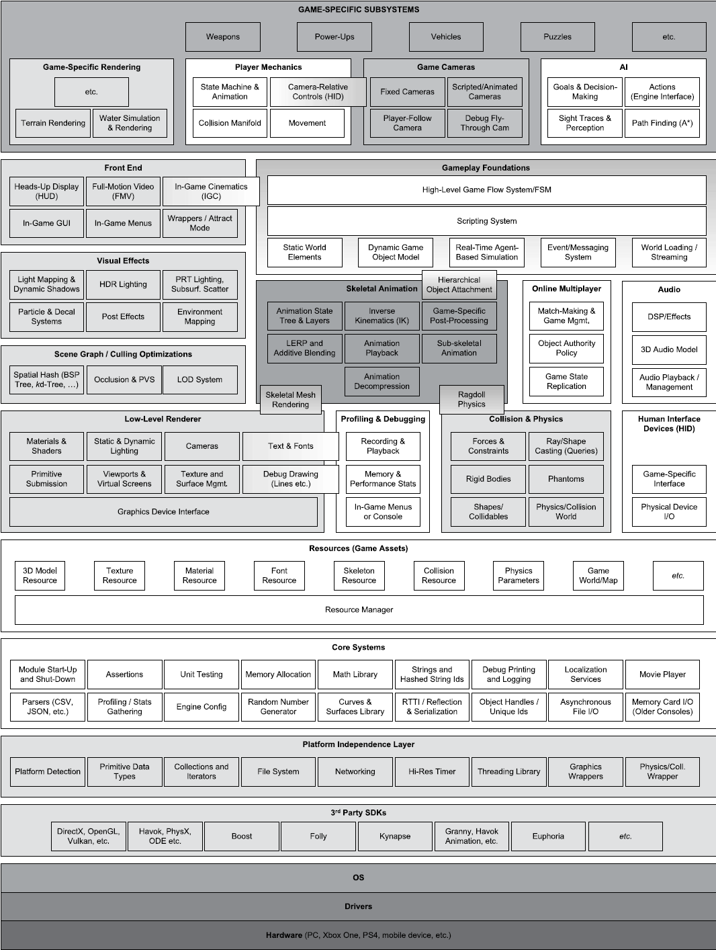
Runtime Engine Architecture
Consists of the tools suite and runtime components
Figure shows all of the major runtime components that make up a typical 3D game engine
Game engines are definitely large software systems
This diagram doesn’t even account for all the tools.
Game engines are built in layers.
Upper layers depend on lower layers
When a lower layer depends upon a higher layer, we call this a circular dependency.
  Avoids circular dependencies to maximize reuse and testability

Slide 30
Runtime Engine
Low level components
3rd Party SDKs
Platform independence layer
Core systems
Resources manager
Rendering engine
Profiling/Debugging
Collisions and Physics
Animation
Human Interface Devices
Audio
Gameplay foundation system
AI

Slide 31
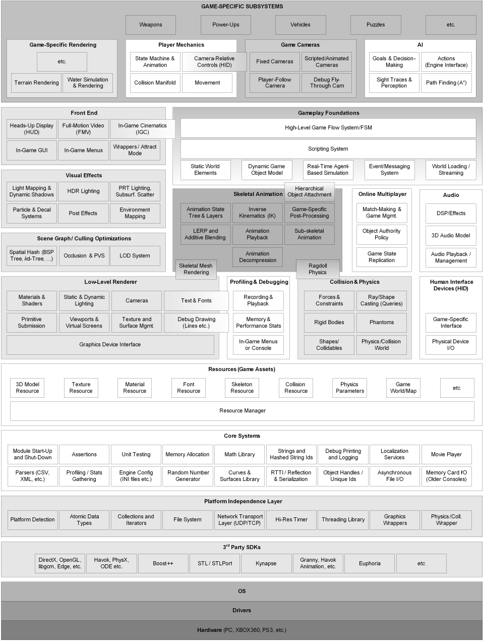
Low level components
Target Hardware
  This is the system (or platforms) or console that the game is to run on
Device Drivers
  Device drivers are low-level software components provided by the operating system or hardware vendor
  Shield the OS and upper layers from low level device communications details
Operating System
  Handles the execution and interruption of multiple programs on a single machine (preemptive multitasking)
A PC game can never assume it has full control of the hardware
Very thin OS on an early consoles.
On Modern Consoles, The operating systems on the Xbox and PlayStation can interrupt the execution of your game, or take over certain system resources, in order to display online messages, or to allow the player to pause the game and bring up the PS4’s “XMB” user interface or the Xbox One’s dashboard, for example.
Notes:
Typical platforms include Microsoft Windows, Linux and
MacOS-based PCs; mobile platforms like the Apple iPhone and iPad, Android
smart phones and tablets, Sony’s PlayStation Vita and Amazon’s Kindle
Fire (among others); and game consoles like Microsoft’s Xbox, Xbox 360 and
Xbox One, Sony’s PlayStation, PlayStation 2, PlayStation 3 and PlayStation 4,
and Nintendo’s DS, GameCube, Wii, Wii U and Switch.
The PS3™ system includes a user interface called XMB™ (XrossMediaBar). The horizontal row shows system features in categories, and the vertical column shows items that can be performed under each category. Select a category or item. Confirm the selected item. Cancel an operation. View the options menu / control panel.
On the PS4 and Xbox One, the OS is continually running background tasks,
such as recording video of your playthrough in case you decide to share it via
the PS4’s Share button, or downloading games, patches and DLC, so you can
have fun playing a game while you wait. So the gap between console and PC
development is gradually closing (for better or for worse).

Slide 32
3rd Party SDKs
Data Structure and Algorithms
Games depend heavily on container data structures and algorithms to manipulate them:
  Boost: a powerful data structures and algorithms library, designed in the style of the standard C++ library, Folly: library used at Facebook, and Loki: a powerful generic programming template library
  STL – C++ standard template library data structures, strings, stream-based I/O (ex: generic container classes such as std::vector and std::list)
Graphics
  Glide, libgcm, OpenGL, DirectX, Edge, Vulkan, Metal
Collisions and Physics
  SDK for collision detection and rigid body dynamics: Havok, PhysX(NVIDIA), Open Dynamic Engine(ODE)
Character Animation
  Granny from Rad Game Tools, Havoc Animation, OrbisAnim by SN Systems
Artificial Intelligence
  Kythera AI, Havoc AI, RAIN AI, OpenAI Gym / Petting Zoo, TensorFlow/PyTorch, Recast & Detour
Biomechanical Character Models: Endorphin and Euphoria (produce character motion using advanced biomechanical models) produce character motion using advanced biomechanical models
Notes:
Most game engines leverage a number of third-party software development
kits (SDKs) and middleware. The functional or classbased
interface provided by an SDK is often called an application programming
interface (API).
libgcm is a low-level direct interface to the PlayStation 3’s RSX graphics
hardware, which was provided by Sony as a more efficient alternative to
OpenGL.
Edge is a powerful and highly efficient rendering and animation engine
produced by Naughty Dog and Sony for the PlayStation 3 and used by
a number of first- and third-party game studios.
Vulkan is a low-level library created by the Khronos™ Group which enables
game programmers to submit rendering batches and GPGPU compute
jobs directly to the GPU as command lists, and provides them with
fine-grained control over memory and other resources that are shared
between the CPU and GPU

Slide 33
Platform independence layer
Allows the engine to be developed without the concern of the underlying platform
Provides wrappers to common target specific operations
Include things like primitive types, network, file systems, etc.
Companies like Electronic Arts and Activision Blizzard target their games at a wide variety of platforms
This layer sits atop the hardware, drivers, operating system and other third-party software
There are two primary reasons to “wrap” functions as part of your game engine’s platform independence layer
1. Some APIs like those provided by the operating system, or even some functions in older “standard” libraries like the C standard library differ significantly from platform to platform; wrapping these functions provides the rest of your engine with a consistent API across all of your targeted platforms.
2. Even when using a fully cross-platform library such as Havok, you might want to insulate yourself from future changes, such as transitioning your engine to a different collision/physics library in the future.

Slide 34
Core systems
Every game engine requires a grab bag of useful software utilities.
We’ll categorize these under the label “core systems.”
Assertions: lines of error-checking code that are inserted to catch logical mistakes(stripped out of the final production build of the game)
Memory Management: every game engine implements its own custom memory allocation system
Math library: These libraries provide facilities for vector and matrix math, quaternion rotations, trigonometry, geometric operations, etc.
Custom data structures: any other data structures for managing fundamental data structures (linked lists, dynamic arrays, binary trees, hash maps, etc.) and algorithms (search, sort, etc.) -- data structures and algorithms other than Boost and Folly

Slide 35
Resource manager
Provides a unified interface for accessing assets
The level of complexity is dictated by need
Some engines do this in a highly centralized and consistent manner (e.g., Unreal’s packages, OGRE’s Resource-Manager class).
Other engines take an ad hoc approach, often leaving it up to the game programmer to directly access raw files on disk or within compressed archives such as Quake’s PAK files.

Slide 36
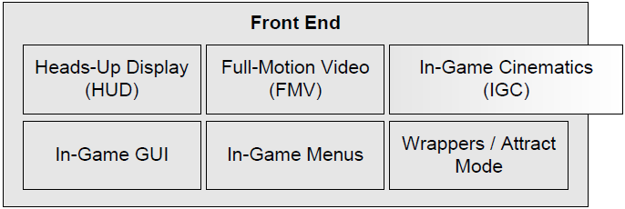
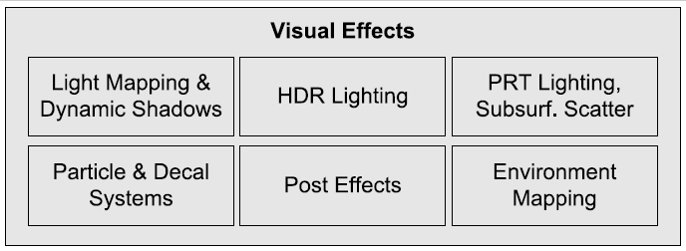
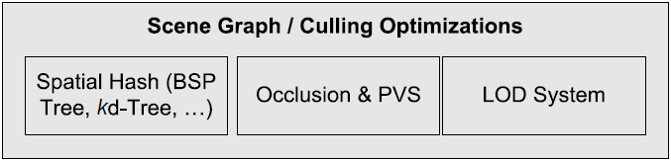
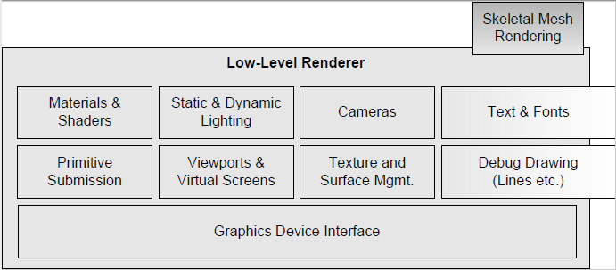
Rendering engine
The rendering engine is one of the largest and most complex components of any game engine.
Most modern rendering engines share some fundamental design philosophies, driven in large part by the design of the 3D graphics hardware upon which they depend.
One common approach to rendering engine design is to employ a layered architecture
  Low-level Renderer
  Scene graph management
  Visual effects
  Front end

Slide 37
Low-level Renderer
Encompasses all of the raw rendering facilities of the engine.
  Focuses on rendering primitives as quickly and richly as possible
  Does not consider visibility
  It contains the following subcomponents:
Graphics Device Interface component:
  Graphics SDKs, such as DirectX, OpenGL or Vulkan, require:
    Access and enumerate the graphics devices
    Initialize the GD
    Setup buffering (back-buffer, stencil buffer)
    “Message Pump”: For a PC game engine, you also need code to integrate your renderer with the Windows message loop.
Other subcomponents:
  Collect submissions of geometric primitives (render packets), such as meshes, line lists, point lists, particles, terrain patches, text strings
  Provide abstraction of the camera interface (field of view, near/far plane locations
  Material system: Each submitted primitive is associated with a material
  Dynamic lighting system: Each submitted primitive is affected by n dynamic lights
  Text and fonts

Slide 38
Scene graph
The low-level renderer draws all of the geometry submitted to it, without
much regard for whether or not that geometry is actually visible (other than
back-face culling and clipping triangles to the camera frustum).
A higher-level component is usually needed in order to limit the number of primitives submitted for rendering, based on some form of visibility determination.
For very small game worlds, a simple frustum cull (i.e., removing objects that the camera cannot “see”) is enough.
For larger game worlds, a more advanced spatial subdivision data structure might be used.
  allowing the potentially visible set (PVS) of objects to be determined
  Spatial subdivisions can take many forms, including a binary space partitioning tree, a quadtree, an octree, a kdtree or a sphere hierarchy.
  A spatial subdivision is sometimes called a scene graph
  Portals or occlusion culling methods might also be applied in this layer
The low-level renderer should be completely agnostic to the type of spatial subdivision or scene graph being used
OGRE provides a plug-and-play scene graph architecture.
Notes:
In computer-generated imagery and real-time 3D computer graphics, portal rendering is an algorithm for visibility determination. For example, consider a 3D computer game environment, which may contain many polygons, only a few of which may be visible on screen at a given time. By determining which polygons are currently not visible, and not rendering those objects, significant performance improvements can be achieved.
A portal system is based on using the partitioning of space to form generalizations about the visibility of objects within those spaces. Regions of map space are divided into polygonal, generally convex, areas called zones, or sometimes sectors. Adjacent zones are linked to one another via shared dividing polygons termed portals. Approaches that precompute visibility for zones are referred to as potentially visible set or PVS methods.

Slide 39
Visual effects
Modern game engines support a wide range of visual effects:
Particle systems (for smoke, fire, water splashes, etc.)
Decal systems (for bullet holes, foot prints, etc.)
Light mapping and environment mapping
Dynamic shadows
Full-screen post effects, applied after the 3D scene has been rendered to an off-screen buffer.
• high dynamic range (HDR) tone mapping and bloom;
• full-screen anti-aliasing (FSAA);
• color correction and color-shift effects, including bleach bypass, saturation and desaturation effects, etc.
The particle and decal systems are usually distinct components of the rendering engine and act as inputs to the low-level renderer.
Light mapping, environment mapping and shadows are usually handled internally within the rendering engine proper
Full-screen post effects are either implemented as an integral part of the renderer or as a separate component that operates on the renderer’s output buffers.
Notes:
Tone mapping is a technique used in image processing and computer graphics to map one set of colors to another to approximate the appearance of high-dynamic-range images in a medium that has a more limited dynamic range
Bleach bypass, also known as skip bleach or silver retention, is a chemical effect which entails either the partial or complete skipping of the bleaching function during the processing of a color film. By doing this, the silver is retained in the emulsion along with the color dyes. The result is a black-and-white image over a color image.
Color saturation is the expression of the bandwidth of light from a source. The term hue refers to the color of the image itself, while saturation describes the intensity (purity) of that hue.
When color is fully saturated, the color is considered in purest (truest) version.

Slide 40
Front end
Most games employ some kind of 2D graphics overlaid on the 3D scene
for various purposes.
the game’s heads-up display (HUD);
• in-game menus, a console and/or other development tools,
which may or may not be shipped with the final product;
• possibly an in-game graphical user interface (GUI), allowing the player to manipulate his or her character’s inventory, configure units for battle or perform other complex in-game tasks.
Two-dimensional graphics are usually implemented by drawing textured quads (pairs of triangles) with an orthographic projection. Or they may be rendered in full 3D, with the quads bill-boarded so they always face the camera.
FMV plays full-screen movies that have been recorded earlier
IGC allows cinematic sequences to be choreographed within the game itself, in full 3D (ex: player walks through a city, a conversation between two key characters might be implemented as an in-game cinematic.)
Uncharted 4: A Thief’s End, have moved away from pre-rendered movies entirely, and display all cinematic moments in the game as real-time IGCs.

Slide 41
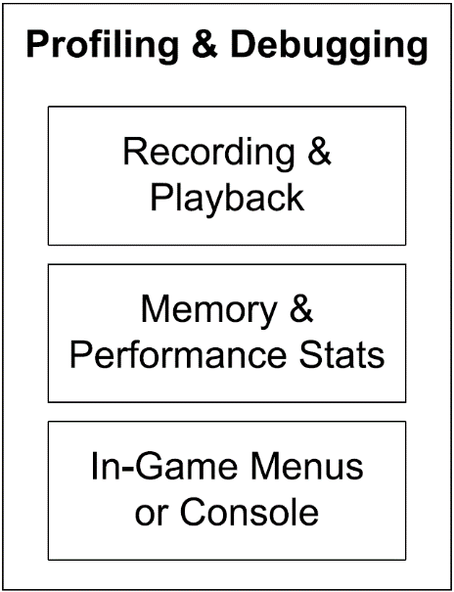
Profiling/Debugging
Tools to profile the performance of their games in order to optimize performance.
Memory resources are usually scarce, so developers make heavy use of memory analysis tools
In-game debugging facilities, such as debug drawing, an in-game menu system or console and the ability to record and play back
gameplay for testing and debugging purposes.
general-purpose software profiling tools: Intel’s Vtune, IBM’s Quantify and Purify (part of the PurifyPlus tool suite),
Insure++ by Parasoft, and Valgrind by Julian Seward and the Valgrind development team.
Most game engines also incorporate a suite of custom profiling and debugging tools:
  Code timing
  Display the profiling statistics on-screen while the game is running
  Dumping performance stats to a text file
  Determining memory usage used by the engine, and by each subsystem, including various on-screen displays
  Dumping memory usage, high water mark and leakage stats when the game terminates and/or during gameplay
  Record and playback game events for tracking down bugs.
  Print statement output control, along with an ability to turn on or off different categories of debug

Slide 42
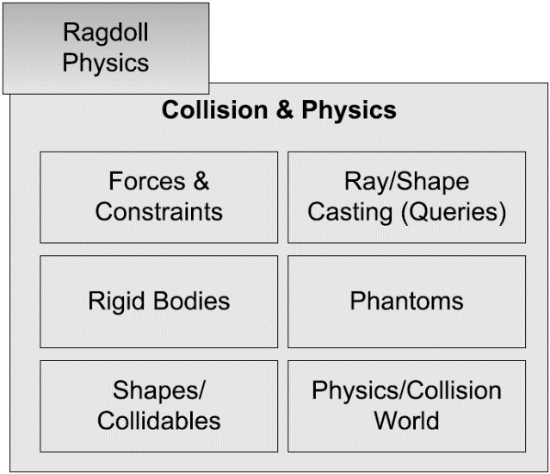
Collisions and Physics
“physics system” in the game industry = rigid body dynamics
Focus: the motion (kinematics) of rigid bodies and the forces and torques (dynamics) that cause this motion to occur.
Collision and physics are usually quite tightly coupled.
Physics engine creation is its own unique undertaking
Most game companies use a third party SDK such as:
  Havok: the gold standard in the industry today
  PhysX: PhysX by NVIDIA is another excellent collision and dynamics engine. It was integrated into Unreal Engine 4 and is also available for free as a stand-alone product for PC game development.
  Open Dynamics Engine (ODE): An open source physics and collision engine (http://www.ode.org)
  I-Collide, V-Collide and RAPID: non-commercial collision detection engines developed at (UNC)
Notes:
when collisions are detected, they are almost always resolved as part of the
physics integration and constraint satisfaction logic.

Slide 43
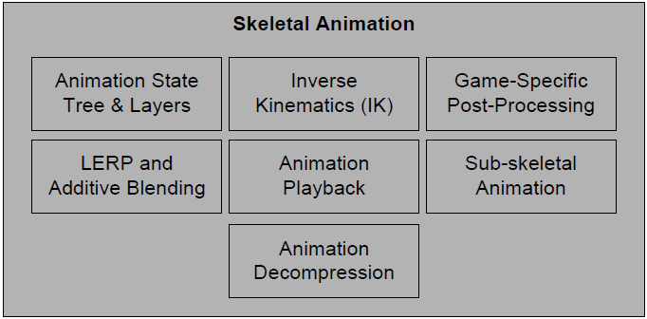
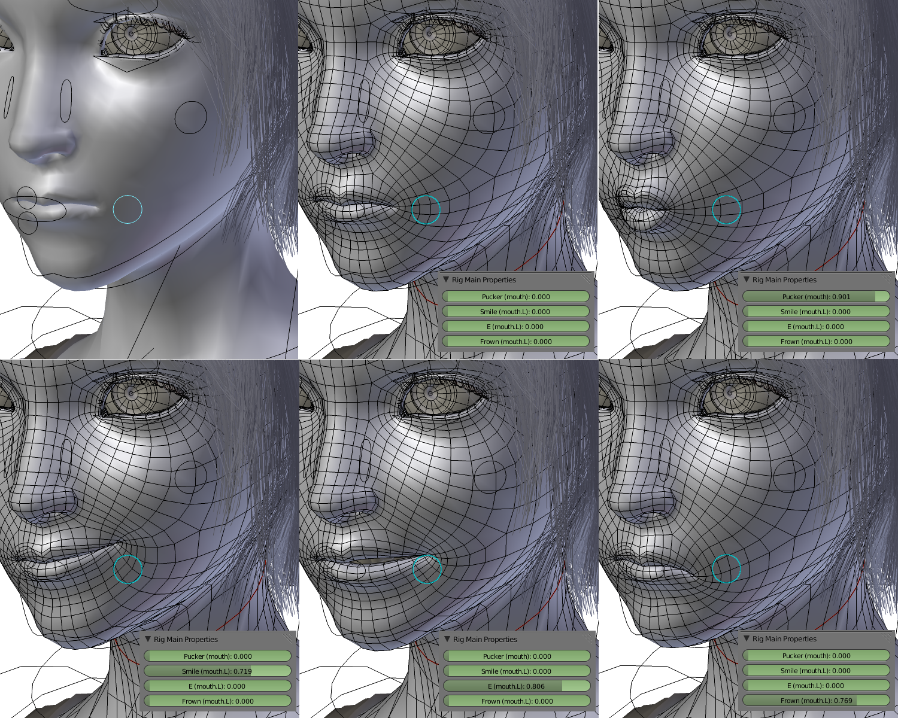
Animation
Any game that has organic or semi-organic characters (humans, animals, cartoon
characters or even robots) needs an animation system.
Five types of animation are used
  Sprite/texture animation
  Rigid body hierarchy animation
  Skeletal animation
  Vertex animation
  Morphing (morph target)
Skeletal animations still the most popular:
  The animation system produces a pose for every bone in the skeleton
  These poses are passed to the rendering engine as a palette of matrices.
  The renderer transforms each vertex by the matrix or matrices in the palette, in order to generate a final blended vertex position.
  This process is known as skinning.
Notes:
The "morph target" is a deformed version of a shape. When applied to a human face, for example, the head is first modelled with a neutral expression and a "target deformation" is then created for each other expression. When the face is being animated, the animator can then smoothly morph (or "blend") between the base shape and one or several morph targets.
Skeletal animation permits a detailed 3D character mesh to be posed by an
animator using a relatively simple system of bones. As the bones move, the
vertices of the 3D mesh move with them. Although morph targets and vertex
animation are used in some engines, skeletal animation is the most prevalent
animation method in games today.
Ragdoll physics is a type of physics engine procedural animation which is often used as a replacement for traditional static death animations in video games and animated films. (https://en.wikipedia.org/wiki/Ragdoll_physics)
There is also a tight coupling between the animation and physics systems
when rag dolls are employed. A rag doll is a limp (often dead) animated character,
whose bodily motion is simulated by the physics system. The physics
system determines the positions and orientations of the various parts of the
body by treating them as a constrained system of rigid bodies. The animation
system calculates the palette of matrices required by the rendering engine in
order to draw the character on-screen

Slide 44
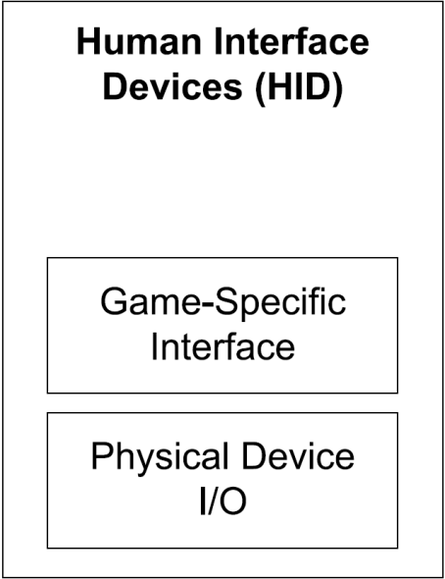
HID
Every game needs to process input from the player, obtained from various human interface devices (HIDs) including
• the keyboard and mouse,
• a joypad, or
• other specialized game controllers, like steering wheels, fishing rods, dance pads, the Wiimote, etc.
The HID engine component is sometimes architected to divorce the low level
details of the game controller(s) on a particular hardware platform from the high-level game controls.
It massages the raw data coming from the hardware, introducing a dead zone around the center point of each joypad stick, debouncing
button-press inputs, detecting button-down and button-up events, interpreting and smoothing accelerometer inputs (e.g., from the PlayStation
Dualshock controller) and more.

Slide 45
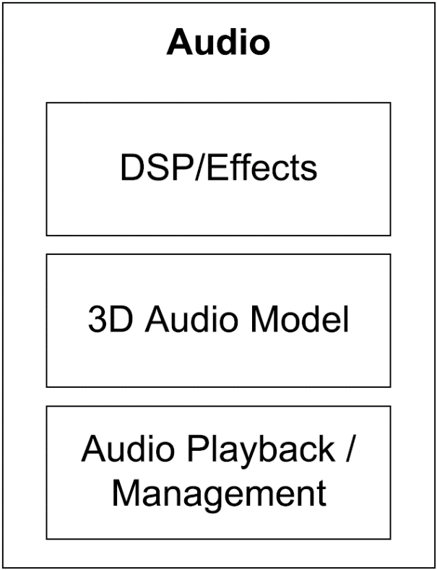
Audio
Often overlooked until the end
Varies in sophistication based on need
Quake’s audio engine is pretty basic, and game teams usually augment it with custom functionality.
Unreal Engine 4 provides a reasonably robust 3D audio rendering engine.
For DirectX platforms (PC, Xbox 360, Xbox One), Microsoft provides an excellent runtime audio engine called XAudio2.
Electronic Arts has developed an advanced, high-powered audio engine internally called SoundR!OT
Sony Interactive Entertainment (SIE) provides a powerful 3D audio engine called Scream.

Slide 46
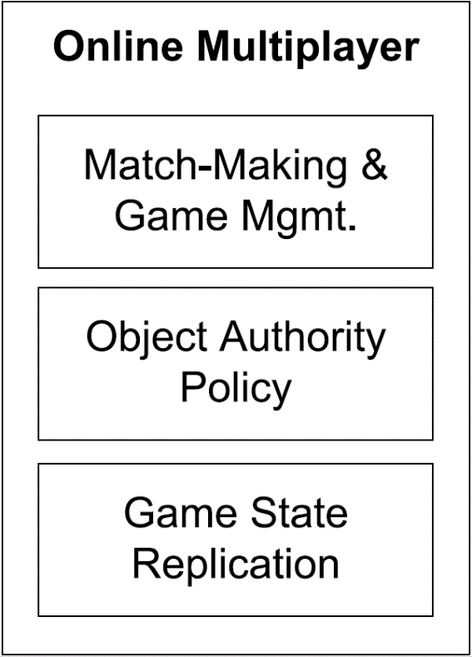
Multiplayer/networking
Multiplayer games come in at least four basic flavors:
  Single screen – multiple players on the same screen (Smash Brothers, Lego, Star Wars and Gauntlet)
  Split-screen multiplayer – multiple perspectives on the same screen (multiple HIDs attached to a single game machine)
  Networked multiplayer – multiple computers networked together
  Massive multiplayer online games (MMOG) – hundreds of thousands of users can be playing simultaneously within a
  giant, persistent, online virtual world hosted by a powerful battery of central servers.
Multiplayer games are quite similar in many ways to their single-player counterparts.
Difficult to convert single to multiplayer, easy to do the opposite.
Many game engines treat single-player mode as a special case of a multiplayer game.
The Quake engine is well known for its client-on-top-of-server mode, in which a single executable, running on a single PC, acts both as the client and the server in single-player campaigns.

Slide 47
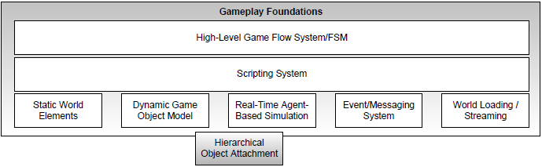
Gameplay foundation system
The term gameplay refers to the action that takes place in the game,
the rules that govern the virtual world in which the game takes place,
the abilities of the player character(s) (known as player mechanics)
and of the other characters and objects in the world,
and the goals and objectives of the player(s).
Gameplay is typically implemented either in the native language in which the rest of the engine is written or in a high-level scripting language—or sometimes both.
To bridge the gap between the gameplay code and the low-level engine systems that we’ve discussed thus far, most game engines introduce a layer that I’ll call the gameplay foundations layer.
Gameplay foundations layer introduces a game world (both static and dynamic elements)
Game World are modelled in an object-oriented matter.
The collection of object types that make up a game is called the game object model

Slide 48
Game Object Model
The game object model provides a real-time simulation of a heterogeneous collection of objects in the virtual game world:
• static background geometry, like buildings, roads, terrain (often a special case), etc.;
• dynamic rigid bodies, such as rocks, soda cans, chairs, etc.;
• player characters (PC);
• non-player characters (NPC);
• weapons;
• projectiles;
• vehicles;
• lights (which may be present in the dynamic scene at runtime, or only used for static lighting offline);
• cameras;
The game world model is intimately tied to a software object model
Notes:
In the context of game engines, the
software object model answers questions, such as:
• Is your game engine designed in an object-oriented manner?
• What language will you use? C? C++? Java? OCaml?
• How will the static class hierarchy be organized? One giant monolithic
hierarchy? Lots of loosely coupled components?
• Will you use templates and policy-based design, or traditional polymorphism?
• How are objects referenced? Straight old pointers? Smart pointers?
Handles?
• How will objects be uniquely identified? By address in memory only?
By name? By a global unique identifier (GUID)?
• How are the lifetimes of game objects managed?
• How are the states of the game objects simulated over time?

Slide 49




Event system
Objects need to communicate with one another.
For example, the object sending the message might simply call a member function of the receiver object.
An event driven architecture is also a common approach to inter-object communication.
In an event-driven system:
The sender creates a little data structure called an event or message, containing the message’s type and any argument data that are to be sent.
The event is passed to the receiver object by calling its event handler function.
Events can also be stored in a queue for handling at some future time.

Slide 50





Scripting system
Many game engines employ a scripting language in order to make development of game-specific gameplay rules and content easier and more rapid.
Allows for the creation on new game logic without recompiling
When a scripting language is integrated into your engine, changes to game logic and data can be made by modifying and reloading the script code.
Some engines allow script to be reloaded while the game continues to run.
Speeds software development considerably.

Slide 51
Artificial intelligence foundations
Traditionally, artificial intelligence has fallen squarely into the realm of game specific software.
AI was usually not considered part of the game engine in the past.
Game companies have recognized patterns that arise in almost every AI system.
AI foundations are slowly starting to fall under the purview of the engine proper.
Kynogon developed a middleware SDK named Kynapse, which provides much of the low-level technology required to build commercially viable game AI.
Autodesk bought Kynogon and redesigned a middleware called Gameware that provides many of Kynapse features and more.
AI foundations Provides AI Building Blocks:
  Path finding
  Nav mesh generation
  Static and dynamic object avoidance
  Identification of vulnerabilities within a play space (e.g., an open window from which an ambush could come) and a well-defined interface between AI and animation.

Slide 52
Built-in Game Engine AI Systems
Many popular game engines already come with strong AI tools:
Unity ML-Agents
  Unity’s open-source toolkit for training NPCs with reinforcement learning, imitation learning, and other ML techniques.
  Great for research and commercial games.
Unreal Engine (Behavior Trees + EQS)
  Built-in Behavior Tree system for decision-making and Environment Query System (EQS) for spatial reasoning.
  Used in AAA titles (e.g., Fortnite).

Slide 53
AI Middleware / Frameworks
These are specialized AI systems you can integrate into engines:
Kythera AI
  Middleware for Unreal and custom engines.
  Handles navigation meshes, behavior trees, and crowd simulation.
Havok AI
  Part of Havok’s middleware suite (owned by Microsoft).
  Optimized for large-scale pathfinding and navigation.
RAIN AI (for Unity)
  Free AI toolkit (though not actively updated).
  Offers pathfinding, decision-making, and sensors.

Slide 54
Machine Learning / Research-Oriented AI
For developers who want to push boundaries with ML-driven gameplay:
TensorFlow / PyTorch (integrated with Unity or Unreal)
  Often used with Unity ML-Agents or custom pipelines.
  Great for adaptive NPCs or AI opponents.
OpenAI Gym / PettingZoo
  For prototyping reinforcement learning in game-like environments.
  More for experimentation than production.

Slide 55
Navigation & Pathfinding Libraries
Recast & Detour
Industry-standard for navmesh generation and pathfinding.
Used in many engines (Unity, Unreal, custom engines).
A Pathfinding Project (Unity)*
Popular Unity plugin for grid, navmesh, and point graph pathfinding.

Slide 56
Classic AI Techniques (Engine-Agnostic)
Even without middleware, most studios rely on tried-and-true approaches:
Finite State Machines (FSMs) – simple, predictable AI.
Behavior Trees – modular, hierarchical logic for NPCs.
GOAP (Goal-Oriented Action Planning) – flexible planning AI (used in F.E.A.R.).
Utility AI – scoring-based decision-making (used in The Sims 4).

Slide 57
Game AI Engines & Frameworks – Comparison
AI Engine / Framework | Pros ✅ | Cons ❌ | Best Use Cases 🎯 | Skill Level
Unity ML-Agents | - Easy Unity integration - Supports reinforcement & imitation learning - Active community | - Training requires compute power - Can be overkill for simple NPCs | Smart adaptive NPCs, training bots, research experiments | Intermediate–Advanced
Unreal Engine (Behavior Trees + EQS) | - AAA-grade tools - Integrated with navmesh & animation - Powerful EQS for decision-making | - Steep learning curve - Less suited for ML-based AI out of the box | AAA shooters, RPGs, open-world games | Intermediate
Kythera AI | - Advanced navmesh & crowd simulation - Middleware for Unreal/custom engines - Handles large-scale environments | - Commercial license (not free) - Best for studios with budget | Large open worlds, MMO AI, simulation-heavy games | Advanced (Studio-level)
Havok AI | - Industry-proven - Highly optimized navigation/pathfinding - Supports dynamic worlds | - Proprietary & costly - Limited flexibility vs. custom ML | AAA titles, physics-heavy games needing scalable AI | Advanced
RAIN AI (Unity) | - Free Unity toolkit - Provides FSMs, sensors, decision-making - Easy setup | - No longer actively updated - Limited vs. ML-Agents | Simple NPC AI in Unity projects | Beginner–Intermediate
Recast & Detour | - Gold standard navmesh generator - Used in many commercial engines - Fast, stable | - Only handles navigation/pathfinding - No decision-making AI | Custom engines, Unity/Unreal extensions | Intermediate
A Pathfinding Project (Unity)* | - Very popular Unity asset - Grid, navmesh, & point graph support - Optimized for 2D & 3D | - Navigation only (no high-level AI) - Limited ML support | Indie projects, 2D/3D games with AI agents | Beginner–Intermediate
TensorFlow / PyTorch (with Unity/Unreal) | - Cutting-edge ML libraries - Great for research & adaptive AI - Integrates with Unity ML-Agents | - Requires deep ML knowledge - Can be heavy for real-time games | Adaptive AI, procedural content, experimental gameplay | Advanced (AI/ML experience)
OpenAI Gym / PettingZoo | - Great for prototyping RL agents - Good benchmarking environment - Active research ecosystem | - Not production-ready - Integration with game engines takes effort | Research, prototyping, AI training simulations | Advanced (Research/ML focus)

Slide 58
Recommendations
Indie Devs / Beginners → A* Pathfinding Project, RAIN AI, or Unity ML-Agents (if curious about ML).
AAA Studios → Unreal Engine AI tools + Kythera AI or Havok AI.
Researchers / Innovators → Unity ML-Agents + TensorFlow/PyTorch.
Custom Engines → Recast & Detour for navmesh + your own FSM/Behavior Tree system.

Slide 59
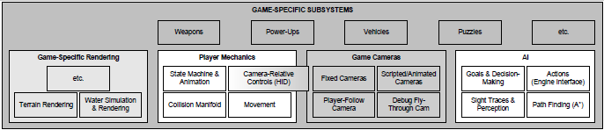
Game-specific subsystems
All of the specific stuff needed for a game
This layer could be considered outside of the game engine itself
On top of the gameplay foundation layer and the other low-level engine components, gameplay programmers and designers cooperate to implement the features of the game itself.
Gameplay systems are usually numerous, highly varied and specific to the game being developed.
Game-specific subsystems include to the mechanics of the player character, various in-game camera systems, artificial intelligence for the control of non-player characters, weapon systems, vehicles, etc.
The game-specific subsystems and the gameplay foundations defines the clear line between the game engine and the game.

Slide 60
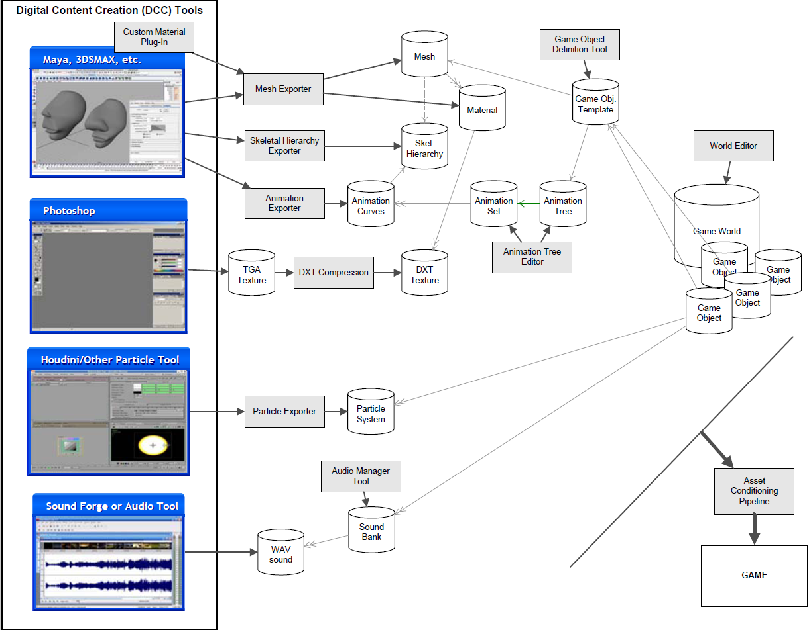
Tools and the asset pipeline
Any game engine must be fed a great deal of data, in the form of game assets, configuration files, scripts and so on.
The thicker dark-grey arrows show how data flows from the tools used to create the original source assets all the way through to the game engine itself.
The thinner light-grey arrows show how the various types of assets refer to or use other assets.

Slide 61
Digital Content Creation
Games are multimedia applications by nature.
3D Meshes, game world layout (Autodesk’s Maya and 3ds Max and Pixologic’s Zbrush)
Game engines deal with data in many forms.
Textures (Adobe’s Photoshop)
The tools that the artists use are called digital content creation (DCC) applications.
Sound (SoundForge)
DCC tools need to be easy to use and very reliable
Animations
Some types of game data cannot be created using an off-the-shelf DCC app.

Slide 62





Assets conditioning pipeline
DCC tools produce a variety of file formats that are not optimized for game
Game engines usually store the data in an easy to read and platform specific format
Game studio is shipping its game on more than one platform, the intermediate files might be processed differently for each target platform.
3D mesh data might be exported to an intermediate format, such as XML, JSON
The mesh data might then be organized and packed into a memory image suitable for loading on a specific hardware platform.
The ACP does this translation. Every Game Engine has its own Assets Conditioning Pipeline!
The DCC app’s in-memory model of the data is usually much more complex than what the game engine requires.
The DCC application’s file format is often too slow to read at runtime, and in some cases it is a closed proprietary format.
Notes:
For example, Maya stores a directed
acyclic graph (DAG) of scene nodes, with a complex web of interconnections.
It stores a history of all the edits that have been performed
on the file. It represents the position, orientation and scale of every object
in the scene as a full hierarchy of 3D transformations, decomposed
into translation, rotation, scale and shear components.

Slide 63



Conditioning assets
3D Model/Mesh data
Skeletal animation data
Audio data
Particle system data
3D Models – Must be properly tessellated
Brush Geometry – A collection of convex hulls with multiple planes (volumetric geometry for older games)
A skeletal mesh(skin) is a special kind of mesh that is bound to a skeletal hierarchy for the purposes of articulated animation.
Must be compressed and converted to properly work
Should convert multiple formats to a single format (like .wav) for the target system
Audio clips are usually exported from Sound Forge or some other audio production tool
Usually need a custom editing tool within the engine or you can use a third party tool like Houdini.
Notes:
I will use the term “mesh” to refer to a single renderable shape,
and “model” to refer to a composite object that may contain multiple meshes,
plus animation data and other metadata for use by the game.
Meshes are typically created in a 3D modeling package such as 3ds Max,
Maya or SoftImage. A powerful and popular tool by Pixologic called Zbrush
In order to render a skeletal mesh, the game engine requires three distinct
kinds of data:
1. the mesh itself,
2. the skeletal hierarchy (joint names, parent-child relationships and the
base pose the skeleton was in when it was originally bound to the mesh),
and
3. one or more animation clips, which specify how the joints should move
over time.

Slide 64
Game world editor
The game world is where everything in a game engine comes together.
Some variant of the Radiant game editor is used by most game engines based on Quake technology.
There are no commercially available game world editors
The Half-Life 2 Source engine provides a world editor called Hammer.
There are number of commercially available game engines provide good world editors:
UnrealEd is the Unreal Engine’s world editor. This powerful tool also serves as the asset manager for all data types that the engine can consume.
Sandbox is the world editor in CRYENGINE.

Slide 65
Resource database
Need a way to store and manage the vast amounts of data
Every asset also carries with it a great deal of metadata. The metadata provides the asset conditioning pipeline. For animation:
  A unique id that identifies the animation clip at runtime.
  The name and directory path of the source Maya (.ma or .mb) file.
  The frame range—on which frame the animation begins and ends.
  Whether or not the animation is intended to loop.
  The animator’s choice of compression technique and level.
Every game engine requires some kind of database to manage all of the metadata associated with the game’s assets
Some companies use relational database MySQL or Oracle
Some companies use text files managed by version control software Subversion, Perforce, or GIT
Others also use custom software to edit the metadata. Naughty Dog uses a custom GUI called Builder

Slide 66
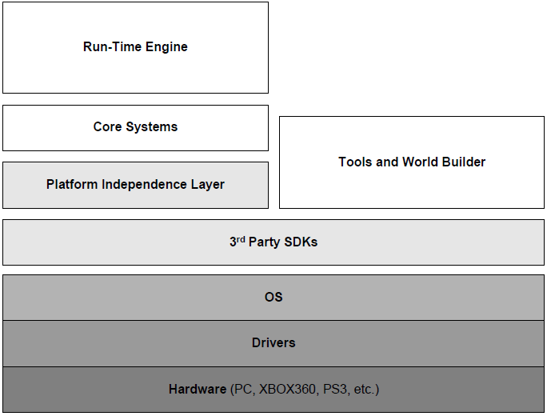
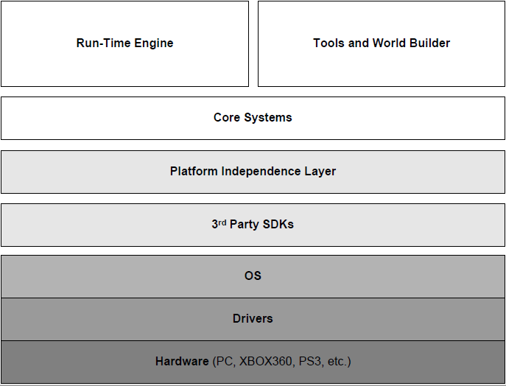
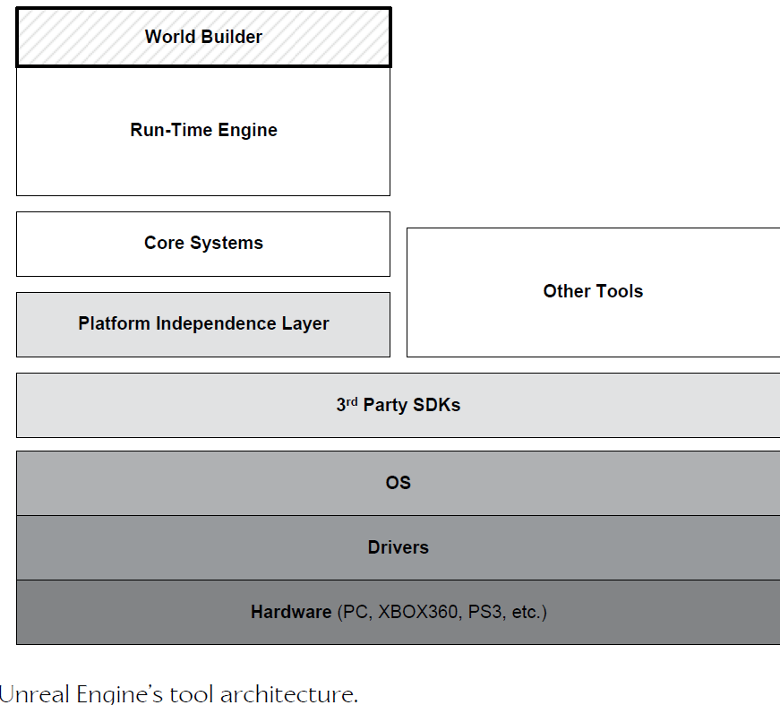
Approaches to Tool Architecture
Stand alone
Integrated
Example
Notes:
A game engine’s tool suite may be architected in any number of ways. Some
tools might be stand-alone pieces of software, as shown in Figure (left). Some
tools may be built on top of some of the lower layers used by the runtime
engine, as Figure (right) illustrates.
For example, Quake- and Unreal-based games both boast an in-game console
that permits developers and “modders” to type debugging and configuration
commands while running the game.
As an interesting and unique example, Unreal’s world editor and asset
manager, UnrealEd, is built right into the runtime game engine. To run the
editor, you run your game with a command-line argument of “editor.”

Slide 67



Web-based tools
Various uses
Asset management
Scheduling
Bug management
Easier to build
Usually easier to build than a stand alone application
Easier to update without forcing a reinstall
Web apps require no special installation
If it just needs to present tabular data and have forms – use a web interface
Notes:
Finally, web-based user interfaces are
becoming more and more popular for certain kinds of tools.
Web interfaces also force us to design
our tools using a client-server architecture. This opens up the possibility
of distributing our tools to a wider audience. For example, Naughty Dog’s
localization tool is available directly to outsourcing partners around the globe

