Slide 1
Week 5
Game Engine Development Unity
VFX
Hooman Salamat

Slide 2
Objective & Concept
Objective
Define the acronym VFX
Explain different applications of VFX in real-time 3D experiences, such as gameplay and environmental effects
Describe the impact that VFX can have on the level of polish in a project
Understand the differences between Unity's Built-in Particle System and VFX Graph
Concepts
VFX are simulated motion effects added to enhance a scene, ranging from a subtle splash of water to a massive fiery explosion. In this lecture, you will learn what VFX are, who makes them in the industry, and then you will tinker with a fire effect in Unity.

Slide 3
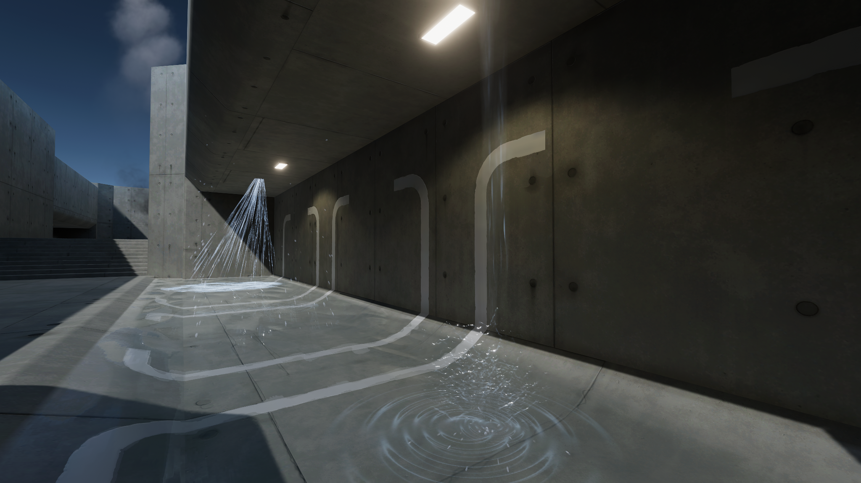
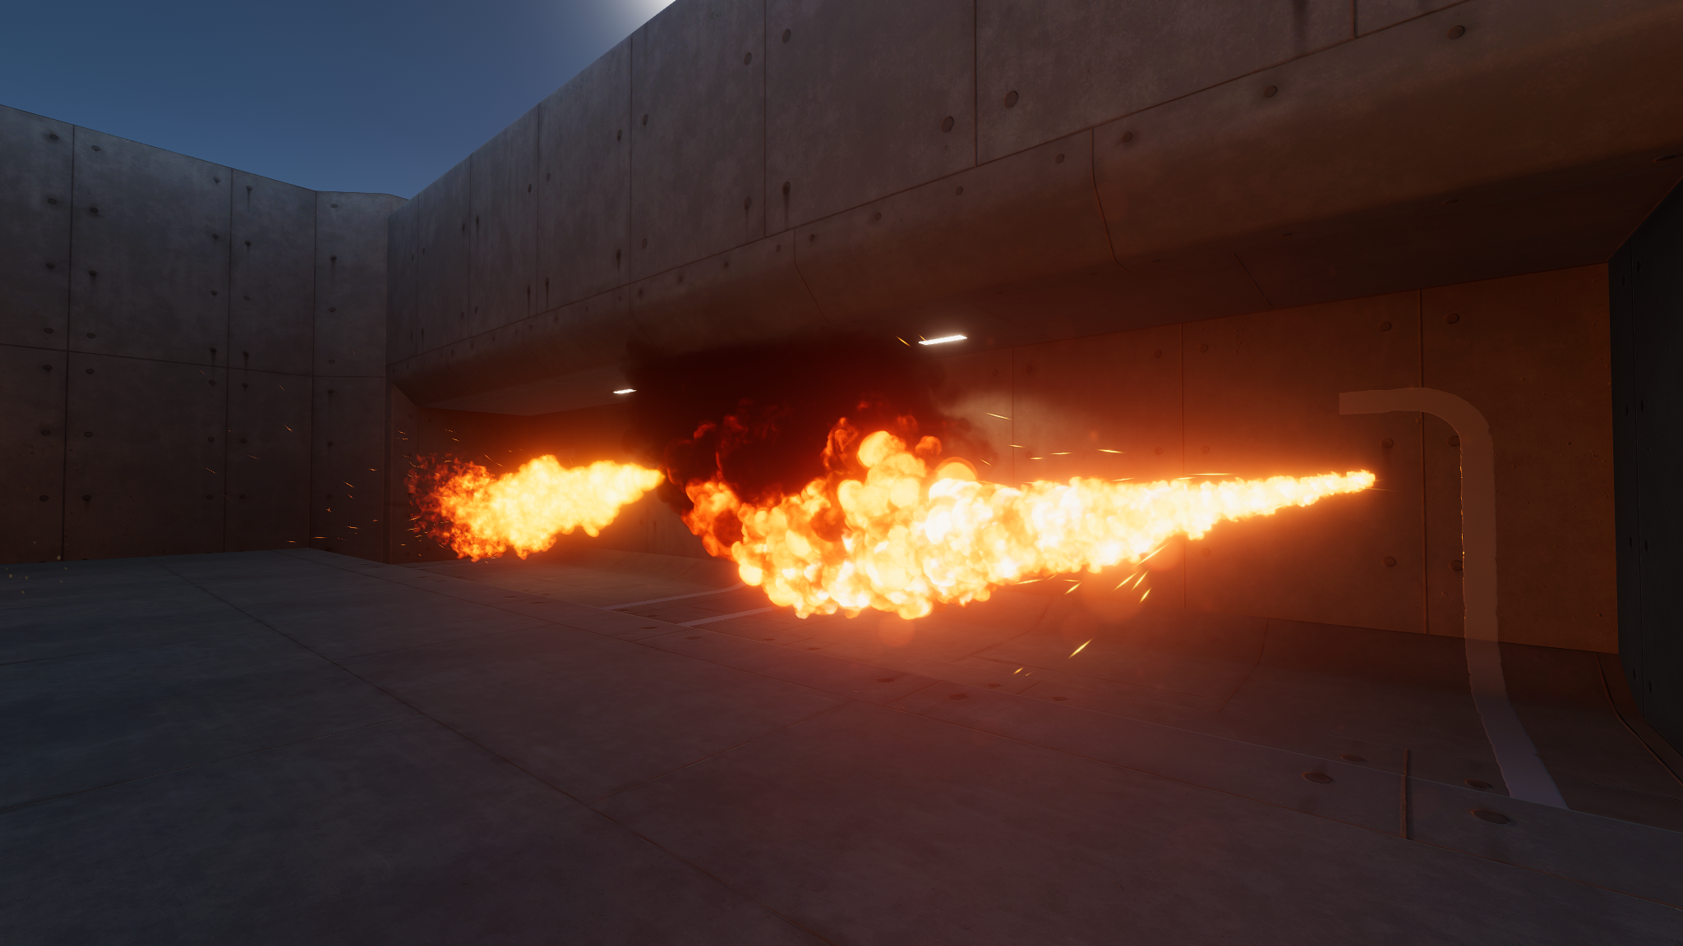
VFX overview
Visual Effects (VFX) can be the wow factor in a real-time 3D project, ranging from a subtle splash of water to a massive fiery explosion.
Without VFX, an environment can feel dull. These effects introduce movement into an environment, bringing it to life.

Slide 4
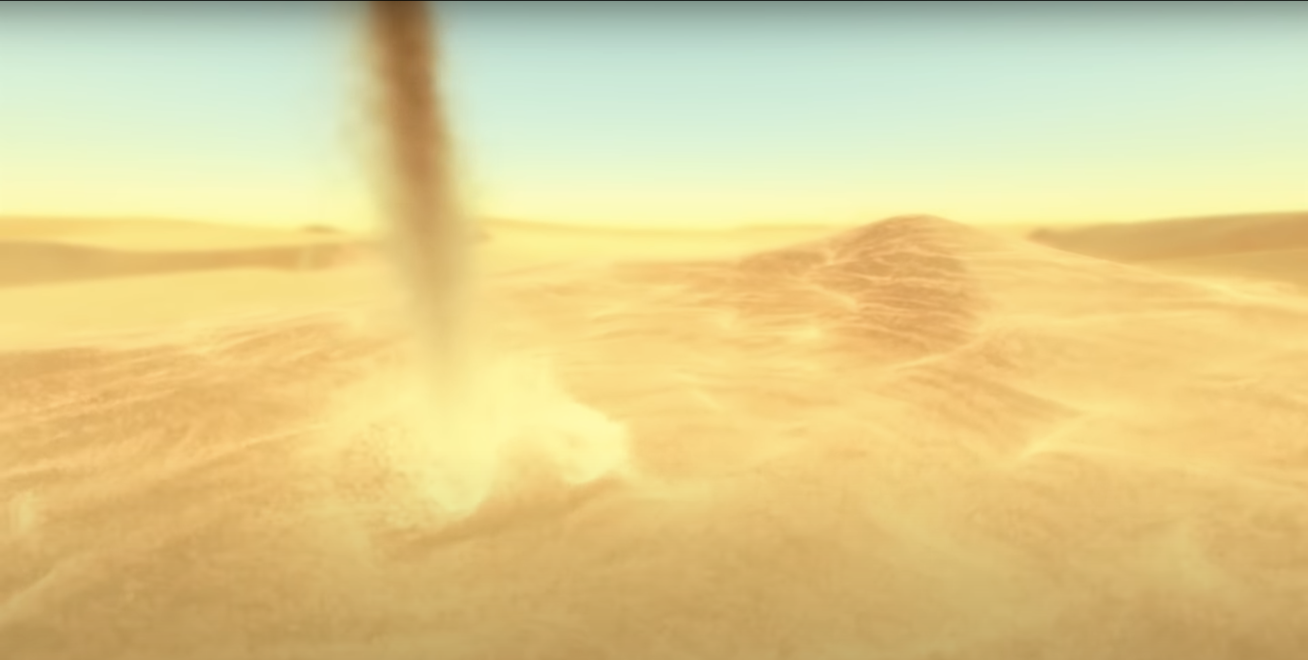
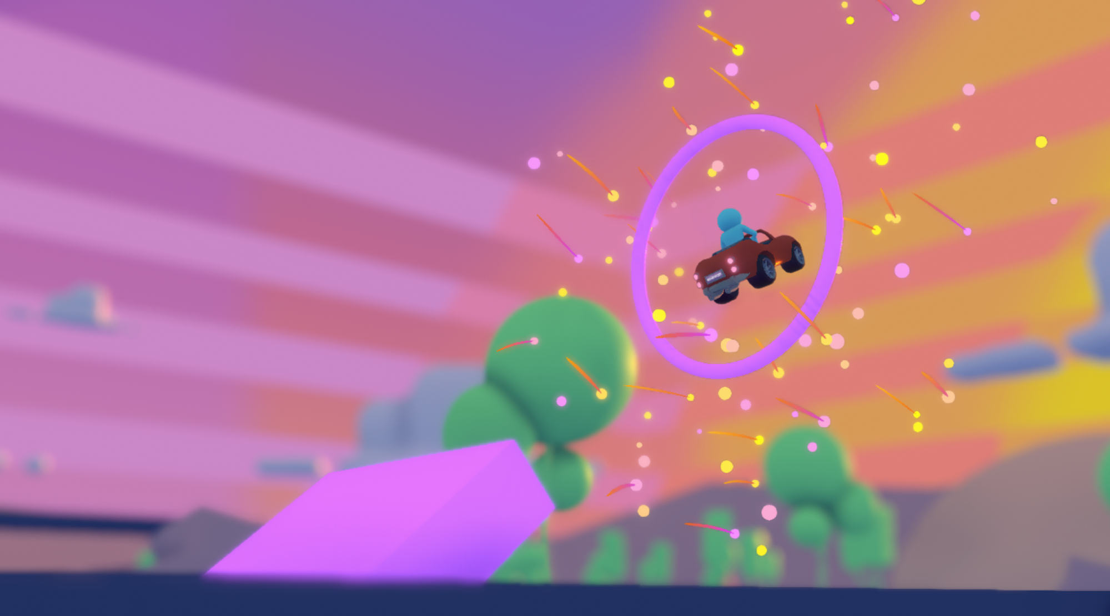
What are VFX?
VFX can be broken down into two categories:
Environmental effects are meant to represent physical occurrences, such as fire, rain, mist, or explosions.
Gameplay effects are meant to enhance or draw attention to specific user interactions. For example, you could add a glowing effect when an object is selected, or a celebration effect that accompanies an in-game achievement.

Slide 5
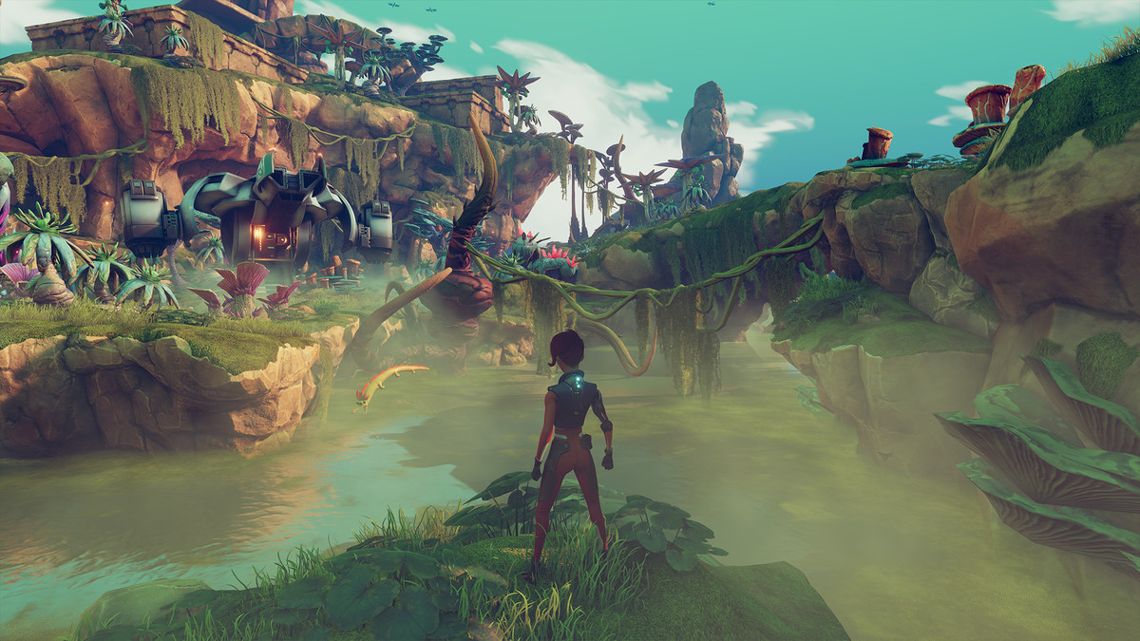
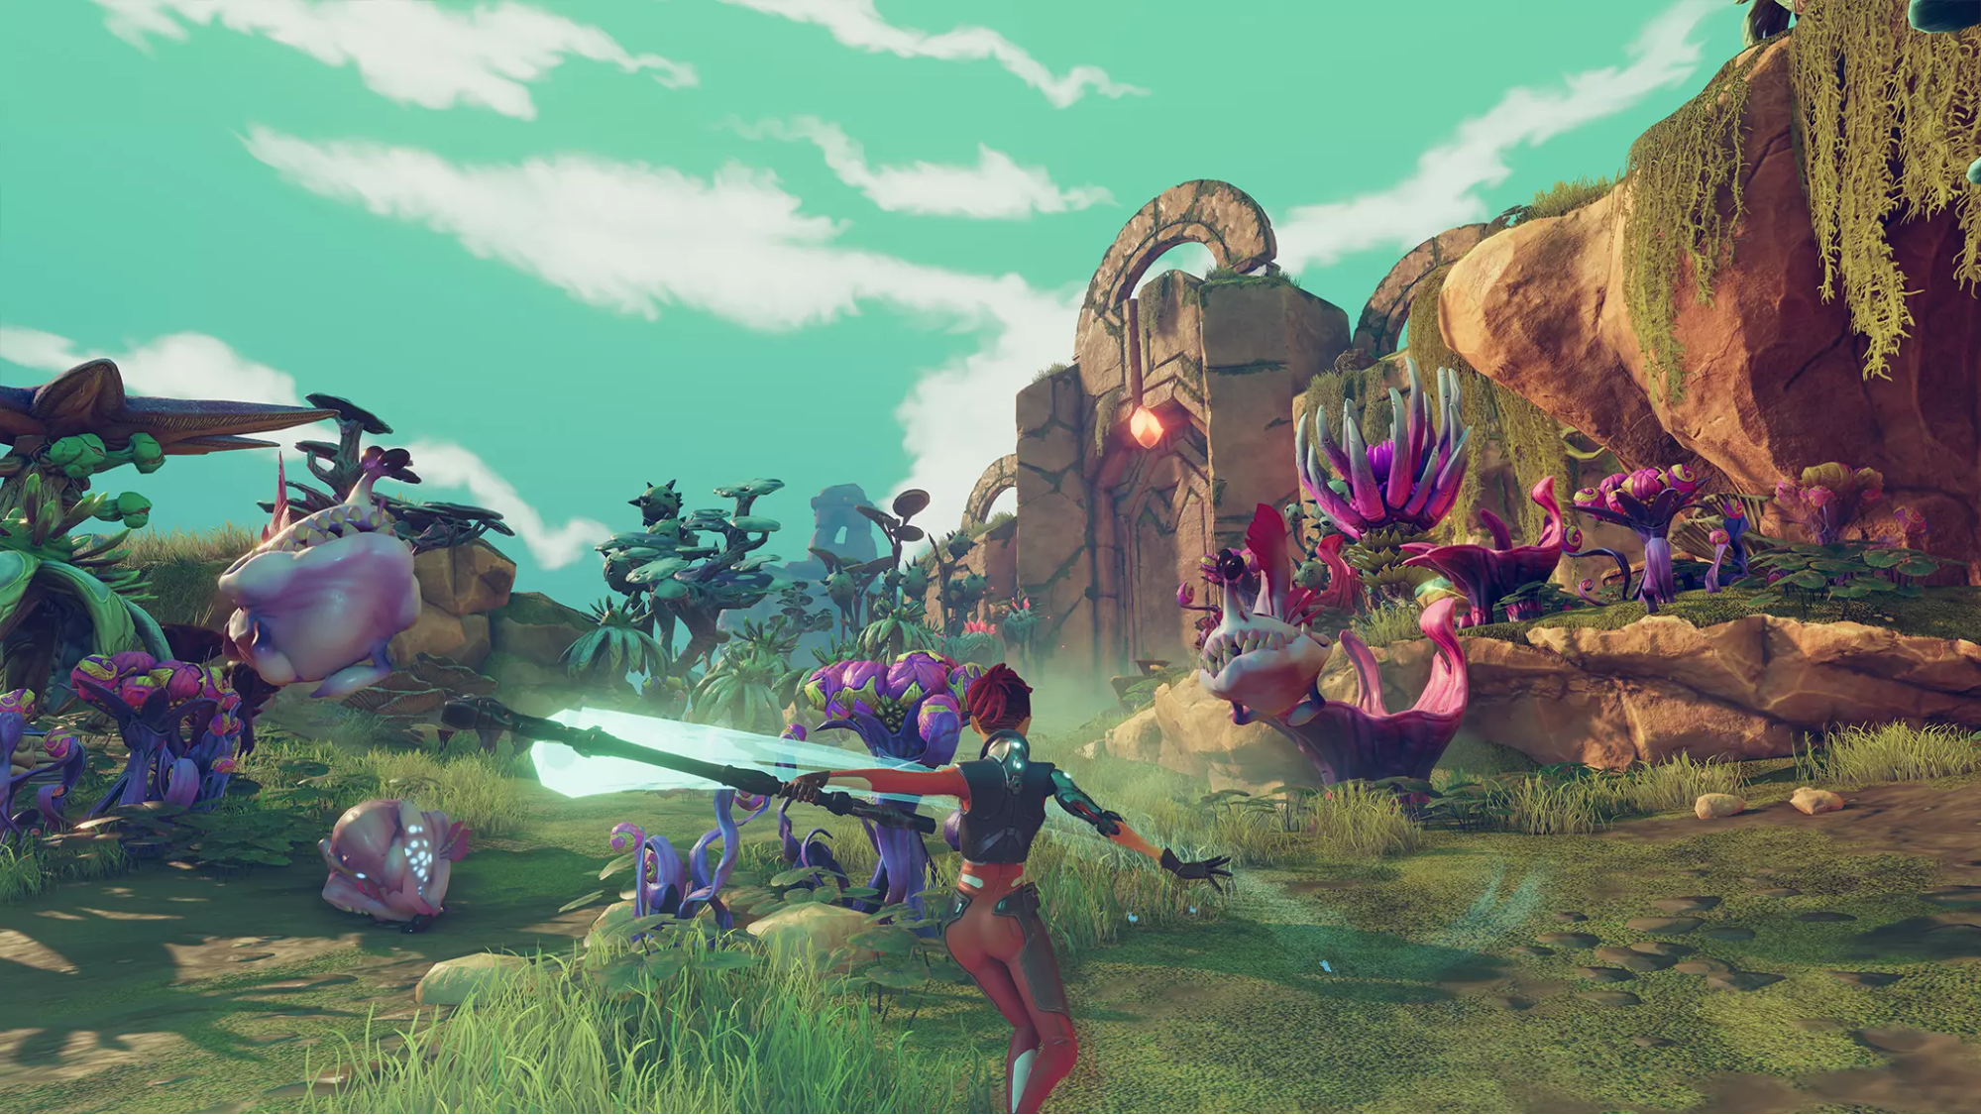
Identify the VFX
The first image shows an environmental mist effect hovering over the water. This adds an element of mystery and danger to the scene.
The second image shows a gameplay effect, where a blue slash trail follows the player’s swinging staff. This makes the swinging interaction much more satisfying and noticeable for the player.

Slide 6
What does a VFX artist do?
A VFX artist is usually responsible for any computer-generated imagery (CGI) that moves but isn’t a character or animal.
If it doesn’t move (like a tree or building), it’s probably made by a 3D artist, including 3D modelers and texture artists.
If it’s an animated character, it’s probably the responsibility of a character artist, rigging artist, or animator.
When people think of VFX, they usually think of live action movies, where effects are added on top of real footage.
Most VFX artists will have a foundation in traditional art principles, like color, texture, and composition. They will also be familiar with physics and fluid dynamics in order to understand how liquids, types of cloth, or particles behave in different conditions.

Slide 7
Tools
In addition to Unity, VFX artists might use or be familiar with other software programs, including the following:
2D image editing software, such as Photoshop, to create 2D textures and particles
3D modeling and animation software, such as Maya, to create 3D shapes for certain effects
Software specializing in procedural simulations like fluids and particles, such as Houdini

Slide 8
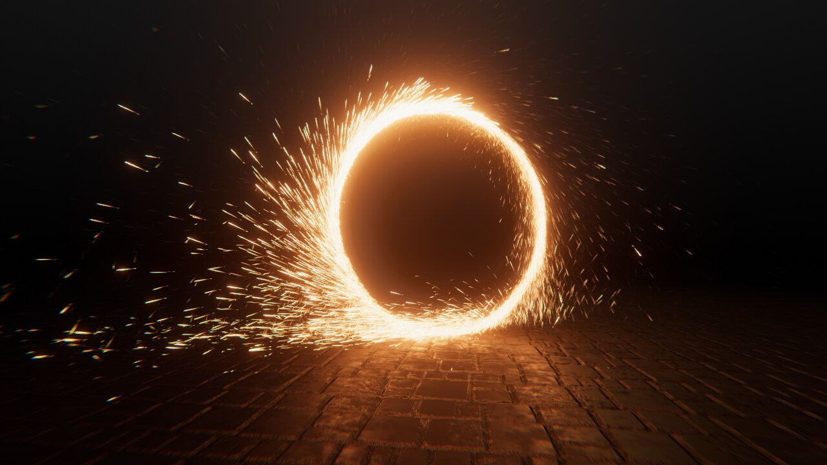
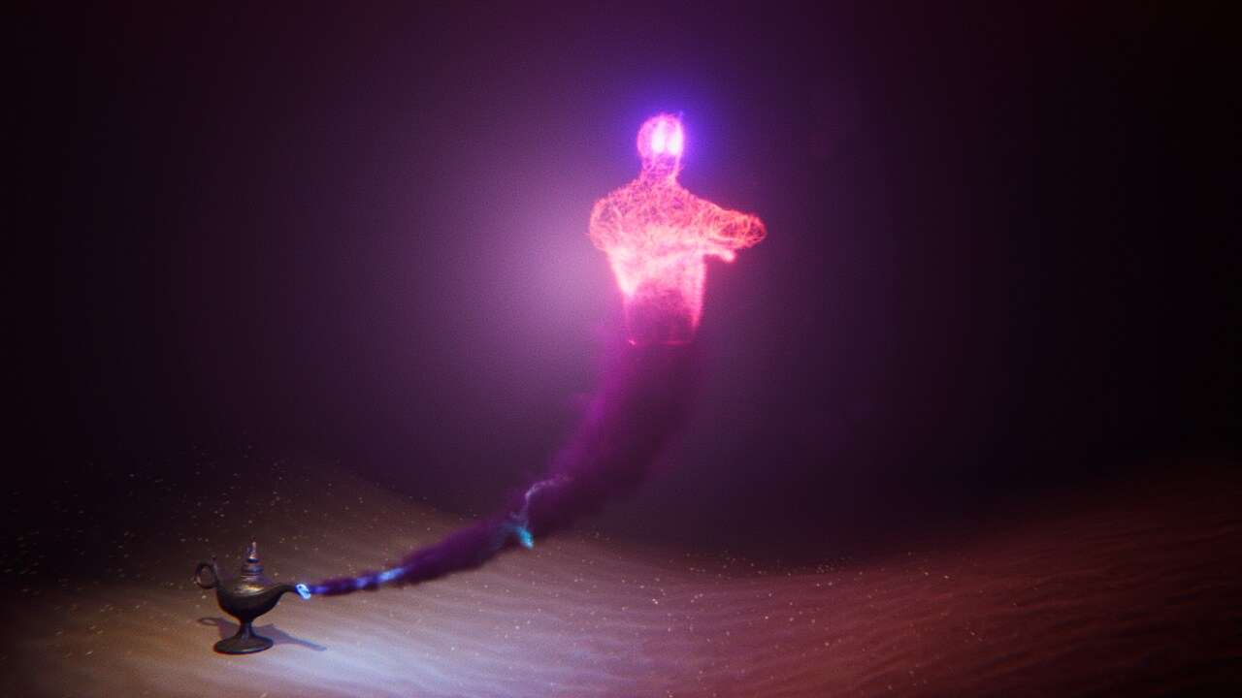
Particle Systems vs VFX Graph
Unity actually has two separate systems for developing VFX: the Built-in Particle System and VFX Graph.
The Built-in Particle System is Unity’s default component-based system that you will find in most Unity projects. VFX Graph is a newer, node-based system, which is extremely powerful but a bit more difficult to learn.
Here are examples of some highly complex simulations made possible with VFX Graph.

Slide 9
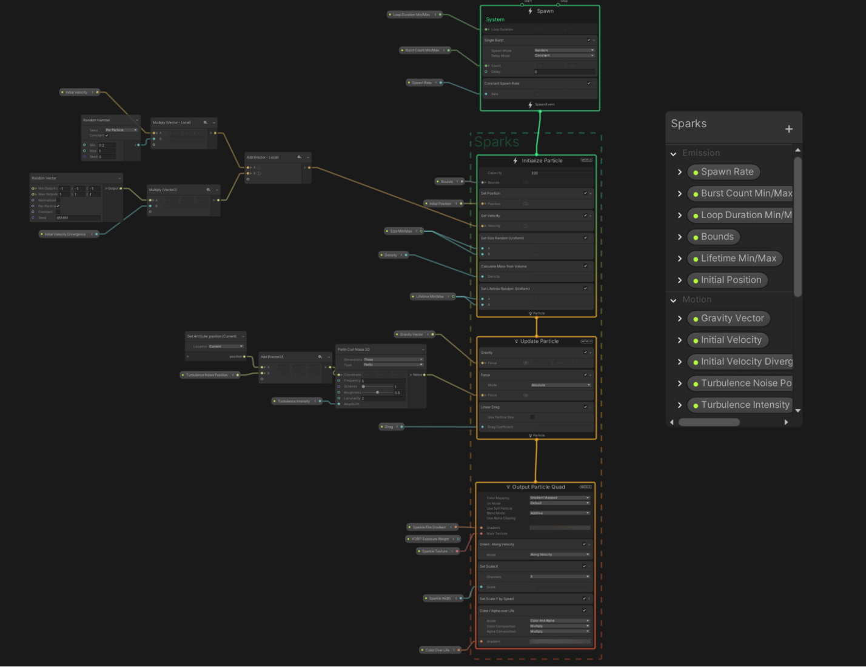
VFX Graph
VFX Graph is a node-based editor for creating effects in Unity. Here is an example of what a VFX Graph might look like for a more complex effect:

Slide 10
Advantages vs. Disadvantages
Advantages of VFX Graph
VFX Graph can process millions of simultaneous particles, while Particle Systems can only process thousands.
VFX Graph can produce more complex simulations, such as the genie shown above, which would not be feasible using a Particle System.
Disadvantages of VFX Graph
VFX Graph is a bit more challenging for beginners to learn than Particle Systems.
VFX Graph has stricter hardware requirements than Particle Systems, preventing it from running successfully on certain target devices.
Since VFX Graph runs on the GPU and Unity physics calculations are done on the CPU, VFX Graph particles cannot interact with the rest of your app’s physics (collide with the ground, for example). Particle Systems run on the CPU, so they can interact with other physics-based components.

Slide 11
Choosing between VFX Graph and Particle Systems
How do you choose whether to use VFX Graph or the Particle System?
If you’re pretty experienced and want to create something really complex or something that requires millions of particles, you might want to use VFX Graph.
If you’re not an expert and want to create something simple, something that runs on all devices, or something that can interact with other physics-based objects in your scene, use a Particle System.

Slide 12
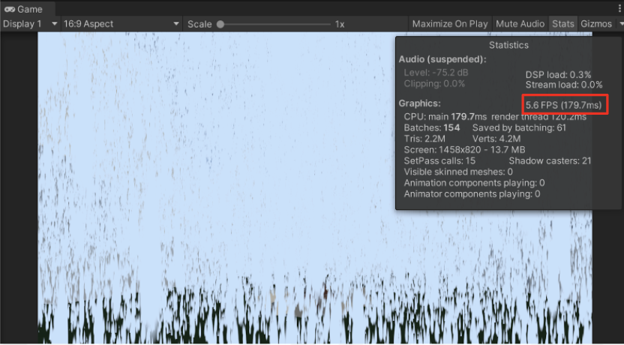
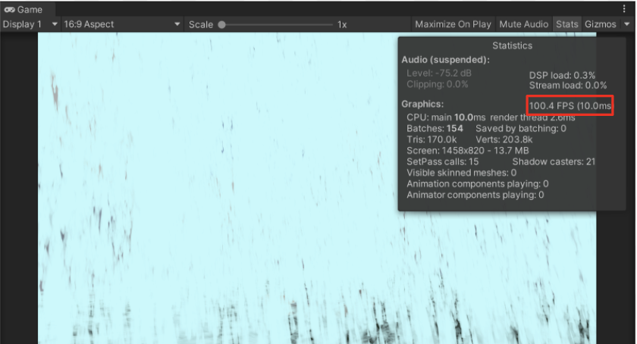
Example
In the case of the weather effect in the scene, we may want a higher number of particles.
Take a look at the two screenshots. The first shows a Particle System simulating one million particles. It has an abysmal frame rate of around 5fps.
Compare that to this effect, which uses VFX Graph to simulate one million particles, and still has an excellent frame rate of around 100 frames per second.

Slide 13
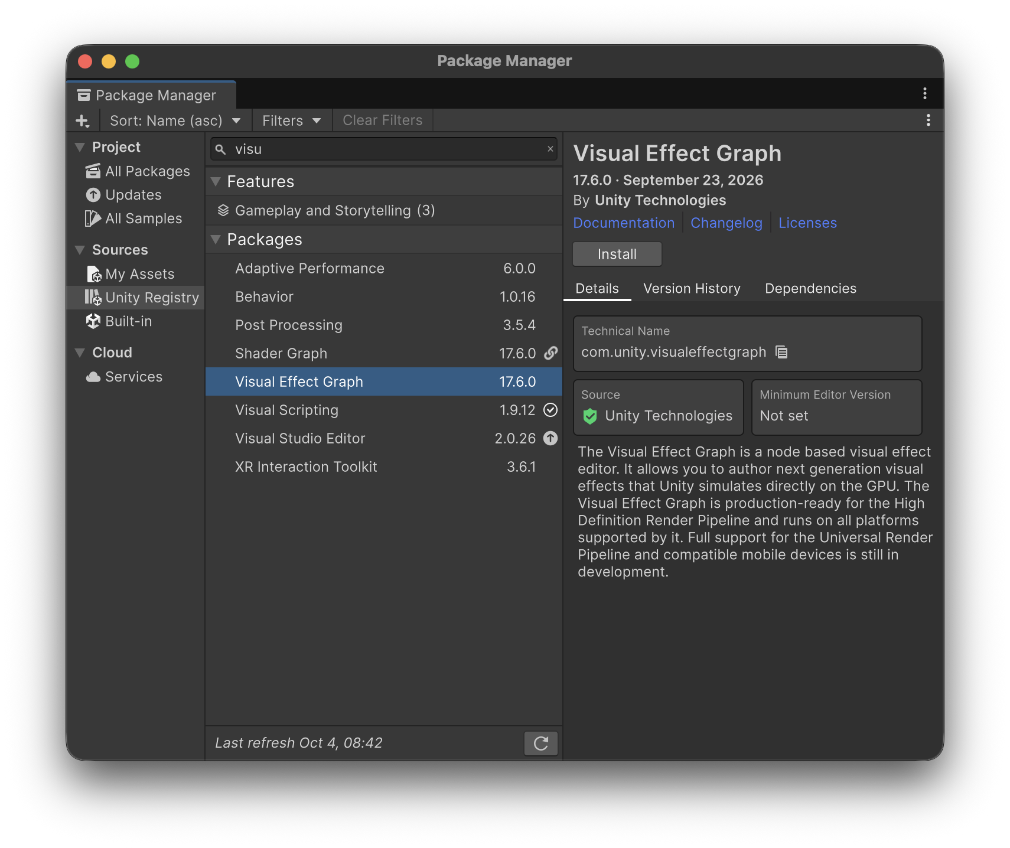
Visual Effect Graph

Slide 14
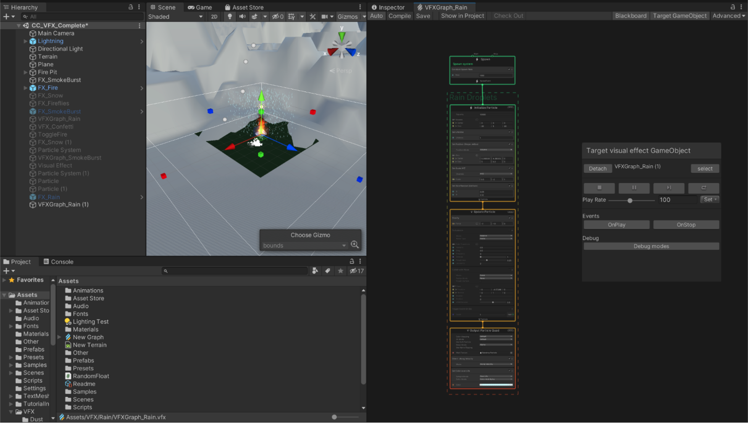
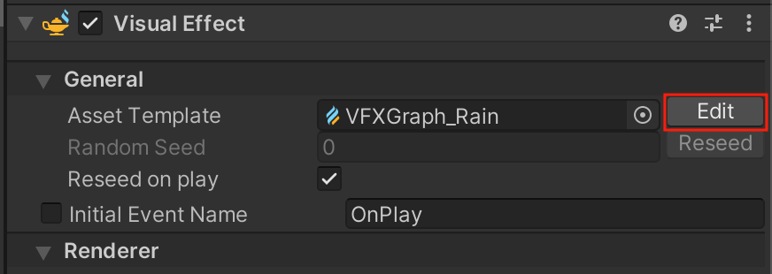
Edit Visual Effect Graph
1. With the VFX Graph object selected, locate the Visual Effect component. Notice the little lamp icon next to the component’s name – that is the icon for VFX Graph.
2. Select the Edit button to open the VFX Graph editor window.

Slide 15
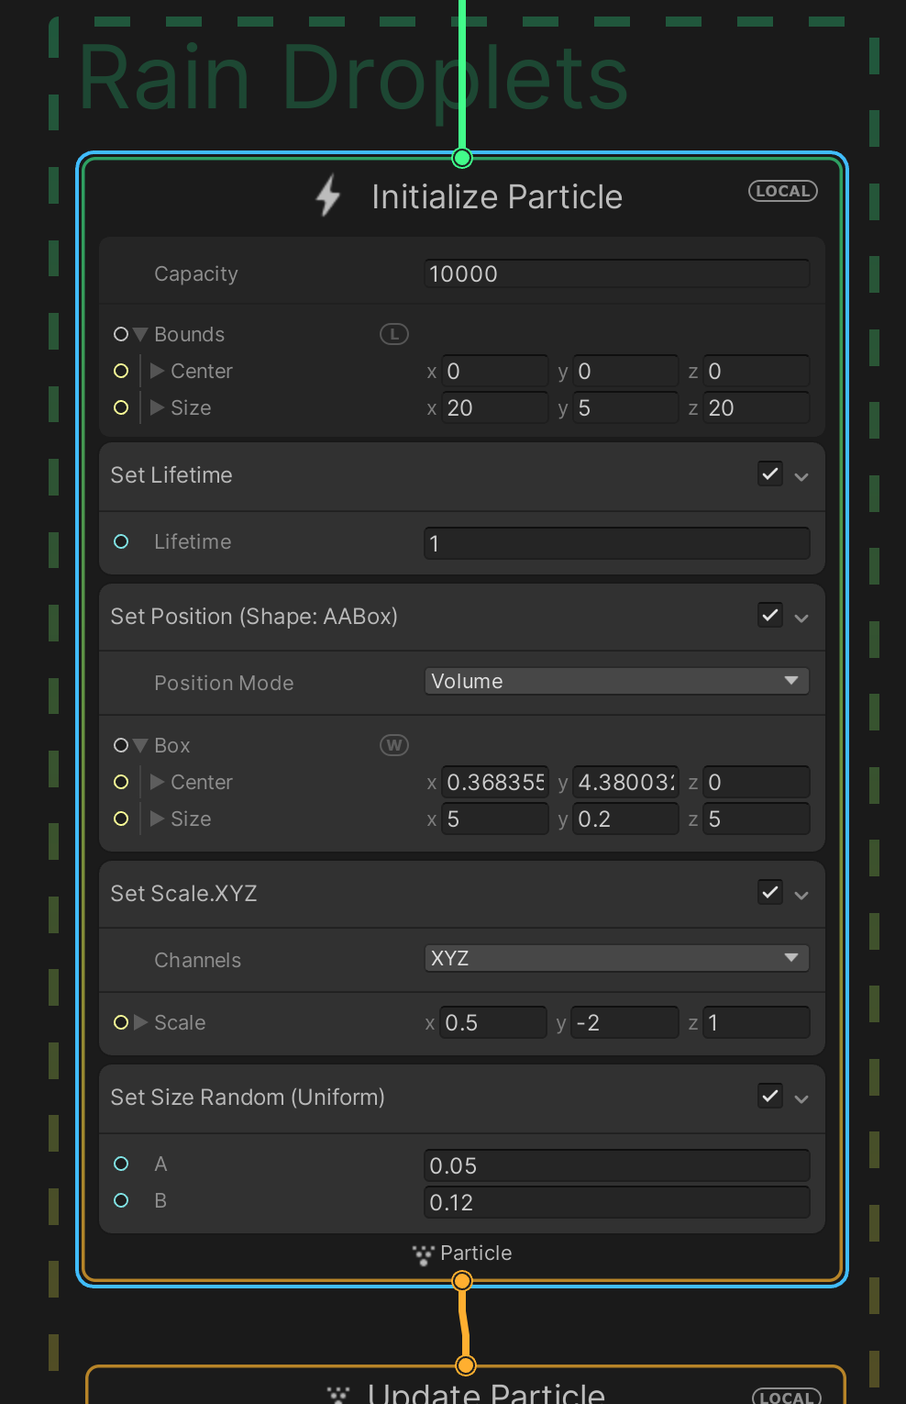
Navigate the VFX Graph window
Pan: Middle-click and drag, or hold Alt (Windows) or Option (macOS) and click and drag.
Zoom: Rotate the wheel or use your trackpad zoom.
Focus and zoom in: Select an element and press the F key.
Fit to window: Press the A key.

Slide 16
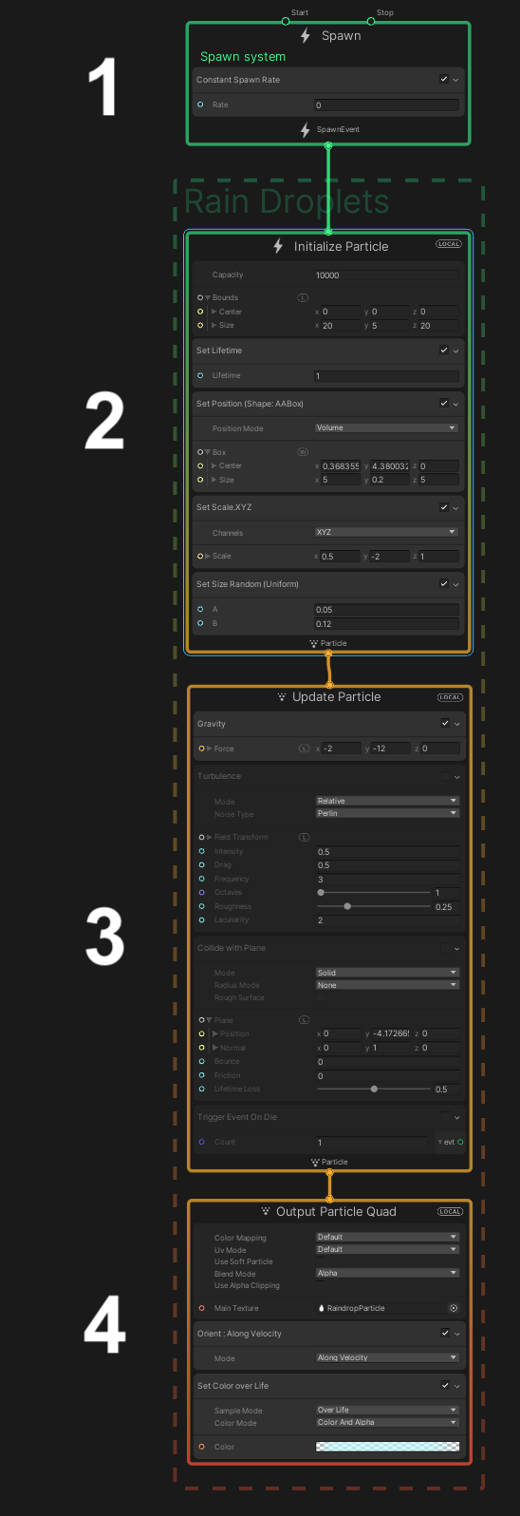
Nodes
With the full VFX Graph in view, the first thing you’ll notice is that it is made up of four main nodes, which are stacked vertically on top of each other.
These four default nodes are called the Context Nodes (or “Contexts” for short) and are read from top to bottom. We’ll go through those in detail in the next step.

Slide 17
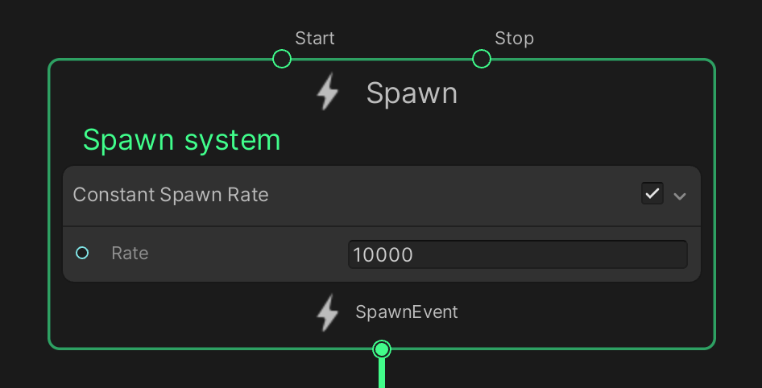
Spawn Context
This first context controls the spawning of particles, similar to the Emission module for a Particle System. To quickly frame the Spawn context in view, select it and press F.
By default, a new VFX Graph uses a constant spawn rate, but you can set up variable, periodic, or bursts of particles, just like you did with the smoke burst effect.
1. Adjust the Rate property so that the VFX Graph version of the effect matches your original Particle System effect.
You can increase the spawn rate to a very high value without much of an impact on frame rate.

Slide 18
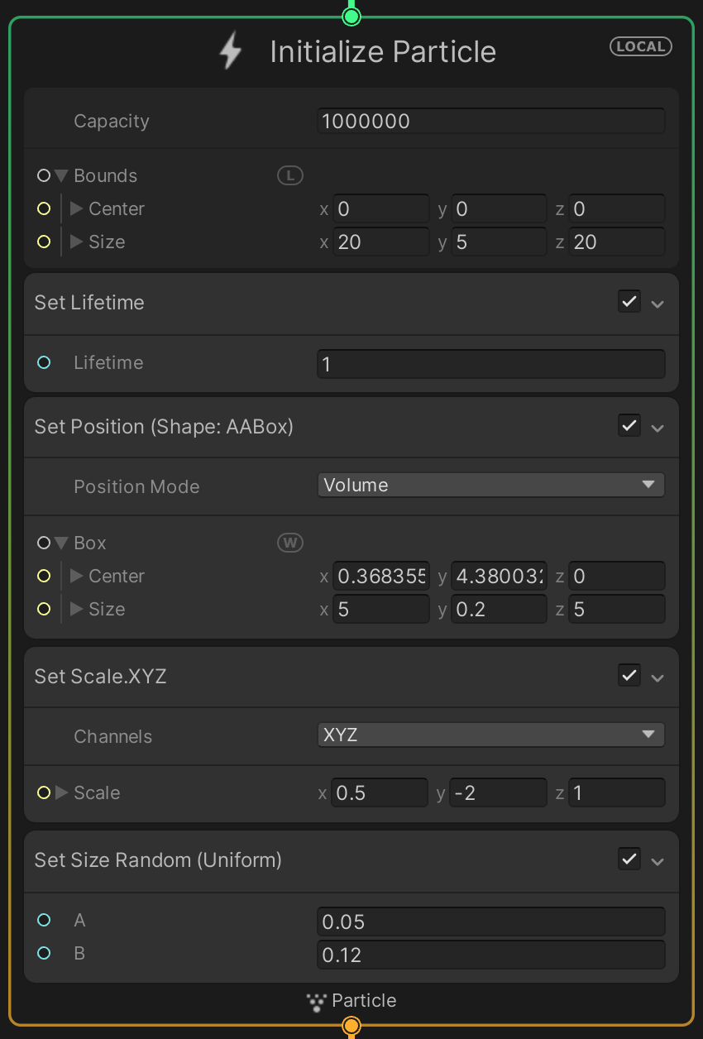
Initialize Particle Context
The Initialize Particle context controls where and how the particles first appear.
This includes many of the same properties as the Particle System’s main module, including the particles’ initial size, shape, velocity, lifetime, and maximum capacity.
It also includes the equivalent of the Shape module, which defines the volume from which the particles are generated.

Slide 19
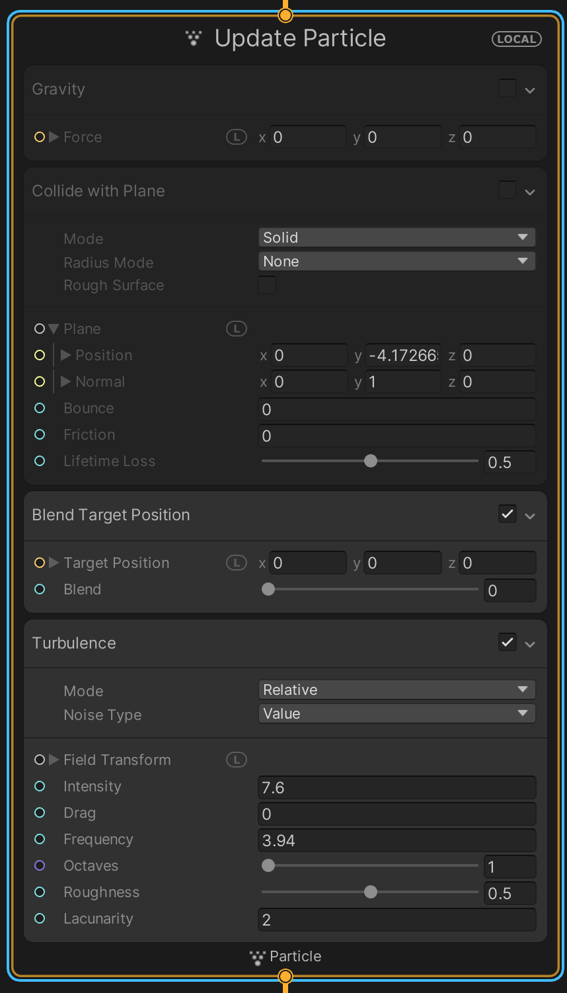
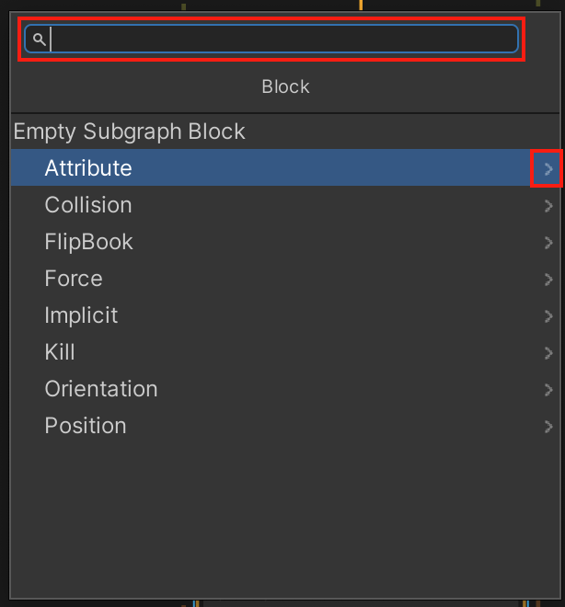
Update Particle Context
The Update Particle context controls any changes to the particles from the moment they are generated until the moment they die (disappear).
This updates the particles and runs each frame. This includes properties similar to the Particle System’s Color over Lifetime, Size over Lifetime, Noise (called Turbulence in VFX Graph), and Texture Sheet Animation (called Flipbook Player in VFX Graph).
Each of these behaviors can be added as a new Block in the context. In the screenshot above, for example, Turbulence is a Block.
3. Experiment with new Blocks by right-clicking in the Context and selecting Create Block. Then either browse through the sub-menus or use the search bar to explore.

Slide 20
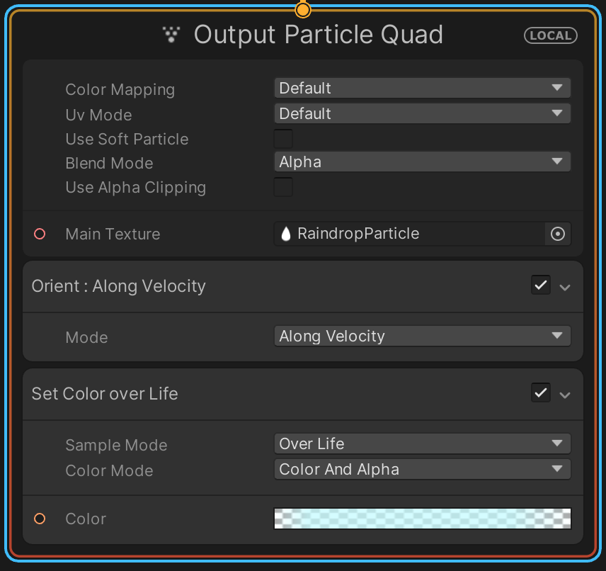
Output Particle Context
The Output Particle context controls the appearance of each of the particles, very similar to the Renderer module of a Particle System. This is where you assign a material for your particles.

Slide 21
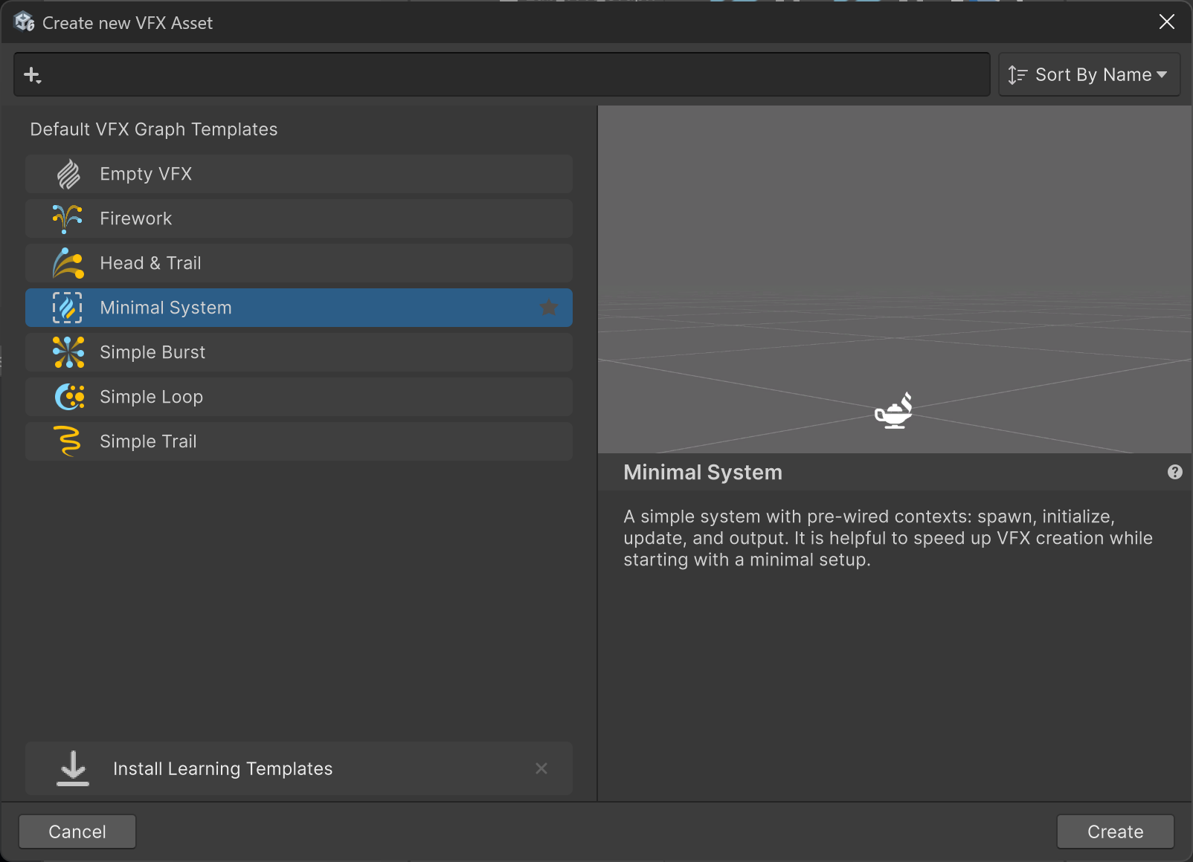
Create a minimal graph
From the project tab, create a new “Minimal System” VFX Asset.

Slide 22
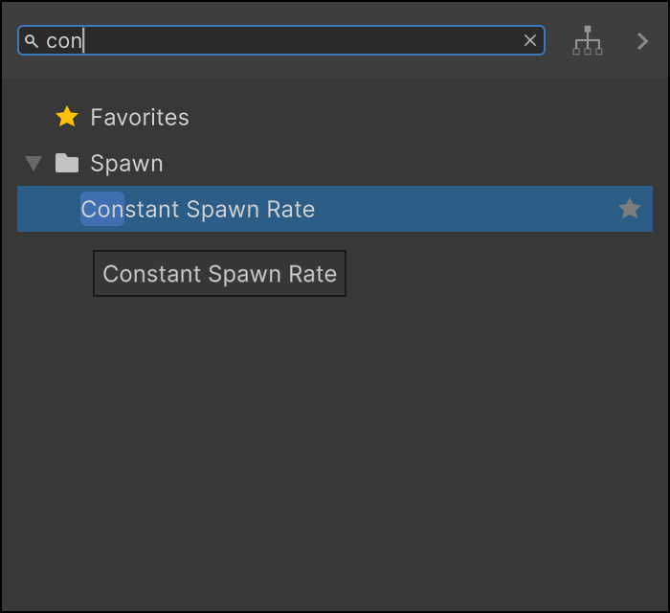
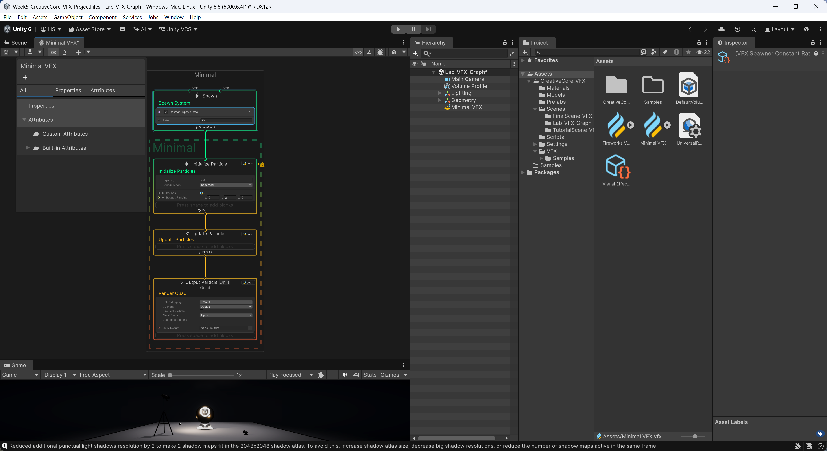
Add a “Constant Spawn Rate” block in the “Spawn” context

Slide 23
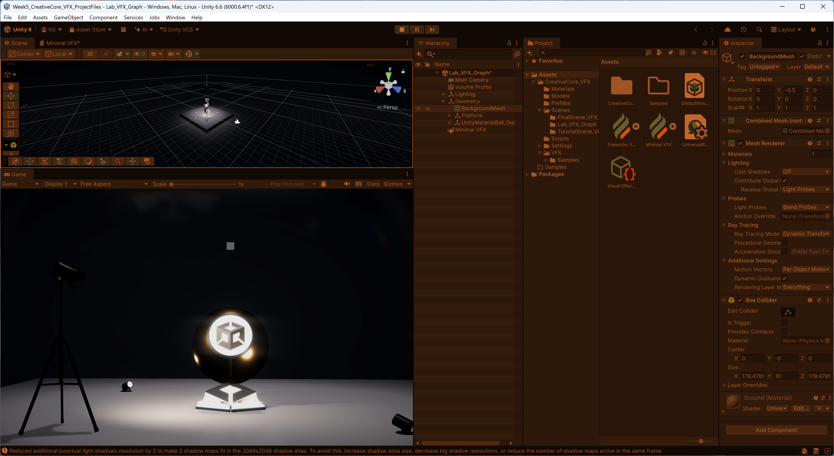
Run
You should see a grey quad at the location of “minimal VFX”!

Slide 24
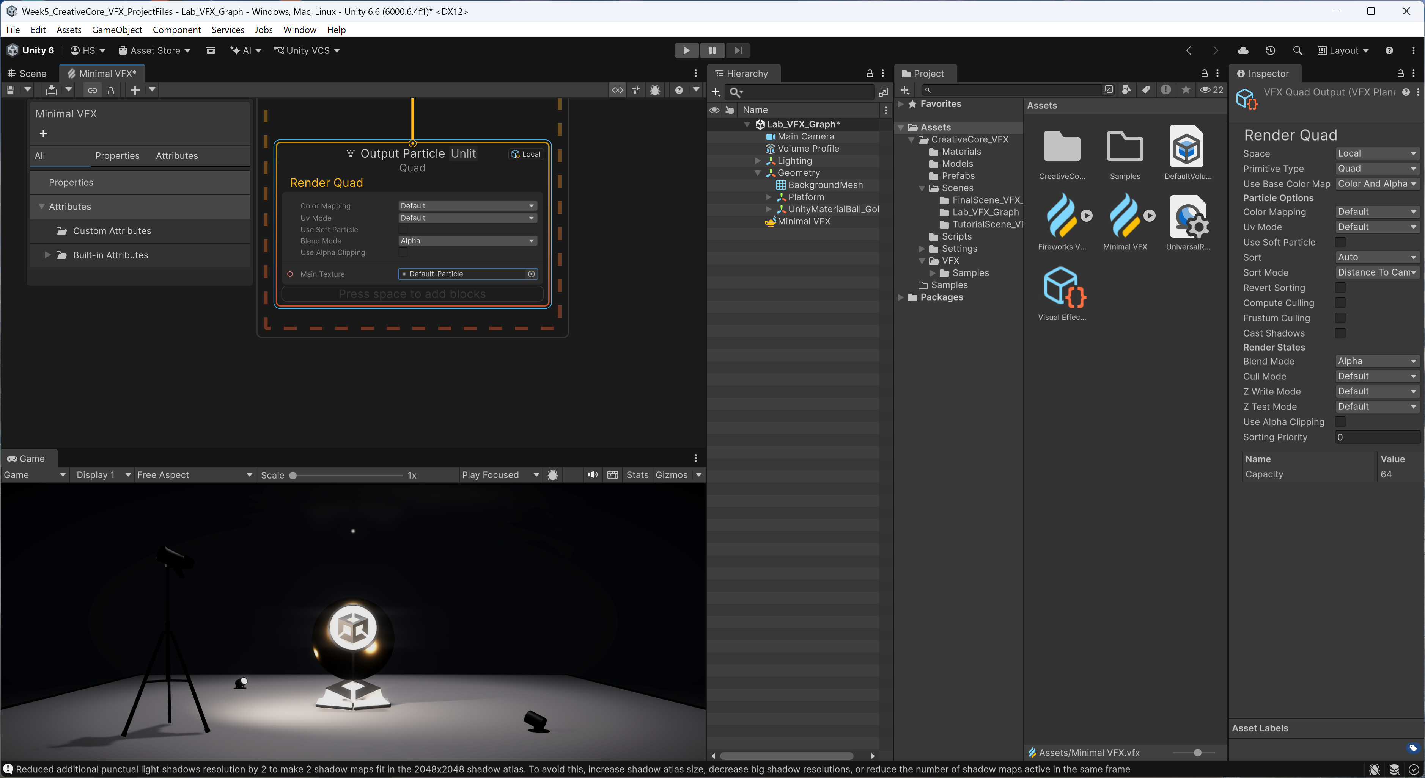
Add a texture
In “Output Particle Unlit”, add “Default Particle” texture to “Main Texture”

Slide 25
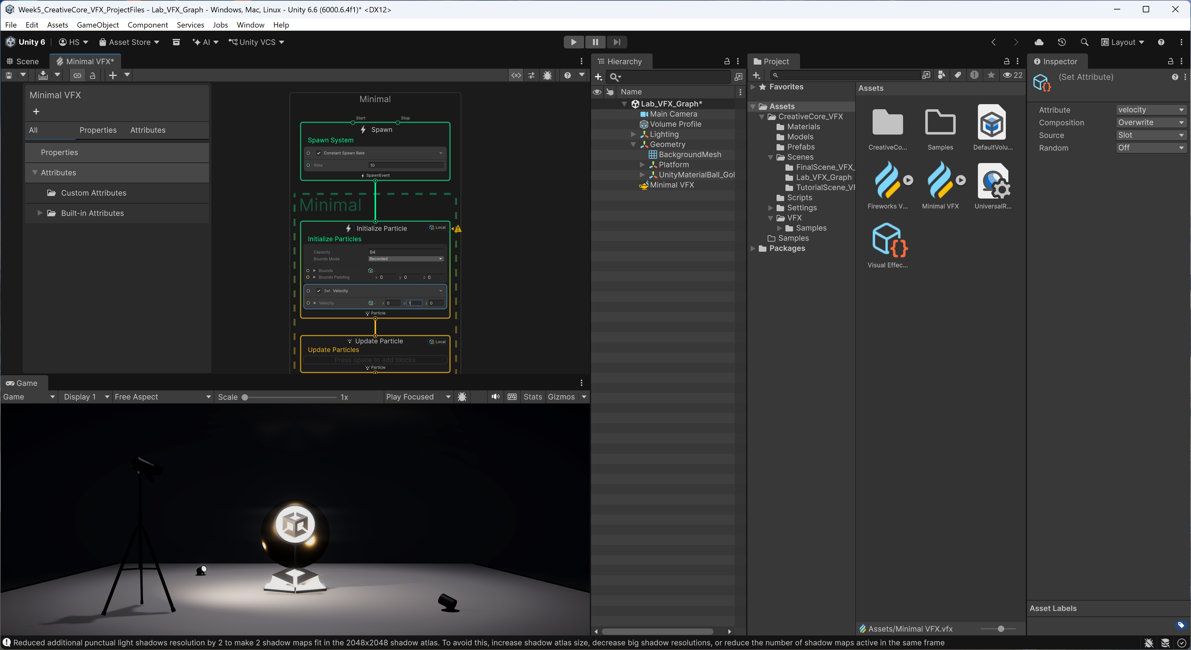
Initialize Particle: Set Velocity
In “Initialize Particle”, add “Set Velocity” block, and set “y” to 1.
Run the application and see particles vertically flying upward.
Spawn rate is currently set to 10.
Notice that it runs out after it’s hit its capacity at a rate of 10.

Slide 26
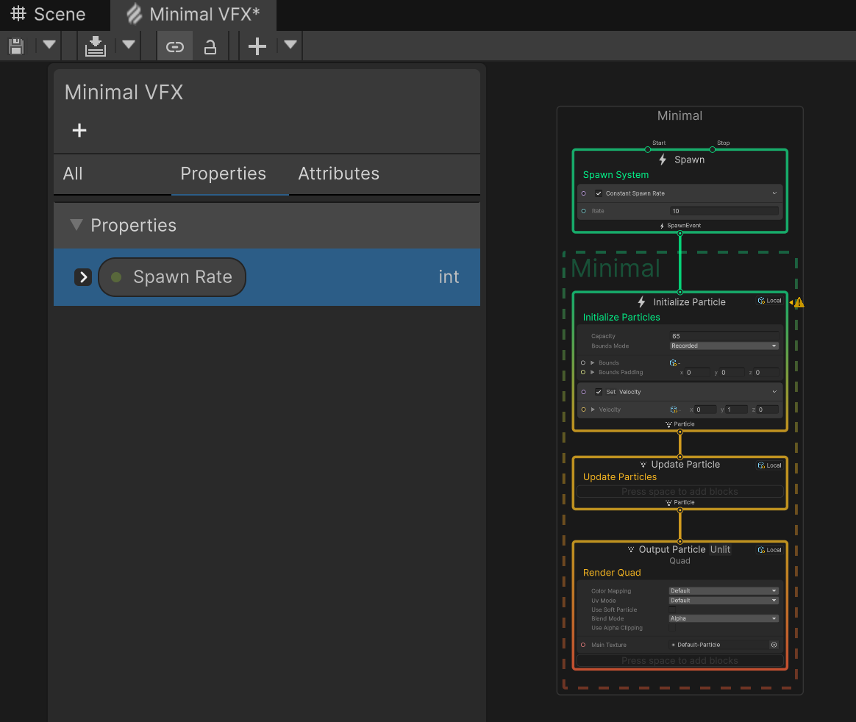
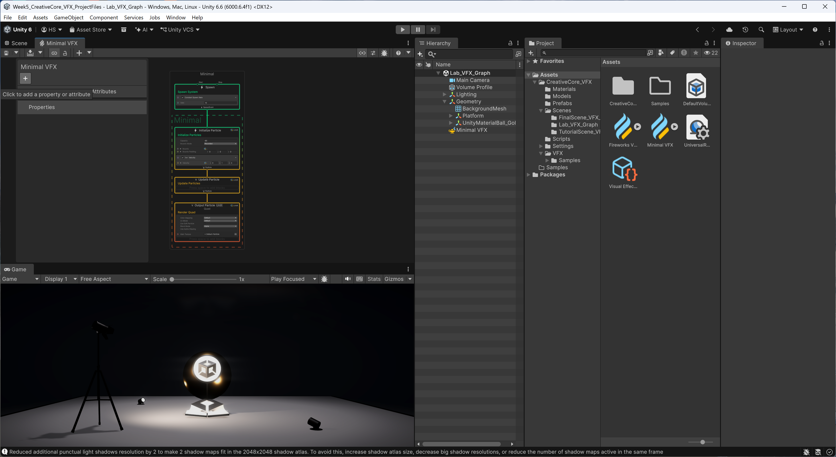
Add an Int Property (Spawn Rate)

Slide 27
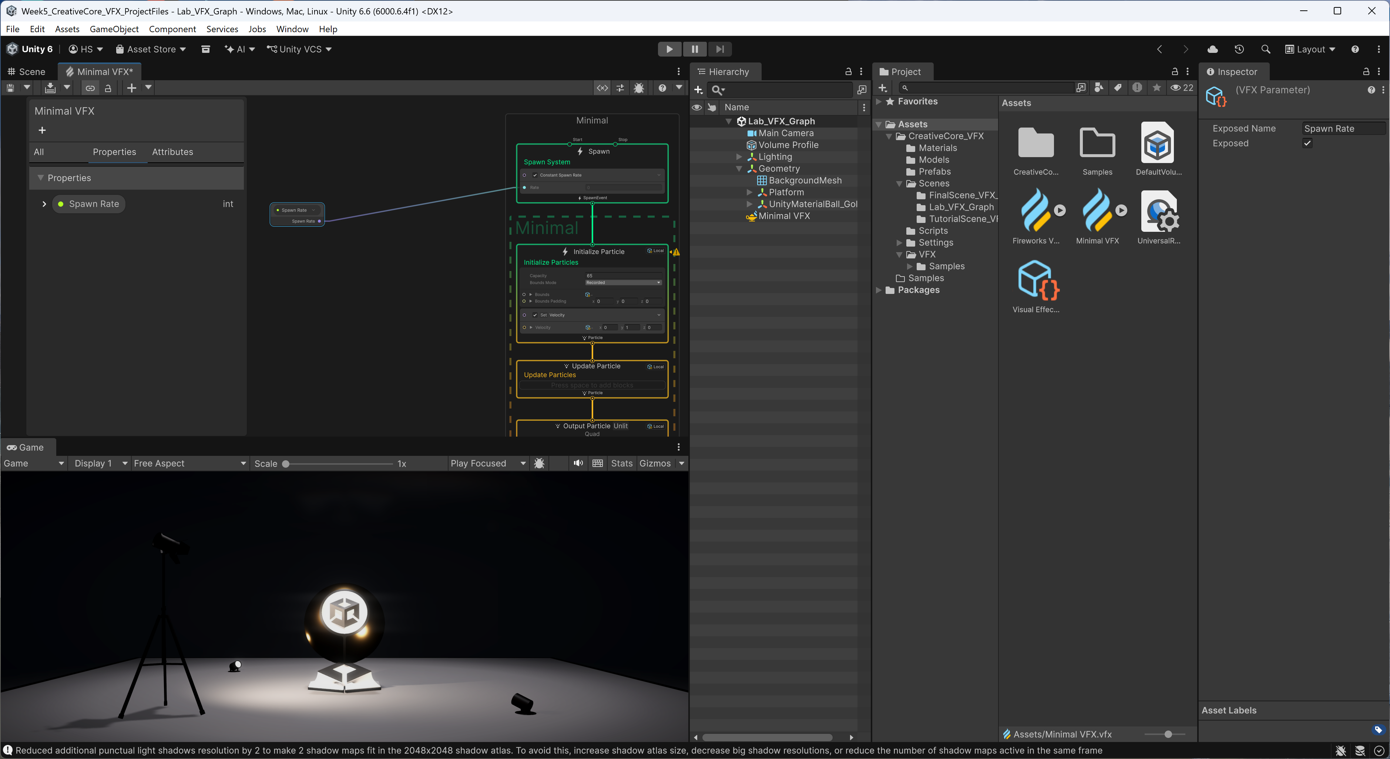
Connect Spawn Rate to “Spawn” context
Drag Spawn Rate to the graph and connect it to the “Rate”

Slide 28
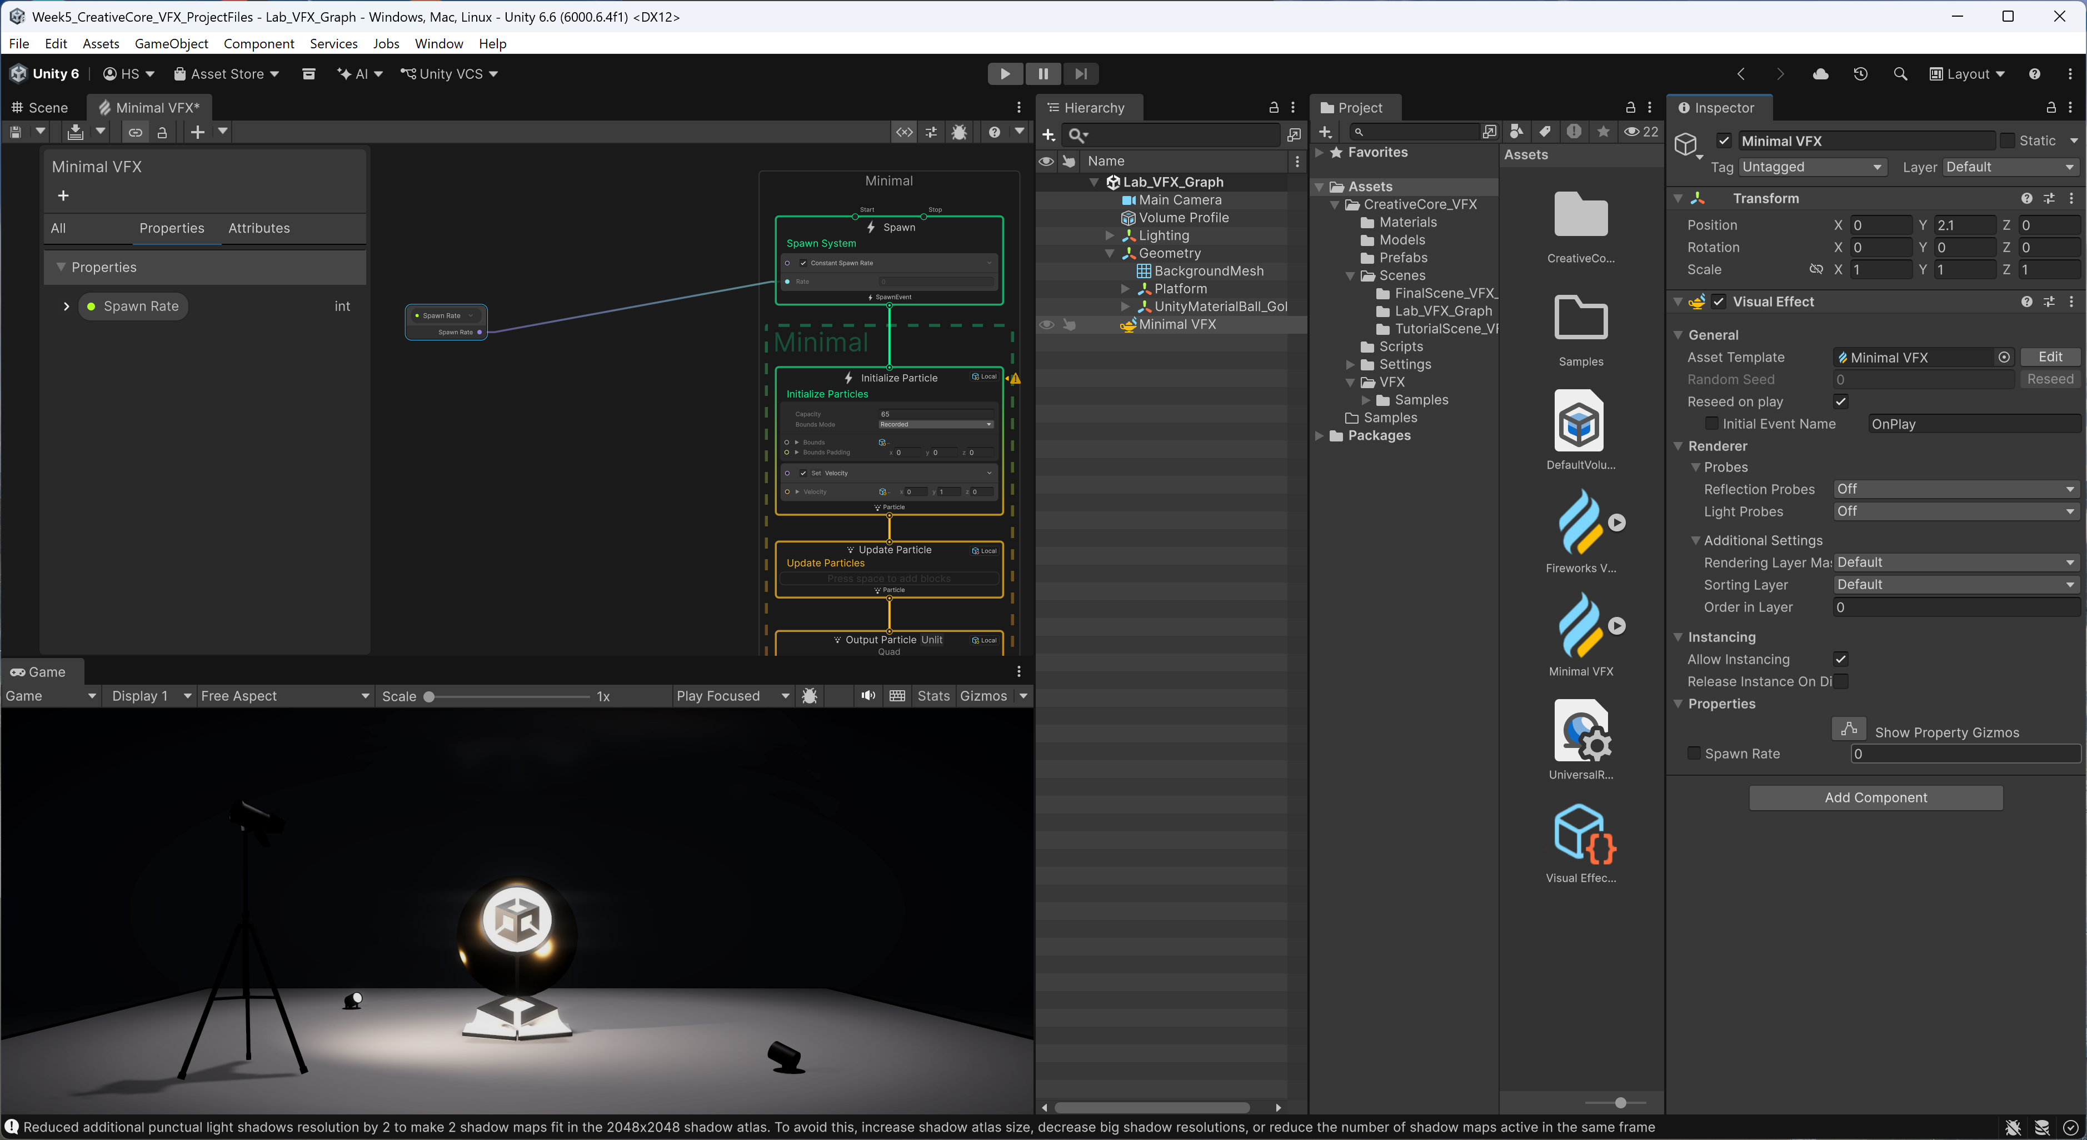
Inspector
Notice that “Spawn Rate” has been added to the “Properties” section of the “Visual Effect”.
Change the “Spawn Rate” value to 50!
Change the “Capacity” to 5000.

Slide 29
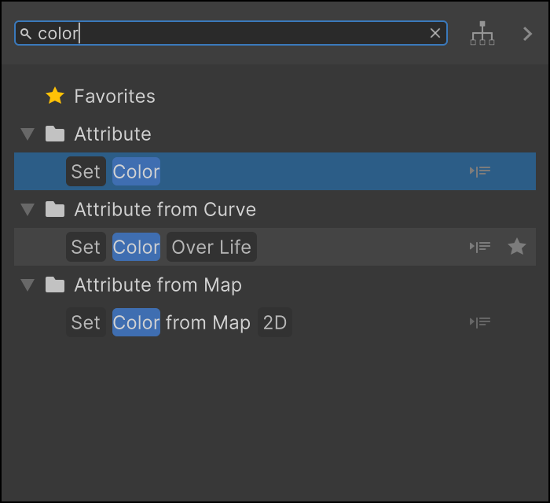
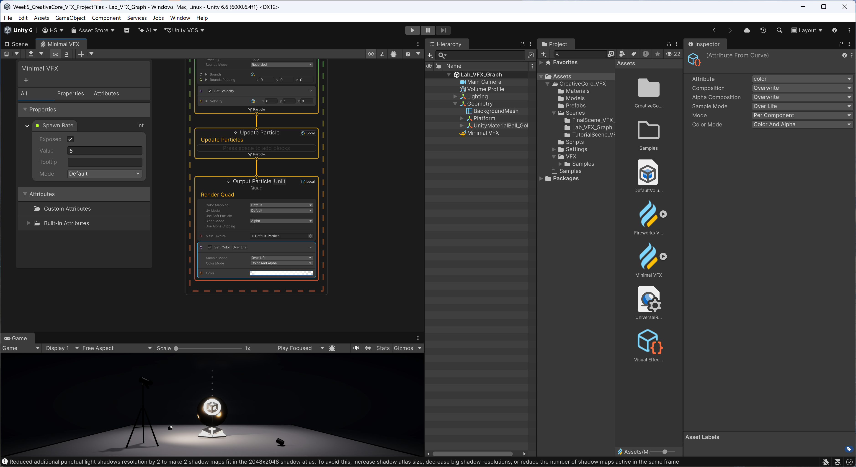
Output Particle: Color Over Life
Add “Color Over Life” block to Output Particle and see how the particles fade away. The reason it’s blending is the “Color Mode” is set to “Color and Alpha”.

Slide 30
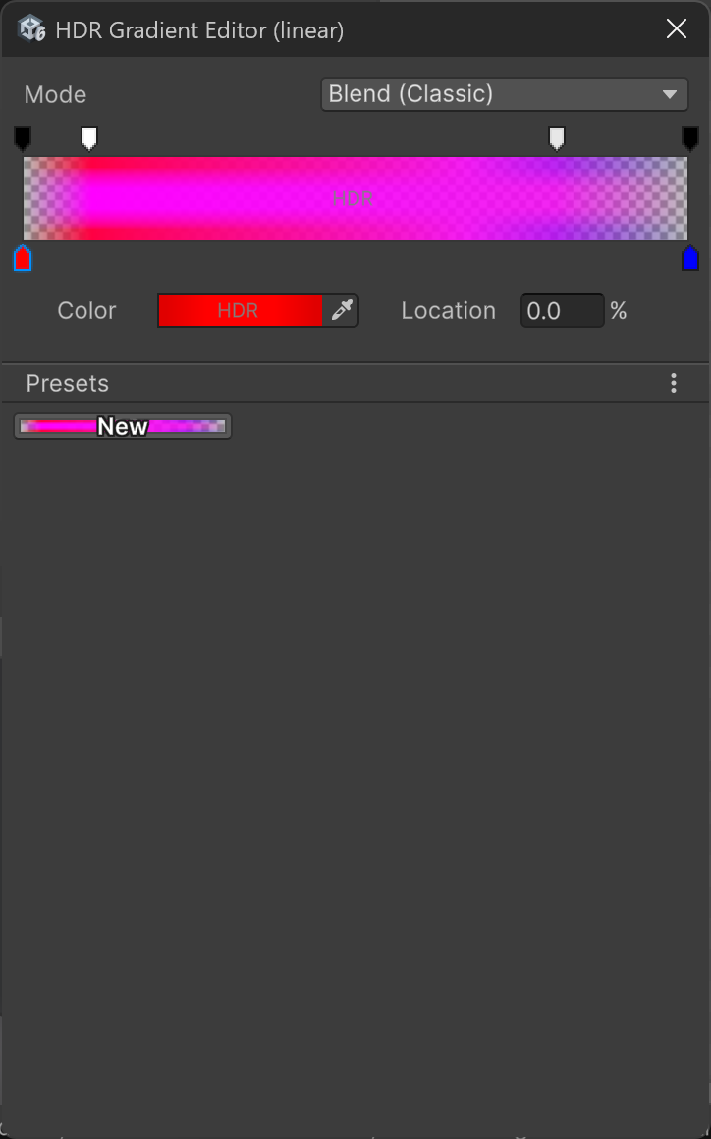
Change the Color and Intensity
Remember like “Particles”, the bottom arrows are color and top arrows are alpha!

Slide 31
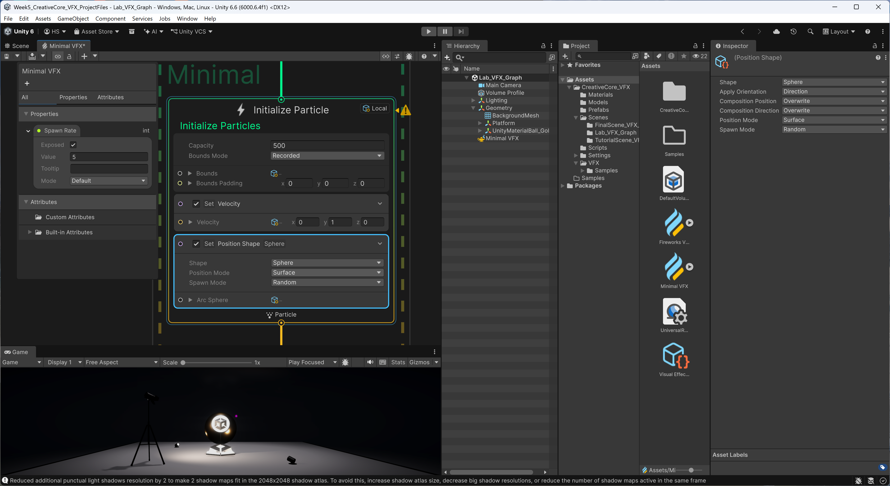
Initialize Particle: Set Position Shape Sphere
Add “Set position Shape sphere ” block to “Initialize Particle”

Slide 32
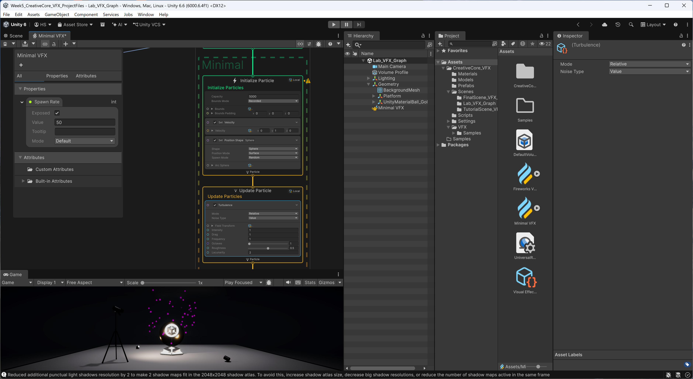
Update Particle: Turbulence
Add “Turbulence” force to “Update Particle”.
Change some attributes values. For example, change the intensity to 2, change the drag to 5.

Slide 33
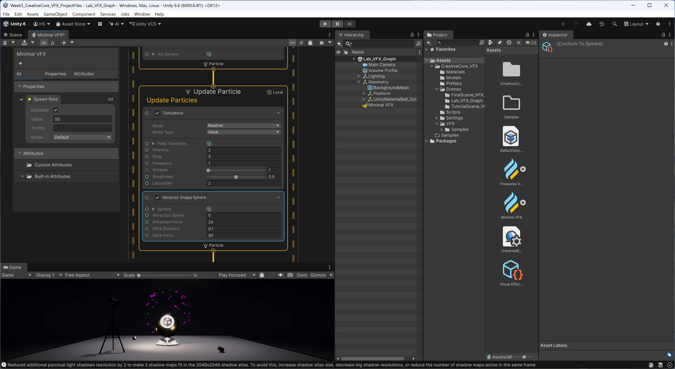
Update Particle: Attractor Shape Sphere
Add “Attractor Shape Sphere” to make sure that particles stay in the sphere shape.

Slide 34
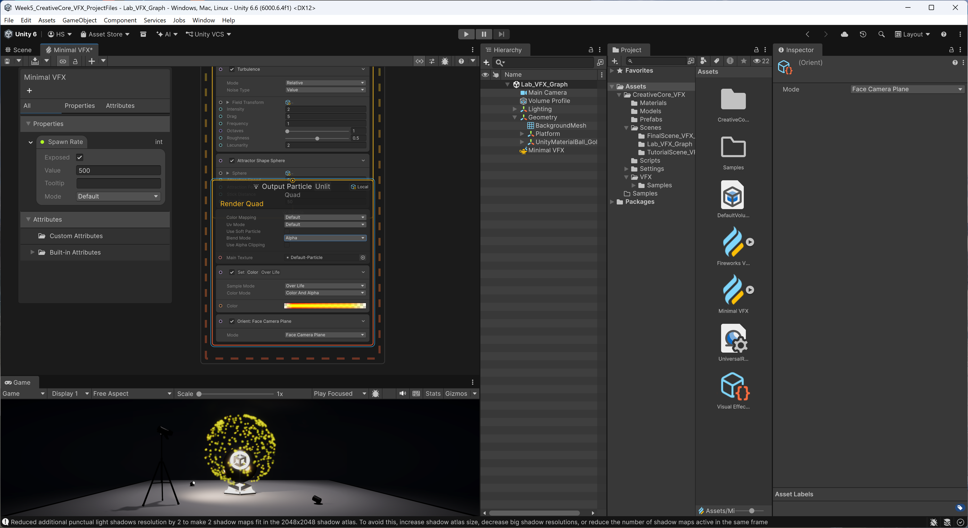
Output Particle: Orient Face Camera Plane
Make sure that the particle always face the camera!

