Slide 1
Week 7
Game Engine Development Unity
User Interface
Hooman Salamat

Slide 2
Objective & Concept
Objective
Types of input devices
Interfacing with a HID
Types of input
Types of output
Game engine HID systems
Concepts
A user interface (UI) is what allows a user to interact with a program and a UI designer is responsible for making those interactions as clear and enjoyable as possible. In this lecture, you’ll learn a bit more about what UI design is and the tools available in Unity to help you create UIs. Then, you’ll open your project and begin customizing your scene.
Define "UI" and the role of user interfaces in real-time 3D experiences.
Distinguish between Unity's three available UI systems: uGUI (or Unity UI), IMGUI (or “Immediate Mode” GUI), and UI Toolkit.

Slide 3
HID
A human interface device or HID is a type of computer device usually used by humans that takes input from humans and gives output to humans.
The term "HID" most commonly refers to the USB-HID specification.
The term was coined by Mike Van Flandern of Microsoft when he proposed that the USB committee create a Human Input Device class working group
The working group was renamed as the Human Interface Device class at the suggestion of Tom Schmidt of DEC because the proposed standard supported bi-directional communication.
Notes:
https://en.wikipedia.org/wiki/Human_interface_device

Slide 4
Types of HIDs
Consoles typically come with a Joypad device
Computers often use the keyboard and mouse
Arcade games have very specialized input
Many specialized devices
  Guitar Hero
  Dance Dance Revolution
Modifiers on existing devices
  Steering wheel for WiiMote
Nintendo Switch’s hybrid console
  Can be used as either a home console or portable device
Azure Kinect
  The new iteration of Kinect technology designed primarily for enterprise software and artificial intelligence usage. It is designed around the Microsoft Azure cloud platform, and is meant to "leverage the richness of Azure AI to dramatically improve insights and operations
Notes:
https://en.wikipedia.org/wiki/Nintendo_Switch
https://en.wikipedia.org/wiki/Xbox_One
https://en.wikipedia.org/wiki/Kinect#Azure_Kinect_(2019)
https://en.wikipedia.org/wiki/HoloLens_2

Slide 5
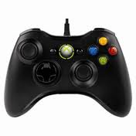
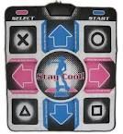

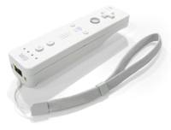
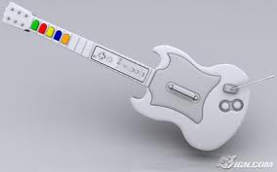
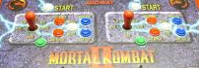


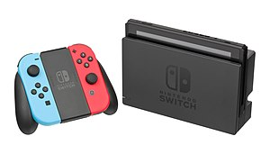

Types of HIDs
Notes:
Standard joypads for the Xbox 360 and PlayStation 3 consoles.
Wii Remote for the Nintendo Wii.
DualShock 4 joypad for the PlayStation 4
The Wii U controller by Nintendo
guitar and drum devices are available for the Guitar Hero series of games
steering wheels for driving games: Mario Kart Wii comes with a plastic steering wheel adapter into which the Wiimote can be inserted
Buttons and joysticks for the arcade game Mortal Kombat II by Midway.
and games like Dance Dance Revolution use a special dance pad device.

Slide 6
Interfacing to a HID
Depends on the device
Polling – reading the state once per iteration
  Hardware register
  Memory mapped I/O port
  Using a higher level function
XInput on the XBox 360 is a good example
  Call XInputGetState() which returns a XINPUT_STATE struct

Slide 7
Interfacing
Interrupts
  Triggered by a state change in the hardware
  Temporarily interrupts the CPU to run a small piece of code
    Interrupt Service Routine (ISR)
  ISRs typically just read the change and store the data
Wireless
  Many of the wireless controllers use Bluetooth to communicate
  Software requests HID state
  Usually handled by a separate thread
  Looks like polling to the application developer

Slide 8
Type of input
Almost every HID has at least a few digital buttons Digital Buttons
  Have two states
  Pressed represented by a 1
  Not pressed represented as a 0
  Depends on the hardware developer
Electrical engineers speak of a circuit containing a switch as being closed(meaning electricity is flowing through the circuit) or open (no electricity is flowing)
Often the button state is combine into one struct

Slide 9
wButtons
#define XINPUT_GAMEPAD_DPAD_UP 0x0001 // bit 0
#define XINPUT_GAMEPAD_DPAD_DOWN 0x0002 // bit 1
#define XINPUT_GAMEPAD_DPAD_LEFT 0x0004 // bit 2
#define XINPUT_GAMEPAD_DPAD_RIGHT 0x0008 // bit 3
#define XINPUT_GAMEPAD_START 0x0010 // bit 4
#define XINPUT_GAMEPAD_BACK 0x0020 // bit 5
#define XINPUT_GAMEPAD_LEFT_THUMB 0x0040 // bit 6
#define XINPUT_GAMEPAD_RIGHT_THUMB 0x0080 // bit 7
#define XINPUT_GAMEPAD_LEFT_SHOULDER 0x0100 // bit 8
#define XINPUT_GAMEPAD_RIGHT_SHOULDER 0x0200 // bit 9
#define XINPUT_GAMEPAD_A 0x1000 // bit 12
#define XINPUT_GAMEPAD_B 0x2000 // bit 13
#define XINPUT_GAMEPAD_X 0x4000 // bit 14
#define XINPUT_GAMEPAD_Y 0x8000 // bit 15
Notes:
It is quite common for the states of all of the buttons on a device to be packed into a single unsigned integer value
a 16-bit unsigned integer (WORD) variable named wButtons that holds the state of all buttons.

Slide 10
Xinput_gamepad
typedef struct _XINPUT_GAMEPAD {
WORD wButtons;
BYTE bLeftTrigger;
BYTE bRightTrigger;
SHORT sThumbLX
SHORT sThumbLY
SHORT sThumbRX
SHORT sThumbRY
}
xButtons contains the state of all the buttons and you apply masks to get their current state
bool IsButtonADown(const XINPUT_GAMEPAD& pad)
{
// Mask off all bits but bit 12 (the A button).
return ((pad.wButtons & XINPUT_GAMEPAD_A) != 0);
}
Notes:
An individual button’s state can be read by masking the wButtons word
with the appropriate bitmask via C/C++’s bitwise AND operator (&) and then
checking if the result is nonzero

Slide 11
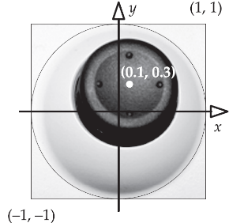
Analog axes and buttons
An analog input is one that can take on a range of values (rather than just 0 or 1).
Unlike buttons, joysticks have a range of values
Analog inputs are sometimes called analog axes, or just axes
They aren’t truly analog because they are digitized
  Range from -32,768 to +32,767
  or -1 to +1
Notes:
Two analog inputs can be used to represent the x and y deflection of a joystick.

Slide 12
_XINPUT_GAMEPAD
XINPUT_GAMEPAD: Microsoft represents the deflections of the left and right thumb sticks on the Xbox 360 gamepad using 16-bit signed integers (sThumbLX and sThumbLY for the left stick and sThumbRX and sThumbRY for the right).
these values range from -32,768 (left or down) to 32,767 (right or up).
To represent the positions of the left and right shoulder triggers, Microsoft chose to use eight-bit unsigned integers (bLeftTrigger and bRightTrigger, respectively).
These input values range from 0 (not pressed) to 255 (fully pressed).
Different game machines use different digital representions for their analog axes.
typedef struct _XINPUT_GAMEPAD
{
WORD wButtons;
// 8-bit unsigned
BYTE bLeftTrigger;
BYTE bRightTrigger;
// 16-bit signed
SHORT sThumbLX;
SHORT sThumbLY;
SHORT sThumbRX;
SHORT sThumbRY;
} XINPUT_GAMEPAD;

Slide 13
Relative axes
Most of the time the position of the trigger, joystick, or thumb stick is absolute – relative to a 0,0 point
Some input devices provide information in a relative format
  They return 0 if the device has not moved from its past position
Examples include mice, mice wheels, and track balls

Slide 14
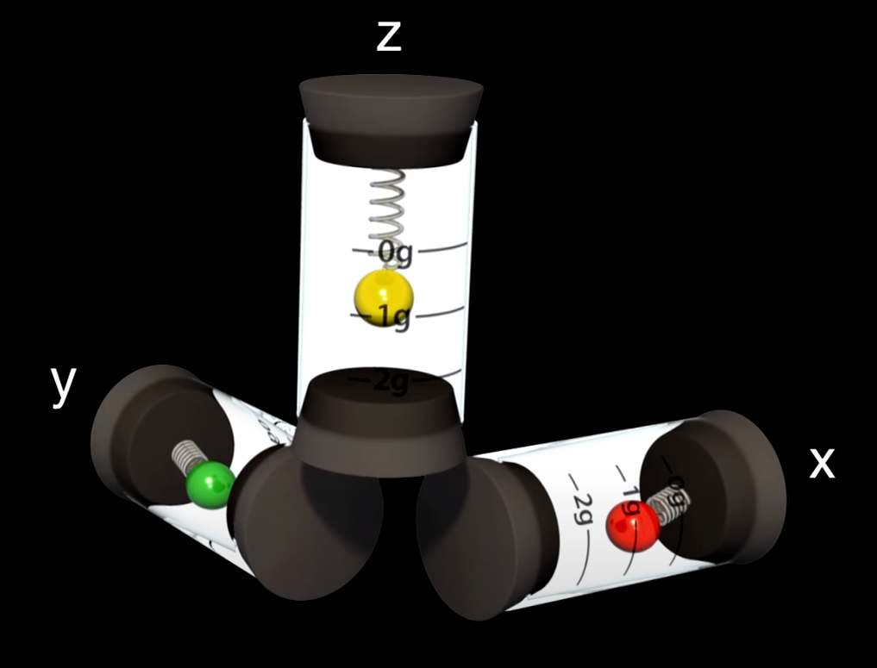
Accelerometers
Newer controllers have accelerometers built in
These provide information about g-force in three directions (1 g ~ 9.8 m/s2).
These are relative analog inputs, much like a mouse’s two-dimensional axes.
When the controller is not accelerating these inputs are zero.
When the controller is accelerating, they measure the acceleration up to 3 g along each axis, quantized into three signed eight-bit integers, one for each of x, y and z.
Notes:
https://www.youtube.com/watch?v=tNIDPXqZHCY
https://www.youtube.com/watch?v=i2U49usFo10
https://www.youtube.com/watch?v=KZVgKu6v808
https://en.wikipedia.org/wiki/Accelerometer

Slide 15
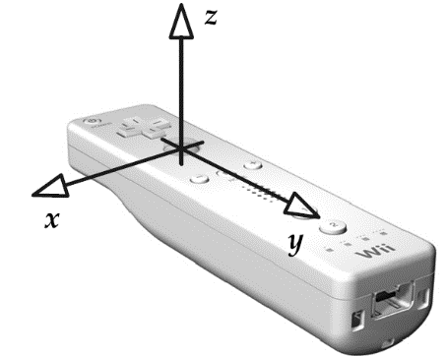
WiiMote and DualShock
One issue is that the accelerometers don’t give you orientation information
One way to do it is to remember that gravity has 1g of force in the downward direction
If the player is holding the device, is not holding still, the accelerometer inputs will include this acceleration in their values, invalidating our math.
The z-axis of the accelerometer has been calibrated to account for gravity, but the other two axes have not!
you can calibrate the device based on which axis is experiencing 1g of force
Notes:
A trio of accelerometers can be used to detect the orientation of the Wiimote
or DualShock joypad, because of the fact that we are playing these games on
the surface of the Earth where there is a constant downward acceleration due
to gravity of 1 g ( 9.8 m/s2). If the controller is held perfectly level, with the
IR sensor pointing toward your TV set, the vertical (z) acceleration should be
approximately -1 g.
Holding the Wiimote at a 45-degree angle should produce roughly sin(45◦) =
cos(45◦) = 0.707 g on both the y and z inputs. Once we’ve calibrated the
accelerometer inputs to find the zero points along each axis, we can calculate
pitch, yaw and roll easily, using inverse sine and cosine operations.

Slide 16
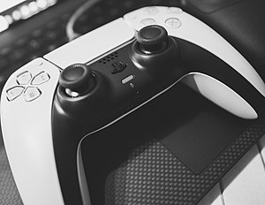
Dual Sense
The DualSense is the PlayStation 5's controller and was unveiled on April 7, 2020.
It is based on the DualShock 4 controller
It incorporates a more ergonomic design that is somewhat bigger and rounder than the DualShock 4

Slide 17
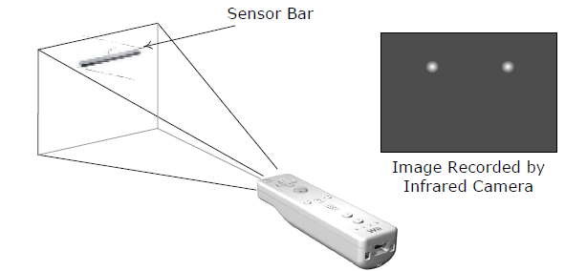
Cameras
The Wii uses a very low resolution IR camera to read the location of the WiiMote
  WiiMote has two IR LEDs
The distance between the two dots, the size of the dots, and the relative position of the dots provides a lot of information about where the mote is pointing
Other examples include the Sony EyeToy and Xbox Kinect

Slide 18
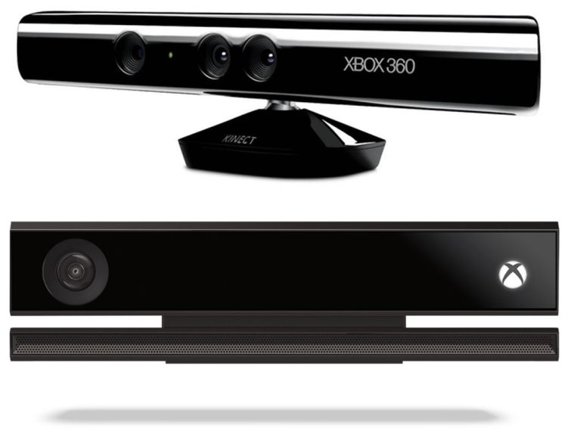
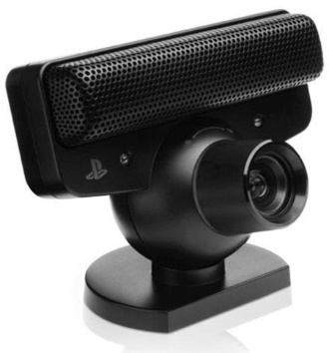
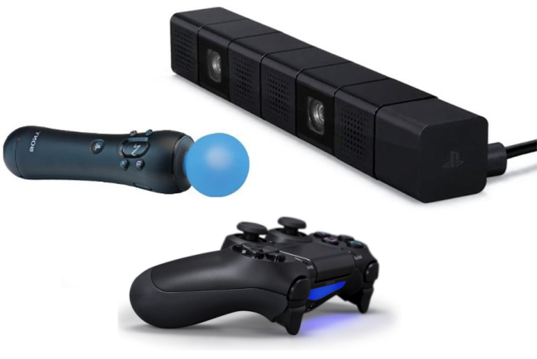
Camera input
Notes:
The left picture: is Sony’s PlayStation Eye for the PS3
With the PlayStation 4, Sony has improved the Eye and re-dubbed it the
PlayStation Camera. When combined with the PlayStation Move controller
or the DualShock 4 controller, the PlayStation can detect gestures
in basically the same way as Microsoft’s Kinect system can
The bottom picture: Sony’s PlayStation Camera, PlayStation Move controller and DualShock 4 joypad for the PS4.
The right picture: The Microsoft Kinect for Xbox 360 (top) and Xbox One

Slide 19
Types of output
Rumble
  Vibrations are usually produced by one or two motors with an unbalanced weight at various speed.
  The game can turn these motors on and off, and control the speed to create different feels
Force feedback
  A motor attached to the HID that resists input from the user
  In arcade driving games, where the steering wheel resists the player’s attempt to turn it
  The Sixaxis was succeeded by the DualShock 3, an updated version of the controller that, like the DualShock and DualShock 2 controllers, incorporates haptic technology – also known as force feedback
Audio
  WiiMote has has low-quality speaker
  DualShock 4, Xbox 360 and Xbox One controllers have headphone jack
Others
  Some have LEDs that can be controlled via software
Notes:
Human interface devices are primarily used to transmit inputs from the player
to the game software. However, some HIDs can also provide feedback to the
human player via various kinds of outputs.
Game pads like the PlayStation’s DualShock line of controllers and the Xbox
and Xbox 360 controllers have a rumble feature. This allows the controller to
vibrate in the player’s hands, simulating the turbulence or impacts that the
character in the game world might be experiencing.
https://en.wikipedia.org/wiki/Sixaxis
The six degrees of freedom: forward/back, up/down, left/right, yaw, pitch, rol

Slide 20
Game Engine HID Systems
Most game engines don’t use “raw” HID inputs directly
Most engines introduce at least one additional level of indirection between the HID and the game in order to abstract HID inputs in various ways
Most game engine massage the data coming in from the controllers
For example, a button-mapping table might be used to translate raw button inputs into logical game actions, so that human players can reassign the buttons’ functions as they see fit.

Slide 21
Typical requirements
Dead zones
Analog signal filtering
Event detection
Detection of sequences and chords
Gesture detection
Management of multiple HIDs
Multiplatform HID support
Controller input re-mapping
Context sensitive inputs
The ability to disable certain inputs

Slide 22
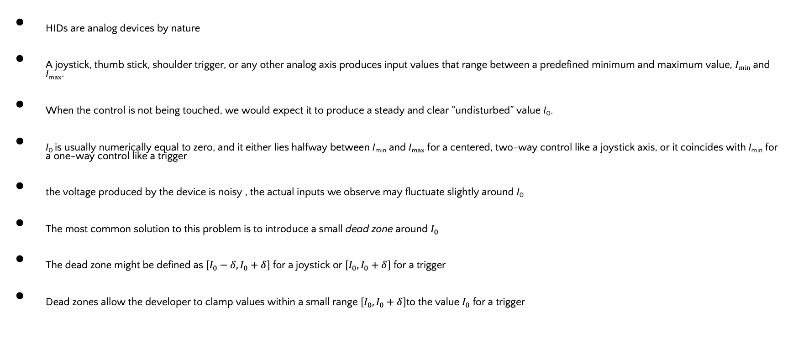
Dead zones
HIDs are analog devices by nature
A joystick, thumb stick, shoulder trigger, or any other analog axis produces input values that range between a predefined minimum and maximum value, $Imin⁡$ and I_{max}.
When the control is not being touched, we would expect it to produce a steady and clear “undisturbed” value I₀.
I₀ is usually numerically equal to zero, and it either lies halfway between I_{min} and I_{max} for a centered, two-way control like a joystick axis, or it coincides with I_{min} for a one-way control like a trigger
the voltage produced by the device is noisy , the actual inputs we observe may fluctuate slightly around I₀
The most common solution to this problem is to introduce a small dead zone around $I_{0}$
The dead zone might be defined as $\left[I_{0}−δ,I_{0}+δ\right]$ for a joystick or $\left[I_{0},I_{0}+δ\right]$ for a trigger
Dead zones allow the developer to clamp values within a small range $\left[I_{0},I_{0}+δ\right]$to the value $I_{0}$ for a trigger

Slide 23
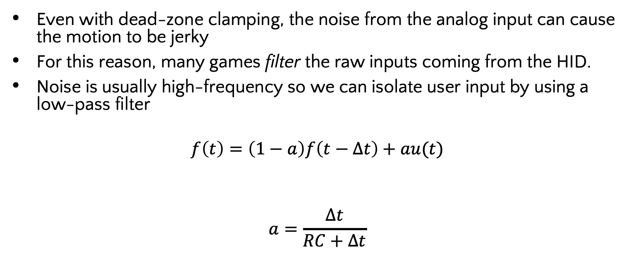
Analog signal filtering
Even with dead-zone clamping, the noise from the analog input can cause the motion to be jerky
For this reason, many games filter the raw inputs coming from the HID.
Noise is usually high-frequency so we can isolate user input by using a low-pass filter
$$f\left(t\right)=\left(1−a\right)f\left(t−Δt\right)+au(t)$$
$$a=\frac{Δt}{RC+Δt}$$
filtered
unfiltered
Notes:
A discrete first-order low-pass filter can be implemented by combining the
current unfiltered input value with last frame’s filtered input. If we denote
the sequence of unfiltered inputs by the time-varying function u(t) and the
filtered inputs by f (t), where t denotes time
where the parameter a is determined by the frame duration Δt and a filtering
constant RC (which is just the product of the resistance and the capacitance in
a traditional analog RC low-pass filter circuit):

Slide 24
Low-pass filter
F32 lowPassFilter(F32 unfilteredInput,
F32 lastFramesFilteredInput,
F32 rc, F32 dt)
{
F32 a= dt / (rc +dt);
return (1-a) * lastFramesFilteredInput
+ a * unfilteredInput;
}

Slide 25
Moving average
An equally interesting way of filtering the data is to use a moving average
This can be done using a circular queue that maintains the last n values
You can also keep the running sum by adding the new value and subtracting the one it is replacing in the queue
template< typename TYPE, int SIZE >
class MovingAverage
{
TYPE m_samples[SIZE];
TYPE m_sum;
U32 m_curSample;
U32 m_sampleCount;
public:
MovingAverage() :
m_sum(static_cast<TYPE>(0)),
m_curSample(0),
m_sampleCount(0)
{
}
void addSample(TYPE data)
{
if (m_sampleCount == SIZE)
{
m_sum -= m_samples[m_curSample];
}
else
{
m_sampleCount++;
}
m_samples[m_curSample] = data;
m_sum += data;
m_curSample++;
if (m_curSample >= SIZE)
{
m_curSample = 0;
}
}
F32 getCurrentAverage() const
{
if (m_sampleCount != 0)
{
return static_cast<F32>(m_sum)
/ static_cast<F32>(m_sampleCount);
}
return 0.0f;
}
};
Notes:
For example, if we want to average the input data over a 3/30 second (3
frame) interval, we simply store the raw input values in a 3-element circular buffer.
The filtered input value is then the sum of the values in this array at
any moment, divided by 3. There are a few minor details to account for when
implementing such a filter. For example, we need to properly handle the first
two frames of input, during which the 3-element array has not yet been filled
with valid data. However, the implementation is not particularly complicated.
The code above shows one way to properly implement an N-element moving
average.

Slide 26
Input event detection
The easiest way to detect a change to states is to keep the previous state and XOR it with the current state
  XOR produces a 1 when the state has changed
In m_buttonDowns and m_buttonUps , the bit corresponding to each button will be 0 if the event has not occurred in this frame and 1 if it has.
We can then mask out the up events and the down events by using AND
  ANDing the original state with the changed state gives us the DOWNs
  NANDing gives us the UPs
class ButtonState
{
U32 m_buttonStates; // current frame's button states
U32 m_prevButtonStates; // previous frame's states
U32 m_buttonDowns; // 1 = button pressed this frame
U32 m_buttonUps; // 1 = button released this frame
void DetectButtonUpDownEvents()
{
// Assuming that m_buttonStates and
// m_prevButtonStates are valid, generate
// m_buttonDowns and m_buttonUps.
// First determine which bits have changed via XOR.
U32 buttonChanges = m_buttonStates ^ m_prevButtonStates;
// Now use AND to mask off only the bits that are DOWN.
m_buttonDowns = buttonChanges & m_buttonStates;
// Use AND-NOT to mask off only the bits that are UP.
m_buttonUps = buttonChanges & (~m_buttonStates);
}
// ...
};
Notes:
The exclusive OR (XOR) operator produces a 0 if its two inputs are identical
and a 1 if they differ. So if we apply the XOR operator to the previous and
current button state words, we’ll get 1’s only for buttons whose states have
changed between the last frame and this frame.
To determine whether the
event is a button-up or a button-down, we need to look at the current state of
each button. Any button whose state has changed that is currently down generates
a button-down event, and vice versa for button-up events.

Slide 27
Chords
Chords are combinations of button presses
  A+B at the same time
Easy to create masks for chords, but there are some subtle issues
  Users aren’t perfect in the timing of the presses
  The code must be robust to not triggering the non-chord events too
Lots of ways to resolve these
  Design button inputs so the chord does the individual actions plus something else
  Introduce a delay in processing individual inputs so a chord can form
  Wait for button release to start an event
  Start a single button move right away and override it with a chord move

Slide 28
Sequences and gestures
The idea of introducing a delay between when a button actually goes down and when it really “counts” as down is a special case of gesture detection.
A gesture is a sequence of actions performed via a HID by the human player over a period of time.
Sequences are usually done by storing the input events and tagging them with time
When the next button is pressed, determine if the time for the sequence has expired or if the sequence is invalid
Can be used for
  Rapid button tapping
  Button sequences
  Thumb stick rotations

Slide 29
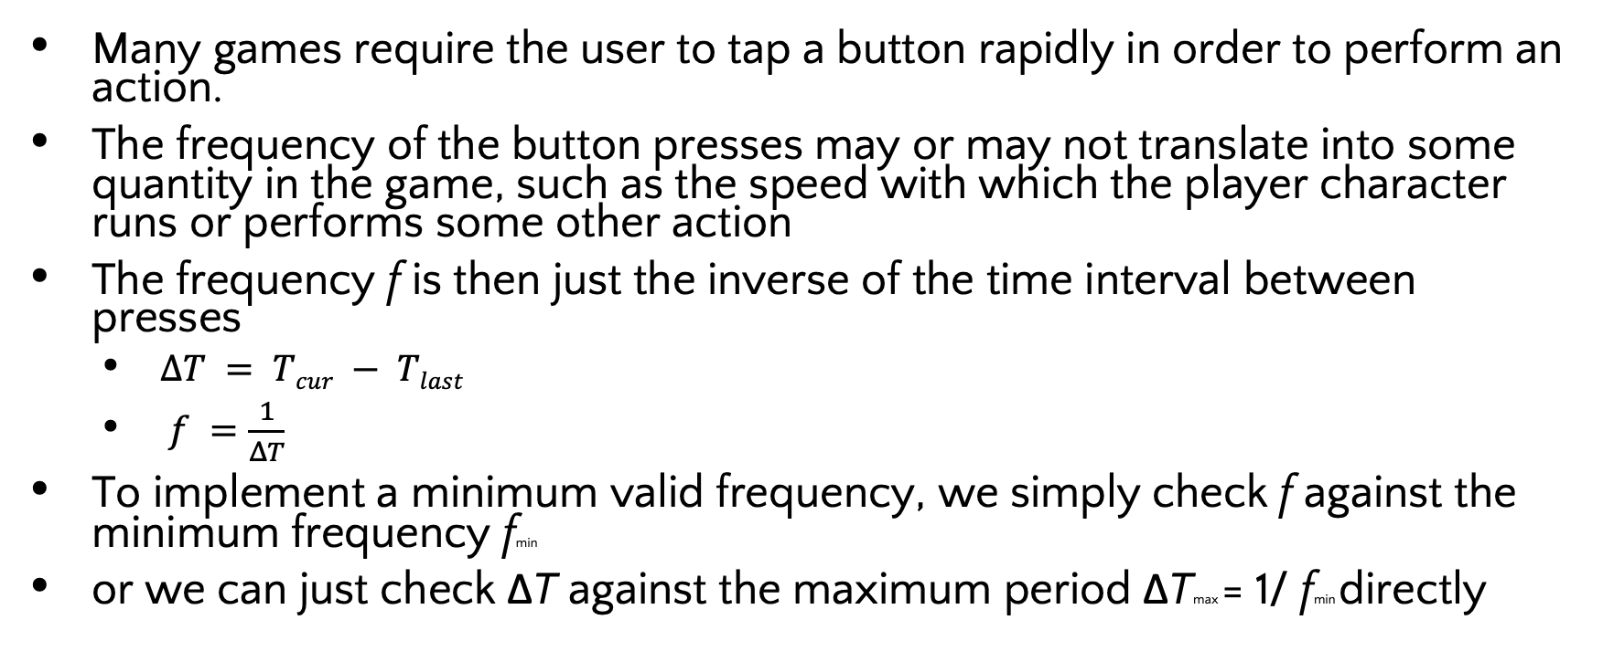
Rapid Button Tapping
Many games require the user to tap a button rapidly in order to perform an action.
The frequency of the button presses may or may not translate into some quantity in the game, such as the speed with which the player character runs or performs some other action
The frequency f is then just the inverse of the time interval between presses
  $ΔT = Tcur − Tlast$
  $f =\frac{1}{ΔT}$
To implement a minimum valid frequency, we simply check f against the minimum frequency fmin
or we can just check ΔT against the maximum period ΔTmax = 1/ fmin directly
Notes:
If this threshold (mi frequency) is satisfied, we update the value of Tlast, and the gesture is considered
to be on-going. If the threshold is not satisfied, we simply don’t update
Tlast. The gesture will be considered invalid until a new pair of rapid-enough
button-down events occurs.

Slide 30
ButtonTapDetector
class ButtonTapDetector
{
U32 m_buttonMask; // which button to observe (bit mask)
F32 m_dtMax; // max allowed time between presses
F32 m_tLast; // last button-down event, in seconds
public:
// Construct an object that detects rapid tapping of
// the given button (identified by an index).
ButtonTapDetector(U32 buttonId, F32 dtMax) :
m_buttonMask(1U << buttonId),
m_dtMax(dtMax),
m_tLast(CurrentTime() - dtMax) // start out invalid
{
}
// Call this at any time to query whether or not
// the gesture is currently being performed.
bool IsGestureValid() const
{
F32 t = CurrentTime();
F32 dt = t - m_tLast;
return (dt < m_dtMax);
}
// Call this once per frame.
void Update()
{
if (ButtonsJustWentDown(m_buttonMask))
{
m_tLast = CurrentTime();
}
}
};
Notes:
we assume that each button is identified by a
unique id. The id is really just an index, ranging from 0 to N - 1 (where N is
the number of buttons on the HID in question). We convert the button id to a
bitmask by shifting an unsigned 1 bit to the left by an amount equaling the button’s
index (1U << buttonId). The function ButtonsJustWentDown()
returns a nonzero value if any one of the buttons specified by the given bitmask
just went down this frame. Here, we’re only checking for a single button-down
event, but we can and will use this same function later to check for multiple
simultaneous button-down events.

Slide 31
Multibutton Sequence
class ButtonSequenceDetector
{
U32* m_aButtonIds; // sequence of buttons to watch for
U32 m_buttonCount; // number of buttons in sequence
F32 m_dtMax; // max time for entire sequence
U32 m_iButton; // next button to watch for in seq.
F32 m_tStart; // start time of sequence, in seconds
public:
// Construct an object that detects the given button
// sequence. When the sequence is successfully
// detected, the given event is broadcast so that the
// rest of the game can respond in an appropriate way.
ButtonSequenceDetector(U32* aButtonIds,
U32 buttonCount,
F32 dtMax,
EventId eventIdToSend) :
m_aButtonIds(aButtonIds),
m_buttonCount(buttonCount),
m_dtMax(dtMax),
m_eventId(eventIdToSend), // event to send when complete
m_iButton(0), // start of sequence
m_tStart(0) // initial value
// irrelevant
{
}
// Call this once per frame.
void Update()
{
ASSERT(m_iButton < m_buttonCount);
// Determine which button we're expecting next, as
// a bitmask (shift a 1 up to the correct bit index).
U32 buttonMask = (1U << m_aButtonId[m_iButton]);
// If any button OTHER than the expected button just went down, invalidate the sequence. (Use the bitwise NOT operator to check for all other buttons.)
if (ButtonsJustWentDown(~buttonMask))
{
m_iButton = 0; // reset
}
// Otherwise, if the expected button just went
// down, check dt and update our state appropriately.
else if (ButtonsJustWentDown(buttonMask))
{
if (m_iButton == 0)
{
// This is the first button in the sequence.
m_tStart = CurrentTime();
m_iButton++; // advance to next button
}
else
{
F32 dt = CurrentTime() - m_tStart;
if (dt < m_dtMax)
{
// Sequence is still valid.
m_iButton++; // advance to next button Is the sequence complete?
if (m_iButton == m_buttonCount)
{
BroadcastEvent(m_eventId);
m_iButton = 0; // reset
}
}
else
{
// Sorry, not fast enough.
m_iButton = 0; // reset
}}}}};
Notes:
The logic goes like this: Whenever we see a button-down event that matches
the button we’re currently looking for, we check its time stamp against the
start time of the entire sequence, Tstart. If it occurred within the valid time
window, we advance the current button to the next button in the sequence; for
the first button in the sequence only (i = 0), we also update Tstart. If we see
a button-down event that doesn’t match the next button in the sequence, or
if the time delta has grown too large, we reset the button index i back to the
beginning of the sequence and set Tstart to some invalid value (such as 0).

Slide 32
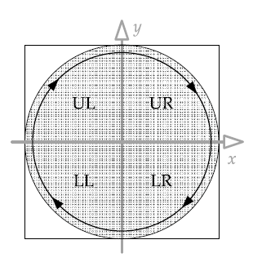
Thumb Stick Rotation
How to detect when the player is rotating the left thumb stick in a clockwise circle.
Divide the two-dimensional range of possible stick positions into quadrants
In a clockwise rotation, the stick passes through the upper-left quadrant, then the upper-right, then the lower-right and finally the lower-left.
We can treat each of these cases like a button press and detect a full rotation with a slightly modified version of the sequence detection code

Slide 33
Multiple HIDs
This just involves mapping the correct input to the correct player
Also involves detecting HID changes due to serious events
  Controller unplugged
  Batteries dying
  Player being assaulted

Slide 34
Cross platform HIDs
Two main ways to handle this
  Conditional compilations – YUCK messy code
  #if TARGET_XBOX360
  if (ButtonsJustWentDown(XB360_BUTTONMASK_A))
  #elif TARGET_PS3
  if (ButtonsJustWentDown(PS3_BUTTONMASK_TRIANGLE))
  #elif TARGET_WII
  if (ButtonsJustWentDown(WII_BUTTONMASK_A))
  #endif
  {
  // do something...
  }
Hardware abstraction layer
  Create your own input classes and add a translation layer
  Certainly superior because it is easy to add new HIDs

Slide 35
Hardware abstraction layer
enum AbstractControlIndex
{
// Start and back buttons
AINDEX_START, // Xbox 360 Start, PS3 Start
AINDEX_BACK_SELECT, // Xbox 360 Back, PS3 Select
// Left D-pad
AINDEX_LPAD_DOWN,
AINDEX_LPAD_UP,
AINDEX_LPAD_LEFT,
AINDEX_LPAD_RIGHT,
// Right "pad" of four buttons
AINDEX_RPAD_DOWN, // Xbox 360 A, PS3 X
AINDEX_RPAD_UP, // Xbox 360 Y, PS3 Triangle
AINDEX_RPAD_LEFT, // Xbox 360 X, PS3 Square
AINDEX_RPAD_RIGHT, // Xbox 360 B, PS3 Circle
// Left and right thumb stick buttons
AINDEX_LSTICK_BUTTON, // Xbox 360 LThumb, PS3 L3, Xbox white
AINDEX_RSTICK_BUTTON, // Xbox 360 RThumb, PS3 R3, Xbox black
// Left and right shoulder buttons
AINDEX_LSHOULDER, // Xbox 360 L shoulder, PS3 L1
AINDEX_RSHOULDER, // Xbox 360 R shoulder, PS3 R1
// Left thumb stick axes
AINDEX_LSTICK_X,
AINDEX_LSTICK_Y,
// Right thumb stick axes
AINDEX_RSTICK_X,
AINDEX_RSTICK_Y,
// Left and right trigger axes
AINDEX_LTRIGGER, // Xbox 360 -Z, PS3 L2
AINDEX_RTRIGGER, // Xbox 360 +Z, PS3 R2
};
Notes:
In performing the mapping between physical and abstract controls, we’ll
sometimes need to get a bit clever. For example, on the Xbox, the left and right
triggers act as a single axis, producing negative values when the left trigger is
pressed, zero when neither is trigger is pressed, and positive values when the
right trigger is pressed. To match the behavior of the PlayStation’s DualShock
controller, we might want to separate this axis into two distinct axes on the
Xbox, scaling the values appropriately so the range of valid values is the same
on all platforms.

Slide 36
Input re-mapping
We can provide a very nice feature by adding in a few classes that create a level of indirection – input remapping
If we give names to events that have nothing to do with the input that triggers it, then we simple create an input to event lookup table
Requires us to normalize the input a bit
  Think about keyboard versus mouse for aircraft control
Notes:
A common option is the sense of the vertical axis of the right thumb stick for camera control in a console
game. Some folks like to push forward on the stick to angle the camera up, while others like an inverted control scheme, where pulling back on the
stick angles the camera up (much like an airplane control stick). Other games
allow the player to select between two or more predefined button mappings.
Some PC games allow the user full control over the functions of individual
keys on the keyboard, the mouse buttons and the mouse wheel, plus a choice
between various control schemes for the two mouse axes.

Slide 37
Input values
Different controls produce different kinds of inputs.
Analog axes may produce values ranging from -32,768 to 32,767, or from 0 to 255, or some other range
A reasonable set of classes for a standard console joypad and their normalized input values:
  Digital buttons. States are packed into a 32-bit word, one bit per button.
  Unidirectional absolute axes (e.g., triggers, analog buttons). Produce floating-point input values in the range [0, 1].
  Bidirectional absolute axes (e.g., joy sticks). Produce floating-point input values in the range [-1, 1].
  Relative axes (e.g., mouse axes, wheels, track balls). Produce floating-point input values in the range [-1, 1], where 1 represents the maximum relative offset possible within a single game frame (i.e., during a period of 1/30 or 1/60 of a second).

Slide 38
Context sensitive controls
Often the controls will trigger different events based on the situation
  The “use” button is a classic case
One way to implement this is to use a state machine
  In state “walking” L1 means fire primary weapon
  In state “driving” L1 means turbo
When mixed with user re-mapping the system can become quite complex

Slide 39
Disabling inputs
One simple, but Draconian approach is to introduce a mask
  When a control is disabled, set the bit to 0
  The mask is then ANDed with the control input before further process
Make sure the bit gets set back to 1 again otherwise you loose control forever
Sometimes you want to disable it for a particular set of actions, but other systems might want to see it...

Slide 40
In practice
It takes a serious amount of time and effort to build an effective HID system.
It is super important because it radically affects game play

Slide 41
Unity HID Support
Human Interface Device (HID) is a specification to describe peripheral user input devices connected to computers via USB or Bluetooth.
HID is commonly used to implement devices such as gamepads, joysticks, or racing wheels.
The Input System directly supports HID (connected via both USB and Bluetooth) on Windows, MacOS, and the Universal Windows Platform (UWP).
The system might support HID on other platforms, but not deliver input through HID-specific APIs.
For example, on Linux, the system supports gamepad and joystick HIDs through SDL, but doesn't support other HIDs.
Notes:
https://docs.unity3d.com/Packages/com.unity.inputsystem@1.8/manual/HID.html

Slide 42
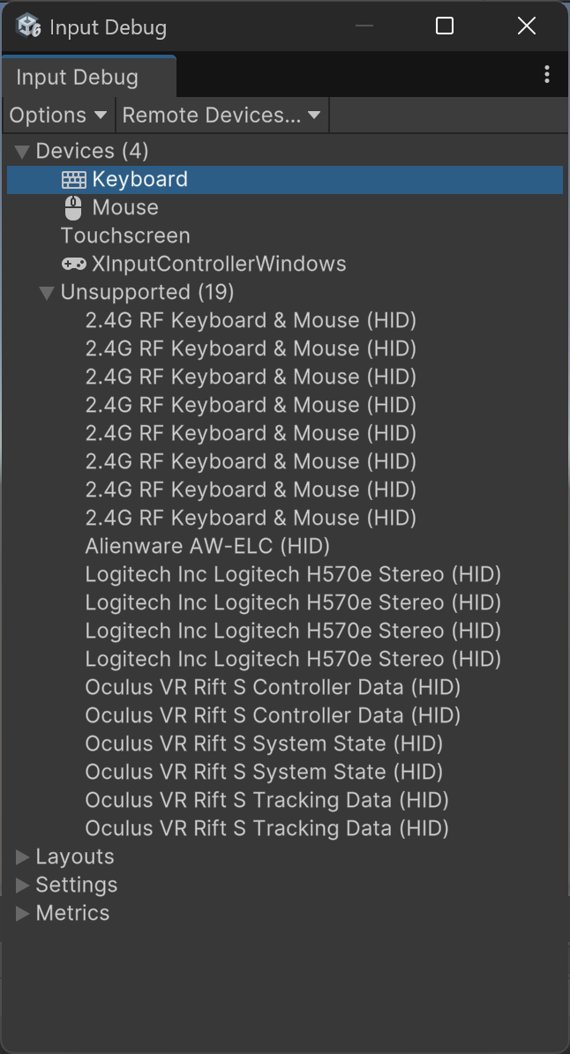
Input Debugger
When something isn't working as expected, the quickest way to troubleshoot what's wrong is the Input Debugger in the Unity Editor.
The Input Debugger provides access to the activity of the Input System in both the Editor and the connected Players.
To open the Input Debugger, go to Window > Analysis > Input Debugger from Unity's main menu.

Slide 43
HID Descriptor
Every HID comes with a device descriptor.
Install the Input System
Window→ Analysis → Input Debugger
Double click on Mouse or Keyboard
Keyboard and Mouse have “Raw Input” interfaces
Regular game control has “XInput” interface
If you have an HID, you’ll see HID as an interface
To browse through the descriptor of an HID from the Input Debugger, click the HID Descriptor button in the device debugger window(HID Descriptor appears if you have an HID interface device!)
To specify the type of the device, the HID descriptor reports entry numbers in the HID usage tables, and a list of all controls on the device, along with their data ranges and usages.
Notes:
The RawInput provides support for specific, user-defined devices that aren't properly handled by Microsoft's XInput API (Application Programming Interface), usually flight sticks and steering wheels.

Slide 44
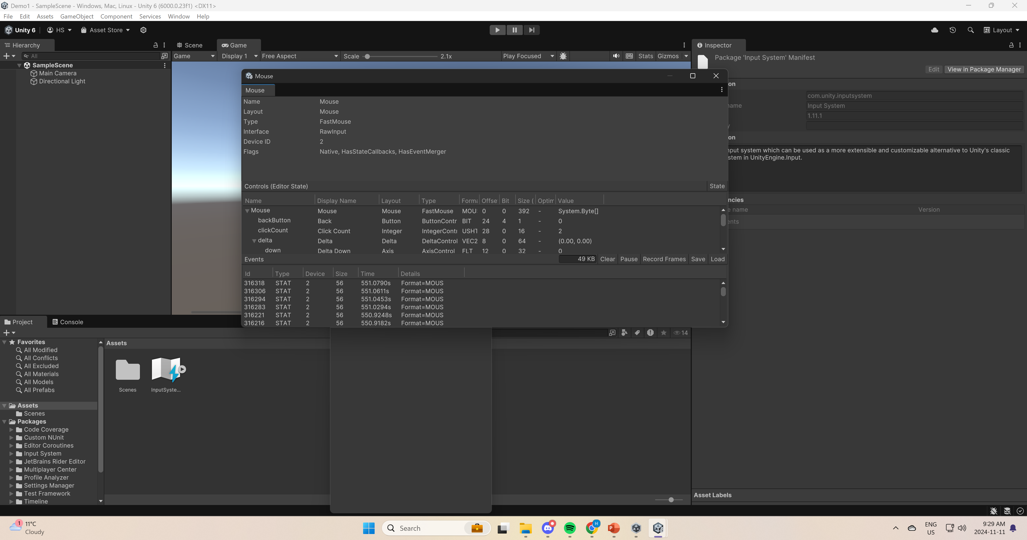
Mouse

Slide 45
Input Debugger
Item | Description
Devices | A list of all Input Devices that are currently in the system, and a list of unsupported/unrecognized Devices.
Layouts | A list of all registered Control and Device layouts. This is the database of supported hardware, and information on how to represent a given piece of input hardware.
Actions | Only visible in Play mode, and only if at least one Action is enabled. A list of all currently enabled Actions, and the Controls they are bound to. See Debugging Actions.
Users | Only visible when one or more InputUser instances exist. See documentation on user management. A list of all currently active users, along with their active Control Schemes and Devices, all their associated Actions, and the Controls these Actions are bound to. Note that PlayerInput uses InputUser to run. When using PlayerInput components, each player has an entry in this list. See Debugging users and PlayerInput.
Settings | The currently active Input System settings.
Metrics | Statistics about Input System resource usage.

Slide 46
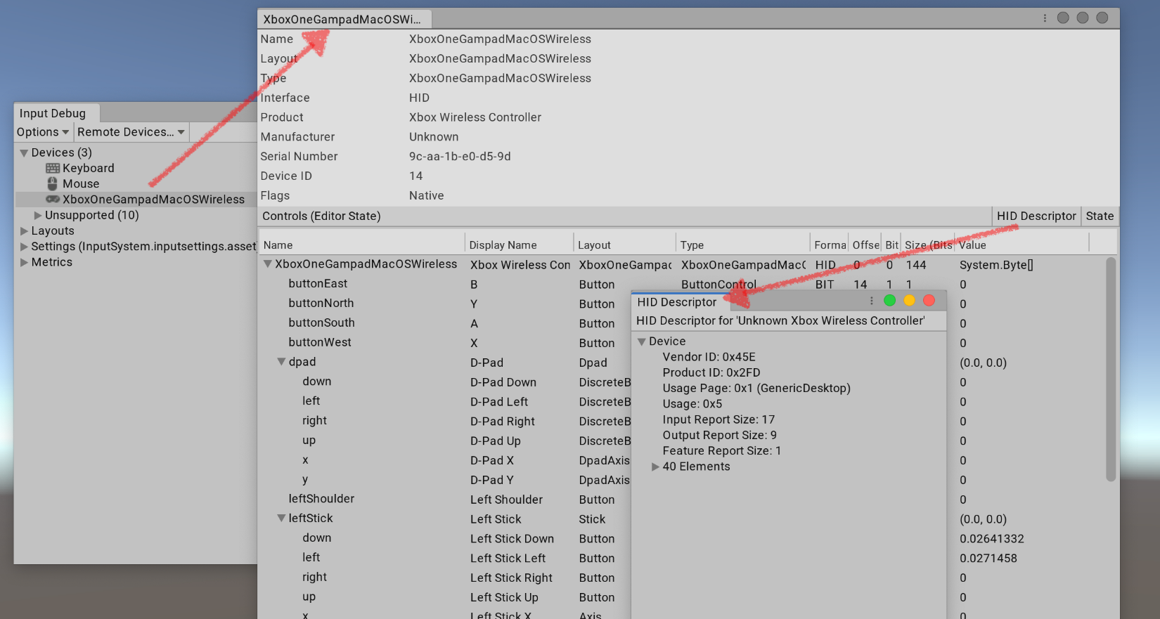
HID Layout
The Input System handles HIDs in one of two ways:
  The system has a known layout for the specific HID.
  If the system does not have a known layout, it auto-generates one for the HID.

Slide 47
Monitoring Devices
To be notified when new Devices are added or existing Devices are removed, use InputSystem.onDeviceChange.
InputSystem.onDeviceChange += (device, change) =>
{
switch (change)
{
case InputDeviceChange.Added:
Debug.Log("New device added: " + device);
break;
case InputDeviceChange.Removed:
Debug.Log("Device removed: " + device);
break;
}
};

Slide 48
HID output
HIDs can support output
  for example, to toggle lights or force feedback motors on a gamepad
Unity controls output by sending HID Output Report commands to a Device.
Output reports use Device-specific data formats.
To use HID Output Reports, call InputDevice.ExecuteCommand to send a command struct with the typeStatic property set as "HIDO" to a Device.
The command struct contains the Device-specific data sent out to the HID.

Slide 49
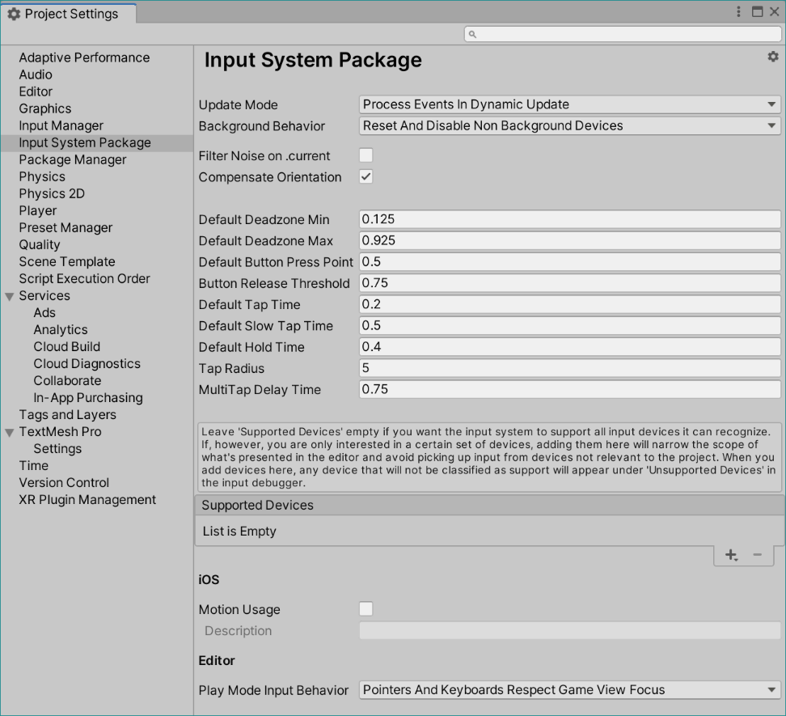
Input Settings
To configure the Input System individually for each project, go to Edit > Project Settings… > Input System Package from Unity's main menu.
The Input System stores input settings in Assets.
If your Project doesn't contain an input settings Asset, click Create settings asset in the Settings window to create one.
If your Project contains multiple settings Assets, use the gear menu in the top-right corner of the window to choose which one to use.
You can also use this menu to create additional settings Assets.

Slide 50
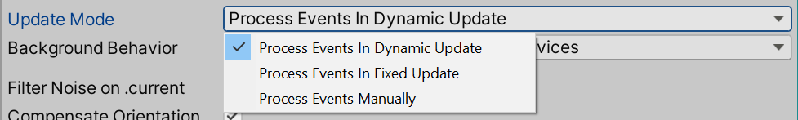
Update Mode
Type | Description
Process Events In Dynamic Update | The Input System processes events at irregular intervals determined by the current framerate.
Process Events In Fixed Update | The Input System processes events at fixed-length intervals. This corresponds to how MonoBehaviour.FixedUpdate operates. The length of each interval is determined by Time.fixedDeltaTime.
Process Events Manually | The Input System does not process events automatically. Instead, it processes them whenever you call InputSystem.Update().

Slide 51
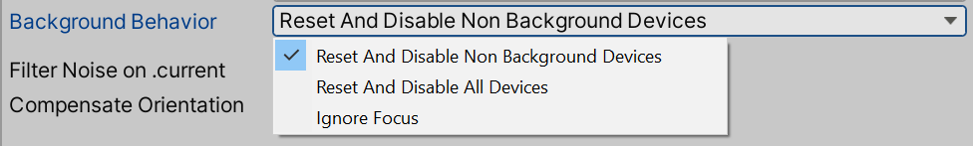
Background Behavior
What happens when focus is lost or gained and how input behaves while the application is not in the foreground.
This setting is only relevant when "Run In Background" is enabled in the Player Settings for the project.
Note that in the editor, "Run In Background" is considered to always be enabled as the player loop will be kept running regardless of whether a Game View is focused or not.
When a Device is reset, Actions bound to Controls on the device will be cancelled. This ensures, for example, that a user-controlled character in your game doesn't continue to move when focus is lost while the user is pressing one of the W, A, S or D keys.

Slide 52
Background Behavior
Setting | Description
Reset And Disable Non Background Devices | When focus is lost, perform a soft reset on all Devices that are not marked as canRunInBackground and also subsequently disable them. Does not affect Devices marked as being able to run in the background. When focus is regained, re-enable any Device that has been disabled and also issue a sync request on these Devices in order to update their current state. If a Device is issued a sync request and does not respond to it, soft-reset the Device. This is the default setting.
Reset And Disable All Devices | When focus is lost, perform a soft reset on all Devices and also subsequently disable them. When focus is regained, re-enable all Devices and also issue a sync request on each Device in order to update it to its current state. If a device does not respond to the sync request, soft-reset it.
Ignore Focus | Do nothing when focus is lost. When focus is regained, issue a sync request on all Devices.

Slide 53
Filter Noise On Current
Whenever there is input on a Device, the system makes the respective Device .current.
For example, if a Gamepad receives new input, Gamepad.current is assigned to that gamepad.
Some Devices have noise in their input, and receive input even if nothing is interacting with them.
If the user is “not” using the Xbox controller/the PS4 controller, they still push themselves to the front continuously and makes themselves current.
This setting is disabled by default, and it's only relevant for apps that use the .current properties (such as Gamepad.current) in the API.

Slide 54
Compensate Orientation
If this setting is enabled, rotation values reported by sensors are rotated around the Z axis as follows:
  Screen orientation Effect on rotation values
  ScreenOrientation.Portrait Values remain unchanged
  ScreenOrientation.PortraitUpsideDown Values rotate by 180 degrees.
  ScreenOrientation.LandscapeLeft Values rotate by 90 degrees.
  ScreenOrientation.LandscapeRight Values rotate by 270 degrees.
This setting affects the following sensors:
  Gyroscope
  GravitySensor
  AttitudeSensor
  Accelerometer
  LinearAccelerationSensor

Slide 55
Default value properties
Default Deadzone Min
  The default minimum value for Stick Deadzone or Axis Deadzone processors when no min value is explicitly set on the processor.
Default Deadzone Max
  The default maximum value for Stick Deadzone or Axis Deadzone processors when no max value is explicitly set on the processor.
Default Button Press Point
  The default press point for Button Controls, and for various Interactions. For button Controls which have analog physics inputs (such as triggers on a gamepad), this configures how far they need to be held down for the system to consider them pressed.
Default Tap Time
  Default duration for Tap and MultiTap Interactions. Also used by by touchscreen Devices to distinguish taps from to new touches.
Default Slow Tap Time
  Default duration for SlowTap Interactions.
Default Hold Time
  Default duration for Hold Interactions.
Tap Radius
  Maximum distance between two finger taps on a touchscreen Device for the system to consider this a tap of the same touch (as opposed to a new touch).
Multi Tap Delay Time
  Default delay between taps for MultiTap Interactions. Also used by touchscreen Devices to count multi-taps (See TouchControl.tapCount).

Slide 56
Supported Devices
A Project usually supports a known set of input methods. For example, a mobile app might support only touch, and a console application might support only gamepads. A cross-platform application might support gamepads, mouse, and keyboard, but might not require XR Device support.
To narrow the options that the Editor UI presents to you, and to avoid creating input Devices and consuming input that your application won't use, you can restrict the set of supported Devices on a per-project basis.
If Supported Devices is empty, no restrictions apply, which means that the Input System adds any Device that Unity recognizes and processes input for it.
However, if Support Devices contains one or more entries, the Input System only adds Devices that are of one of the listed types.

Slide 57
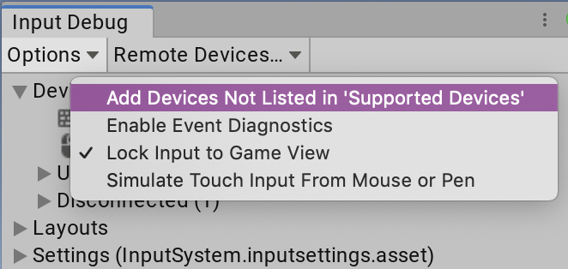
Override in Editor
In the Editor, you might want to use input Devices that the application doesn't support.
  For example, you might want to use a tablet in the Editor even if your application only supports gamepads.
To force the Editor to add all locally available Devices, even if they're not in the list of Supported Devices,
  open the Input Debugger (menu: Window > Analysis > Input Debugger), and select Options > Add Devices Not Listed in 'Supported Devices'.

Slide 58
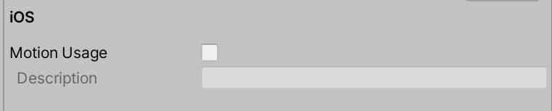
Platform-specific settings
iOS/tvOS
Motion Usage
  Governs access to the pedometer ( or step-counter) on the device. If enabled, the Description string supplied in the settings will be added to the application's Info.plist

Slide 59
Play Mode Input Behavior
Determines how input is handled in the Editor when in play mode.
Unlike in players, in the Editor Unity (and its input backends) will keep running for as long as the Editor is active regardless of whether a Game View is focused or not.
Pointers And Keyboards Respect Game View Focus: This setting is the default.
  Only Pointer and Keyboard Devices require the Game View to be focused. Other Devices will route their input into the application regardless of Game View focus.

Slide 60
Supported Input Devices
Device | Windows | Mac | Linux | UWP | Android | iOS | tvOS | Xbox(3) | PS4(3) | Switch(3) | WebGL
Mouse | Yes | Yes | Yes | Yes | Yes | No | No | Yes | Yes | No | Yes
Keyboard | Yes | Yes | Yes | Yes | Yes | No | No | Yes | Yes | No | Yes
Pen | Yes | No (1) | No | Yes | Yes | Yes | No | No | No | No | No
Touchscreen | Yes | No | No | Yes | Yes | Yes | Yes(4) | No | No | No | Yes
Sensors | No | No | No | No | Yes | Yes | No | No | No | No | Yes(5)
Joystick | Yes | Yes | Yes | Yes | Yes | No | No | No | No | No | Yes

Slide 61
Pointers
Pointer Devices are defined as InputDevices that track positions on a 2D surface.
The Input System supports three types of pointers:
  Touch
  Mouse
  Pen
Each of these types implements a common set of Controls.

Slide 62
Pointer Controls
Control | Type | Description
position | Vector2Control | The current pointer coordinates in window space.
delta | Vector2Control | Provides motion delta in pixels accumulated (summed) over the duration of the current frame/update. Resets to (0,0) each frame. Note that the resolution of deltas depends on the specific hardware and/or platform.
press | ButtonControl | Whether the pointer or its primary button is pressed down.
pressure | AxisControl | The pressure applied with the pointer while in contact with the pointer surface. This value is normalized. This is only relevant for pressure-sensitive devices, such as tablets and some touch screens.
radius | Vector2Control | The size of the area where the finger touches the surface. This is only relevant for touch input.
Notes:
Window space
The coordinates within Player code are in the coordinate space of the Player window.
Within Editor code, the coordinates are in the coordinate space of the current EditorWindow. If you query Pointer.current.position in UnityEditor.EditorWindow.OnGUI, for example, the returned 2D vector will be in the coordinate space of your local GUI (same as UnityEngine.Event.mousePosition).

Slide 63
Keyboard support
The Keyboard class defines a Device with a set of key Controls defined by the Key enumeration.
The location of individual keys is agnostic to keyboard layout. This means that, for example, the A key is always the key to the right of the Caps Lock key.
To query which (if any) character is generated by a given key, use the key Control's displayName property.

Slide 64
Lab1: The old input manager
Add a cube (name it player),
Add a Rigid body component (with no gravity) to the player,
Create a script called PlayerController and attach the script to the Player GameObject
Attach the cube to the rigid body: rb
using System.Collections;
using System.Collections.Generic;
using UnityEngine;
public class PlayerController : MonoBehaviour
{
public Rigidbody rb;
public float moveSpeed = 5f;
Vector3 moveDirection = Vector3.zero;
void Start()
{
Debug.Log(Time.fixedDeltaTime);
}
void Update()
{
float moveX = Input.GetAxis("Horizontal");
float moveY = Input.GetAxis("Vertical");
moveDirection = new Vector2(moveX, moveY).normalized;
}
private void FixedUpdate()
{
rb.velocity = new Vector3(moveDirection.x * moveSpeed, moveDirection.y * moveSpeed, moveDirection.z * moveSpeed);
}
}

Slide 65
The old input manager
Go to Project Setting → Input Manager
Expand the Axes and check out Horizontal/Vertical inputs
You had to use verbatims
float moveX = Input.GetAxis("Horizontal");
float moveY = Input.GetAxis("Vertical");

Slide 66
Lab2: Getting input directly from an Input Device Using New Input System Manager
The quickest way to get started in script is to read the current state directly from Input Devices.
For example, the following code gets the gamepad/keyboard/mouse that a player last used, and reads its current state:
  var keboard = Keyboard.current;
  if (keboard == null)
  return; // No keyboard connected.
  if (Keyboard.current[Key.A].wasPressedThisFrame)
  {
  moveX = -10;
  Debug.Log(Keyboard.current[Key.A].ReadValue()); // +1.
  }

Slide 67
PlayerController2.cs
public class PlayerController2 : MonoBehaviour
{
public Rigidbody rb;
public float moveSpeed = 5f;
Vector3 moveDirection = Vector3.zero;
float moveX = 0;
float moveY = 0;
void Update()
{
var keboard = Keyboard.current;
if (keboard == null)
return; // No keyboard connected.
if (Keyboard.current[Key.A].wasPressedThisFrame)
{
moveX = -1;
Debug.Log(Keyboard.current[Key.A].ReadValue());
}
if (Keyboard.current[Key.D].wasPressedThisFrame)
{
moveX = 1;
}
if (Keyboard.current[Key.W].wasPressedThisFrame)
{
moveY = 1;
}
if (Keyboard.current[Key.S].wasPressedThisFrame)
{
moveY = -1;
}
moveDirection = new Vector2(moveX, moveY).normalized;
}
private void FixedUpdate()
{
rb.linearVelocity = new Vector3(moveDirection.x * moveSpeed, moveDirection.y * moveSpeed, moveDirection.z * moveSpeed);
}
}
//for GamePad
//var gamepad = Gamepad.current;
//if (gamepad == null)
// return; // No gamepad connected.
//if (gamepad.rightTrigger.wasPressedThisFrame)
//{
// // 'Use' code here
//}
//Vector2 move = gamepad.leftStick.ReadValue();
// 'Move' code here
//mouse example
//var mouse = Mouse.current;
//if (mouse != null)
// look = mouse.delta.ReadValue();

Slide 68
Input Actions
Input Actions are designed to separate the logical meaning of an input from the physical means of input (that is, activity on an input device) that generate the input.

Slide 69
Input Actions
Instead of writing input code like this:
var look = new Vector2();
var gamepad = Gamepad.current;
if (gamepad != null)
look = gamepad.rightStick.ReadValue();
var mouse = Mouse.current;
if (mouse != null)
look = mouse.delta.ReadValue();
You can write code that is agnostic to where the input is coming from:
  myControls.gameplay.look.performed +=
  context => look = context.ReadValue<Vector2>();

Slide 70
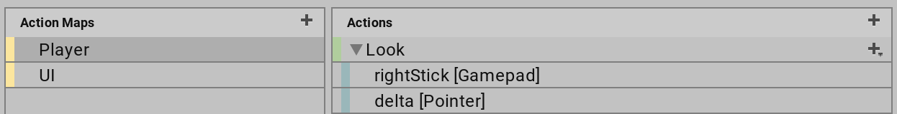
Input Action
You can then use the visual editor to establish the mapping:
Actions use InputBinding to refer to the inputs they collect.
Each Action has a name (InputAction.name), which must be unique within the Action Map
Each Action also has a unique ID (InputAction.id), which you can use to reference the Action.

Slide 71
3 classes for Actions
Class | Description
InputActionAsset | An Asset that contains one or more Action Maps and, optionally, a sequence of Control Schemes.
InputActionMap | A named collection of Actions.
InputAction | A named Action that triggers callbacks in response to input.

Slide 72
Creating Actions
You can create Actions in one of the following ways:
  Use the dedicated editor for .inputactions Assets.
  Embed them in MonoBehaviour components.
  Manually load them from JSON.
  Create them directly in code.

Slide 73
Lab3: Creating Input Action Assets
To create an Asset that contains Input Actions in Unity, right-click in the Project window or go to Assets > Create > Input Actions from Unity's main menu.
To bring up the Action editor, double-click an .inputactions Asset in the Project Browser, or select the Edit Asset button in the Inspector for that Asset.

Slide 74
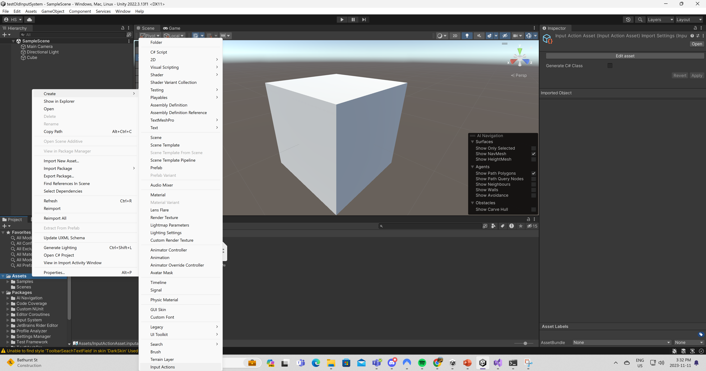
Create Input an Action Asset

Slide 75
Setting Up the Action Map
To add a new Action Map, select the Add (+) icon in the header of the Action Map column.
To add a new Action, select the Add (+) icon in the header of the Action column.
To add a new Binding, select the Add (+) icon on the action you want to add it to, and select the binding type from the menu that appears.
The most important property of any Binding is the control path it's bound to. To edit it, open the Path drop-down list. This displays a Control picker window.

Slide 76
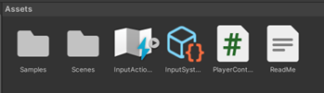
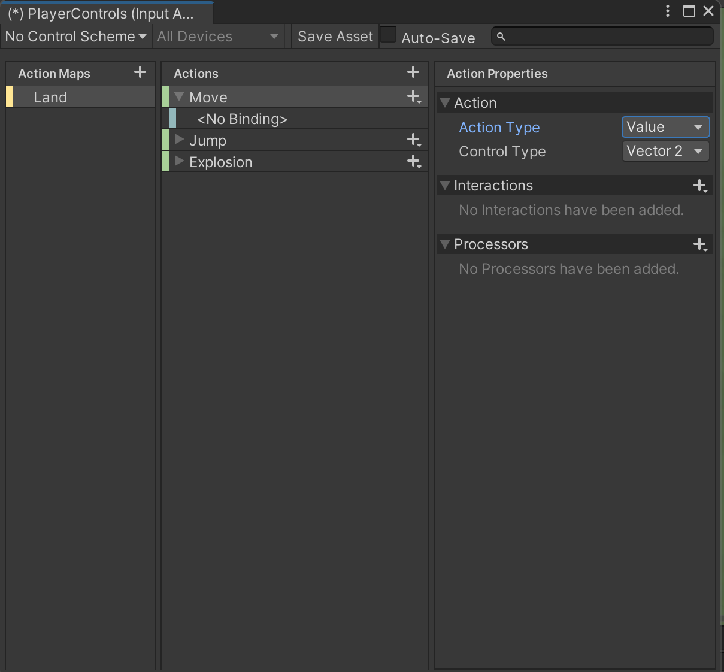
Setting Up an Action Type
Double click on InputAction asset (.inputactions)
Create a “Land” action map
Create three Actions: Move, Jump, Explosion
There are three action types:
  Value
  Button
  Pass Through (if you have several controls bound to this action, “Value” selects the main one, but “Pass Through” gets them all)
Move: Value
Jump: Button

Slide 77
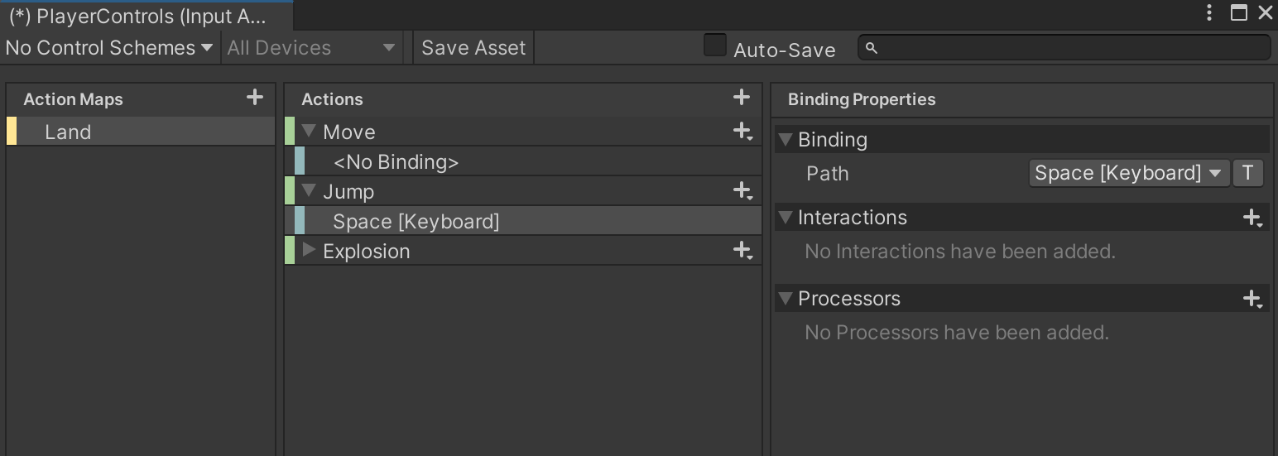
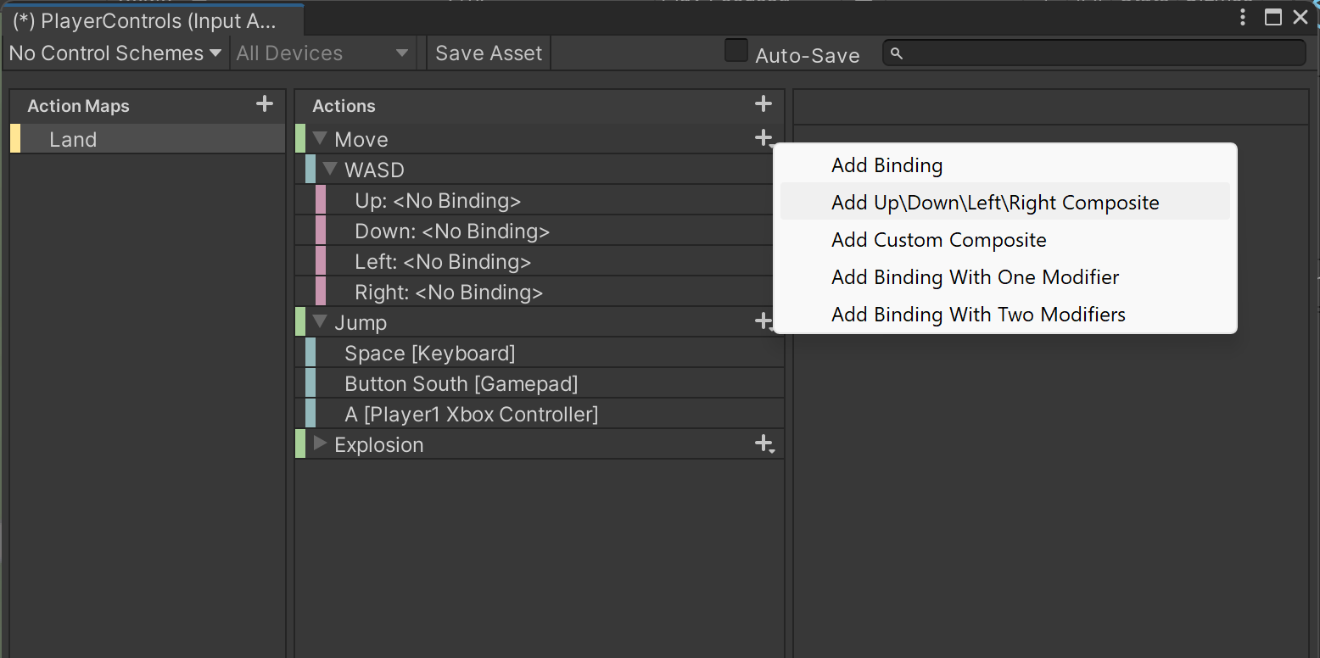
Setting Up an Action Binding
Composite is a group of different bindings (WASD)
Input System has an event callbacks
Input System Callback:
  Started (Control(s) changed value from the default value)
  Performed (Control(s) changed value)
  Cancelled (Control(s) are no longer actuated)

Slide 78
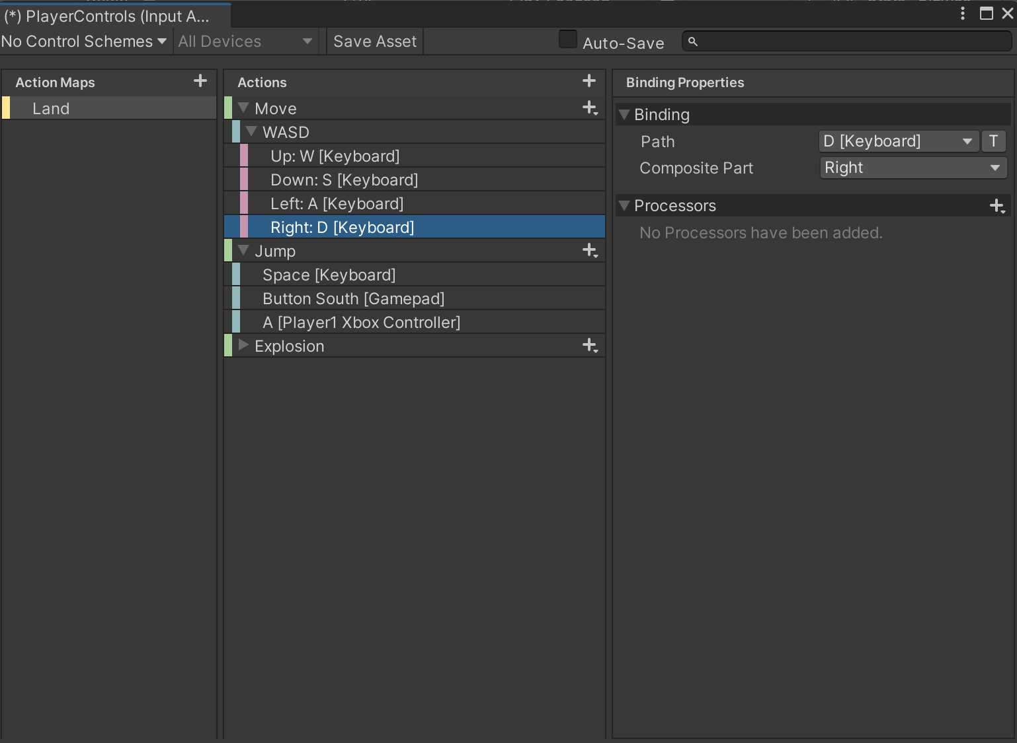
Setting Up a Path for each binding

Slide 79
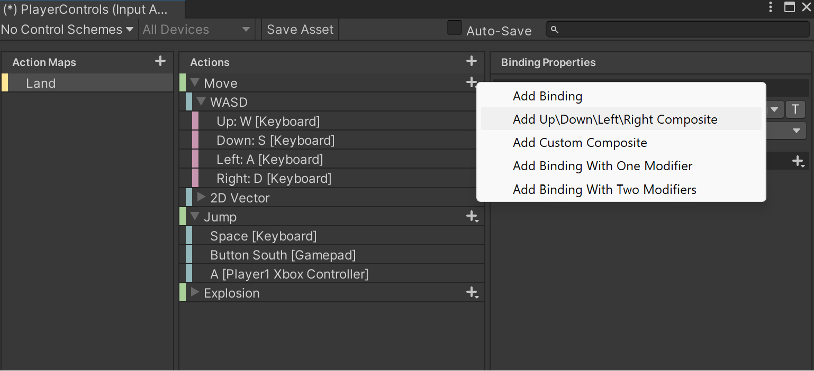
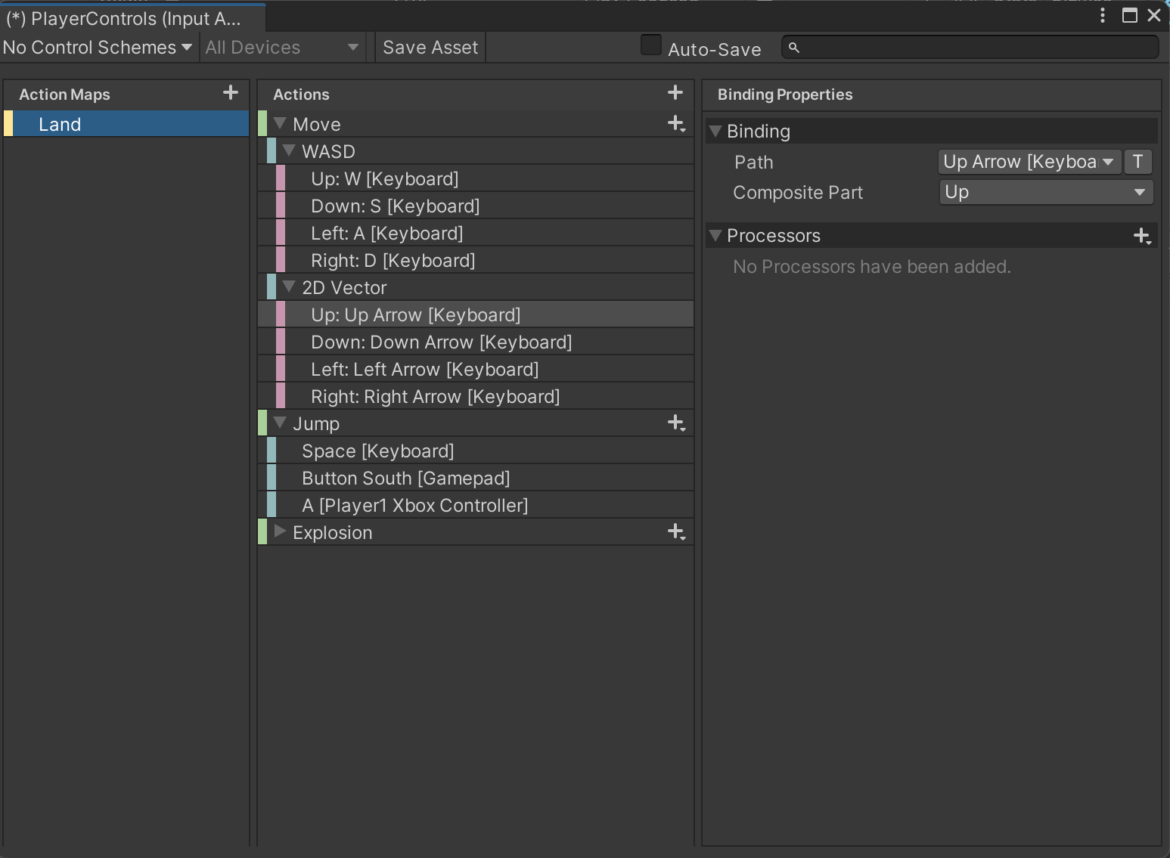
Add arrow keys
Add another 2 vector composite in “Move” Action in to add arrow keys

Slide 80
PlayerController3
using System.Collections;
using System.Collections.Generic;
using UnityEngine;
using UnityEngine.InputSystem;
public class PlayerController3 : MonoBehaviour
{
public Rigidbody rb;
public float moveSpeed = 0.1f;
Vector3 moveDirection = Vector3.zero;
Vector2 moveXY = Vector2.zero;
public void Jump(InputAction.CallbackContext context)
{
Debug.Log("Jump!");
}
public void Move(InputAction.CallbackContext context)
{
Debug.Log("Move!");
var moveXY = context.ReadValue<Vector2>();
Debug.LogFormat("Move Directtion: ({0}, {1})", moveXY.x, moveXY.y);
moveDirection = moveXY.normalized;
}
private void FixedUpdate()
{
rb.linearVelocity = new Vector3(moveDirection.x * moveSpeed * Time.fixedDeltaTime, moveDirection.y * moveSpeed * Time.fixedDeltaTime, moveDirection.z * moveSpeed * Time.fixedDeltaTime);
}
}

Slide 81
Using Action Assets with PlayerInput
The PlayerInput component provides a convenient way to handle input for one or multiple players.
It requires you to set up all your Actions in an Input Action Asset, which you can then assign to the PlayerInput component.
PlayerInput can then automatically handle activating Action Maps and selecting Control Schemes for you.

Slide 82
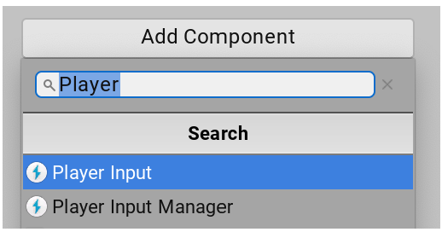
Add a PlayerInput Component
Getting input directly from an Input Device is quick and convenient, but requires a separate path for each type of Device. That also makes it harder to later change which Device Control triggers a specific event in the game.
Alternatively, you can use Actions as an intermediary between Devices and the in-game responses they trigger. The easiest way to do this is to use the PlayerInput component. To add this component, click the Add Component button in the GameObject Inspector:

Slide 83
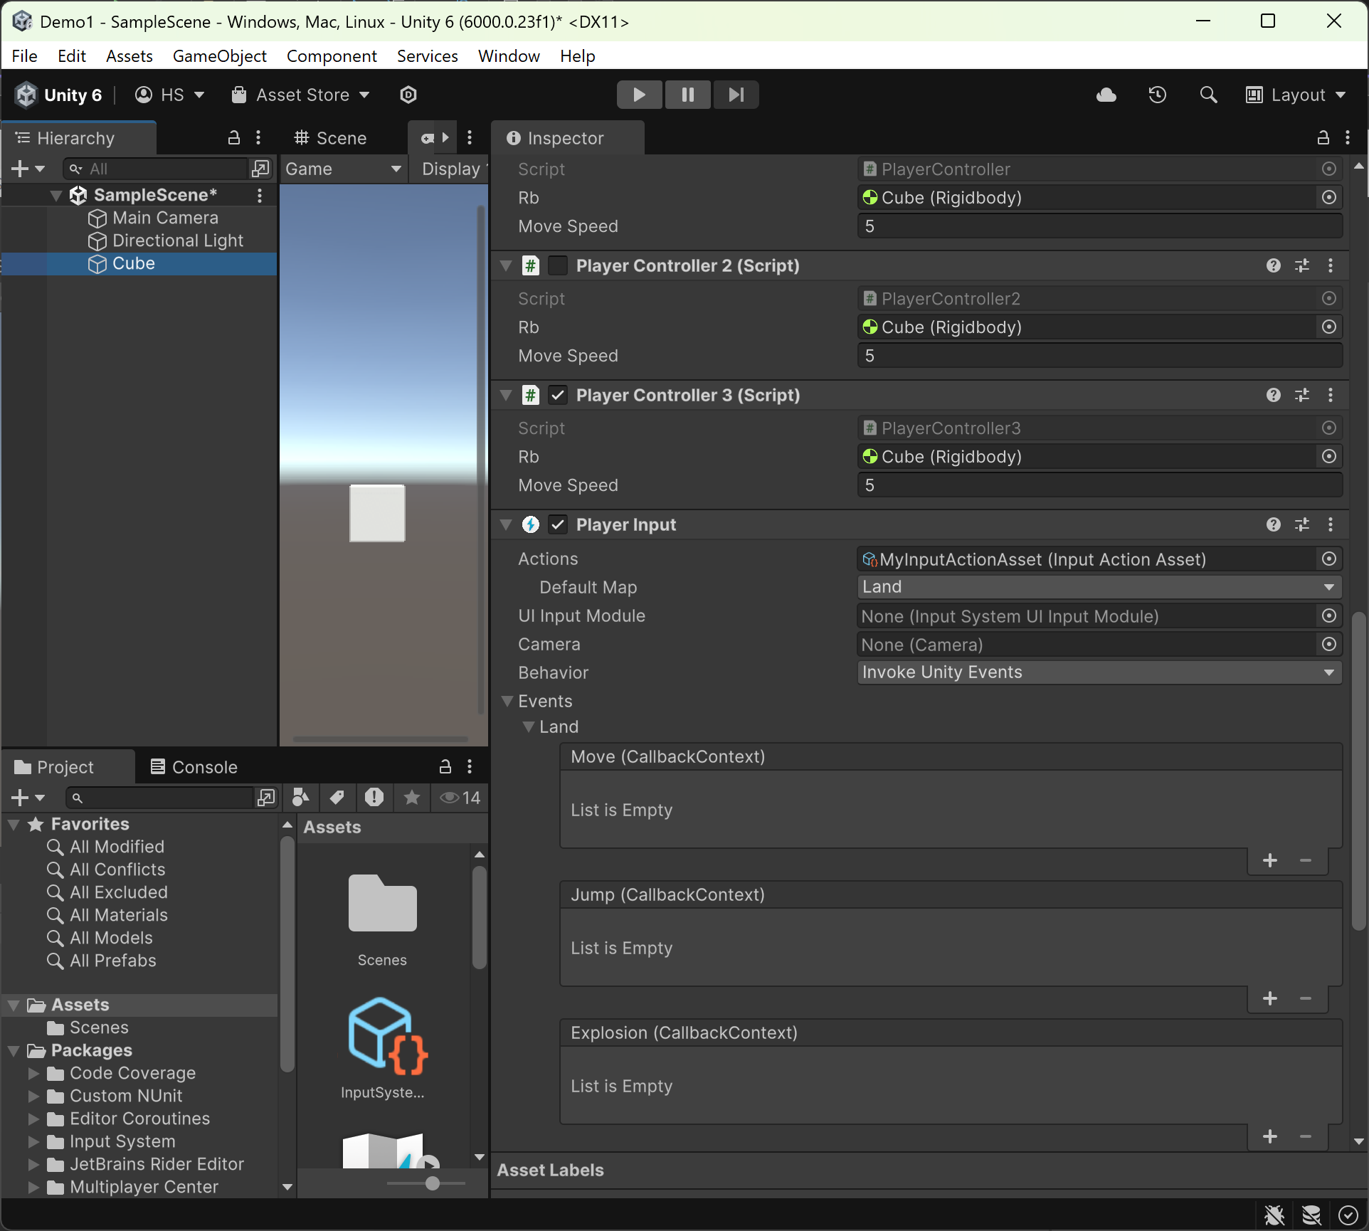
“Player Input” component
Add “Player Input” component to your “Player/Cube” game object
Select the action map (Land)
Select the behavior as “Invoke Unity Events”

Slide 84
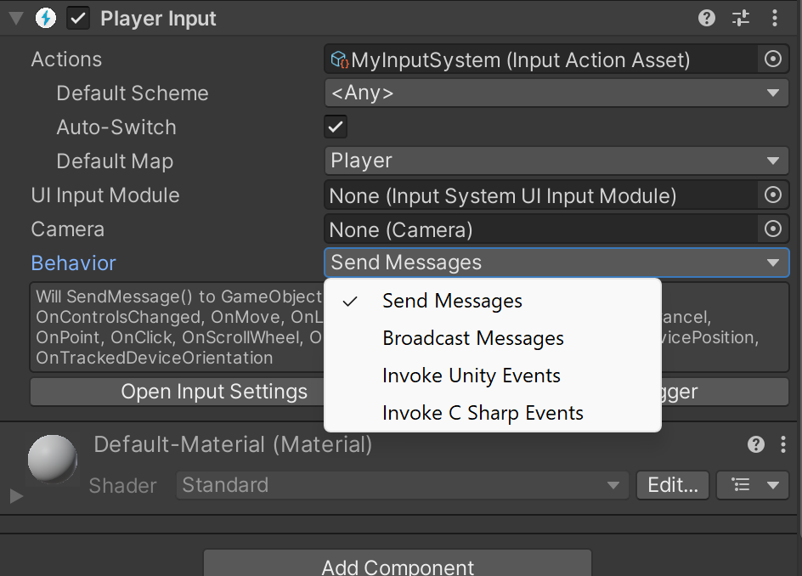
Setting up Action responses
Once the component has its Actions, you must set up a response for each Action. PlayerInput allows you to set up responses in several ways, using the Behavior property in the Inspector window.
Select “Invoke UnityEvent” , which is in the same way the Unity UI does. Unity displays an event for each Action that is linked to the component. This allows you to directly wire in the target method for each event.

Slide 85
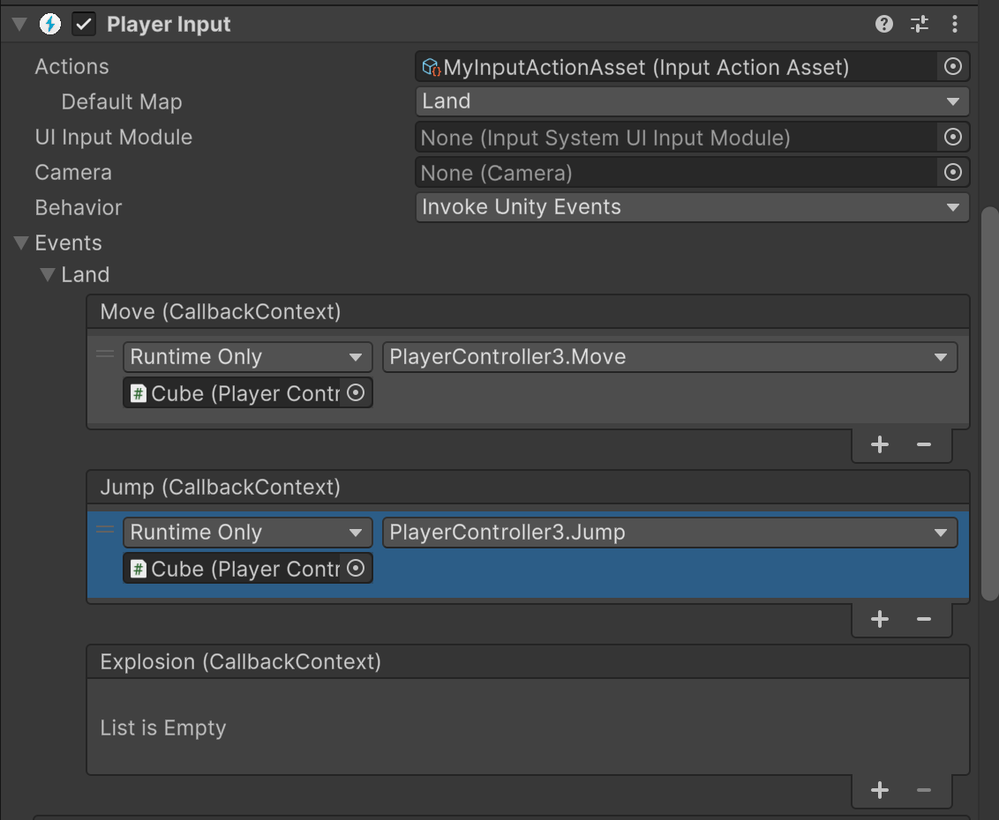
Set the callback context
Select “Move” method for “Move” callback context
Select “Jump” method for “Jump” callback context
Run and test the application

Slide 86
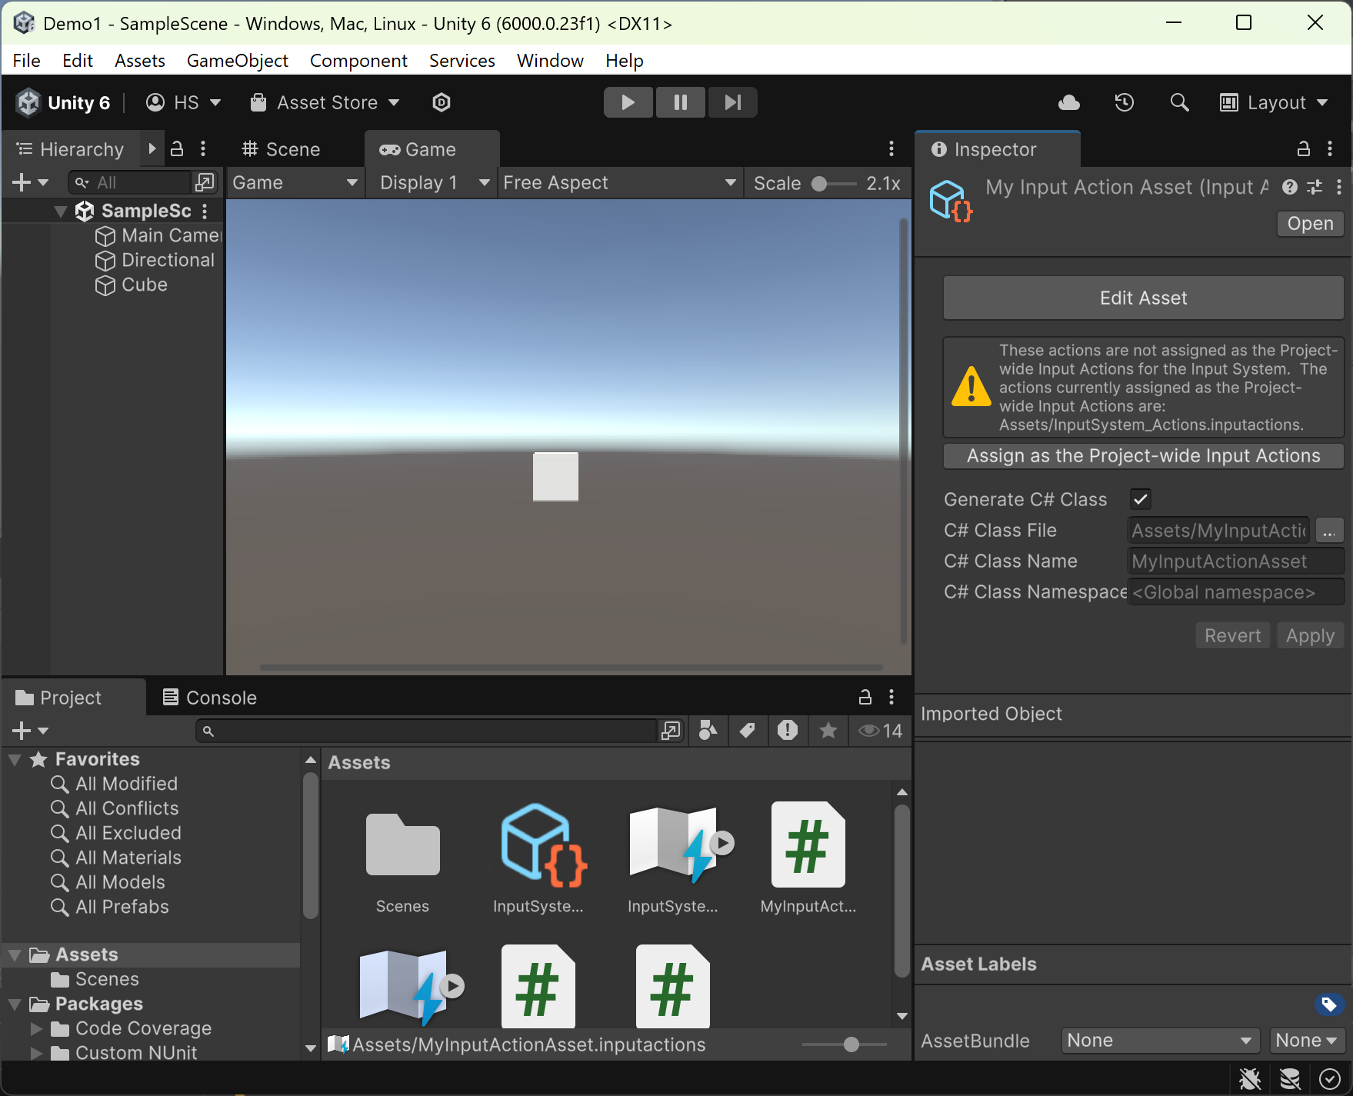
Lab4: Generate C# Class
Select your input action asset under “Assets”
Select the “Generate C# class”
Press “Apply”
One of the most convenient ways to work with .inputactions Assets in scripts is to automatically generate a C# wrapper class for them.
This removes the need to manually look up Actions and Action Maps using their names, and also provides an easier way to set up callbacks.

Slide 87
PlayerController4.cs
using UnityEngine;
public class PlayerController4 : MonoBehaviour
{
//step1: Make a reference to PlayerControls
private MyInputActionAsset playerControls;
public float moveSpeed = 5f;
//Step2: Instantiate
private void Awake()
{
playerControls = new MyInputActionAsset();
}
//Step3: Enable/Disable the action map
private void OnEnable()
{
playerControls.Enable();
}
private void OnDisable()
{
playerControls.Disable();
}
// Update is called once per frame
void Update()
{
//step4
Vector2 move = playerControls.Land.Move.ReadValue<Vector2>();
//horizontalInput = Input.GetAxis("Horizontal");
transform.Translate(Vector3.right * move.x * Time.deltaTime * moveSpeed);
transform.Translate(Vector3.up * move.y * Time.deltaTime * moveSpeed);
//if (playerControls.Land.Jump.ReadValue<float>() == 1)
if (playerControls.Land.Jump.triggered) //same as above
{
//Launch a projectile from the player
Debug.Log("Jump!");
}
}
}

Slide 88
Lab5: Embedding Actions in MonoBehaviours
using UnityEngine;
using UnityEngine.InputSystem;
public class PlayerController5 : MonoBehaviour
{
//step1: Make a reference to PlayerControls
private MyInputActionAsset playerControls;
public float moveSpeed = 5f;
private InputAction move;
private InputAction fire;
//Step2: Instantiate
private void Awake()
{
if (playerControls == null)
{
playerControls = new MyInputActionAsset();
}
}

Slide 89
Enable/Disable Actions
You must manually enable and disable Actions and Action Maps that are embedded in MonoBehaviour components.
  private void OnEnable()
  {
  playerControls.Enable();
  move = playerControls.Land.Move;
  move.Enable();
  move.performed += OnMove;
  fire = playerControls.Land.Jump;
  fire.Enable();
  //Register the fire method to the event
  fire.performed += OnJump;
  }
  private void OnDisable()
  {
  playerControls.Disable();
  move.Disable();
  fire.Disable();
  }

Slide 90
Events
void Update()
{
}
private void OnJump(InputAction.CallbackContext context)
{
Debug.Log("We jumped");
}
public void OnMove(InputAction.CallbackContext context)
{
// 'Move' code here.
Debug.Log("Player Moved");
//step4
Vector2 move = playerControls.Land.Move.ReadValue<Vector2>();
transform.Translate(Vector3.right * move.x * Time.deltaTime * moveSpeed);
transform.Translate(Vector3.up * move.y * Time.deltaTime * moveSpeed);
}
}

Slide 91
Lab6: Loading Actions from JSON
// Load a set of action maps from JSON.
var maps = InputActionMap.FromJson(json);
// Load an entire InputActionAsset from JSON.
var asset = InputActionAsset.FromJson(json);

Slide 92
Lab7: Creating Actions in code
  // Create free-standing Actions.
  var lookAction = new InputAction("look", binding: "<Gamepad>/leftStick");
  var moveAction = new InputAction("move", binding: "<Gamepad>/rightStick");
  lookAction.AddBinding("<Mouse>/delta");
  moveAction.AddCompositeBinding("Dpad")
  .With("Up", "<Keyboard>/w")
  .With("Down", "<Keyboard>/s")
  .With("Left", "<Keyboard>/a")
  .With("Right", "<Keyboard>/d");
  // Create an Action Map with Actions.
  var map = new InputActionMap("Gameplay");
  var lookAction = map.AddAction("look");
  lookAction.AddBinding("<Gamepad>/leftStick");
  // Create an Action Asset.
  var asset = ScriptableObject.CreateInstance<InputActionAsset>();
  var gameplayMap = new InputActionMap("gameplay");
  asset.AddActionMap(gameplayMap);
  var lookAction = gameplayMap.AddAction("look", "<Gamepad>/leftStick");

Slide 93
Lab8: Default Actions
An asset called DefaultInputActions.inputactions containing a default setup of Actions comes with the Input System Package.
You can reference this asset directly in your projects like any other Unity asset. However, the asset is also available in code form through the DefaultInputActions class.
  void Start()
  {
  // Create an instance of the default actions.
  var actions = new DefaultInputActions();
  actions.Player.Look.performed += OnLook;
  actions.Player.Move.performed += OnMove;
  actions.Enable();
  }

Slide 94
Responding to Actions
An Action doesn't represent an actual response to input by itself. Instead, an Action informs your code that a certain type of input has occurred. Your code then responds to this information.
There are several ways to do this:
Each Action has a started, performed, and canceled callback.
Each Action Map has an actionTriggered callback.
The Input System has a global InputSystem.onActionChange callback.
You can poll the current state of an Action whenever you need it.
InputActionTrace can record changes happening on Actions.

Slide 95
Action callbacks
You can read the current phase of an action using InputAction.phase.
The Started, Performed, and Canceled phases each have a callback associated with them.
Each callback receives an InputAction.CallbackContext structure, which holds context information that you can use to query the current state of the Action and to read out values from Controls that triggered the Action (InputAction.CallbackContext.ReadValue).
  var action = new InputAction();
  action.started += ctx => /* Action was started */;
  action.performed += ctx => /* Action was performed */;
  action.canceled += ctx => /* Action was canceled */;

Slide 96
InputActionMap.actionTriggered callback
Instead of listening to individual actions, you can listen on an entire Action Map for state changes on any of the Actions in the Action Map.
var actionMap = new InputActionMap();
actionMap.AddAction("action1", "<Gamepad>/buttonSouth");
actionMap.AddAction("action2", "<Gamepad>/buttonNorth");
actionMap.actionTriggered +=
context => { ... };

Slide 97
InputSystem.onActionChange callback
Similar to InputSystem.onDeviceChange, your app can listen for any action-related change globally.
  InputSystem.onActionChange +=
  (obj, change) =>
  {
  // obj can be either an InputAction or an InputActionMap
  // depending on the specific change.
  switch (change)
  {
  case InputActionChange.ActionStarted:
  case InputActionChange.ActionPerformed:
  case InputActionChange.ActionCanceled:
  Debug.Log($"{((InputAction)obj).name} {change}");
  break;
  }
  }

Slide 98
Polling Actions
Instead of using callbacks, it might be simpler sometimes to poll the value of an Action where you need it in your code.
  public InputAction moveAction;
  public float moveSpeed = 10.0f;
  public Vector2 position;
  void Start()
  {
  moveAction.Enable();
  }
  void Update()
  {
  var moveDirection = moveAction.ReadValue<Vector2>();
  position += moveDirection * moveSpeed * Time.deltaTime;
  }

Slide 99
InputAction.WasPerformedThisFrame()
To determine whether an action was performed in the current frame, you can use InputAction.WasPerformedThisFrame():
private InputAction action;
void Start()
{
// Set up an action that triggers when the A button is
// held for 1 second.
action = new InputAction(
type: InputActionType.Button,
binding: "<Gamepad>/buttonSouth",
interactions: "hold(duration=1)");
action.Enable();
}
void Update()
{
if (action.WasPerformedThisFrame())
Debug.Log("A button on gamepad was held for one second");
}

Slide 100
poll for button presses and releases
public PlayerInput playerInput;
public void Update()
{
// IsPressed
if (playerInput.actions["up"].IsPressed())
transform.Translate(0, 10 * Time.deltaTime, 0);
// WasPressedThisFrame
if (playerInput.actions["teleport"].WasPressedThisFrame())
Teleport();
// WasReleasedThisFrame
if (playerInput.actions["submit"].WasReleasedThisFrame())
ConfirmSelection();
}

Slide 101
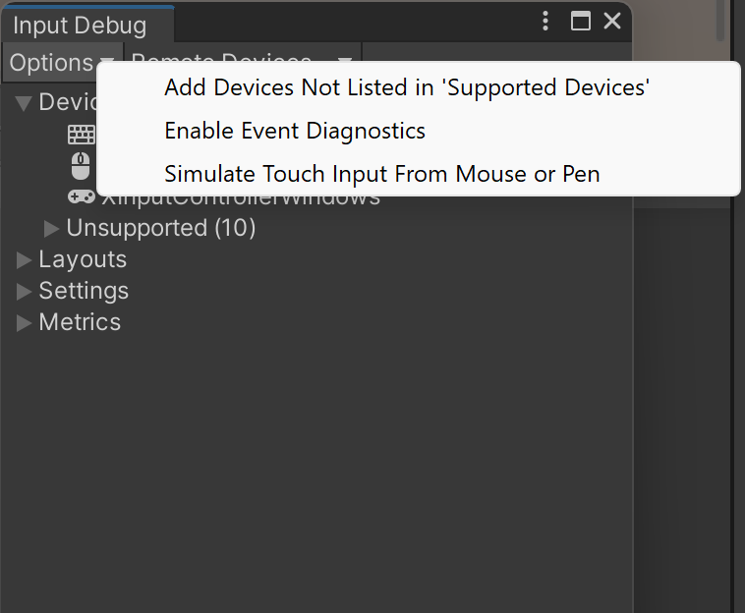
How to Simulate Touch Screen

