Slide 1
Information Visualization Coding Session 1
2024.03.13.
Seongouk Kim

Slide 2
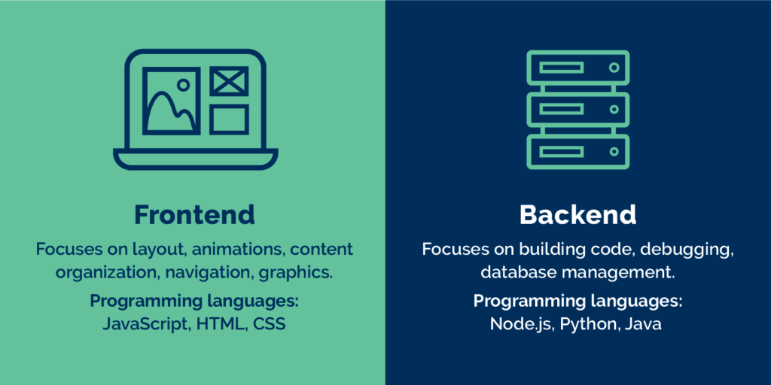
Web Development

Slide 3
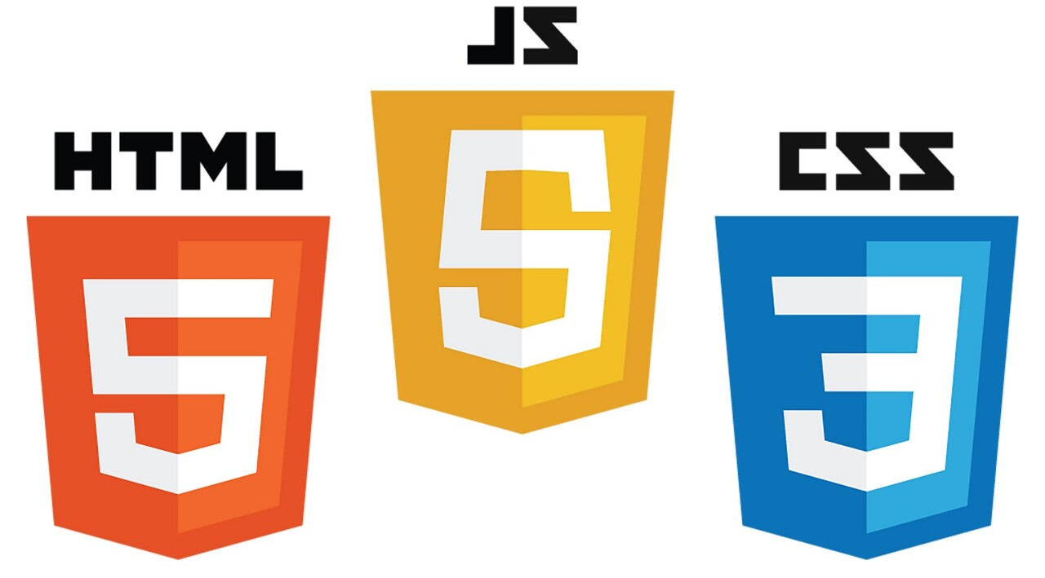
Web Development

Slide 4



Environment
Editor: Any text editor (even notepad!)
But recommend to use proper editor (vscode, webstorm, etc)
Rendering: Any web browsers which supports HTML5 (newer than IE8)

Slide 5
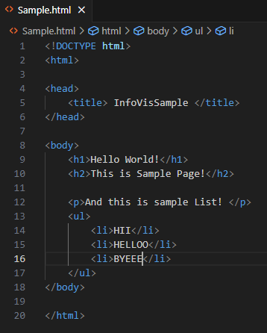
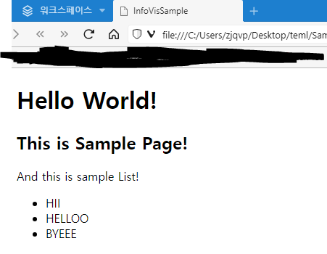
HTML (Hyper Text Markup Language)

Slide 6

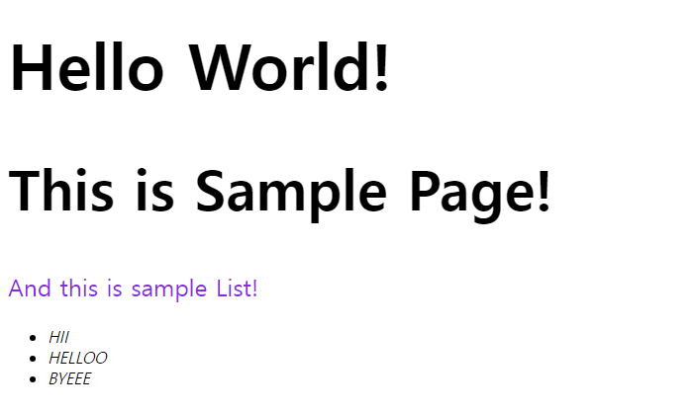
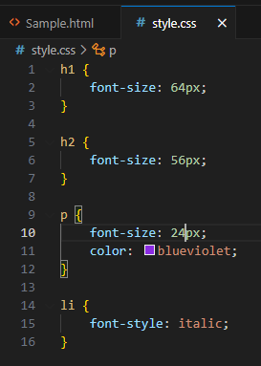
CSS (Cascading Style Sheet)

Slide 7
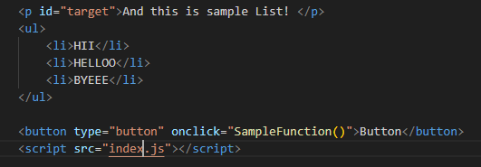
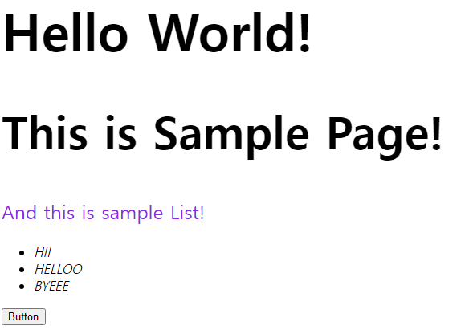
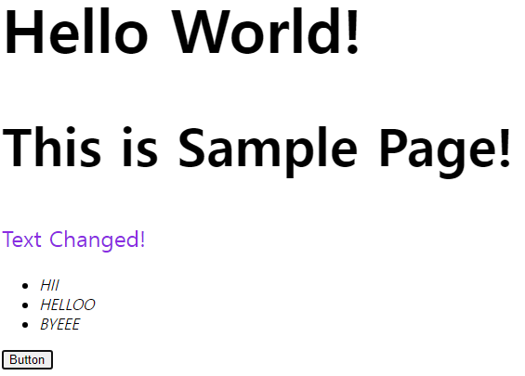


JavaScript

Slide 8
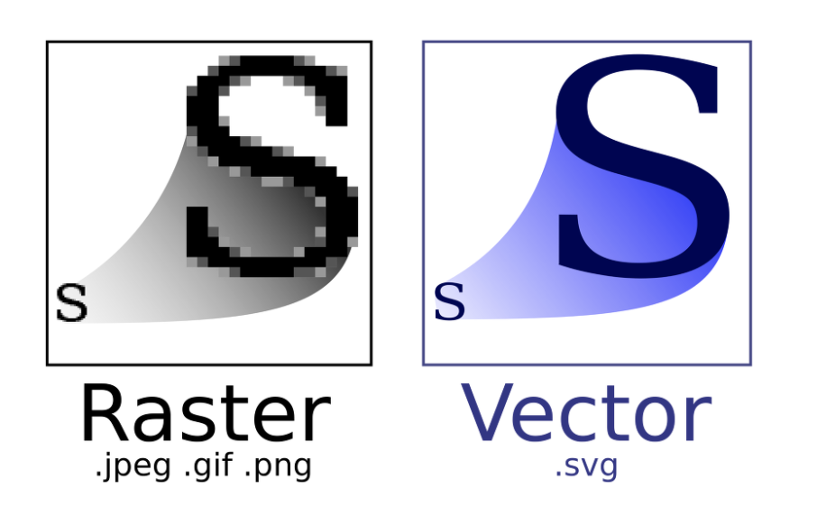
SVG (Scalable Vector Graphics)
XML (eXtensible Markup Language) to generate Vector Image
Can generate directly in HTML or dynamically in JavaScript
Quality doesn’t change when resizing
Depth order follows the generated order

Slide 9
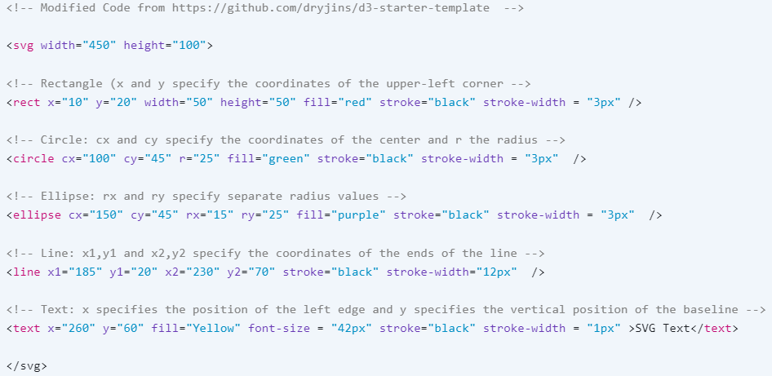

SVG with HTML

Slide 10
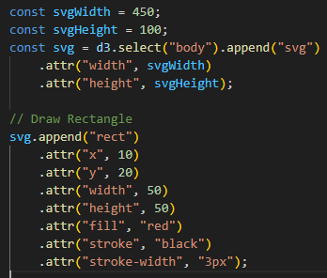

SVG with D3.js
=

Slide 11
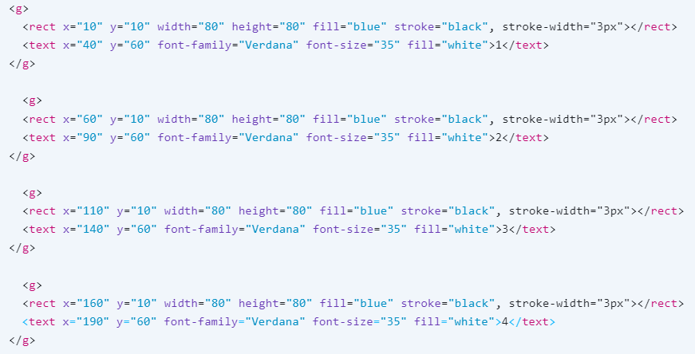
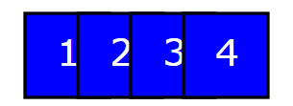
Depth order of SVG objects

Slide 12
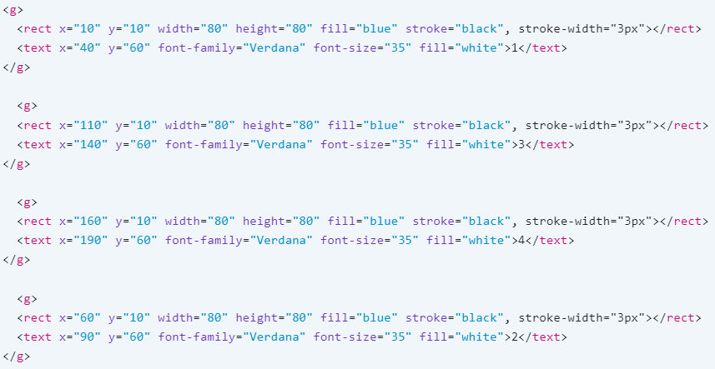
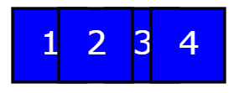
Depth order of SVG objects

Slide 13

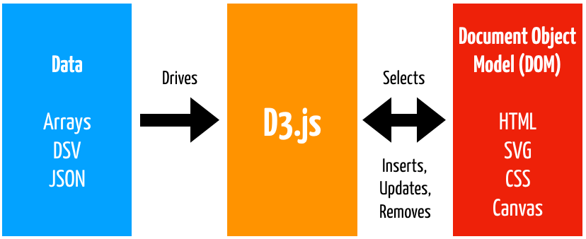
D3 (Data-Driven Document)
Open-source JS library to create dynamic and interactive visualization
Manipulate documents in data-driven manner

Slide 14
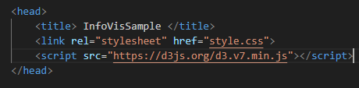
D3 Environment Set Up
Just add this code in HTML!
<script src="https://d3js.org/d3.v7.min.js"></script>

Slide 15

D3 Basic - Selection
select(“selector”) – Return first element matching with selector

Slide 16

D3 Basic - Selection
selectAll(“selector”) – Return All elements matching with selector

Slide 17
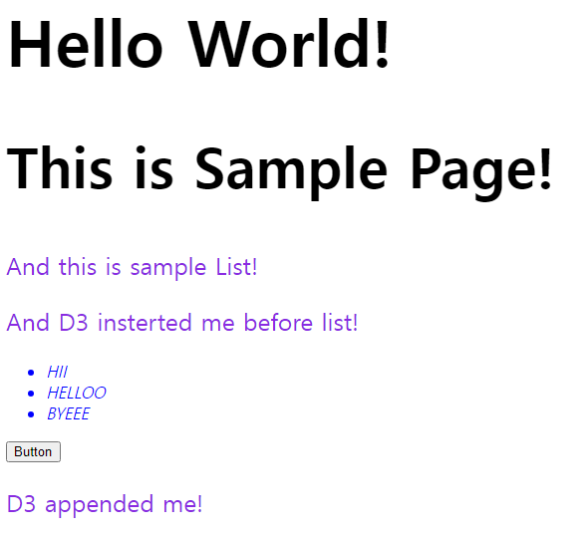
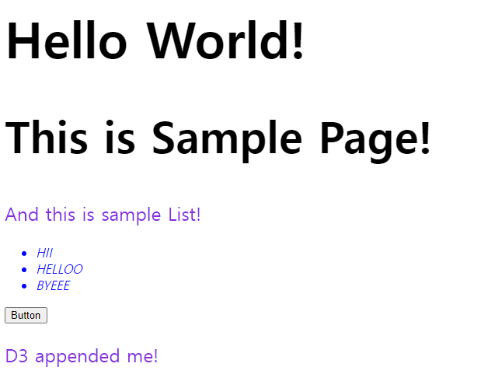
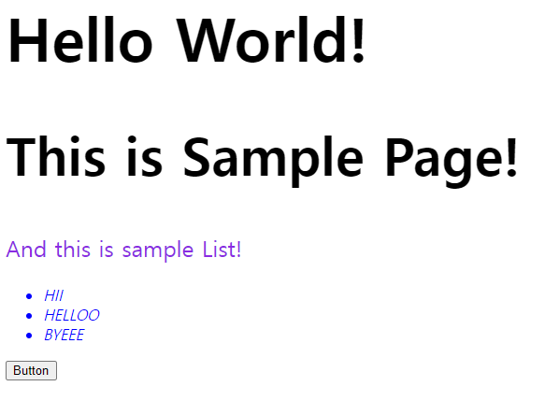

D3 Basic - Manipulation
append(“element”) – Add element at the end of the selected element.
insert(“element”, “location”) - Add element in the selected element, but right before the selected location.

Slide 18
D3 Basic - Manipulation
attr(“attribute”, value) - Set attribute of selected element into value

Slide 19


D3 Basic – Data Binding
Can load external data with d3.csv(), d3.json(), d3.tsv(), etc
* To load external data, you should run the web on the server and follow CORS policy. If you don’t, browsers will prohibit importing the data.
data(data) – Bind data to selected elements

Slide 20

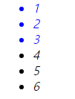
D3 Basic – Data Binding
enter() – Dynamically create placeholder references corresponding to the number of data values

Slide 21
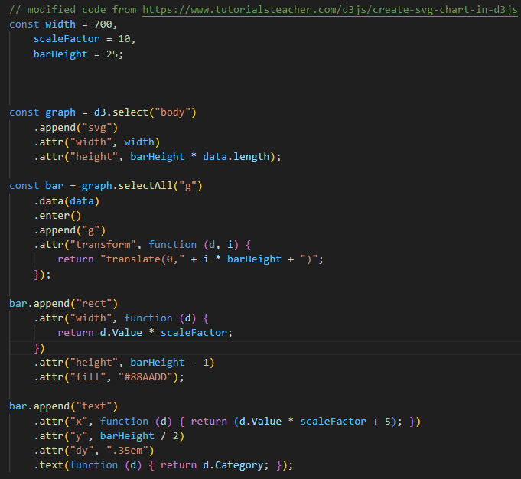
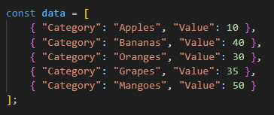
D3 Basic

Slide 22
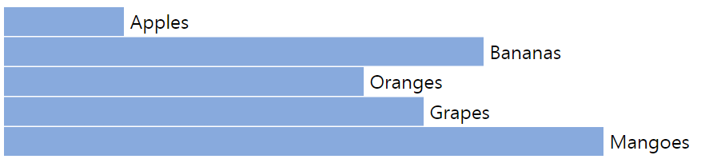
D3 Basic

Slide 23
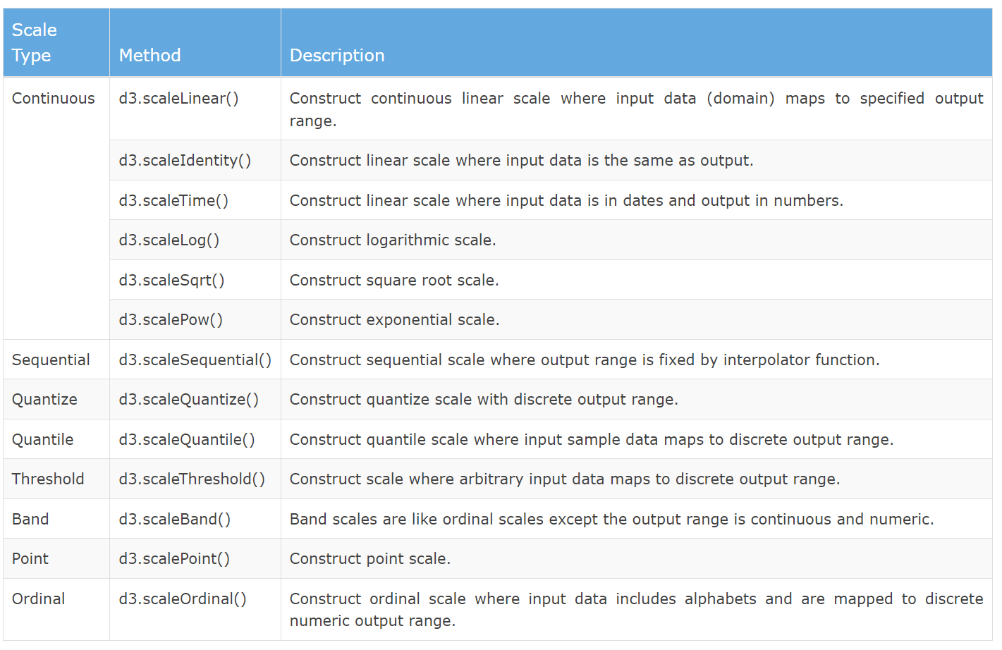
D3 Basic - Scaling
Map input ranges(Domain) into output ranges(Range)

Slide 24
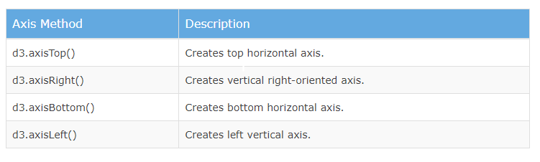
D3 Basic - Axes
Renders human-readable reference marks based on the scales

Slide 25
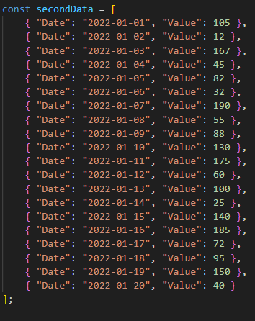
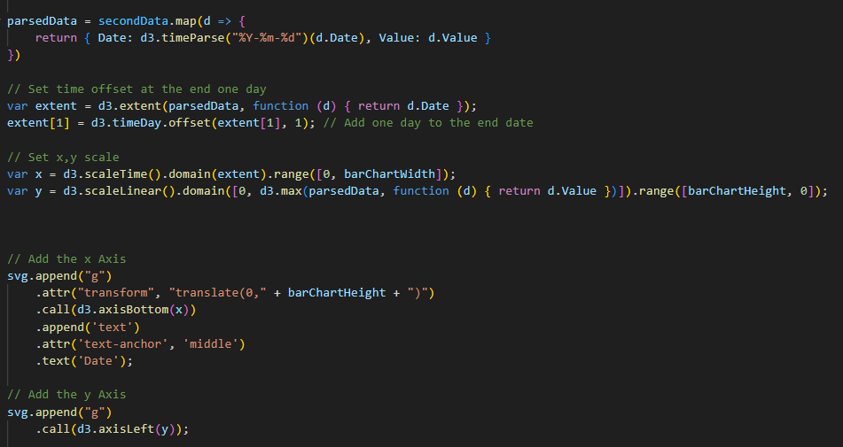
D3 Basic

Slide 26
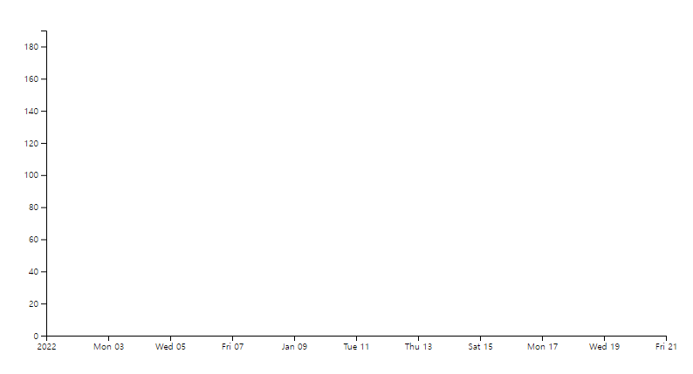
D3 Basic

Slide 27
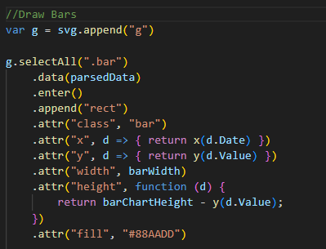
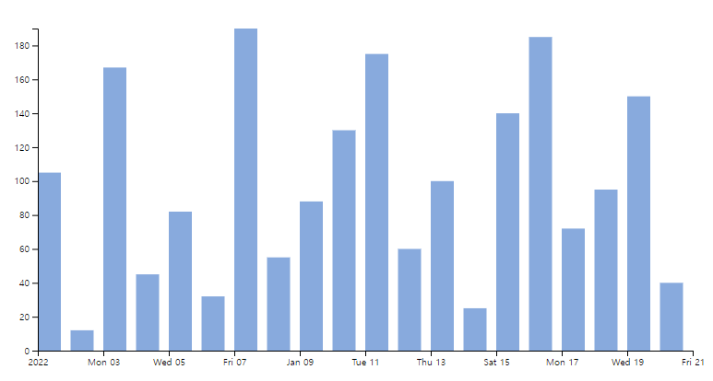
D3 Basic
* Added this code above axis code

Slide 28
Sources
https://www.w3schools.com - Basics of HTML/JS/CSS & SVG
https://www.tutorialsteacher.com/d3js - Basics of D3
https://observablehq.com/@d3/gallery - Various examples of D3 examples

Slide 29
Thank you!

