Slide 1
Information Visualization Coding Session 2
2024.04.24.
Seongouk Kim
Notes:
In this session, we are going to talk about interactions.

Slide 2
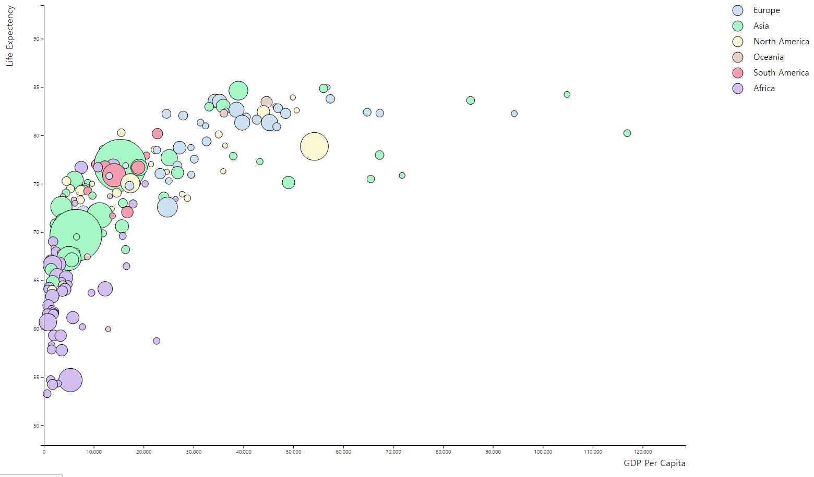
Motivation
How should I distinguish?
What is this point?
Eww…
Notes:
Let’s start with why we want to interact with visualizations.
See this simple bubble chart.
You can see tendency and approximate information in this chart
You may already notice some problems with this.

Slide 3
Motivation
How to solve?
Interaction!

Slide 4

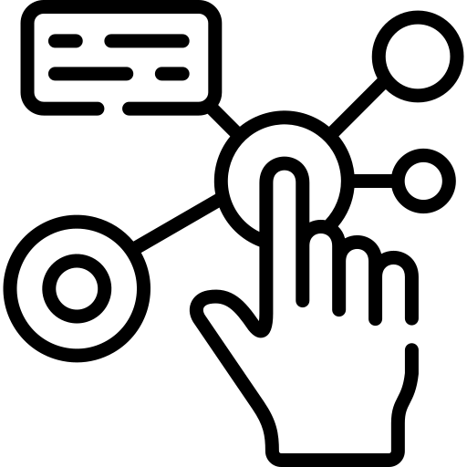
Interaction
+
Event
Animation
Notes:
Action feedback
Interactive icons created by Freepik – Flaticon
Animation icons created by Freepik - Flaticon

Slide 5
Interaction
Event
Animation
Notes:
Interactive icons created by Freepik – Flaticon
Animation icons created by Freepik - Flaticon

Slide 6



Event
Actions occurring in the system
Handle with selection.on(event, function)
Notes:
Computer mouse icons created by Freepik
Keyboard icons created by Freepik - Flaticon
Input icons created by Ch.designer - Flaticon

Slide 7
Interaction
Event
Animation
Notes:
Interactive icons created by Freepik – Flaticon
Animation icons created by Freepik - Flaticon

Slide 8
Transition for Animation
selection-like interface for animating changes to the DOM
Notes:
Transitions are methods that smoothly interpolate the DOM from its current state to the desired target state over a given duration

Slide 9
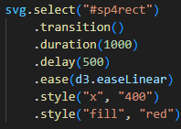
Transition
Declare Transition
Set Duration
Set Delay
Set Ease
Set Target State
Notes:
transitions smoothly interpolate the DOM from its current state to the desired target state over a given duration

Slide 10
Example

Slide 11
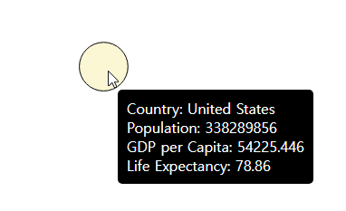
Tooltip

Slide 12
Tooltip
mouseover
mousemove
mouseout

Slide 13
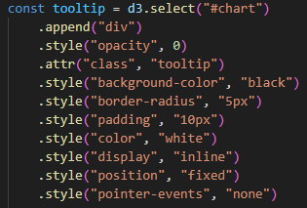
Tooltip

Slide 14
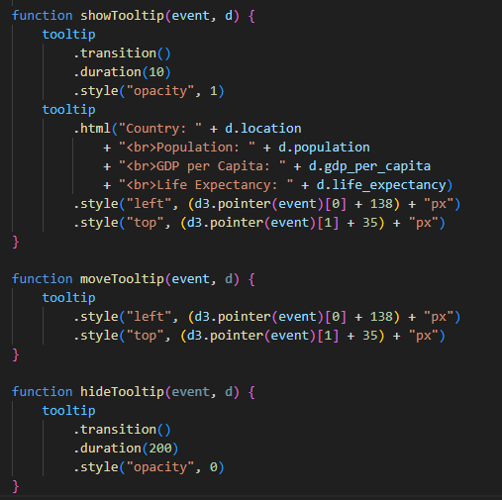
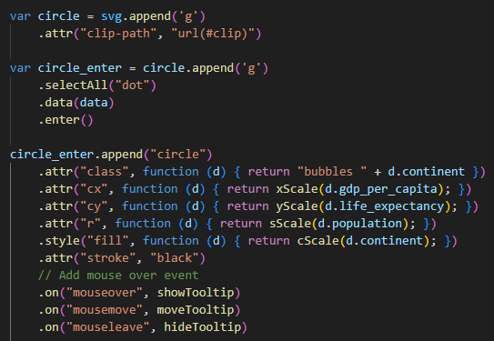
Tooltip

Slide 15
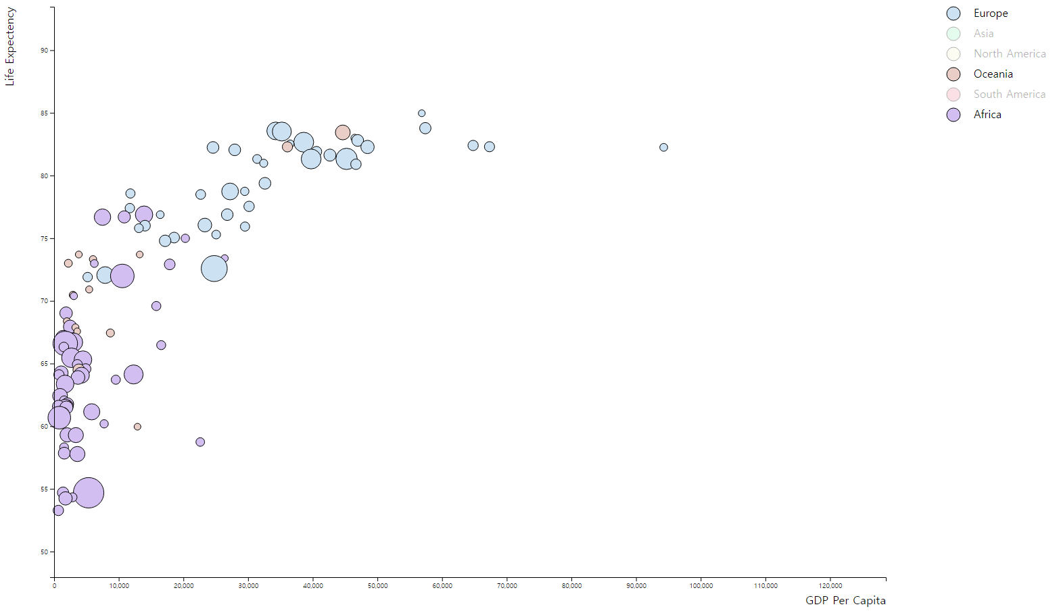
Toggle

Slide 16
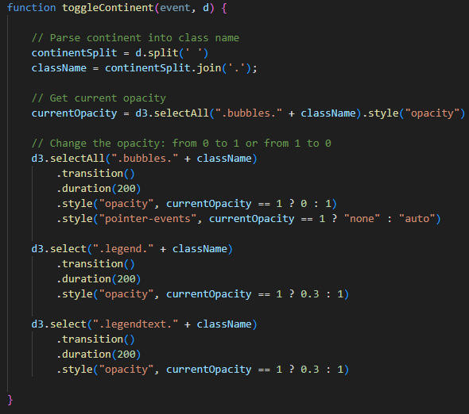
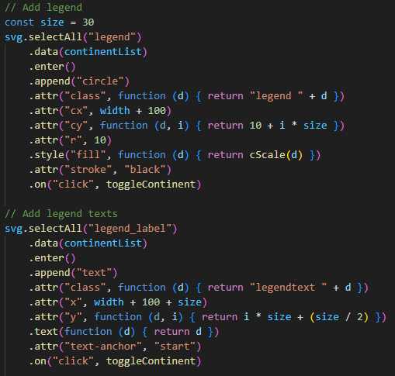
Toggle

Slide 17
Before Zoom - clipPath
Notes:
We should prevent this circles from sticking out like this.

Slide 18

Before Zoom - clipPath

Slide 19
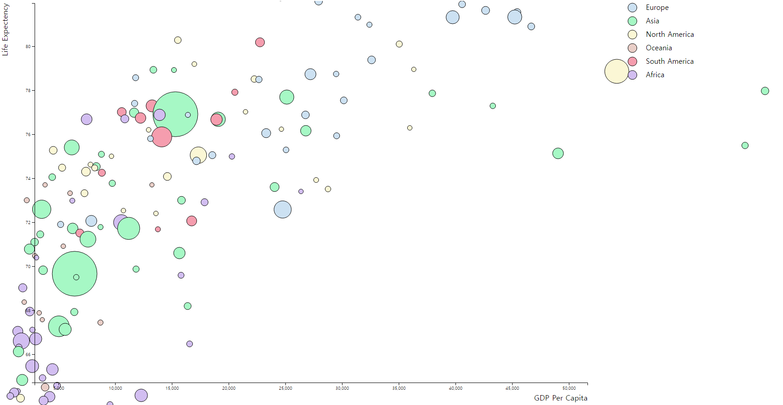
Before Zoom - clipPath

Slide 20
Before Zoom - clipPath
Notes:
If you have experience with clipping masks in Photoshop, it may be easy to understand. (It’s basically the same thing!)
https://observablehq.com/@eesur/svg-clippath-using-d3

Slide 21
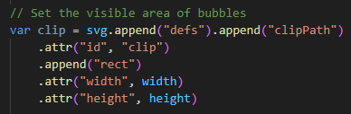
Before Zoom - clipPath

Slide 22
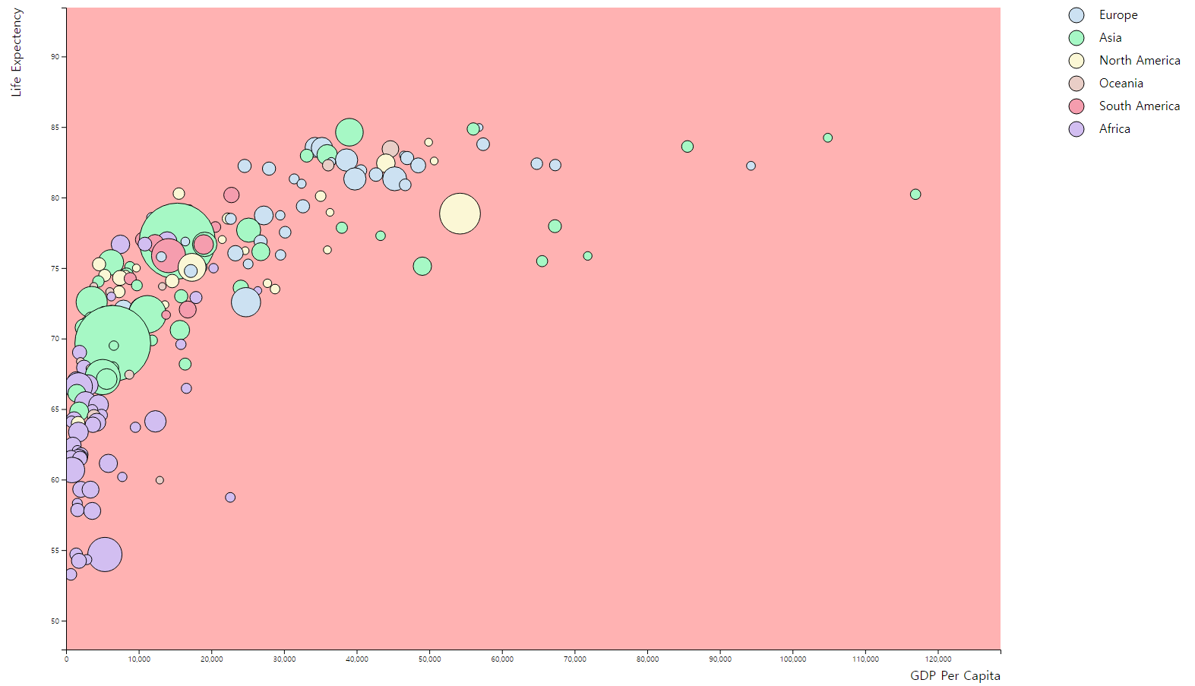
Before Zoom - clipPath

Slide 23
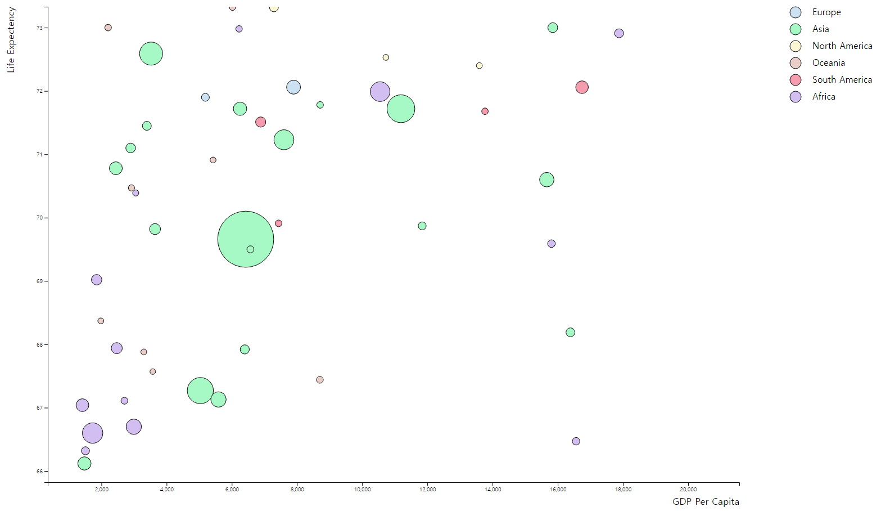
Zoom

Slide 24
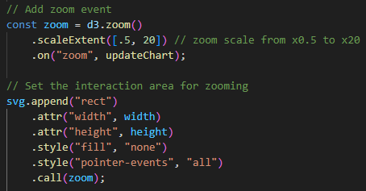
Zoom

Slide 25
Zoom

Slide 26
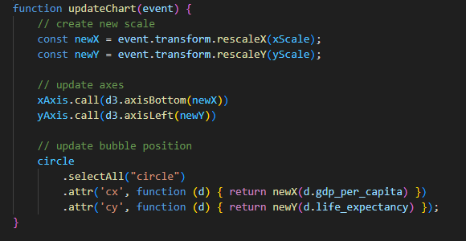
Zoom

Slide 27
References
https://d3js.org/d3-selection/events
https://d3js.org/d3-transition
https://d3js.org/d3-transition/timing
https://d3-graph-gallery.com/bubble.html
https://d3-graph-gallery.com/interactivity.html

Slide 28
Thank you!

