Slide 1
Information Visualization Coding Session 3
2024.05.08.
Seongouk Kim

Slide 2
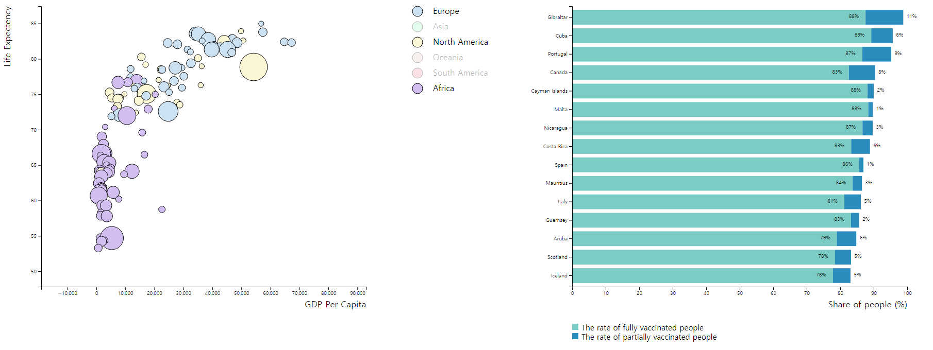
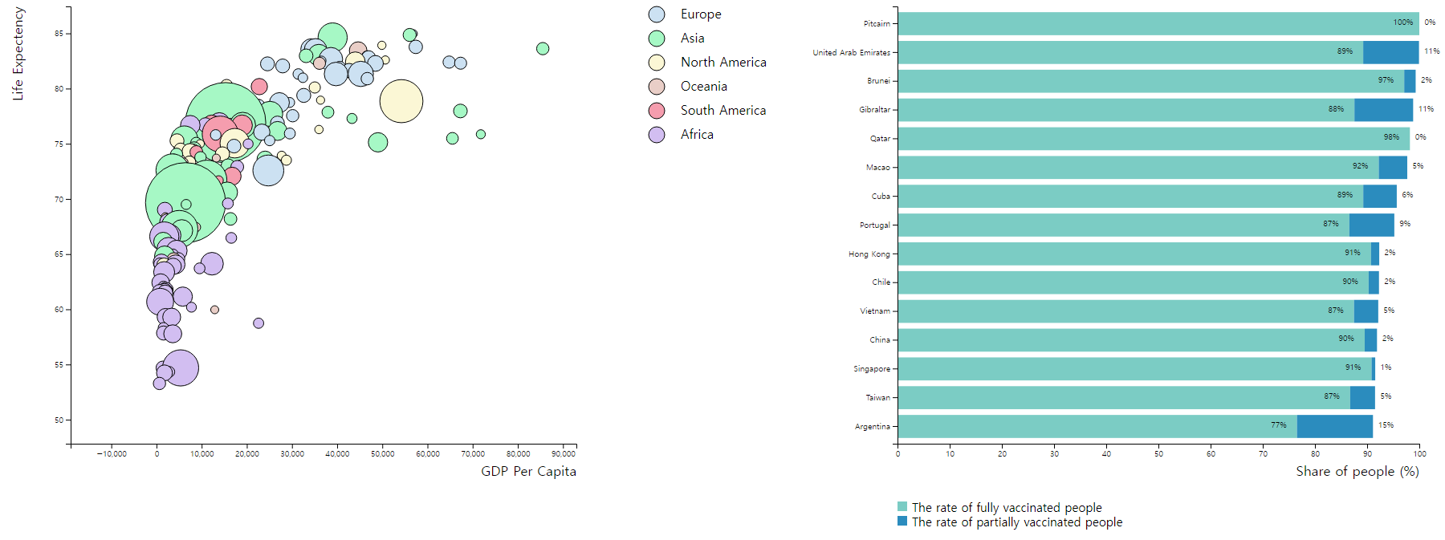
Today’s goal
Linked Interaction for Dashboard!

Slide 3
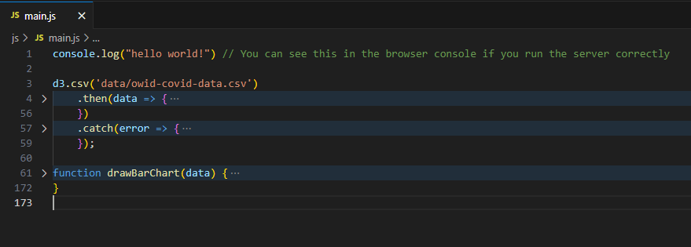
Code migration
One Vis in One .js file
Multiple Vis in One .js will be messy!

Slide 4
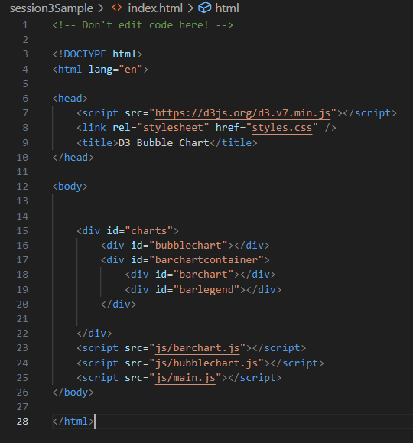
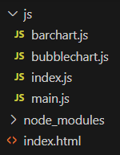
Code migration

Slide 5
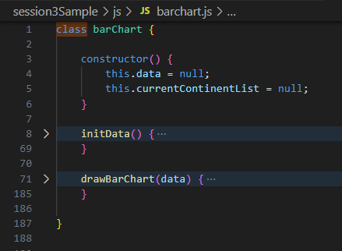
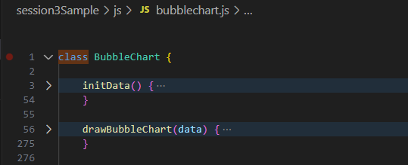
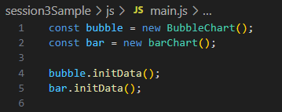
Code migration

Slide 6
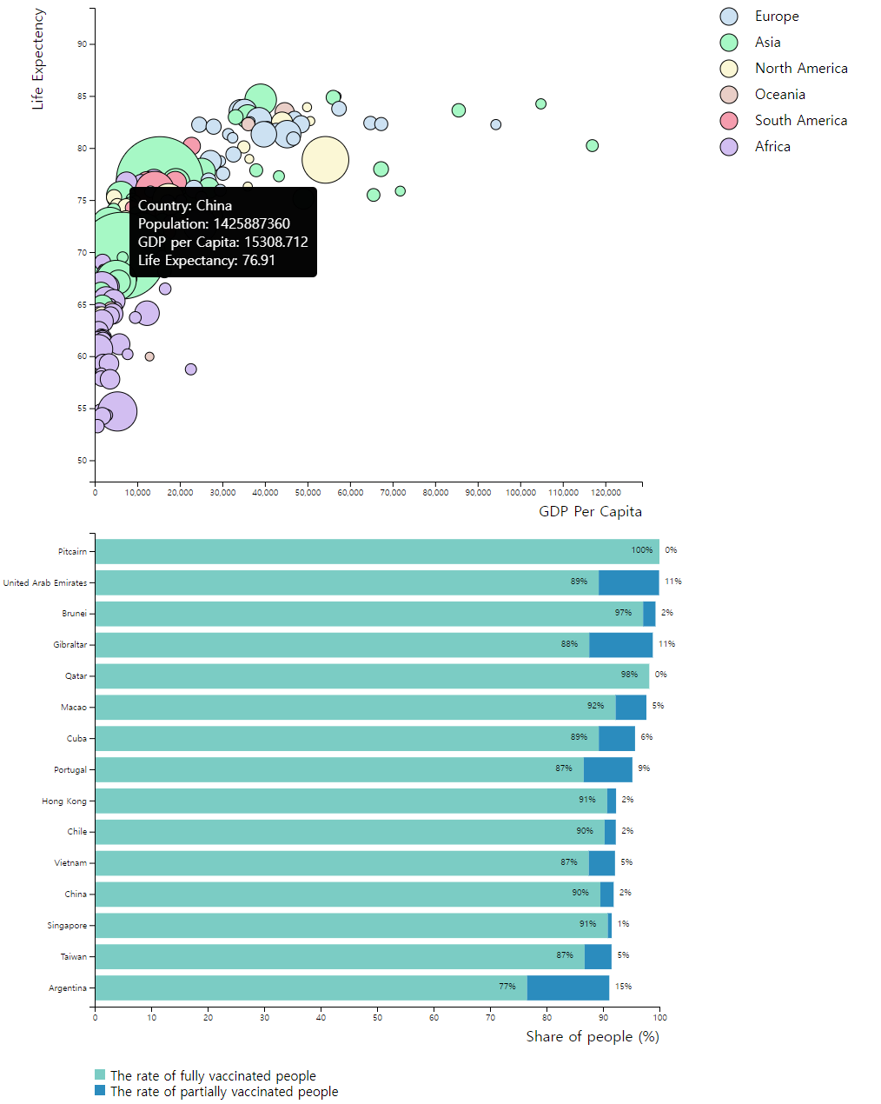
After Code migration

Slide 7
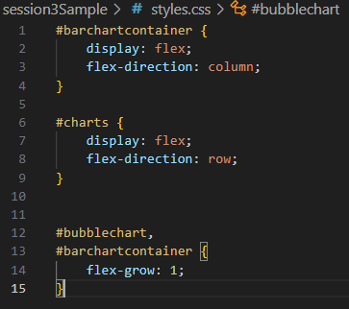
Change Arrangement

Slide 8
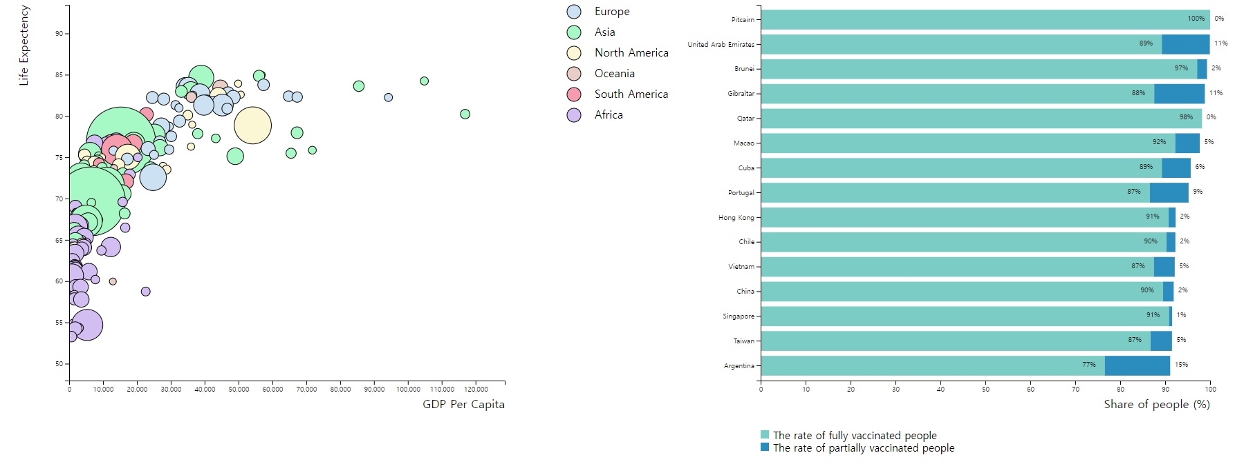
Change Arrangement

Slide 9
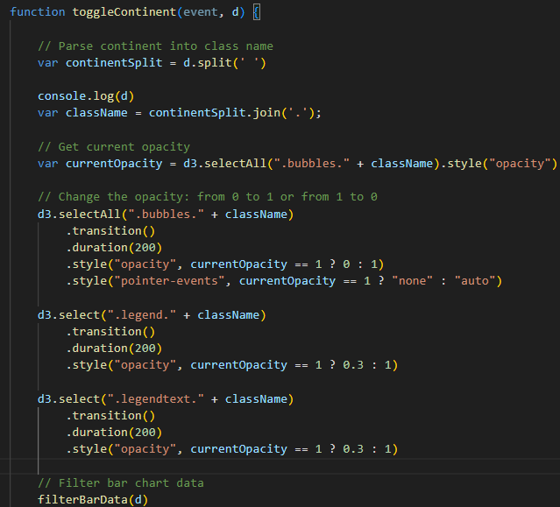
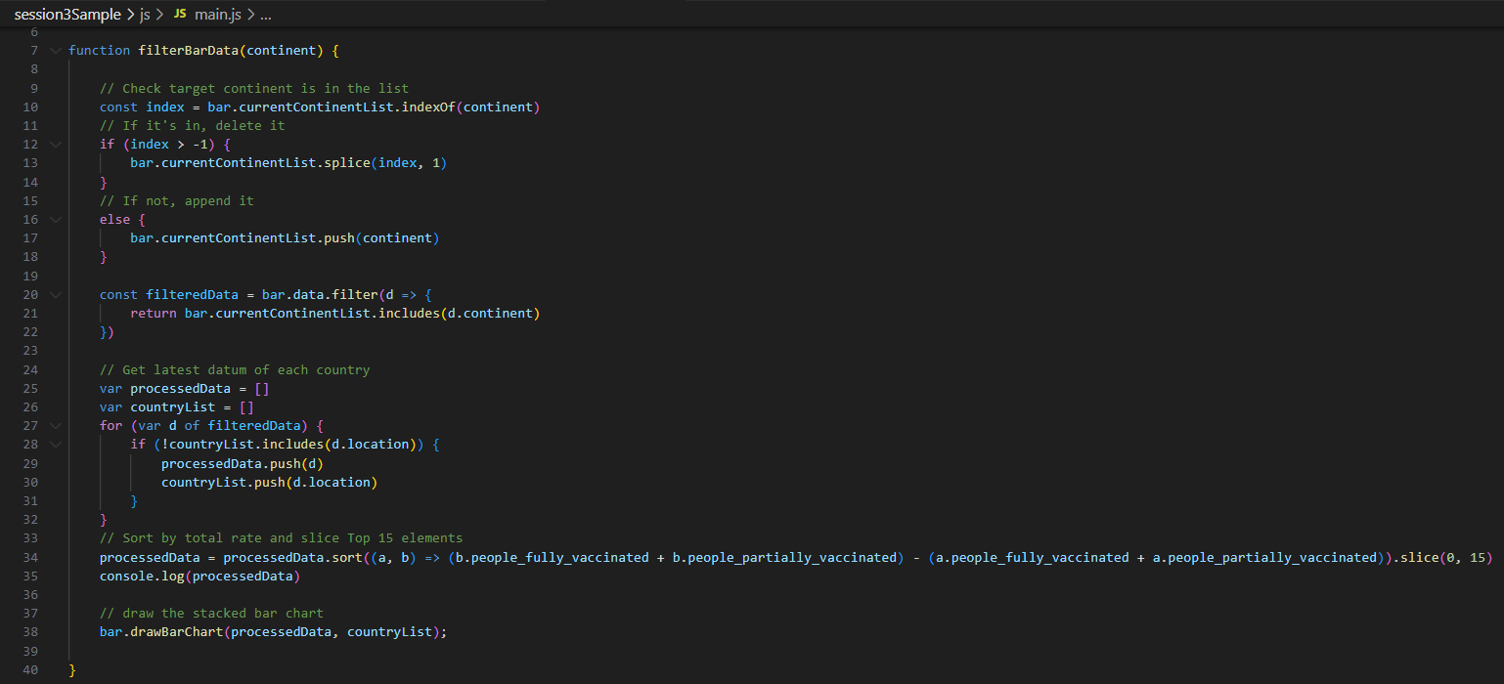
Linked Interaction

Slide 10
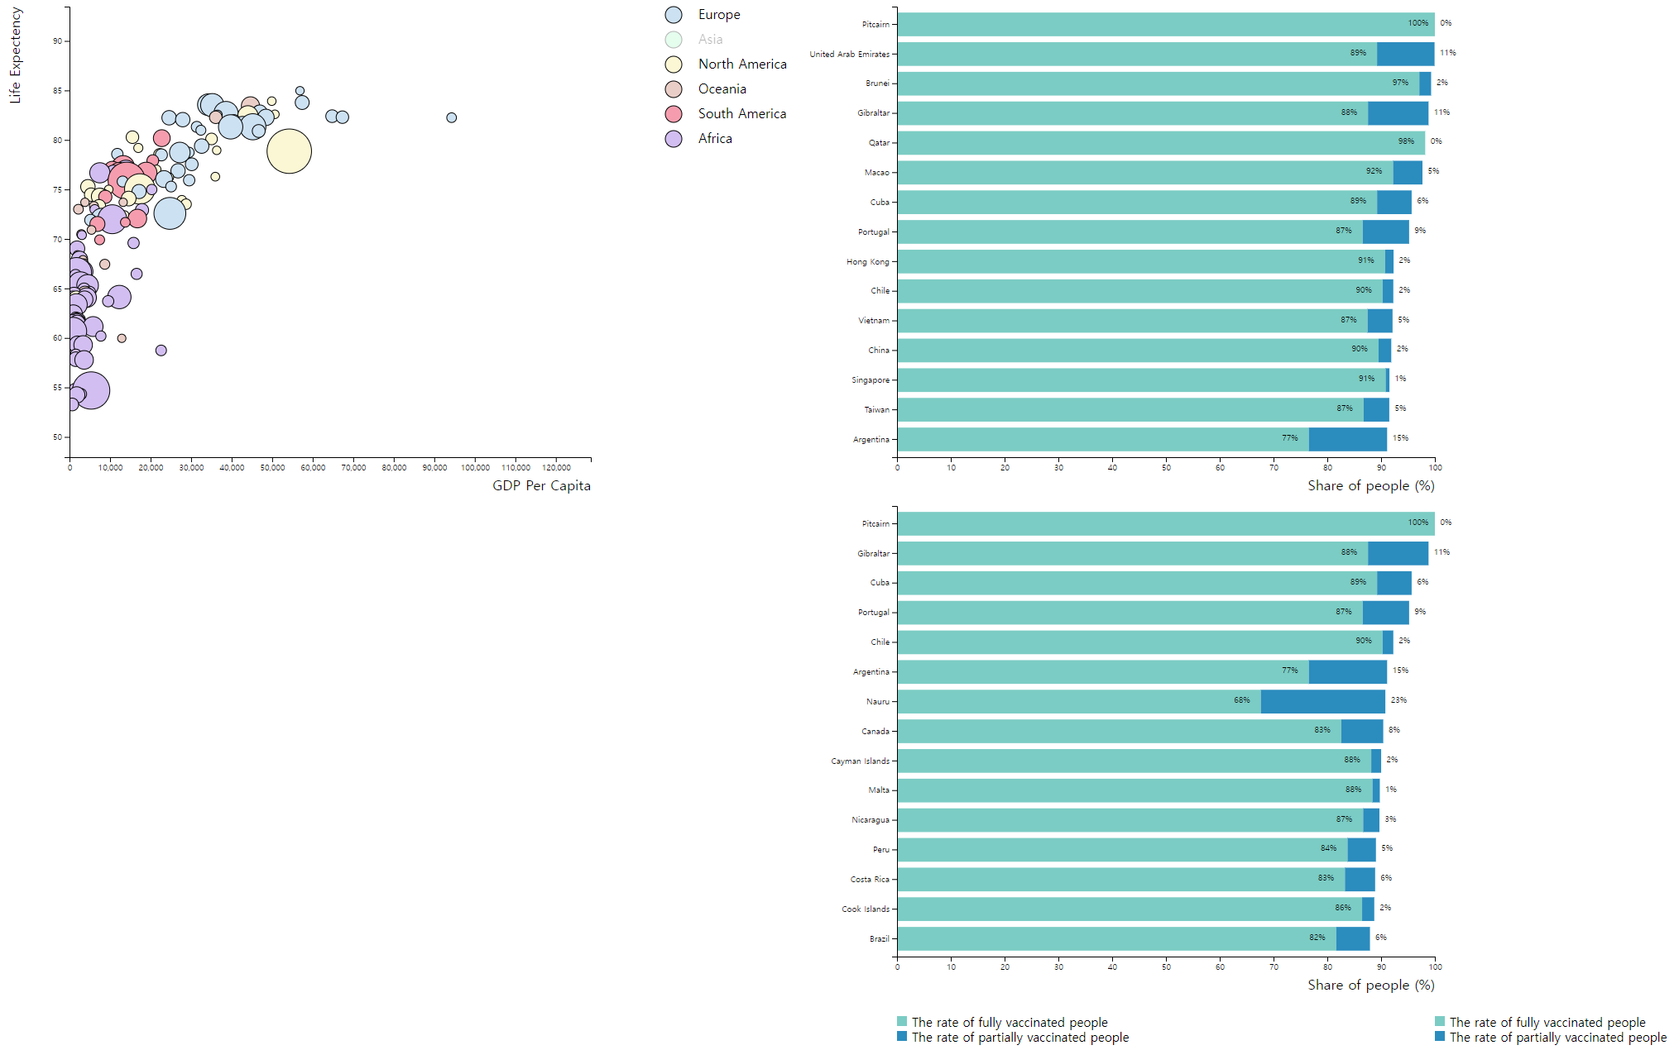
Linked Interaction
Don’t forget to remove the previous shapes!!

Slide 11
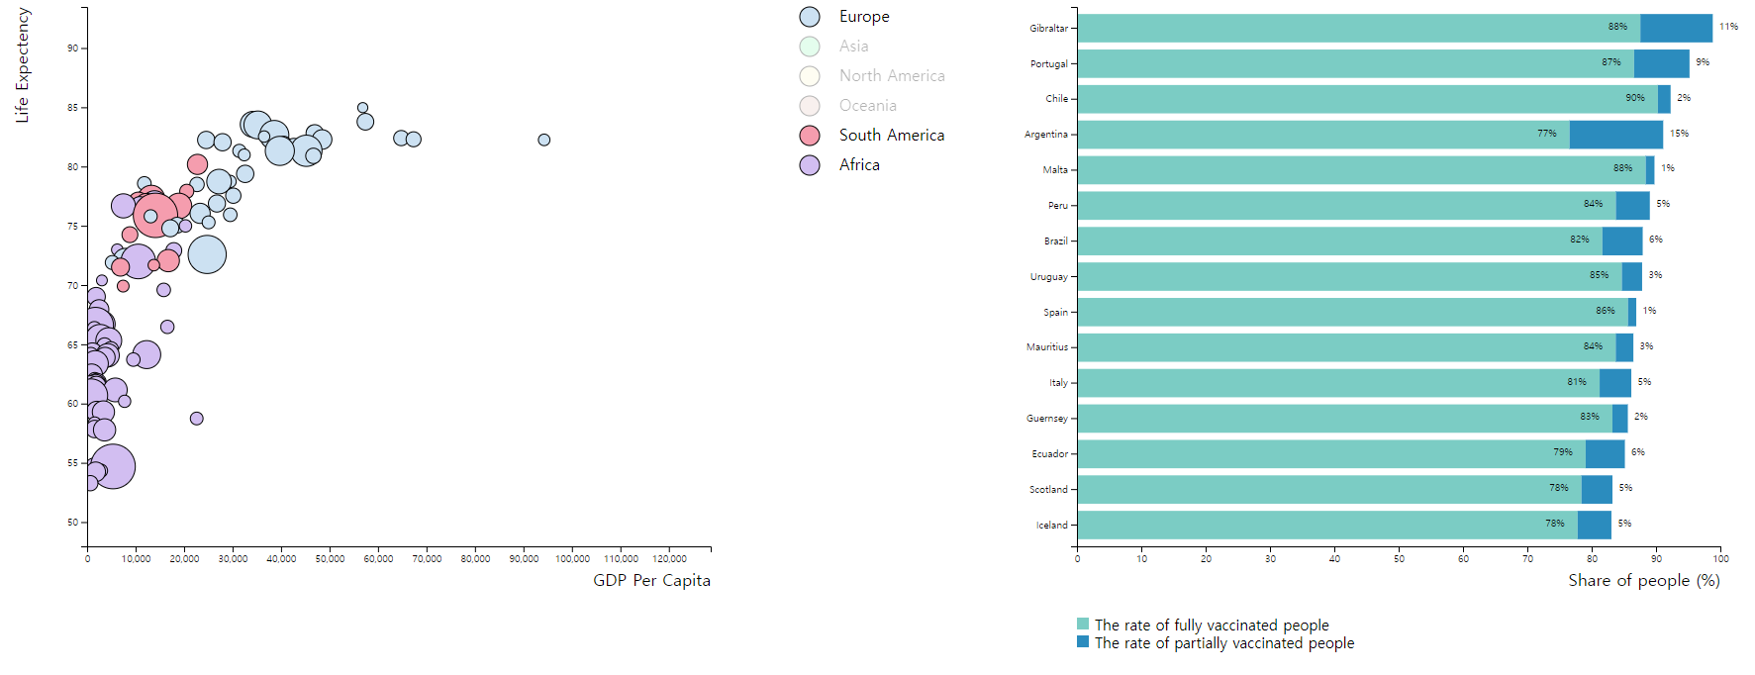
Linked Interaction

Slide 12
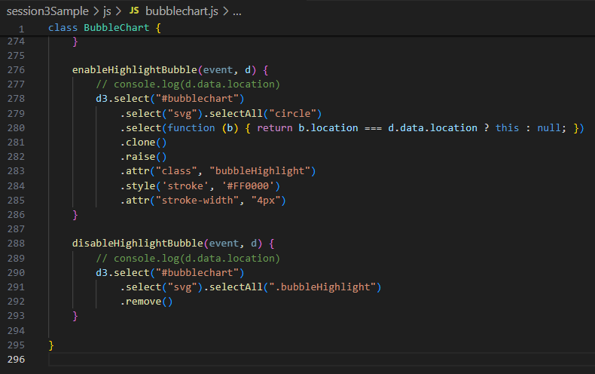

Linked Interaction

Slide 13
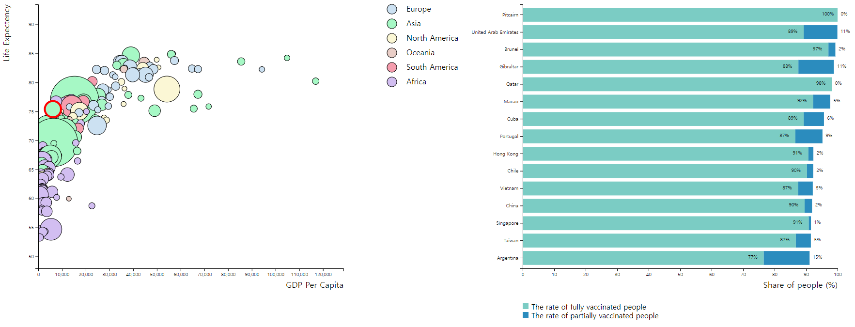
Linked Interaction

Slide 14
Thank you!

