Slide 1

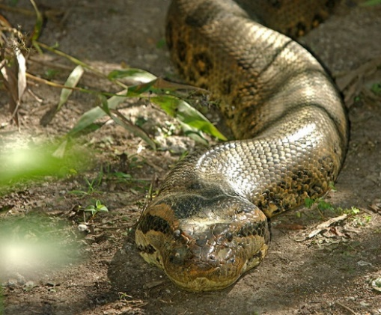
ANACONDA: A Non-Adaptive CONDitional Sampling Algorithm for Distribution Testing
Gautam Kamath
Simons Institute → University of Waterloo
ACM-SIAM Symposium on Discrete Algorithms (SODA 2019)
January 6, 2019
Joint work with
Christos Tzamos
(UW Madison)
ChrHISSSSStos

Slide 2
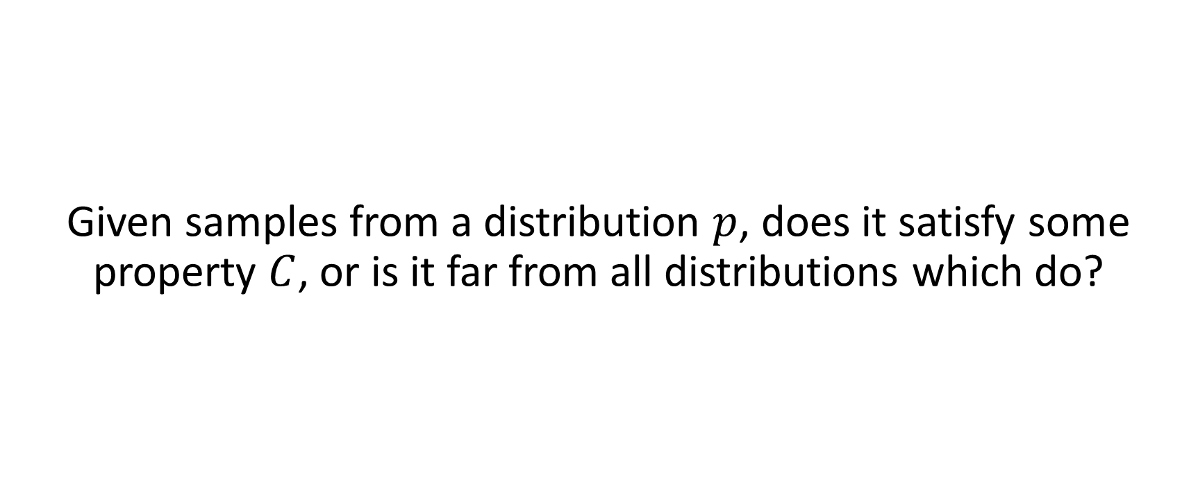
Distributional Property Testing
Given samples from a distribution $p$, does it satisfy some property $C$, or is it far from all distributions which do?

Slide 3
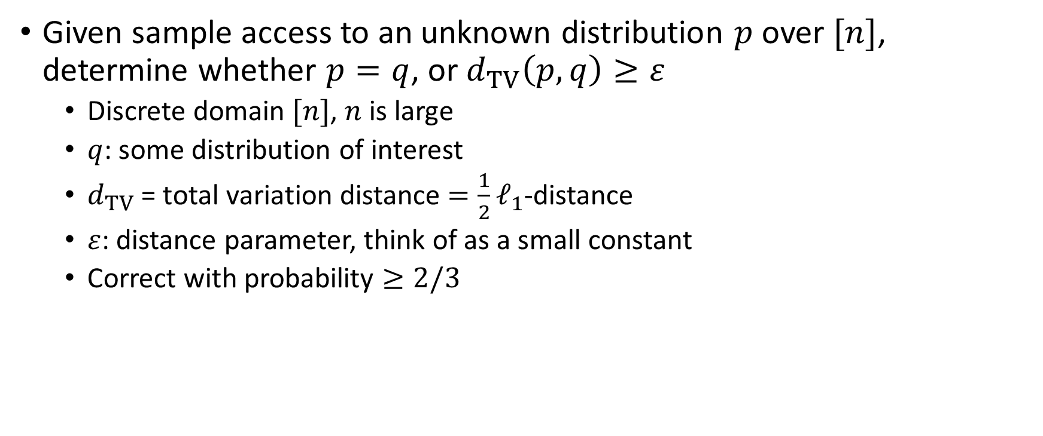
Distributional Property Testing
Given sample access to an unknown distribution $p$ over $[n]$, determine whether $p=q$, or $d_{TV}\left(p, q\right)≥ε$
Discrete domain $[n]$, $n$ is large
$q$: some distribution of interest
$d_{TV}$ = total variation distance $=\frac{1}{2}ℓ_{1}$-distance
$ε$: distance parameter, think of as a small constant
Correct with probability $≥2/3$

Slide 4
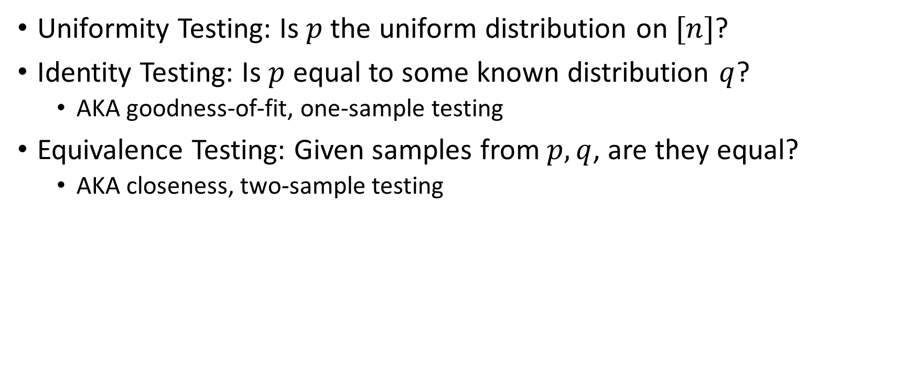
Distributional Property Testing
Uniformity Testing: Is $p$ the uniform distribution on $[n]$?
Identity Testing: Is $p$ equal to some known distribution $q$?
AKA goodness-of-fit, one-sample testing
Equivalence Testing: Given samples from $p, q$, are they equal?
AKA closeness, two-sample testing

Slide 5
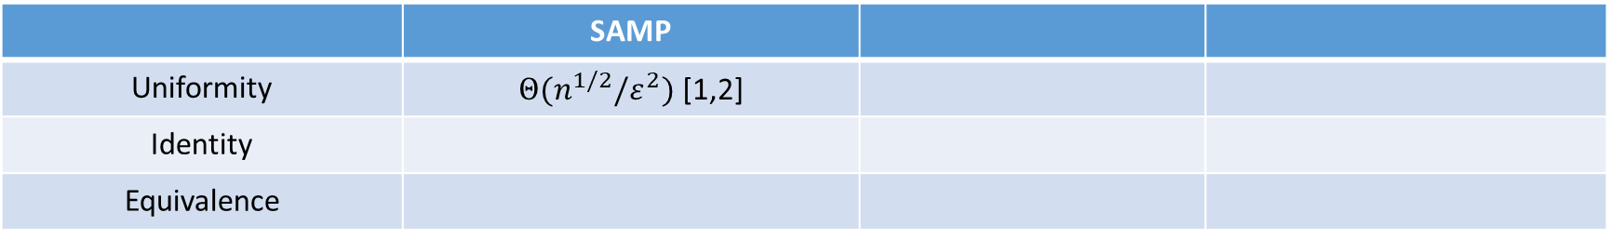
Distribution Testing Results
 | SAMP
Uniformity | $Θ(n^{1/2}/ε^{2})$ [1,2]
Identity
Equivalence
[1] Paninski, Transactions on Information Theory 2008
[2] G. Valiant, P. Valiant, FOCS 2014

Slide 6
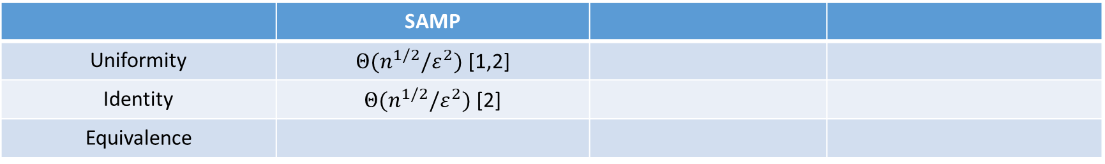
Distribution Testing Results
 | SAMP
Uniformity | $Θ(n^{1/2}/ε^{2})$ [1,2]
Identity | $Θ(n^{1/2}/ε^{2})$ [2]
Equivalence
[1] Paninski, Transactions on Information Theory 2008
[2] G. Valiant, P. Valiant, FOCS 2014

Slide 7
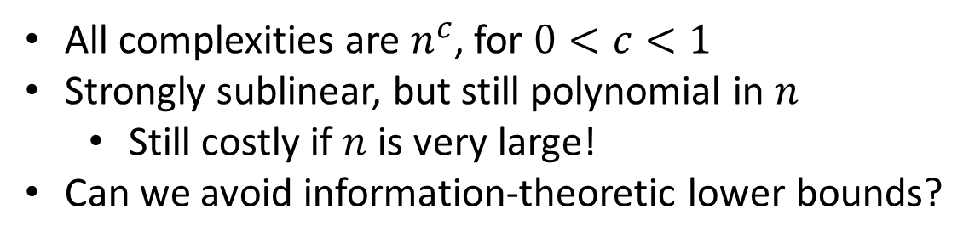
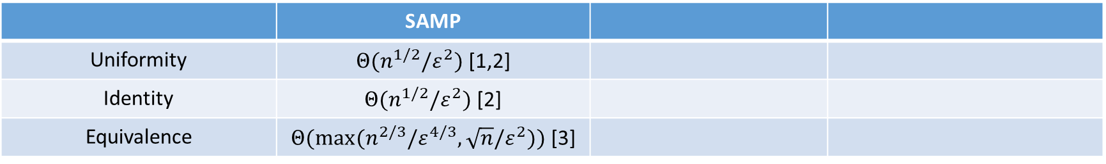
Distribution Testing Results
 | SAMP
Uniformity | $Θ(n^{1/2}/ε^{2})$ [1,2]
Identity | $Θ(n^{1/2}/ε^{2})$ [2]
Equivalence | $Θ(max(n^{2/3}/ε^{4/3},\sqrt{n}/ε^{2}))$ [3]
All complexities are $n^{c}$, for $0<c<1$
Strongly sublinear, but still polynomial in $n$
Still costly if $n$ is very large!
Can we avoid information-theoretic lower bounds?
[1] Paninski, Transactions on Information Theory 2008
[2] G. Valiant, P. Valiant, FOCS 2014
[3] Chan, Diakonikolas, G. Valiant, P. Valiant, SODA 2014

Slide 8
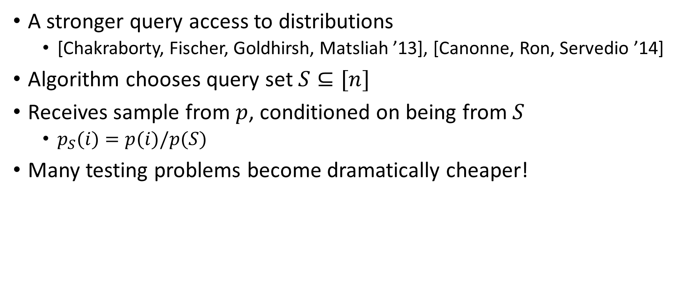
Conditional Sampling: COND
A stronger query access to distributions
[Chakraborty, Fischer, Goldhirsh, Matsliah ’13], [Canonne, Ron, Servedio ’14]
Algorithm chooses query set $S⊆[n]$
Receives sample from $p$, conditioned on being from $S$
$p_{S}(i)=p(i)/p(S)$
Many testing problems become dramatically cheaper!

Slide 9
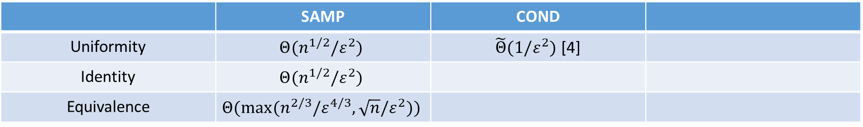
Distribution Testing with Conditional Samples
 | SAMP | COND
Uniformity | $$Θ(n^{1/2}/ε^{2})$$ | $\tilde{Θ}(1/ε^{2})$ [4]
Identity | $$Θ(n^{1/2}/ε^{2})$$
Equivalence | $$Θ(max(n^{2/3}/ε^{4/3},\sqrt{n}/ε^{2}))$$
[4] Canonne, Ron, Servedio, SODA 2014

Slide 10
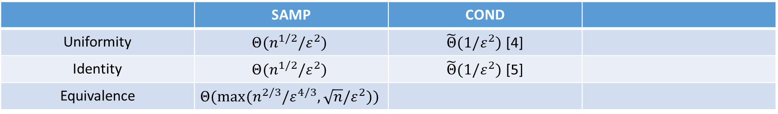
Distribution Testing with Conditional Samples
 | SAMP | COND
Uniformity | $$Θ(n^{1/2}/ε^{2})$$ | $\tilde{Θ}(1/ε^{2})$ [4]
Identity | $$Θ(n^{1/2}/ε^{2})$$ | $\tilde{Θ}(1/ε^{2})$ [5]
Equivalence | $$Θ(max(n^{2/3}/ε^{4/3},\sqrt{n}/ε^{2}))$$
[4] Canonne, Ron, Servedio, SODA 2014
[5] Falahatgar, Jafarpour, Orlitsky, Pichapati, Suresh, COLT 2015

Slide 11

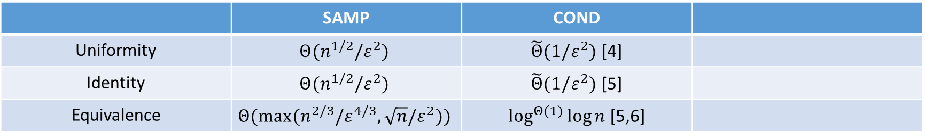
Distribution Testing with Conditional Samples
 | SAMP | COND
Uniformity | $$Θ(n^{1/2}/ε^{2})$$ | $\tilde{Θ}(1/ε^{2})$ [4]
Identity | $$Θ(n^{1/2}/ε^{2})$$ | $\tilde{Θ}(1/ε^{2})$ [5]
Equivalence | $$Θ(max(n^{2/3}/ε^{4/3},\sqrt{n}/ε^{2}))$$ | $\log^{Θ(1)}{\log{n}}$ [5,6]
Uniformity and identity testing become very cheap
Lose dependence on $n$
Equivalence is qualitatively different: doubly-logarithmic in $n$
UB of $O_{ε}(\log{\log{n}})$ [5], LB of $Ω\left(\sqrt{\log{\log{n}}}\right)$ [6]
[4] Canonne, Ron, Servedio, SODA 2014
[5] Falahatgar, Jafarpour, Orlitsky, Pichapati, Suresh, COLT 2015
[6] Acharya, Canonne, K., RANDOM 2015

Slide 12
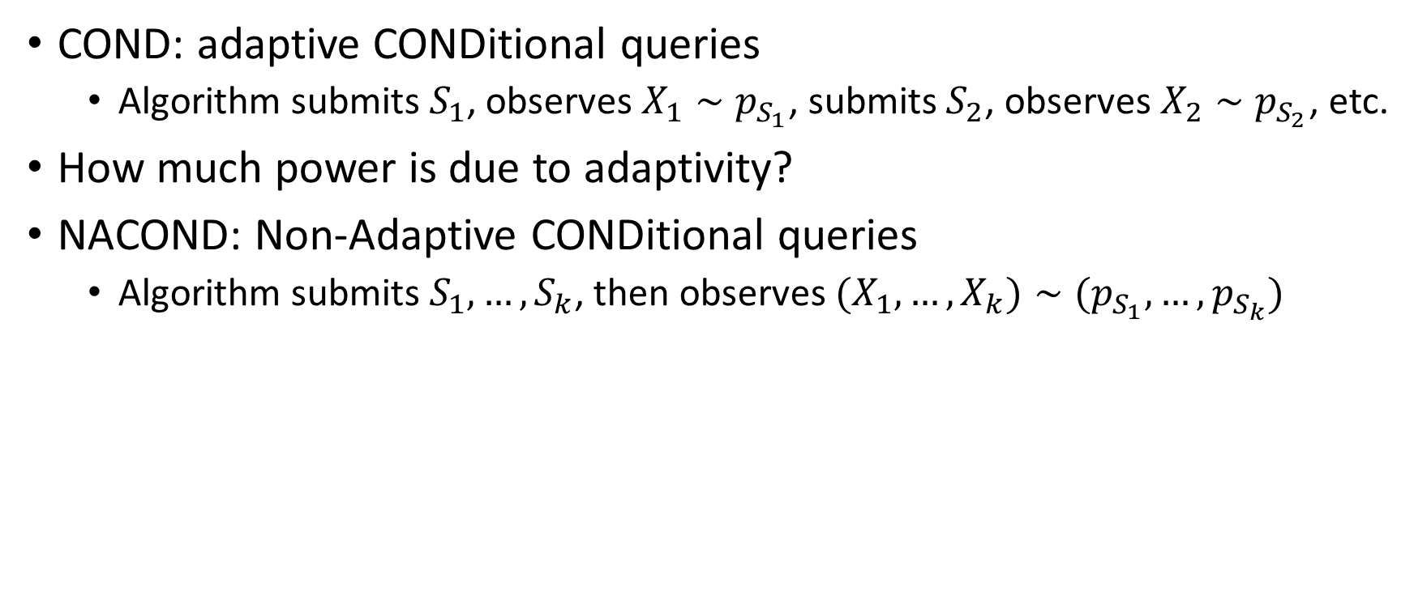
The Power of Adaptivity?
COND: adaptive CONDitional queries
Algorithm submits $S_{1}$, observes $X_{1}∼p_{S_{1}}$, submits $S_{2}$, observes $X_{2}∼p_{S_{2}}$, etc.
How much power is due to adaptivity?
NACOND: Non-Adaptive CONDitional queries
Algorithm submits $S_{1}, …, S_{k}$, then observes $(X_{1},…,X_{k})∼(p_{S_{1}},…,p_{S_{k}})$

Slide 13
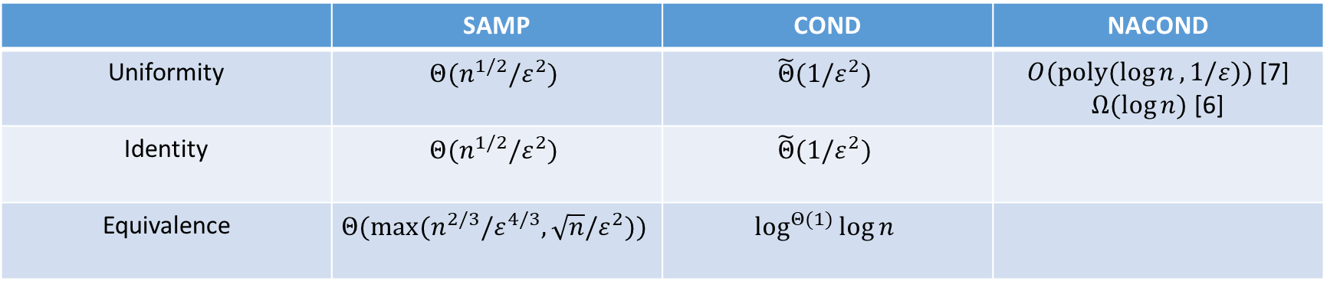
Previously known about NACOND
 | SAMP | COND | NACOND
Uniformity | $$Θ(n^{1/2}/ε^{2})$$ | $$\tilde{Θ}(1/ε^{2})$$ | $O(poly(\log{n},1/ε))$ [7] $Ω(\log{n})$ [6]
Identity | $$Θ(n^{1/2}/ε^{2})$$ | $$\tilde{Θ}(1/ε^{2})$$
Equivalence | $$Θ(max(n^{2/3}/ε^{4/3},\sqrt{n}/ε^{2}))$$ | $$\log^{Θ(1)}{\log{n}}$$
[6] Acharya, Canonne, K., RANDOM 2015
[7] Chakraborty, Fischer, Goldhirsh, Matsliah, ITCS 2013

Slide 14
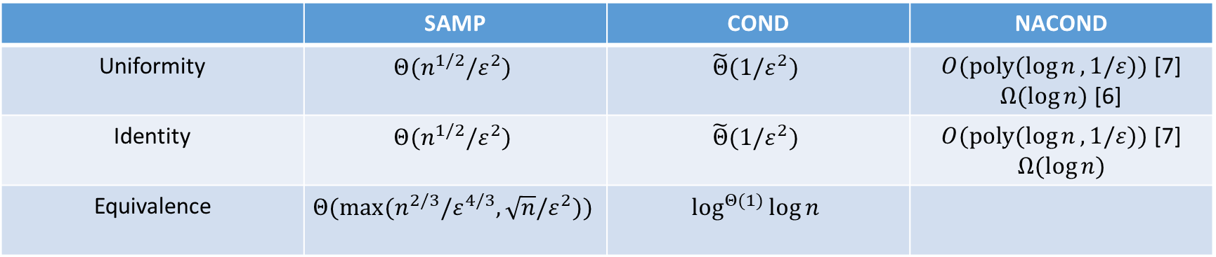
Previously known about NACOND
 | SAMP | COND | NACOND
Uniformity | $$Θ(n^{1/2}/ε^{2})$$ | $$\tilde{Θ}(1/ε^{2})$$ | $O(poly(\log{n},1/ε))$ [7] $Ω(\log{n})$ [6]
Identity | $$Θ(n^{1/2}/ε^{2})$$ | $$\tilde{Θ}(1/ε^{2})$$ | $O(poly(\log{n},1/ε))$ [7] $$Ω(\log{n})$$
Equivalence | $$Θ(max(n^{2/3}/ε^{4/3},\sqrt{n}/ε^{2}))$$ | $$\log^{Θ(1)}{\log{n}}$$
[6] Acharya, Canonne, K., RANDOM 2015
[7] Chakraborty, Fischer, Goldhirsh, Matsliah, ITCS 2013

Slide 15
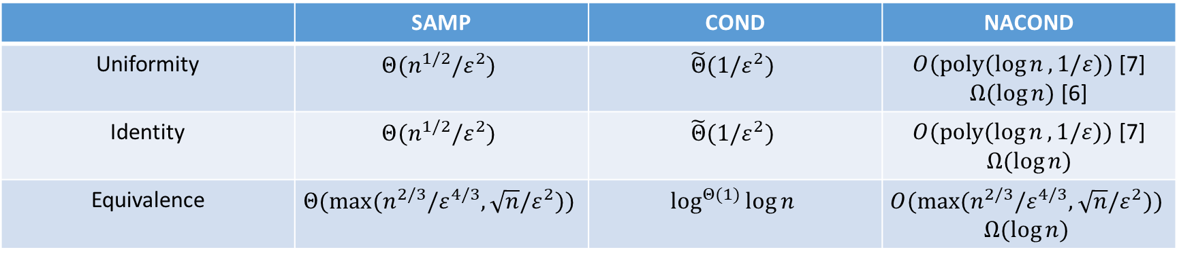
Previously known about NACOND
 | SAMP | COND | NACOND
Uniformity | $$Θ(n^{1/2}/ε^{2})$$ | $$\tilde{Θ}(1/ε^{2})$$ | $O(poly(\log{n},1/ε))$ [7] $Ω(\log{n})$ [6]
Identity | $$Θ(n^{1/2}/ε^{2})$$ | $$\tilde{Θ}(1/ε^{2})$$ | $O(poly(\log{n},1/ε))$ [7] $$Ω(\log{n})$$
Equivalence | $$Θ(max(n^{2/3}/ε^{4/3},\sqrt{n}/ε^{2}))$$ | $$\log^{Θ(1)}{\log{n}}$$ | $$O(max(n^{2/3}/ε^{4/3},\sqrt{n}/ε^{2}))$$ $$Ω(\log{n})$$
Uniformity and identity are between SAMP and COND
Polylogarithmic, versus polynomial and constant
Complexity of equivalence testing was wide open
Should it be polynomial or polylogarithmic?
[6] Acharya, Canonne, K., RANDOM 2015
[7] Chakraborty, Fischer, Goldhirsh, Matsliah, ITCS 2013

Slide 16
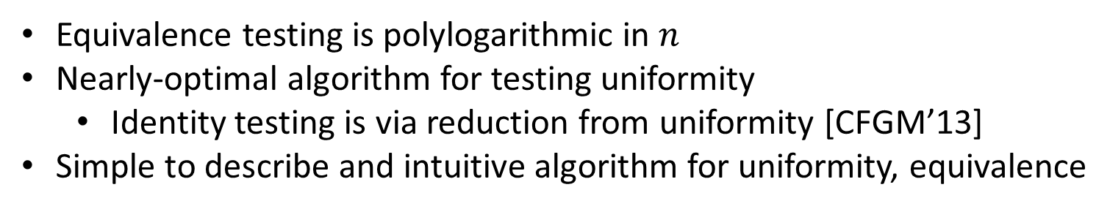
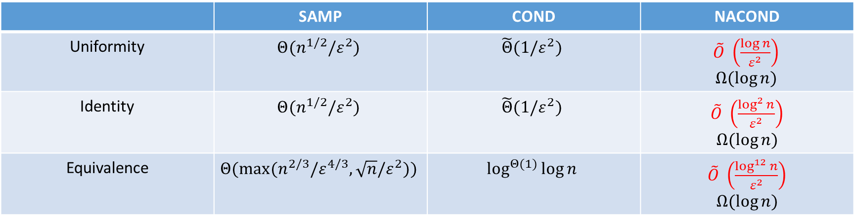
Results
 | SAMP | COND | NACOND
Uniformity | $$Θ(n^{1/2}/ε^{2})$$ | $$\tilde{Θ}(1/ε^{2})$$ | $\tilde{O} \left(\frac{\log{n}}{ε^{2}}\right)$ $$Ω(\log{n})$$
Identity | $$Θ(n^{1/2}/ε^{2})$$ | $$\tilde{Θ}(1/ε^{2})$$ | $\tilde{O} \left(\frac{\log^{2}{n}}{ε^{2}}\right)$ $$Ω(\log{n})$$
Equivalence | $$Θ(max(n^{2/3}/ε^{4/3},\sqrt{n}/ε^{2}))$$ | $$\log^{Θ(1)}{\log{n}}$$ | $\tilde{O} \left(\frac{\log^{12}{n}}{ε^{2}}\right)$ $$Ω(\log{n})$$
Equivalence testing is polylogarithmic in $n$
Nearly-optimal algorithm for testing uniformity
Identity testing is via reduction from uniformity [CFGM’13]
Simple to describe and intuitive algorithm for uniformity, equivalence

Slide 17
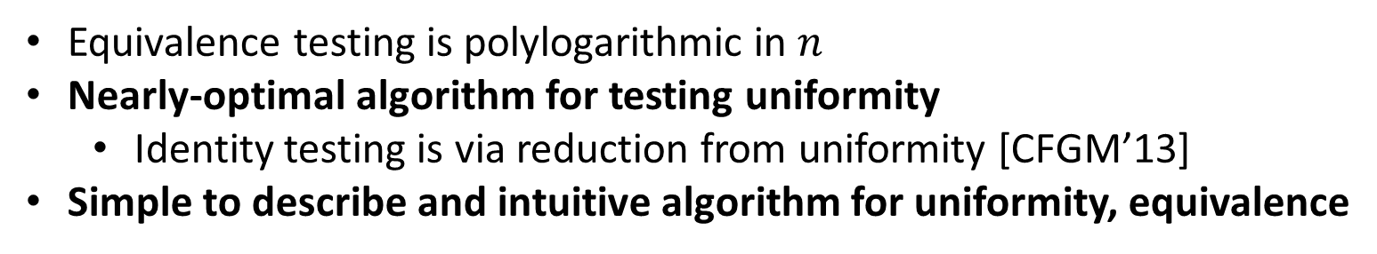
Results
 | SAMP | COND | NACOND
Uniformity | $$Θ(n^{1/2}/ε^{2})$$ | $$\tilde{Θ}(1/ε^{2})$$ | $\tilde{O} \left(\frac{\log{n}}{ε^{2}}\right)$ $$Ω(\log{n})$$
Identity | $$Θ(n^{1/2}/ε^{2})$$ | $$\tilde{Θ}(1/ε^{2})$$ | $\tilde{O} \left(\frac{\log^{2}{n}}{ε^{2}}\right)$ $$Ω(\log{n})$$
Equivalence | $$Θ(max(n^{2/3}/ε^{4/3},\sqrt{n}/ε^{2}))$$ | $$\log^{Θ(1)}{\log{n}}$$ | $\tilde{O} \left(\frac{\log^{12}{n}}{ε^{2}}\right)$ $$Ω(\log{n})$$
Equivalence testing is polylogarithmic in $n$
Nearly-optimal algorithm for testing uniformity
Identity testing is via reduction from uniformity [CFGM’13]
Simple to describe and intuitive algorithm for uniformity, equivalence

Slide 18
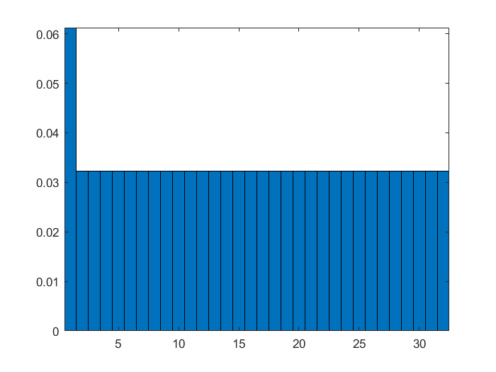
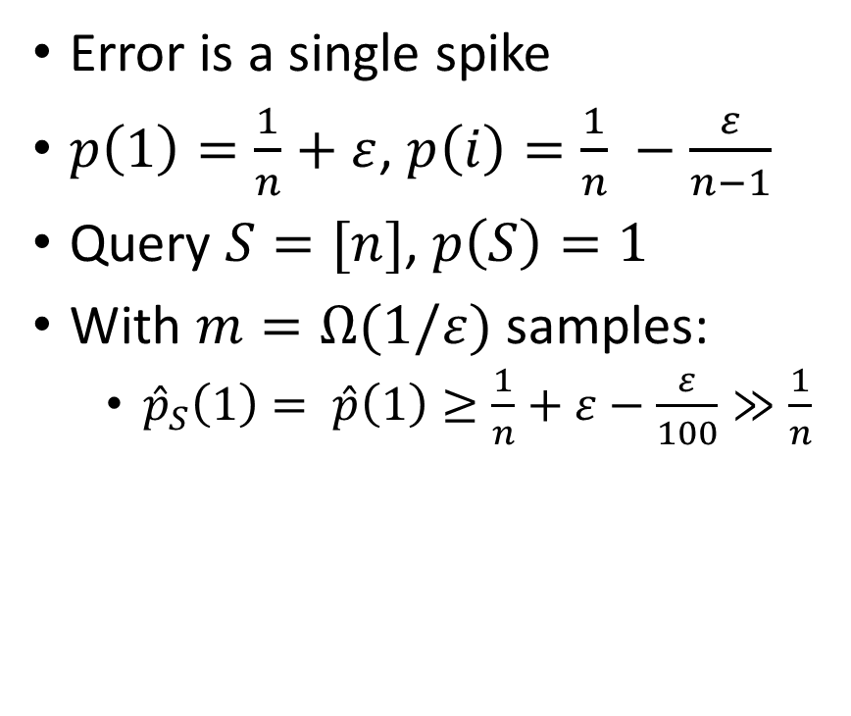
Uniformity Testing: Two Simple Cases
Error is a single spike
$p\left(1\right)=\frac{1}{n}+ε$, $p\left(i\right)=\frac{1}{n} −\frac{ε}{n−1}$
Query $S=[n]$, $p\left(S\right)=1$
With $m=Ω(1/ε)$ samples:
${\hat{p}}_{S}\left(1\right)= \hat{p}\left(1\right)≥\frac{1}{n}+ε−\frac{ε}{100}≫\frac{1}{n}$
Notes:
Note that this is all non-adaptive
n = 32; eps = 0.03; p1 = (1/n) * ones(1, n); figure(1); bar(p1,1); axis([0.5 n + 0.5 0 (1/n + eps)]);
p2 = p1 + eps * [1 (1/(n-1))*ones(1,n-1)]; figure(2); bar(p2,1); axis([0.5 n + 0.5 0 (1/n + eps)]);
p3 = p1 + (2*eps/n)*repmat([1 -1], 1, n/2); figure(3); bar(p3,1); axis([0.5 n + 0.5 0 (1/n + eps)]);

Slide 19
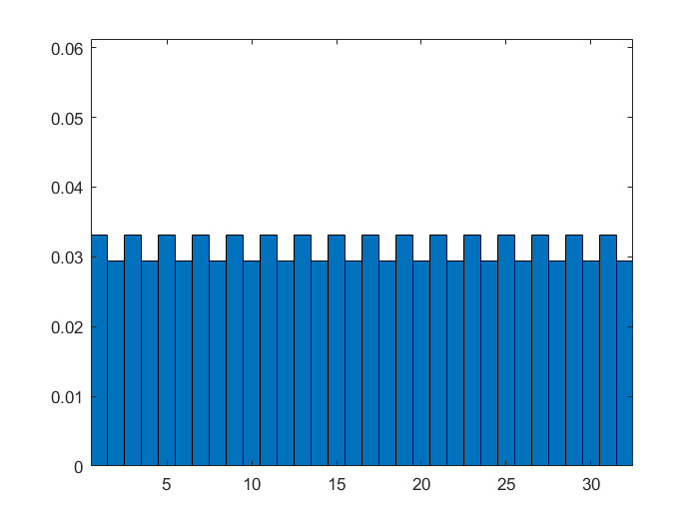
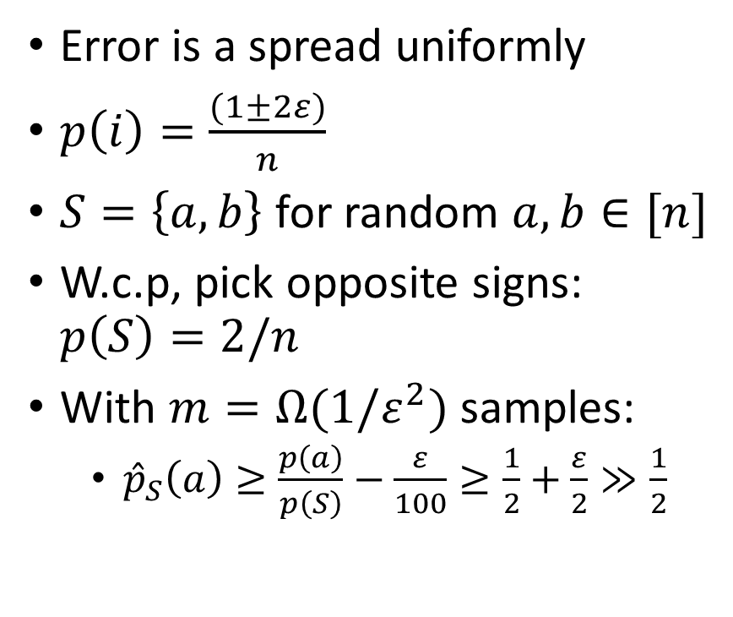
Uniformity Testing: Two Simple Cases
Error is a spread uniformly
$p\left(i\right)=\frac{(1±2ε)}{n}$
$S=\left\{a,b\right\}$ for random $a,b∈[n]$
W.c.p, pick opposite signs: $p\left(S\right)=2/n$
With $m=Ω(1/ε^{2})$ samples:
${\hat{p}}_{S}\left(a\right)≥\frac{p\left(a\right)}{p\left(S\right)}−\frac{ε}{100}≥\frac{1}{2}+\frac{ε}{2}≫\frac{1}{2}$

Slide 20
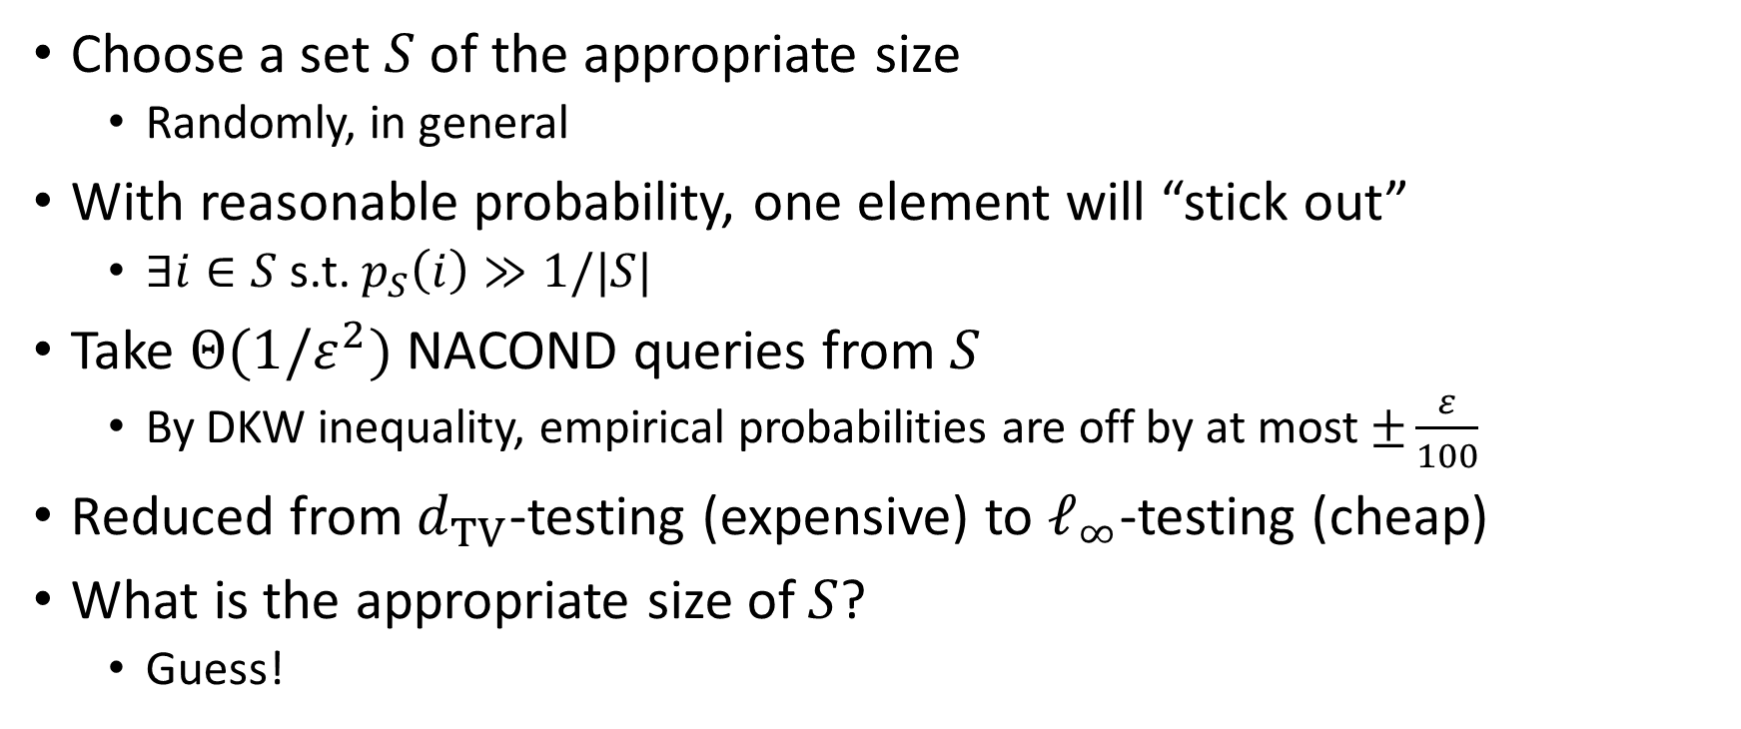
Common observations
Choose a set $S$ of the appropriate size
Randomly, in general
With reasonable probability, one element will “stick out”
$∃i∈S$ s.t. $p_{S}\left(i\right)≫1/|S|$
Take $Θ(1/ε^{2})$ NACOND queries from $S$
By DKW inequality, empirical probabilities are off by at most $±\frac{ε}{100}$
Reduced from $d_{TV}$-testing (expensive) to $ℓ_{∞}$-testing (cheap)
What is the appropriate size of $S$?
Guess!

Slide 21
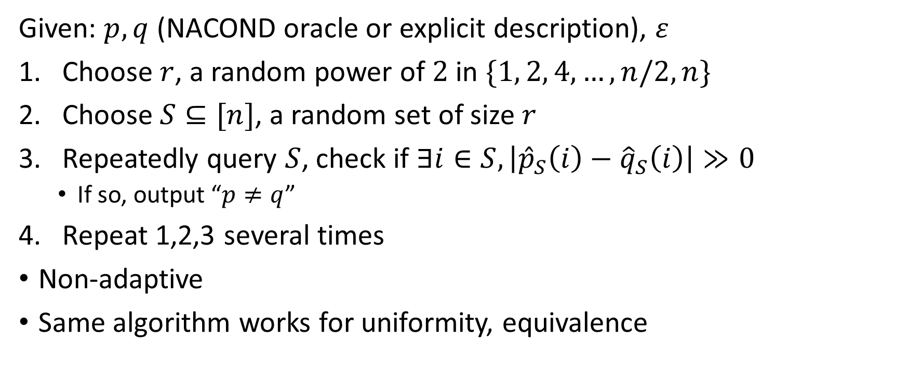
ANACONDA
Given: $p,q$ (NACOND oracle or explicit description), $ε$
Choose $r$, a random power of $2$ in $\{1, 2, 4, …, n/2,n\}$
Choose $S⊆[n]$, a random set of size $r$
Repeatedly query $S$, check if $∃i∈S, \left|{\hat{p}}_{S}\left(i\right)−{\hat{q}}_{S}\left(i\right)\right|≫0$
If so, output “$p≠q$”
Repeat 1,2,3 several times
Non-adaptive
Same algorithm works for uniformity, equivalence

Slide 22
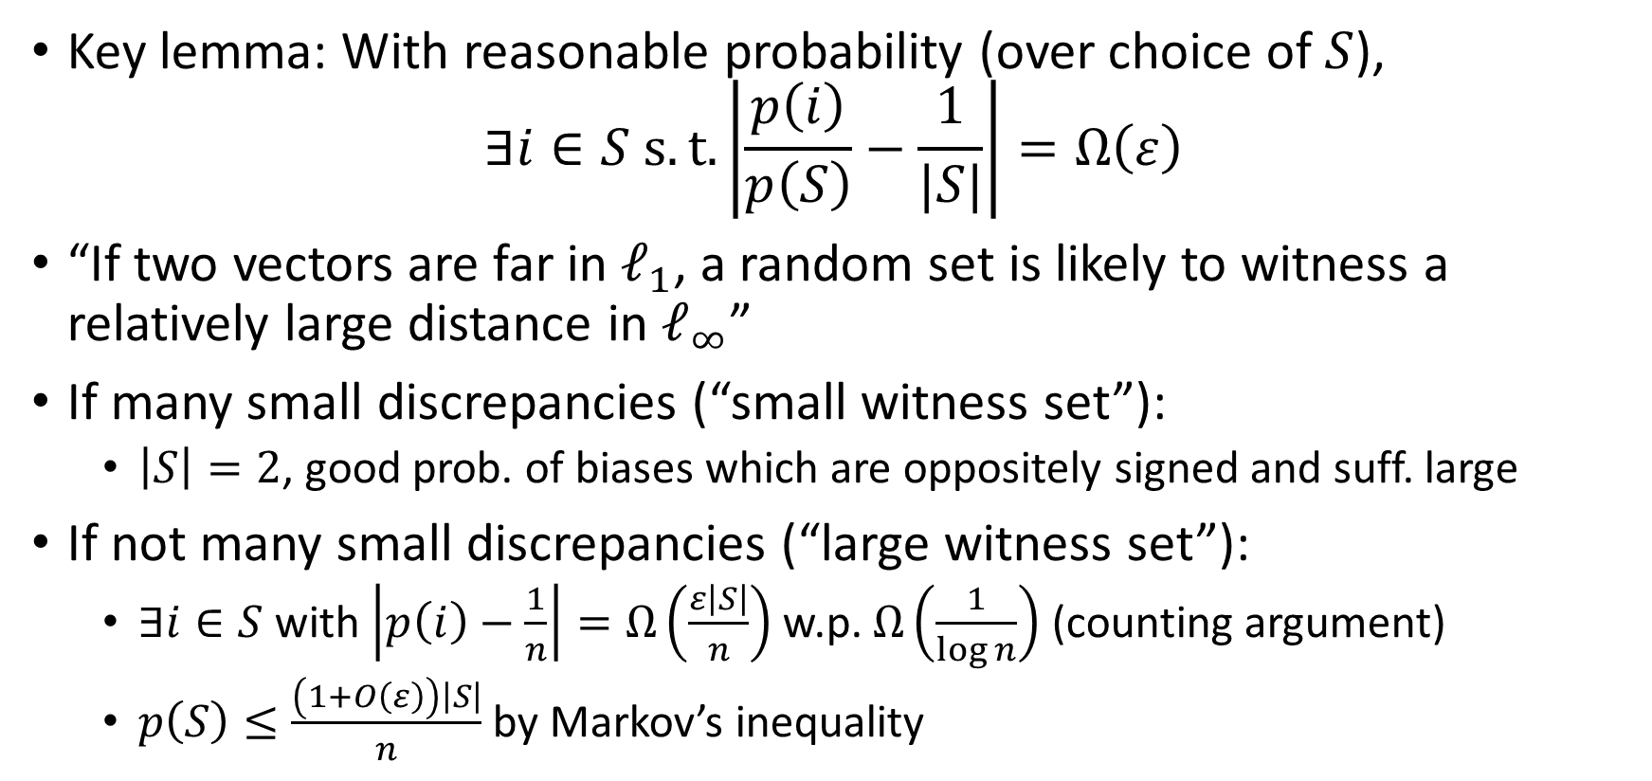
Uniformity Testing Analysis Sketch
Key lemma: With reasonable probability (over choice of $S$),
$$∃i∈S s.t.\left|\frac{p\left(i\right)}{p\left(S\right)}−\frac{1}{|S|}\right|=Ω\left(ε\right)$$
“If two vectors are far in $ℓ_{1}$, a random set is likely to witness a relatively large distance in $ℓ_{∞}$”
If many small discrepancies (“small witness set”):
$\left|S\right|=2$, good prob. of biases which are oppositely signed and suff. large
If not many small discrepancies (“large witness set”):
$∃i∈S$ with $\left|p\left(i\right)−\frac{1}{n}\right|=Ω\left(\frac{ε\left|S\right|}{n}\right)$ w.p. $Ω\left(\frac{1}{\log{n}}\right)$ (counting argument)
$p\left(S\right)≤\frac{\left(1+O\left(ε\right)\right)\left|S\right|}{n}$ by Markov’s inequality

Slide 23
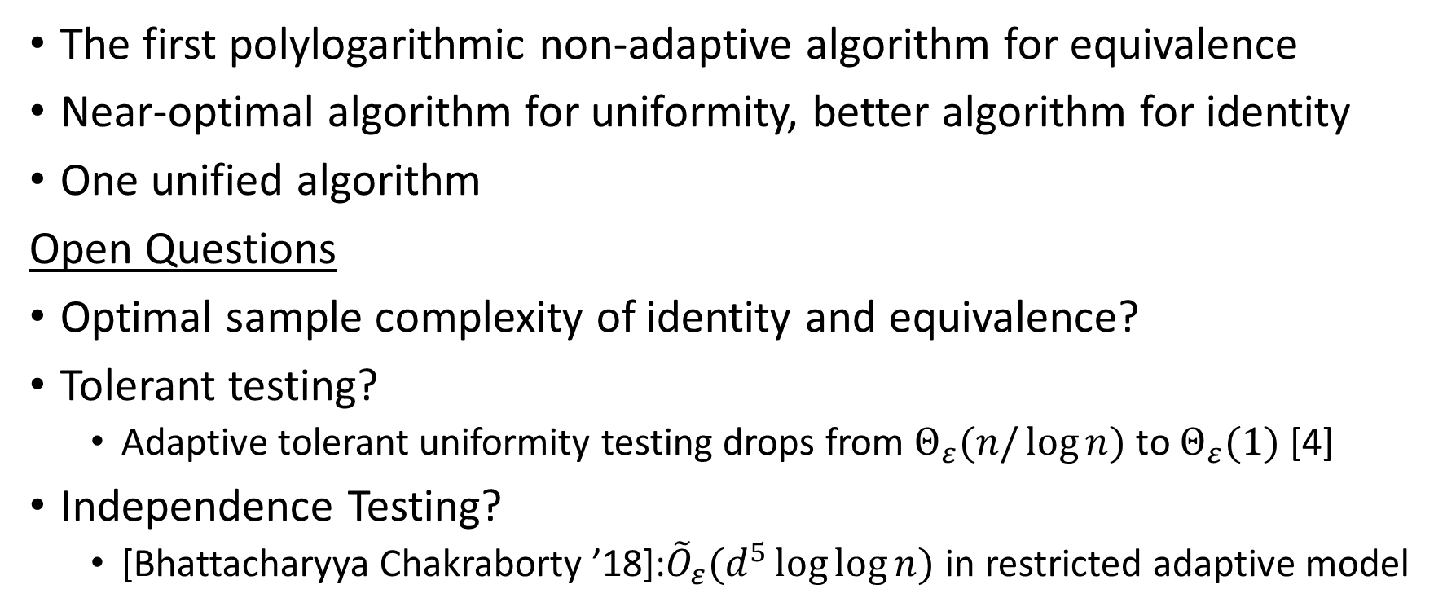
Conclusions and Open Questions
The first polylogarithmic non-adaptive algorithm for equivalence
Near-optimal algorithm for uniformity, better algorithm for identity
One unified algorithm
Open Questions
Optimal sample complexity of identity and equivalence?
Tolerant testing?
Adaptive tolerant uniformity testing drops from $Θ_{ε}(n/\log{n})$ to $Θ_{ε}(1)$ [4]
Independence Testing?
[Bhattacharyya Chakraborty ’18]:${\tilde{O}}_{ε}(d^{5}\log{\log{n}})$ in restricted adaptive model

Slide 24

Thanks!

